Slide 1
PIP-II LB650 Transport
J. Holzbauer on behalf of the PIP-II Transport Team
Monday, August 30, 2021

Slide 2
Transport Scope
CEA and STFC-UKRI are transporting production CMs to FNAL, goal is to align these efforts as much as possible
FNAL/STFC-UKRI own first transport demonstration
pHB650 CM/Transport Frame Design
Transport System Design (dummy load, procedures, travelers, instrumentation, etc.)
Execution of escalating validation testing ending in shipment from FNAL to UK and back
CEA is strongly involved, and it is critical that the CEA transport scope will follow the same process including lessons learned
CEA owns the LB650 CM design, the LB Transport frame design, production, local testing, transport system design.
FNAL owns actual shipment to US

Slide 3
Transport Communication
Collaboration and communication is critical for transport success and efficiency
FNAL SPM: Jeremiah Holzbauer
STFC-UKRI SPC: Mitchell Kane
CEA SPC: Robin Cubizolles
All teams are invited to all transport meetings, notes documented and transmitted to all, and lessons learned communicated widely
It is expected that CEA will be fully informed and involved with pHB650 validation testing to inform the LB650 transport work

Slide 4
Transportation Planning
LB CM Design
Standard requirements
Transport System Design
Frame Design
Transport Validation
Local Testing validates frame performance
Transport design report
Instrumentation
Dummy Load
pHB650 shipping test validates logistics
Validation testing during production
Procedures and travelers
Lifting Fixture Certification
Transport configuration

Slide 5
HB/LB650 Transport Documentation Status
For reference:
Doc Name | HB650 | LB650
Transport Spec | ED0012328 | ED0013421
Transport Plan | ED0012594 | ED0013424
Transport ISD | ED0012741 | ED0013425
Transport FMEA | ED0012325 | ED0013422
Transport PtD | ED0012559 | ED0013423
Frame Design Report | ED0012560 | TBD
pCM Transport Analysis | ED0012420 | TBD

Slide 6
Transport Documentation Plans
Procedures will be developed for significant activities:
CM reconfiguration from testing to transport (and back)
Mating of the CM and Frame
Configuration of the Transport System (CM+Frame) for transport (short range and long range) including mounting to trailer
Acceptance Criteria for Transport System will be developed for start and end of ALL transports (supplementary to CM Acceptance Criteria)
Visual inspection of frame, paneling, etc.
Instrumentation configuration/operation
All transports will have detailed travelers referencing updated procedures, include planning and results documents, and specifically note changes since prior transport (design changes, lessons learned)

Slide 7
Outgoing Transportation Stages
End of Module Production/Validation
Reconfiguration for Transport (Gross Mechanical Rearrangement)
Detailed Preparation for Transportation (checkouts, transport sensors, etc.)
Assembly of the transport system (Module in Frame)
Sensors triggered and Handoff to Transport Vendor

Slide 8
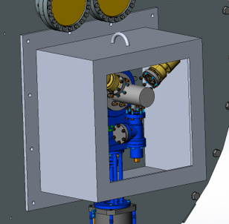
Warm Outgoing Inspections/Shipping Assembly
Standard acceptance testing after major configuration changes are made:
Electrical Checkouts of sensors/heaters/etc.
RF measurement of cavity with adaptor caps in place
Record beamline vacuum pressure
Installation of any CM-interior sensors
Installation of any dedicated shipping supports
Spiders to hold piping
Foam inserts to damp shield motion
Bumper supports for cold-end couplers
Blank flanges to ‘close’ insulating vacuum space
Protective cage around beamline vacuum manifolds
Will be during validation process

Slide 9
Backup Slides

Slide 10
HB650 Configurations
End of production, fully assembled, ready for cold testing
Beamline Vacuum Manifold
Transport Configuration: Cryogenic top-hat removed, HX removed, piping capped, RF warm-end couplers removed

Slide 11
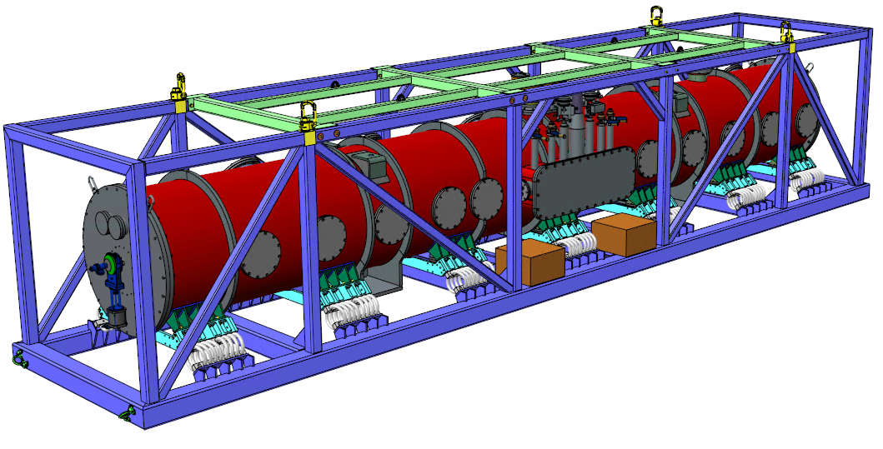
Transportation Instrumentation
Vibration, GPS, Vacuum, Temperature sensors for each CM transport
On board instrumentation system must be self-contained, including electrical power for the duration
Data captures are specified
Reserved space on transport frame

Slide 12
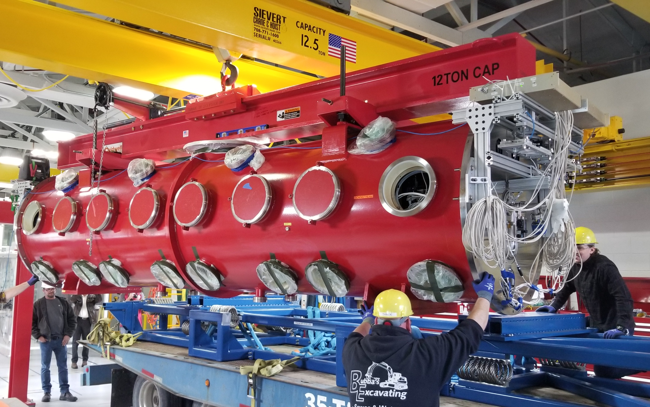
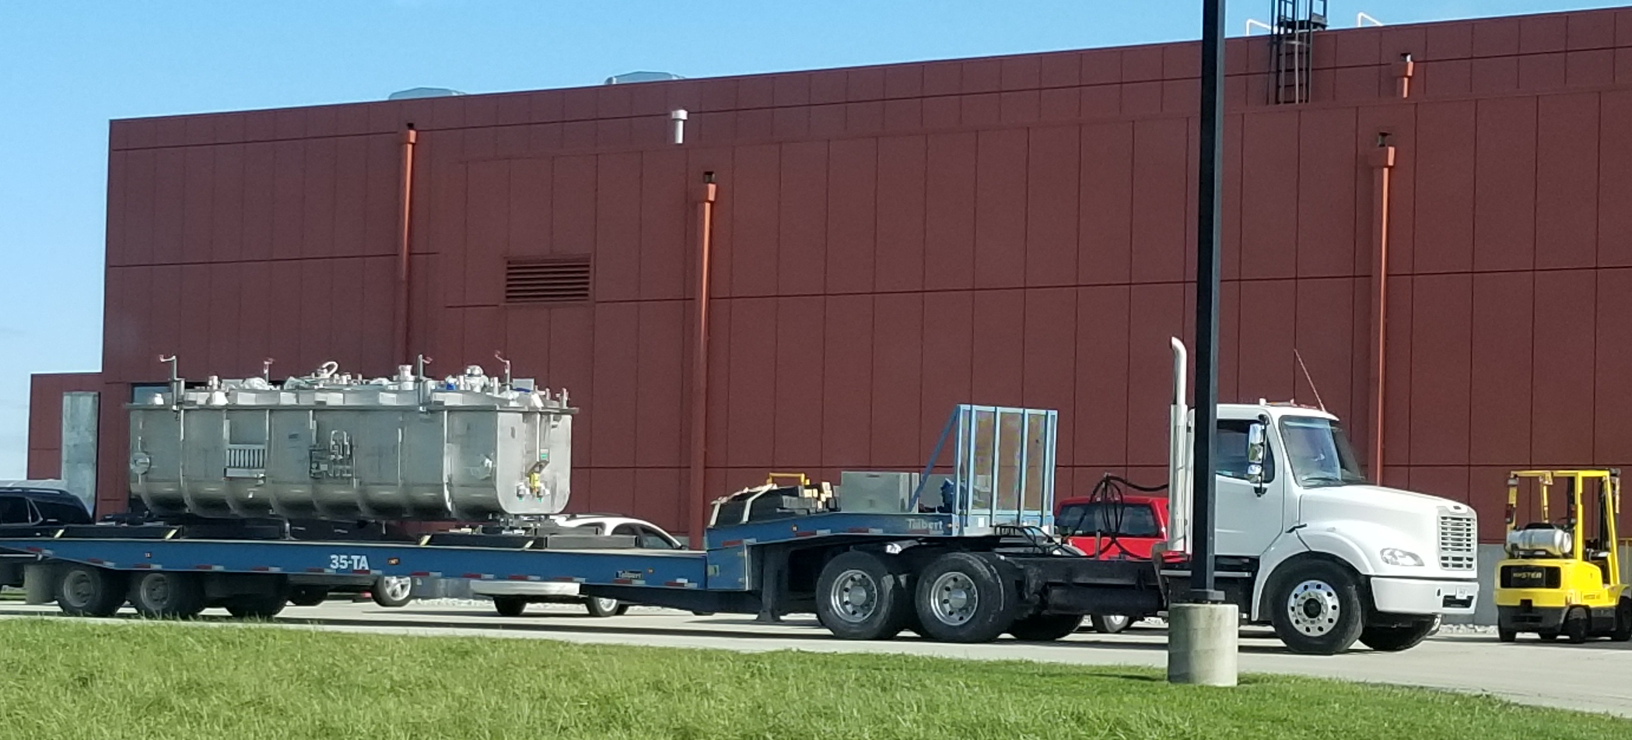
Cryomodule Transport Experience
LCLS-II
1.3GHz & 3.9GHz
Shipping CM’s to SLAC
Partnership with JLab
Onsite transport
PIP-II
SSR1
Onsite Transport
HWR
Transport from Argonne
Onsite transport

Slide 13
PIP-II HB650 Transportation Specification – Section 9
The transportation system shall include instrumentation to actively monitor critical values during the entirety of transport to the extent allowed by external regulations (e.g. GPS devices are often restricted during air transport). These critical values include:
Beamline vacuum pressure at least 1x/minute
Temperature of the vacuum vessel at least 1x/minute
GPS location at least 1x/minute
Acceleration on the outer transport frame captured at >300 Hz with a range sufficient to capture all shocks experienced (>10g) at a minimum of two wide-spread locations on the outer frame
Acceleration experienced on the cryomodule vacuum vessel captured at >300 Hz with a range sufficient to capture all shocks experienced (>10g) at a minimum of two wide-spread locations on the vacuum vessel
Acceleration experienced on critical cryomodule components captured at >300 Hz with a range sufficient to capture all shocks experienced (>10g) at the set of locations defined in the FNAL Cryomodule Shipping Configuration.

Slide 14
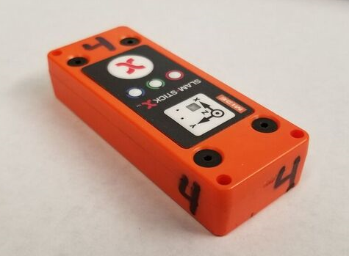
Slam Sticks
All in one device
Accelerometers
Data logging
Configuration
DC MEMS sensor
Digital Capacitance Micro Electro Mechanical System
16g range of acceleration measurement
Frequency response <500Hz
Other sensors built in
Temperature, pressure, humidity, light
Recently rebranded as enDAQ sensors

Slide 15
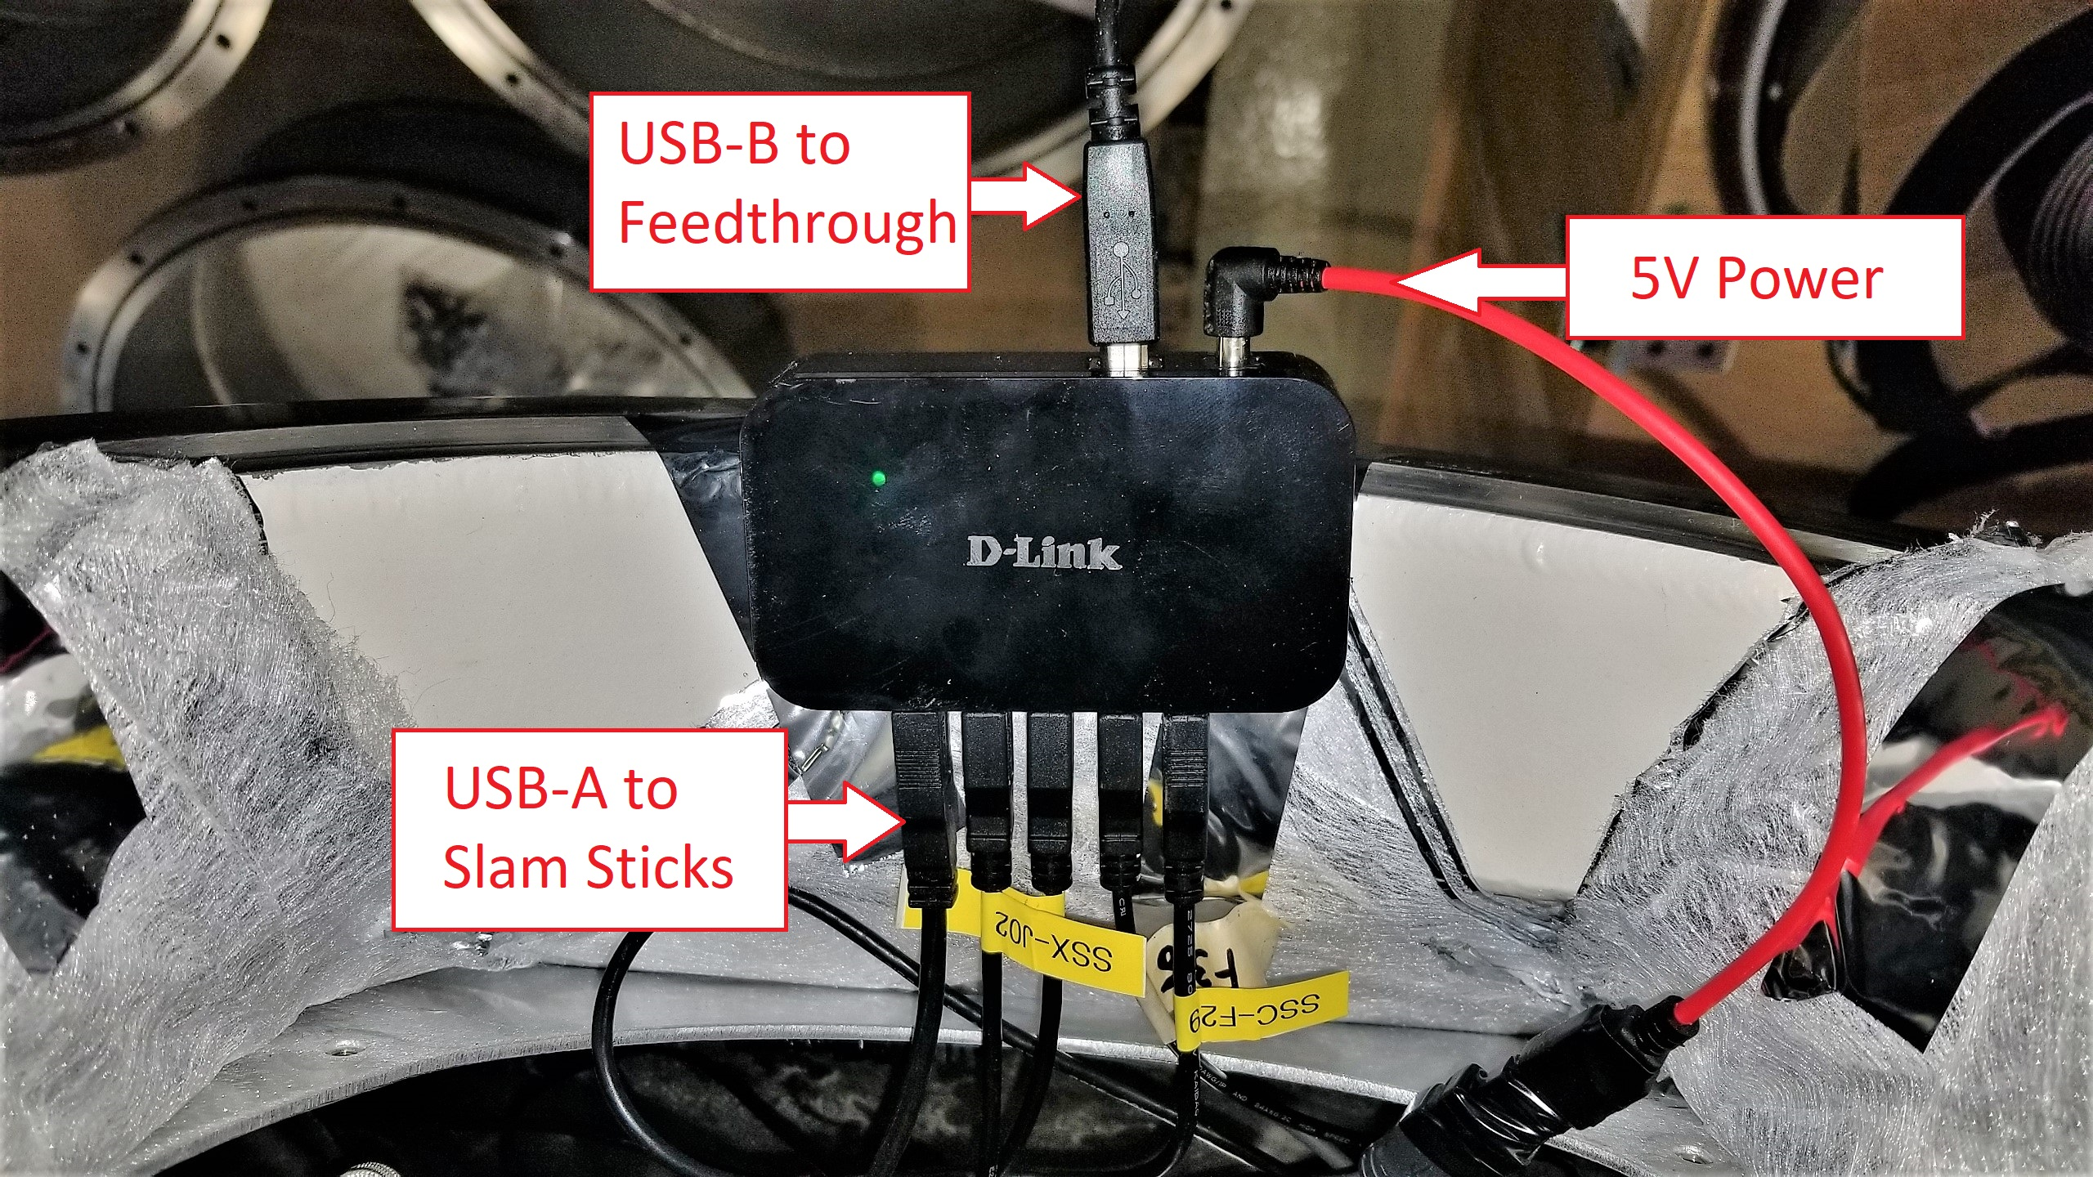
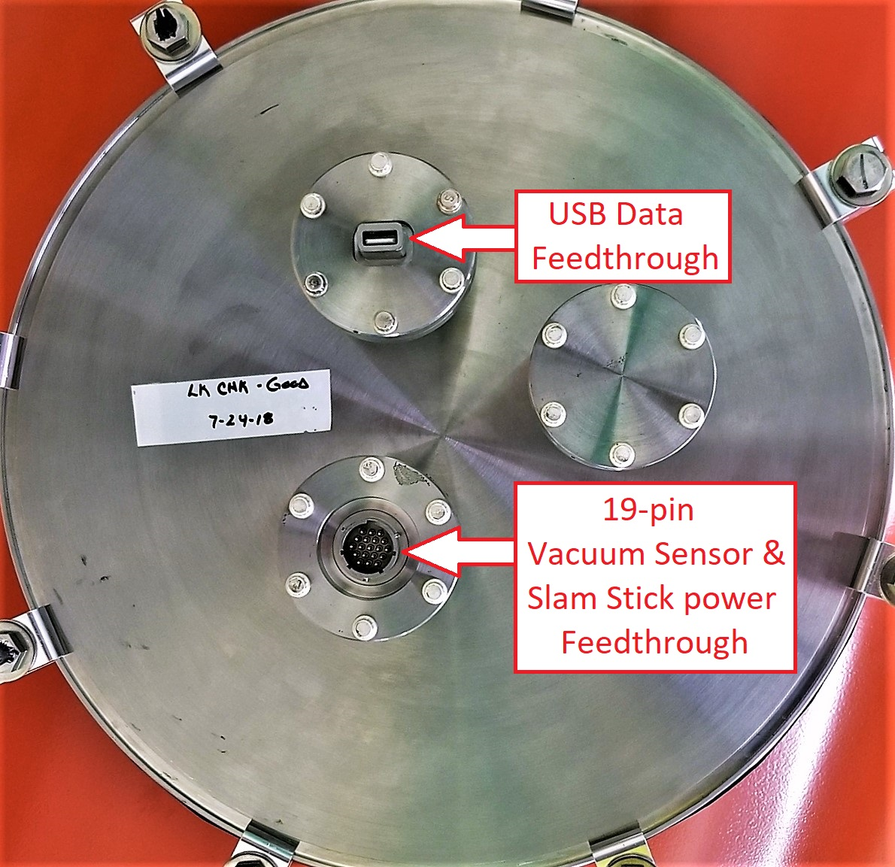
USB Hub Network
Slam Sticks mounted inside CM
Interface/configure
Remote start
External battery power
Data hubs
Interfacing
Distribute 5V to sensors
Power hub
24V to 5V
Modified Tuner Access Port Covers
D-Link USB Data Hub
LCLS-II Modified TAP Port Cover

Slide 16
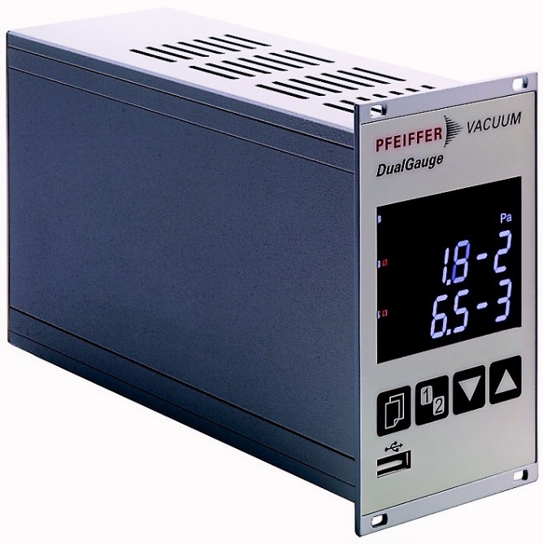
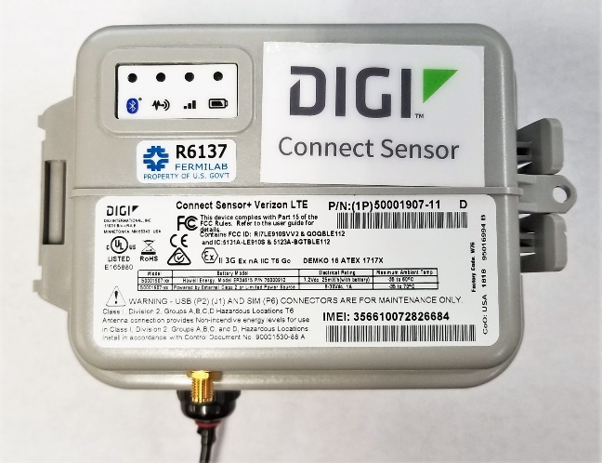
Real-time Beamline Vacuum Pressure Monitoring
LCLS-II Beamline Vacuum Pressure Monitoring System

Slide 17
Successful Transport Vacuum Data

Slide 18
Unsuccessful Transport Vacuum Data

Slide 19
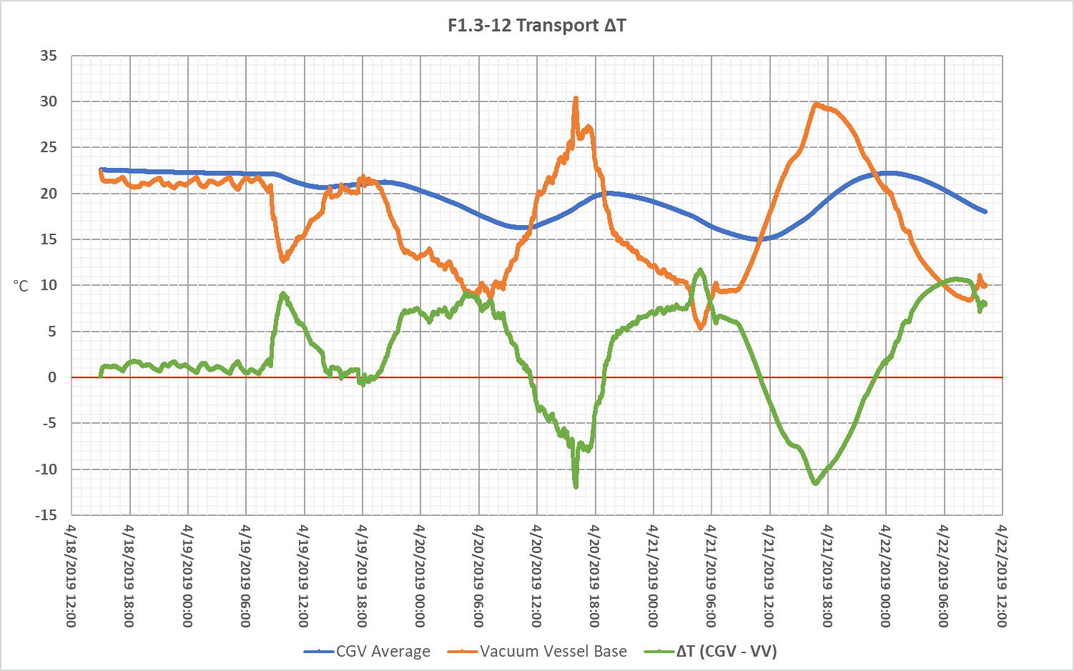
Temperature Monitoring
DIGI
External ambient temperature
Monitor in real time
Slam Sticks
External and internal surface temperature
Cannot monitor in real time

Slide 20
GPS Tracking
Amcrest GPS Tracker
Used on all previous LCLS-II and PIP-II transports
Logs location at minimum 1 minute intervals
Transmits data over cellular network

Slide 21
Transport Monitoring Website

Slide 22
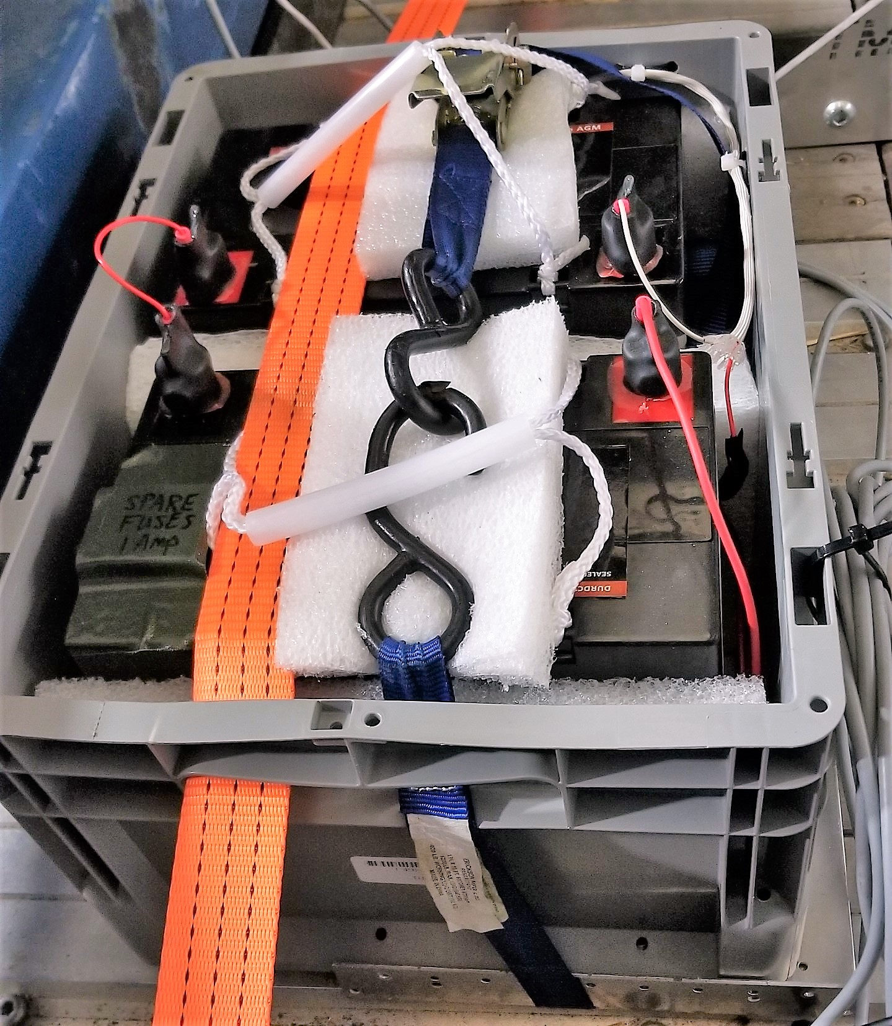
Battery Power
LCLS-II
Transport lasts 4 days
24V, 55Ah SLA assembly for vacuum monitoring system
12V, 55Ah SLA assembly for Slam Stick system
5V USB Li-Polymer battery packs for external Slam Sticks and GPS
LCLS-II 24V Battery Assembly
5V USB Li-Polymer Battery

