Slide 1
IKC Change Control
Allan Rowe
CEA Quality Workshop
August 30, 2021

Slide 2
Partner Originated Changes: Main Points of Contact
Schedule Changes (SPM, L3M/CAM, IKC PM)
Changes to PPD Table 1 I-MS milestones
Scope Changes (SPM, L3M/CAM, IKC PM, IKC TIM)
Scope changes, especially scope reductions/transfer to FNAL
Interface Changes (SPM, L3M/CAM, IKC TIM)
External interface changes to other L3 sub-systems
Internal interface changes potentially impacting requirements or performance
Requirements or Performance Changes (SPM, L3M/CAM, IKC TIM)
Changes requested to FRS, TRS, and Acceptance Criteria
Design Changes (SPM, L3M/CAM, IKC TIM)
Changes where release documentation needs to be revised and re-released
*May not always trigger a formal review

Slide 3
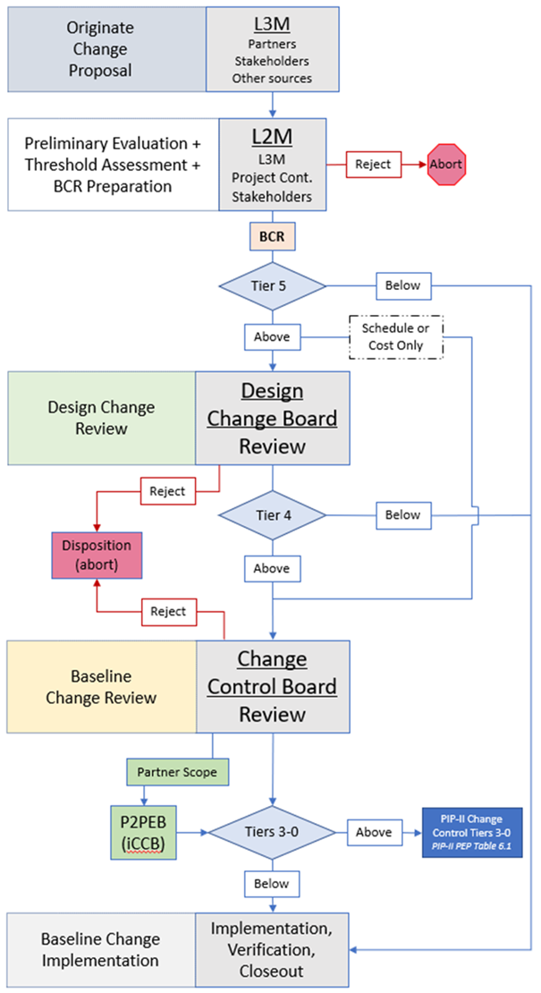
Design Change Request and Baseline Change Request Process
Process Formalized in the PIP-II Configuration Management Plan (PIP-II docDB 2937)
  Design Change Request (DCR) = Technical Changes
  Baseline Change Request (BCR) = Cost and Schedule Changes
Change evaluation and justification is largest effort where key stakeholders weigh in and help the L2M determine whether to proceed
Tier assessment is defined on (DOE) cost, schedule, or technical impact thresholds to the Project
iCCB is a concurrence mechanism since Partners should be informed beginning with the evaluation

Slide 4
Primary Change Control Takeaways
Change control requires two-way communication between the Project and Partners
When in doubt, inform the main points of contact according to slide 2 early in the evaluation phase
The Project needs to know about changes to PPD I-MS
The Project needs to know about any technical changes to the deliverable that impacts interfacing sub-systems especially changes to interfaces, requirements, or released design changes

