Slide 1
Quality control during Assembly
2021 August the 30th
Stéphane BERRY

Slide 2
Outline
          Scope of the presentaion
          Main tests and controls during cryomodule assembly
          Assembly Hall - work station organisation for ESS and PIP-II
          Cryomodule assembly - documentation
          Remaining QC definition work for PIP-II

Slide 3
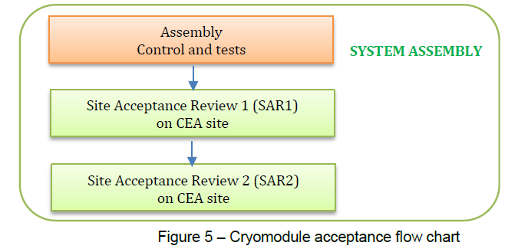
a ) Cryomodule Acceptance Flow Chart *
Scope of the document : Quality controls during the assembly of the system « cryomodule ready for RF cold testing »
set of documents (part of ADP : Acceptance Data Package) to be reviewed in SAR1
  Assembly configuration (As built configuration status list) specifying the serial numbers of the device and its sub-assemblies, as well as the manufacturing file,
  Travelers filled during assembly,
  List of tests carried out and the corresponding test reports,
  Certificates of compliance with regulatory requirements (when applicable),
  List of non-conformances and a copy of non-conformance of levels L2 and L3
* from « PIP-II PROJECT QUALITY ASSURANCE PLAN » PIP2-00003
COLD RF TEST

Slide 4
b) Main tests and controls during cryomodule assembly
Domains of control
Types of control
RF measurement
Leaktightness (helium and pressure test)
Electric checks
Particles cleanliness (airbone, in vacuum)
Survey (Laser tracker, HBCAM)
Welds control
Visual inspection
Back-up slide: Molecular cleanliness (RGA)
Measurement → test report
Hold point → traveler validation
  Each workstation
Audit → report

Slide 5
RF measurements
Component number, operator name, date
Equipment references
Frequence of modes
Flag to check the difference of Pi mode freq. With the expected freq.
PIP-II Freq difference criteria is needed
The ESS automated test bench need to be adapted to PIP-II
Time domain response is also possible for RF cables

Slide 6
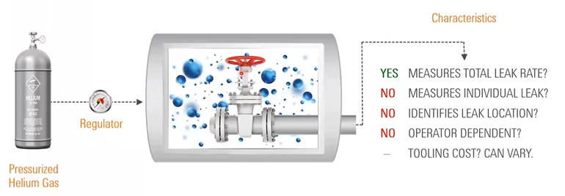
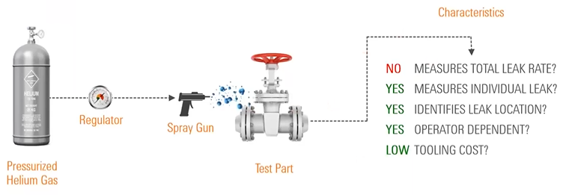
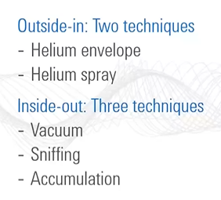
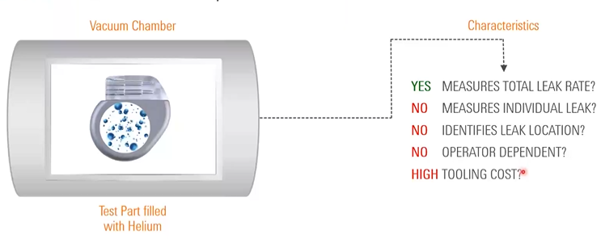
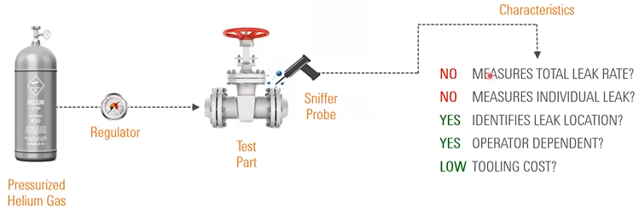
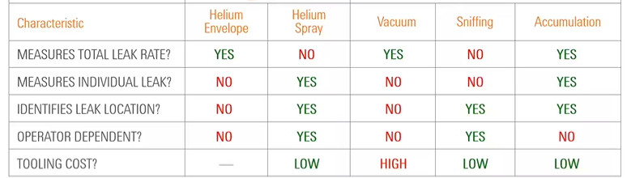
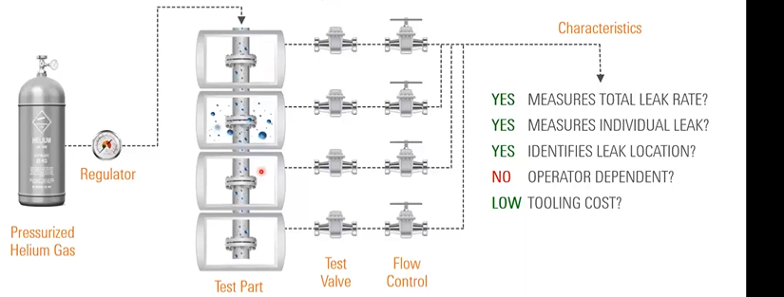
Leak tightness (helium)
Detection methods used in CM Assembly
Green square represent the leak detector
HE : cav. Tank, beam line in clean room & in cryomodule
HS : valve, coupler or preliminary test
V :
S :
A : Helium piping
Detection limit : ~10-11 mbarL/s
Usual specification for helium piping 10-8 mbarL/s
Usual specification for beam line: 1*10-10 mbarL/s
Back ground – Leak signal<1*10-10mbarL/s
Webinar Agilent : https://www.agilent.com/en/video/fundamentals-of-leak-detection

Slide 7
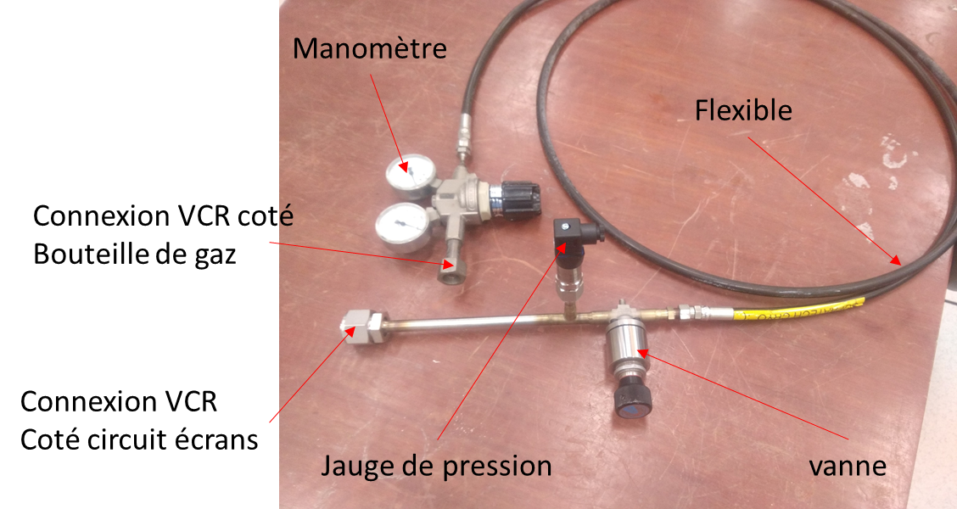
Leak tightness (pressure test)
For ESS this method is used to test the piping of the thermal shields at 20 Bar
(recently upgraded to 25 bars with new set-up)
A pressure regulator, 200 – 20 bar, SERIAL NO. 717-01181
A high pressure valve (200 bar)
A pressure sensor, 0 – 25 bar absolute
A 2500 PSI hose (172.2 bar)
Two stages pressure increase, 15 minutes observation for each stage

Slide 8
Electrical controls
Temperatures sensors: resistance and insulation to ground
Tuner motors:
Piezos: capacitance
Heaters: resistance
Field probe: insulation to ground
Helium level jauge: resistance and insulation to ground
Test at several steps of the assembly recorded in the same file
Last check in the module: electrical measurements of the electrical interfaces will be performed with an automatic test bench (to be developed)

Slide 9
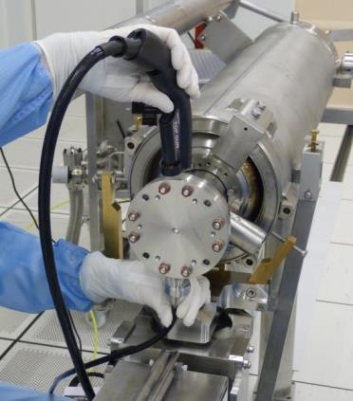
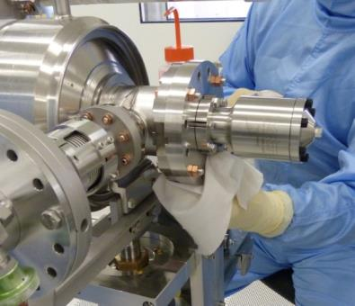
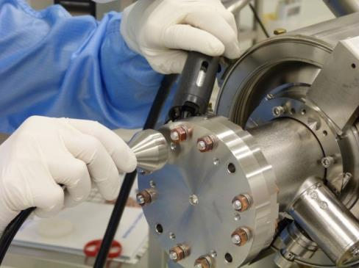
Cleaning of all components and tools and particle checks
Wiping with clean room tissues and Isopropyl. Alc.
Blowing with ionized nitrogen
control step: counting particles with
airbone particles counter
Counted are below 10 parts (size>0,3 µm) during 1 min
with particle counter 1CFM
Some key records are stored in the assembly report
Robot assistance for flange cleaning is possible

Slide 10
c) Assembly Hall - work station organisation for ESS and PIP-II

Slide 11
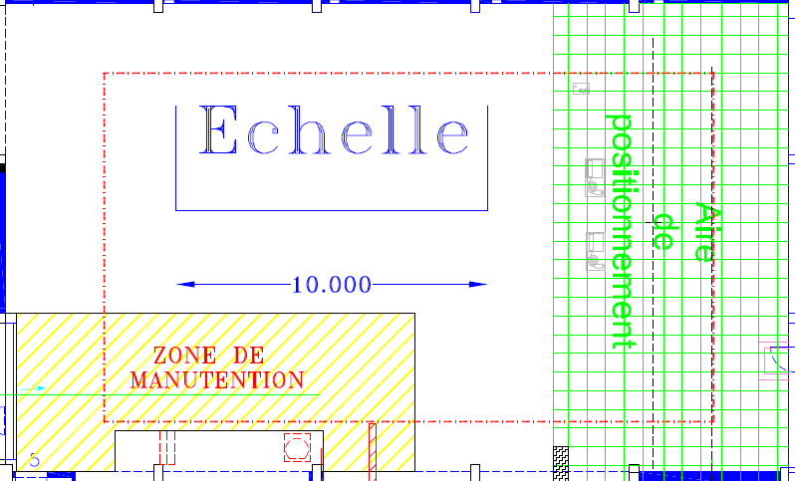
Assembly hall : ORGANISATION of Work Stations
ESS example
MAF2
MAF 1
Clean room ISO4
Spaceframe + Thermal shield
COU
Space frame+thermal shield+ cold mass
Cavity string
Coupler assembly on cavity
TRA
CRY
Vacuum Vessel
COU : Coupler assembly on cavity
TRA : Cavity string assembly
MAF 1 : Equipped cold mass
MAF 2 : Cold mass assembly on the space frame
SPA : Thermal shield assembly on the space frame
CRY : Transfer of the cold mass into the vacuum vessel
CLO : Coupler bell assembly
CHA : Cryomodule transferred to the shipping area
EXP : Shipping area
Coupler Bell Assembly
Cryomodule transfer
Cavity string
SPA
CLO
CHA

Slide 12
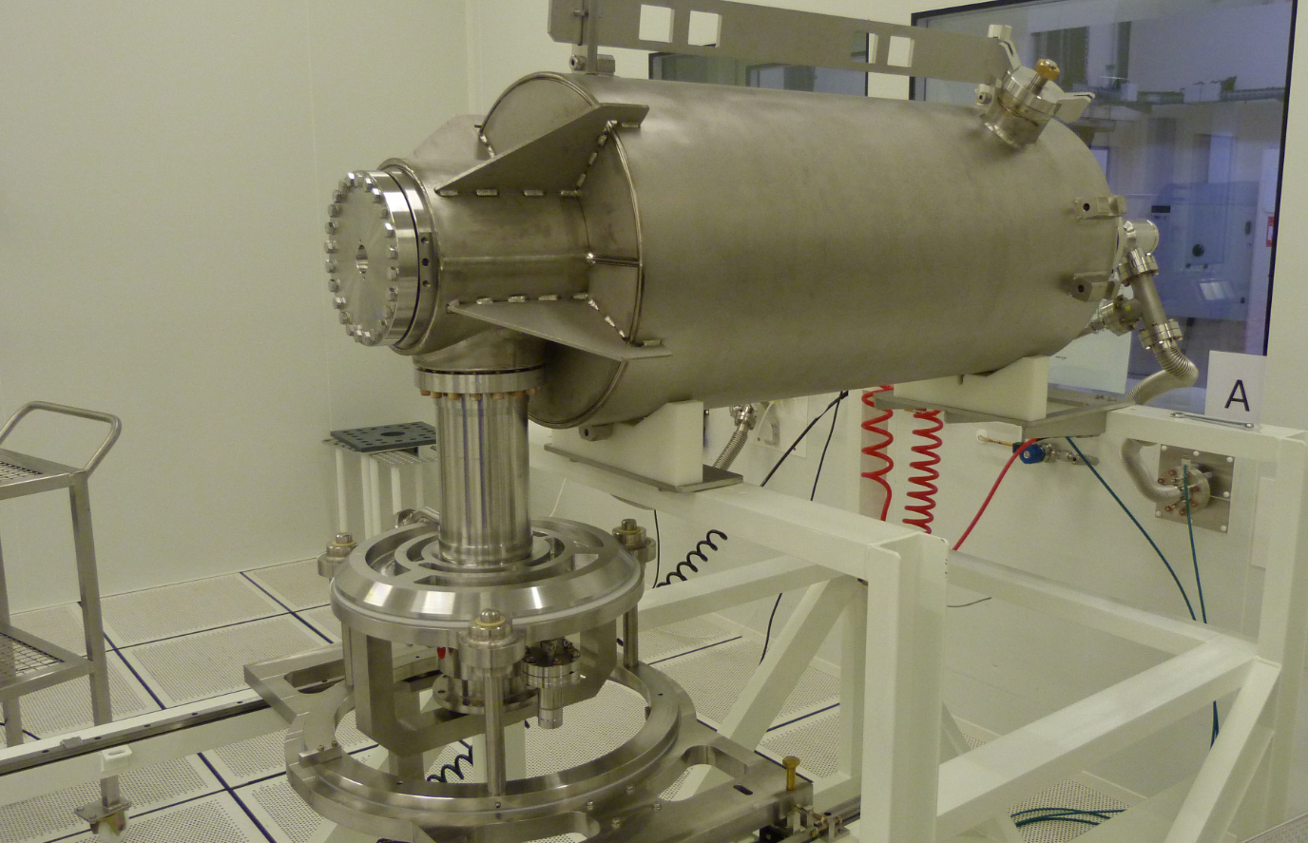
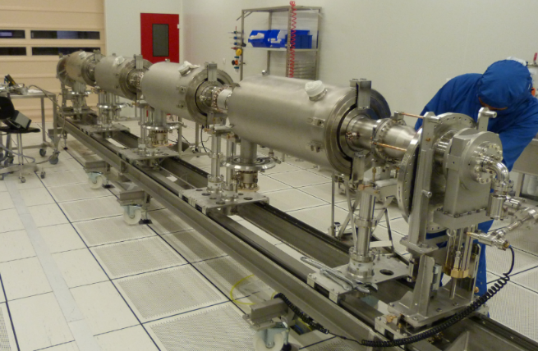
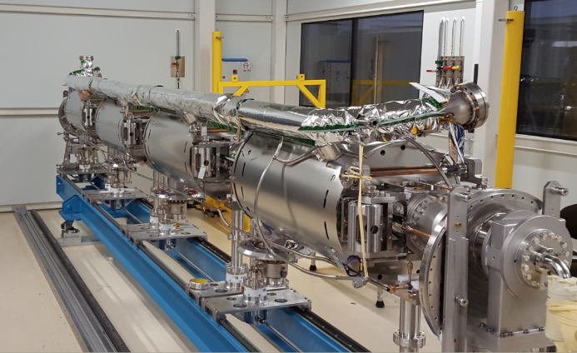
Main tests and Controls during ESS cryomodule assembly (1/3)
COU
TRA
MAF 1
Before assembly :
Leak check of the cavity
Leak check of the coupler
RF measurement of the cavity at atmospheric pressure
After assembly :
Leak check and RGA
Visual inspection (hold point)
Leak check and RGA of the cavity string
Dimensional control
Visual inspection before roll-out (hold point)
Survey control
Visual inspection of the weldings (Helium pipe)
Leak check (Helium pipe)
RF monitoring during tuner assembly
Check of tuner assembly
Electrical measurements (temperature probes, piezos)
Mechanical check and visual inspection (hold point)

Slide 13
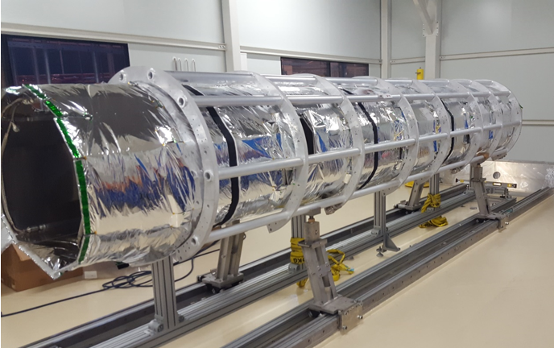
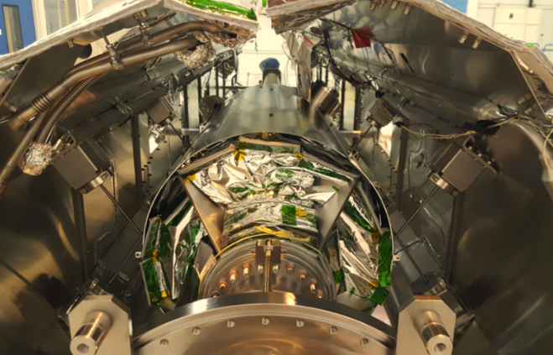
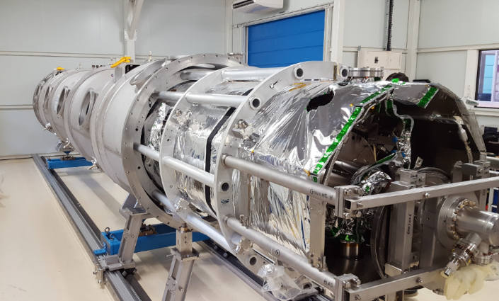
Main tests and Controls during ESS cryomodule assembly (2/3)
SPA
MAF 2
CRY
Electrical measurements (temperature probes)
Mechanical check and visual inspection (hold point)
Cold mass alignement
Leak check (thermal shields)
Electrical measurements (temperature probes)
Mechanical check and visual inspection (hold point)
Alignement of the cold mass into the vacuum vessel
Leak check (cryogenic line)
Electrical measurements (temperature probes, heaters)
Mechanical check and visual inspection (hold point)

Slide 14
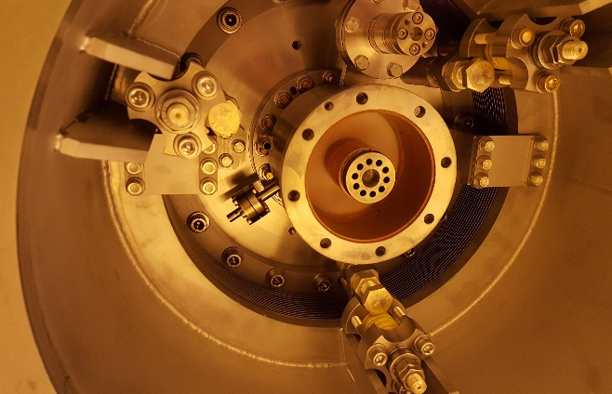
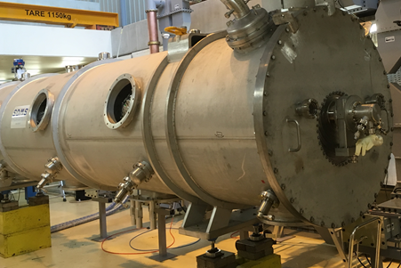
Main tests and Controls during ESS cryomodule assembly (3/3)
CLO
EXP
Check of the coupler bell assembly
RF measurements
Leak check (cavity string)
Visual inspection (hold point before transfer to the EXP workstation)
Electrical tests (all the instrumentation)
Leak check (vacuum vessel)
Outgoing inspection (before shipment)
Documentation check

Slide 15
General logic of the workstations of PIP-II on Saclay site
WAS/PRE
Washing the components in BELIMED
Preparation of the parts before entering the clean room
CAP
ABE
SPA
BLA
in Clean room Assembly Preparation
Assembly of the components of the equipped cavity string
Strongback assembly
Beam Line Assembly
Clean Room
CLO
CRY
COS
Vacuum vessel closure
Assembly of the cold mass / strongback in the vacuum vessel
Assembly of the cold mass on the strongback
BUN
EXP
Final test in bunker
Preparation for shipment
Notes:
WAS : WAShing of elements
PRE : PREparation of elements before clean room
CAP : in Clean room Assembly Preparation
BLA : Beam Line Assembly
ABE : Assembly of Beam line Equipments
SPA : Strongback Preparation Area
COS : Coldmass On Strongback
CRY : CRYostating
CLO : Closure of cryomodule
BUN: cold RF test in the bunker
EXP : EXPedition

Slide 16
d) Cryomodule assembly - documentation

Slide 17
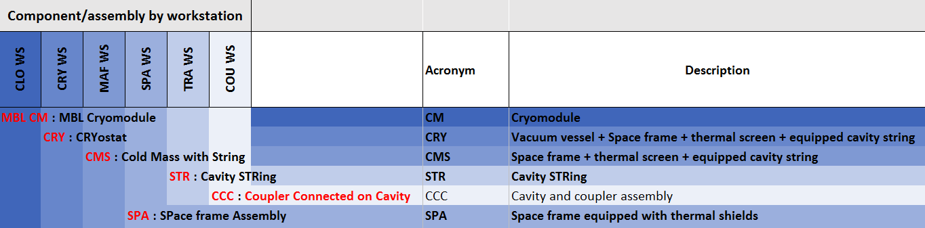
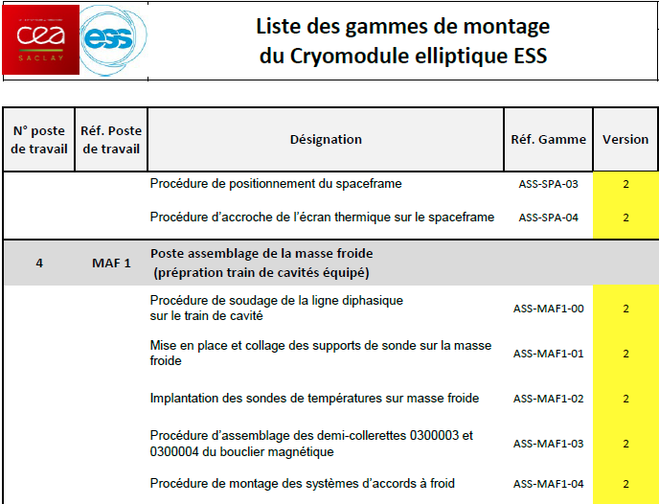
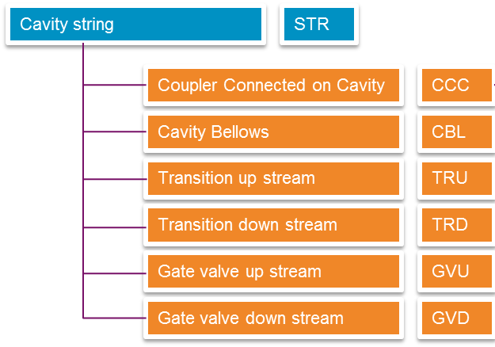
Cryomodule Documentation structure
  Documentation organisation based on the cryomodule assembly process.
ESS example

Slide 18
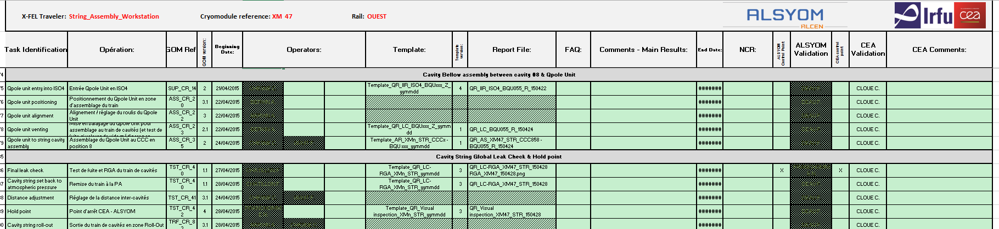
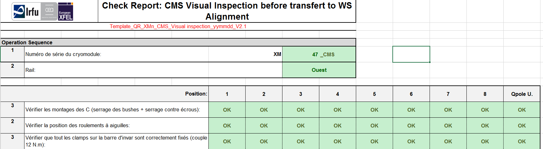
Traveler and hold point (XFEL)
Travelers : monitoring of the assembly and test operations with the operator names, the report references and all the non-conformities detected.
Hold point : inspection checks performed by CEA and sub-contractor at key points (tuner assembly…) and at the end of each work station authorizing transfer to the next workstation.

Slide 19
Cryomodule assembly documentation
Cryomodule data package travelers, test & control reports, configuration report, NC…
CEA specifications
Technical specifications,
Drawings,
PBS
Manufacturing file
Assembly procedures, welding file, test procedures, quality control…
Cryomodule data package travelers, test & control reports, configuration report, NC…
Cryomodule data package travelers, test & control reports, configuration tables, NC…
CEA
Subcontractor for the assembly
Subcontractor
CEA validation
FAT
Outgoing inspection report
SAR1
Once, a series of acceptance tests (SAR1) are planned to be undertaken by CEA to assess system conformance (physical and electrical parameters) against Fermilab’s specifications and assess cryomodule readiness for RF cold testing.
Quality control
Documentation check
Subcontractor & CEA
FERMILAB
SAT
Test report
SAR2
Test report of the cryomodule tested at Saclay

Slide 20
          e) Remaining QC definition work for PIP-II

Slide 21

Preparation of the QC for PIP-II
  For PIP-II, the sequence and the number of controls will be refined in parallel with the assembly sequence
  Hold points are defined in the traveler.
  Occurrences : at the end of critical assemblies or tests and between each workstation
  They are carried out by CEA quality representative and technical experts (RF, alignment, vacuum…) with sub-contractor quality representative.
  The approbation of an Hold point involves the verification of :
    Visual inspection of the assembly
    Mechanical check if needed
    Control of the tests reports
  Non conformity are generated if test report is not conform, assembly difficulties or visual inspection all time during the assembly or at the hold point meeting

Slide 22
Thank you for your attention

Slide 23
Molecular contamination with mass spectrometer (optional)
Residual Gas Analysis : m/q up to 100, conformity (300*Σ₄₅¹⁰⁰I_{k}< Σ₀¹⁰⁰I_{k})
Criteria 1 : Leak-free means Integral leak rate ≤ 1 10-10 mbarl/s
Criteria 2 : Content of hydrocarbons:
leak-free system reaches a total pressure below 10-7 mbar
ratio between the sum of partial pressures from m/q=45 to 100 and total pressure is less than 1/300 (factor for ESS: 1/300, factor for XFEL: 1/1000)
Typical CONTAMINANT | CHARACTERISTIC m/q
Acetone | 43;58;
Ethanol | 31;45
Isopropanol | 45;
Benzene | 50;51;52;77;78
Sulphur Dioxide | 64;48;32
Fluorine-based polymer | 69;31;others

Slide 24
Survey
Laser tracker and HBAM

Slide 25
Welds control
Visual inspection
Leak tightness
« Ressuage »
X ray

