Slide 1
Non-Conformance Management
30 August 2021
A.Le Baut

Slide 2
Outline
Non-conformance process
Classification
Non-conformity reports
Non-conformities processing
Non-conformance meetings

Slide 3
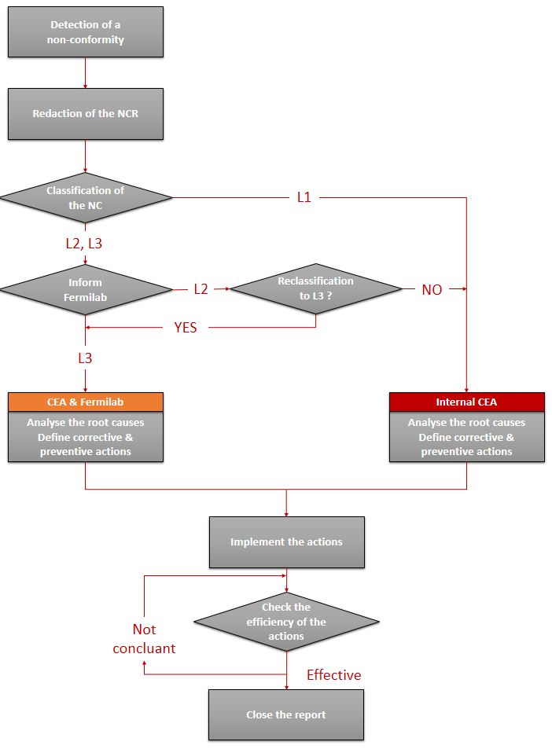
Non-conformance process
Non-conformances affecting equipment are subject to formalized management and treatment once the reference configuration is established.
Non-conformance process flow-chart →
L1 : Minor
L2 : Moderate
L3 : Critical

Slide 4
Classification
Level | Description | Responsibility
Minor (L1) | NC that will affect internal interfaces, performances and functional requirements with no impact at Fermilab level. | It is processed internally by the CEA team. Fermilab is not informed immediately. A summary is provided to Fermilab once a month, or is included in the component (e.g. cryomodule) traveler.
Moderate (L2) | NC that will affect interfaces, safety, lifetime, performances, functional requirements with an impact at Fermilab level. After corrective actions, the item is compliant to all specified requirements. | The actions are implemented after CEA approval. Fermilab is informed of occurrence and mitigation/repair plan. Fermilab can request reclassification to L3.
Critical (L3) | NCR that will affect interfaces, safety, lifetime, performances, and functional requirements with an impact at Fermilab level. | Fermilab is informed of occurrence, is invited to partake in the definition and approval of the mitigation/repair plan, and is requested to approve NCR closure.

Slide 5
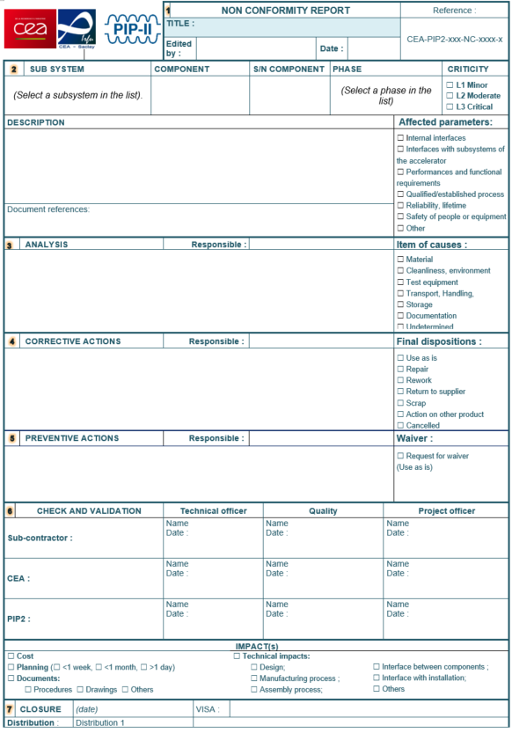
Nonconformity report
Classification
Affected parameters
(criteria for the classification)
Corrective actions
Actions to eliminate or mitigate the non-conformity after its appearance
Preventive actions
Actions to eliminate the root cause of th non-conformity, and avoid future similar occurrences on other components
NC reports are usually written in french for internal use or suppliers exchanges.
If they have to be sent to Fermilab, they’ll be written in english.

Slide 6
Nonconformities processing
Once the NC report has been completed, a decision is made about the actions to take on the part :
Use as is
The component is found to be usable without eliminating the nonconformity.
Rework
The component is recoverable to conform completely to all specified requirements. Preliminary work might be necessary before the recovery, but should not interfere with previous or future operations.
Repair
The component is recoverable such that it fulfils the intended usage requirements, however it will not comply with the initial requirements.
Return to supplier
A non conform product may be returned to the supplier for repair or rework when the corrective actions cannot be performed at CEA.
Scrap
The component is affected by major non conformities. It is not recoverable by any means, for technical or economical reasons.

Slide 7
NC meetings
Regular meetings are organized by the Quality Manager at CEA. These meetings are held for the following purposes :
Classification of the deviations (L1, L2, L3)
Status checking of the NC in progress and their associated actions
Preparation of the NC meetings with Fermilab
Update of the configuration

Slide 8
Thank you for your attention
Any questions ?

