Slide 1
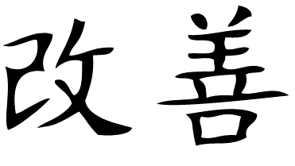
Continuous Improvement
N. BAZIN
Kaizen : “change for the better”

Slide 2
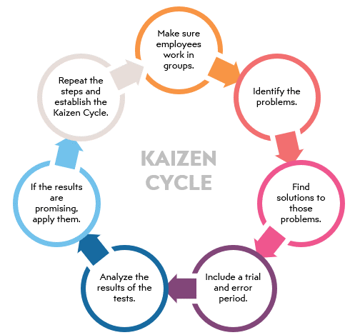
What is continuous improvement?
Definition: continuous improvement process is an ongoing effort to improve products, services or processes.
Broader definition of the Chartered Quality Institute (CQI): continuous improvement is a gradual never-ending change which is focused on increasing the effectiveness and/or efficiency of an organization to fulfil its objectives.
Efforts can result in "incremental" improvement over time or "breakthrough" improvement all at once.
Among the widely used methods of continuous improvement, the Kaizen method is famous:
Japanese word kaizen means "change for better“
Based on many small changes rather than radical changes
Involves all employees

Slide 3
Continuous Improvments Applied on Cryomodules
Continuous improvements on cryomodule can come from:
Lessons learnt from other projects
New ideas
Non-conformances (see A. Le Baut’s presentation)

Slide 4
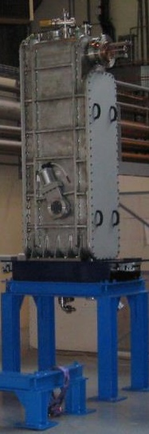
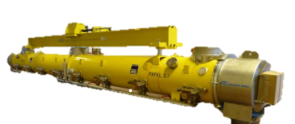
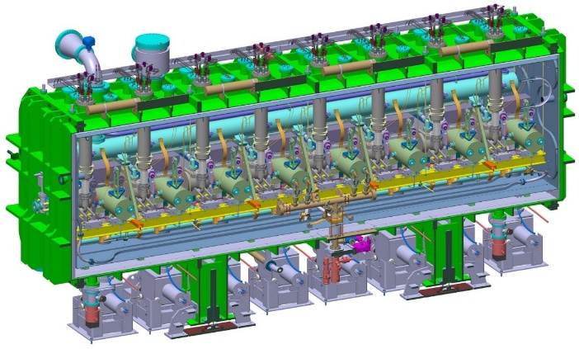
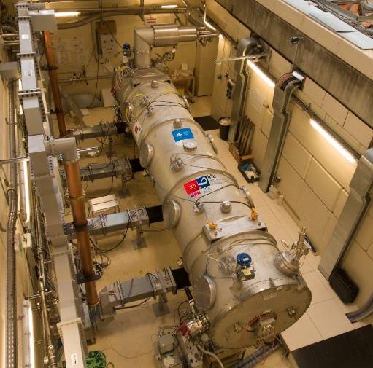
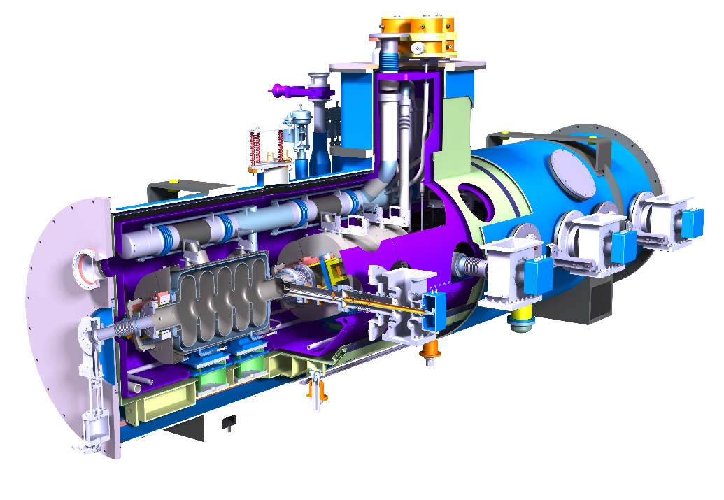
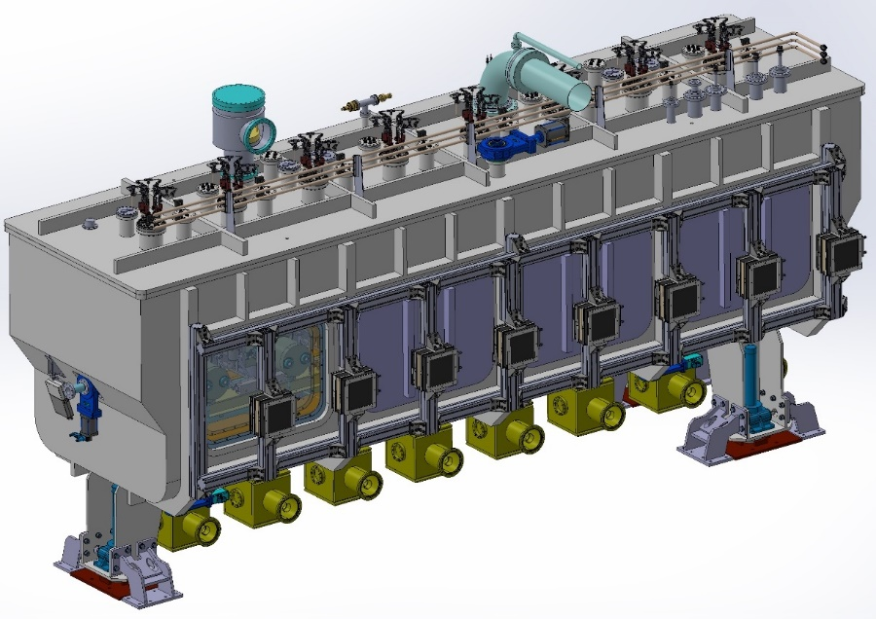
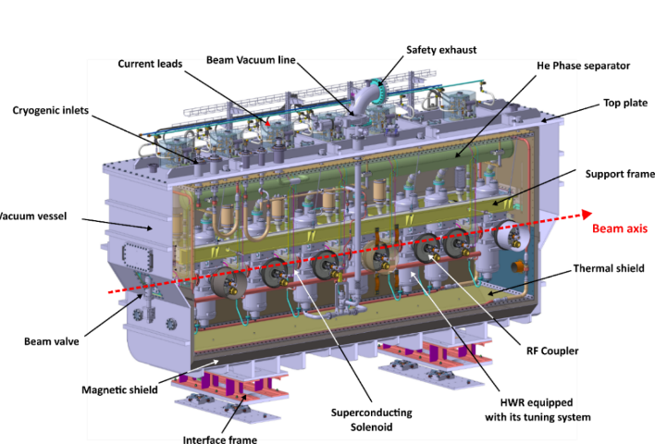
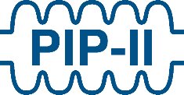
CEA Experience on Superconducting Linac
Booster
MACSE
SOLEIL
TTF, SLS
SPIRAL2
XFEL
IFMIF EVEDA
ESS, SARAF
PIP-II
IFMIF DONES
Futur
SPIRAL2: design and assembly of 12 cryomodules
XFEL: assembly of 103 cryomodules
IFMIF EVEDA: 1 cryomodule
ESS: cavity and coupler design, integration of 30 cryomodules
SARAF Phase2: 4 cryomodules
PIP-II: 9+1 cryomodules
IFMIF DONES: 5 cryomodules

Slide 5
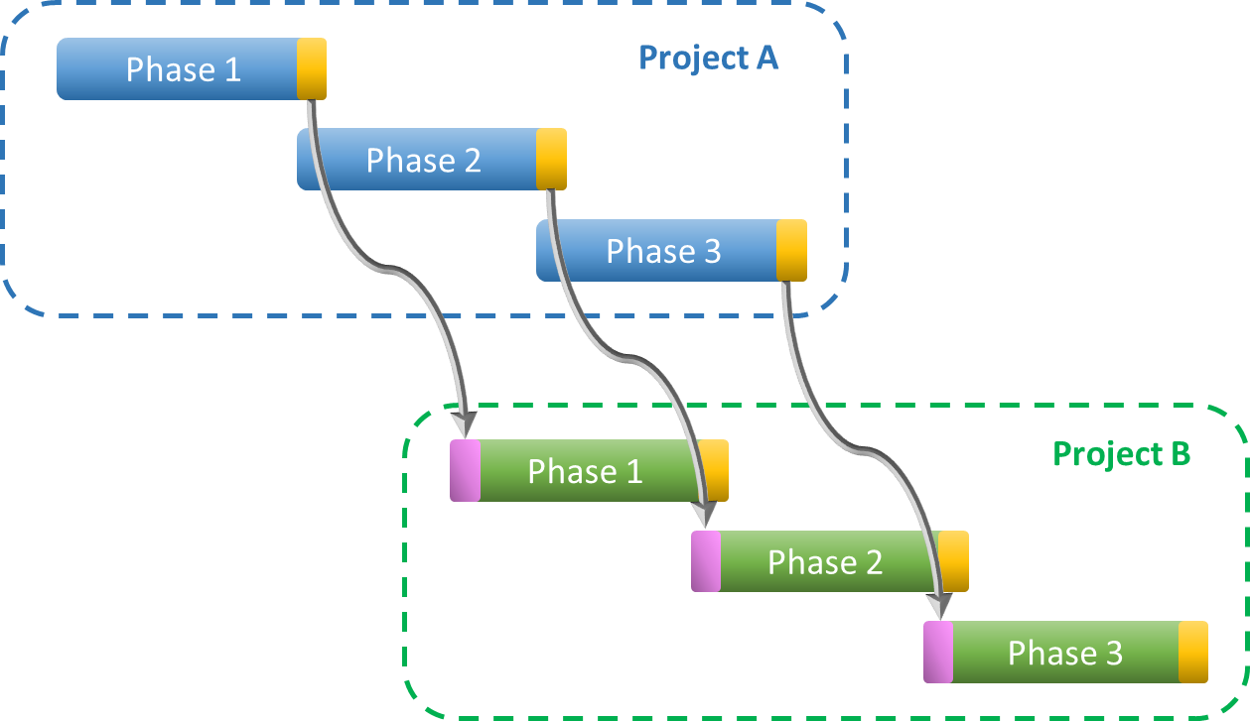
Implementing Lessons Learnt between CEA projects
Implementing method on lessons learnt from one project to another depends whether they overlap or not:
Project B starting when Project A is ended: lessons learnt from Project A is implemented at the start of Project B
Project B overlapping Project A: lessons learnt from Project A is implemented in Project B at each phase of the project (design, manufacturing, assembly, test and shipment)

Slide 6
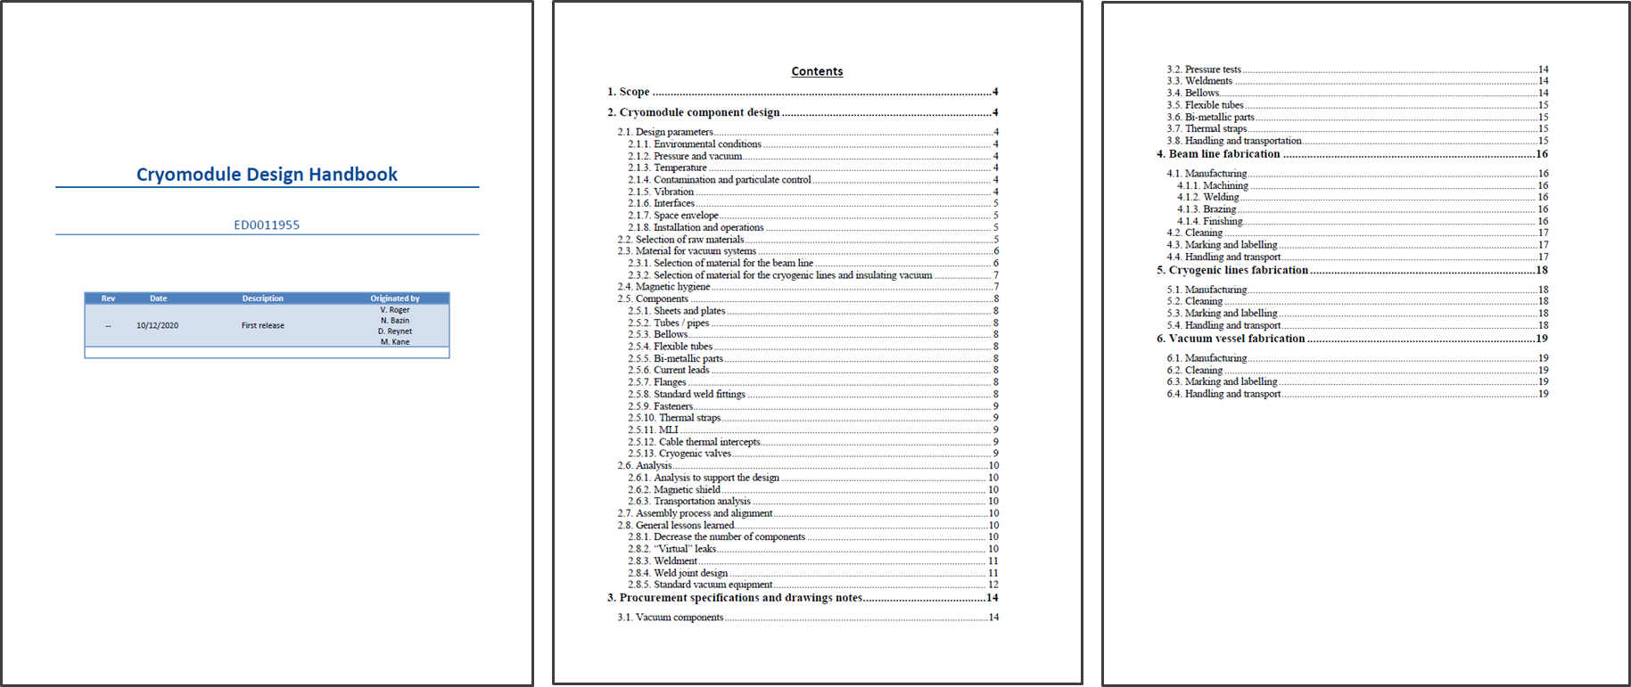
Lessons Learnt within PIP-II Collaboration
As stated in Tom’s presentation at the PIP-II Quality Control Coordination Group meeting in June, lessons learned is an opportunity for improvement among all.
Lots of information shared within the collaboration during the first PIP-II Technical Workshop in December 2020, leading to many lessons learnt.
https://indico.fnal.gov/event/45681/
Design Principles Coordination Group: release of the PIP-II Cryomodule Design Handbook (reference ED0011955) in December 2020
The PIP-II Cryomodule Design Handbook summarizes the best practices and lessons learned associated with cryomodules components design and specifications. This handbook is not intended to impose requirements but guidelines.

Slide 7
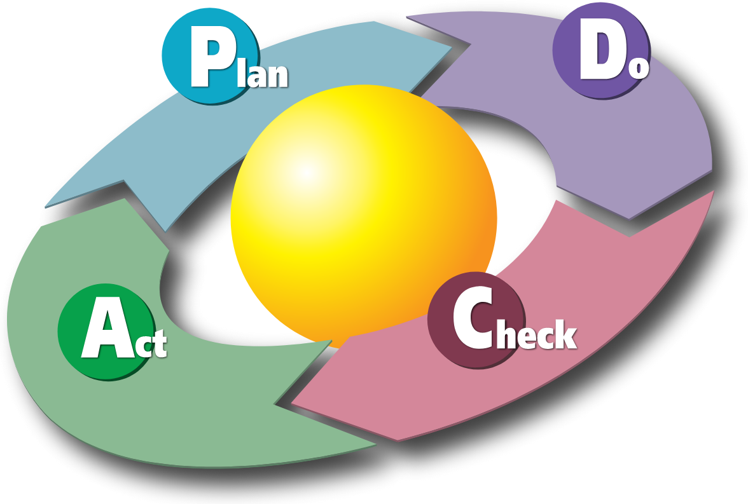
PDCA: Plan, Do, Check, Act
Among the widely used methods of continuous improvement, the plan-do-check-act (PDCA) cycle is mostly used on cryomodules at CEA
Plan: Identify an opportunity and plan for change.
Do: Implement the change on a small scale.
Check: Use data to analyze the results of the change and determine whether it made a difference or not.
Act: If the change was successful, implement it on a wider scale and continuously assess your results. If the change did not work, begin the cycle again.

Slide 8
PDCA during cryomodule integration
Courtesy of S. Berry
“CEA expertise with clean room assembly of XFEL”
Presentation at the 4th SHLIPP meeting
https://indico.esss.lu.se/event/139/contributions/981/attachments/849/1430/2014_May__4th_SLHIPP_Berry_v3.pptx

Slide 9
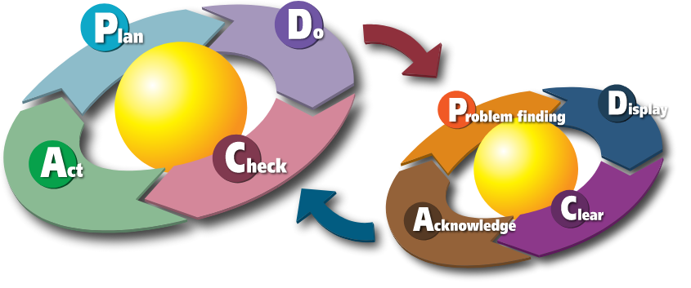
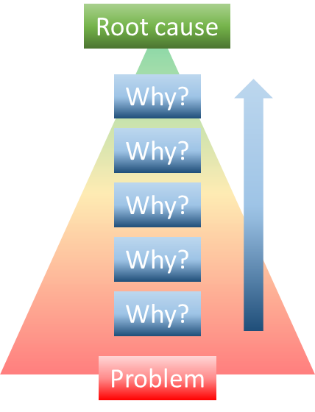
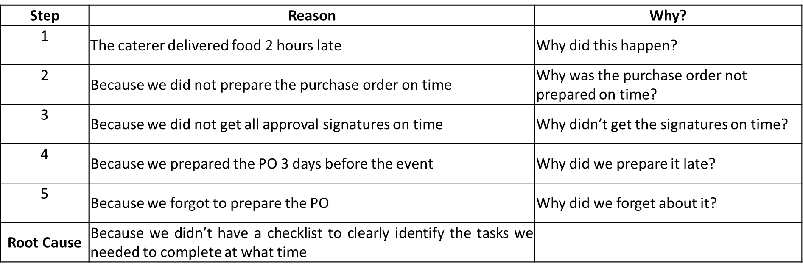
5-Why Method
PDCA is an integrative process as problems could be found during the ‘Do’ phase
For each problem, the 5-why method could be used to identify the root cause: repeat the question “why?”. Each answer forms the basis of the next question.
Example:
Example taken from https://web.archive.org/web/20101028174801/http://blog.bulsuk.com/2009/02/taking-first-step-with-pdca.html

Slide 10
PDCA during cryomodule integration
Courtesy of S. Berry
“CEA expertise with clean room assembly of XFEL”
Presentation at the 4th SHLIPP meeting
https://indico.esss.lu.se/event/139/contributions/981/attachments/849/1430/2014_May__4th_SLHIPP_Berry_v3.pptx

Slide 11
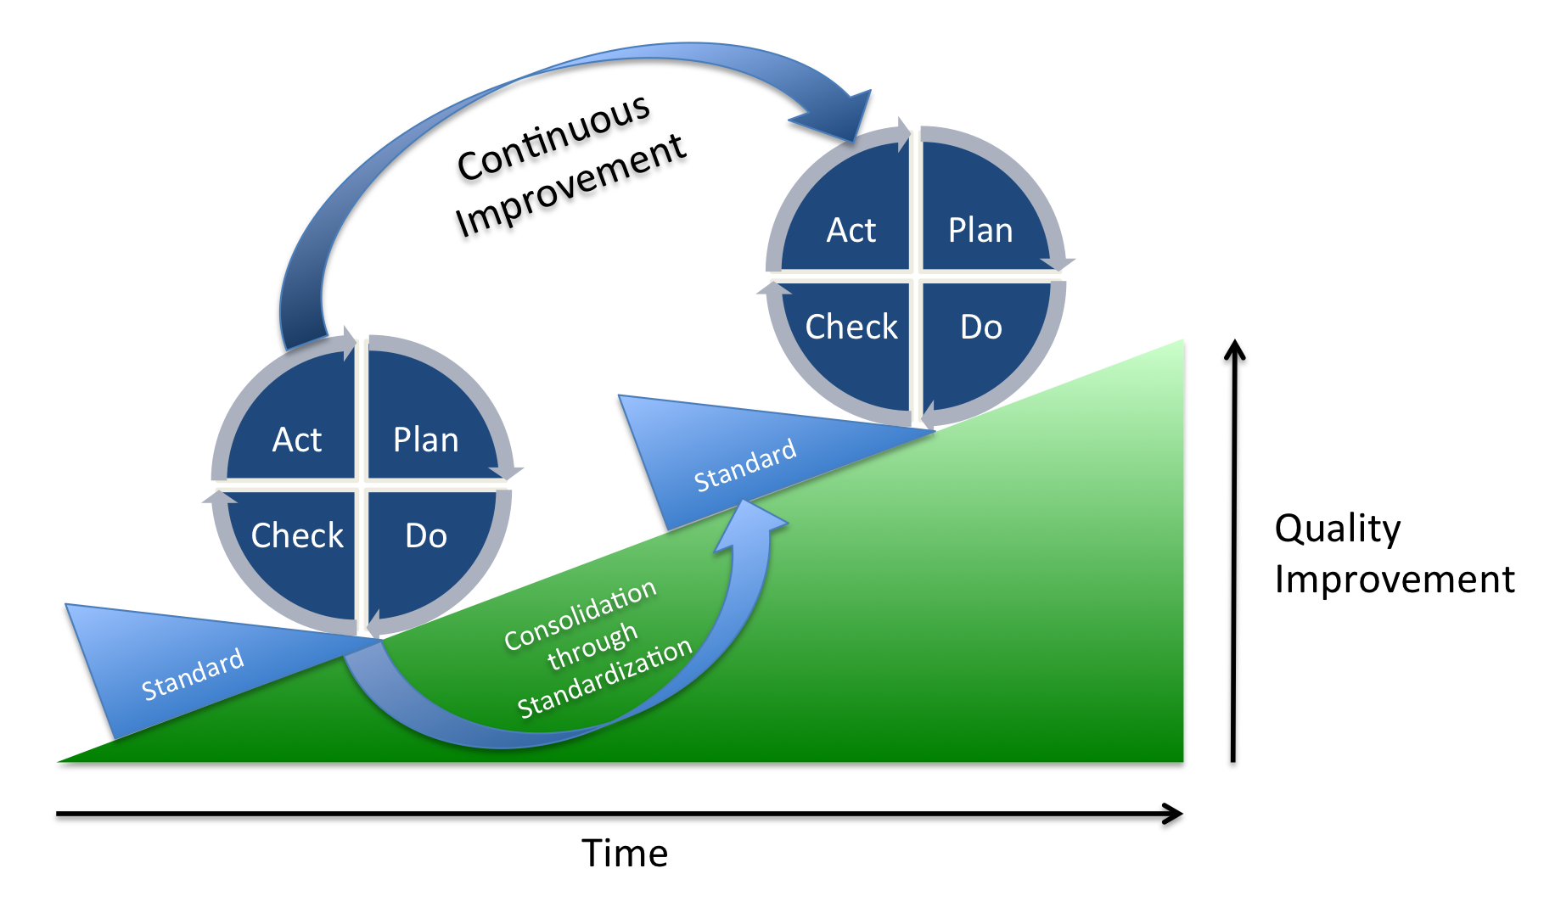
PDCA Method Applied to QMS
The Quality Management System used on CEA projects continuously improved overtime.
New project benefits of the QMS improvements of previous projects.
Project B
Project A

Slide 12
CIP during cryomodule production
During cryomodule production, the 5S methodology used in lean production could be applied.
The 5S quality tool is derived from five Japanese terms beginning with the letter "S" used to create a workplace suited for visual control and lean production:
Seiri – Sort: Eliminate whatever is not needed by separating needed tools, parts, and instructions from unneeded materials.
Seiton – Set in order: Organize whatever remains by neatly arranging and identifying parts and tools for ease of use.
Seiso – Shine: Clean the work area by conducting a cleanup campaign.
Seiketsu – Standardize: Schedule regular cleaning and maintenance by conducting seiri, seiton, and seiso daily.
Shitsuke – Sustain: Make 5S a way of life by forming the habit of always following the first four S’s

Slide 13
Thank you for your attention

