Slide 1
High-intensity low energy muon beamline at MTA
C. Johnstone
Review 8-23-2021
Carol Johnstone, Anna Mazzacane, Rob Ridgway, Chris Izzo, J. Morgan
PPD contributors: Mandy Kiburg and Evan Niner

Slide 2
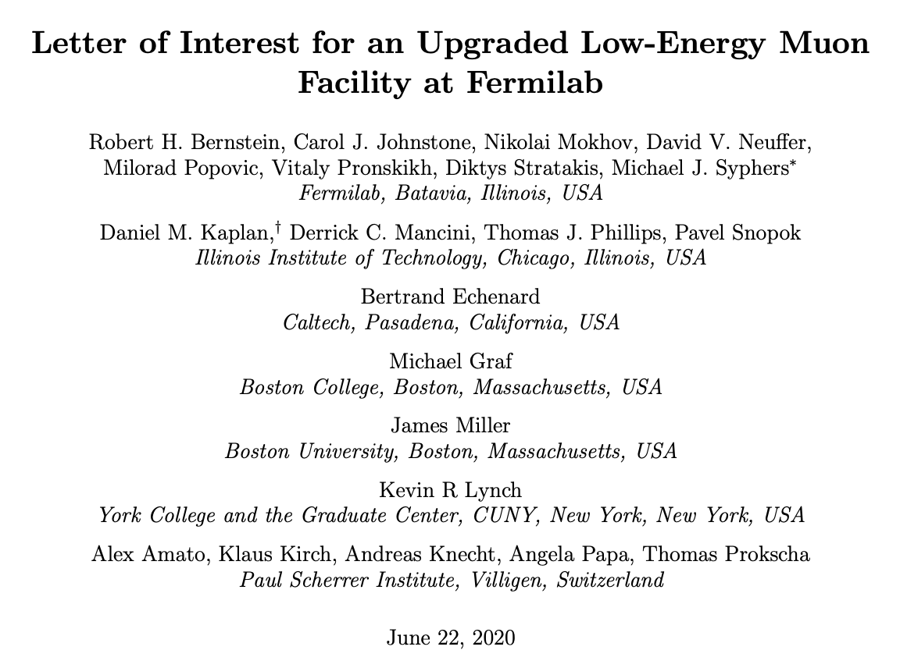
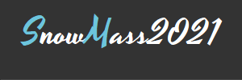
Community interest in opportunities for future low energy muon experiments
LOIs to be discussed during the 2021-22 “Snowmass” community planning process for high energy physics
lepton flavor violation
muon decay to 3 electrons
muonium - antimuonium
muon hydrogen and the proton radius
muon EDM
muon catalyzed fusion

Slide 3
Current muon beam facilities worldwide
Fermilab currently supports muon beams for Muon g – 2 & Mu2e using 8 GeV protons, likewise COMET at J-PARC
Several current muon facilities are for MuSR (μ⁺, < 30 MeV/c)
Except for the planned Mu2e W target, the production targets are light
  4% IL graphite targets at PSI and ISIS
  ≤ 25% IL Be target at TRIUMF
  Graphite planned for COMET, J-PARC (Phase II maybe tungsten)
  Tungsten at Mu2e – chosen for heat tolerance and deformation properties

Slide 4
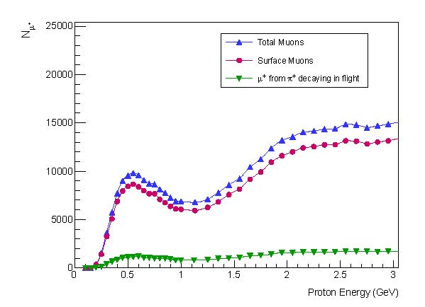
Pion Production Physics : Thresholds
  Single pion: 280 MeV
  Pair Threshold: 600 MeV 4 production channels (PIPII)
  Total pion production cross sections begin to level at ~800 MeV
    Fermilab 400-MeV Linac produces experimentally-significant pulsed intensities
    800 MeV PIP II beam can provide unprecedented low-energy muon intensities
MTA
PIP II/ISIS
PIP II
Total single π+ production cross section dependence on proton energy
Variation of µ⁺ yield with incident proton energy for muons with momenta ≤ 30 MeV/c; i.e. surface muons

Slide 5
A Heavy (W, Ta) target for low energy mu⁻ production
Total cross sections for π⁺/π– production beyond carbon to a good approximation are
σ_{Τ}(π⁺) ≈ 24.5 Ζ^{1/3}
σ_{Τ}(π–) ≈ 2.33 Ν^{2/3}
Heavier targets favor both π⁺ and π–
Tantalum/tungsten has a factor of 3 (8) π⁺ (π –) production increase over graphite
π⁺ /π – ratio decreases from 5 to 2
NO facility is currently using a heavy production target
  Issue with primary beam program priorities and management
D.R.F. Cochran, et al, “Production of Charged Pions by 730-MeV Protons from Selected Nuclei”, Phys. Rev. D 6, 3085 (1972)

Slide 6
Angular Distribution of Low-energy Pion Production by 730-MeV protons
π+
π -
Differential 30-MeV pion production cross sections as a function of angle
Low-energy μ⁻ energy production from π⁻ will be ~ isotropic
D.R.F. Cochran, et al, “Production of Charged Pions by 730-MeV Protons from Selected Nuclei”, Phys. Rev. D 6, 3085 (1972)

Slide 7
MARs simulations of low energy muon production in MTA enclosure:
1” RF cavity steel windows, 2” total, (~2007)
  Peak production angle backward (π+ dominated)
  Highest net flux ~>90°
  Muon energy range 4-100 MeV
  Primary protons within a forward ±20° cone
Muon flux in the experimental hall for 2.67 x 10¹¹ protons/sec , 1.6 x 10¹³ protons/pulse and 1 pulse/minute on RF test cell with 1” steel walls
Muon energy spectrum from 400-MeV protons incident on a gas-filled RF test cell for 2.67 x 10¹¹ p/sec (1.6 x 10¹³ p/pulse and 1 pulse/minute)

Slide 8
Fermilab LDRD 2021: Multi-slice Target Development
Develop an economical approach to producing an intense mutli-application low energy muon source, both π ⁻ and π ⁺
    Emphasis on an intense, multi-application π ⁻ beam
Provide essential R&D for muon beam planning for PIP-II era
Develop a heavy target for lower-energy proton beams (<1 GeV)
    Optimize interaction length, beamline orientation and capture Ω
    Optimize target geometry and orientation
    Optimize # of target slices and spacing
Test concepts at Fermilab MTA facility at the end of the 400 MeV linac
    Install a precision low-energy muon beamline in the MTA with in-house components during summer 2021 accelerator shutdown
    Study performance compared to simulations
    Support ARPA-E funded muon catalyzed fusion experiment to further quantify performance and successful application

