Slide 1
High-intensity low energy muon beamline at MTA
Magnets and Optics
C. Johnstone
Review 8-23-2021
Carol Johnstone, Anna Mazzacane, Rob Ridgway, Chris Izzo, J. Morgan

Slide 2
Fermilab LDRD 2021: Multi-slice Target Development
Develop an economical approach to producing an intense mutli-application low energy muon source, both π ⁻ and π ⁺
    Emphasis on an intense, multi-application π ⁻ beam
Provide essential R&D for muon beam planning for PIP-II era
Develop a heavy target for lower-energy proton beams (<1 GeV)
    Optimize interaction length, beamline orientation and capture Ω
    Optimize target geometry and orientation
    Optimize # of target slices and spacing
Test concepts at Fermilab MTA facility at the end of the 400 MeV linac
    Install a precision low-energy muon beamline in the MTA with in-house components during summer 2021 accelerator shutdown
    Study performance compared to simulations
    Support ARPA-E funded muon catalyzed fusion experiment to further quantify performance and successful application

Slide 3
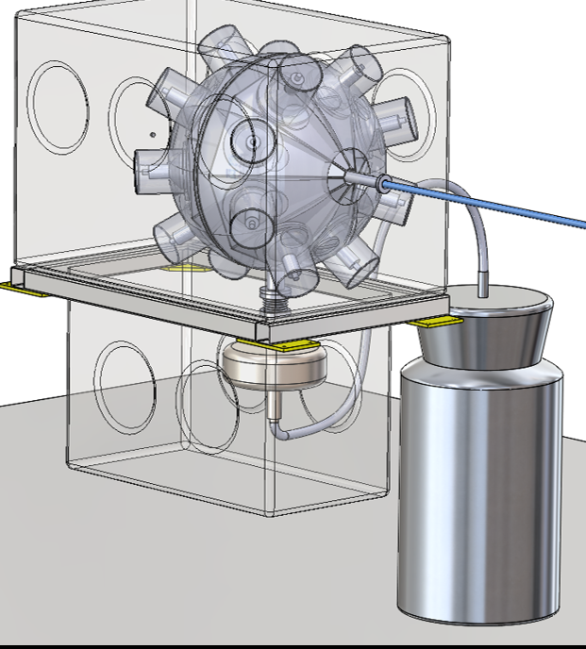
Muon Catalyzed Fusion Experiment Beam Request
Initial Beam Request
  6x10⁵ μ– per data point (±5% statistics)
    Aperture of diamond anvil cell: 5 mm² area
  100 data points
    different temp/pressures of deuterium target
  10-50 MeV (0.54 – 128 MeV/c ) tunable, dp/p ±10%
    Any pulse length acceptable
Translating into beamline design optics
  Enormous momentum acceptance, small beta functions
  Dispersion suppression @experiment
Compatible with ITA operation
  Production target retractable
  Local primary beam absorber movable out of beam
“Death Star” Detector
Diamond anvil cell for high pressure/temperatures to measure muon fusion rates (sticking fraction) in deuterium and tritium

Slide 4
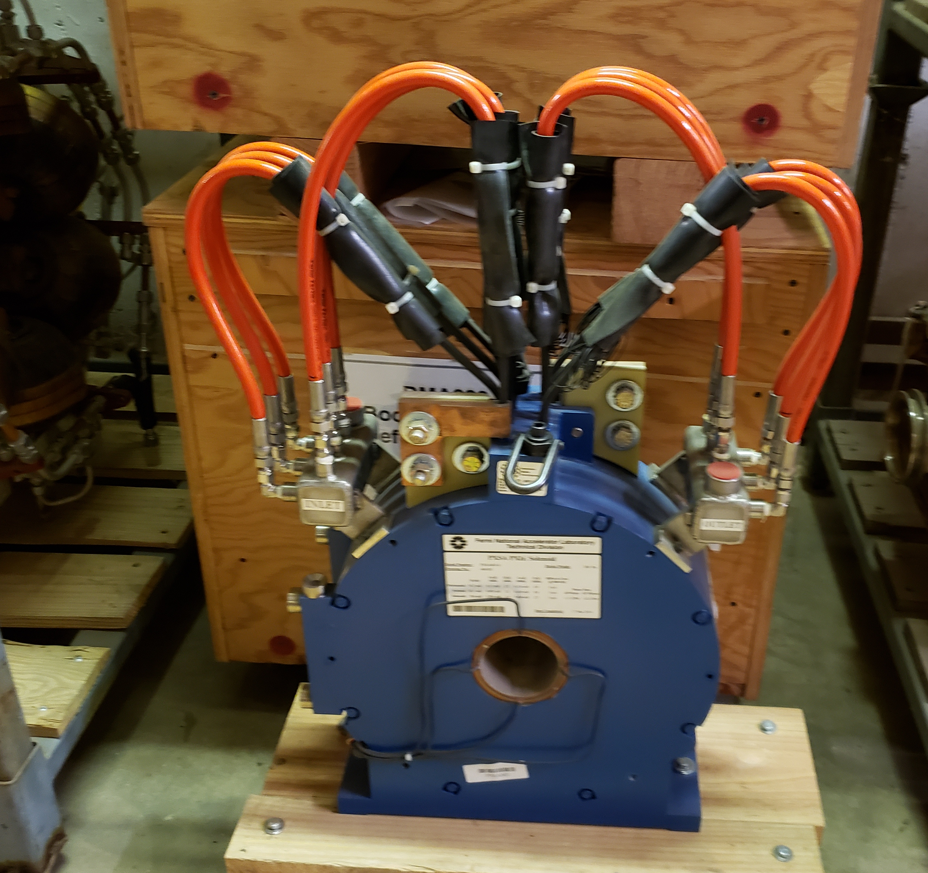
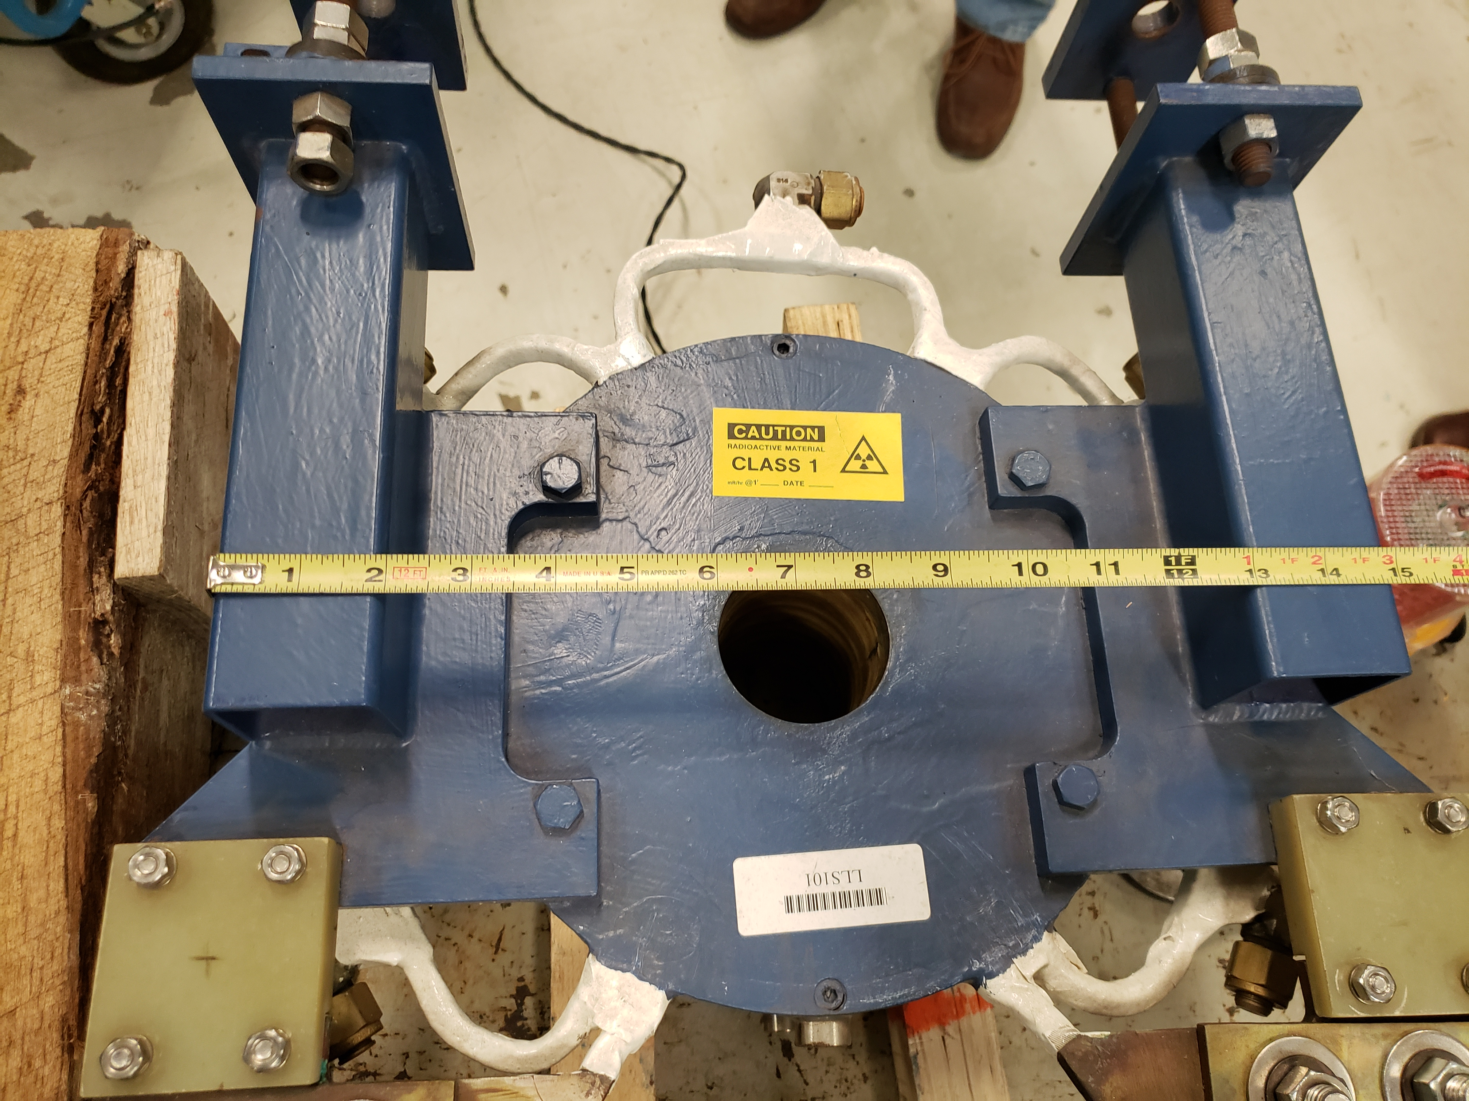
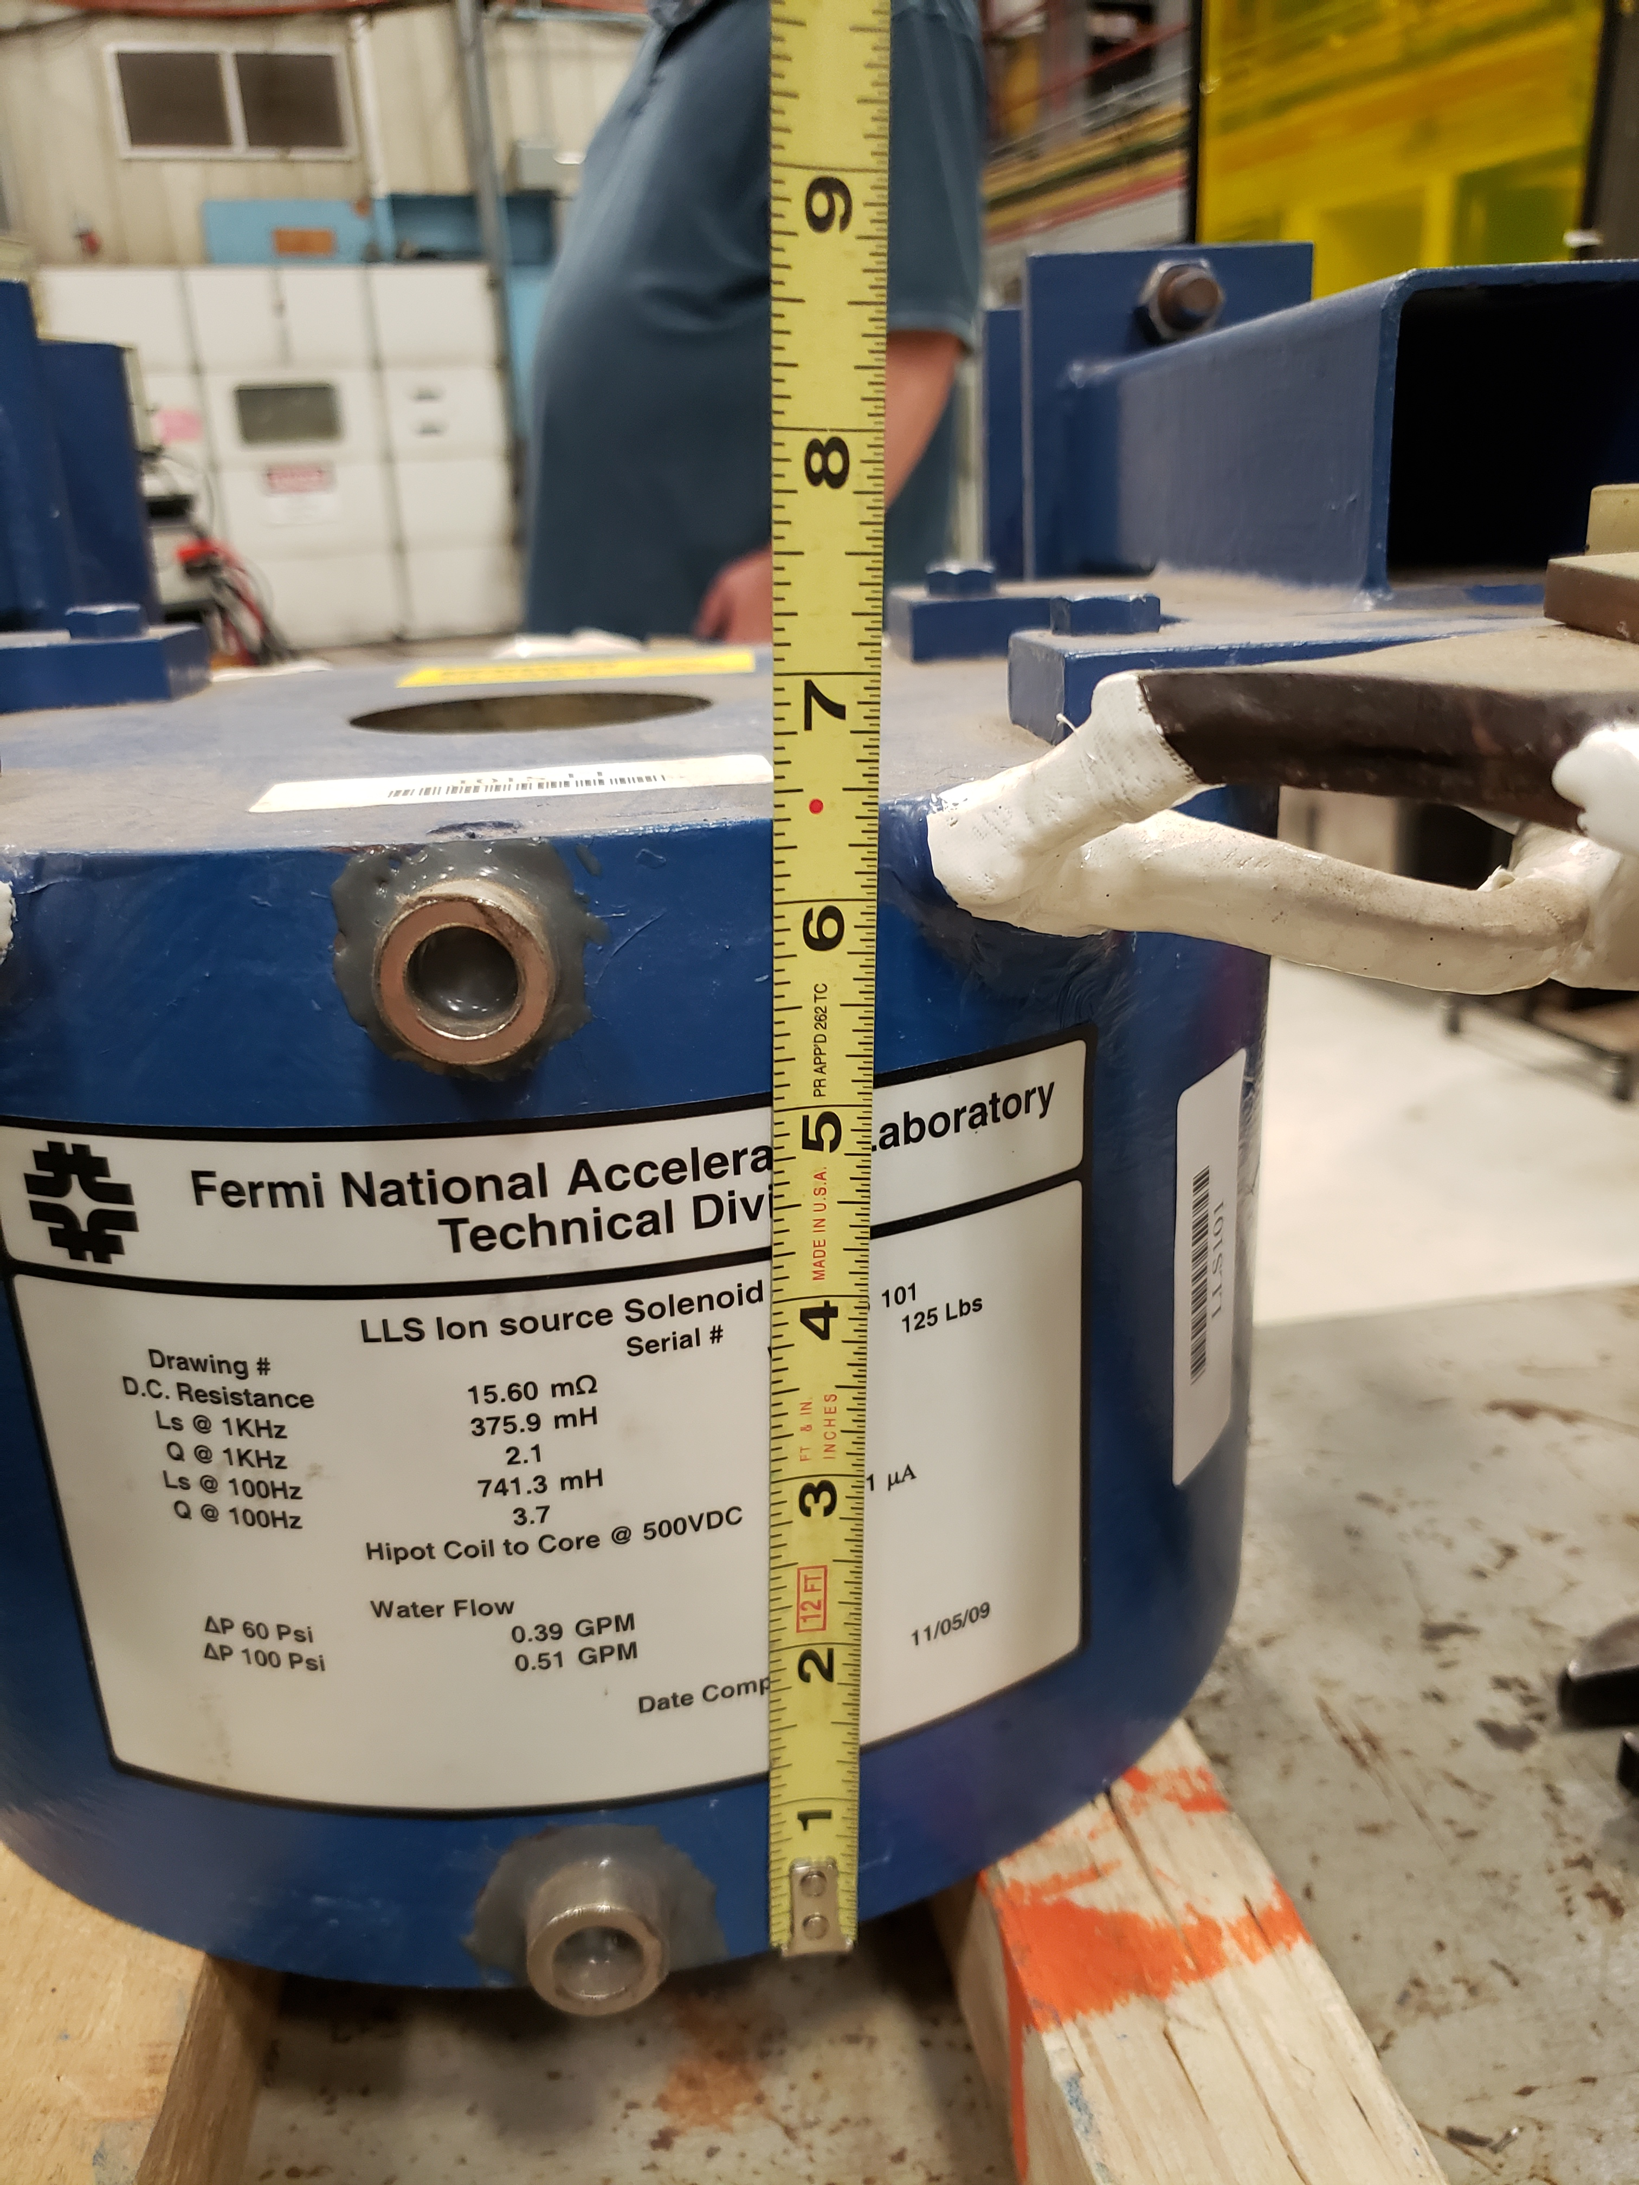
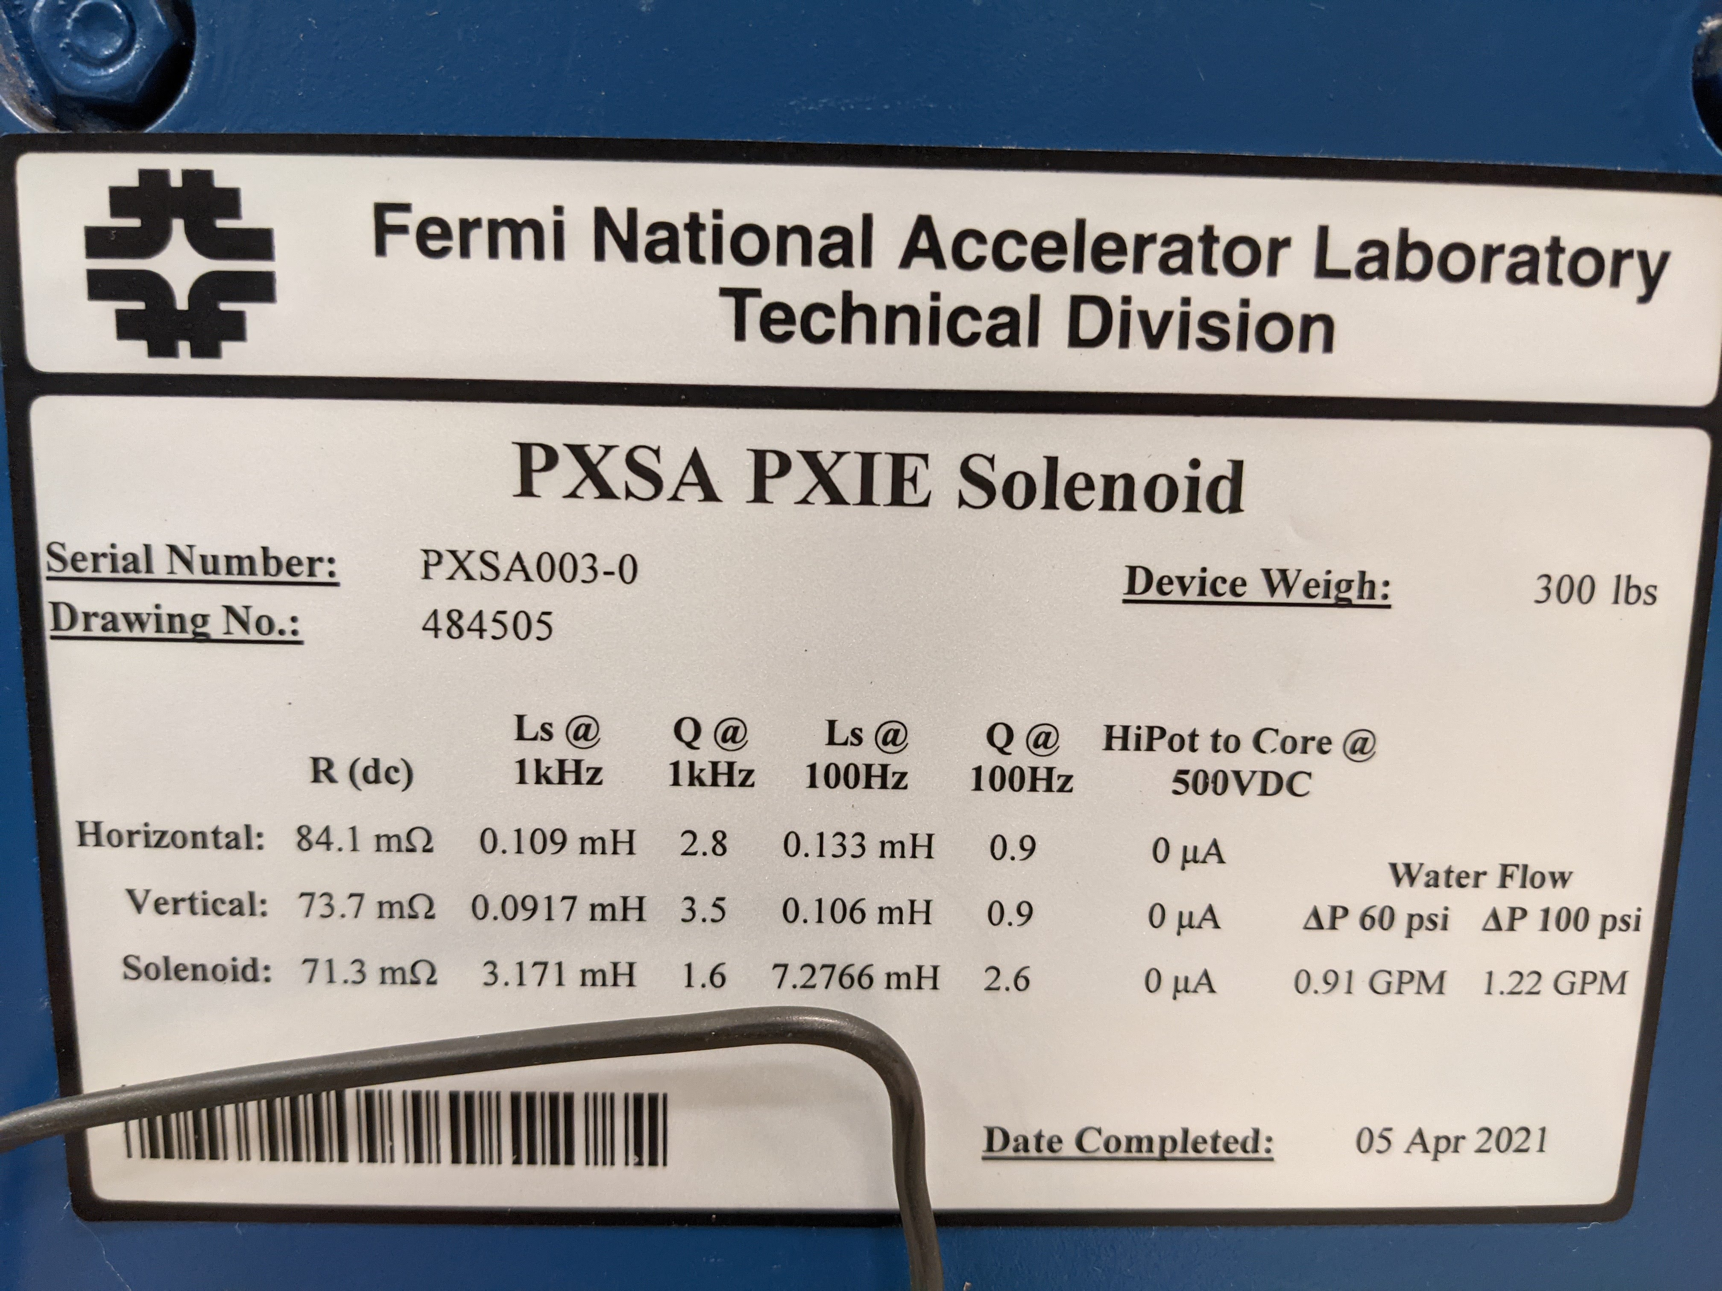
Solenoid Choices
LL: ~400A x 16mΩ = 6.4W
PIPII: ~200A x 70m Ω = 14W

Slide 5
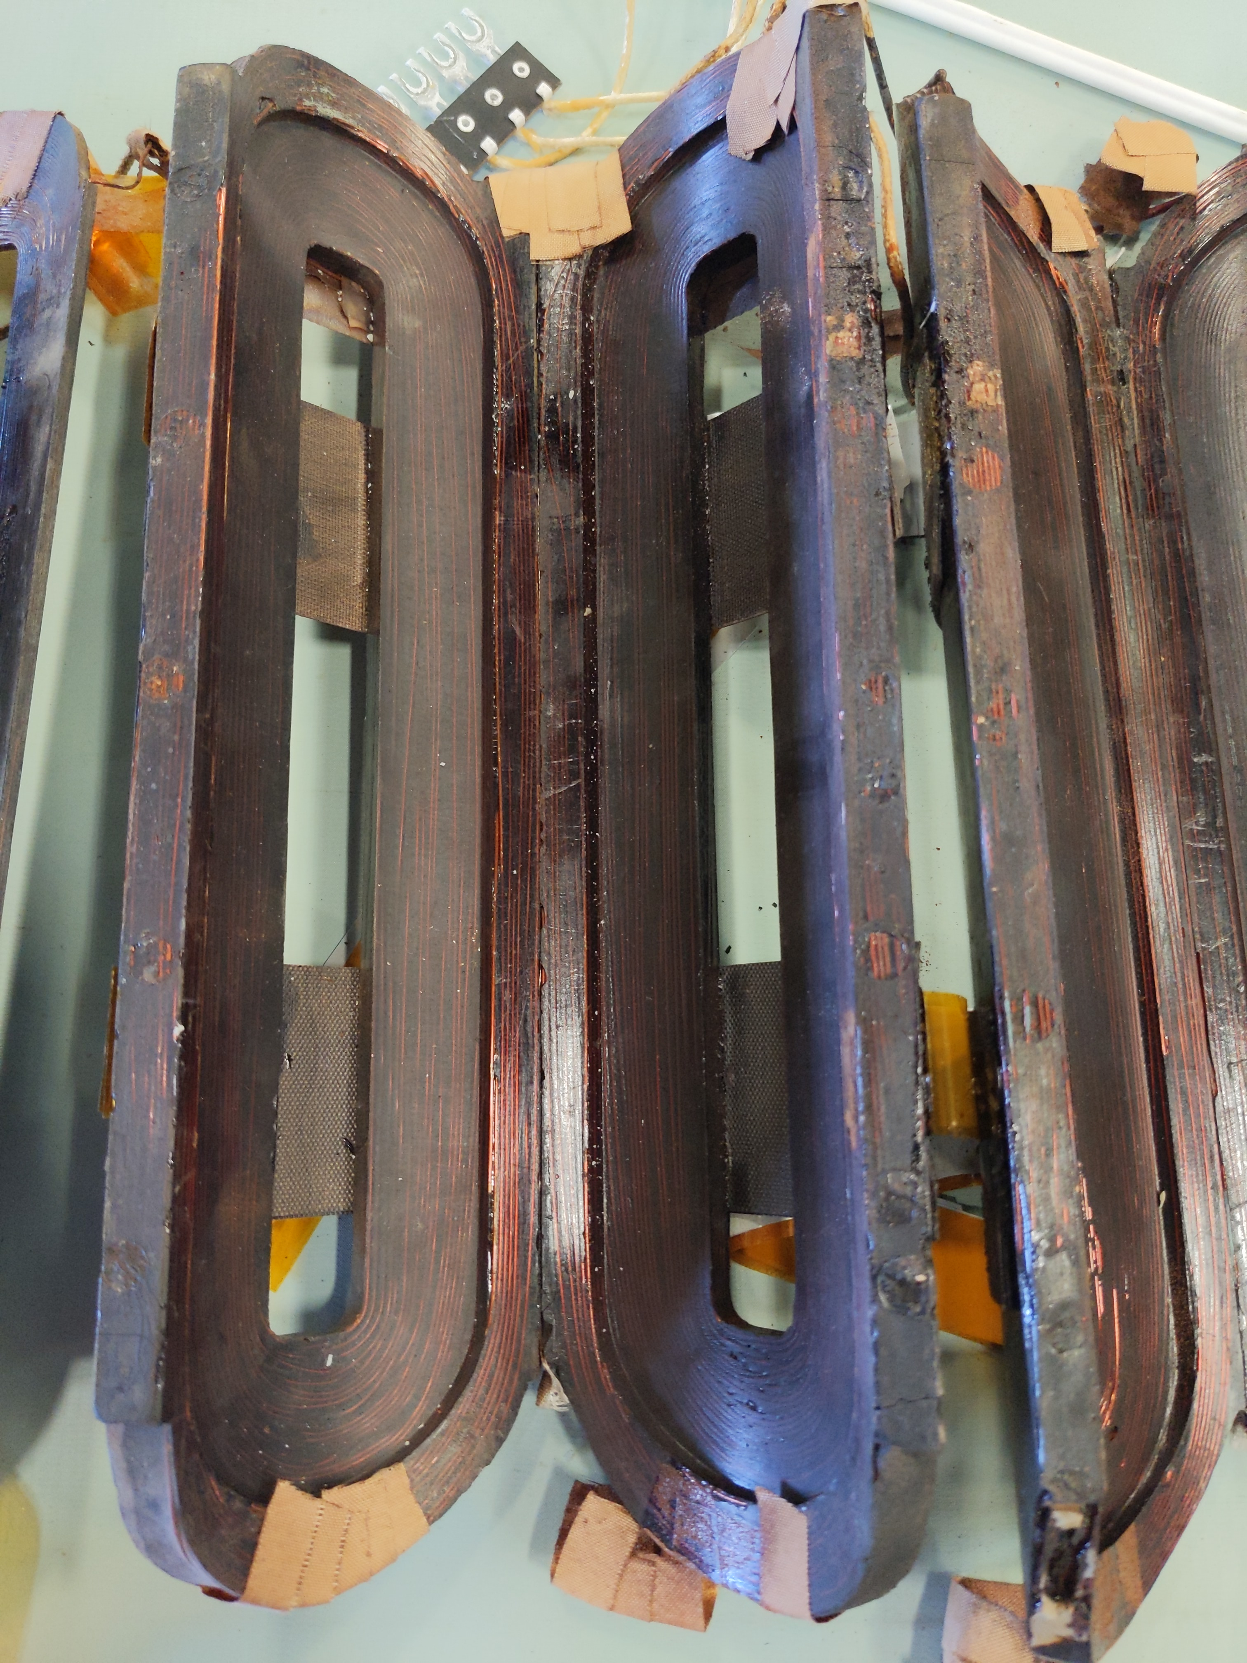
Booster Corrector magnets
Only low-energy option available
  Total weight : 160 lbs
Corrector quads
  4” aperture
  Wrap around beam pipe
  8.9 G/cm, eff. Length = 0.247 m
Dipoles can be used as trims
Increased cooling for higher than nominal operation
  Outer correctors removed
  Temperature tests performed on full complement and individual correctors

Slide 6
Initial Beamline Design & Integration with Experiment for 10 MeV muons
Capture solenoid matched to FODO cell
Two 90° FODO cells
  Booster corrector quads
    8.9 gauss/cm & magnetic length of ~0.247 m;
    @50 MeV/c, k ~0.5 m⁻² , f~8m
    Large #of quads AND
    Large increase over nominal 1A current
      Ramping required
Momentum Selection
  4D16 dipoles
Dispersion suppression:
  180° phase advance
  Reflection symmetry
  Only linear dispersion suppression
THIS CONCEPT HAD TO BE ABANDONED
ITA Cave
Front Porch
TUNGSTEN TARGET
2.4 m
45°
33°
6.1 m
Rollup Door
2 m
2 m
Open concrete enclosure
Future Exp Area?
2 m
4 m

Slide 7
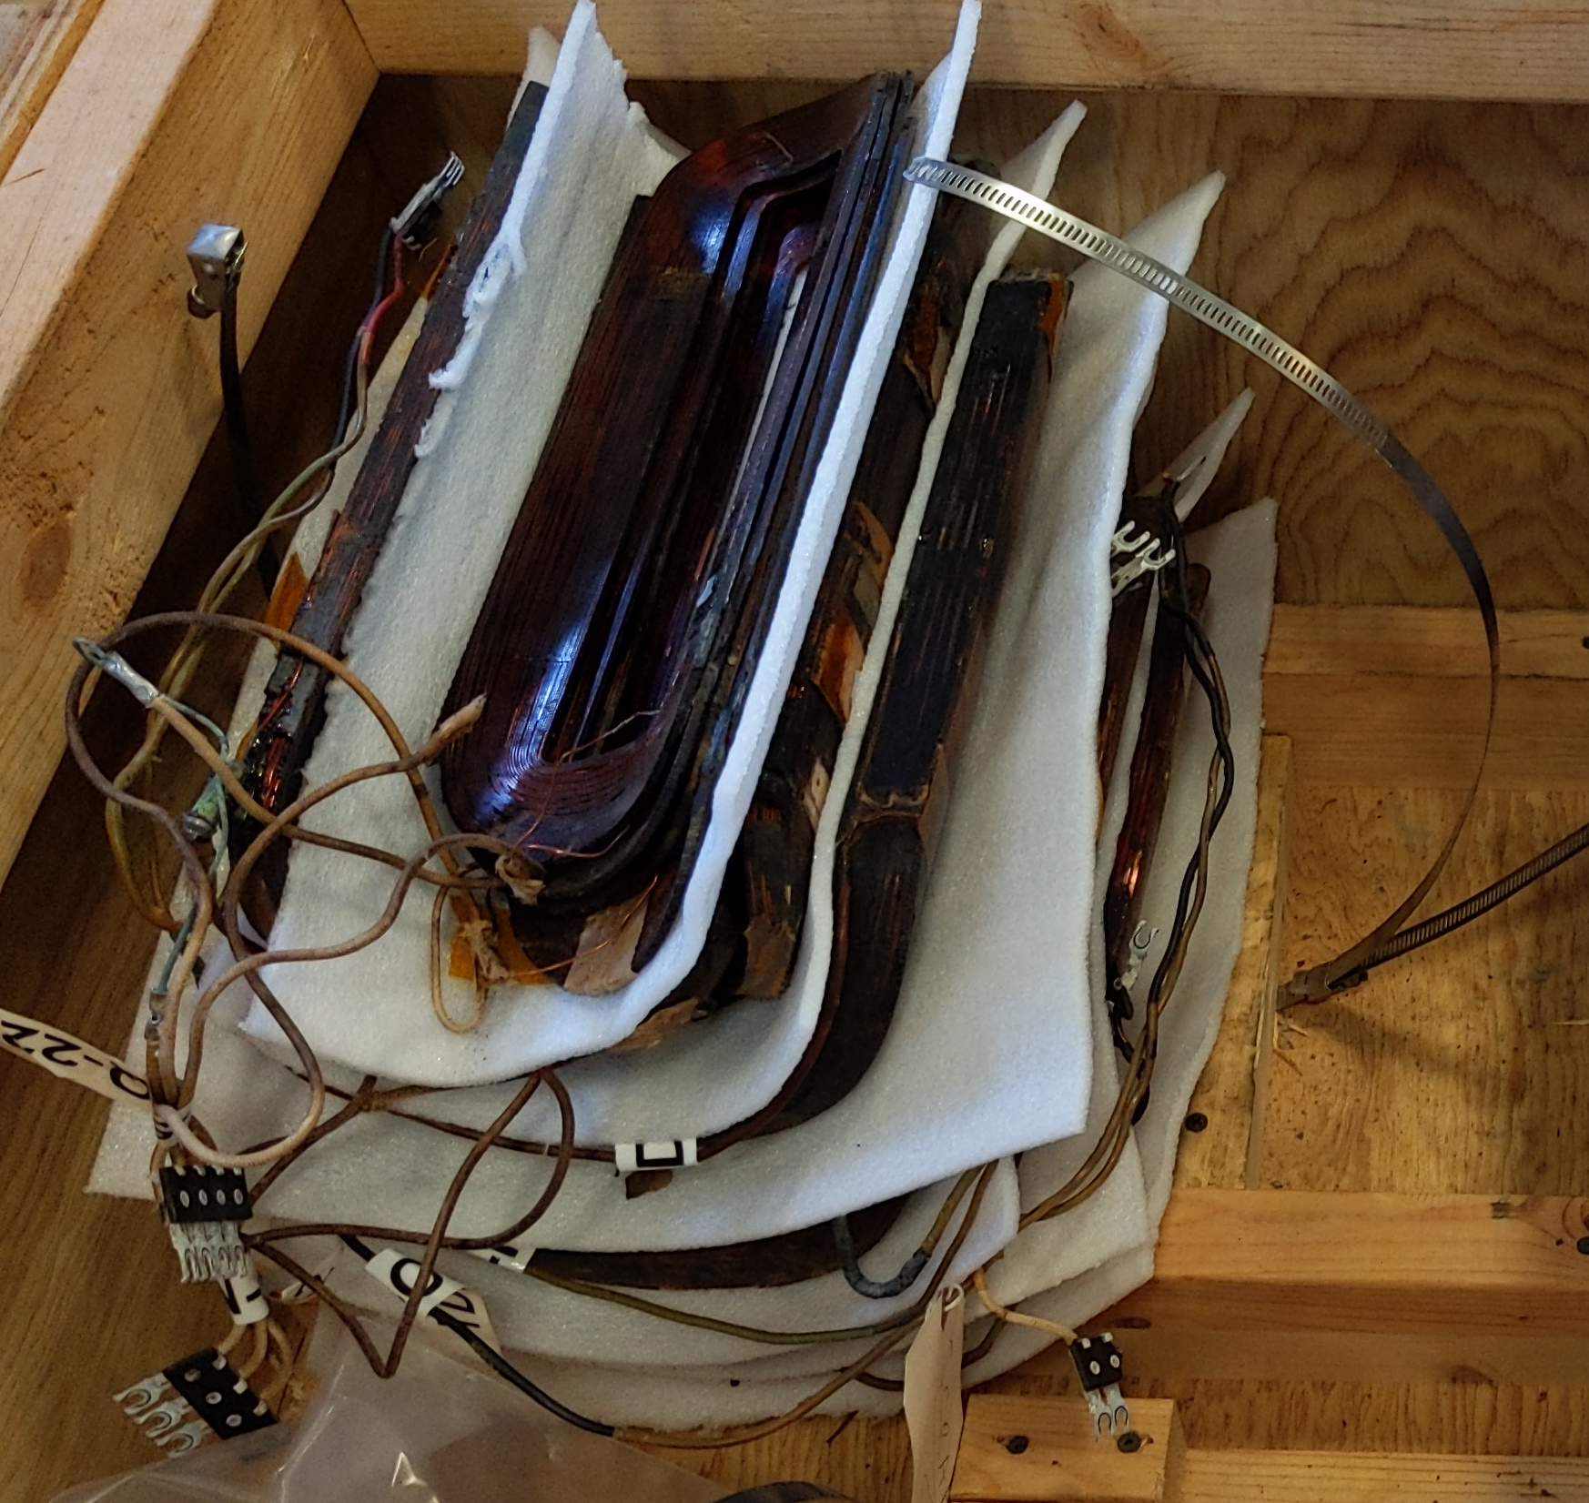
Design – major revisions and operational limits of components
Studies indicated 54 MeV/c (10 MeV) pion energy should be increased to 100 MeV/c (30 MeV)
Booster corrector quads and dipoles fully tested
  Full corrector package sustained 2.4 A DC on quads (vs 1A nominal)
  Twelve corrector packages (2 spares) have been
    Electrically tested and broken down into individual magnets
  Six beamline magnets are bare quadrupoles –
    significantly reducing the weight and temperature
  Inner dipoles will be installed around 4 quads as trims
No bend dipoles – insufficient space and strength
  Linear dispersion suppression for +/-10% dp/p isn’t sufficient
Final length of line established with in-hall measurements
  19.5’ to upstream end of hall and 154-155”’ to easterly wall
  A 33.5° angle or (146.5° relative to primary beam direction)
Loma Linda solenoid chosen for strength, aperture, smaller cross-section
  passed electrical inspection and mechanically positioned relative to target chamber.
Optics of the beamline were re-designed – even a unit FODO cell beyond the quad strength

Slide 8
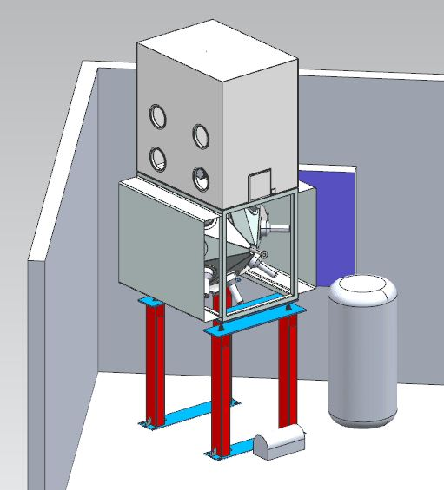
Final Beamline Geometry & Integration with Experiment
Straight shot to corner is 146.5°
Experiment ~2m insertion length
Remaining length for beamline
  ~5m
  Insufficient for a full FODO cell
  Even with more quads and ramped currents
No dispersion - bonus
Large transverse acceptance
  On and off momentum
ITA Cave
Front Porch
TUNGSTEN TARGET
Target is 3’ upstream of MW8 connecting flange
z
33.5°
234” / 5.9436 m (z)
x
85.1”
2.2 m (x)
Rollup Door
280.614” 7.1276 m
154.9”
3.934 m (x)
EXP
EXP – side view

Slide 9
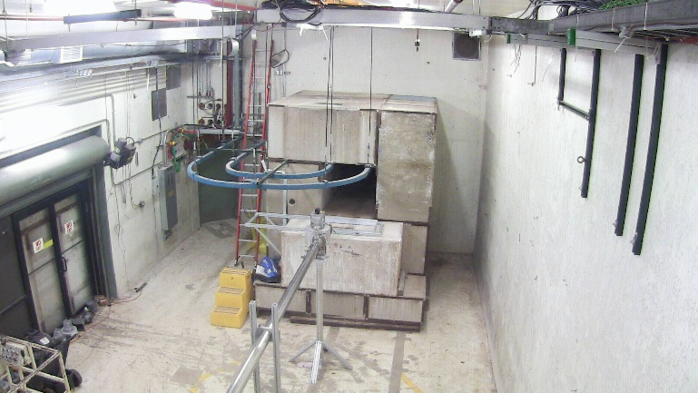
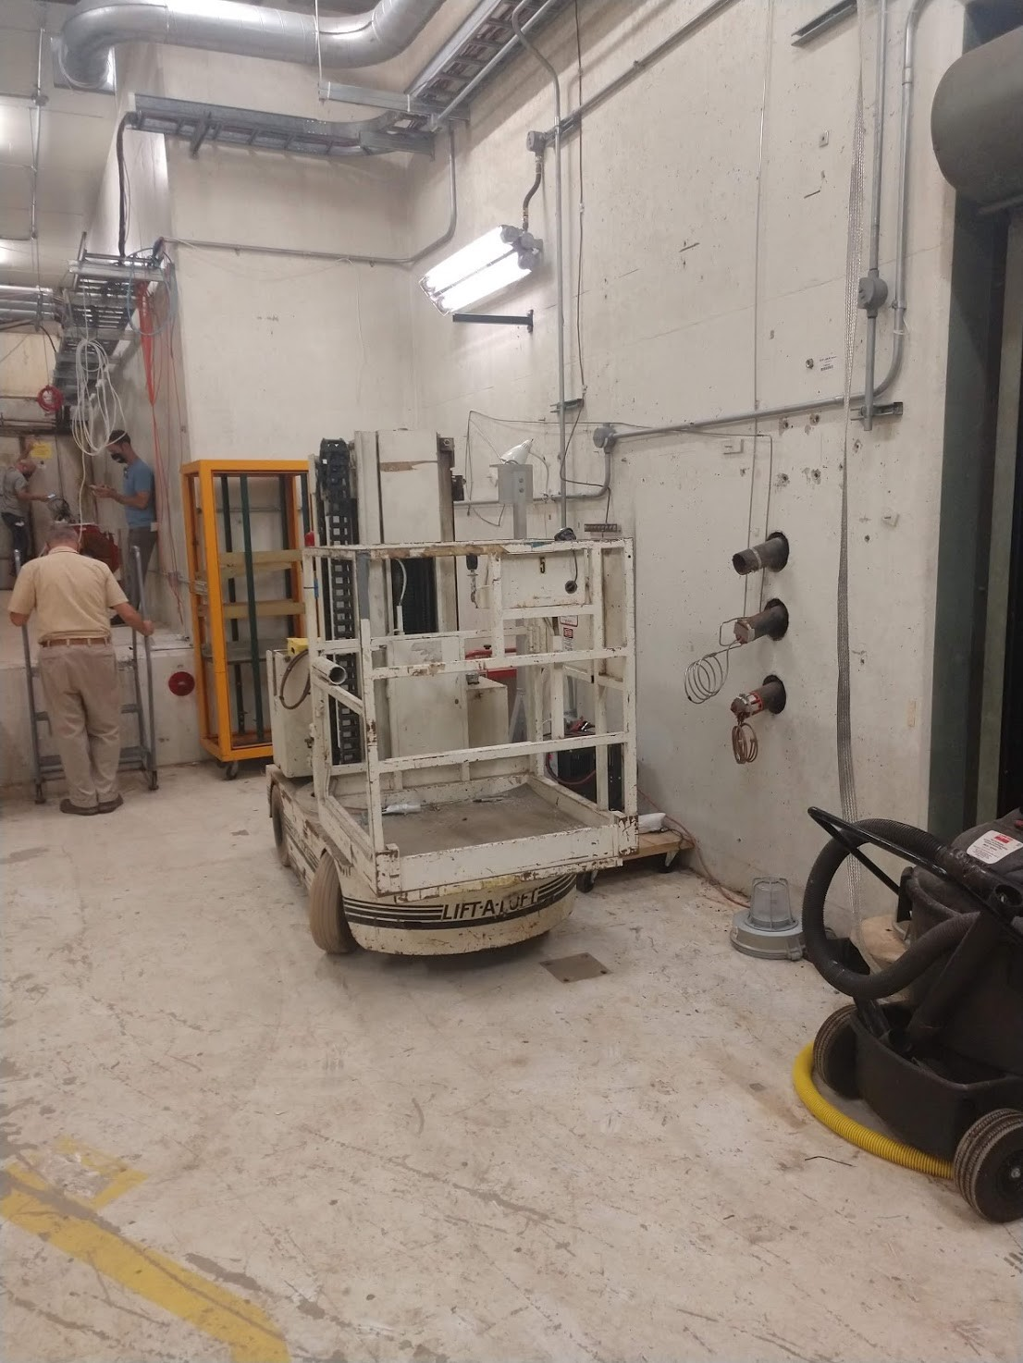
Views of MTA Experimental Hall
Downstream hall:
primary beamline & ITA cave
Upstream Stub:
primary beamline out of shield wall separating MTA from Linac enclosure
Location of experiment:
east Side of MTA hall

Slide 10
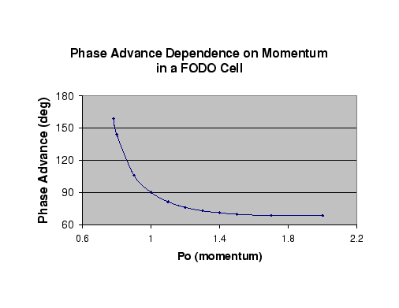
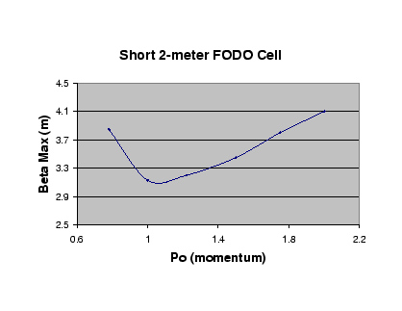
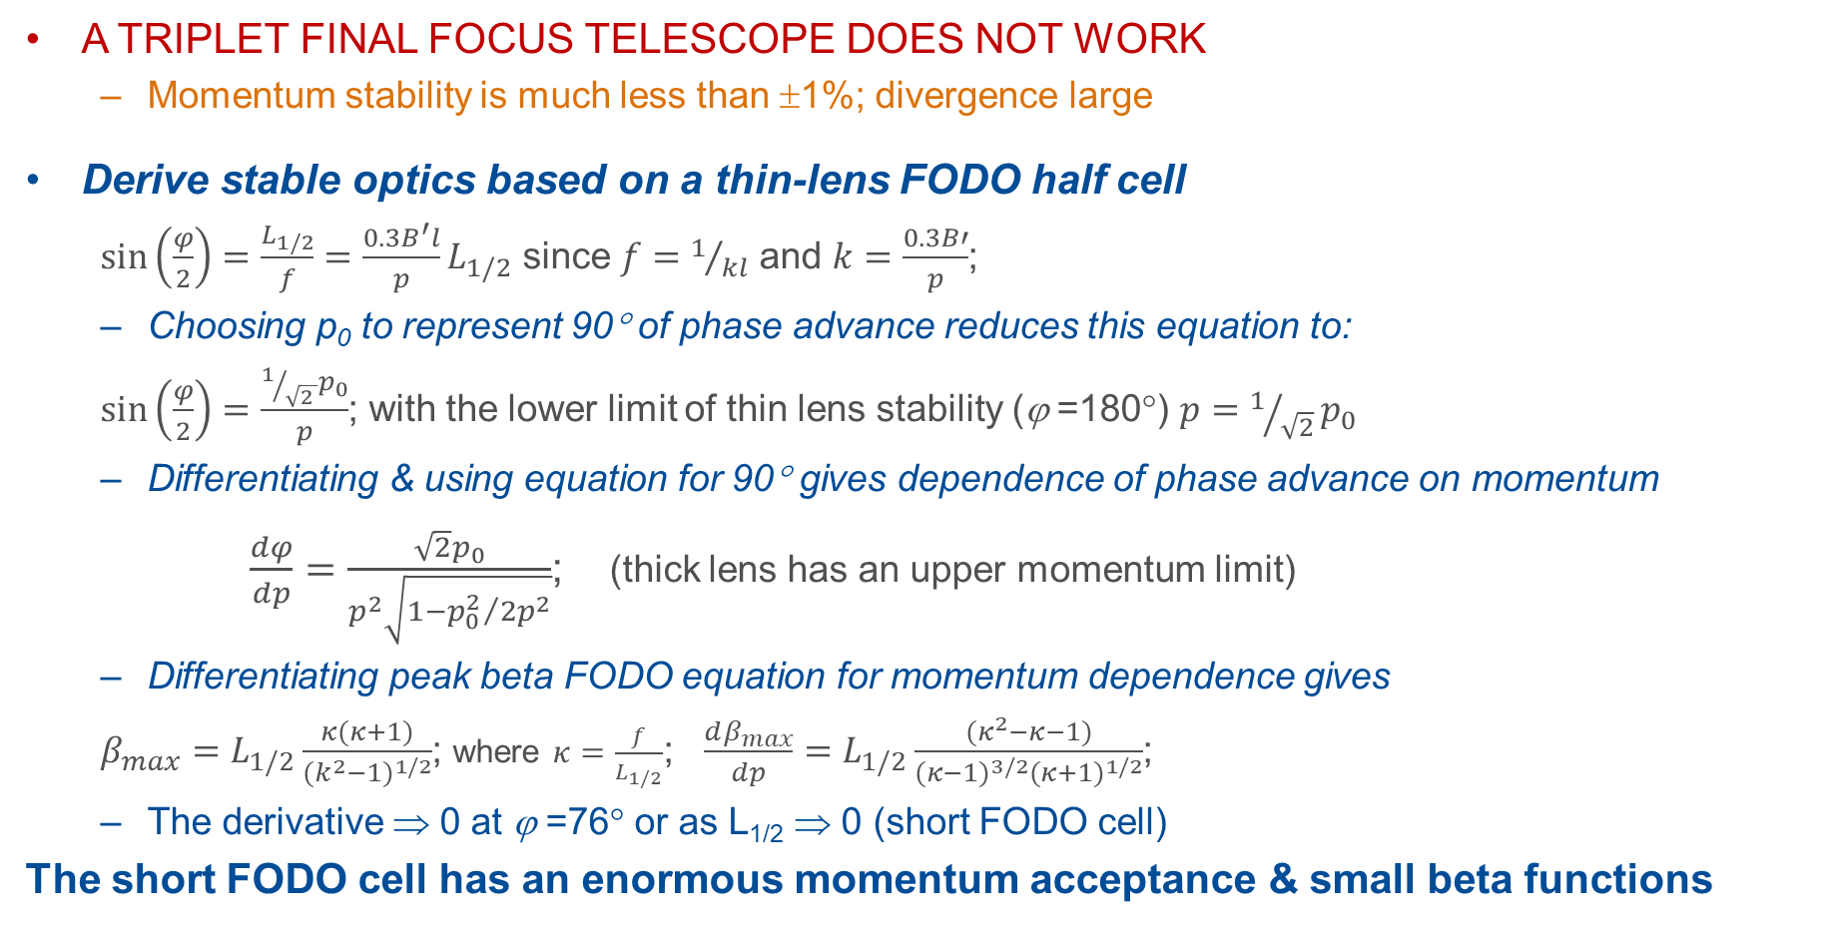
Designing a small beta, large momentum acceptance channel
A TRIPLET FINAL FOCUS TELESCOPE DOES NOT WORK
  Momentum stability is much less than ±1%; divergence large
Derive stable optics based on a thin-lens FODO half cell
  $\sin\left(\frac{φ}{2}\right)=\frac{L_{1/2}}{f}=\frac{0.3B^{′}l}{p}L_{1/2}$ since $f=1/{kl}$ and $k=\frac{0.3B′}{p}$;
  Choosing p₀ to represent 90° of phase advance reduces this equation to:
  $\sin\left(\frac{φ}{2}\right)=\frac{1/{\sqrt{2 }}p_{0}}{p}$; with the lower limit of thin lens stability (ϕ =180°) $p=1/{\sqrt{2}}p_{0}$
  Differentiating & using equation for 90° gives dependence of phase advance on momentum
$\frac{dφ}{dp}=\frac{\sqrt{2}p_{0}}{p^{2}\sqrt{1−{p_{0}^{2}}/{2p^{2}}}}$; (thick lens has an upper momentum limit)
  Differentiating peak beta FODO equation for momentum dependence gives
  $β_{max}=L_{1/2}\frac{κ(κ+1)}{{(k^{2}−1)}^{1/2}}$; where $κ=\frac{f}{L_{1/2}}$; $\frac{dβ_{max}}{dp}=L_{1/2}\frac{(κ^{2}−κ−1)}{{(κ−1)}^{3/2}{(κ+1)}^{1/2}}$;
  The derivative ⇒ 0 at ϕ =76° or as L_{1/2} ⇒ 0 (short FODO cell)
The short FODO cell has an enormous momentum acceptance & small beta functions

Slide 11
The optics is based on a short 90° FODO cell for 30 MeV muons
The FODO cell optics used is shown below - note that the full FODO cell is too long
  Other criteria
    Simultaneous minimize horz and vert beta functions at entrance to experiment
    Beam should be maximally parallel in both planes (waist)
    Alternating max/min beta functions is clearly not optimal
Quads @ crossing point of FODO cell can minimize divergence and beam size in both planes
  ±α ⇒ 0, or waist
  Only a half cell is required – fits in available space
  Meets requirements for matching to experiment
If I have a double, equal waist – match to a solenoid
  Matching section not required
  Beta function required at solenoid position is 5m to match
Initial optics: target can be approximated as a waist
  Two starting ellipses: point vs an extended target

Slide 12
Solenoid – optical solutions
The min distance to the front face is ~or 13” (Loma Linda solenoid).
  The geometric acceptance of the beamline is (4” aperture correctors) is ~200π mm-mr for a peak beta function of 12 m;
  After matching and optimizing to a beta function of ~5 m at the solenoid per optics:
    The geometric acceptance of the PIP-II solenoid is ~340 mm
    The geometric acceptance of the Loma Linda solenoid is 200π mm-mr (better match)
There are two solutions for the solenoid strength using plus beta function for β ~ 5 m @solenoid and back-propagating optics to target position.
  Point to parallel (β_{x,y} ~0.03 to 5 m); solenoid strength, B²L = 0.4 (B~1.5T)
    B field eliminates point to parallel optics; highly achromatic – corresponds to focal length of a solenoid
  Parallel to parallel (4.85 m to 5 m); solenoid strength B²L = 0.026 (B~0.4T)
Match point
Match point
LL solenoid:
0.4 T is ~400A

Slide 13
Matching Solenoid to Production Target size
Two beam envelope solutions because the linear dynamics solution is quadratic in target beam size – beam diverges from the target:
  β_{sol} (thin lens)= β_{tgt}+ s²/β_{tgt} (where β is ∝ beam size²)
  For β_{sol} =5m and distance to center of solenoid = 0.4102m
    β_{tgt} = 0.03 m – solenoid captures a small, high divergent beam spot
    β_{tgt} = 4.85 m – solenoid captures a parallel beam
Using the acceptance of the beamline (180π mm-mr) gives target size
  Δl_{tgt@low β} = ±2.3 mm; Δl_{tgt@high β} = ± 30 mm
x’
Two optical solutions
Two target solutions
x’
x
x
Spot size
Primary beam
Spot size
For low β, IL = 2.3% for W
0.5 cm target length
For higher β, IL = 60% for W
6 cm target length

Slide 14
Local Beam Absorber
Modeled after MuCool operation
  20 cm steel beam absorber after RF cavity (in air)
  RF cavity: additional 2” of steel
Reuse two tungsten bricks
  Used for beam tests
  Removable (manual motion table)
  In a vacuum break between target housing and MW8
    As close as possible to target housing downstream port
  Additional shielding will be installed
    Target and beam absorber
Schematic of HPRF cavity Beam Test at MTA units in mm
Residual activation of Cu insert in beam
absorber. (Two 50-μs pulses provide 4.3 × 10¹¹ p/sec.) Will be repeated for W absorber.

Slide 15
MTA Magnets, power supply names, peak currents, and properties
C. Johnstone, J. Morgan
August 19, 2021
Magnet Type Current (A) Power Supply
Solenoid LLS Solenoid 500 E:USL200
UQ201 BTA quad 2.4 E:UQ201
UHT201 BTA In Dipole 4.0 E:UHT201
UQ202 BTA quad 2.4 E:UQ201
UVT202 BTA In Dipole 4.0 E:UVT202
UQ203 BTA quad 2.4 E:UQ201
UQ204 BTA quad 2.4 E:UQ204
UQ205 BTA quad 2.4 E:UQ204
UQ206 BTA quad 2.4 E:UQ204
UQ207 BTA quad 2.4 E:UQ204
UQ208 BTA quad 2.4 E:UQ208
UQ209 BTA quad 2.4 E:UQ208
UHT209 BTA In Dipole 4.0 E:UHT209
UQ210 BTA quad 2.4 E:UQ208
UVT210 BTA In Dipole 4.0 E:UVT210
Magnet Properties
Magnet Type Physical/Effective Cold/Warm
Length (in) Resistance (Ω)
Loma Linda Solenoid 6.3/? 0.0156
BTA Outer Dipole 12.75/7.87 2.32/2.78 (est.)*
BTA Inner Dipole 12.81/8.66 4.03/4.84 (est.)*
BTA Quad 12.75/11.14 14.1/17.0*
Resistance when cold, it can be 20 – 30% higher after reaching thermal equilibrium because these are air-cooled magnets.

Slide 16
Power Supplies for quads and dipoles and solenoid
Quads and Dipoles
TDK-LAMBDA GENH750W 150V@5A or AMETEK DLM 600 #DLM-150-4 150V@4A - regulates on the quads with out an external regulator. May require 2 supplies for the 4 center quads
~$1k a unit
Solenoid
I:LAM52 a power supply that can run 32V@625A. A regulation system will be required for operation in current mode on inductive loads.
A couple of choices for the external regulator that compensates for the inductance are available.

Slide 17
Notes on Power supplies –
S. Hays, J. Morgan, J. Budlong
The solenoid power supply will be one of two surplus units. If we choose to use the 12.5 Volt/800 Amps 208V supply that's available, it will simplify LOTO by allowing the use of a single disconnect for all of your supplies. The other supply is a 32 Volt/625 Amps and is powered by 480V, Steve thinks this better matches your use. For reference, I estimate that it will take 9.25 Volts get 400 Amps. We will use 4 MCM250 cables for ease of installation.
Quads would be powered by commercial units, he believes they have a chassis built that you could pay to replace.
Trims would be powered by Linac-style quadrant supplies, like those already used for the existing MTA Line. These would have to be built.
We believe we have enough left-over 8 Gauge 2-conductor wire from Muon for your quadrupole and trim circuits. We also think we have the larger cable required for the solenoid, but the choice will be influenced by the current requirement. I specified 400 Amps in the spreadsheet, which requires more than a 500 MCM cable pair.
The initial time estimate is about 3 months, as long as personnel are available to work on it. E.E. Support is very thin on people right now and I suspect they won't be able to do significant work until the shutdown ends.
See specs, cost estimates on spreadsheet

Slide 18
Summary of Design Approach
The experimental line captures ultra-low energy secondaries at a 146.5° backward angle relative to primary beam
At low energies, the geometric emittance is large; don’t have the advantage of long distances at MTA; optics must be highly efficient and compatible
  The experiment has requested 10-50 MeV muons; dp/p ~ ±10%
    Energy has been finalized at 100 MeV/c (~30 MeV muons) based on simulations/components; dp/p > ±20%
    Experiment has adapted to this energy and momentum spread
For large acceptance (small betas) and a large dp/p
  Beamline optics are built on a short 90° FODO cell
  Focal length must be ~4 m to fit (half cell length ~3m); for magnetic length ~0.247 ⇒ k ~1.0 m⁻²
    At 100 MeV/c, 8.9 gauss/cm; k ~0.25 m⁻²
    Requires 4 quads – to achieve this focal length
  For thick lens and 4 quads, k~0.5 m⁻²– this translates into ~2A @100 MeV/c
Solenoid is used to capture pions with equal phase space distributions in both planes
  Focus to the the “crossing” beta function of the FODO cell
  3 Quads match to FODO – similar k value
Local absorber – as in MuCool operation but with additional shielding; MuCool/ITA combined

Slide 19
Alignment
2.6’ step down into hall
Using MW7 & 8 alignment coordinate
Target center ~2’ upstream of upstream MW8 flange
MW7 downstream flange ~ end of hall
Gives 19.5’ from target center to hall upstream
~23’ or 7.6 m target center to east hall corner
MW7
Linac shield wall

Slide 20
In Hall measurements
Target center is 19.5’ from step down into hall
This is 3’ upstream of MW8 flange (spool)
Beamline centerline to easterly wall measured to be 154-155”
Angle to corner is therefore ~33.5°
Final distance target center to hall corner is ~23.4’ or 7.1 m
A removable spool will connect downstream target housing port to MW8 to insert beam absorber
Beam absorber
Target center is ~centered in 40’ long exp hall

Slide 21
Alignment and beam sheet
Target center has been located in DUSAF and location fixed
Preliminary beam sheet has been generated
Waiting final 3D layout of beamline to confirm all final component positions
Ready for alignment stake-out of stands this week
ITA Cave
Beam absorber
Target center is
Site East: 30300. 729918m Site North: 30329.043786m
Elevation: 226.447281m

Slide 22
Operational Parameters of 400-MeV Fermilab Linac beam and MTA/ITA limits
Full Linac Beam Capability
ITA operation (local “cave” shielding)
Parameter | Value | Unit
Kinetic Energy | 401.5 | MeV
Repetition Rate | 20 Hz
Energy Spread | 1 | MeV
RF Structure | 201.24 | MHz
Bunch Length | 0.05 | ns
Max Pulse Length | 80 | µs
Max Particles Per Bunch (28 mA) | 0.88x10⁹
Max Particles Per Pulse | 1.4x10¹³
Peak Current | 28 | mA
Avg Current | 34 | µA
Max Beam Power | 13.4 | kW
Beam Emittance (99%) | 8 | mm-mrad
Local shielding will be implemented for muon production target and a local beam absorber
Note: 6.56x10¹² p/40 μsec or 1.64x10¹¹ p/μsec

Slide 23
BACKUP Slides

Slide 24
Atomic and nuclear properties of tungsten (W)
Quantity | Value | Units | Value | Units
Atomic number | 74
Atomic mass | 183.84(1) | g mole⁻¹
Specific gravity | 19.30 | g cm⁻³
Mean excitation energy | 727.0 | eV
Minimum ionization | 1.145 | MeV g⁻¹cm² | 22.10 | MeV cm⁻¹
Nuclear collision length | 110.4 | g cm⁻² | 5.719 | cm
Nuclear interaction length | 191.9 | g cm⁻² | 9.946 | cm
Pion collision length | 133.9 | g cm⁻² | 6.936 | cm
Pion interaction length | 218.7 | g cm⁻² | 11.33 | cm
Radiation length | 6.76 | g cm⁻² | 0.3504 | cm
Critical energy | 7.97 | MeV (for e⁻) | 7.68 | MeV (for e⁺)
Molière radius | 18.00 | g cm⁻² | 0.9327 | cm
Plasma energy ℏω_{p} | 80.32 | eV
Muon critical energy | 150. | GeV
Melting point | 3695. | K | 3422. | C
Boiling point @ 1 atm | 5828. | K | 5555. | C
NOTES
The nuclear interaction length is 10 cm. An inelastic nuclear interaction is required to make pions
1 cm was initially chosen (10% IL) to be consistent with the shielding assessment for a target in the MTA experimental hall
>10% IL requires a local beam stop - Beam cannot be transported to the high intensity beam dump buried in the berm downstream of the hall
https://pdg.lbl.gov/2021/reviews/constants_atomic_and_related.html

Slide 25
Compare with Carbon
Quantity | Value | Units | Value | Units
Atomic number | 6
Atomic mass | 12.0107(8) | g mole⁻¹
Specific gravity | 2.210 | g cm⁻³
Mean excitation energy | 78.0 | eV
Minimum ionization | 1.742 | MeV g⁻¹cm² | 3.850 | MeV cm⁻¹
Nuclear collision length | 59.2 | g cm⁻² | 26.79 | cm
Nuclear interaction length | 85.8 | g cm⁻² | 38.83 | cm
Pion collision length | 86.5 | g cm⁻² | 39.12 | cm
Pion interaction length | 117.8 | g cm⁻² | 53.30 | cm
Radiation length | 42.70 | g cm⁻² | 19.32 | cm
Critical energy | 81.74 | MeV (for e⁻) | 79.51 | MeV (for e⁺)
Molière radius | 11.08 | g cm⁻² | 5.012 | cm
Plasma energy ℏω_{p} | 30.28 | eV
Sublimination temperature (@ 1 atm) | 4098. | K | 3825. | C
PROJECTED PERFORMANCE
PSI – 1.5 cm 4%IL C target
Factors
30% vs 4%
4 x nuclear interactions
Factor of 3 and 8 from
σ_{Τ}(π⁺) ≈ 24.5 Ζ^{1/3}
σ_{Τ}(π–) ≈ 2.33 Ν^{2/3}
Total increase from a carbon target = 60 for π–
Momentum spread increase?
Rate correction for PSI CW beam (1 π–/10 μsec) vs 20 Hz duty cycle of Linac and macropulse length

