Slide 1
Instrumentation and Cabling
Chris Izzo
MTA Secondary Line Review
August 23, 2021

Slide 2
Cabling Needs for Muon-Catalyzed Fusion Experiment

Slide 3
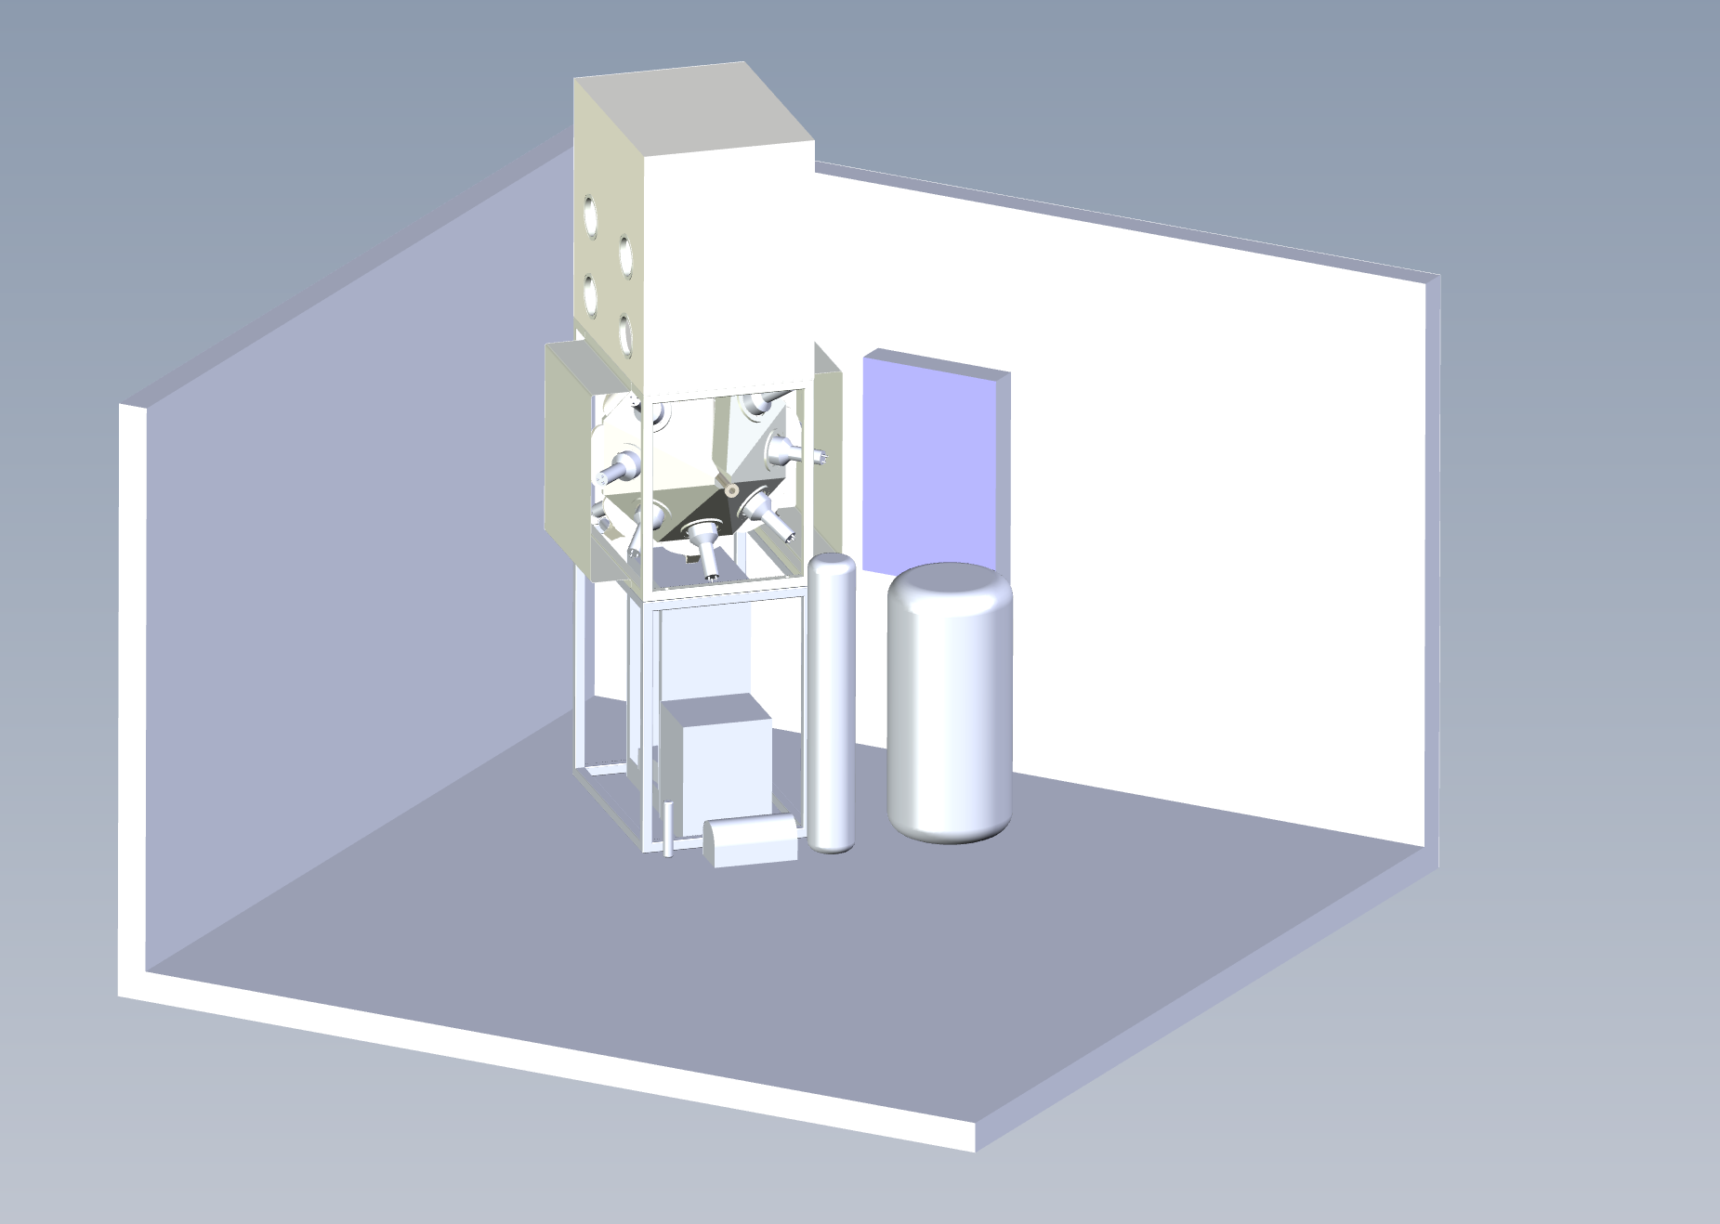
Enclosure
Experiment
Patch 2
Patch 1
Door
Penetrations
Counting House
Electronics Rack

Slide 4
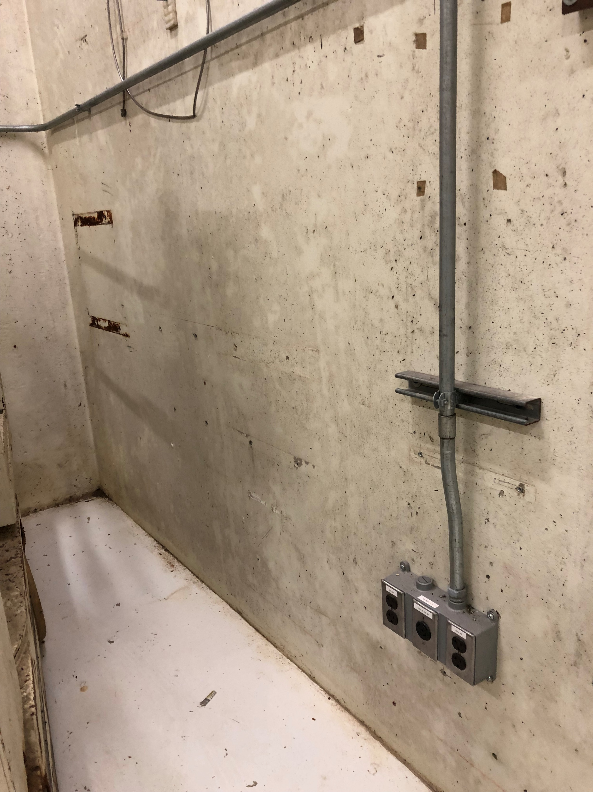
Patch 1
Currently non-existent
Requirements:
At least 58 BNC connections
At least 42 SHV connections
At least 10 RJ-45 connections

Slide 5
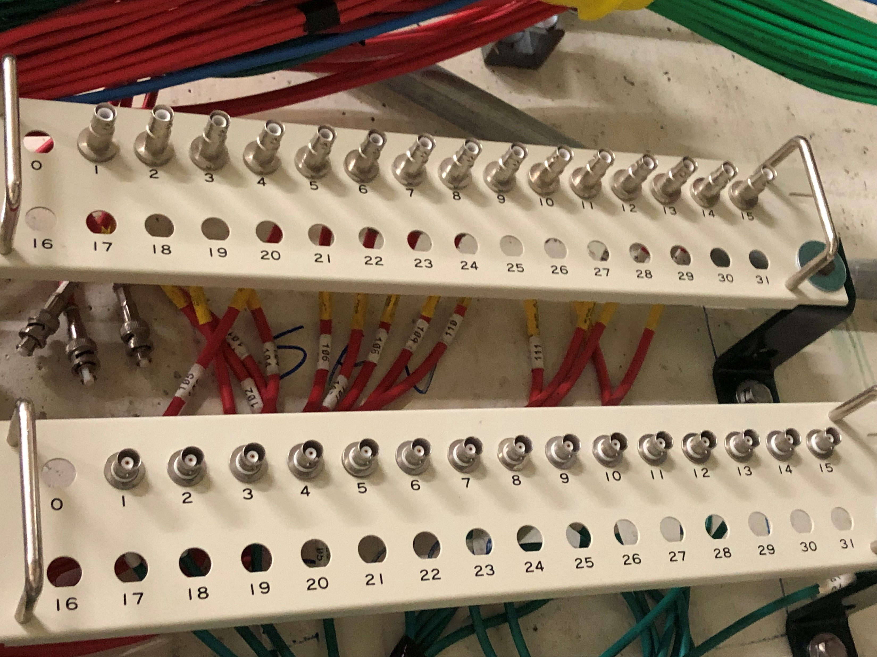
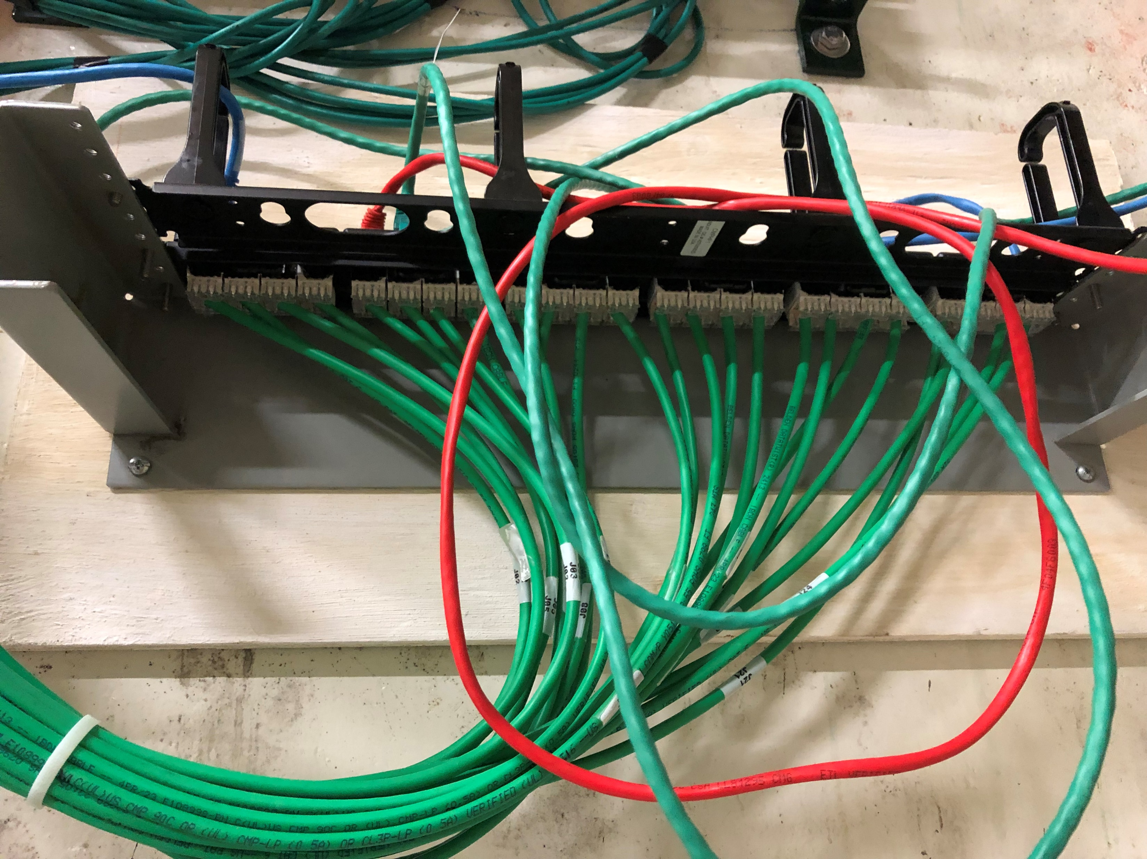
Patch 2
Currently has
15 BNC connections, with ports for 17 more
15 SHV connections, with ports for 17 more
24 RJ-45 connections (2 in use, remaining 22 available)
Requirements:
At least 58 BNC connections
Use 1 current 32-port panel and add 1 more
At least 42 SHV connections
Use 1 current 32-port panel and add 1 more
At least 10 RJ-45 connections
22 available spots are enough, nothing new required

Slide 6
Experiment Cables - Lengths
Conservatively estimating
100’ from Patch 1 to Patch 2
60’ through the penetration
30’ from penetration to wherever needed in counting house
So we need
100’ cables from Patch 1 to Patch 2
60’ + 30’ = 90’ cables from Patch 2 to counting house
100’ + 60’ + 30’ = 190’ cables for those that don’t use patch panels

Slide 7
Experiment Cables - Counts
Cable Type | Termination | Length | Total Required | Number Available | Additional Needed
RG58 (signal) (patch1 to patch2) | BNC | 100’ | 58 | 0 | 58
RG58 (signal) (patch2 to CH) | BNC | 90’ | 58 | 16 | 42
RG58 (HV) (patch1 to patch2) | SHV | 100’ | 42 | 0 | 42
RG58 (HV) (patch2 to CH) | SHV | 90’ | 42 | 20 | 22
Optical Fiber | SMA-905 | 190’ | 4 | 0 | 4
CAT6 UTP Ethernet (patch1 to patch2) | RJ-45 | 100’ | 10 | 0 | 10
CAT6 UTP Ethernet (patch2 to CH) | RJ-45 | 90’ | 10 | 22 | 0
14 AWG power cable (6-conductor, stranded) | Bare | 190’ | 1 | 0 | 1
14 AWG DC power cable (2-conductor, stranded) | Bare | 190’ | 11 | 0 | 11
Belden 8773 | Bare | 190’ | 4 | 0 | 4

Slide 8
Experiment Cables - Additional Details
Optical Fiber
400 um, simplex low-loss, 400-900 nm
14 AWG power cable (6-conductor, stranded)
3ph power for turbopump at 75 VAC/150W, earth, and pump temperature sensor
Note: vacuum pump power cable may be a source of EMI (power frequency is ~1 kHz) and must be run in a separate penetration from sensitive signal cables
Belden 8773
22 AWG, 7/30 stranding, 27 individually shielded twisted pairs

Slide 9
Experiment Cables - Purposes
Signal RG58:
(37) Neutron Detector Signals from Hamamatsu PMTs + (10) Muon Detector SiPMs +(4) Electron Detector SiPMs + (2) HPGe X-Ray Detector + (1) Video Camera + (4) Spares
Total = 58
HV RG58:
(37) Neutron Detector Power for Hamamatsu PMTs + (1) HPGe X-Ray Detector + (4) Spares
Total = 42
Optical Fiber:
(2) 785 nm Raman Probes to Ocean Insight CCD Spectrometer/Integrated Photonic Spectrometer + (2) 605 nm Raman Probe to Ocean Optics CCD Spectrometer/Laser 532 nm
Total = 4
CAT6 Ethernet:
(1) RGA + (1) Anvil Cell Pressure Control + (8) Spare
Total = 10

Slide 10
Experiment Cables - Purposes
Purpose | Number of Twisted Pairs | Notes
XYZT Positioning Stage Power | 4
XYZT Positioning Stage Encoder | 20
XY Positioning Stage Power | 2
XY Positioning Stage Encoder | 10
Cryostat Actuator Encoder | 5
Cryostat Temperature Sensor | 2
Anvil Temperature Sensor | 1
Palladium Cell Temperature Sensors | 2
Muon Detector Temperature Sensor | 1
Gas Control Valves | 12 | 8 solenoids + 1 gate valve + possibly another valve b/w scroll & turbo pump + a couple extras
Pressure Sensors | 2
Vacuum Pressure Sensor on Pump Controller | 3
D/T Bottle Temperature Sensors | 4
Foreline Interlock Switch | 1
Spares | 8
Total | 77 | Belden 8773 has 27 twisted pairs per cable. 4 of these cables = 108 twisted pairs, leaves lots of spares

Slide 11
Experiment Cables - Purposes
14 AWG stranded wire for DC power:
(1) wire pair for cryostat actuator, 24 VDC @ 10 A
(1) wire pair for cryostat heater, 24 VDC @ 5 A
(1) wire pair for anvil cell heater, 24 VDC @ 5 A
(2) wire pairs for palladium membrane hydrogen purifier heaters
(4) wire pairs for D/T gas bottle heaters
(2) spares
Total = 11 wire pairs (22 conductors)
Suggested: (11) two-conductor cables
14 AWG stranded wire power cable for vacuum pump, 6 wires:
(1) Power for vacuum pump. 6 wires = 3-phase supply to motor + 2 for temperature sensor + 1 pump ground

Slide 12
Experiment Cables - Required Tasks
Install Patch 1
At least 58 BNC ports
At least 42 SHV ports
At least 10 RJ-45 ports
Install additional panels for Patch 2
Currently one 32-port BNC panel, add one more for total of (2) 32-port BNC panels
Currently one 32-port SHV panel, add one more for total of (2) 32-port SHV panels
No additional RJ-45 needed
Pull cables from counting house through penetration to enclosure
(see next slides for discussion of which penetrations to use).
Leave sufficient slack on counting house end to run anywhere in counting house (estimated ~30’)
(42) additional 90’ RG58 signal cables w/ BNC termination (16 already in place, for total of 58), end at Patch 2
(22) additional 90’ RG58 HV cables w/ SHV termination (20 already in place, for total of 42), end at Patch 2
(4) 190’ optical fiber cables w/ SMA-905 termination, run over door to end at experiment
(1) 190’ power cable for vacuum pump (14 AWG, 6 stranded wires), run over door to end at experiment
(11) 190’ DC power cables (14 AWG, 2 stranded wires), run over door to end at experiment
(4) 190’ Belden 8773 cables, run over door to end at experiment
4. Run 100’ cables from Patch 1 to Patch 2
(58) RG58 signal cables w/ BNC termination
(42) RG58 HV cables w/ SHV termination
(10) CAT6 ethernet cables w/ RJ-45 termination

Slide 13
Cabling Needs for New Beamline

Slide 14
Beamline Instrumentation
Muon-Catalyzed Fusion
Experiment
2 individual dipoles
Gang of 3 quads, connected in series
Gang of 4 quads, connected in series
(likely 2 sets of 2)
Diagnostics
2 individual dipoles
Gang of 3 quads, connected in series
1 individual dipole
(on primary line)
Loma Linda solenoid
vacuum pump
Actuator for retractable target

Slide 15
Beamline Cabling
2-conductor shielded 8 gauge, 200’:
(2) gangs of 3 quads + (2) sets of two quads + (5) individual dipoles + (6) spares
Total = 15
250 MCM, 200’:
(4) required for the Loma Linda solenoid
Total = 4
Belden 8773, 200’:
Use for Klixon (temperature control) on solenoid and other beamline controls (eg bayonets for diagnostics, valves, etc). One cable has 27 individually shielded twisted pairs.
Total = 1
Signal from diagnostics
Depends on final diagnostics choice, likely standard PWC readout cables used at Fermilab
Vacuum pump power
Waiting on final vacuum pump decision, likely similar to pump power used by experiment

Slide 16
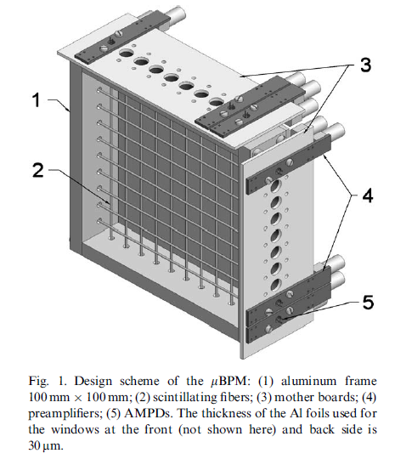
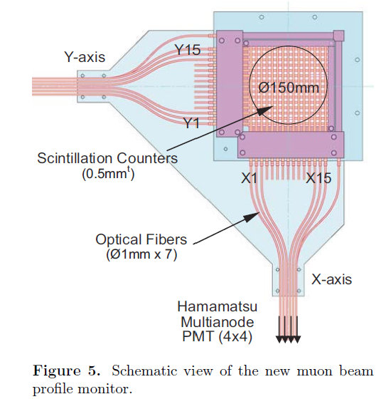
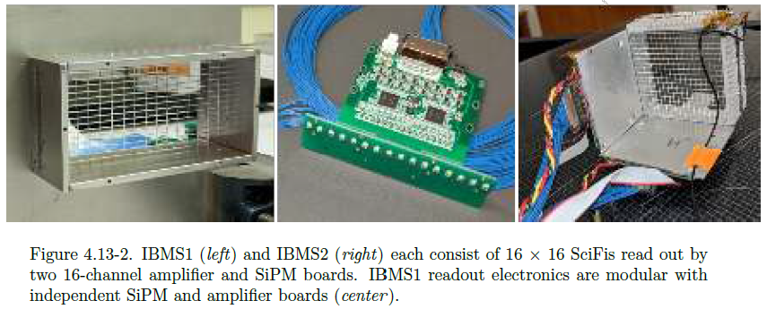
Diagnostics
Common choice for muon beam profiles is X/Y grid of scintillating fibers
PSI
J-PARC
Stoykov et al, Nucl. Instrum. Meth A 550 (2005) 212-216
Strasser et al, J. Phys.: Conf. Ser. 225 (2010) 012050
Muon g-2 @ Fermilab
Injected Beam Monitoring System (IBMS)
UW CENPA Annual Report April 1, 2018 – March 31, 2019

Slide 17
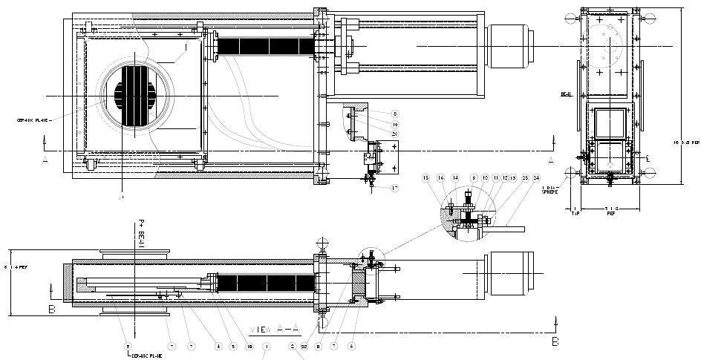
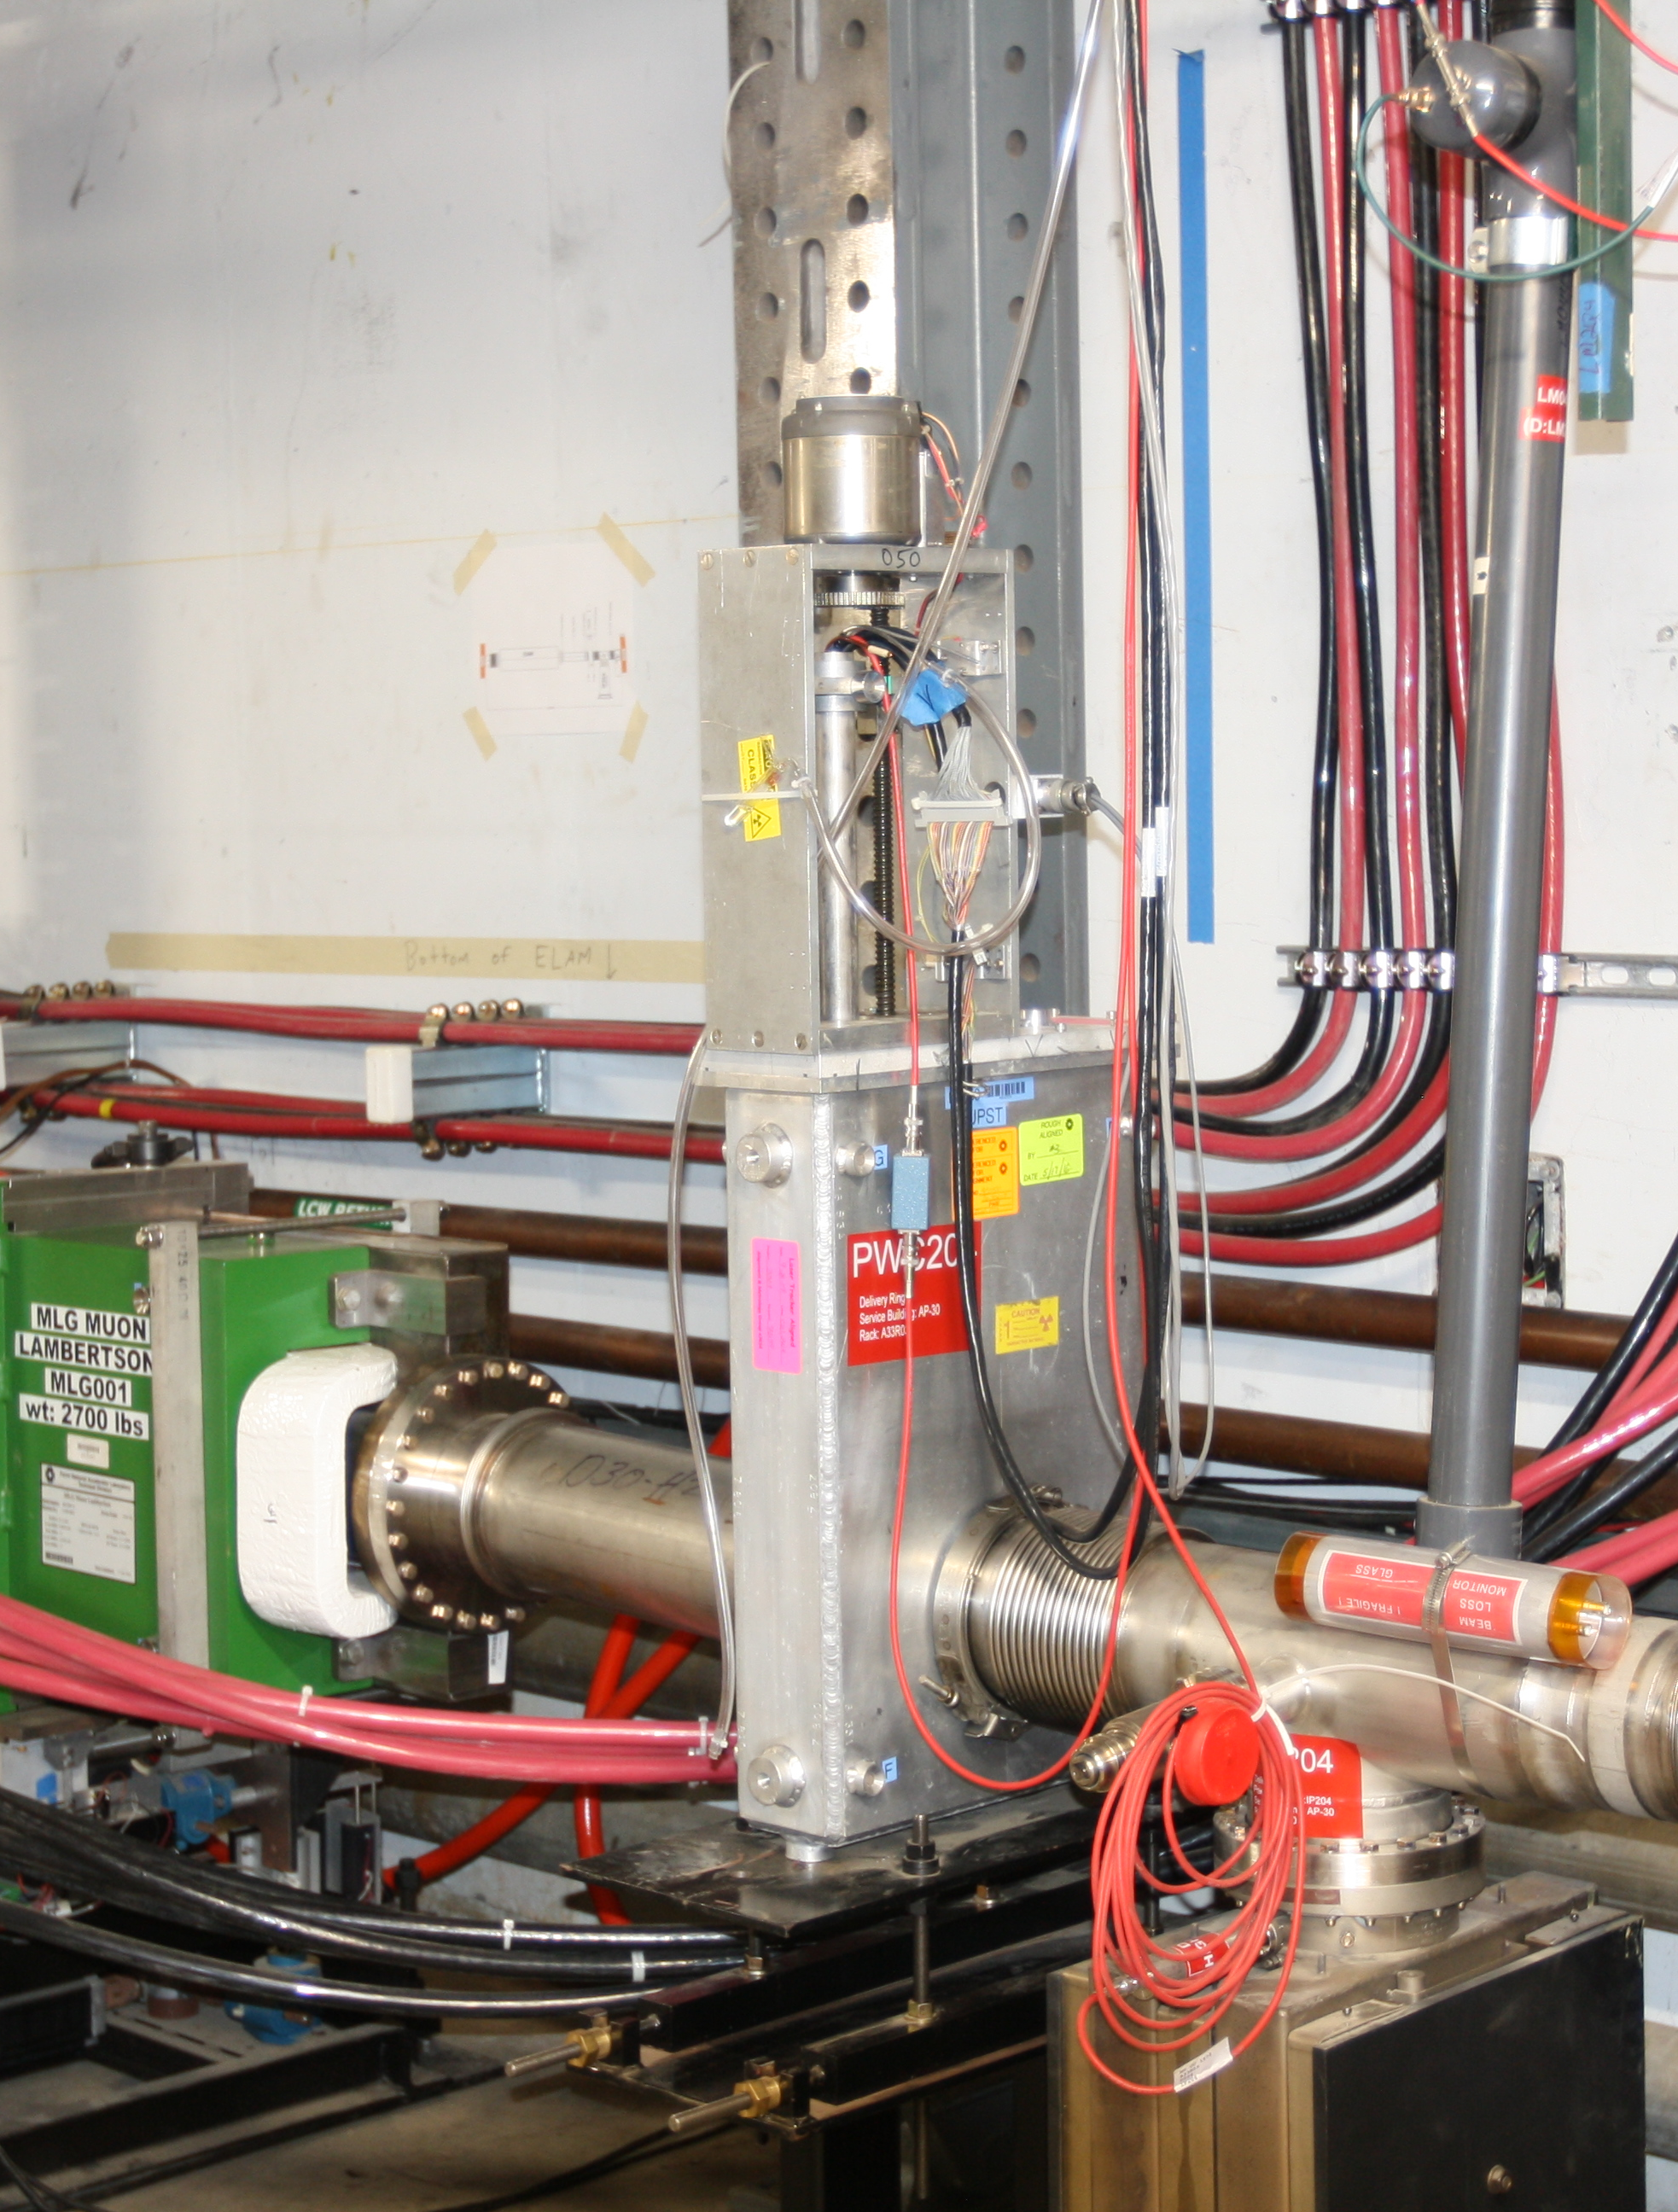
Diagnostics
Plan for MTA secondary line diagnostics in progress.
Muon Catalyzed Fusion experiment will be able to count muons at the end of the line
Have secured at least one, likely two bayonet SWIC housings
Hope to fill SWIC housings with scintillating fiber grid
In communication with Peter Kammel from UW regarding IBMS designs
Possible to use (or adapt) Fiber Profile Monitor developed for M-Test beamline?
May be an iterative process depending on timeline, cost, availability of materials, operational needs

Slide 18
Penetration Availability
Counting House Side
Penetrations viewed from enclosure
A
B
C
D
E
F
G
H
Enclosure Side
D
C
B
A
H
G
F
E

Slide 19
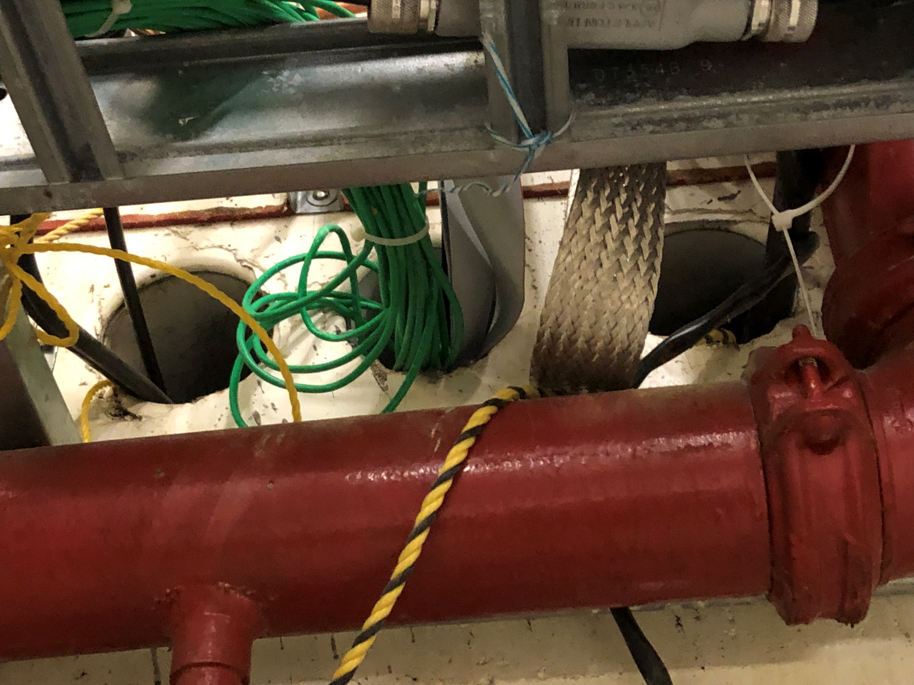
Penetration Availability
Current Contents:
D
Building power/lights. Sealed; very difficult to modify
C
Air hose for ITA vortex chiller & other pneumatics
B
Assortment of cables for readout of AD wire chambers in beam line & controls for stripping foil
A
(20) red RG58 SHV
(16) green RG58 BNC
(1) 2” flat ground braid
F
(24) Cat6 cables
Ribbon cables for PIN diode system in ITA cave
H
Used for FIRUS. Sealed; not easy to reconfigure
G
(3) low voltage cables from interlock group
E
208 V building power

Slide 20
Penetrations for New Cables
For Experiment:
(42) additional 90’ RG58 signal cables w/ BNC termination (16 already in place, for total of 58), end at Patch 2
(22) additional 90’ RG58 HV cables w/ SHV termination (20 already in place, for total of 42), end at Patch 2
Add to Penetration A, if possible.
36 RG58 cables already in A, from this picture it looks like 64 more could fit.
If not, use B for the remainder.
Counting House Side
A
B
C
D
B
A
E
F
G
H
Enclosure Side
D
C
B
A
H
G
F
E
For Beamline:
Use B for beamline profile signals

Slide 21
Penetrations for New Cables
For Experiment:
(4) 190’ optical fiber cables w/ SMA-905 termination, run over door to end at experiment
(4) 190’ Belden 8773 cables, run over door to end at experiment
Add to Penetration G
(current contents = low voltage cables from interlock group)
Counting House Side
A
B
C
D
E
F
G
H
G
Enclosure Side
D
C
B
A
H
G
F
E
For Beamline:
(1) 200’ Belden 8773 cable

Slide 22
Penetrations for New Cables
For Experiment:
190’ power cable for vacuum pump (14 AWG, 6 stranded wires), run over door to end at experiment
(11) 190’ DC power cables (14 AWG, 2 stranded wires), run over door to end at experiment
Add to Penetration E
(current contents = 208 V building power)
Counting House Side
A
B
C
D
E
F
G
H
E
Enclosure Side
D
C
B
A
H
G
F
E
For Beamline:
(15) 200’ 2-conductor shielded 8 gauge cable
Beamline vacuum pump(s) power
If space, add cable for solenoid power

Slide 23
Penetrations for New Cables
If additional penetration space is needed for beamline power cables
Add to Penetration C
(current contents = air hose for ITA vortex chiller & other pneumatics)
Counting House Side
A
B
C
D
E
F
G
H
C
Enclosure Side
D
C
B
A
H
G
F
E

Slide 24
Thank You

