Slide 1
High-intensity low energy muon beamline at MTA
Performance Simulations
C. Johnstone
Review 8-23-2021
Carol Johnstone, Anna Mazzacane, Rob Ridgway, Chris Izzo, J. Morgan

Slide 2
Fermilab LDRD 2021: Multi-slice Target Development
Develop an economical approach to producing an intense mutli-application low energy muon source, both π ⁻ and π ⁺
    Emphasis on an intense, multi-application π ⁻ beam
Provide essential R&D for muon beam planning for PIP-II era
Develop a heavy target for lower-energy proton beams (<1 GeV)
    Optimize interaction length, beamline orientation and capture Ω
    Optimize target geometry and orientation
    Optimize # of target slices and spacing
Test concepts at Fermilab MTA facility at the end of the 400 MeV linac
    Install a precision low-energy muon beamline in the MTA with in-house components during summer 2021 accelerator shutdown
    Study performance compared to simulations
    Support ARPA-E funded muon catalyzed fusion experiment to further quantify performance and successful application

Slide 3
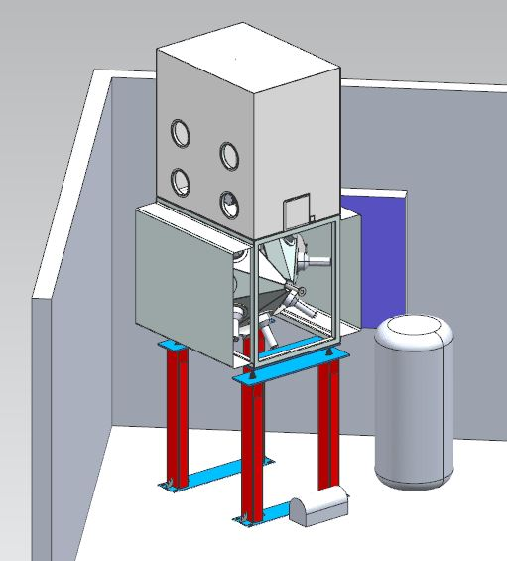
Final Beamline Geometry & Integration with Experiment
Straight shot to corner is 146.5°
Experiment ~2m insertion length
Remaining length for beamline
  ~5m
  Insufficient for a full FODO cell
  Even with more quads and ramped currents
No dispersion - bonus
Large transverse acceptance
  On and off momentum
ITA Cave
Front Porch
TUNGSTEN TARGET
Target is 3’ upstream of MW8 connecting flange
z
33.5°
234” / 5.9436 m (z)
x
85.1”
2.2 m (x)
Rollup Door
280.614” 7.1276 m
154.9”
3.934 m (x)
EXP
EXP – side view

Slide 4
Matching Solenoid to Production Target size
Two beam envelope solutions because the linear dynamics solution is quadratic in target beam size – beam diverges from the target:
  β_{sol} (thin lens)= β_{tgt}+ s²/β_{tgt} (where β is ∝ beam size²)
  For β_{sol} =5m and distance to center of solenoid = 0.4102m
    β_{tgt} = 0.03 m – solenoid captures a small, high divergent beam spot
    β_{tgt} = 4.85 m – solenoid captures a parallel beam
Using the acceptance of the beamline (180π mm-mr) gives target size
  Δl_{tgt@low β} = ±2.3 mm; Δl_{tgt@high β} = ± 30 mm
x’
Two optical solutions
Two target solutions
x’
x
x
Spot size
Primary beam
Spot size
For low β, IL = 2.3% for W
0.5 cm target length
For higher β, IL = 60% for W
6 cm target length

Slide 5
Summary of Design Approach
The experimental line captures ultra-low energy secondaries at a 146.5° backward angle relative to primary beam
At low energies, the geometric emittance is large; don’t have the advantage of long distances at MTA; optics must be highly efficient and compatible
  The experiment has requested 10-50 MeV muons; dp/p ~ ±10%
    Energy has been finalized at 100 MeV/c (~30 MeV muons) based on simulations/components; dp/p > ±20%
    Experiment has adapted to this energy and momentum spread
For large acceptance (small betas) and a large dp/p
  Beamline optics are built on a short 90° FODO cell
  Focal length must be ~4 m to fit (half cell length ~3m); for magnetic length ~0.247 ⇒ k ~1.0 m⁻²
    At 100 MeV/c, 8.9 gauss/cm; k ~0.25 m⁻²
    Requires 4 quads – to achieve this focal length
  For thick lens and 4 quads, k~0.5 m⁻²– this translates into ~2A @100 MeV/c
Solenoid is used to capture pions with equal phase space distributions in both planes
  Focus to the the “crossing” beta function of the FODO cell
  3 Quads match to FODO – similar k value

Slide 6
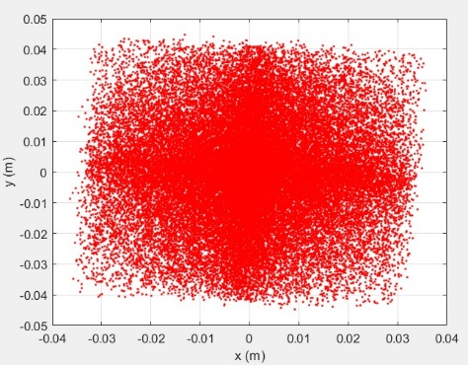
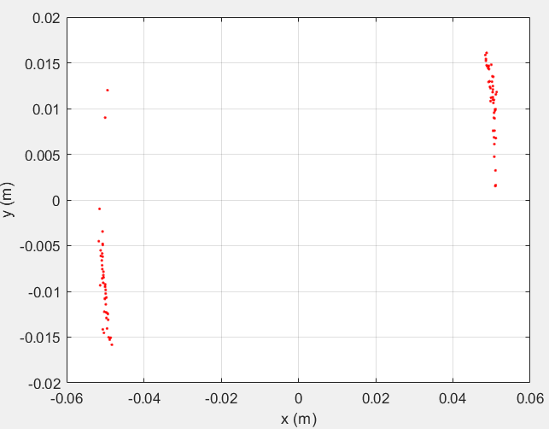
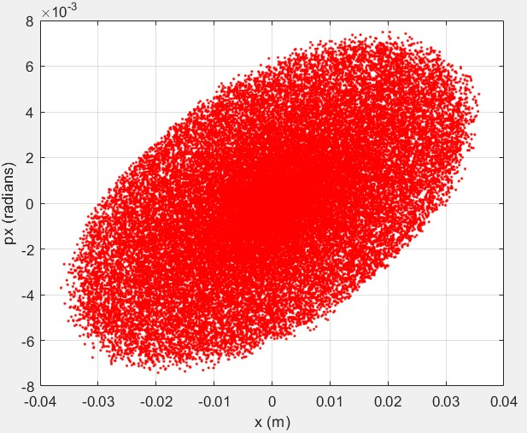
Momentum Dependence of Design and Tracking to end of line
On Momentum
dp/p = +20%
dp/p = -20%
x,y tracking @experiment
200π mm mr
x,y losses @experiment
200π mm mr
Horz Phase space @experiment
200π mm mr

Slide 7
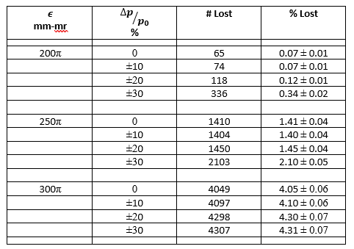
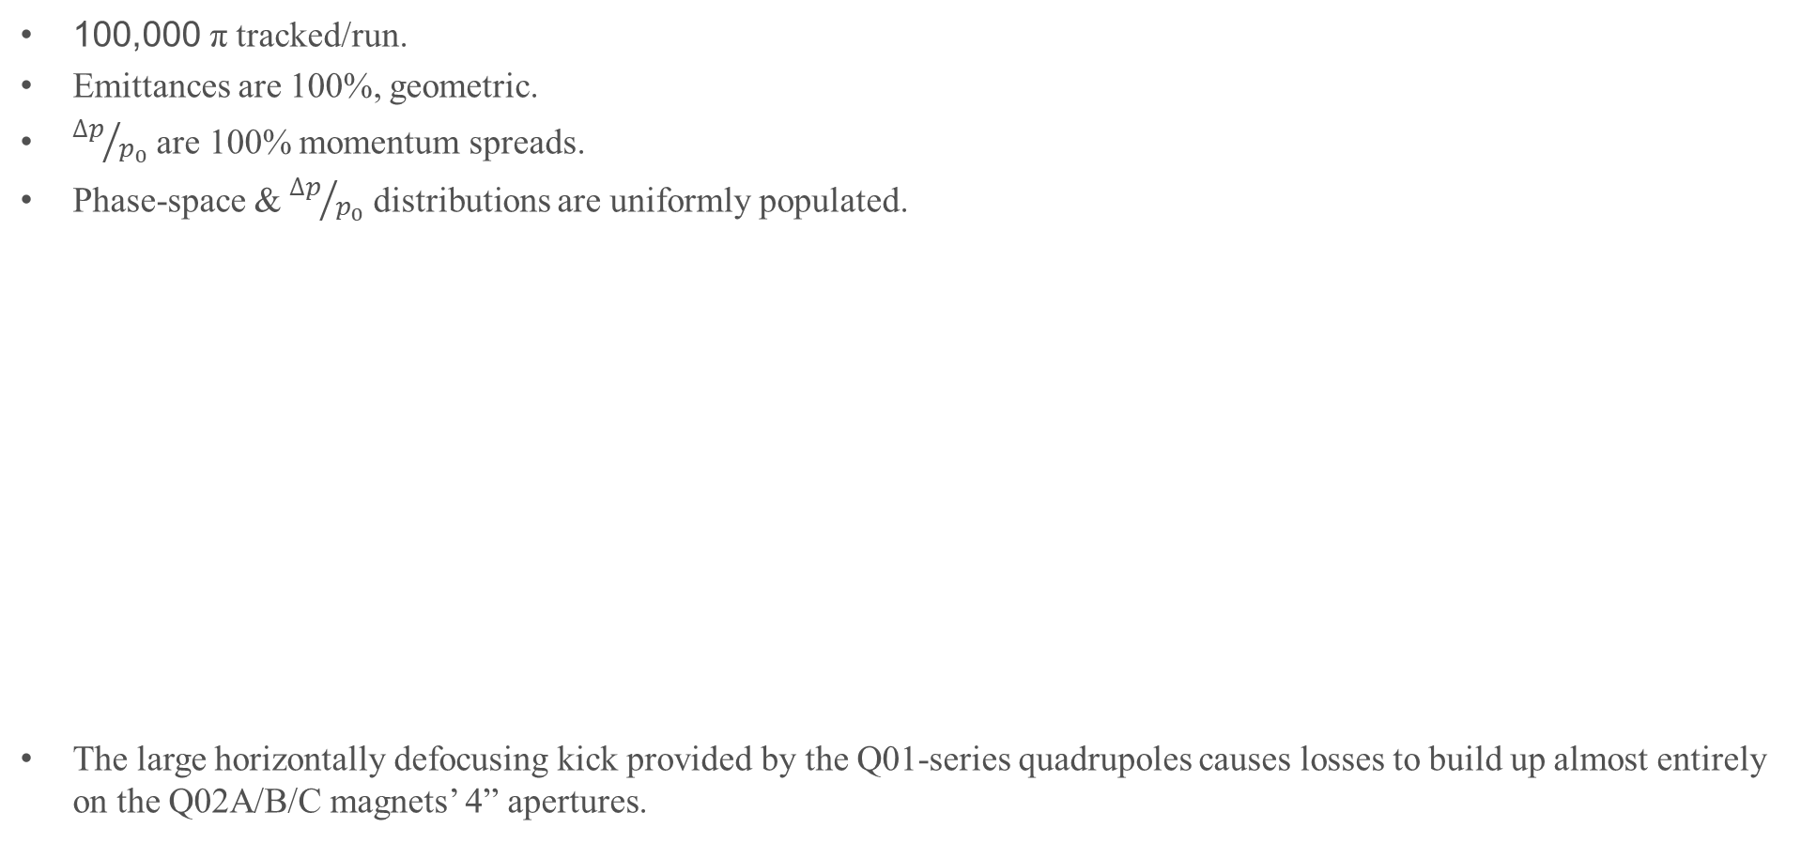
Performance of Beamline
100,000 π tracked/run.
Emittances are 100%, geometric.
${∆p}/{p_{0}}$ are 100% momentum spreads.
Phase-space & ${∆p}/{p_{0}}$ distributions are uniformly populated.
The large horizontally defocusing kick provided by the Q01-series quadrupoles causes losses to build up almost entirely on the Q02A/B/C magnets’ 4” apertures.

Slide 8
Steering in the beamline
A horz inner dipole followed by a vertical inner dipole will be added to the first two quadrupoles in the beamline just after the solenoid
Another horz and vert inner dipole will be added to the last two quadrupoles in the beamline to steer into the experiment’s target area
The trim dipoles are able to provide 10mr of steering @4A.
Upstream moves the beam ~1” at experimental apparatus.
Angle is adjusted with downstream trim dipoles
Position and angle for 10 mr steering down the beamline

Slide 9
The Target: Initial slice concept and rotation to backward production
Target slices reduce the mean free path – initial concept was a 90° facing secondary line
  This had to be rotated backward and concept adapted as dipoles could not be implemented
Filling the Loma Linda solenoid 2.5” (6 cm) aperture with target slices shown on left
  Rotating slices turns it into a longer solid target
8 cm is the longest target that can be accepted by the secondary beamline
6 cm
8.5 cm
6 cm
8 cm rod; 80% IL
Primary beam
45°
(Actual 33.5°)
Primary beam

Slide 10
Sliced Target concept and opposite rotation
A sliced target can be used to increase surface to volume
Opposite orientation rotates into a series of slices normal to the primary beam direction
Pions produced from the opposing side of the target travel through significantly less volume
Net target length is reduced by ~half from the solid target approach
6 cm
8.5 cm
6 cm
four 1 cm slices; 40% IL
Primary beam
45°
(Actual 33.5°)

Slide 11
Preliminary Un-normalized Pion Production 8-cm long solid W target

Slide 12
Un-normalized Pions, 8 cm W target, entering solenoid aperture

Slide 13
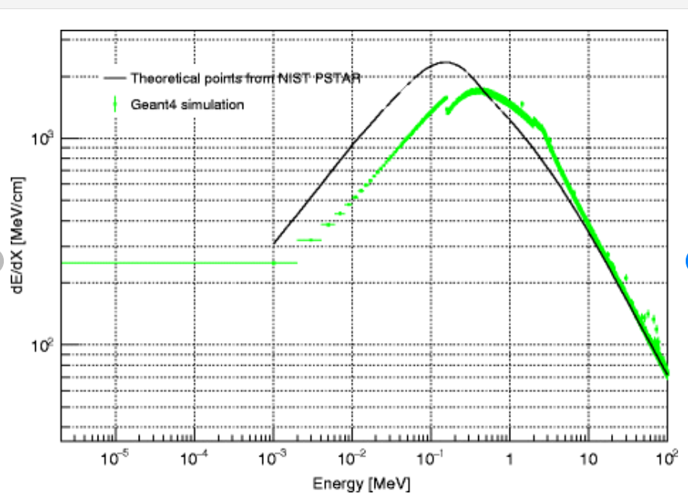

Check of Energy loss and Multiple Scattering in W
W Radiation length; 6.76 g cm⁻² 0.3504 cm
$$θ_{rms}=63 mr$$
At 3 x θ_{rms} beam scatters ~half a cm by the end of the 3 cm target. A 1.5 cm wide target is a reasonable choice to minimize pion reabsorption.
For ~30 MeV/cm, 4 cm to reduce 400 to 280 MeV pion production threshold. This is an energy limitation of the Fermilab Linac and a tungsten target – lighter targets such as graphite can be longer. PIPII @800 MeV will be able to use much longer tungsten production targets.

Slide 14
Target Geometry and Position Considerations
Nuclear interaction models show the expected 10 cm IL behavior
  INCL++ and UrQMD standalone
Pions are not produced beyond 4cm (due to energy loss)
Optimal target length is currently estimated to be 3 cm
  3 cm horz x 1.5 cm wide (measured) x 3 cm vertically
    equal horz and vert spot sizes generated by target
    Horz width will be reduced in Figure and vert increased
  Production models are giving significantly different rates (x10)
  Significant differences in momentum distributions
Exponential nature of cross sections for an extended target
  Nonuniform filling of phase space
  Mean of distribution positioned on centerline of beamline
Double minimum in horz and vert
Horz 99% width will be reduced to 1 cm and vert increased to 3cm

Slide 15
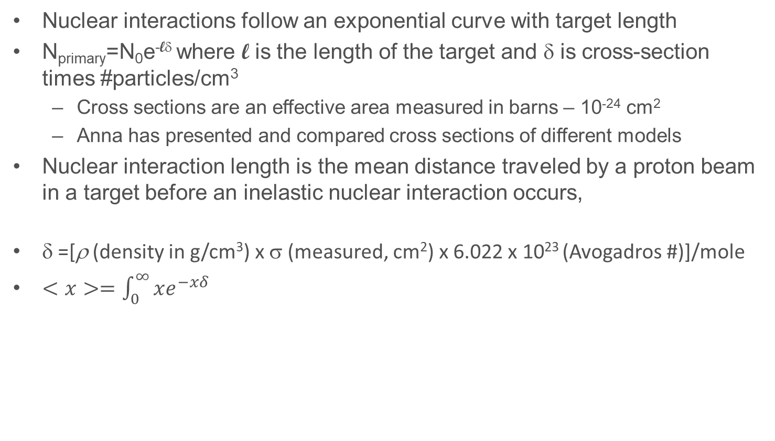
Nuclear Interactions - review
Nuclear interactions follow an exponential curve with target length
N_{primary}=N₀e^{-lδ} where l is the length of the target and δ is cross-section times #particles/cm³
  Cross sections are an effective area measured in barns – 10⁻²⁴ cm²
  Anna has presented and compared cross sections of different models
Nuclear interaction length is the mean distance traveled by a proton beam in a target before an inelastic nuclear interaction occurs,
δ =[ρ (density in g/cm³) x σ (measured, cm²) x 6.022 x 10²³ (Avogadros #)]/mole
$<x>=\int_{0}^{∞}{xe^{−xδ}}$
l
Cross section is area of dots – nuclei interaction region
Cross sections are measured experimentally and there are accurate models
N_{p}
N_{p}-N_{p} δΔx
….
N_{p}-N_{p}δΔx - (N_{p}-N_{p}δΔx) δΔx

Slide 16
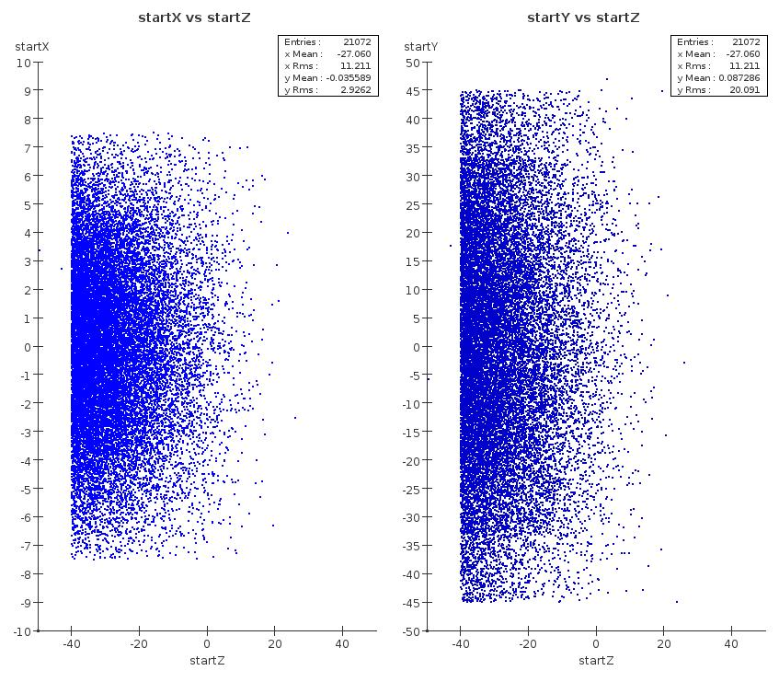
Target alignment
Mean of the distribution from the exponential interaction occurs about 1.3 cm into the target (4 – 2.7 cm).
For a 3 cm target this is only 2 mm from the center
  The production is sufficiently flat as a function of angle that a 2mm offset is likely insignificant

Slide 17
Optimized Solid Target concept: 3 cm path and not rotated
Centered @ mean of distribution produces most dense central phase space
  Important for the small aperture muon catalyzed fusion experiment
  Slices will be more important for distributed or even lower energy muon beams
Centering to be determined from target modeling
1.5 cm
1.7 cm
3.0 cm
1.3 cm
6 cm
1.5 cm target:
beam size ~1 cm
Pion beam
33.5°
Primary beam

Slide 18
Optimized Solid Target concept: 3 cm path, rotated?
Does rotation reduce mean free path? NO
Rotation reduces density of particles – spreads out beam
  More backward the secondary angle, the smaller the secondary beam size
Long narrow target – no rotation is optimal
1.5 cm
1.5 cm
0.5 cm
1.8 cm
0.5 cm
1.4 cm
1.4 cm
2.3 cm
2.5 cm
3.0 cm
33.5°
3 cm
1 cm
1.2 cm
Muon beam rays
1 cm
Primary beam
1 cm

Slide 19
Beam Absorber
Modeled after MuCool operation
  20 cm steel beam absorber after RF cavity (in air)
  RF cavity: additional 2” of steel
Reuse two tungsten bricks
  Used for beam tests
  Removable (manual motion table)
  In a vacuum break between target housing and MW8
    As close as possible to target housing downstream port
  Additional shielding will be installed
    Target and beam absorber
Schematic of HPRF cavity Beam Test at MTA units in mm
Residual activation of Cu insert in beam
absorber. (Two 50-μs pulses provide 4.3 × 10¹¹ p/sec.) Will be repeated for W absorber.

Slide 20
Expectations - Summary
Highest center phase space density is created by a solid rod target
Increase in pion production per proton vs PSI:
  30% vs 4% interaction length
  Factor of 8 in π- production cross section, tungsten vs graphite
    Factor of 2 rather than 5 less vs π+ production (this is seen in studies)
  Factor of 10(?) increase in momentum acceptance
  Maybe a total factor of 600 increase in # π-/μ- per proton
    Does not take into account pion production cross section is higher at 600 MeV
    PSI is CW MTA hall operational ASE and Linac duty cycle
Two 1.5-cm targets separated by 1 cm will also be studied

Slide 21
Operational Parameters of 400-MeV Fermilab Linac beam and MTA/ITA limits
Full Linac Beam Capability
ITA operation (local “cave” shielding)
Parameter | Value | Unit
Kinetic Energy | 401.5 | MeV
Repetition Rate | 20 Hz
Energy Spread | 1 | MeV
RF Structure | 201.24 | MHz
Bunch Length | 0.05 | ns
Max Pulse Length | 80 | µs
Max Particles Per Bunch (28 mA) | 0.88x10⁹
Max Particles Per Pulse | 1.4x10¹³
Peak Current | 28 | mA
Avg Current | 34 | µA
Max Beam Power | 13.4 | kW
Beam Emittance (99%) | 8 | mm-mrad
Local shielding will be implemented for muon production target and a local beam absorber
Note: 6.56x10¹² p/40 μsec or 1.64x10¹¹ p/μsec

Slide 22
Readiness Summary
Optics Design Complete
Major target studies complete
  Shielding assessment started
  Final performance and rate studies initiating
Layout complete
All beamline components tested and ready for installation
Alignment stake-out of stands and final beamsheet ~end of week
Target and housing modeled and target thermal analysis complete
Vacuum and stands engineered including experimental stand
  Drafting and engineering note in progress
  Materials list ready for order
Power supplies identified
Cabling and cable runs complete
  Electrician req was submitted a couple of months ago
Diagnostics – R&D
  Experiment has sophisticated muon and other radiation detectors

Slide 23
BACKUP Slides

Slide 24
Atomic and nuclear properties of tungsten (W)
Quantity | Value | Units | Value | Units
Atomic number | 74
Atomic mass | 183.84(1) | g mole⁻¹
Specific gravity | 19.30 | g cm⁻³
Mean excitation energy | 727.0 | eV
Minimum ionization | 1.145 | MeV g⁻¹cm² | 22.10 | MeV cm⁻¹
Nuclear collision length | 110.4 | g cm⁻² | 5.719 | cm
Nuclear interaction length | 191.9 | g cm⁻² | 9.946 | cm
Pion collision length | 133.9 | g cm⁻² | 6.936 | cm
Pion interaction length | 218.7 | g cm⁻² | 11.33 | cm
Radiation length | 6.76 | g cm⁻² | 0.3504 | cm
Critical energy | 7.97 | MeV (for e⁻) | 7.68 | MeV (for e⁺)
Molière radius | 18.00 | g cm⁻² | 0.9327 | cm
Plasma energy ℏω_{p} | 80.32 | eV
Muon critical energy | 150. | GeV
Melting point | 3695. | K | 3422. | C
Boiling point @ 1 atm | 5828. | K | 5555. | C
NOTES
The nuclear interaction length is 10 cm. An inelastic nuclear interaction is required to make pions
1 cm was initially chosen (10% IL) to be consistent with the shielding assessment for a target in the MTA experimental hall
>10% IL requires a local beam stop - Beam cannot be transported to the high intensity beam dump buried in the berm downstream of the hall
https://pdg.lbl.gov/2021/reviews/constants_atomic_and_related.html

Slide 25
Compare with Carbon
Quantity | Value | Units | Value | Units
Atomic number | 6
Atomic mass | 12.0107(8) | g mole⁻¹
Specific gravity | 2.210 | g cm⁻³
Mean excitation energy | 78.0 | eV
Minimum ionization | 1.742 | MeV g⁻¹cm² | 3.850 | MeV cm⁻¹
Nuclear collision length | 59.2 | g cm⁻² | 26.79 | cm
Nuclear interaction length | 85.8 | g cm⁻² | 38.83 | cm
Pion collision length | 86.5 | g cm⁻² | 39.12 | cm
Pion interaction length | 117.8 | g cm⁻² | 53.30 | cm
Radiation length | 42.70 | g cm⁻² | 19.32 | cm
Critical energy | 81.74 | MeV (for e⁻) | 79.51 | MeV (for e⁺)
Molière radius | 11.08 | g cm⁻² | 5.012 | cm
Plasma energy ℏω_{p} | 30.28 | eV
Sublimination temperature (@ 1 atm) | 4098. | K | 3825. | C
PROJECTED PERFORMANCE
PSI – 1.5 cm 4%IL C target
Factors
30% vs 4%
4 x nuclear interactions
Factor of 3 and 8 from
σ_{Τ}(π⁺) ≈ 24.5 Ζ^{1/3}
σ_{Τ}(π–) ≈ 2.33 Ν^{2/3}
Total increase from a carbon target = 60 for π–
Momentum spread increase?
Rate correction for PSI CW beam (1 π–/10 μsec) vs 20 Hz duty cycle of Linac and macropulse length

