Slide 1
MTA Secondary Beamline – Mechanical Engineering
Structural/Vacuum/Target Design & Installation Plans
Robert Ridgway AD/MSD/PSG/ENG
Review for the MTA Secondary Line
23 August 2021

Slide 2
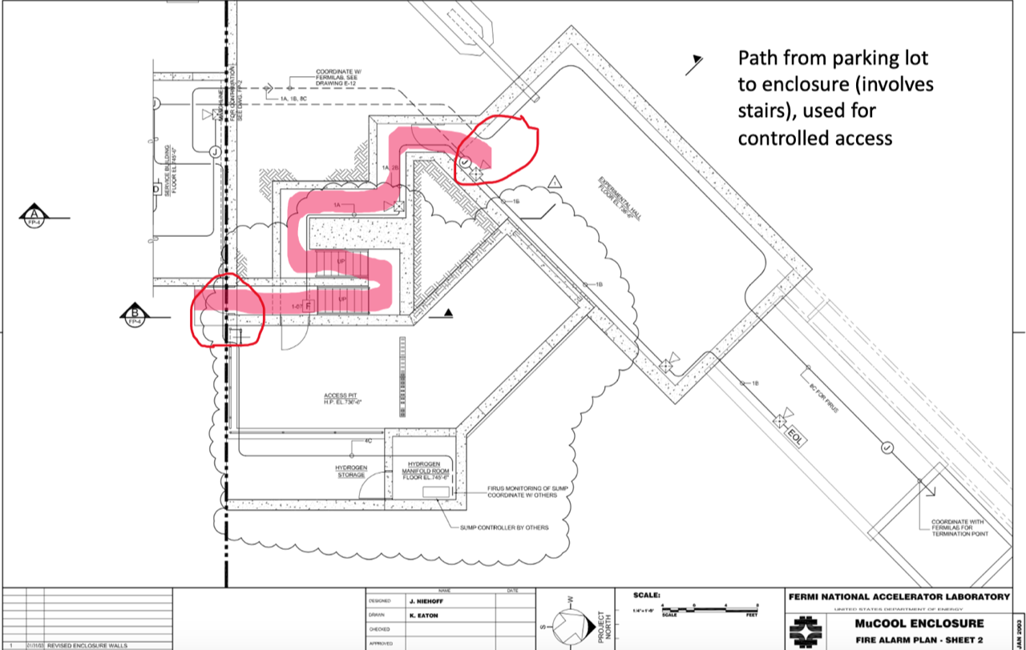
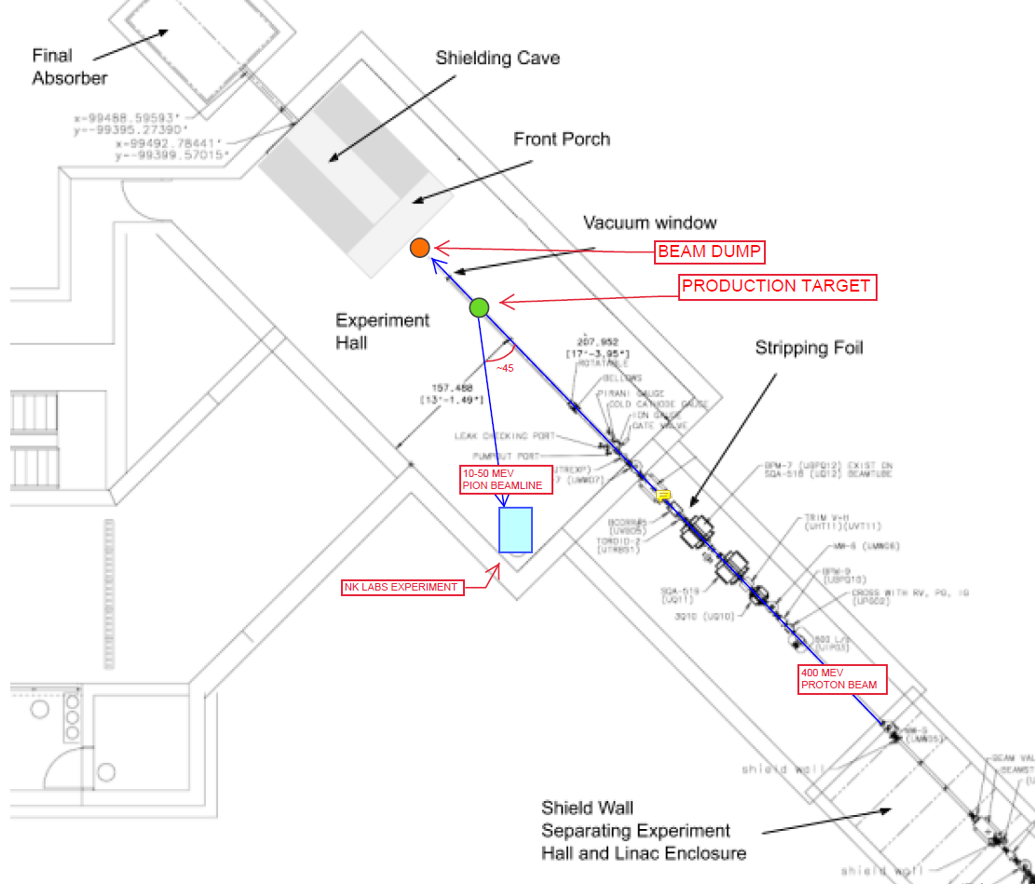
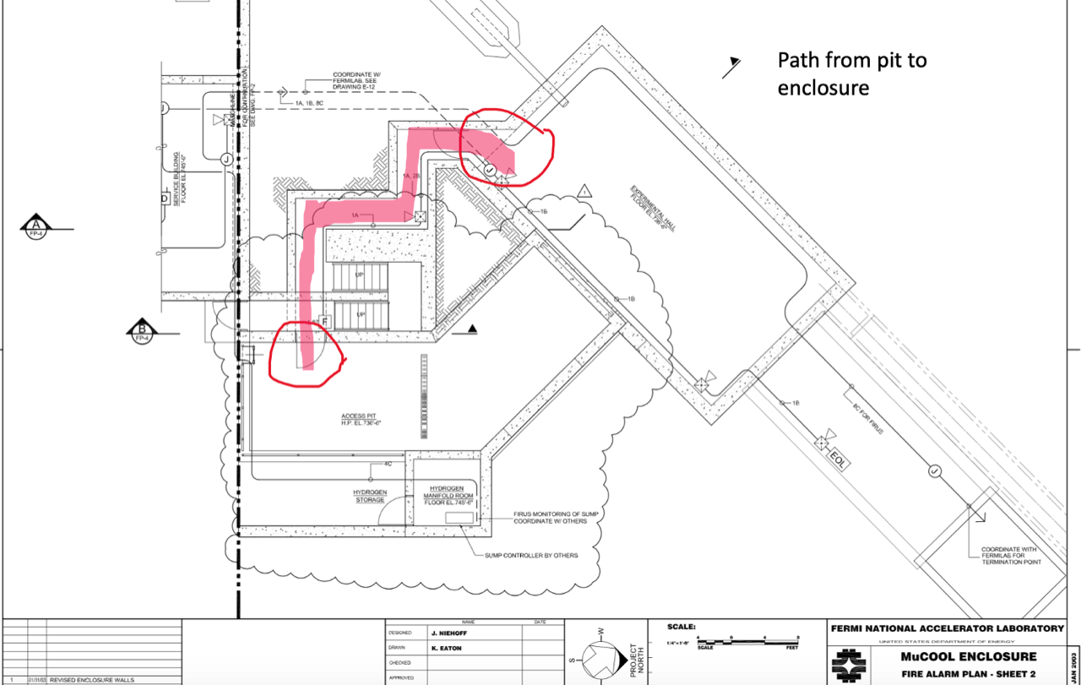
Initial Design Constraints
END
END
INSTALL LOCATION
INSTALL LOCATION
START
START

Slide 3
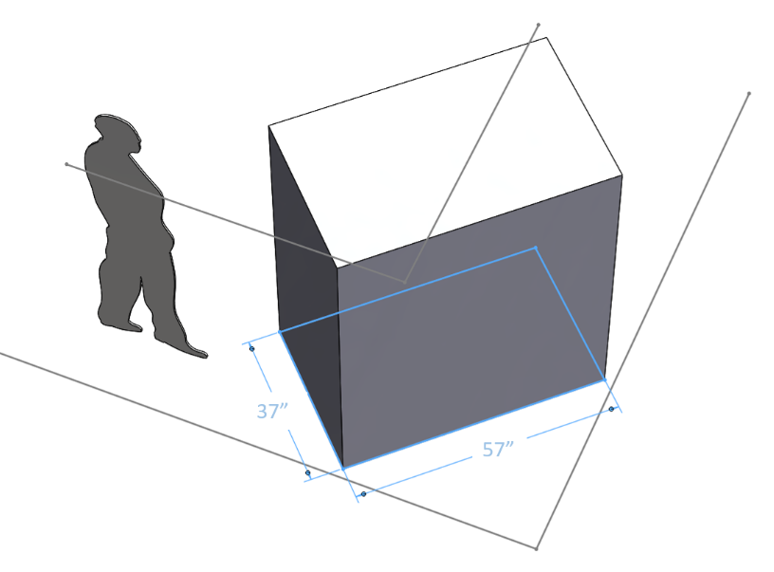
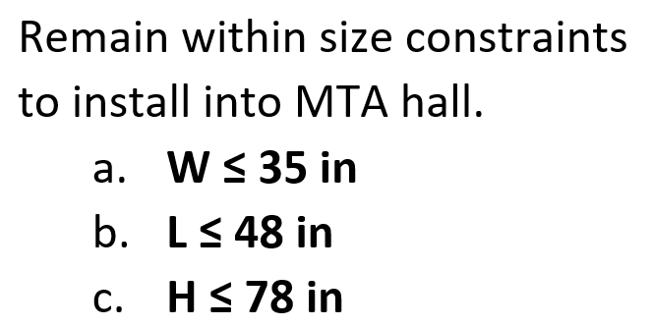
Initial Design Constraints
< 78
<35
< 35
< 48

Slide 4
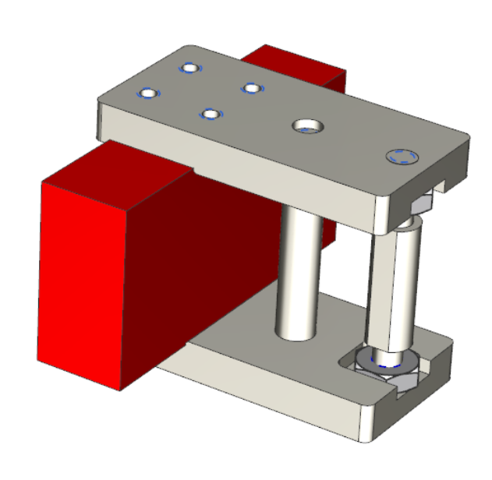
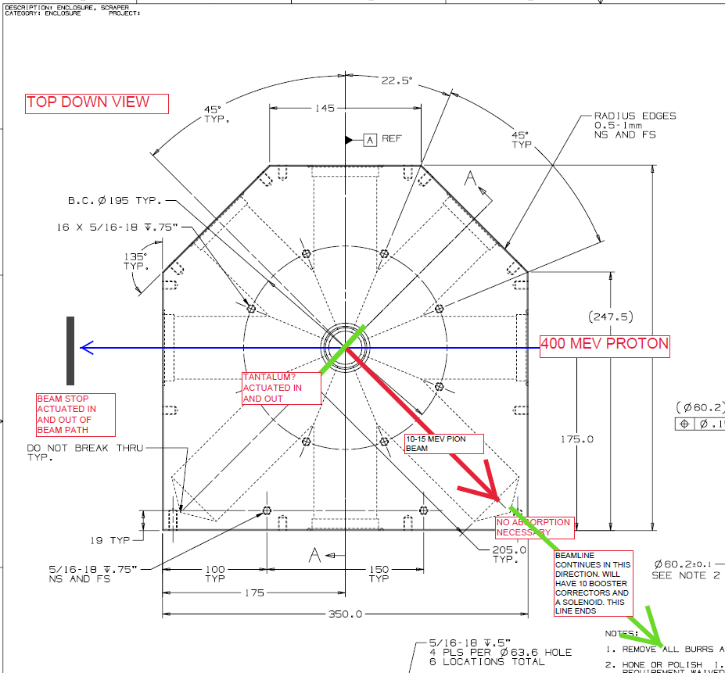
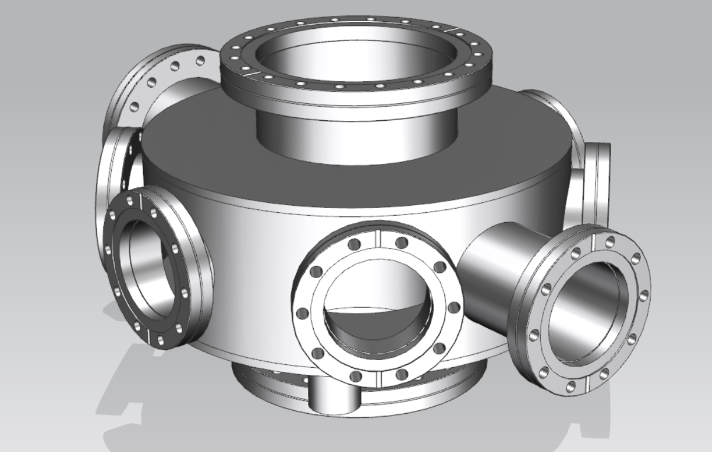
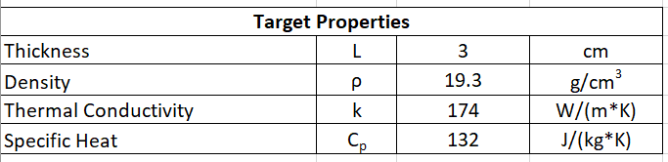
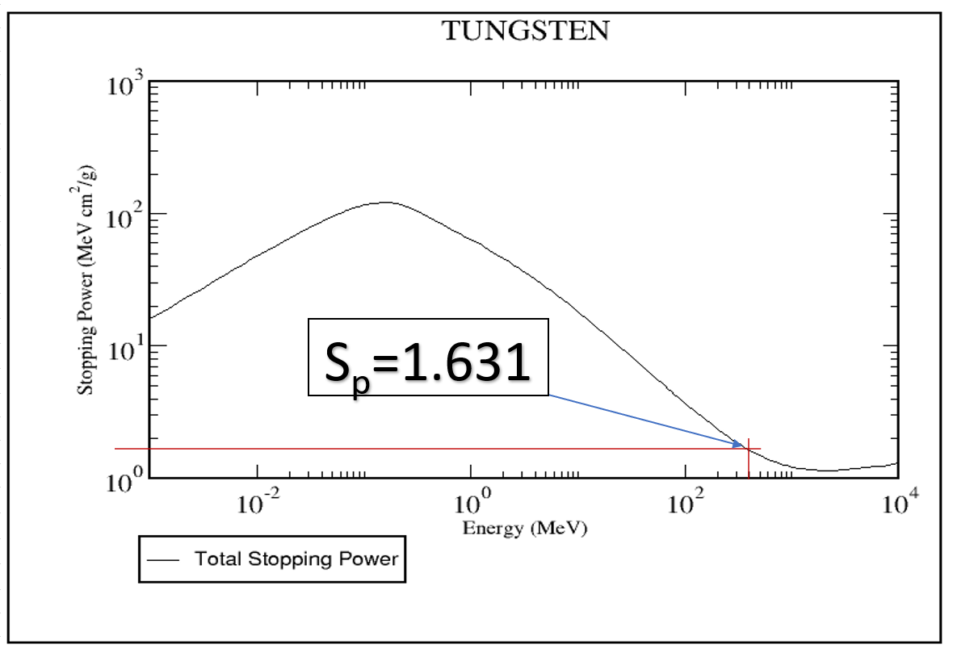
Production Target
Melting Point: 3410°C (~64% Surface Temperature of The Sun)

Slide 5
Production Target

Slide 6
Production Target

Slide 7
Production Target

Slide 8
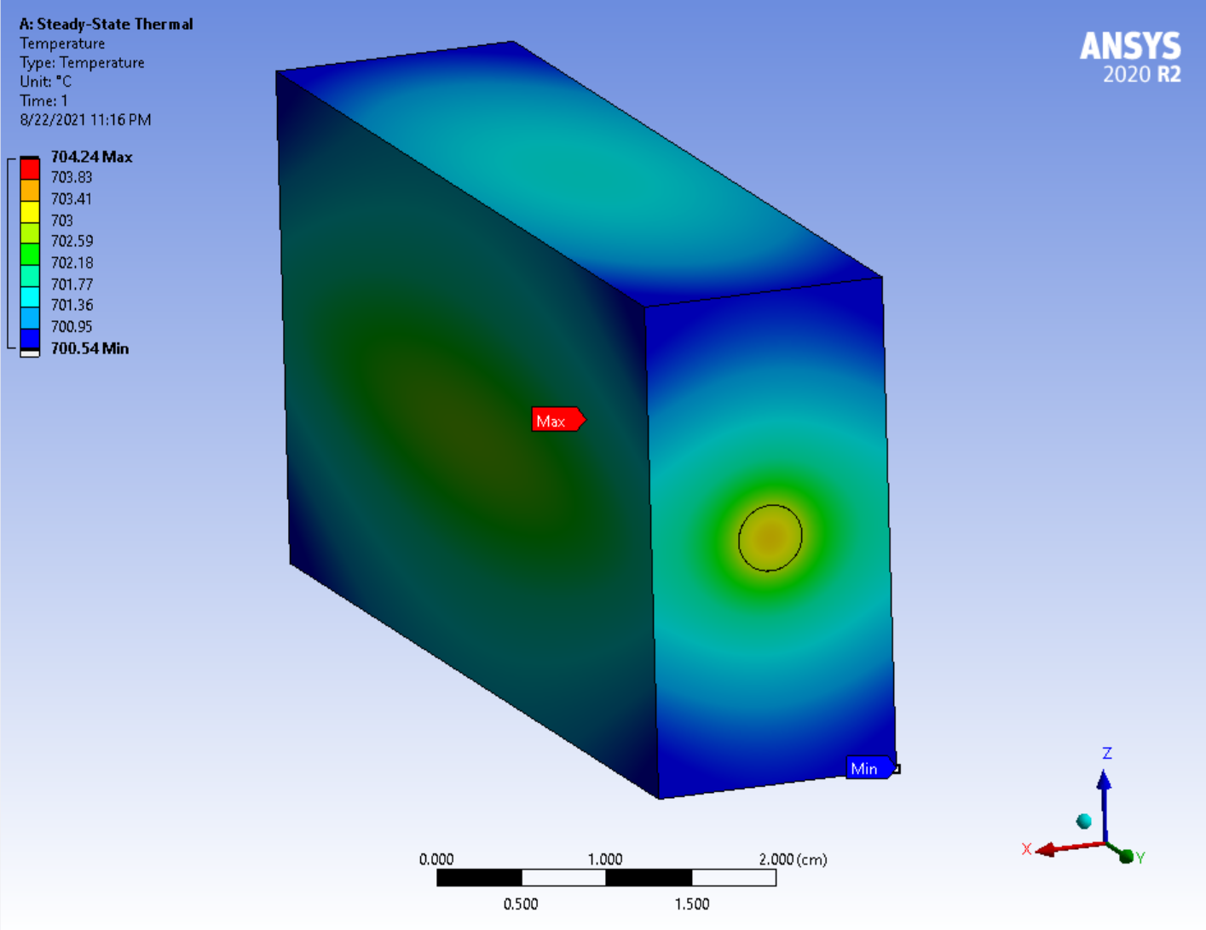
Production Target – Steady State Thermal Calculation

Slide 9
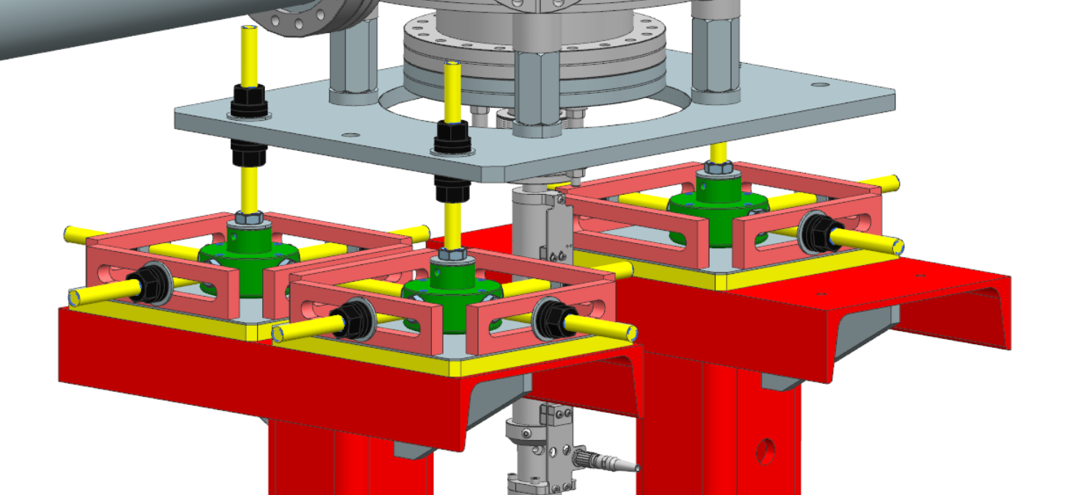
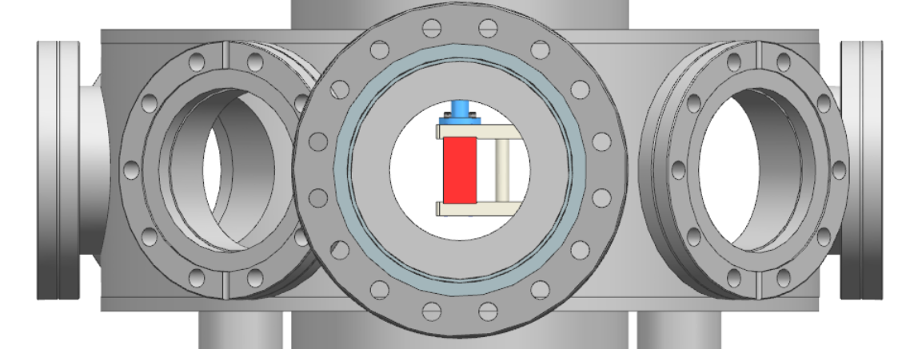
Production Target - Installation Assembly

Slide 10
Solenoid - Installation Assembly

Slide 11
Corrector Magnets (3 Set & 4 Set) - Installation Assembly

Slide 12
NKLabs Experiment - Installation Assembly

Slide 13
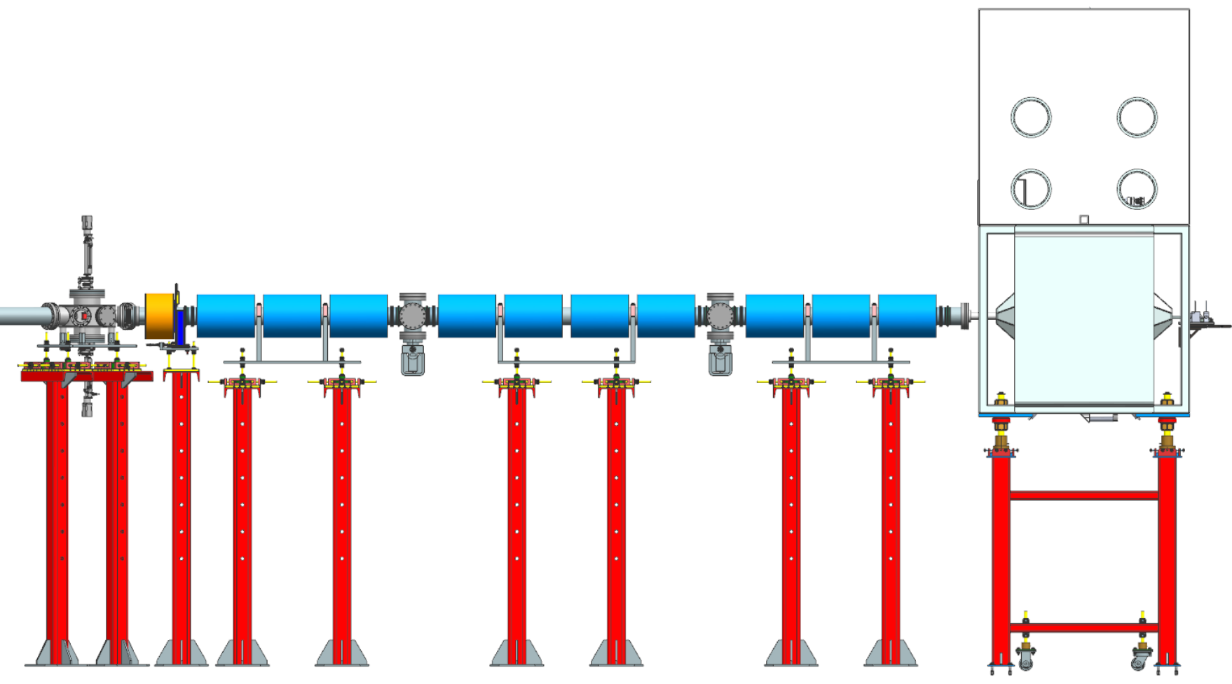
Beamline Layout

Slide 14
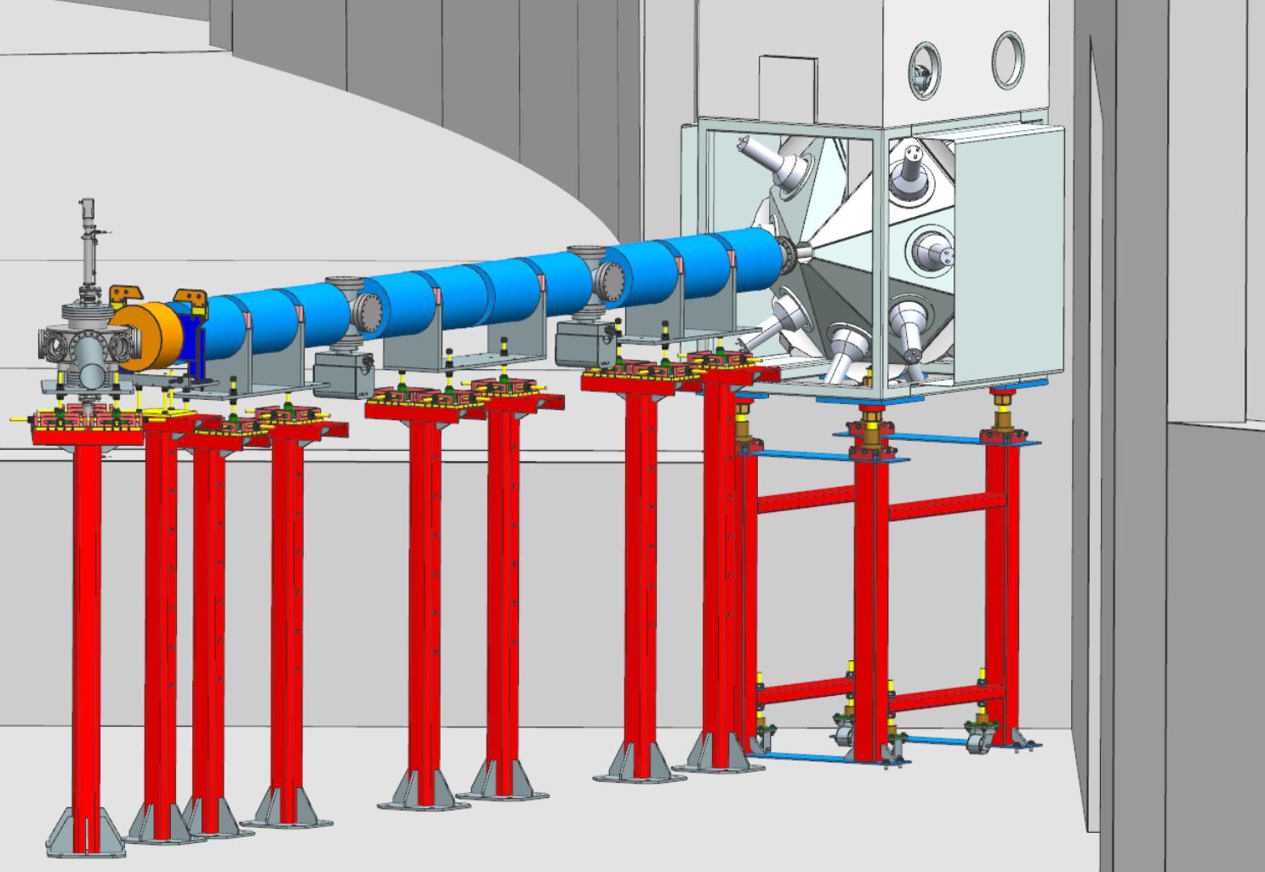
Beamline Layout

Slide 15
Low Energy Pion Beamline Vacuum Calculations
Bob Donahue
11 August 2021

Slide 16
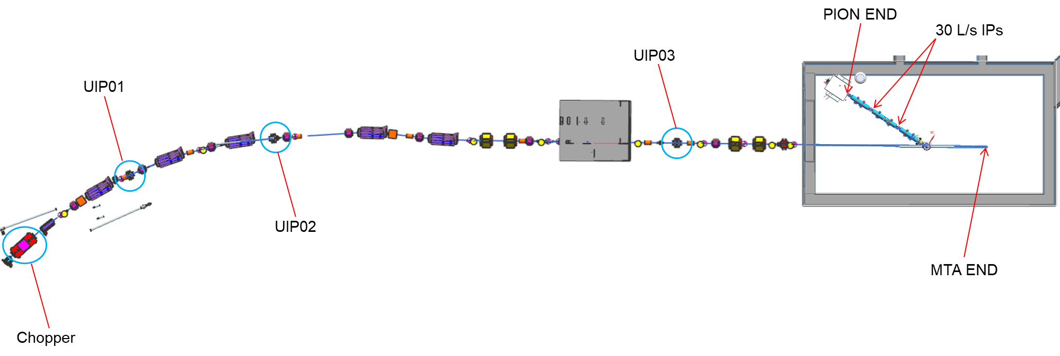
Beamline Layout

Slide 17
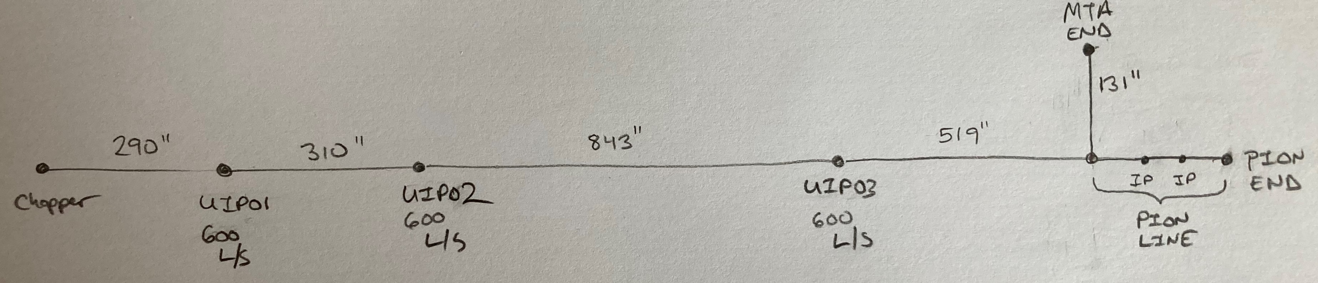
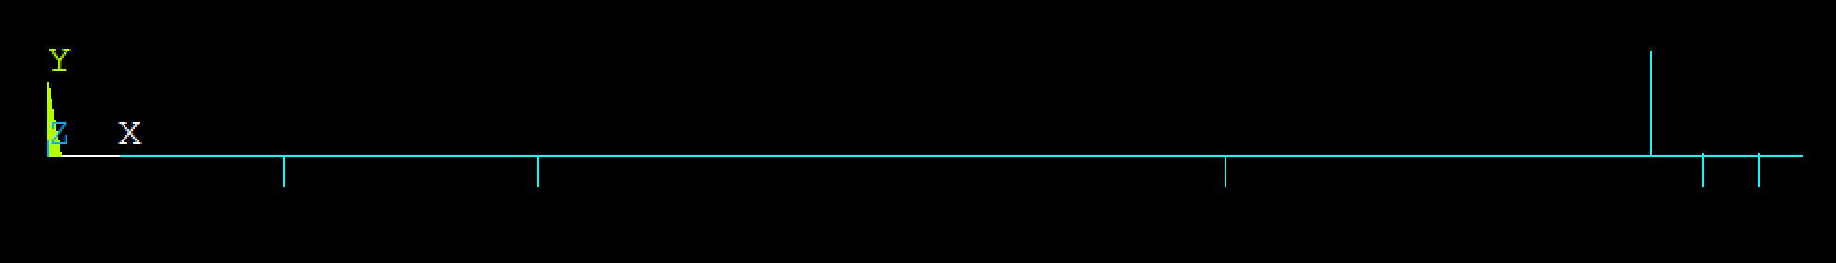
Simulation Beamline Layout

Slide 18
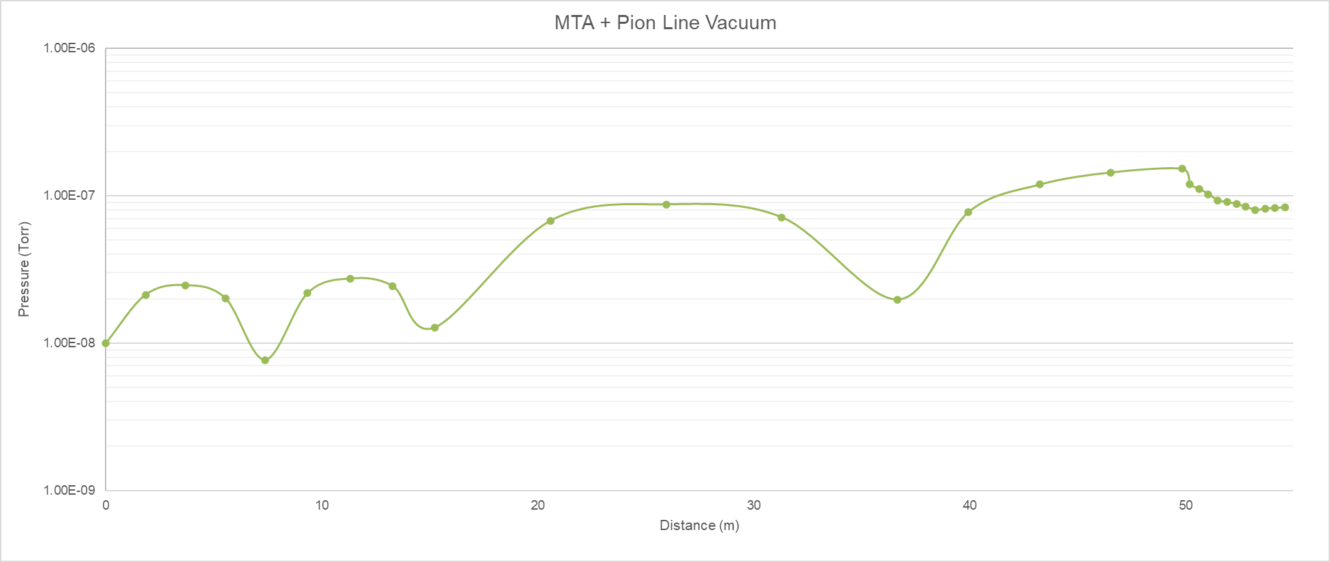
MTA + Pion Line Vacuum Simulation Results
PION END
30 L/s IPs
UIP03
Chopper
UIP02
UIP01

Slide 19
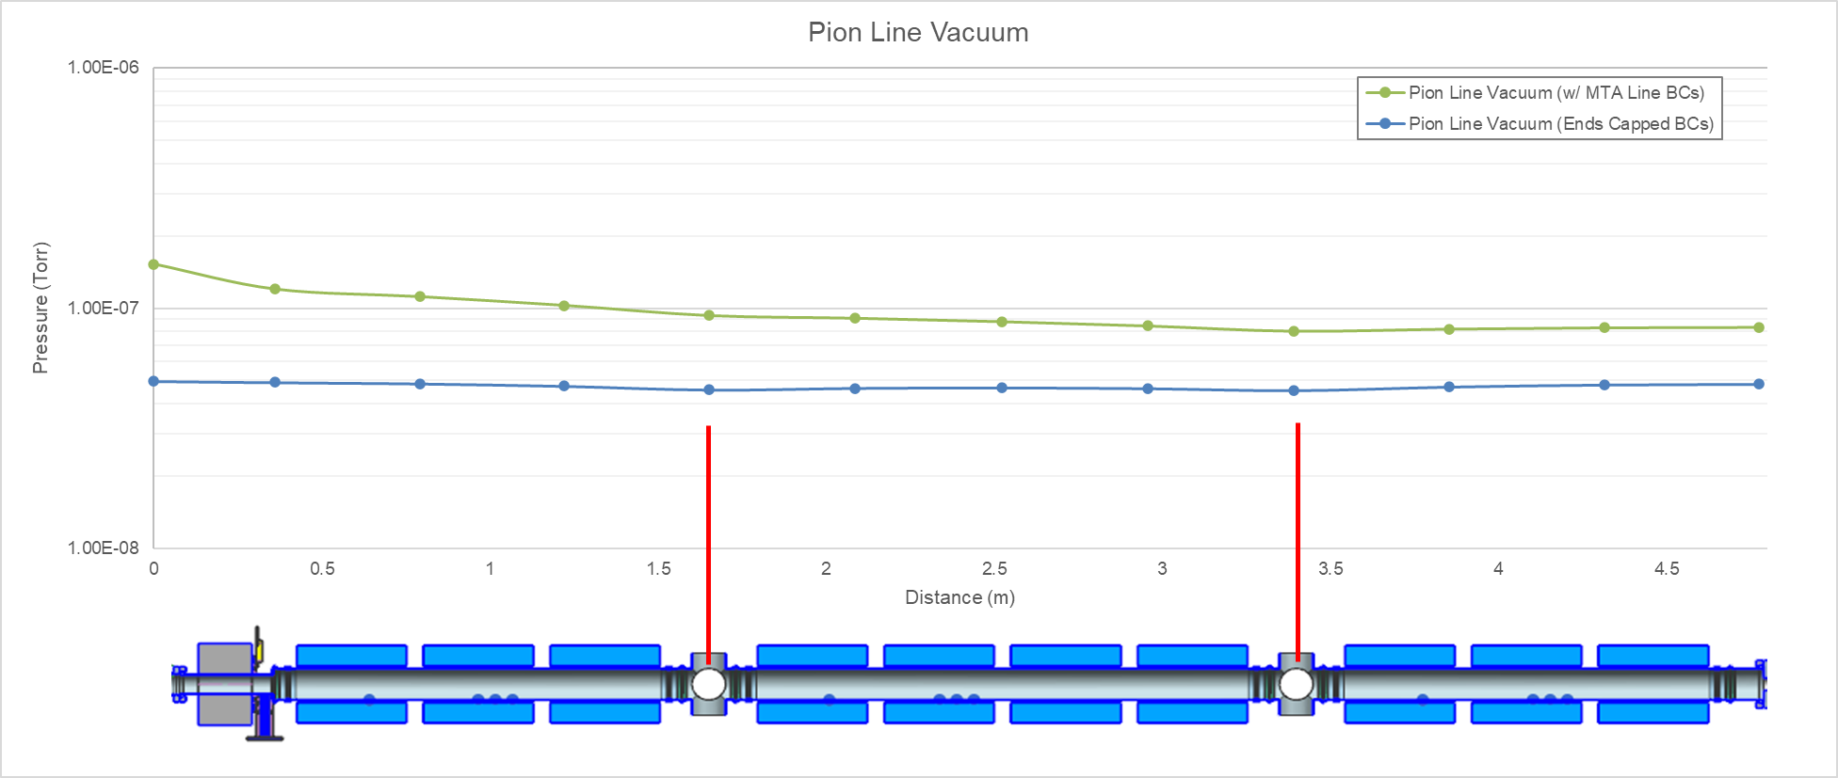
Pion Line Vacuum Simulation Results

Slide 20
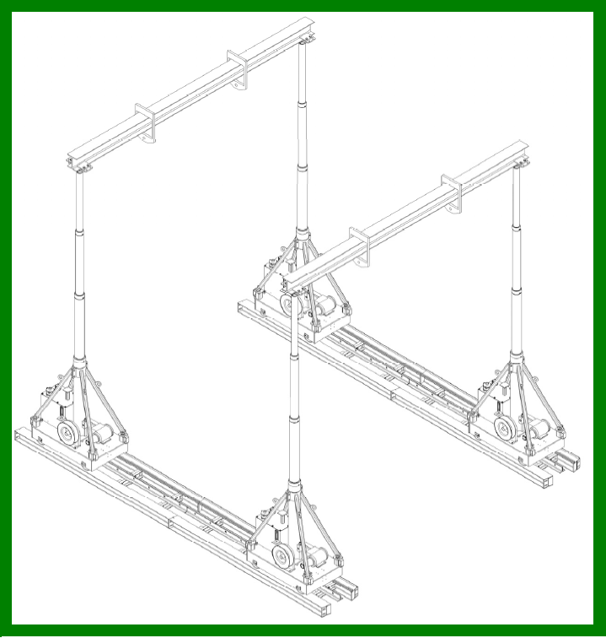
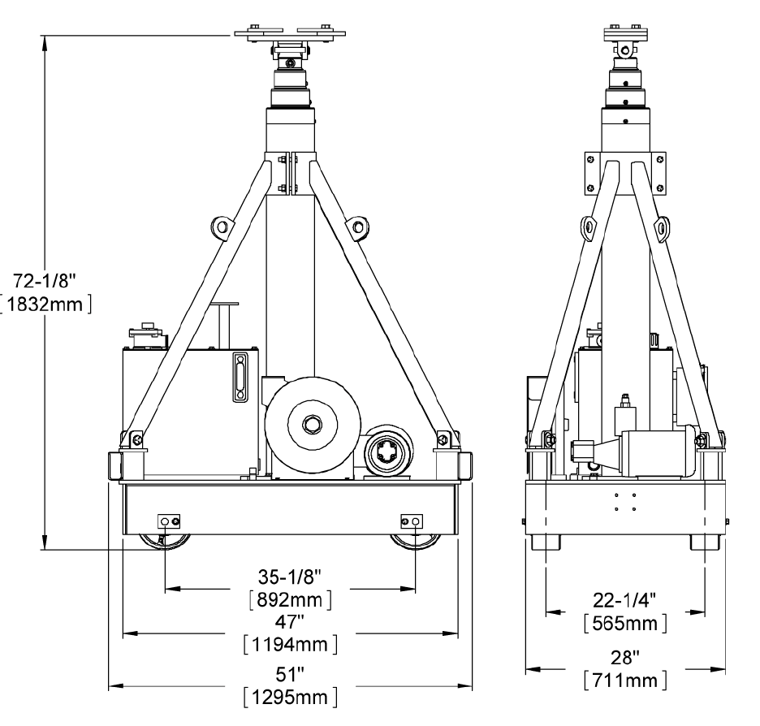
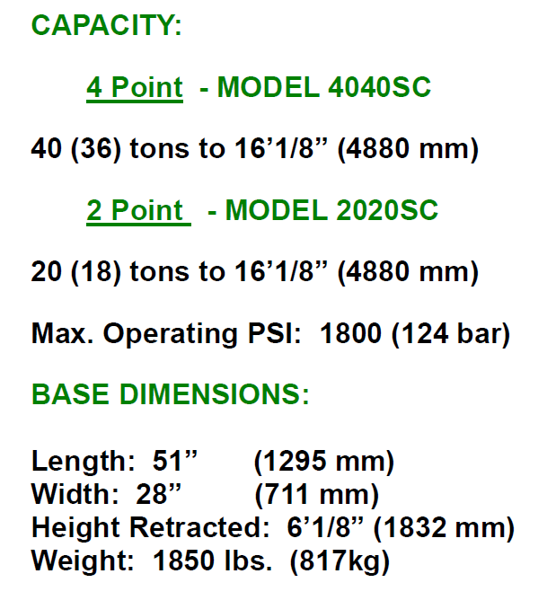
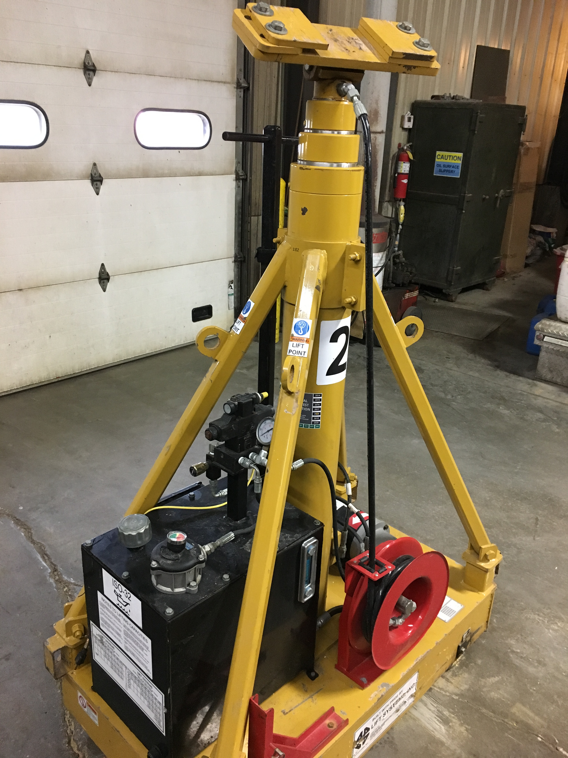
LIFT SYSTEMS, INC GANTRY RENTAL

