Slide 1
Using GPUaaS in LArSoft with the NuSONIC inference client interface
Michael Wang
LArSoft Coordination Meeting
24 August 2021

Slide 2
Introduction
The past few years have seen a sharp increase in the use of deep learning algorithms in LArTPC based experiments, which is understandable because the data are essentially images that are well suited to a DL approach.
Unfortunately, the CPU-centric grid worker nodes on which offline reconstruction is performed are ill-suited for DL algorithms, because CPU architectures are terribly inefficient for DL inference tasks.
The result is a dramatic increase in the computational workload of LArTPC reconstruction workflows, with DL algorithms responsible for a significant fraction.
An obvious solution is to use accelerator hardware like GPUs that are purpose built for DL applications. But the question is how?
In this presentation, we describe the practical approach of deploying GPUs “as a Service” (GPUaaS). We will show you how to do this using the latest tools available in LArSoft.

Slide 3
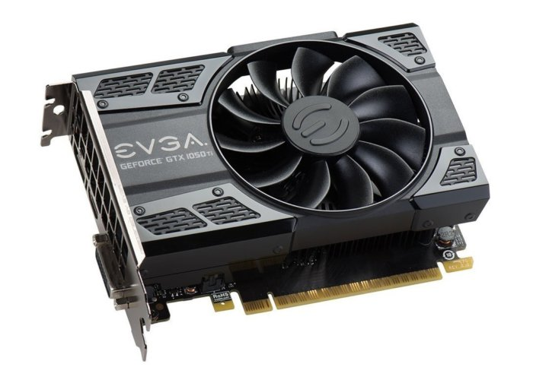
Naïve solution: deploy GPUs on every worker node
Cloud computing cluster
+
Assuming a moderately sized cluster with 100 nodes:
Even with low to mid-range “gamer-class” GPUs,
easily cost $20k-30k
Increased hardware and software maintenance
Increased power and cooling requirements
Inefficient use of GPU resources
Less flexible and more costly to upgrade or replace
+
+
Worker node
+ GPU

Slide 4
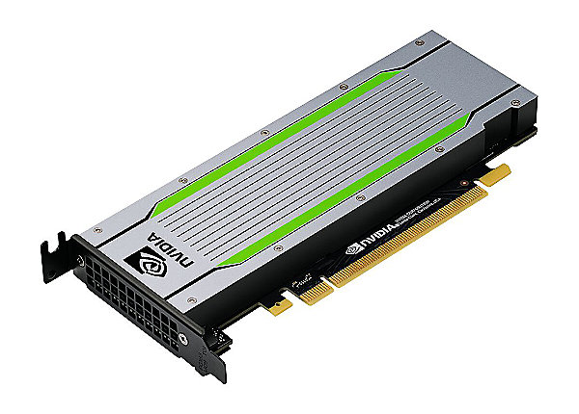
Alternative: GPU as a Service (GPUaaS)
Cloud computing cluster
+
Triton inference server
+
+
Worker nodes send inference requests to
and receive results from a machine equipped
with a GPU, running Nvidia’s free, off-the-shelf
Triton Inference Server
+
Worker node
+ GPU

Slide 5
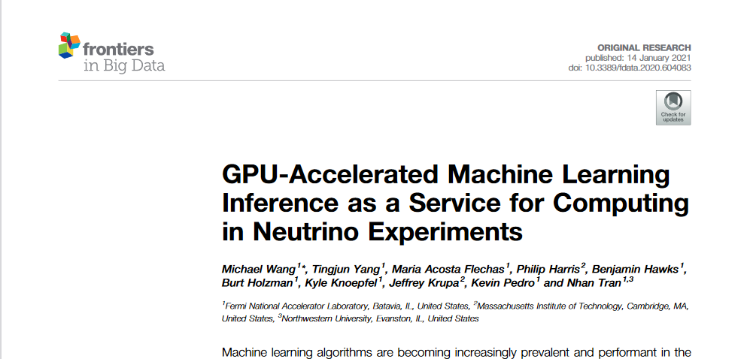
GPUaaS approach actually works!
In the past year, we have demonstrated a proof-of-principle by applying GPUaaS to the EMTrackMichelId module in the ProtoDUNE workflow. This module uses a CNN to classify hits as being shower-like, tracklike, or Michel electron like.
Details of the implementation including scaling studies using an inference server deployed on a 4-GPU Kubernetes cluster on the Google cloud platform are described in this paper:
Summary of results with MC ProtoDUNE events:
On CPUs: EmTrackMichelId module consumed 65% of entire workflow
With GPUaaS: module execution time reduced by 17x, from 330s to 123s
Overall event processing time reduced by 2.4x
Optimal processing achieved at a ratio of 68:1 simultaneous grid jobs per GPU.

Slide 6
Nu SONIC
For the ProtoDUNE proof-of-principle in the previous slide, we used the Nvidia Triton C++ client library API directly in the relevant LArSoft code for EmTrackMichelId
Recently, we introduced the NuSONIC inference client library, which is a layer sitting on top of the Triton C++ API:
  Based on CMSSW’s SONIC (Services for Optimized Network Inference on Coprocessors), essentially a pared down version retaining only components most relevant for LArSoft
  Higher level interface that abstracts away Triton specific details, making it easier to use
  Insulates the LArSoft user from future updates to the Triton API, simplifying maintenance
  Found in LArSoft since v09_27_00, specifically since larrecodnn v09_08_00
In the following slides, we demonstrate how to use it in LArSoft code, once again, with EmTrackMichelId as an example application.

Slide 7
Prerequisites for using Nu SONIC
Server side:
Must have an Nvidia Triton inference server running:
  Either locally on computer, in a docker container for example
  Or remotely on a dedicated server
Machine learning model for your algorithm must be available in the model repository of the Triton inference server
  Must be configured in a specific way and we will provide instructions on how to do this later on in these slides

Slide 8
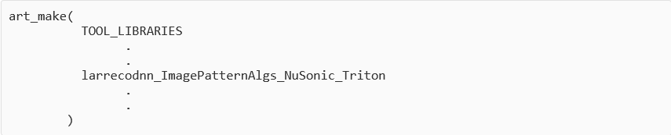
Prerequisites for using NuSonic
Client side software:
Modify the CMakeLists.txt file to include line for NuSonic Triton library:
Include the following header in your code:

Slide 9
Four basic steps in using NuSonic client in code
Once the requirements in the previous slides are satisfied, implementing an inference client in your code with NuSonic involves only the following 4 simple steps:
  Creating the client
  Describe or prepare the data for the corresponding model input
  Send the inference request to the server
  Retrieve the inference results from the server

Slide 10
Step 1: client constructor
Step 1: create a Triton client by constructing a lartriton::TritonClient object:
The argument for the constructor is a fhicl::Parameter set with the user-specified parameters described on the next slide.

Slide 11
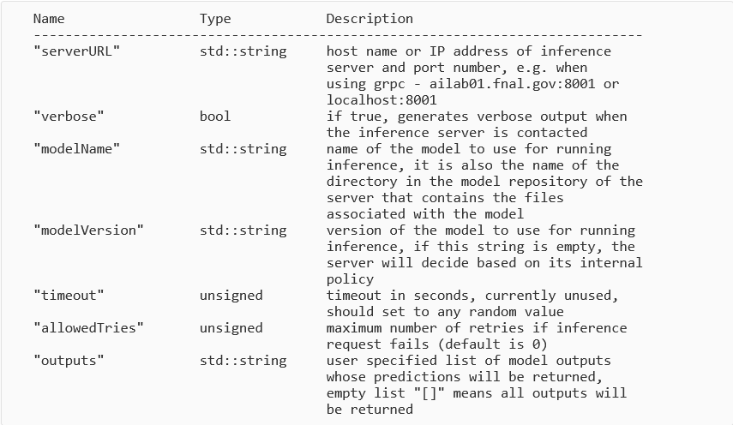
Step 1: client constructor (continued)

Slide 12
Step 2: Preparing the data
Set the batch size
Create a lartriton::TritonInput container of the appropriate data type for the model and reserve enough capacity for the specified batch size:

Slide 13
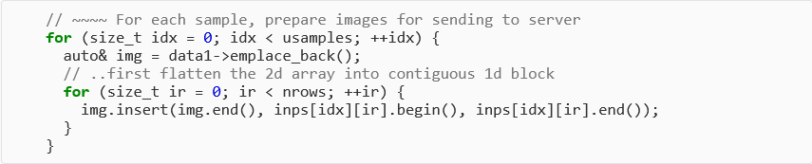
Step 2: Preparing the data (continued)
Fill each element of container with flattened 1D representation of image:

Slide 14
Step 2: Preparing the data (continued)
Get the TritonInputData instance associated with the model input to which data will be sent:
Convert data into native format of the inference server:

Slide 15
Step 3: Send the inference request to the Triton server
Send the entire batch of images prepared in the previous step to the server with the dispatch method of the Triton client:
And wait for the blocking call above to return …

Slide 16
Step 4: Retrieving the results
Once the dispatch call in the previous step returns successfully, the predictions can be retrieved by name for any output through the TritonOutputData object:
The results need to be converted from the native format of the server back into the data type associated with each output:

Slide 17
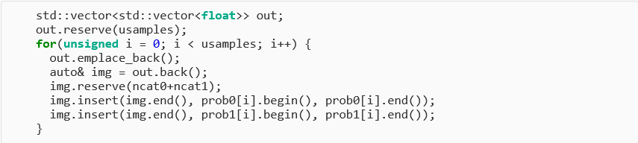
Step 4: Retrieving the results
Get the number of classifications or categories associated with each output:
Get predictions for each classification/category in each output for every image in the batch. In this example, we store these results in a 2D vector:
Loop over images in batch
Make enough room for all categories in all outputs
1st output
2nd output

Slide 18
Resetting the client
Before repeating the 4 steps described above for a new batch of images, you will need to reset the Triton client. This will re-initialize all TritonInputData instances by clearing out any values set by previous calls in the data preparation phase:

Slide 19
Model repository on the inference server
The ML model used to perform the inference must be installed in the model repository of the inference server. In our example server, the root directory of this repository is “/models”. Each model is installed in a subdirectory of its own. For example, the EmTrackMichelId model is in “cnn_emtrkmichel_1”:
[mwang@ailab01 models]$ pwd
/models
[mwang@ailab01 models]$ ls
cnn_emtrkmichel_1 densenet_onnx particlenet_AK8_MassRegression
deepcalo facile_all particlenet_AK8_MD-2prong
deepmet facile_all_v2 pseudofacile
deeptau_core facile_plan pseudofacile_plan_10k
deeptau_ensemble facile_plan_10k pseudofacile_tf
deeptau_inner facile_tf resnet50
deeptau_nosplit inception_graphdef simple
deeptau_outer particlenet
deeptau_python particlenet_AK4
[mwang@ailab01 models]$ ls -R cnn_emtrkmichel_1/
cnn_emtrkmichel_1/:
1 config.pbtxt labels_em_trk_none.txt labels_michel.txt
cnn_emtrkmichel_1/1:
model.graphdef

Slide 20
Directory structure & naming conventions for model repository
The name of the subdirectory containing all the files associated with the model is what you use to identify which model to use when constructing the NuSonic Triton inference client. The modelName fhicl parameter passed to the Triton client constructor is set to this subdirectory name. For the EmTrackMichelId example, modelName should be set to “cnn_emtrackmichel_1”
Under the main subdirectory for a particular model are additional subdirectories for different versions of the model specified by a numeric value that does not begin with zero. For our example, there is only one version (version 1) of the model, thus we have a subdirectory named “1” as in “cnn_emtrkmichel_1/1”
In our example, the model is contained in a frozen tensorflow “graphdef” with extension .pb. We copied this frozen graphdef with extension .pb from the dune_pardata area to the cnn_emtrackmichelid_1/1 subdirectory, and renamed it model.graphdef, which the inference server expects by default.

Slide 21
Installing the model in the repository
Took the frozen .pb tensorflow graphdef of the CNN from dune_pardata …
mwts{mwang}1029% pwd
/products/dune_pardata/v01_54_01/CnnModels
mwts{mwang}1030% ls
cnn_emtrkmichel_pitch_5_wire_44_drift_48_down_6_mean_notes_protoduneBeamAndCosmics_calib_cascadedouts.pb
cnn_emtrkmichl_pitch_5_wire_48_drift_48_down_6_mean_notes_protoduneBeamAndCosmicsMCC11.pb
cnn_ndkemtrk_pitch_5_wire_44_drift_48_down_6_mean_notes_AtmAndNdk.nnet
pdune_em-trk-michel_clean_on_neutrinos_iter100_aw.nnet
README
README~
mwts{mwang}1029% pwd
/products/dune_pardata/v01_54_01/CnnModels
mwts{mwang}1030% ls
cnn_emtrkmichel_pitch_5_wire_44_drift_48_down_6_mean_notes_protoduneBeamAndCosmics_calib_cascadedouts.pb
cnn_emtrkmichl_pitch_5_wire_48_drift_48_down_6_mean_notes_protoduneBeamAndCosmicsMCC11.pb
cnn_ndkemtrk_pitch_5_wire_44_drift_48_down_6_mean_notes_AtmAndNdk.nnet
pdune_em-trk-michel_clean_on_neutrinos_iter100_aw.nnet
README
README~
… and copied it into the /models repository
on ailab01.fnal.gov,
renaming it to
model.graphdef:
[mwang@ailab01 models]$ pwd
/models
[mwang@ailab01 models]$ ls -R cnn_emtrkmichel_1/
cnn_emtrkmichel_1/:
1 config.pbtxt labels_em_trk_none.txt labels_michel.txt
cnn_emtrkmichel_1/1:
model.graphdef
[mwang@ailab01 models]$ pwd
/models
[mwang@ailab01 models]$ ls -R cnn_emtrkmichel_1/
cnn_emtrkmichel_1/:
1 config.pbtxt labels_em_trk_none.txt labels_michel.txt
cnn_emtrkmichel_1/1:
model.graphdef

Slide 22
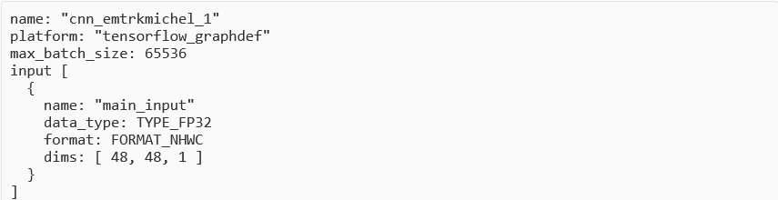
Anatomy of the config.pbtxt file
In the main subdirectory for the model is a “config.pbtxt” file (refer to bash shell output on slide 17). This file describes the detailed properties of the model.
Let’s take a closer look at the config.pbtxt file for the EmTrackMichelId CNN:
modelName
Model backend: tensorflow, Model format: graphdef
Max number of images per batch
Name of the CNN’s input
Datatype expected at input: TYPE_FP32==DT_FLOAT
Format of input data: N: # batches, H: height, W: width, C: channels
Dimensions: H=48, W=48, C=1

Slide 23
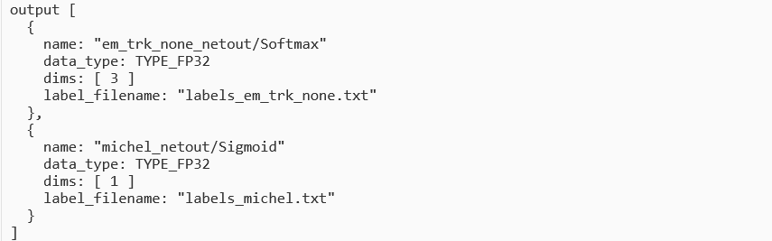
Anatomy of the config.pbtxt file
Output section:
First output
Output name
Output datatype
Number of output categories
Name of file containing output
category names
Second output

Slide 24
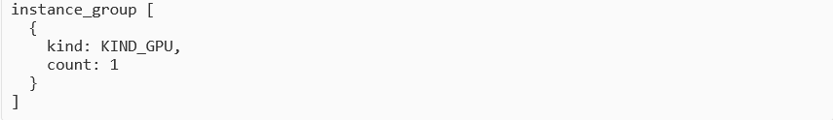
Anatomy of the config.pbtxt file
Instance group section:
Type of available hardware resource
Number of model instances to run on the hardware resource

Slide 25
Anatomy of the config.pbtxt file
At the same directory level as the config.pbtxt file are the “labels” files that contain the names of each category in an output (refer to slide 21).
Our example has one 3-category output (em_trk_none_netout/Softmax) and one single category output (michel_netout/Sigmoid):
[mwang@ailab01 cnn_emtrkmichel_1]$ pwd
/models/cnn_emtrkmichel_1
[mwang@ailab01 cnn_emtrkmichel_1]$ ls
1 config.pbtxt labels_em_trk_none.txt labels_michel.txt
[mwang@ailab01 cnn_emtrkmichel_1]$ cat labels_em_trk_none.txt
track
em
none
[mwang@ailab01 cnn_emtrkmichel_1]$ cat labels_michel.txt
michel

Slide 26
Conclusion
We have demonstrated how to take advantage of the NuSonic inference client libraries in your LArSoft applications to greatly simplify the use of GPUaaS in order to perform inference tasks more efficiently
For more details, please refer to the NuSonic documentation in the LArSoft redmine wiki pages:
https://cdcvs.fnal.gov/redmine/projects/larsoft/wiki/_GPU_as_a_Service_

Slide 27
End

