Slide 1
The Snowmass Energy Frontier
Snowmass Day
September 24, 2021
Laura Reina (FSU), Meenakshi Narain (Brown U.), Alessandro Tricoli (BNL)
Snowmass Day, Sept 24, 2021

Slide 2
Energy Frontier Restart
2020
2021
Energy Frontier Kick-off Meeting, May 21, 2020, see agenda
Energy Frontier Workshop “Open Questions and New Ideas”, July 20-22, 2020, with Panel discussion on “The importance of the Energy Frontier in the US HEP future planning” (Zoom recording of Panel Discussion)
EF slowed down activities in 2021 until June
Community continued to work collaboratively
Monte Carlo production activities continued to support the needs of EF
Occasional and informal Topical Group ‘conversations’ to assure scientific continuity and support of ongoing activities
EF Restart Workshop, Aug. 30-Sept. 3:https://indico.fnal.gov/event/49756/
Many interesting talks in plenary and parallel sessions
Joint parallel sessions with CompF and CF
Unstructured discussion sessions with CEF and AF
Regroup after the few months of slowdown/pause of Snowmass activities
Assess progress made so far
Share new studies that may have been started in the meantime
Identify gaps in our strategies
Update the community with schedule, goals and plans towards the final reports in summer 2022
Snowmass Day, Sept 24, 2021

Slide 3
The Energy Frontier Group (I)
EF Convenors: Laura Reina (FSU), Meenakshi Narain (Brown U.), Alessandro Tricoli (BNL)
Ten Topical Groups (TGs):
Topical Group | Co-Conveners
EF01: EW Physics: Higgs Boson properties and couplings | Sally Dawson (BNL), Andrey Korytov (U Florida), Caterina Vernieri (SLAC)
EF02: EW Physics: Higgs Boson as a portal to new physics | Patrick Meade (Stony Brook), Isobel Ojalvo (Princeton)
EF03: EW Physics: Heavy flavor and top quark physics | Reinhard Schwienhorst (MSU), Doreen Wackeroth (Buffalo)
EF04: EW Physics: EW Precision Physics and constraining new physics | Alberto Belloni (Maryland), Ayres Freitas (Pittsburgh), Junping Tian (Tokyo)
EF05: QCD and strong interactions: Precision QCD | Michael Begel (BNL), Stefan Hoeche (FNAL), Michael Schmitt (Northwestern)
EF06: QCD and strong interactions: Hadronic structure and forward QCD | Huey-Wen Lin (MSU), Pavel Nadolsky (SMU), Christophe Royon (Kansas)
EF07: QCD and strong interactions: Heavy Ions | Yen-Jie Lee (MIT), Swagato Mukherjee (BNL)
EF08: BSM: Model specific explorations | Jim Hirschauer (FNAL), Elliot Lipeles (UPenn), Nausheen Shah (Wayne State)
EF09: BSM: More general explorations | Tulika Bose (U Wisconsin), Zhen Liu (Maryland), Simone Pagan-Griso (LBL)
EF10: BSM: Dark Matter at colliders | Caterina Doglioni (Lund), LianTao Wang (Chicago), Antonio Boveia (Ohio State)
NEW
Monte Carlo Task Force and Production Team: coordinated by John Stupak (U. Oklahoma)
1) Assess the MC needs ⇒ “Task force” (work completed)
2) Produce MC samples ⇒ “Production Team” (ongoing)
Snowmass Day, Sept 24, 2021

Slide 4
Topical Group Activities
EW Topical Groups
EF01, EF02, EF03, EF04
QCD & Strong Interact.
Topical Groups
EF05, EF06, EF07
General Energy Frontier Wiki
Electroweak TGs
EF01, EF02, EF03, EF04
QCD and Strong Interaction TGs
EF05, EF06, EF07
BSM TGs
EF08, EF09, EF10
BSM Topical Groups
EF08, EF09, EF10
Other
Frontiers
Other
Frontiers
Other
Frontiers
Multiple Ongoing Activities
See Topical Group Wiki pages and indico meeting agendas for details of ongoing activities
EF calendar and communications via mailing lists and Slack
Snowmass Day, Sept 24, 2021

Slide 5
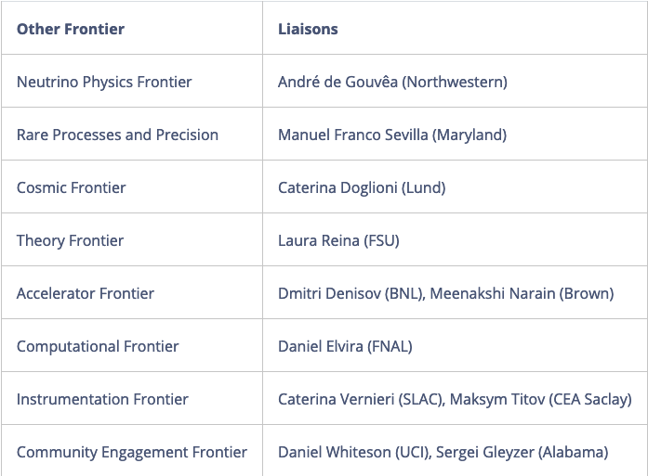
The Energy Frontier Group (II)
NEW
Liaisons: high-level and bi-directional communication b/w Frontiers
Renew interest in Snowmass community for Muon Collider:
Muon Collider Forum established with Accelerator and Theory Frontiers → Wiki (new)
Muon Collider Forum Coordinators
EF: Kevin Black (U. Wisconsin-Madison), Sergo Jindariani (Fermilab)
AF: Derun Li (LBNL), Diktys Stratakis (Fermilab)
TF: Patrick Meade (Stony Brook U.), Fabio Maltoni (Louvain U., Bologna)
Snowmass Day, Sept 24, 2021

Slide 6
The Energy Frontier Group (III)
Snowmass thrives on the participation of Early Career (EC) physicists and offers an ideal environment for young people to get involved and promote their own initiatives
Early Career Representatives
Grace Cummings (U. Virginia) - gec8mf@virginia.edu
Matt LeBlanc (U. Arizona) - matt.leblanc@cern.ch
EC leadership is for a 3-month term (staggered): Grace and Matt are current EF representatives
Get in touch especially if you want to get involved in EF activities, but need guidance how to do it effectively: Grace and Matt will help build bridges between projects and new collaborators
Additional Snowmass resources for Early Careers:
#snowmass-young and #welcome-to-snowmass as points of entry for newcomers
The Snowmass Early Career twiki, which includes a description of our structure, current leadership, and the SEC calendar of all events.
Snowmass Day, Sept 24, 2021

Slide 7
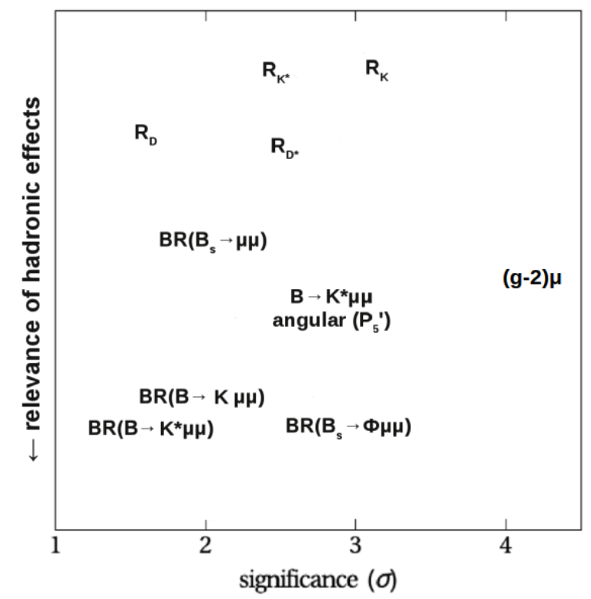
Probing the energy scale for new physics
Landscape changed since we started Snowmass → Evidence of the breaking of the SM in the lepton flavor sector?
by Wolfgang Altmannshofer
Patrick Meade
Broad reach of Collider physics: colliders are needed to test models across a broad range of observables
Unique complementarity between electroweak precision fits and flavor observables etc.
Snowmass Day, Sept 24, 2021

Slide 8
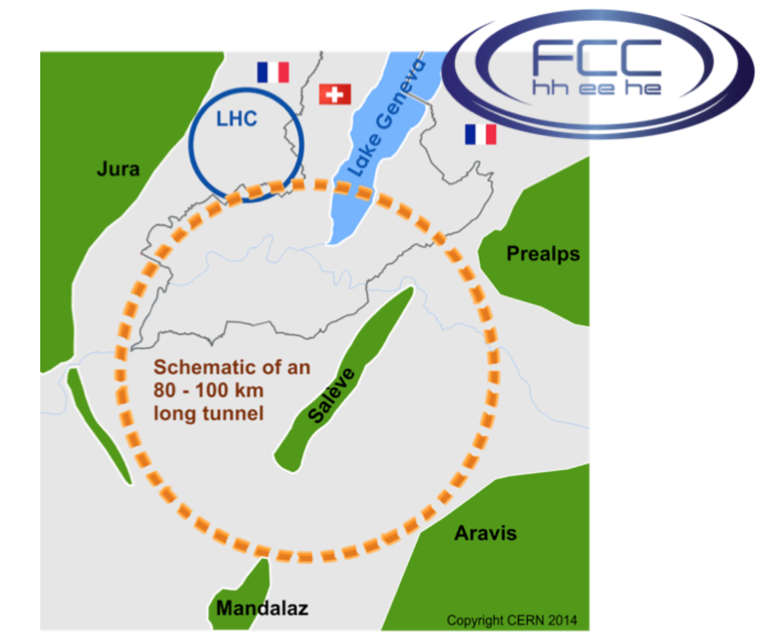
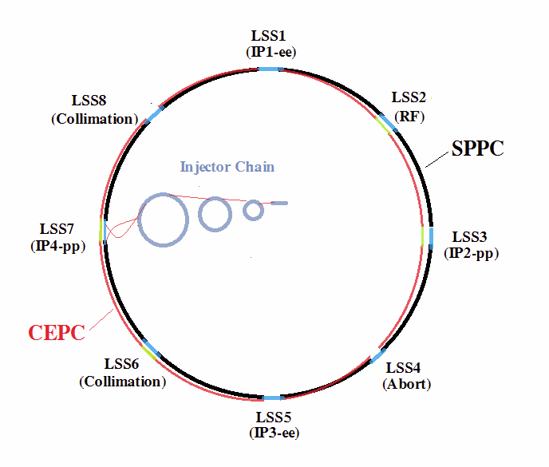
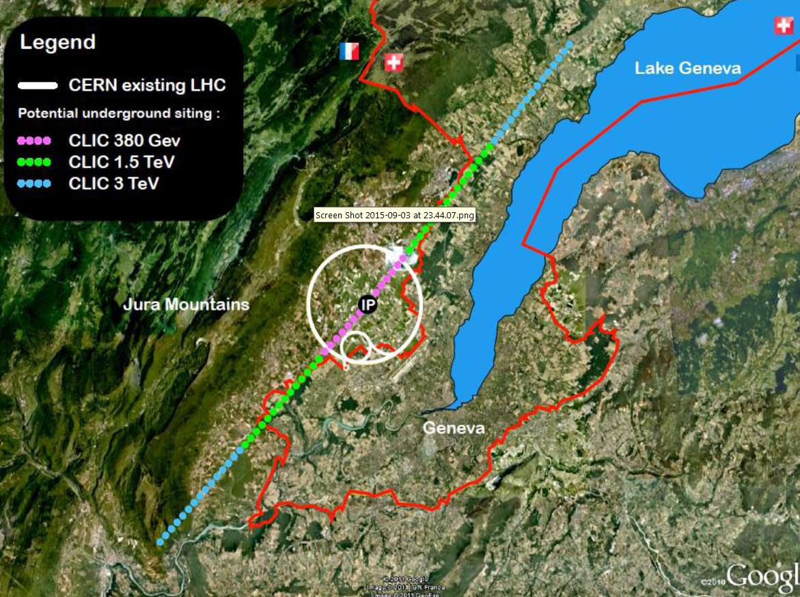
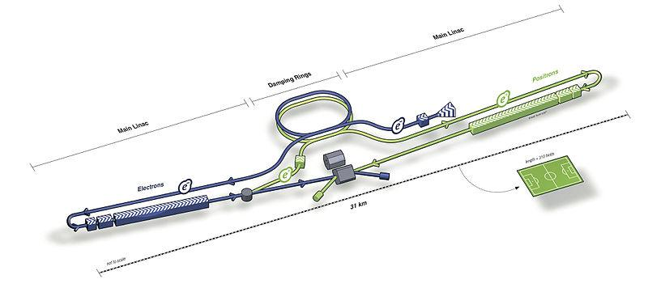
Which machines?
Muon Collider
- e⁺e⁻
- hadron-hadron
- hadron-electron
FCC
CEPC SppC
ILC
CLIC
LHeC
gamma-gamma colliders?
Snowmass Day, Sept 24, 2021

Slide 9
Activities and Timeline
Broad effort of LOI solicitation through dedicated Topical Group meetings
- 376 received - see list here
- 268 have EF as primary
- Cross-frontier LOIs: TF (21), AF (20), IF(17), RF (16), CF (14), NF (11), CompF (9)
LOIs have contributed to shaping Topical Group activities
- see breakout sessions of the Community Planning Meeting (CPM), Oct 5-8, 2020
1/21-6/21 Activity Slowdown | 6/30/21 Restart of Activities | 7/12/21 DPF Meeting + Snowmass Townhall | 8/30/21 EF restart Workshop | 9/24/21 Snowmass day | 3/15/22 Deadline Contributed Paper Submission | 5/31/22 Prelim. TG Reports | 6/30/22 Prelim. Frontier Reports | 7/22 Community Summer Study (UW-Seattle) | 9/30/22 Final Reports | 10/31/22 Snowmass Book & ArXiv docs
Winter 2021-2022: few one-day virtual EF workshops by topic (SM, Higgs, BSM, Colliders,…)
Check progress towards March deadline for contributed papers
Discuss overlap with other frontiers
Spring 2022: EF workshop to review contributed papers
Focus on main themes and messages by contributed papers, towards May deadline for TG reports.
Converge on summary plots and other contributions involving multiple TGs or multiple frontiers
March-July 2022: circulations of preliminary TG and EF reports, then public readings
Snowmass Day, Sept 24, 2021

Slide 10
Summary
Ambitious Energy Frontier plans to pave the way towards addressing big questions
Cross-fertilization across fields (Theory, Cosmics, Accelerators, Instrumentation etc.)
Anomalies in related fields require dedicated and long-term effort in the EF to confirm new physics and unveil their origins
Energy Frontier activities have taken off in 2020, and have already restarted at full steam
Great interest and response from national and international community (numerous LOIs, and ongoing contributions)
EF organization carries on from 2020 with few additions, Strategic plans have been laid out, Connection with other frontiers is established, Early Career representation is active, Monte Carlo sample production has started, Studies are on-going
Plenty of time to join activities, propose new studies and address the many open questions
Join the EF Parallel session! today 2:30 pm - 5:00 pm (EDT)
TG Highlights given by Early Career speakers
An Early Career perspective to EF activity and highlight of EC studies
Snowmass Day, Sept 24, 2021

Slide 11
Backup
Snowmass Day, Sept 24, 2021

Slide 12
Big Picture Questions
Why is physics at the energy frontier important?
How should the US be involved in near future and far future energy-frontier machines after HL-LHC?
What could be the energy-frontier machines that follow the HL-LHC?
How can the US continue to play a leadership role in energy-frontier experiments?
How can the Snowmass process help develop a plan for the energy-frontier research and convince the community about our priorities?
Should we start entertaining the idea of a future collider in the US again? If so, what are our goals, the benefits for the US and the international community, and how can we get there?
etc...
Energy Frontier Kick-off Meeting on May 21, 2020, see agenda
These questions were discussed in the Panel: “The importance of the Energy Frontier in the US HEP future planning” at the “Energy Frontier Workshop - Open Questions and New Ideas”, July 20-22, 2020
By Jorgen D'Hondt, Nima Arkani-Hamed, Sarah Eno, Vladimir Shiltsev, Xinchou Lou, Young-Kee Kim
See Zoom recording of Panel Discussion
Snowmass Day, Sept 24, 2021

Slide 13
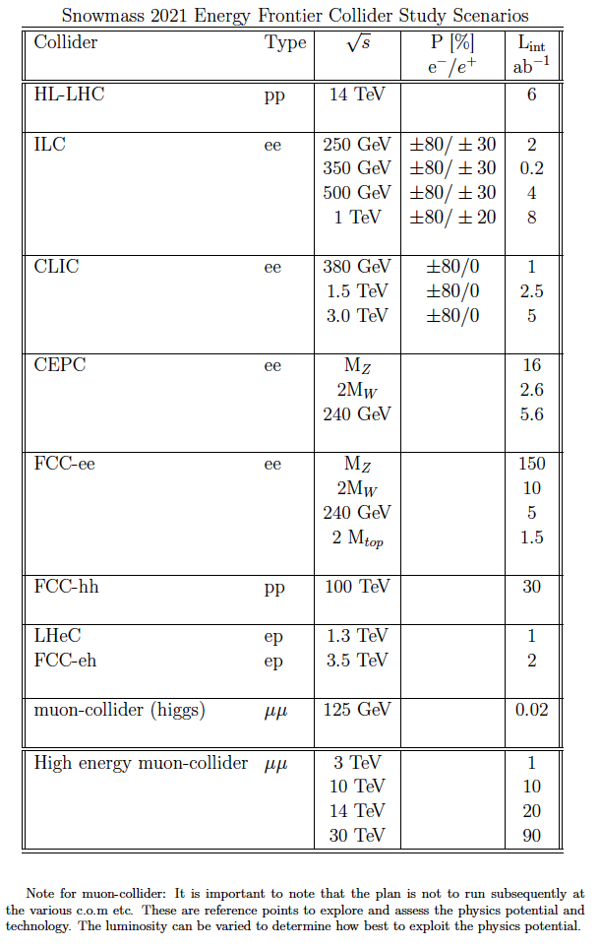
Accelerator Benchmark Parameters
Other options to explore:
Muon collider at a very high energy ( >30 TeV?)
FCC pp >150 TeV? and ~75 TeV documenting sensitivity loss
Very high energy e+e- collider
Other emerging ideas:, e.g. γ-γ collider, and the C³ e⁺e⁻ collider [C³=Cool Copper Collider]
Snowmass Day, Sept 24, 2021

