Slide 1
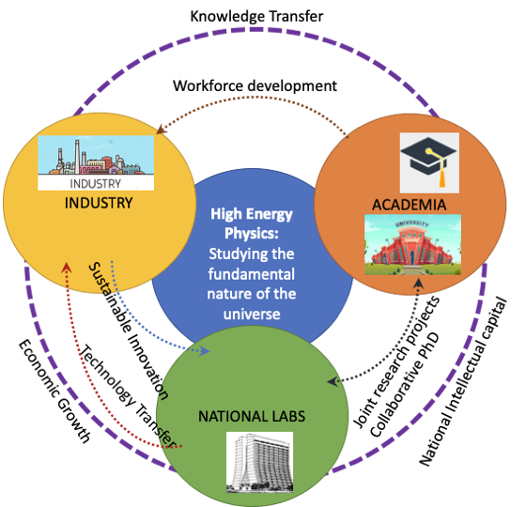
CommF1: Applications and Industry
Farah Fahim, Alex Murokh, Koji Yoshimura

Slide 2
White papers currently under development
Engaging Scaleups (Lead: Ash Ravikumar, CERN)
Tech transfer from National Labs (Lead: Mauricio Suarez, Fermilab)
Application-driven engagement with universities leveraging synergies with other funding agencies (Lead: Jim Hoff, Fermilab, Seda Memik, Northwestern University)
Big Industry engagement to benefit HEP: Microelectronics Support from large CAD companies (Lead: Shaorui Li)

Slide 3
A&I TG areas of interest
Application and Industry topical group is considering the relationship between HEP laboratories, Universities, and Industrial stakeholders. In particular, there are two objectives under consideration:
how to maximize the HEP funded research outcomes which benefit practical applications, and
how to better engage the industrial technology base in support of the long term HEP facilities needs.
The following two white papers serve as examples.

Slide 4
WP: Nurturing the Industrial Accelerator Technology Base in the US
Lead author: Alan Todd, ammtodd@gmail.com
Status: workshop held, WP 50% completed
The purpose of this white paper is to discuss the importance of having a world class domestic industrial vendors base, capable of supporting the needs of the accelerator facilities, and necessary steps to support and develop such base in the United States. The paper focuses on the economic, regulatory, and policy-driven barriers and hurdles, which presently limit the depth and scope of the broader industrial participation in the accelerator construction projects, discusses international competition landscape, and steps to improve the strength and vitality of the domestic industrial sector in this field.

Slide 5
WP: FLASH Radiation Therapy
Lead author: Reinhard Schulte, rschulte@llu.edu
Status: workshop held, put together a WP working group
The purpose of this white paper is to discuss challenges and opportunities in the emerging field of FLASH radiation therapy (FLASH-RT). FLASH-RT refers to ultra-high dose rate delivery of therapeutic radiation doses within microseconds to a fraction of a second. At these dose rates, radiation-induced side effects are greatly reduced, but tumors are not spared. The white paper will cover promising advances in the accelerator and detector technologies, which could potentially accelerate the development and practical realization of FLASH-RT.

