Slide 1
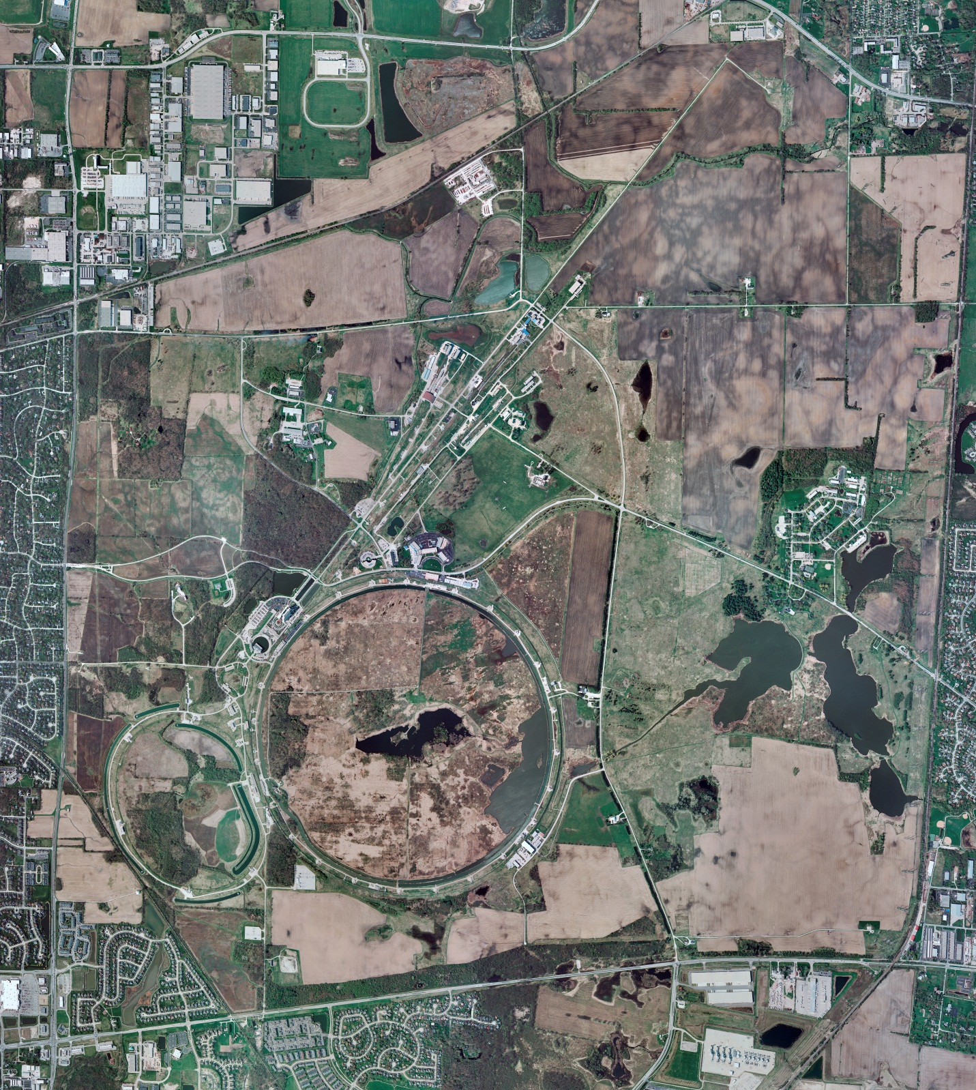
Helium Cryogenics
Status 8/20/2021 J.Makara
CMTF: SCP cryo system was warmed up, shut down, and isolated for LN2 HX work and other maintenance
CMTS: 1.3 GHz HEvCM at RT
PIP2IT: SSR1 at RT
MCTF: cryo system at RT and shut down/isolated except LN2 Tank cold
MDB/HTS: at RT
MDB/STC: at RT
MDB Magnet: at RT
NML/FAST: Mycom comprs online to Fridges running fine; Frick compr running low capacity thus whole cryo is on Purifier system
CC1/CC2/CM: CC1 is cold at 2 K; CC2 cold at 5-60 K as not being used; CM at 2 K
IB1: cryo system running fine with test stands at 2 K and 4 K
HAB: BA comprs and Fridge shut down at RT and isolated; only LN2 Tank still cold but isolated
STF: isolated and not active
Muon Campus: A0 comprs (3) online with MC-1 g-2 cryogenic system at 80 K for purification and maintenance (feeders 46A and 45 planned power outages went well); anticipated cooldown next week.
MISC:

