Slide 1
Facility Overview: Performance and Upgrades
Dan Broemmelsiek
FAST/IOTA Collaboration Meeting
27 October 2021

Slide 2
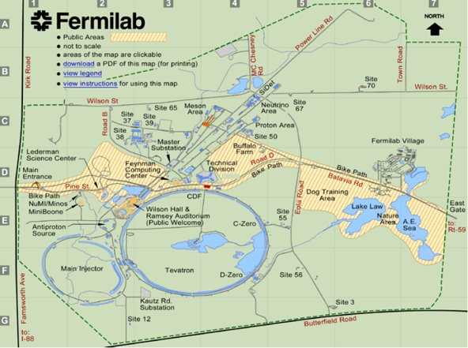
Location
NML
Northern Most Lab
No Man’s Land
No More Letters
Ninety Meters Long
Lab 7
Cathode Prep
NML
FAST
Lab 7

Slide 4
A Brief History​
Advanced Accelerator R&D Facility (AARD)​
Test and operate a full ILC “RF unit” with “ILC beam intensity”. ​
An RF unit consists of 3 ILC cryomodules driven by a single 10 MW klystron. ​
ILC beam intensity is 3.2 nC/bunch @ 3 MHz in a 1 msec long pulse (3000 bunches), with a 5 Hz repetition rate. The RMS bunch length is 300 mm.
Advanced Superconducting Test Accelerator (ASTA)​
New Muon Lab (NML, actually NMS) renamed to NML​
FAST is a Fermilab “Facility for Accelerator Science and Technology”​
Not a DOE Users Facility​
Injector for Integrable Optics Test Accelerator (IOTA)​
Prioritize IOTA -> IOTA/FAST

Slide 5
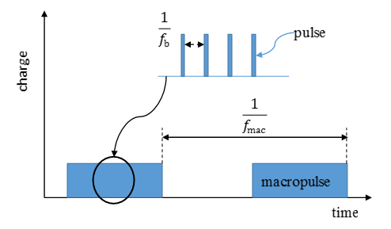
Electron Linac
The lectron injector comprises a number of components, including a 5 MeV electron RF photoinjector, a 25-meter-long low energy (≤50 MeV) beamline and a ~100-meter-long high energy (≤300 MeV) beamline.
Parameter | Value
Beam Energy | 20 MeV – 300 MeV
Bunch Charge | < 10 fC – 3.2 nC per pulse
Bunch Train (Macropulse) | 0.5 – 9 MHz for up to 1 ms (3000 bunches, 3 MHz nominal)
Bunch Train Frequency | 1 – 5 Hz
Bunch Length | Range: 0.9 – 70 ps (Nominal: 5 ps)
Bunch Emittance 50 MeV, 50 pC/pulse | Horz: 1.6 ± 0.2 μm Vert: 3.4 ± 0.1 μm
JINST 12 T03002—2017, S. Antipov, D. Broemmelsiek, D. Bruhwiler, et al

Slide 6
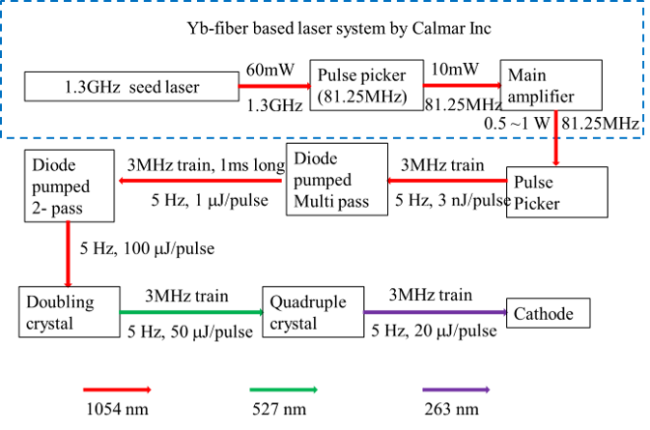
Laser

Slide 7
Laser Capabilities/Upgrades​
Working with vendor to improve IR amplifier.
Nominal laser bunch train is at 3MHz. 9MHz is tested inside laser room.​
Higher frequency is also possible with the current laser configuration. However, the pulse energy is expected to drop linearly with the frequency change.​
Current laser is operated at 1Hz.​
5Hz operation is tested for the system as well.​
Seed laser is at 1.3GHz.​
In principle it is possible to pick 2 bunches separated at integer number of spacing(~720ps) to do pump probe measurement.​
Have demonstrated pulse shaping (IPAC2015 MOPMA043)​

Slide 8
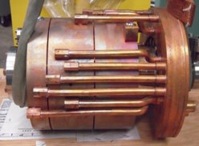
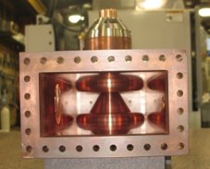
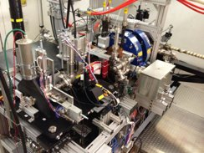
Electron Gun
1.3 GHz, normal conducting, 1.5 cell copper cavity (DESY/PITZ design)​
Up to 45 MV/m accelerating field at the cathode; requires 5 MW klystron; 20 KW average power at full ILC pulse length and repetition rate​
Cs2Te photocathode excited by 263 nm UV laser​
2 identical solenoids for emittance compensation​
Coaxial RF waveguide coupler ​
3 cavities have been fabricated​
1 by DESY – completed and shipped to Fermilab; 1st spare​
3 by Fermilab – 1 shipped to KEK; 1 completed and commissioned at NML; 1 as 2nd spare​

Slide 9
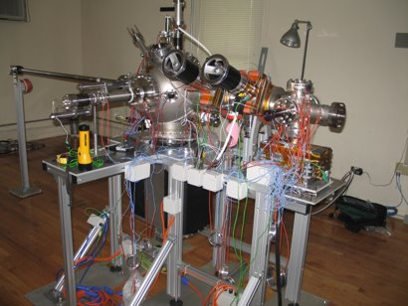
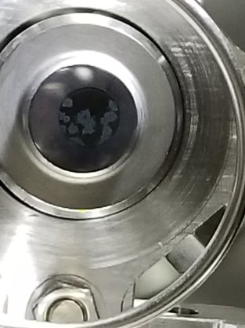
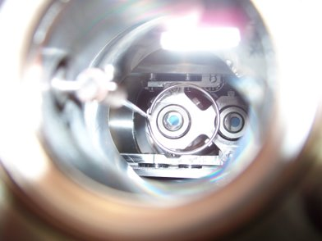
Cathode Preparation
Cathode chambers were fabricated at INFN Milano, Daniele Sertore​
Preparation chamber​
Transport chamber​
Transfer chamber​
Newborn
vs.
6 year old ​
Cathode preparation chamber at Lab 7​

Slide 10
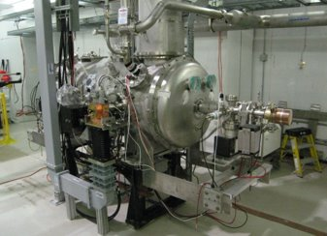
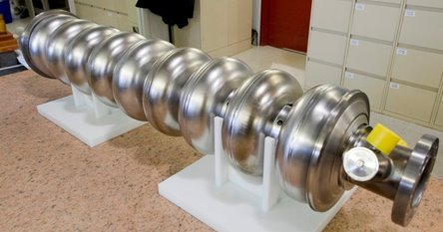
Capture Cavities
Two 1.3 GHz 9-cell SRF cavities​
CC1 at 27.5 MV/m​
CC2 at 17 MV/m​
Parameter scaling, spectrometer based beam energy > 50 MeV​

Slide 12
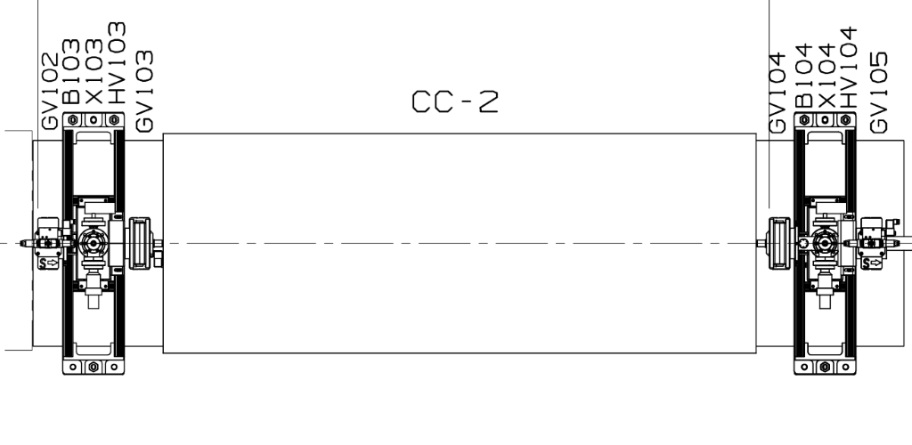
CC2 Tuner Refurbishment
1) Vent up the insulating vacuum of the cryostat.
2) Open side instrumentation flange to access cavity gate valve on the US end.
3) Follow attached procedure to close the US gate valve to isolate the beam line vacuum from the US end of the SRF cavity to the downstream (DS) end of the gate valve located just outside of Capture Cavity 1 (CC1) in the interconnect region.
4) Accelerator Division group (AD) will set up softwall cleanroom and remove all beam line components and tooling in the interconnect region between CC1 and CC2 to allow personnel access as well as US cryostat end dome removal.
5) AD will install a gantry crane spanning above the interconnect region that will allow cryostat end dome to be removed.
6) Attach properly rated eye-bolts to the top of the end dome and attach to gantry crane using properly rated slings.
7) Remove split rings at the beam line connecting the beam pipe to the end dome.
8) Remove all of the bolts on the end dome and using the gantry crane, carefully slide the end dome back (towards the interconnect region) until the dome clears the beam flange, set the dome aside.
9) Remove the flat end thermal shield to expose the cavity
10) Tuner Resonance Team will take baseline RF measurement
11) Disconnect Phytron tuner motor with harmonic drive and replace with upgraded Phytron motor with planetary gears.
12) Test run motor for operation and connect to RF monitoring cart to tune cavity to the proper "warm" frequency.
13) Reverse the order of the previous 12 steps to bring the CC2 cryostat back to operation.

Slide 13
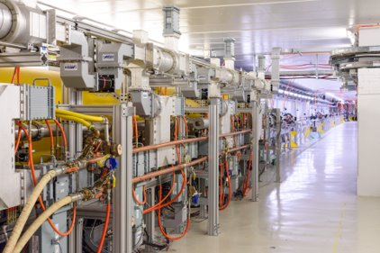
High Energy Beamline
CM commissioned. ILC goal reached. 250 plus MeV for beam.​
Some conditioning will be done in the upcoming run for long bunch train. Currently we did 500 bunches at 3MHz maximum.​
Several beam line locations are available for R&D.
Possible space for more R&D.​
Undulator​
High energy chicane​

Slide 14
Linac Dimensions
B
A
A – 16m in 8 x 2m vacuum segments
B – 2.8m
– Instrumentation Crosses
– New Instrumentation Cross for ~32m spacing after cryomodule

Slide 15
FAST Linac Instrumentation
BPM​
Capable of doing bunch by bunch monitoring at 3MHz ​
Can handle charge from 50pC to 3.2nC with different gain setting​
Transverse profile monitor​
Live display ​
Longitudinal profile measurement​
Streak camera ​
Ceramic gap (non-interruptive)​
Charge measurement​
Faraday cup, Wall current monitor​
HOM detector with Capture cavity and CM​

Slide 16
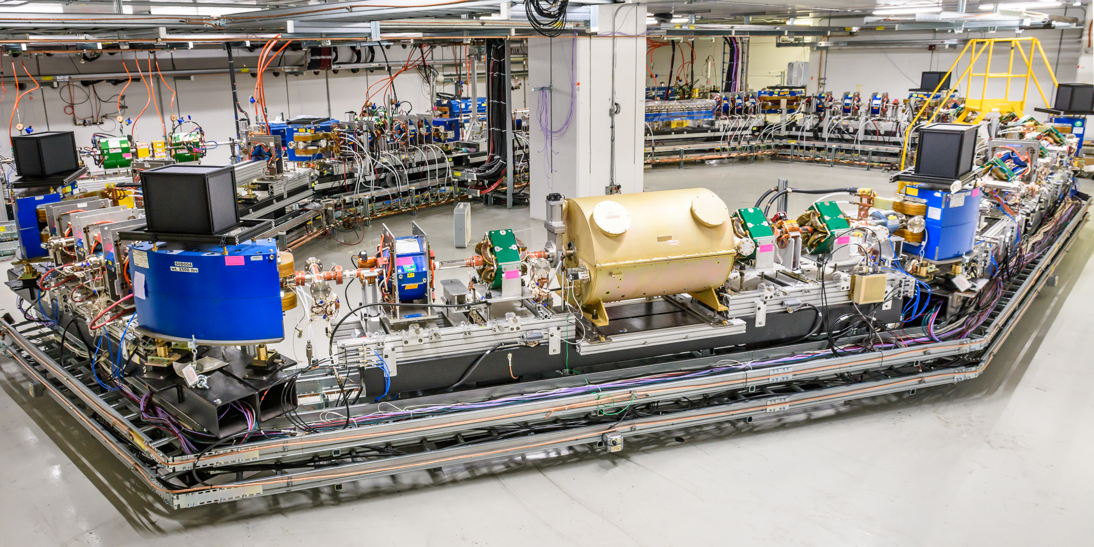
IOTA With Electrons
photo G.Stancari
Design momentum | 50-200 MeV
Perimeter | 40 m
RF voltage | 300 V
RF frequency | 30 MHz
3 Experimental sections | 2x180 cm, 1x150 cm
Main vacuum chamber aperture (R) | 25 mm
Lambertson and kickers aperture (R) | 20 mm

Slide 17
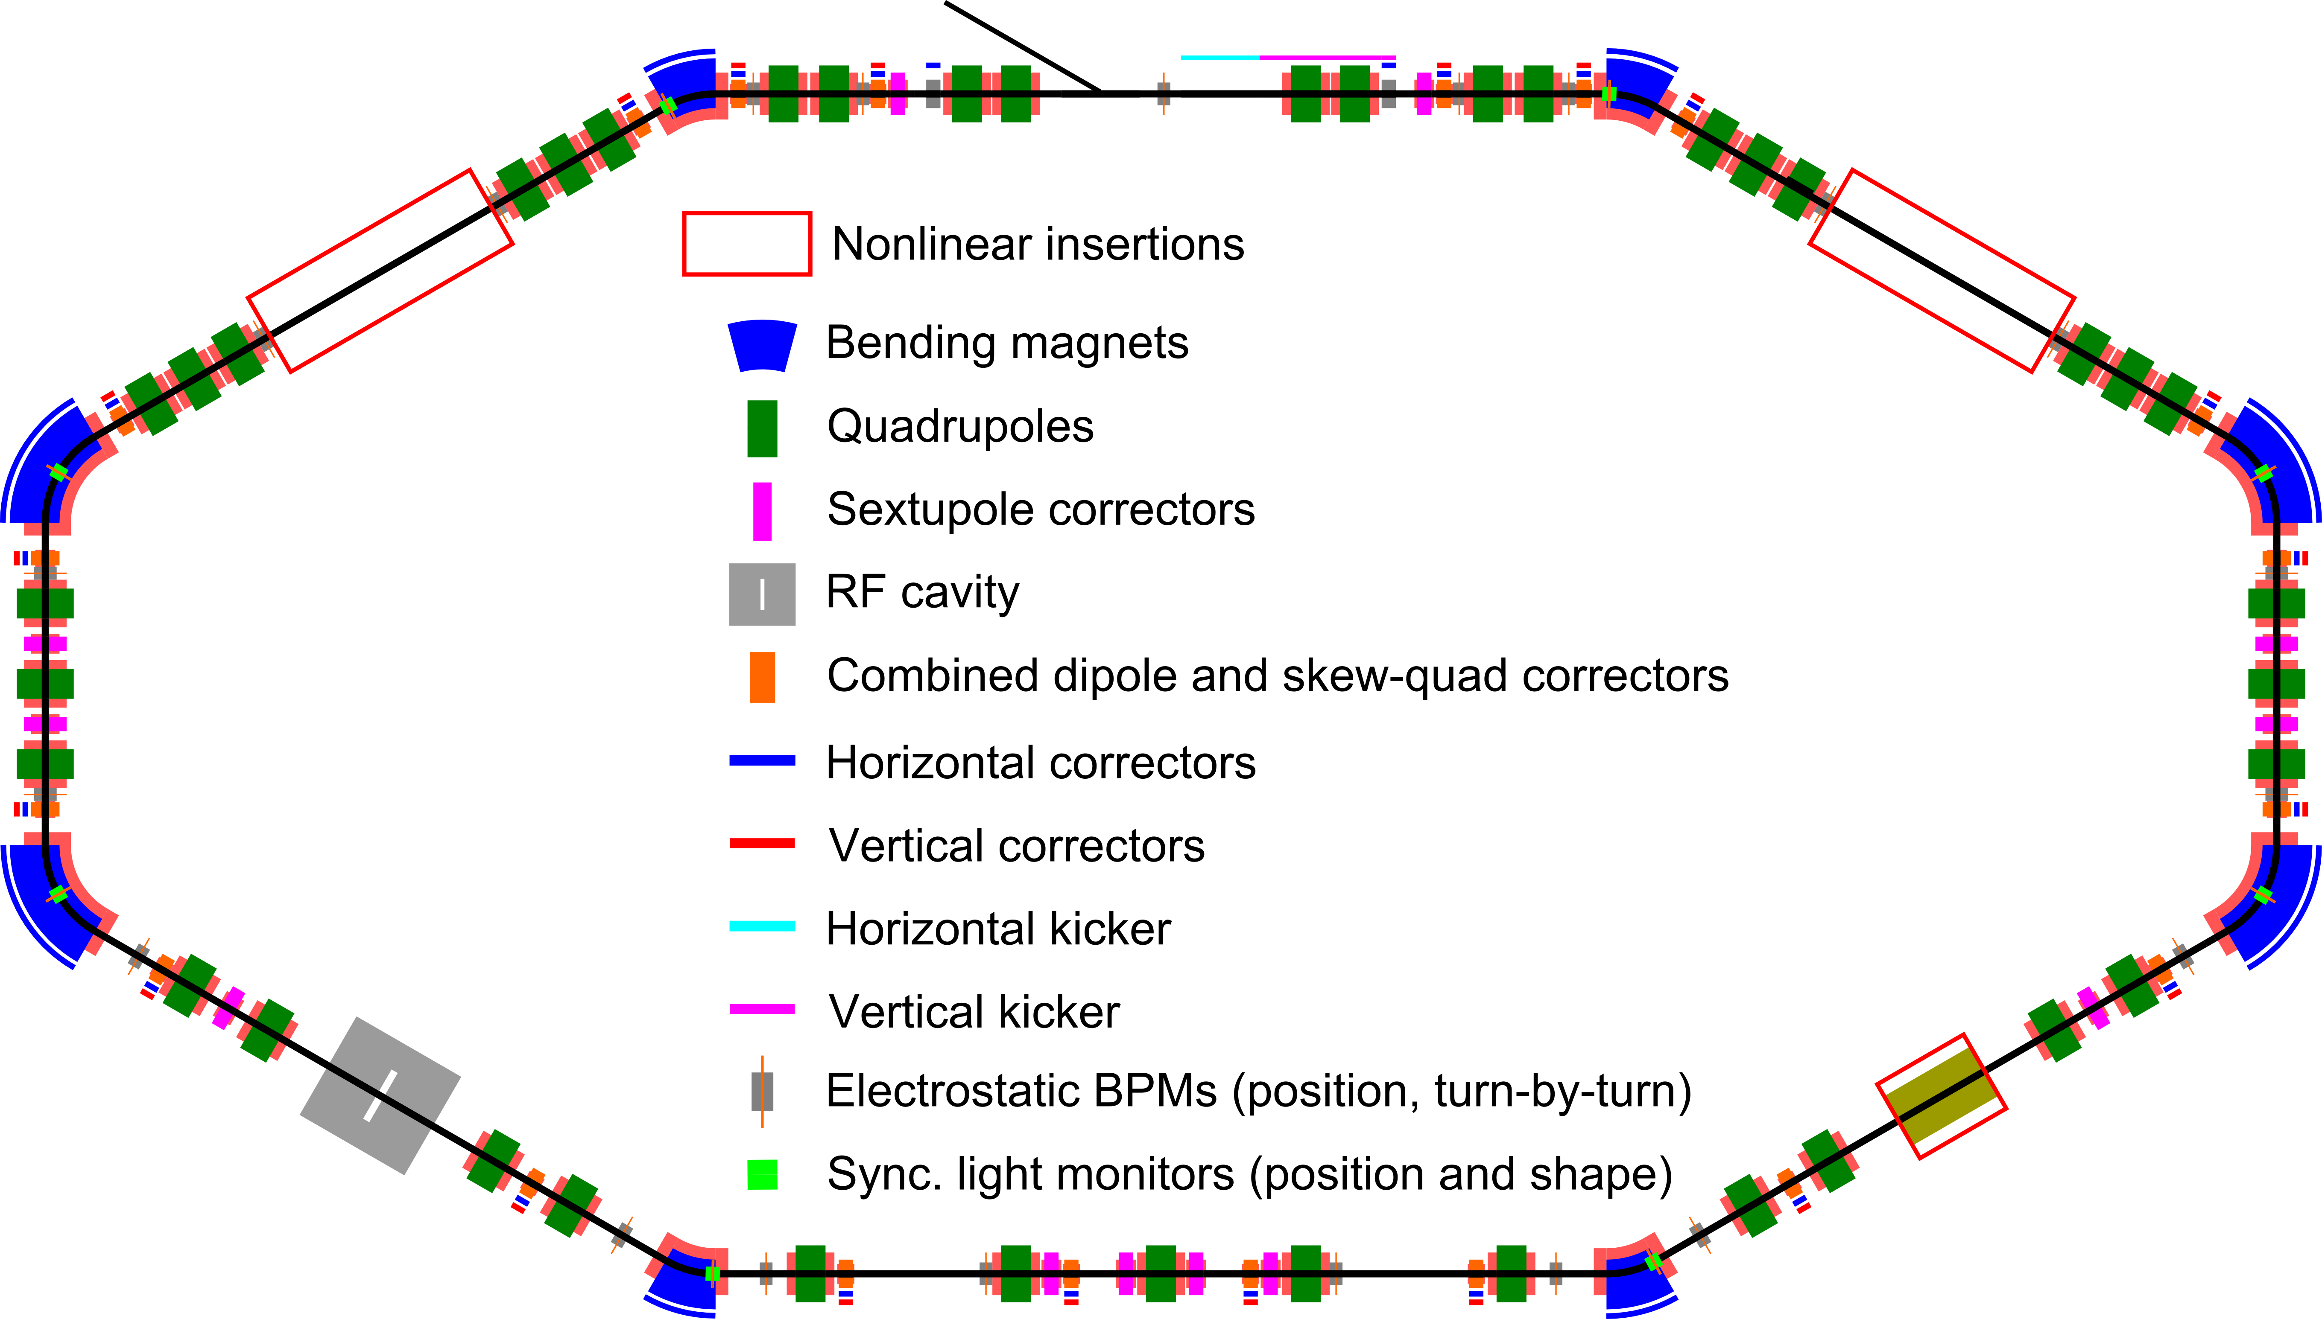
IOTA Layout

Slide 18
IOTA Main Components
Lambertson magnet |  | 1 | Horizontal, injection in vertical plane
Kickers |  | 1 hor. & 1 vert. | Horizontal for studies only
Main dipoles |  | 4x60 deg & 4x30 deg | Powered in series with Lambertson
Quads |  | 39 | Powered in pairs with individual shunts
Trims | Hor. | 8 | In main dipoles
 | Vert. | 2 | For injection bump
 | Hor. | 20 | Combined correctors
 | Vert. | 20
Skew-quads |  | 20
Pickups |  | 21 | Turn-by turn position
Sync. light monitors |  | 8 | Shape and position
RF |  | 1 | Dual frequency
Solenoid |  | 1 | For electron and McMillan lenses
Sextupoles |  | 12 | In six families
DCCT |  | 1 | Precision calibrated DC beam current
Wall current monitor |  | 1 | Bunch currents and longitudinal shape

Slide 19
IOTA – Flexible Lattice Configuration
Parameter | Max error
Betas at the insertion | 1%
Beta beating | 3%
Dispersion | 1 cm
Closed orbit at insertion | 0.05 mm
Phase advance between insertions | 0.001
Momentum | 100 MeV
Tunes, x,y | 5.3, 5.3
Mom. comp. | 0.0756
RMS emit. (x, x&y-coupled) | (42.8, 11.2) nm
Damp. times (x,y,x&y-coupled,s) | (6.7,2.4,3.5,0.90) s
Energy spread | 8.4 E-5
Bunch length @300V | 10.6 cm
Sync. Tune @300V | 3.8 E-4

Slide 20
IOTA Capabilities with Electrons
Commissioned momentum between 50 and 150 MeV/c
Energy limited by LCW system during Run 3. Engineering design review in progress.
Next limitation would be kicker system and magnet power supplies.
Wide range of beam currents: 1e⁻ to 4 mA
Versatile set of diagnostics tools
Individual control of all magnets
Developed set of software tools for new lattice commissioning
Takes 3-4 shifts to fully commission a new IOTA configuration
Injection matching, including FAST linac tuning
LOCO based lattice correction (beta beating 5% or better)
Beam based centering in various elements (50 um in the location of interest, 500um RMS around the ring)
Robust save/restore capabilities for quick switching between different experiments
Good vacuum conditions
Flexible access to the in-tunnel components

Slide 21
Beam Diagnostics
Optical diagnostics
Digital cameras
Up to 130 FPS
Single electron sensitivity (@ 500 ms exposure)
Software and hardware triggering
Streak camera
PMTs
SPADs
Convenient installation and commissioning of custom optical instruments
Electrostatic BPMs
DCCT
Wall-current monitor
Loss monitors

Slide 22
Conclusions
Electron Linac functions well in short pulse mode operation
LLRF and laser upgrades to achieve stable long pulse operation
High bunch charge improvements possible
Cathode uniformity - revisit cathode production facility.
Laser spot intensity/uniformity
IOTA Lattice
Flexible with good precision
IOTA Diagnostics
Thanks for your attention.

