Slide 1
High-Resolution HOM Spectral Studies in Cryomodule 2
Randy Thurman-Keup
FAST/IOTA Users Meeting
27 Oct 2021

Slide 2
Outline
Data acquisition for higher-order mode signals
Higher Order Mode (HOM) spectra
Observation of individual polarizations
Polarization-dependent mode changes with beam steering prior to CM2
Extraction of phase for directional beam steering information

Slide 3
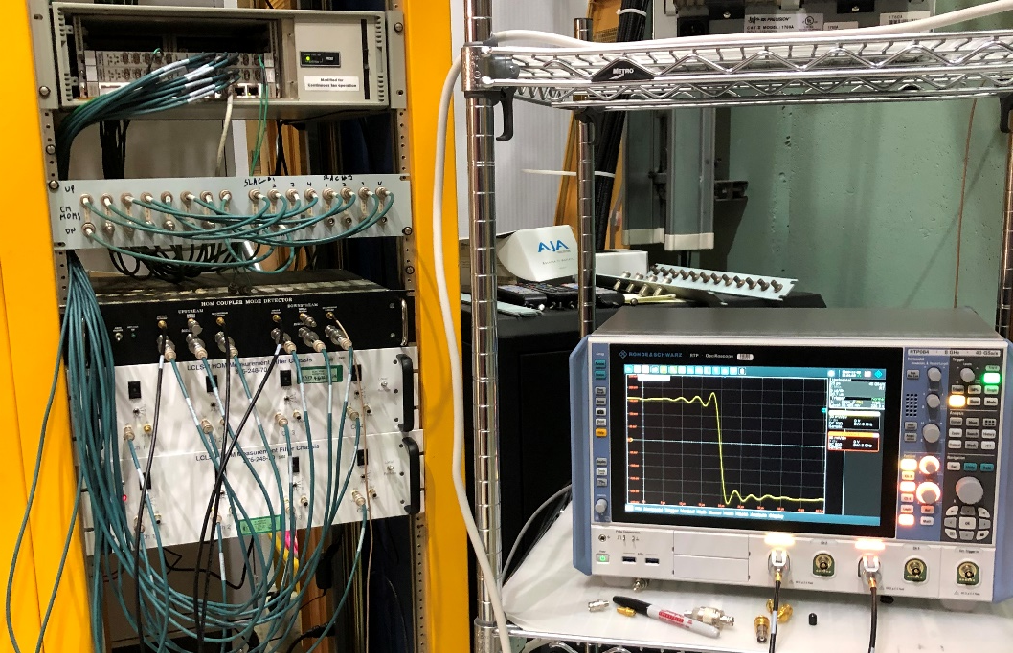
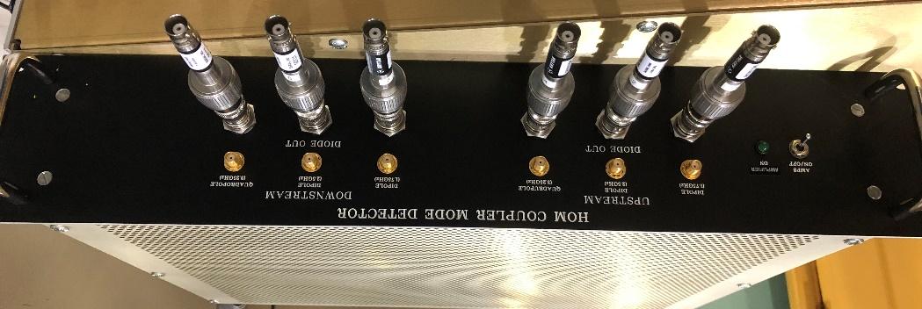
Experimental Setup
Patch Panel
HOM signals are transported to the electronics rack via 1/2” Heliax cables and then transitioned to BNC-terminated RG-58 cables for convenience
The HOM filter box used in this set of measurements contains two channels
Each channel has three bandpass filters: 1.75 GHz, 2.5 GHz, and 3.25 GHz
Each channel has two outputs per filter enabling one to be used in an 8-GHz, 20 GS/s, Rohde & Schwarz RTP084 oscilloscope, and the other to be used in a peak detector
Channel 1
Channel 2
Rohde & Schwarz
RTP084 Oscilloscope
8 GHz, 20 GS/s

Slide 4
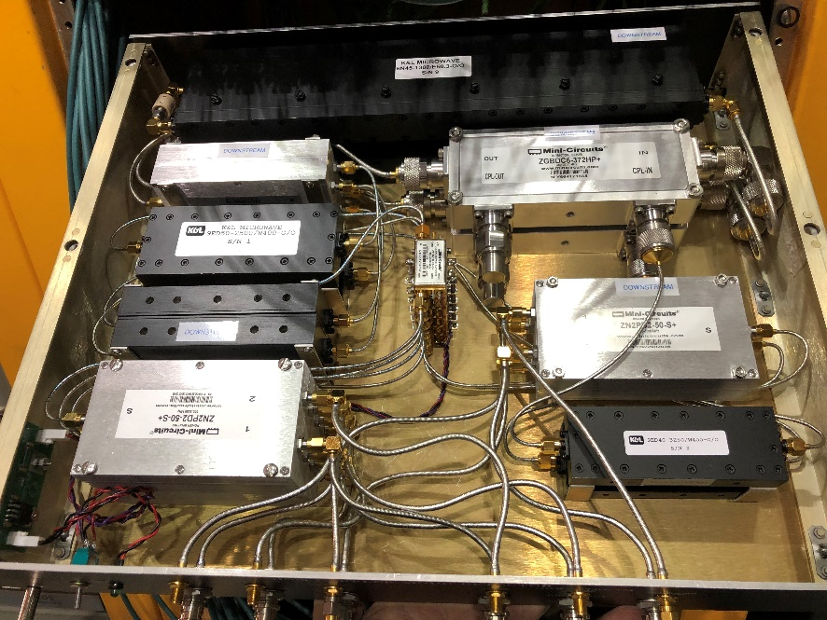
Experimental Setup
The red dB numbers indicate the relative amplitudes of the three channels
Fairview Microwave SD3258
Inside view of FNAL Multi-band HOM box
DC Block
Mini-Circuits
ZGBDC6-372HP+
K&L Microwave
9ED40-3250/W400-O/O
Mini-Circuits
ZX60-53LNB-S+
Mini-Circuits
ZN2PD2-50-S+
1.3 GHz Notch Filter
Bidirectional Coupler
-6 dB
3.25 ± 0.2 GHz Bandpass Filter
Amplifier
20 dB
Power Splitter
K&L Microwave
6N45-1300/E50.3-O/O
K&L Microwave
9ED50-2500/W400-O/O
Mini-Circuits
ZX60-53LNB-S+
Mini-Circuits
ZN2PD2-50-S+
-4 dB
2.5 ± 0.2 GHz Bandpass Filter
Amplifier 20 dB
Power Splitter
Mini-Circuits
ZN2PD2-50-S+
Power Splitter
K&L Microwave
9ED50-1750/W300-O/O
Mini-Circuits
ZX60-53LNB-S+
Mini-Circuits
ZN2PD2-50-S+
-4 dB
1.75 ± 0.15 GHz Bandpass Filter
Amplifier 20 dB
Power Splitter
Schematic of one of the two channels of the filter box showing the three bandpass filters and an optional 20 dB amplifier controlled by a switch on the front panel.

Slide 5
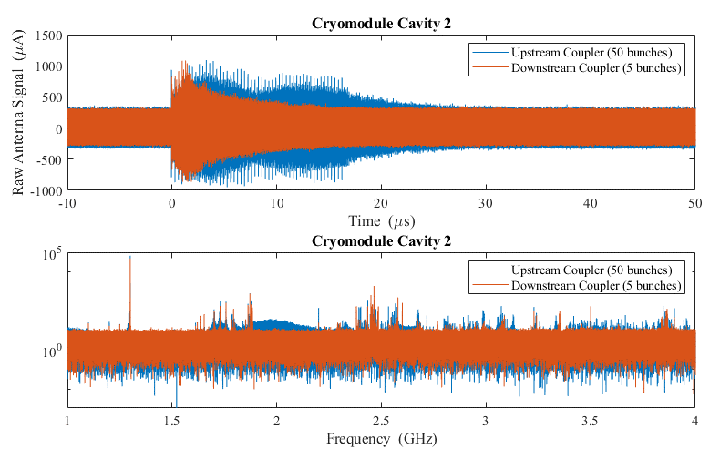
HOM Data
Raw time and spectral plots of the upstream and downstream couplers of cavity 2 in CM2
Cavity fundamental line at 1.3 GHz is about 100 times larger than the HOM lines
Beam harmonics can be seen in the upstream signal (blue)
50 bunches in the pulse
1.3 GHz
Dipole Modes
Beam Harmonics
Other HOMs

Slide 6
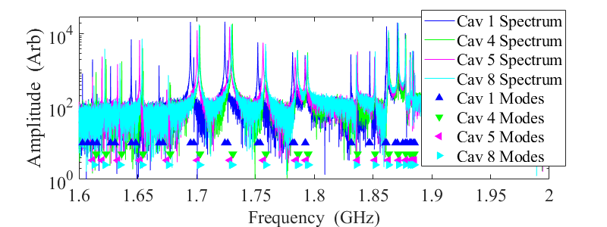
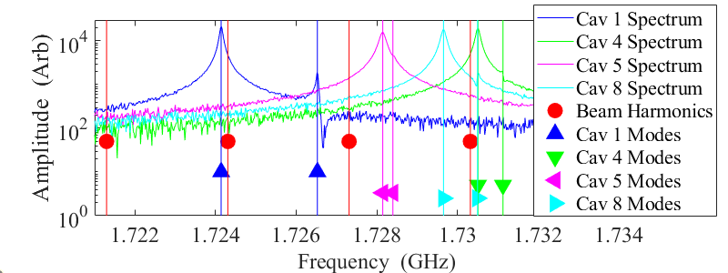
Spectral Mode Data
Data was collected from the upstream and downstream HOM couplers of cavities 1,4,5,8 of CM2
Mode frequencies vary from cavity to cavity by order of several MHz
Cavity 1 had a different manufacturer than 4, 5 and 8
Mode polarization splittings are larger in cavity 1
Spectra of a single bunch for the downstream coupler of cavities 1,4,5,8 of CM2 using the 1.75 GHz filter
Network analyzer mode measurements are overlayed on the plots
Left: Full 1.6 to 1.9 GHz region of dipole modes
Right: Near the 1.73 GHz mode
Beam Harmonics are shown as red circles
Polarization splitting

Slide 7
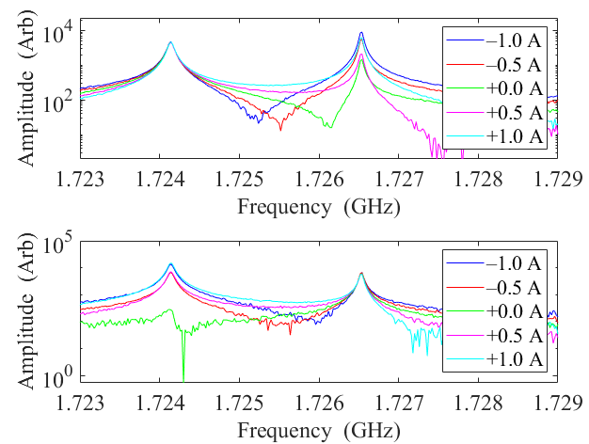
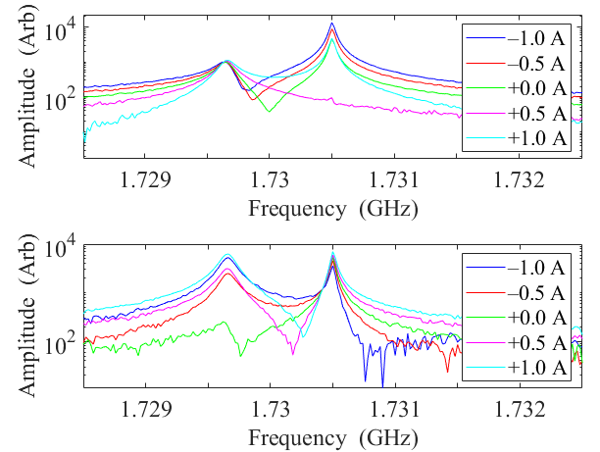
Mode Polarization Spectral Data
We steered the beam horizontally and vertically by corrector magnets H125 and V125 upstream of CM2
Below are HOM spectra from the Upstream coupler for the mode near 1.73 GHz
Polarizations are mostly spatially aligned with horizontal and vertical directions
Horizontal
Cavity 1
Horizontal
Cavity 8
Vertical
Cavity 1
Vertical
Cavity 8

Slide 8
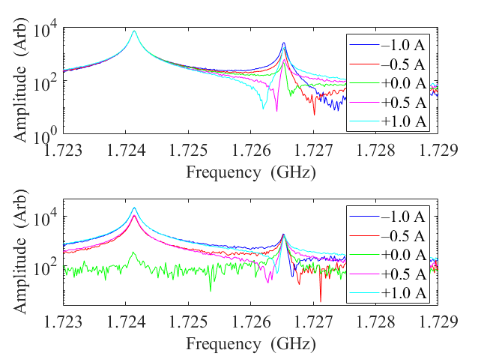
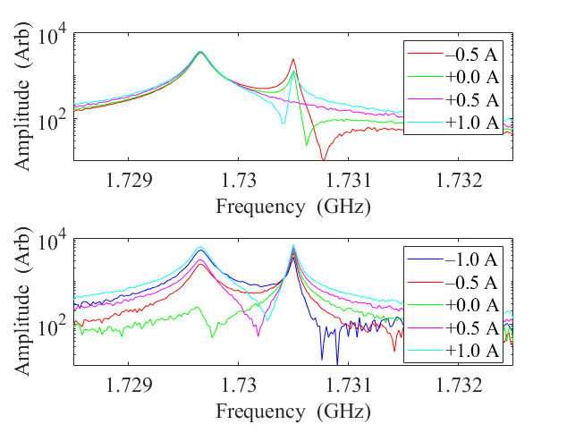
Mode Polarization Spectral Data
Below are HOM spectra taken from the Downstream coupler for the mode near 1.73 GHz
Magnitudes of the two polarizations are different from the Upstream coupler due to orientation and possibly design of coupler and antenna
Horizontal
Cavity 1
Horizontal
Cavity 8
Vertical
Cavity 1
Vertical
Cavity 8

Slide 9
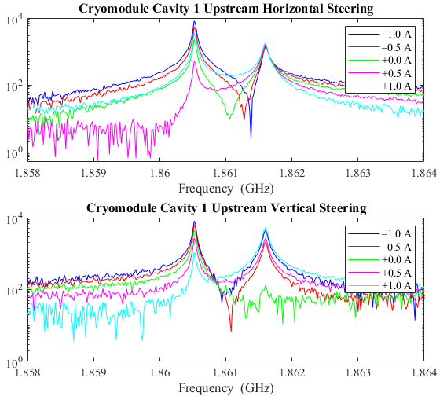
Mode Polarization Spectral Data
Pair of polarizations for the mode at ~1.86 GHz
Horizontal steering changed one polarization, while vertical steering changed both polarizations
One polarization is not aligned with horizontal

Slide 10
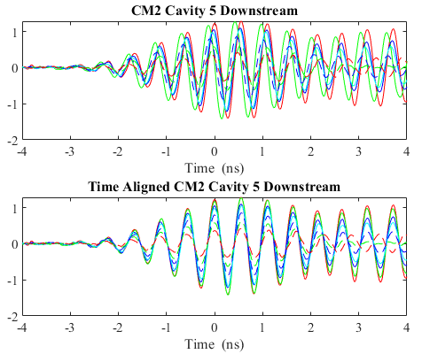
Phase Alignment
Magnitude of a HOM can indicate whether you are at the electromagnetic center of a particular HOM
Doesn’t tell you which direction you are displaced
Requires phase information
The oscilloscope is triggered by a TTL signal timed with the first bunch
Top plot shows the start of the HOM signals for a set of steering magnet currents
Dominated by the arrival time of the bunch at the HOM pickup
Variation in the arrival time needs to be corrected to get the correct phase of the HOMs
Bottom plot shows the signals after adjusting for the jitter using the peak located at t = 0 ns.

Slide 11
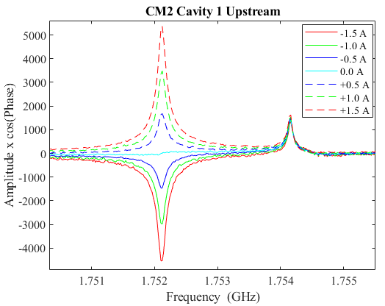
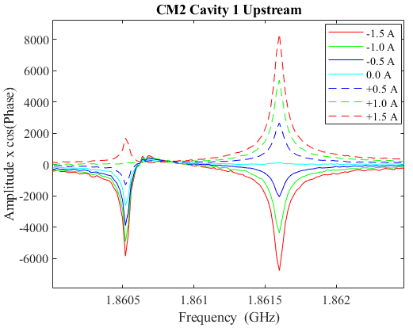
‘Signed’ Spectral Data
Extract phase, $φ$, from FFT of signal at peak magnitude, $M$
Subtract phase of the +1.5 A steering case from all the extracted phases $φ$
Calculate signed magnitude via $M\cos\left(φ−φ\left(+1.5 A\right)\right)$
One sees the expected behavior, where trajectories on opposite sides of the center produce HOMs that are 180 degrees out of phase

Slide 12
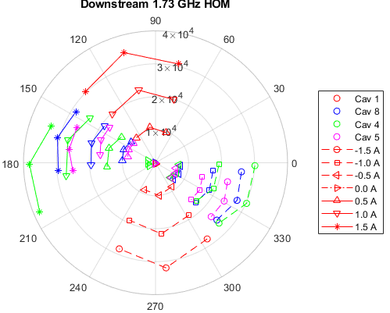
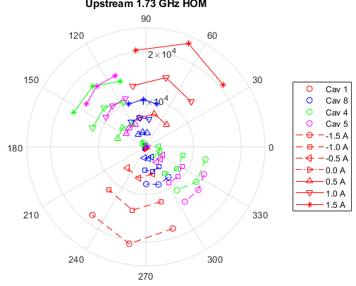
Magnitude and Phase Spectral Data
Plots of the full magnitude and phase of the peak and adjacent spectral values of the 1.73 GHz mode for cavities 1,4,5, and 8 of CM2, for various vertical corrector currents
Note: The phase of cavity 1 is noticeably different from the other cavities.
Cavity 1 is from a different manufacturer than the other 3.

Slide 13
Summary
Using a high bandwidth oscilloscope, we have recorded the dipole HOM signals from four of the cavities in CM2 and reconstructed the phase and magnitude of certain modes.
The reconstruction allows one to ascertain the relative position of the beam with respect to the mode axis.
We have used dipole correctors upstream of the cavities to steer the beam and produce a beam offset in the cavity to produce HOMs of varying amplitudes.
We have produced changes in particular HOM polarizations dependent on the direction of beam steering.

Slide 14
Extras

Slide 15
Introduction
Collaborators
Randy Thurman-Keup, Dean Edstrom, Alex Lumpkin, Peter Prieto, Jinhao Ruan (Fermilab, Batavia, Illinois)
Jorge Diaz-Cruz, Bryce Jacobson, John Sikora, Feng Zhou (SLAC, Menlo Park, California)

Slide 16
Introduction
Beam traversing an accelerating cavity can induce higher order mode (HOM) responses in the cavity. These HOMs may impact the beam in the form of long-range wakefields. At high-brightness electron accelerator facilities such as the European XFEL at DESY [1] and the soon-to-be completed LCLS-II at SLAC [2], these wakefields may cause emittance dilution as the beam is transported down the beamline, particularly through the early cryomodules. In this paper, we focus on the dipole modes of TESLA-type 9-cell cavities [3-5] which are generated when the transverse position of the bunch does not align with the electromagnetic center of the mode. The response of the mode is then a linear function of the transverse distance of the bunch from the electromagnetic center. Each dipole mode has two polarizations which are orthogonal and typically split in frequency due to the cavity shape not being exactly cylindrical.
Previous efforts at DESY to reduce these HOM wakefields involved the use of a narrowband, down-converted signal filtered on the TE111-6 dipole mode at ~1.7 GHz to measure and correct the beam position through the cavities [6]. Here we look at some of the dipole modes from 1.6 GHz to 1.9 GHz in a standalone cavity and in 4 of the cavities of a cryomodule. We have used horizontal and vertical corrector magnets in front of the cavities to steer the beam and produce an average offset through the cavities. These offsets produce varying levels of HOM signals which we process through an oscilloscope to obtain the magnitude and phase of the modes including the two polarizations for some of them. Additionally, we identify modes that are close to beam harmonics which may induce larger effects in the later bunches due to harmonics. In the past [7,8], we have identified modes that caused motion along the bunch train at the difference frequency of the mode and a beam harmonic.

Slide 17
FAST Beamline
The FAST Linac [9] consists of a photocathode electron gun with a Cs₂Te-coated Mo cathode driven by a Nd:YLF laser. The photocathode is embedded in a 1.5 cell normal conducting rf cavity operating at 1.3 GHz and surrounded by 2 solenoids. The laser repetition rate is typically 3 MHz and can produce electron bunches from below 100 pC to several nC which exit the gun with ~<5 MeV of energy. Following the gun are two 9-cell Tesla-type superconducting rf cavities (CC1 and CC2) which can increase the energy up to 50 MeV. After the cavities is a section with quadrupoles and an optional chicane followed by an optional spectrometer magnet and low energy dump. This section has many diagnostic stations in it, including Al OTR foils, YAG:Ce single-crystal screens, and an Al-coated Si transition radiation screen leading to a THz interferometer and a streak camera for bunch length measurements. Beyond this section is the 8-cavity cryomodule (CM2) and the high-energy line ending at the absorber. The cavities all have a higher-order mode (HOM) coupler at each end to extract the HOMs generated by the passing beam. These signals from the couplers are used to determine some properties of the beam. The dipole correctors at location 125 are used to alter the trajectory through CM2 producing varying levels of HOMs.
H101/V101 Correctors
H125/V125 Correctors

Slide 18
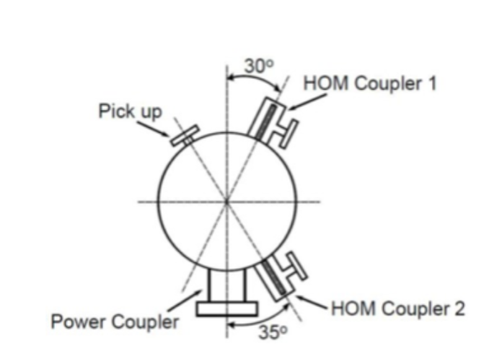
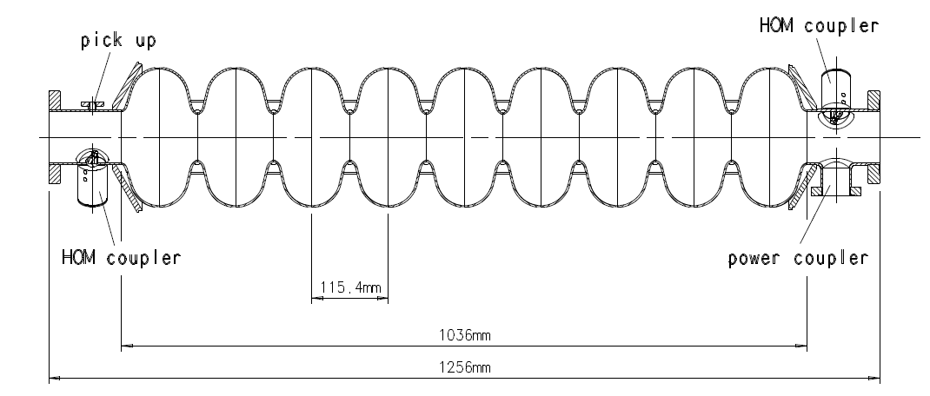
TESLA-Type Cavities
from Ref. 4
Pictures and schematics of the superconducting 9-cell TESLA-type Niobium cavity found in CC1, CC2, and the cryomodule CM2. The diagram below shows the azimuthal angular offset between the two HOM couplers located at the ends of the cavity. The cavity is ~1 meter long.
T. Hellert,
FEL Seminar, 2017
from Ref. 4

Slide 19
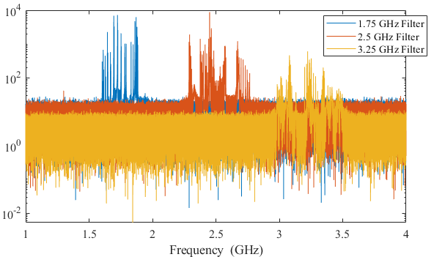
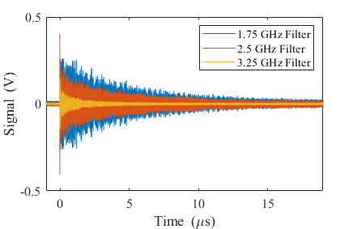
HOM Filter Box Outputs
Overlayed waveforms (below) and spectra (right) of all three filtered outputs for a single bunch in CC1
One can see the slightly smaller 3.25 GHz signal due to the bidirectional coupler. The measurements here focus on the 1.75 GHz region which is the blue and contains the first 18 dipole HOM modes.

Slide 20
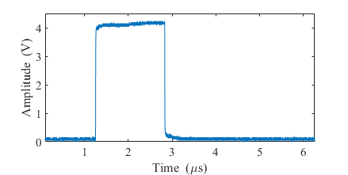
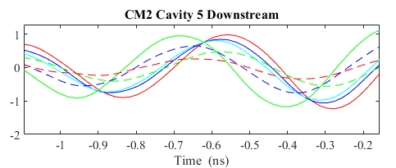
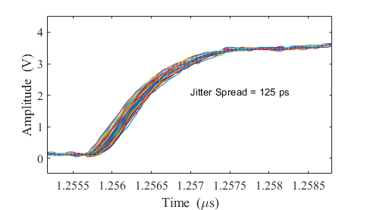
Trigger Jitter
The bottom plot is an enlarged section of one peak in the top plot of the previous slide. The range of peak locations is about 140 ps. The right plots show the first-bunch trigger signal collected in the oscilloscope by triggering on a different version of the signal. The maximum spread in that trigger signal is about 125 ps, which is very close to the observed spread in the HOM signals. We conclude that the spread is mostly a trigger jitter issue and can be removed as demonstrated in the previous slide.
Jitter = 140 ps

Slide 21
Summary
References
[1] H. Weise, “Commissioning and First Lasing of the European XFEL”, in Proc. of 38th International Free Electron Laser Conf., (FEL2017), Santa Fe, NM, paper MOC03. doi:10.18429/JACoW-FEL2017-MOC03
[2] P. Emma, “Status of the LCLS-II FEL Project at SLAC”, presented at the 38th International Free Electron Laser Conf. (FEL2017), Santa Fe, NM, slides MOD01. https://accelconf.web.cern.ch/fel2017/talks/mod01_talk.pdf
[3] B. Aune et al., “Superconducting TESLA cavities”, Phys. Rev. ST Accel. Beams, vol. 3, p. 092001, 2000. doi:10.1103/PhysRevSTAB.3.092001
[4] R. Brinkman et al., “TESLA-Technical Design Report”, DESY, Hamburg, Germany, Rep. DESY-TESLA-2001-23, Part II, 2001. https://flash.desy.de/sites2009/site_vuvfel/content/e1549/e1506/e1509/infoboxContent1511/partII.pdf

Slide 22
Summary
[5] R. Wanzenberg, “Monopole, Dipole and Quadrupole Passbands of the TESLA 9-cell Cavity”, DESY, Hamburg, Germany, Rep. DESY-TESLA-2001-33, 2009. https://flash.desy.de/sites2009/site_vuvfel/content/e403/e1644/e1693/e1694/infoboxContent1727/tesla2001-33.pdf
[6] S. Malloy et al., “High precision superconducting cavity diagnostics with higher order mode measurements”, Phys. Rev. ST Accel. Beams vol. 9, p. 112802, 2006. doi: 10.1103/PhysRevSTAB.9.112802
[7] A.H. Lumpkin et al., “Submacropulse electron-beam dynamics correlated with higher-order modes in Tesla-type superconducting rf cavities”, Phys. Rev. Accel. Beams vol. 21, p. 064401, 2018. doi: 10.1103/PhysRevAccelBeams.21.064401
[8] A.H. Lumpkin et al., “Observations of Long-Range and Short-Range Wakefield Effects on Electron-Beam Dynamics in TESLA-type Superconducting RF Cavities”, in Proc. 8th International Beam Instrumentation Conf. (IBIC2019), Malmo, Sweden, 8-12 September 2019, paper TUPP041, pg. 428-431. doi:10.18429/JACoW-IBIC2019-TUPP041
[9] S. Antipov et al., “IOTA (Integrable Optics Test Accelerator): Facility and Experimental Beam Physics Program”, JINST vol. 12, p. T03002, 2017. doi:10.1088/1748-0221/12/03/T03002
[10] A.H. Lumpkin et al., “Investigations of long-range wakefield effects in a TESLA-type cryomodule at FAST”, presented at the 21st International Particle Accelerator Conf. (IPAC2021), Iguassu Falls, Brasil, 24-28 May 2021, paper TUPAB274.
[11] J. Sikora et al., “Commissioning of the LCLS-II prototype HOM detectors with TESLA-type cavities at FAST”, presented at the 21st International Particle Accelerator Conf. (IPAC2021), Iguassu Falls, Brasil, 24-28 May 2021, paper MOPAB323.

