Slide 1
Studies of Proton Beam Instabilities with a Wake-Building Feedback System
Rob Ainsworth
2021 IOTA/FAST Collaboration Meeting
October 28th 2021

Slide 2
Outline
Motivation
Wake building feedback system - Waker
Instability studies in the Fermilab Recycler
Future plans and moving to IOTA

Slide 3
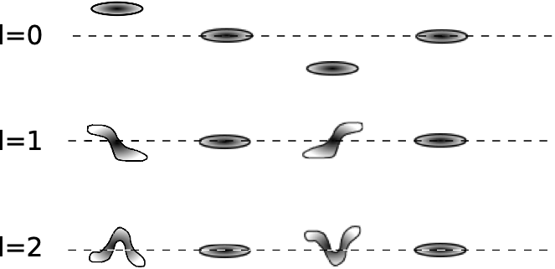
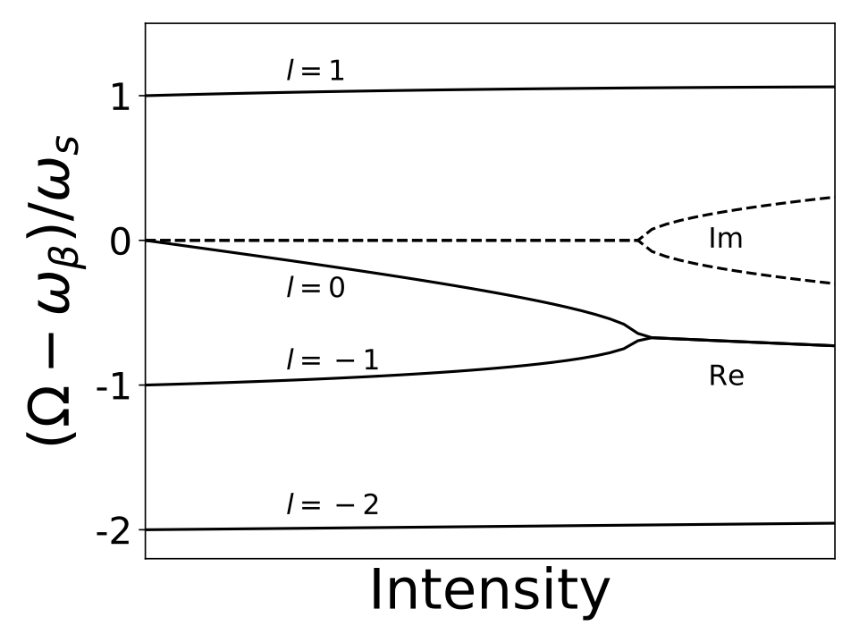
TMCI (Transverse Mode Coupling Instability)
Bunches oscillate with different transverse modes
Impedance in a machine can cause a detuning of these modes which scales with intensity
If the detuning is large enough, the frequencies of two modes couple -> TMCI
Wake parameter

Slide 4
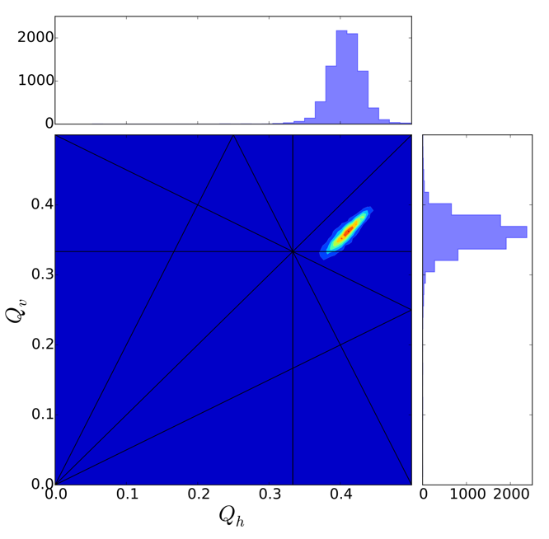
Space charge
Inside a bunch, there is a spread of tunes
Self field results in defocusing which leads to tune shift
Space charge leads to tune shift
increases this spread with intensity
Worse at low energy
Depends on bunch length and beam size
Space charge
tune shift

Slide 5
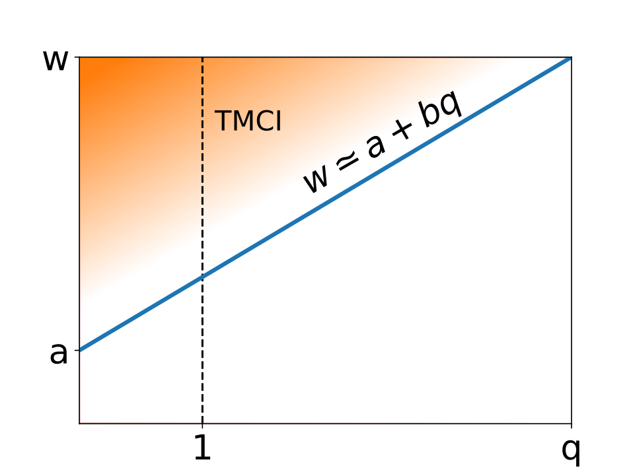
Space charge and TMCI
For many years, space charge was thought to have a stabilizing effect on TMCI
Wake parameter
Coherent tune shift from
wake/Qs
Space charge parameter
Incoherent tune shift from
Space charge/Qs

Slide 6
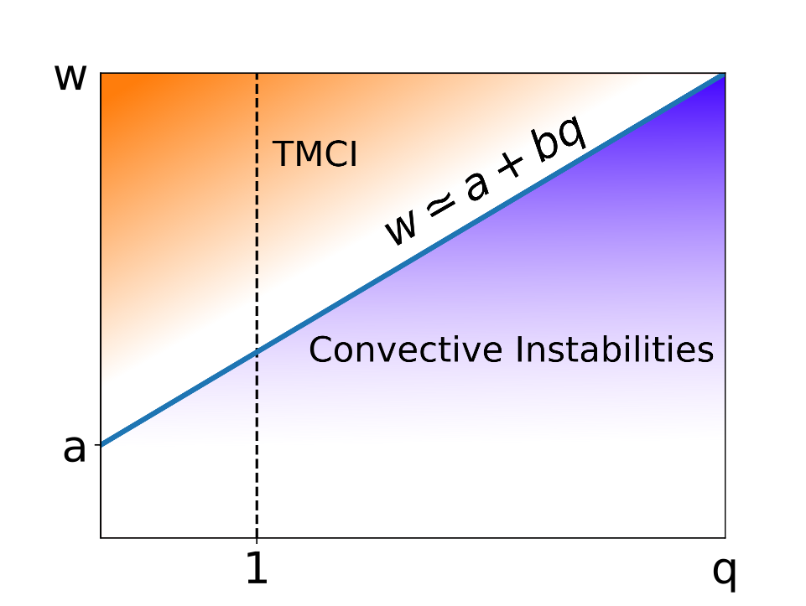
Space charge and TMCI
In 2018, Alexey Burov predicted a new kind of instability, convective instabilities
Occur in place of TMCI at strong space charge
Results in huge amplification from head to tail
Traditional dampers may make things worse
Wake parameter
IOTA (protons)
Space charge parameter

Slide 7
Usually, the wake amplitudes which drive instabilities are machine dependent and are determined by the impedance of the components installed within the machine.
A novel approach to control instabilities will be to install a `waker' system, a dedicated wake-building feedback system.

Slide 8
Waker concept
The waker will mimic kicks from wake using a kicker
The system will measure the position and intensity along the bunch and apply multiple kicks along a single bunch
Bandwidth of the system should be much larger than the inverse bunch length
Waker allows vertical
movement on this plane

Slide 9
IOTA is ideal to deploy the waker
However, it’s 1-2yrs away from protons
Can we take advantage of FNAL accelerator complex in the mean time?

Slide 10
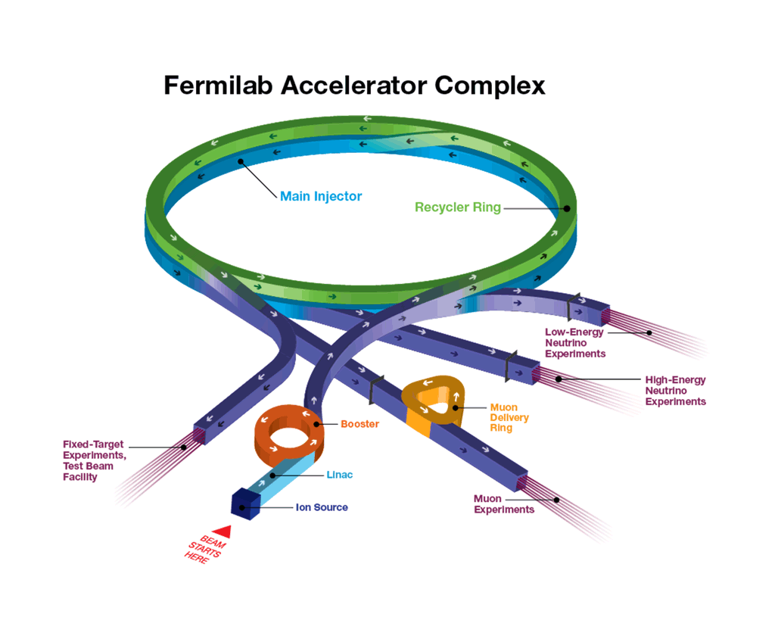
FNAL accelerator complex
H⁻ linac
Booster
h = 84
15 Hz
400 MeV -> 8 GeV
Recycler
h = 588
Slip-stack 12 batches (double bunch intensity)
Main Injector
8 GeV -> 120 GeV

Slide 11
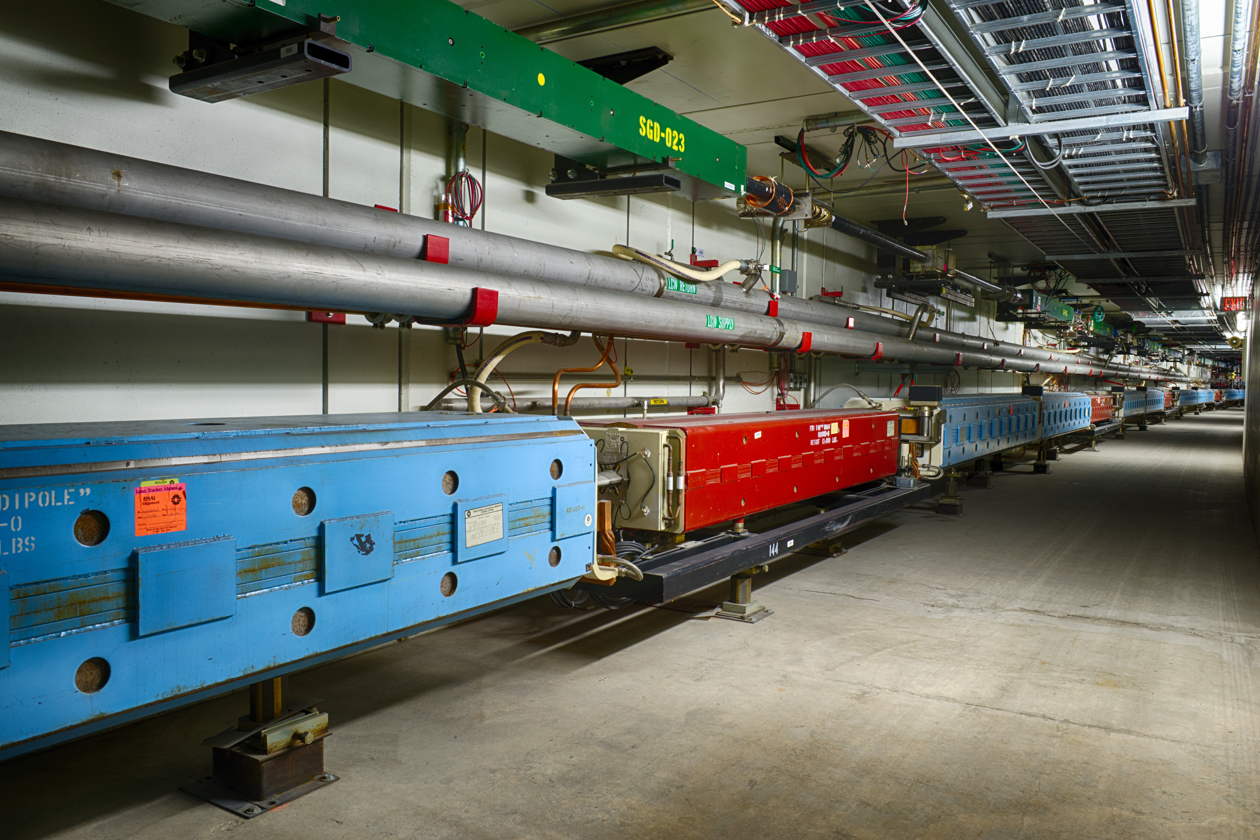
Using the Recycler to study instabilities
Recycler is attractive for studying instabilities
It doesn’t ramp i.e. energy is fixed to 8GeV
It can already operate at strong space charge
Study time availability
SY - MI
NuMI - MI
SY - RR
NuMI - RR
Muon - RR
Study cycle - RR

Slide 12
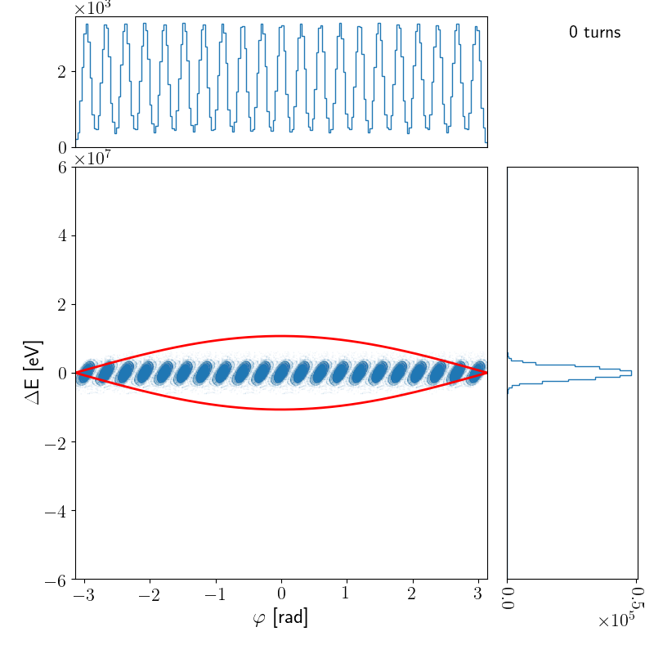
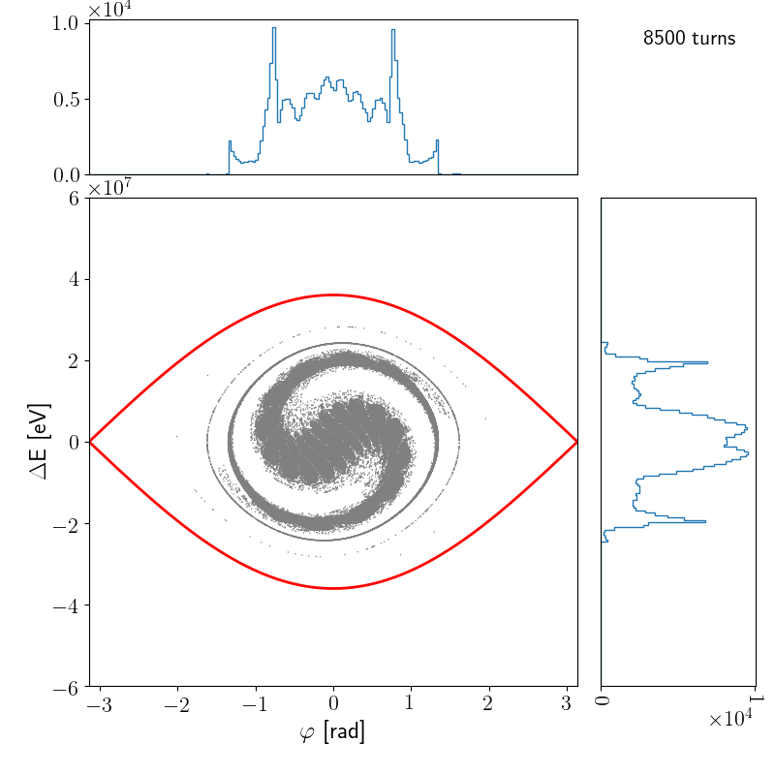
Bandwidth requirements
The waker system needs to excite intra-bunch motion
Needs large bandwidth compared to inverse bunch length
For standard operation this is tricky
bunched at 53 MHz
need a bandwidth on the order of GHz
difficult to build!
Fortunately, RR has ability to create longer bunches
Re-bunched to 2.5 MHz
Need a bandwidth of at least 100 MHz - this is doable
Example of RR rebunch used for muon

Slide 13
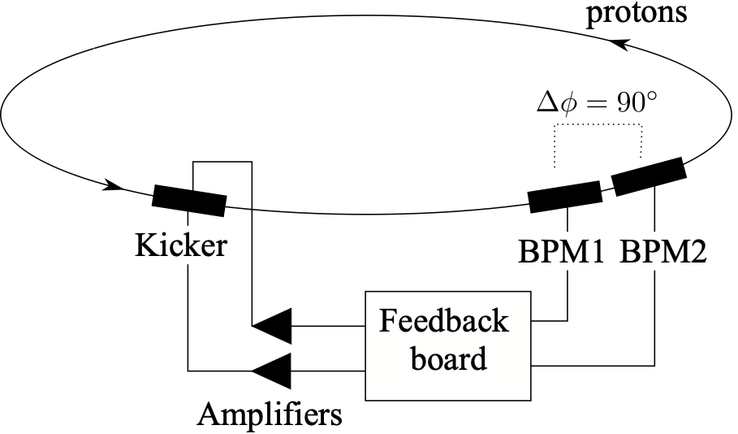
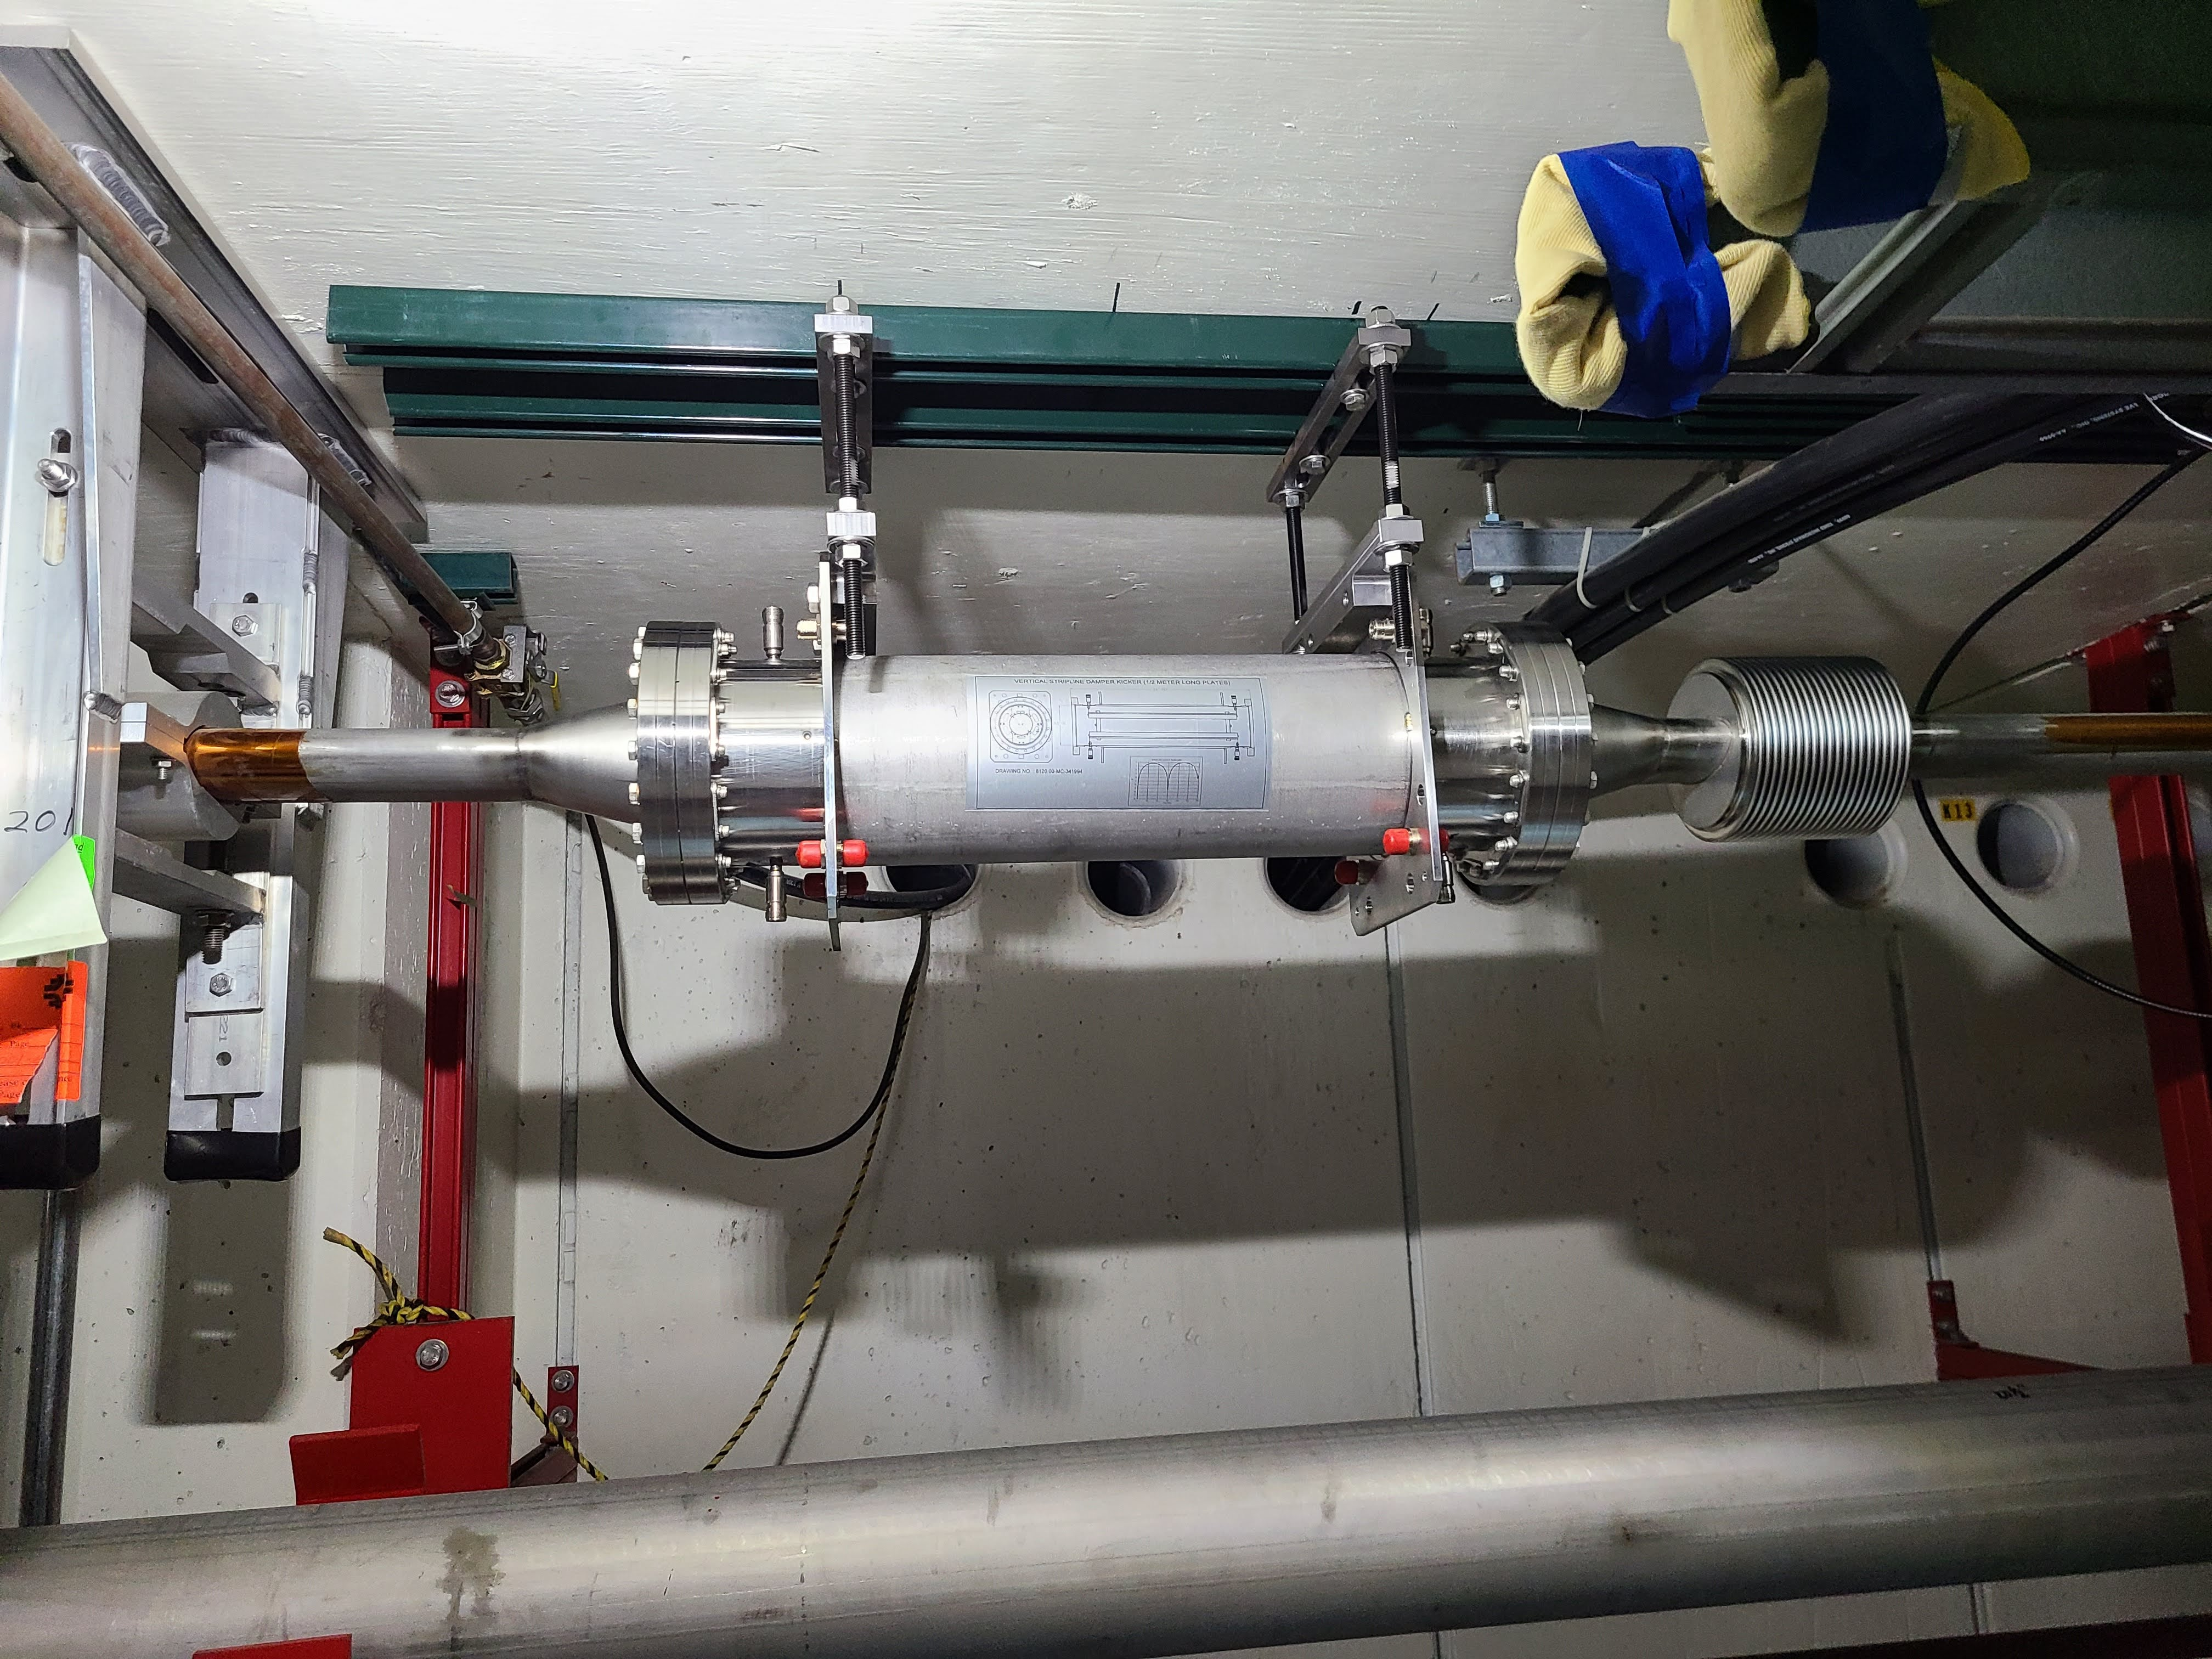
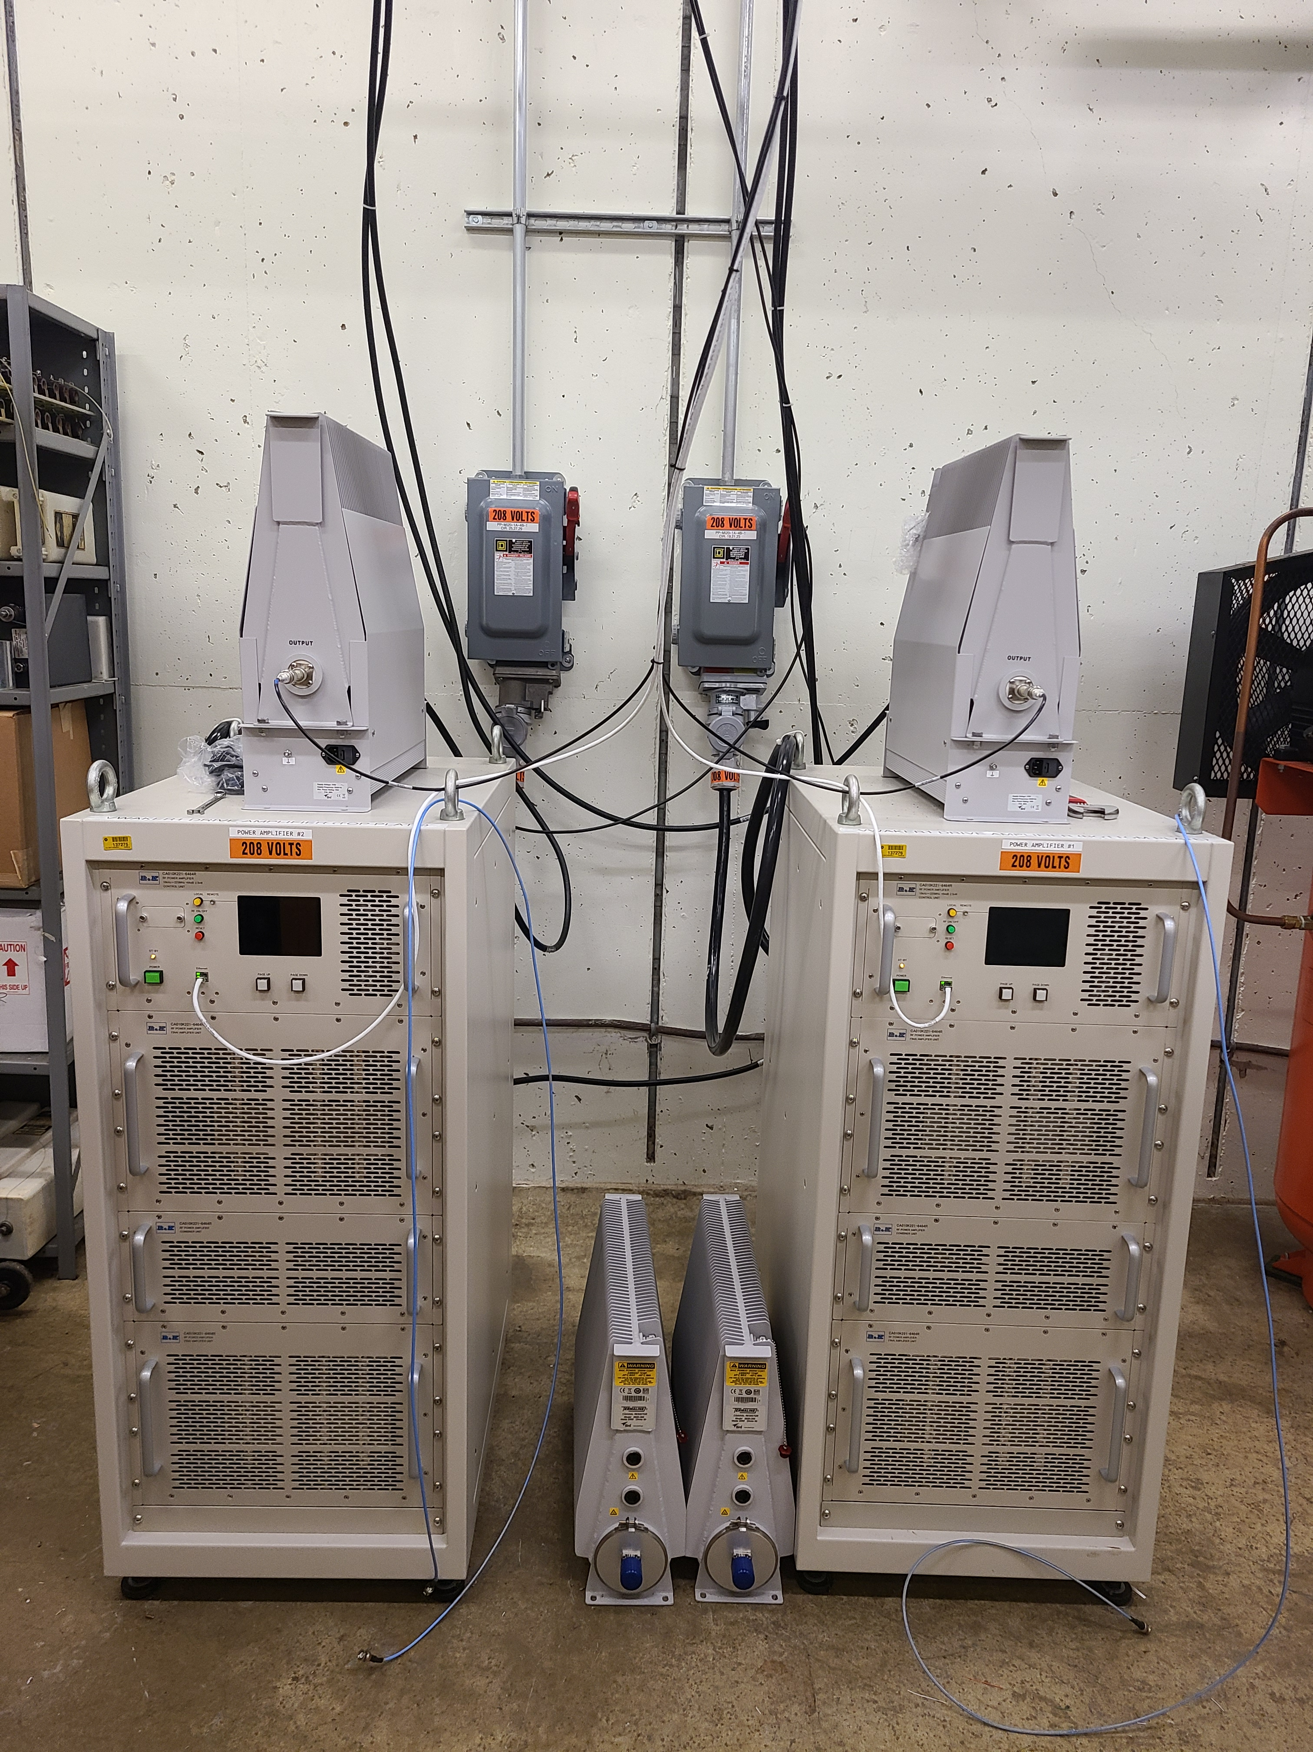
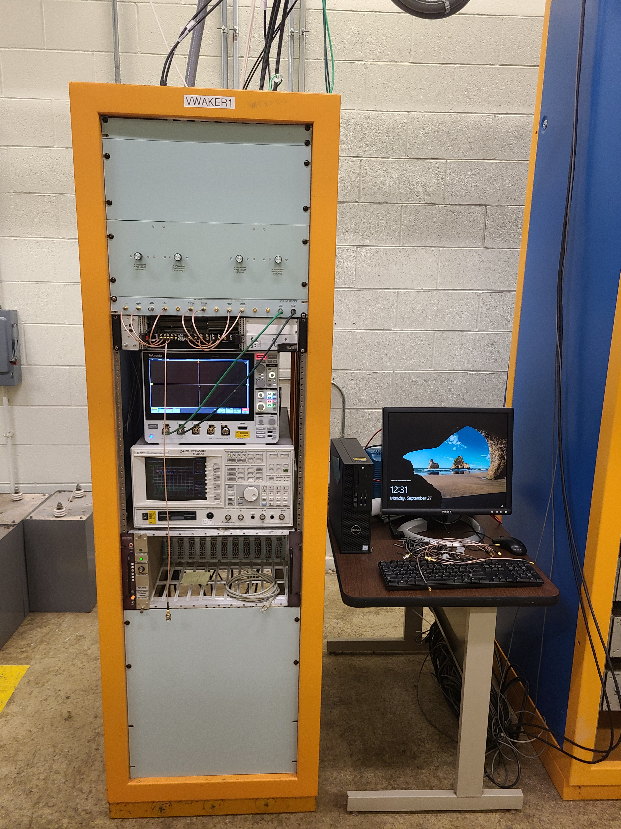
Waker system
Reuse off-axis
Bpms
0.5m stripline kicker
2.5 kW
Amplifiers

Slide 14
Timing in the system
All cables were verified before timing in the system
Correct delay and bpm coefficients were found by performing open loop transfer function measurements.
To verify the system worked as expected, both damping and antidamping was demonstrated for 53 MHz and 2.5 MHz beam

Slide 15
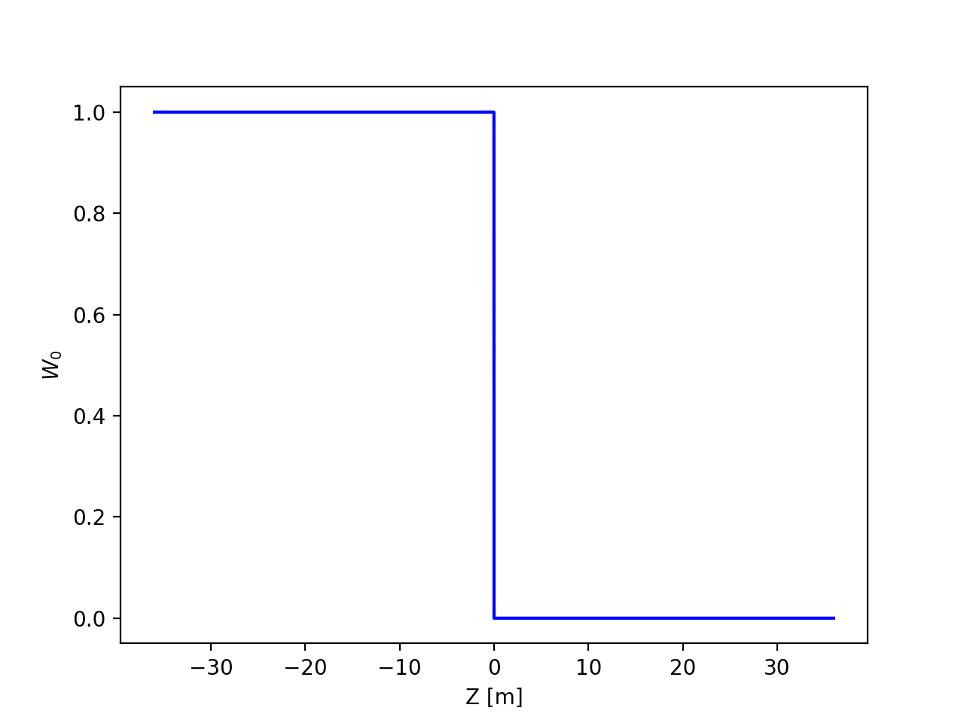
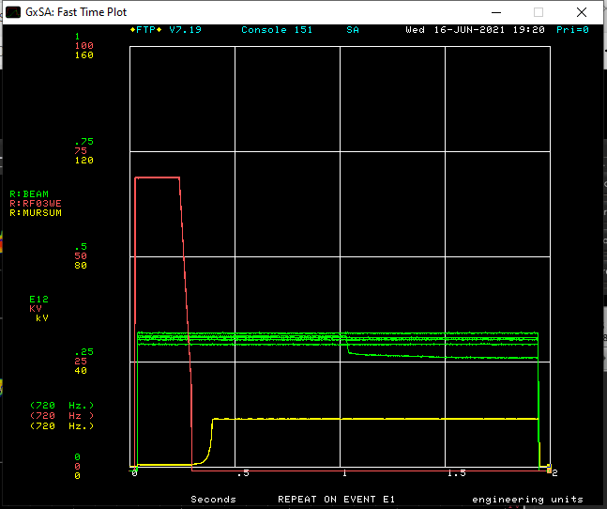
Time to try a wake
Start with Heaviside step function wake (theta wake)
W0=0 ahead of bunch, W0=1 behind
Kick is integral of dipole motion from timeslices infront
Started off at 5 booster turns, couldn’t see much
Increased to 10 booster turns, gain=5
Waker turned on at 1s for 50,000 turns
Beam fallout

Slide 16
First instability observed
Observed on Stripline pickups
Much smaller than bunch length
Signal is current differential
Diff signal
Proportional to
postion x intensity
Sum signal
Intensity

Slide 17
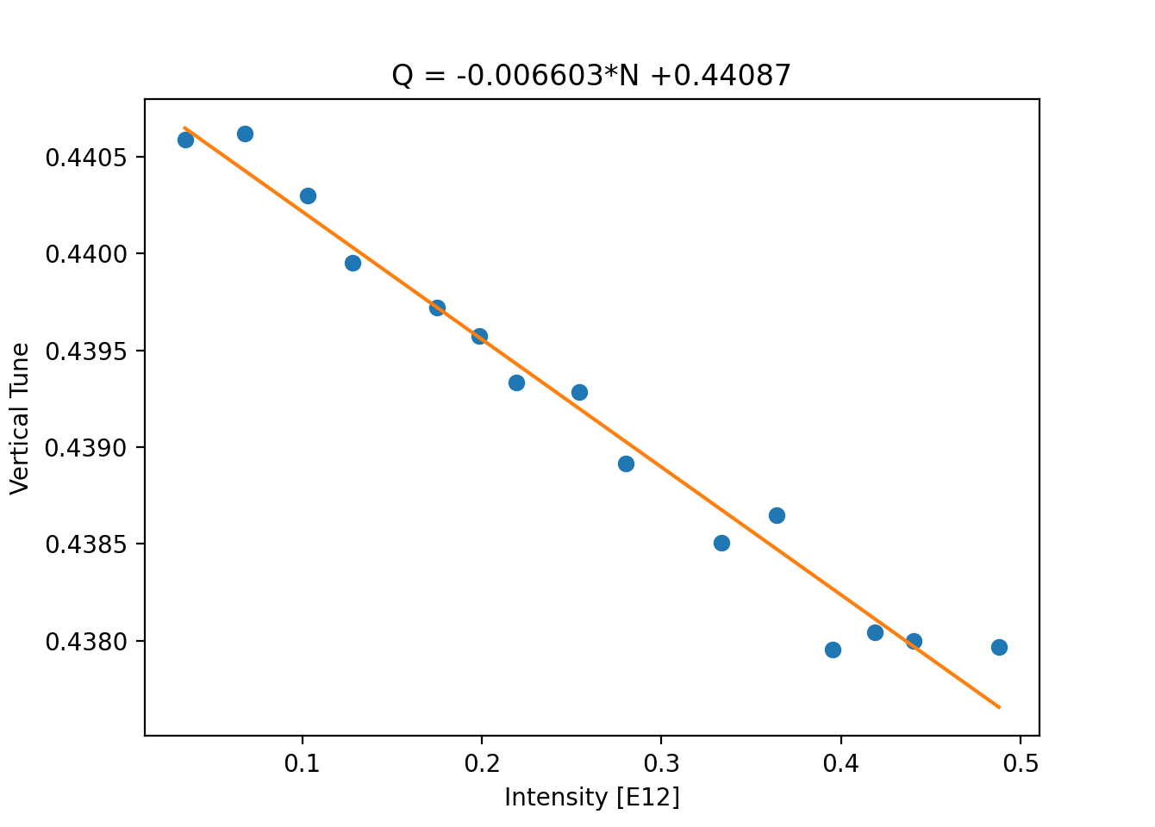
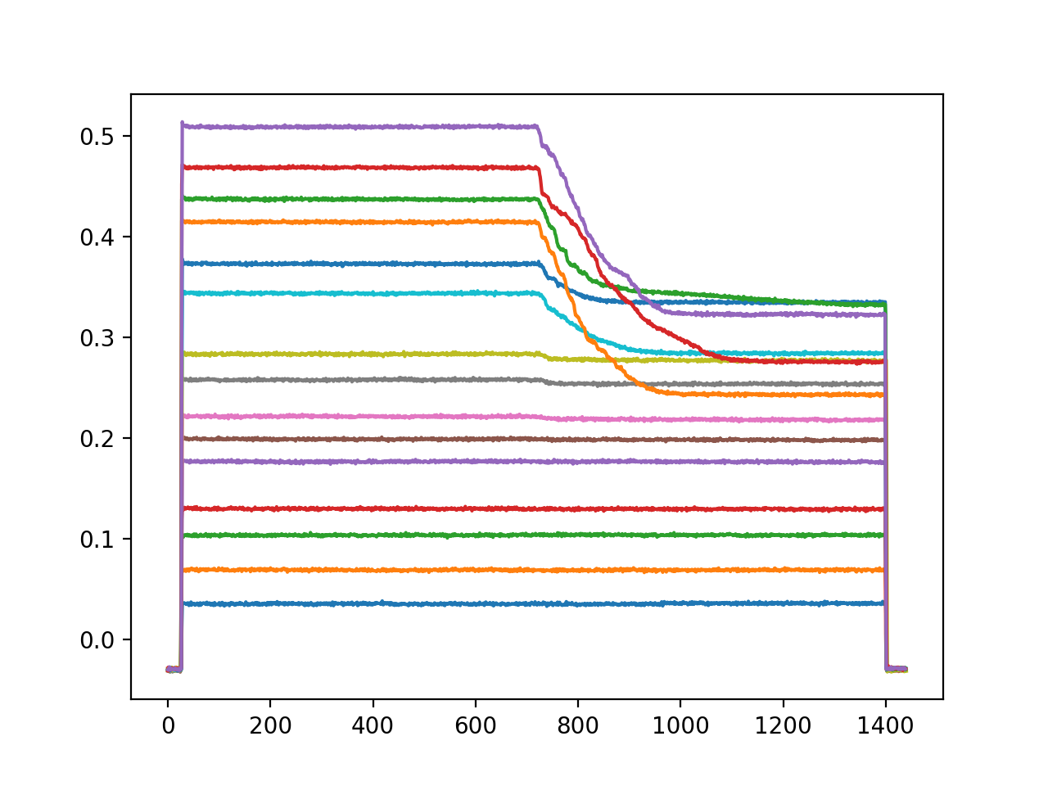
Time for some studies
Tune shift vs intensity with waker off
i.e. natural tune shift
Measurements less trustworthy at high intensity
Ping too strong

Slide 18
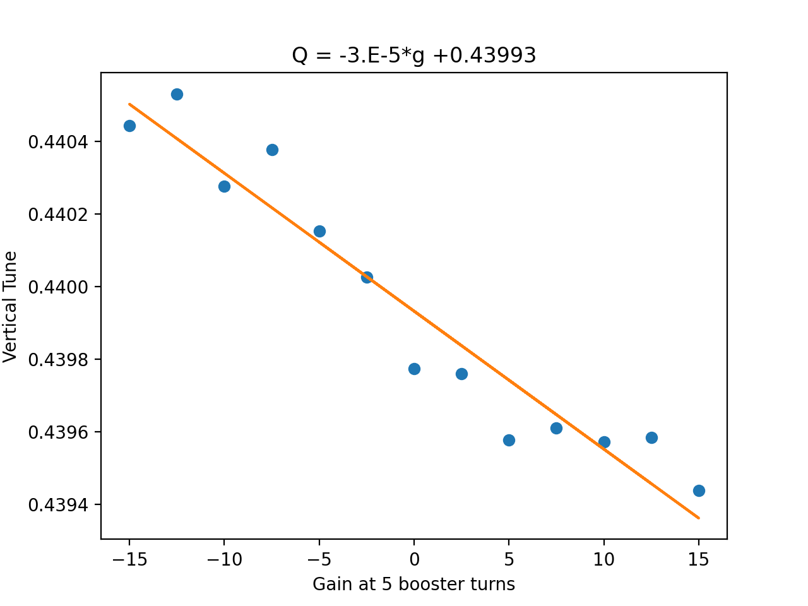
Tune vs gain
Tune vs gain
+ve gain -> -ve tune shift
-ve gain -> +ve tune shift
I’m a little skeptical of this measurements
Tune varies depending on turn window used

Slide 19
Parameters
Parameter | Value
Qs | 0.0005
Chromaticity (x,y) | 0.03,-0.15
Dp/p | 0.0005
Intensity | 1e11 - 5.5e11 ppb
Bunch length | 30 - 40 ns
Normalized emittance, 95% | 15 pi mm mrad
Beta | 0.9944
Machine radius | 528 m

Slide 20
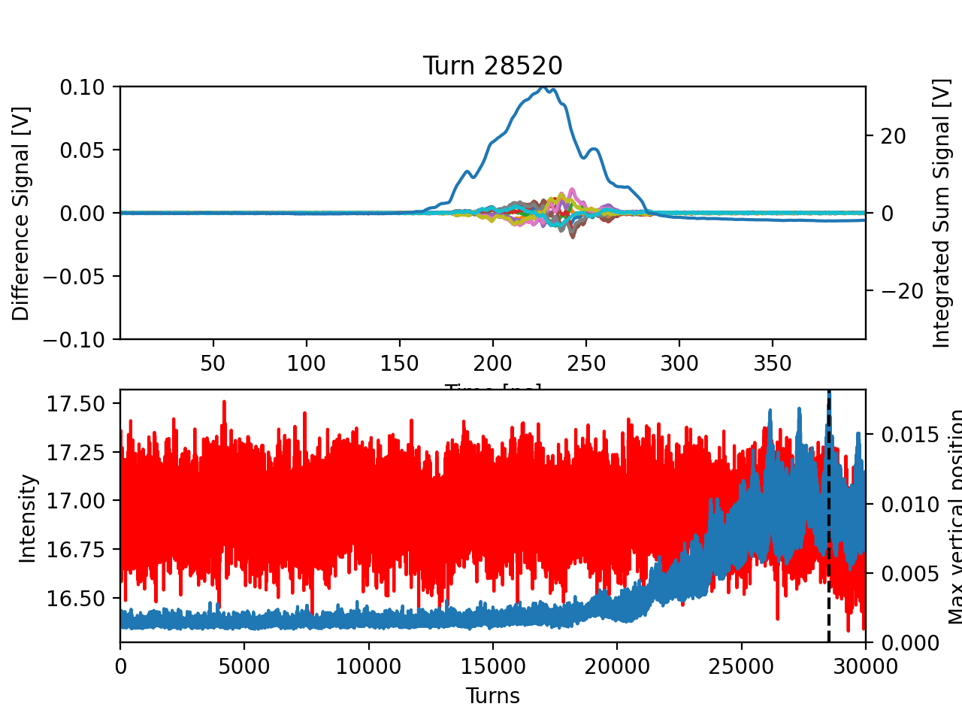
4 booster turns, gain=2, just above threshold
1.1e11 ppb
Qsc=-0.0028
Qs~0.0005
q=Qsc/Qs ~ 5.6
Max
Difference
Signal

Slide 21
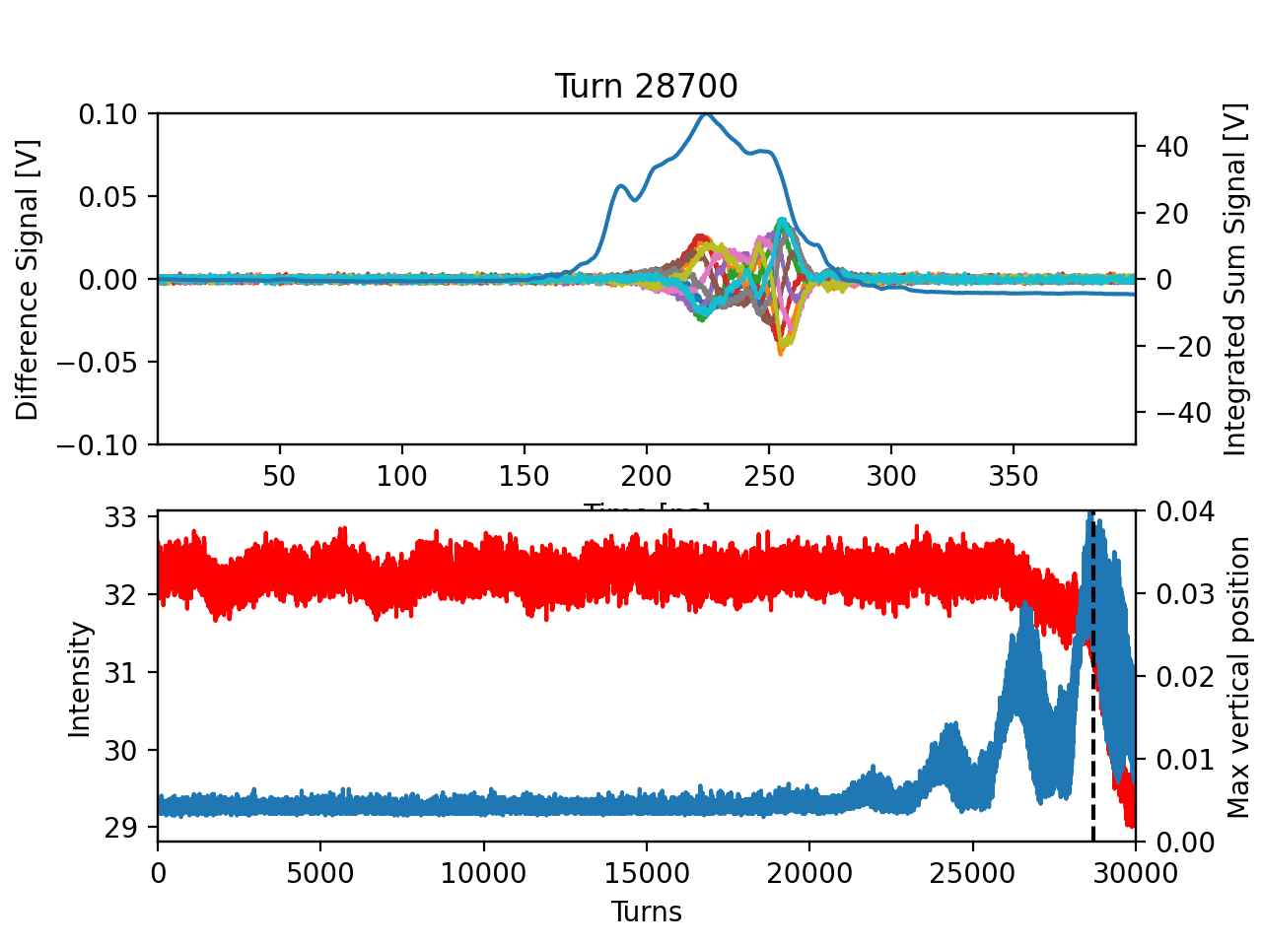
8 booster turns - gain=0.62, just above threshold
2.2e11 ppb
Qsc=-0.0056
Qs~0.0005
q=Qsc/Qs ~ 11
Max
Difference
Signal

Slide 22
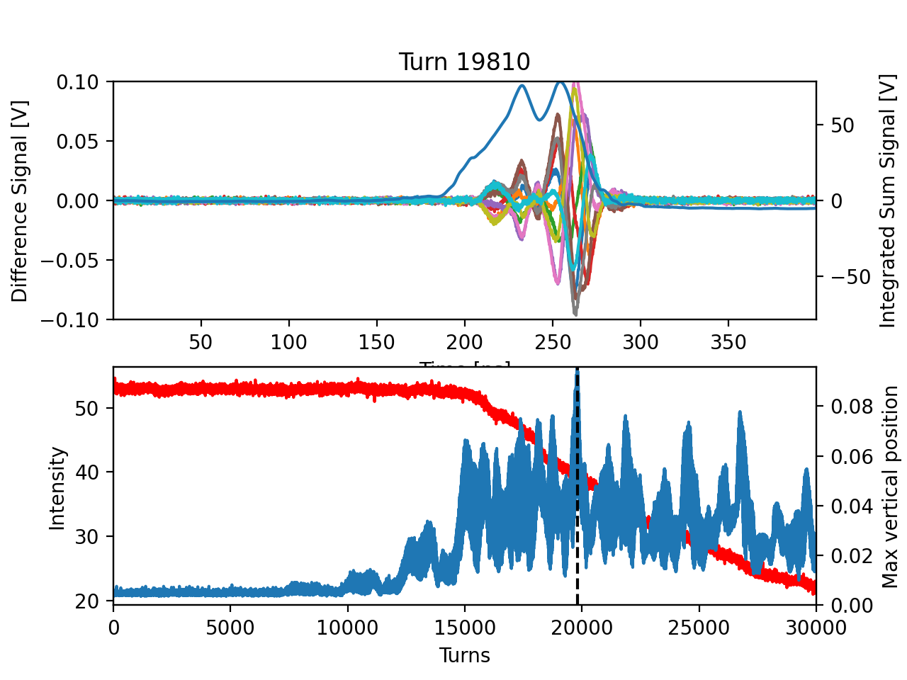
16 booster turns - gain=0.325, just above threshold
5.1e11 ppb
Qsc=-0.013
Qs~0.0005
q=Qsc/Qs ~ 26
Max
Difference
Signal

Slide 23
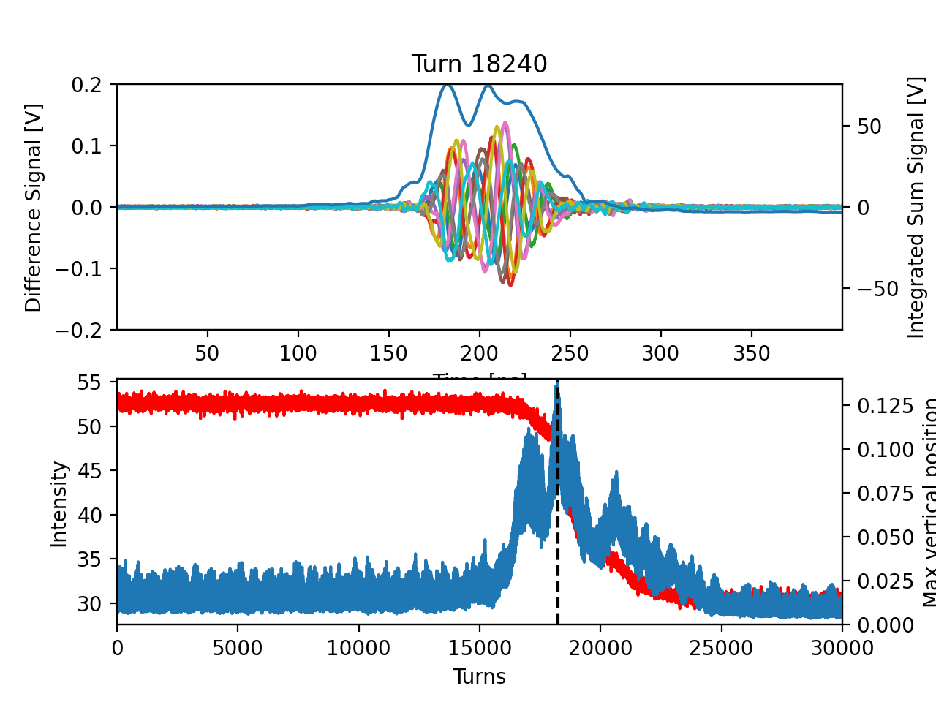
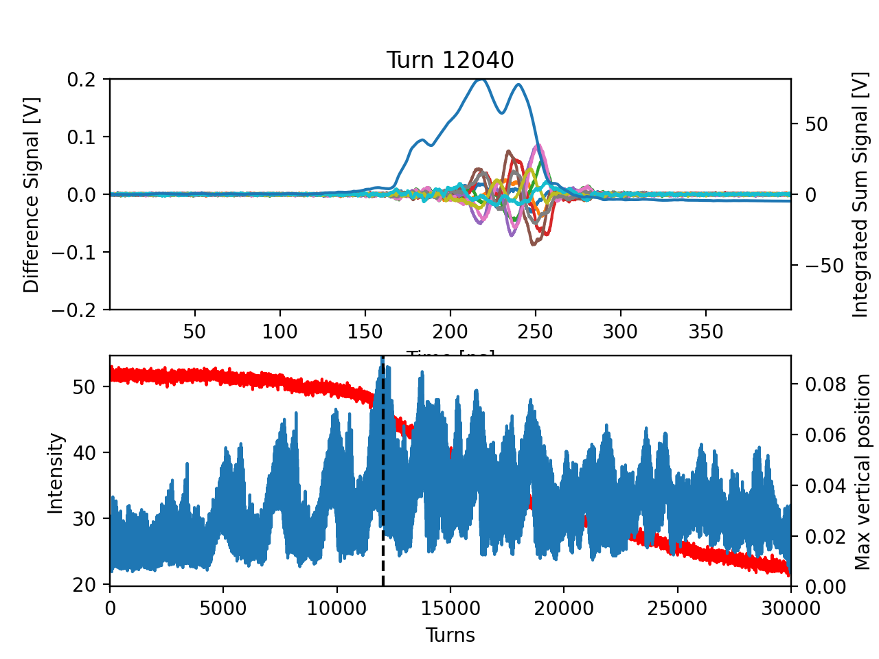
Coupling to +1 vs -1mode
Gain=-9
Threshold at -ve gain appears a much higher gain
Without space charge
Gain should be equivalent going +ve or -ve
With space charge
Should need more gain when shifting tune down
However, machine impedance means waker needs more gain to shift +ve
Qsc=-0.013
Qs~0.0005
q=Qsc/Qs ~ 26
Gain=0.3

Slide 24
Modifications for next run
Need a better way to measure the tune
Will add closed loop transfer function option to board
Need an extra ADC for this
Will doing A-B before board to free up 2 ADCs
200 MHz board in development (500 MHz but only need 200MHz)
Moving from softcore to hardcore on FPGA
Most likely ready by the end of the year
New postdoc (joined September) will be working on this as well

Slide 25
Moving to IOTA
Most significant costs of the system are:
RF amplifiers
Board development
Both are easily moved from Recycler setup
Will need pickups (x2) + kicker to complete system
IOTA RF frequency is similar to Recycler (around 2-2.5MHz)
Reduced revolution time could make things a bit tricky
Recycler revolution time ~ 11 us
IOTA revolution time ~ 1.8 us

Slide 26
IOTA study plan
Recycler has some limitations
Large natural tune shift due to impedance, magnets etc.
Knob to control space charge is mostly based on intensity
IOTA studies
Study instability conditions at strong space charge
Compare with theory
Easier in IOTA due to low velocity I.e. minimal impedance
Couple studies with other experiments
e.g. electron cooling -> more control of phase space -> control of space charge

Slide 27
Summary
Wake building feedback system has been commissioned in Recycler and will eventually be moved to IOTA when protons are ready
Will allow study of instability conditions in varying space charge and wake amplitude
Collaboration is welcome in both RR and IOTA for these studies

Slide 28
Backup

Slide 29
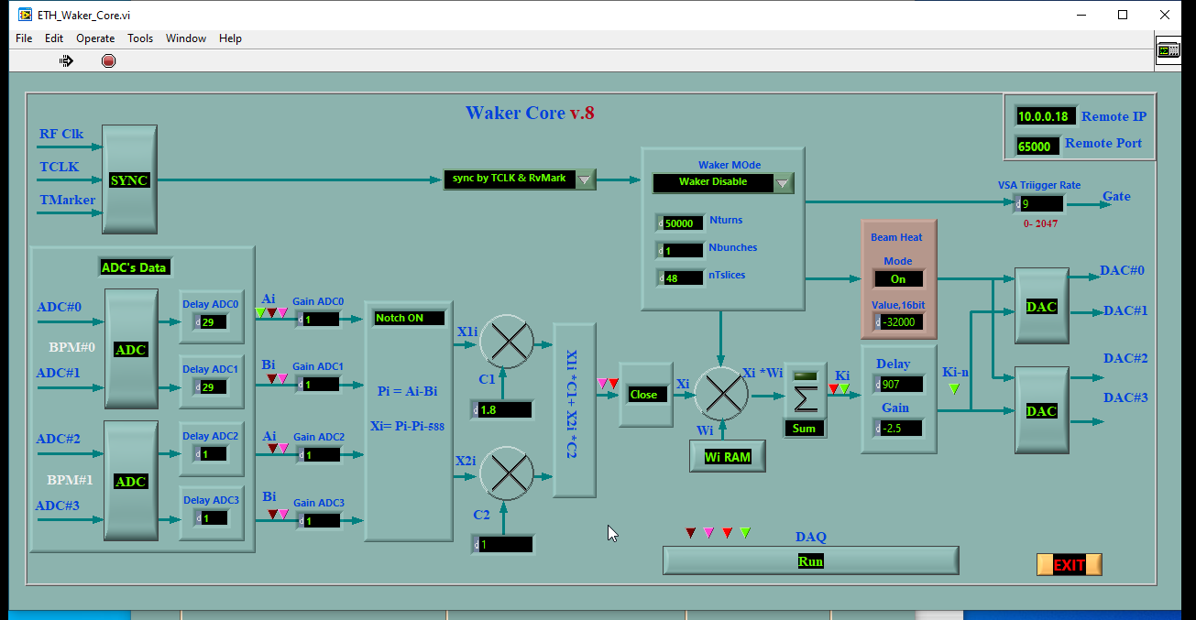
Key Parameters

Slide 30
Timing in the system
Combining the bpm signals with the C1,C2 coefficients
Can simulate a signal with optimal phase advance to the kicker
i.e. 90deg
Set delay such that kicker kicks the beam
Can be found by performing open loop beam transfer function

Slide 31
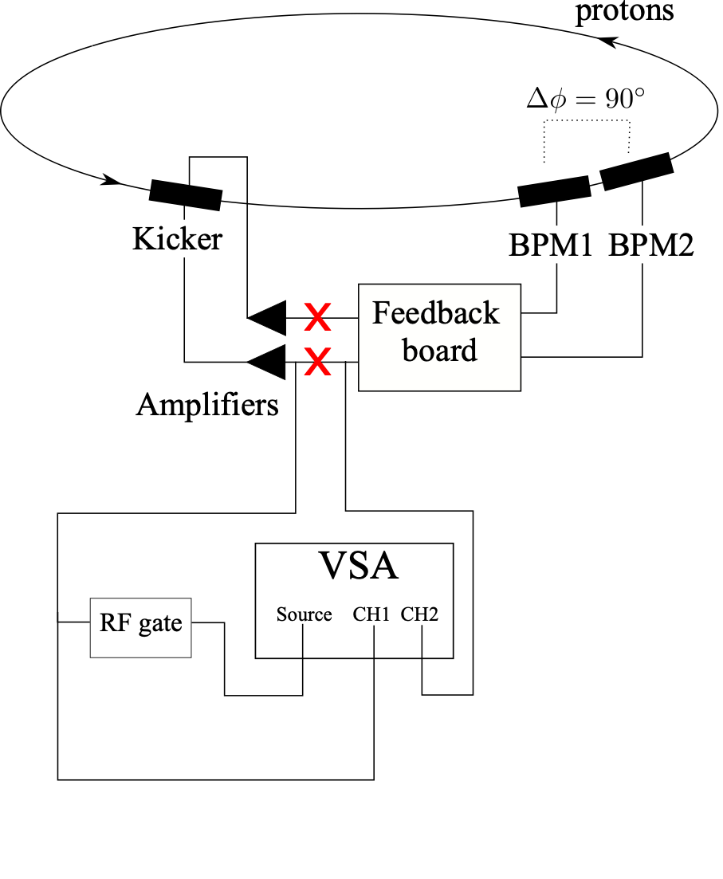
Open Loop Beam Transfer Function measurement setup
Break loop between board and amplifiers
VSA sends noise source in frequency bandwidth to the amplifier
Board sends combined bpm signal to the VSA

Slide 32
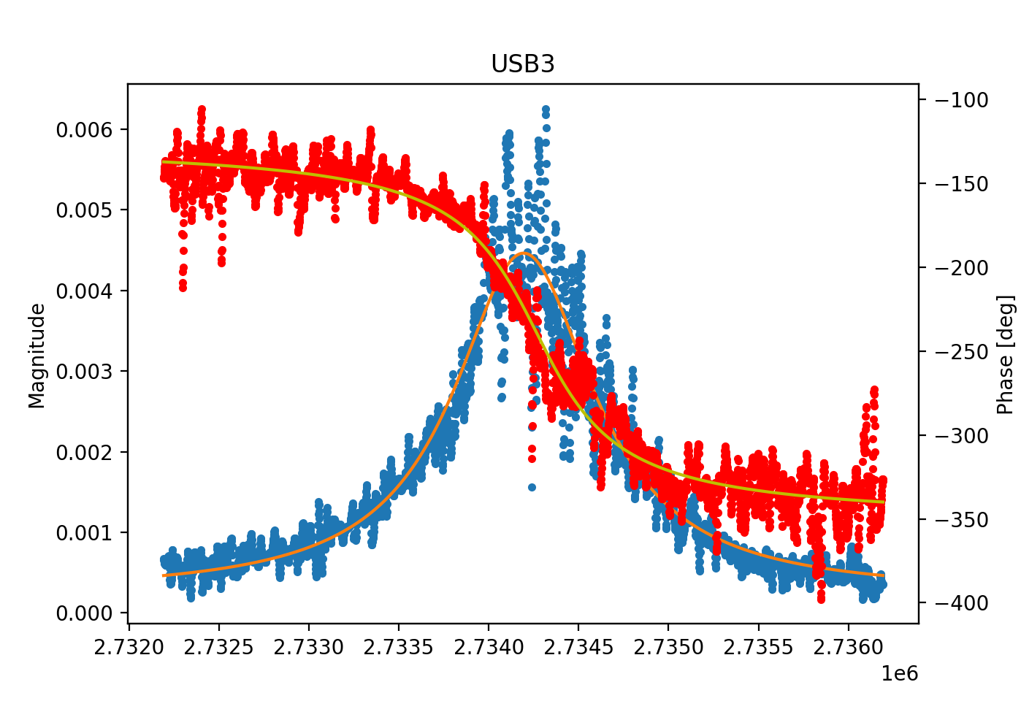
Betatron sidebands
Tune = Q + q
Integer
Fractional
Lower sideband
Upper sideband
(n-q)*f_rev
n*f_rev
(n+q)*f_rev
Example measurement

Slide 33
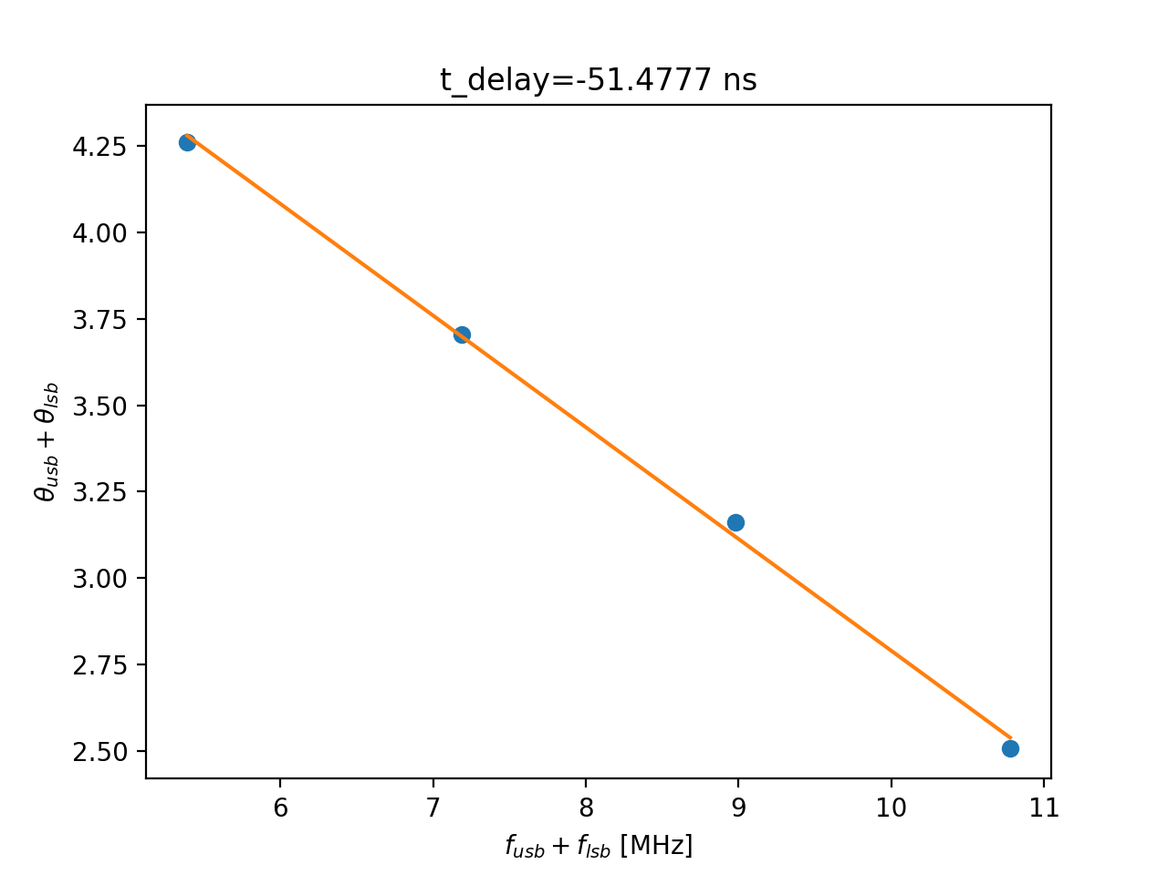
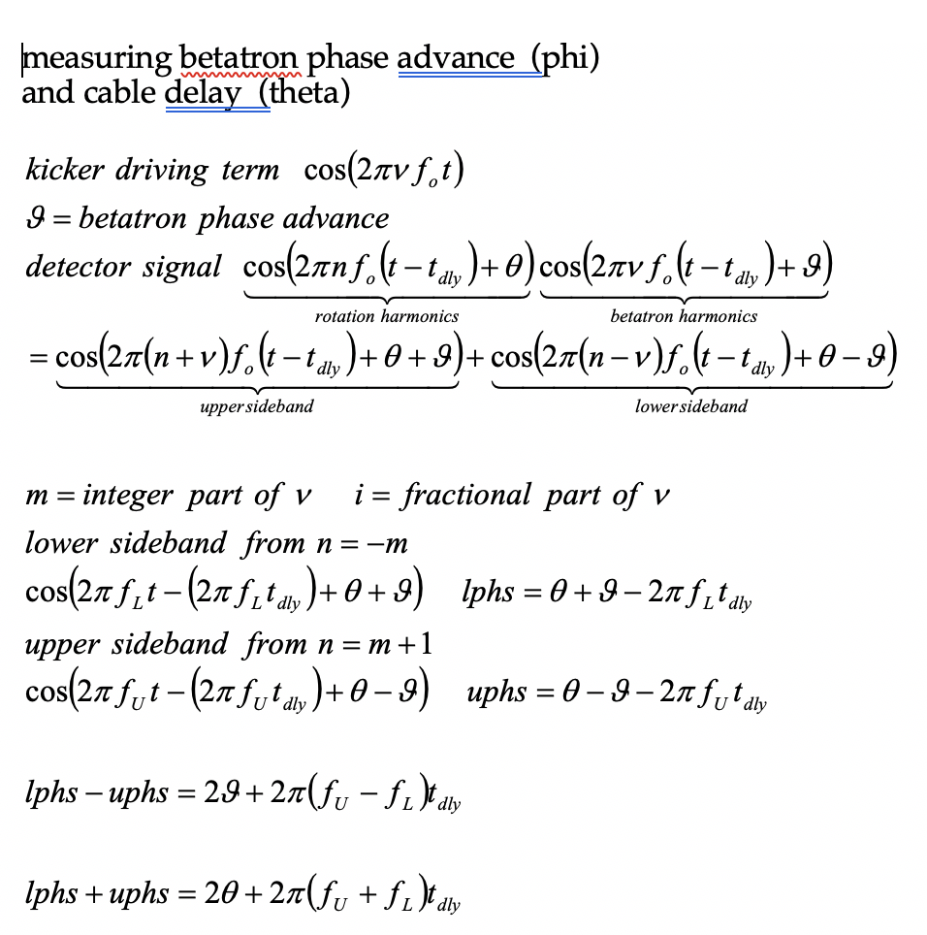
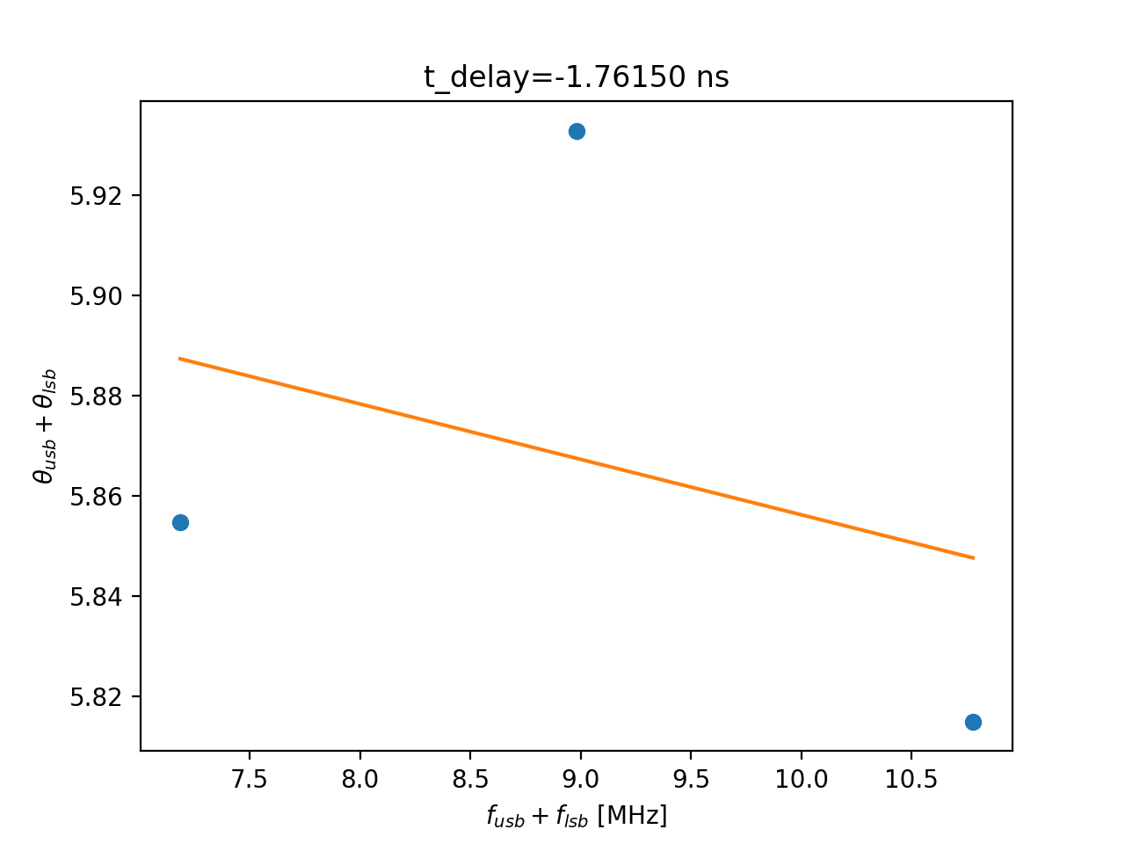
System delay
Sum of upper and lower sideband phase vs combined frequency of sidebands

Slide 34
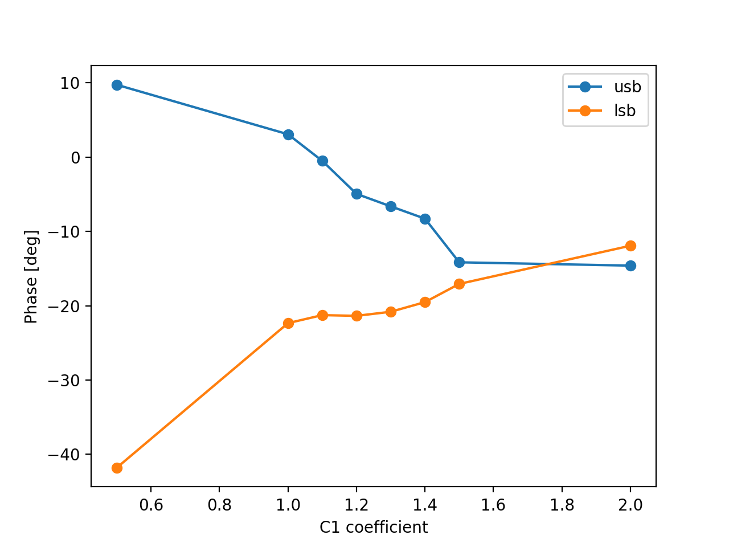
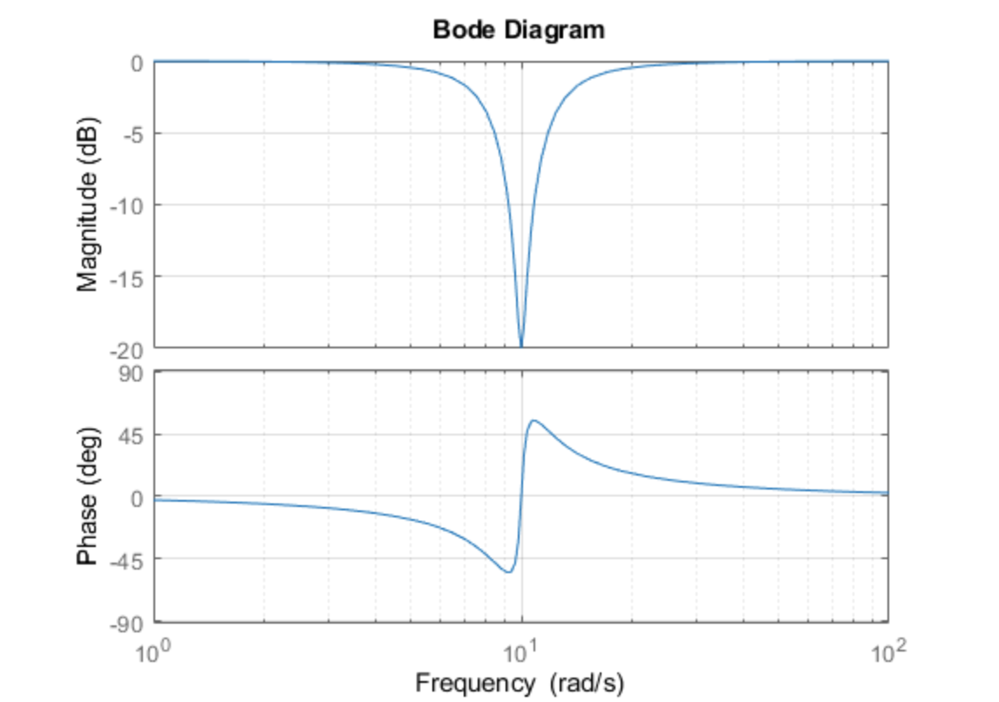
Coefficients of bpm
Once t_dly~0,
Phase difference between 2 sidebands is twice the phase advance from pickup to kicker
Ideal phase advance is 90deg, so sideband difference should be 180
However, phase response from notch results in 180 flip around revolution harmonic
Therefore, both sidebands should have the same phase
Not quite sure where the 10-15 deg offset comes from

Slide 35
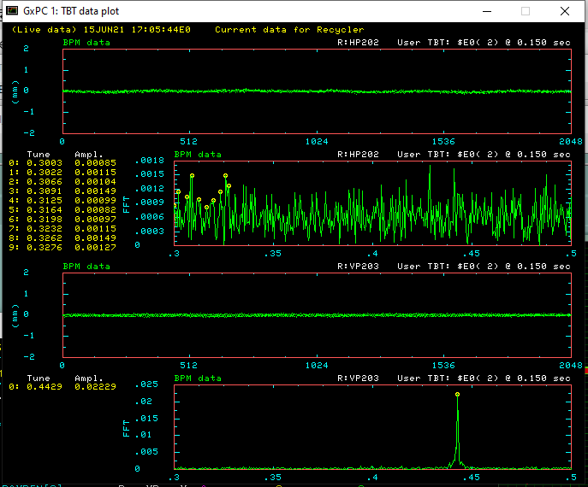
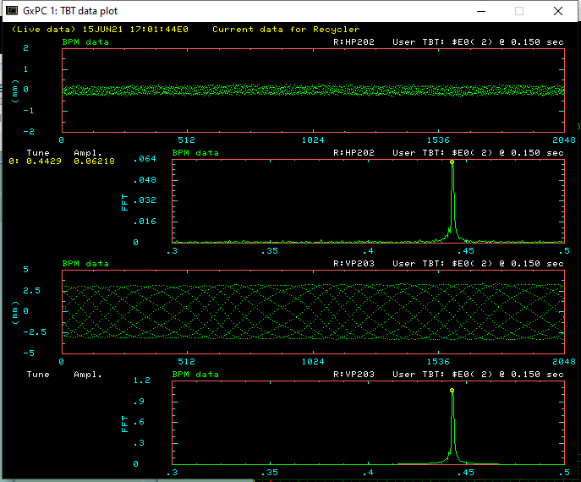
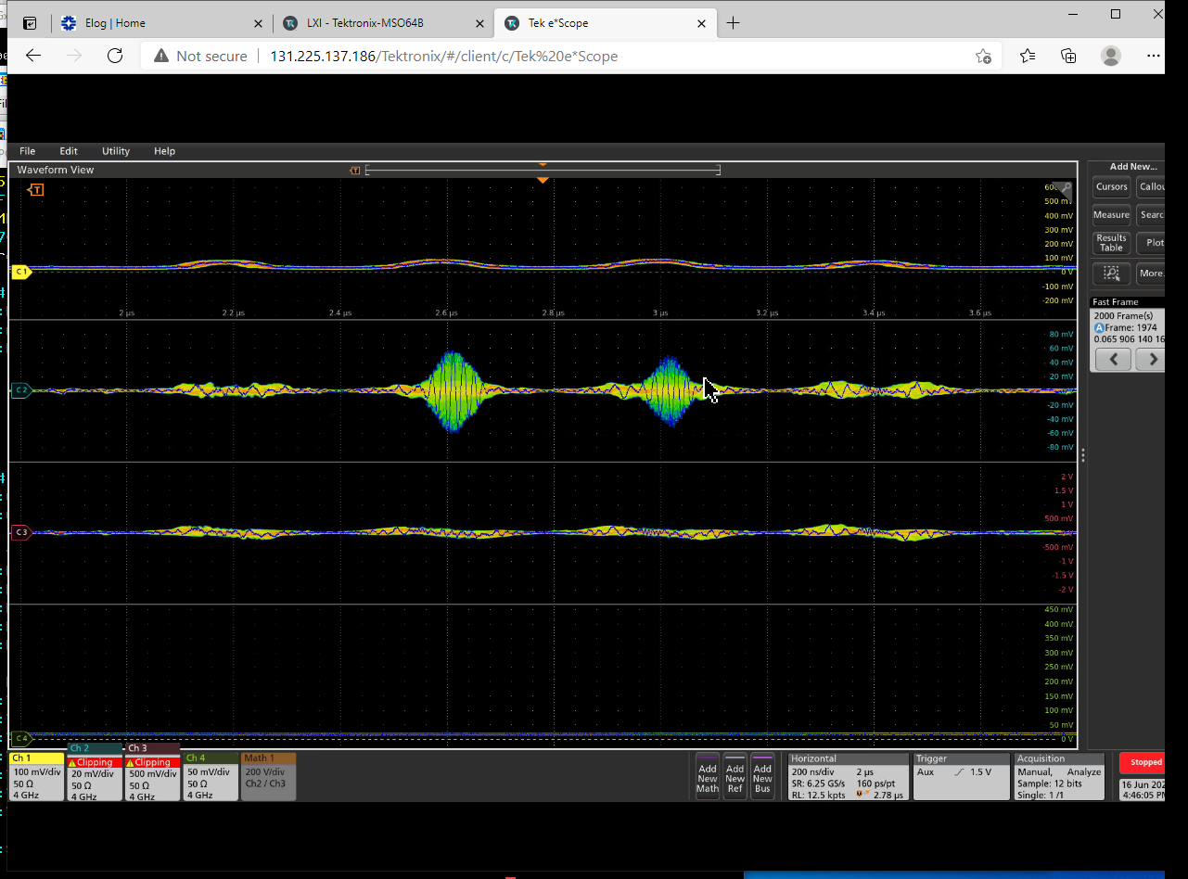
System timed in, try to damp/antidamp as test
First try on 53Mhz beam
Then try anti damp 2.5MHz beam
Not sure why most motion is middle 2 bunches
Damp
Antidamp

Slide 36
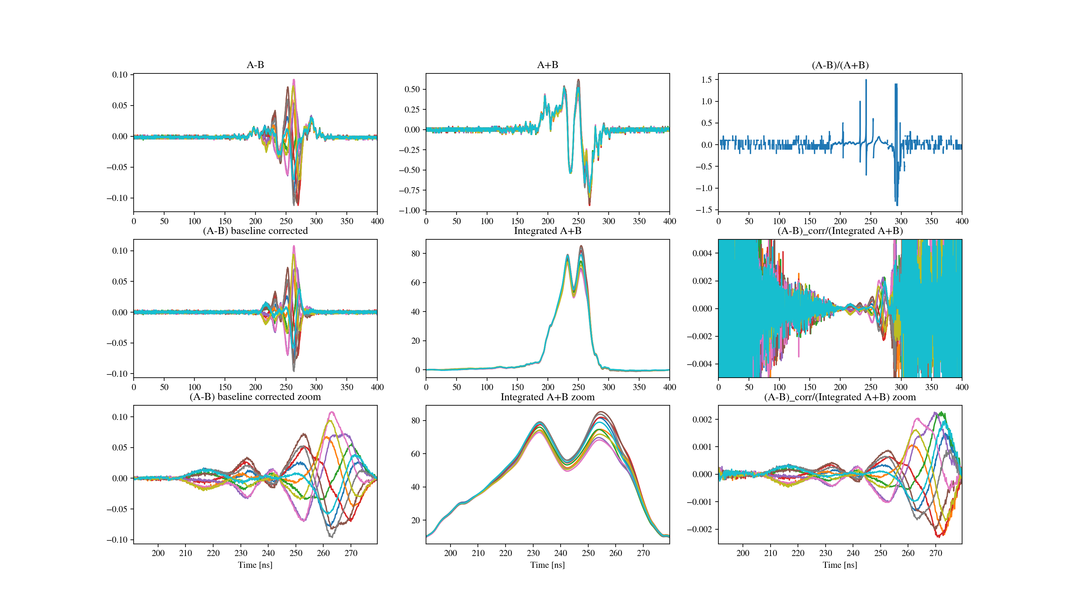
Stripline pickup analysis
Raw
Corrected
Zoom

Slide 37
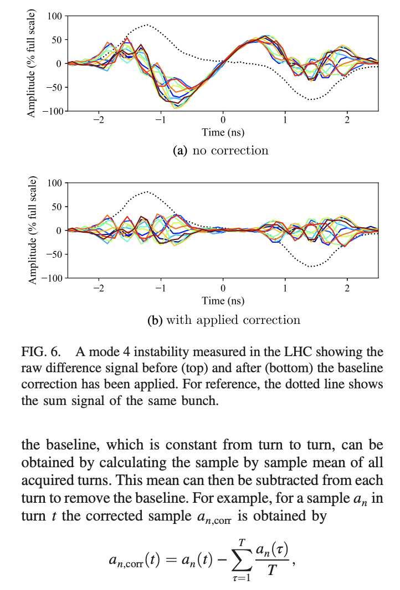
Baseline correction (CERN headtail monitor)

