Slide 1
Research on Electron Cooling in IOTA
Nilanjan Banerjee
2021 IOTA/FAST Collaboration Meeting
29 October 2021

Slide 2
Overview
Motivation and goals
Implementation
Simulations
Hardware
Plans
Conclusion

Slide 3
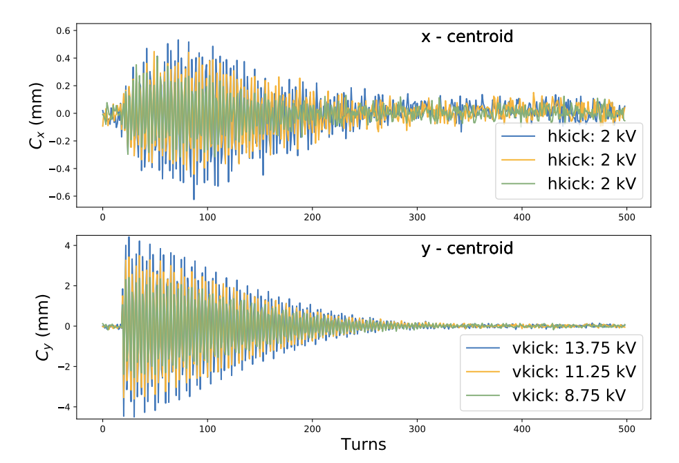
Motivation
Electron cooling is the process of exchanging thermal energy between an ion beam and a co-propagating electron beam which serves as a cold bath. Why in IOTA?
Necessity!
Reduce emittance growth to increase lifetime. Eg. IBS growth at design current are of the order of seconds.
Create low energy spread.
Observe turn-by-turn non-linear dynamics of bunches with reduced decoherence.
Explore and study the intensity frontier.
Electron cooling proposed by G.I. Budker in 1967!
C. Hall et al. in Proc. 10th Int. Particle Accelerator Conf. (IPAC'19), Melbourne, Australia, May 2019

Slide 4
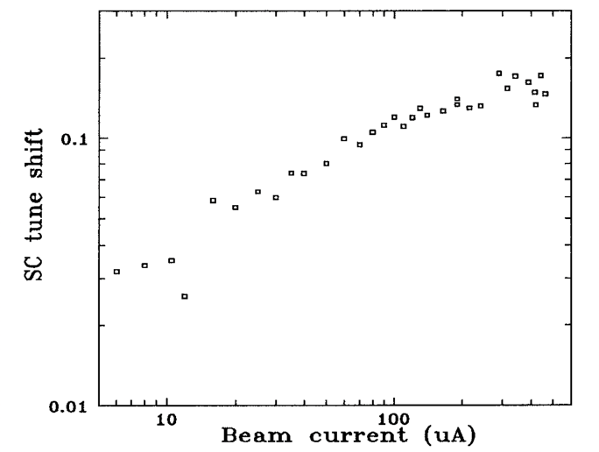
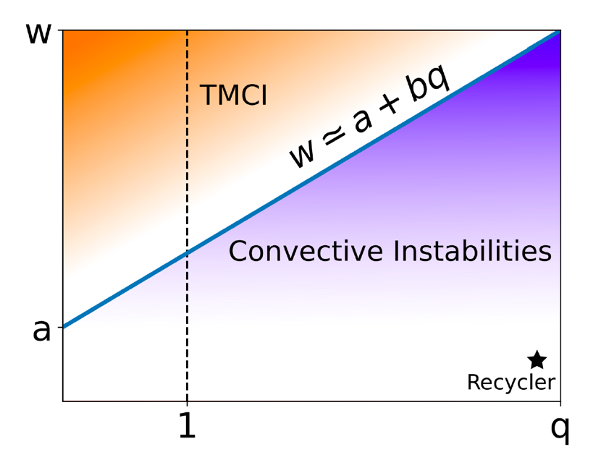
Physics Goals
Study large incoherent tune shift
Space charge forces limits the minimum emittance reached by coolers.
Electron coolers typically operate at tune shifts < 0.01 – 0.1.
Study instabilities
Interplay of wakefields, space-charge and electron cooling.
Electron cooling as a knob for space charge parameter.
Non-linear Integrable Optics with SC and cooling
Realize NIO in the multi-particle regime.
S. Nagaitsev et al., Proceedings Particle Accelerator Conference, 1995, pp. 2937-2939
Anti-damper
Electron Cooling
A. Burov, Phys. Rev. Accel. Beams 22, 034202, 2019

Slide 5
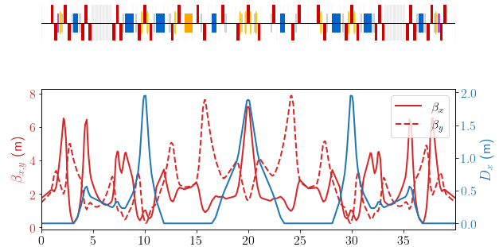
Implementation
IOTA will be configured to recirculate 2.5 MeV protons.
e⁻
Lattice based on the electron lens lattice v8.3
Dispersion is 0 at the electron lens.
C | KE | $$τ_{rev}$$ | h | $$N_{bunch}$$ | $$A_{x,y}$$ | $$ν_{x,y}$$
39.96 m | 2.5 MeV | 1.83 μs | 4 | Coasting or 4 | 87, 78 μm | 4.117, 3.632
G. Stancari et al, JINST 16 P05002, 2021

Slide 6
Operating Parameters
$ε_{x,y}$ (μm) | $$σ_{p}/p$$ | $σ_{s}$ (m)
4.3, 3.0 | 1.32 x 10⁻³ | 0.79
Major sources of emittance growth: Space charge, Intra Beam Scattering, Residual Gas Scattering.
 | Coasting |  | Bunched
Current (mA) | 2.25 | 6.25 | 0.248 | 1.24
Bunch Charge (nC) | 2.28 | 11.4 | 0.113 | 0.565
Tune Shifts ($Δν_{x,y}$) | -0.076, -0.10 | -0.38, -0.50 | -0.076, -0.10 | -0.38, -0.50
RGS (s) | $τ_{RGS, single}$= 1060*, $τ_{RGS, ε_{x}}$= 25.8*, $τ_{RGS, ε_{y}}$= 15.8*
IBS $τ_{IBS, x,y,s}$ (s) | 32.0, 20.9, 40.4 | 6.40, 4.19, 8.08 | 43.4, 29.9, 115 | 8.69, 5.97, 23.01
Cooling times (s) | 1.00, 0.87, 0.496 |  | 1.00, 0.87, 0.992
*Based on P_{eff} = 4.2 x 10⁻⁸ Torr measured in Run 2. Aim to achieve P_{eff} = 1 x 10⁻¹⁰ Torr by baking.
https://indico.fnal.gov/event/43231/contributions/187359/attachments/129996/167589/IBSatIOTAcolaborMeeting.pdf
Emittance growth and beam loss due to space charge under active investigation.

Slide 7
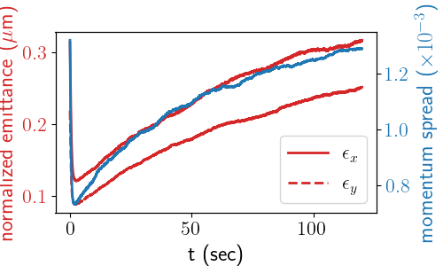
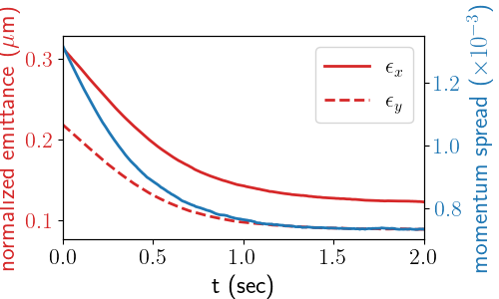
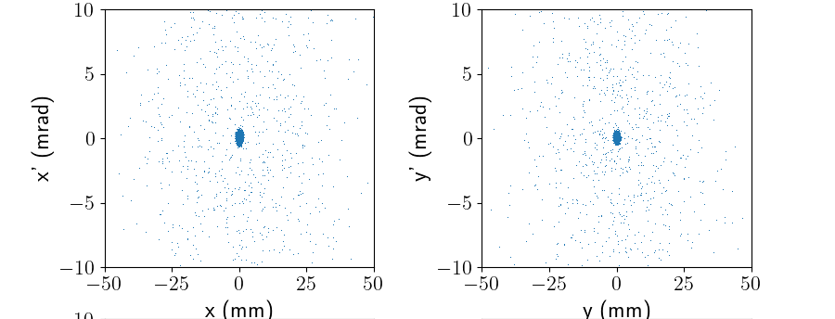
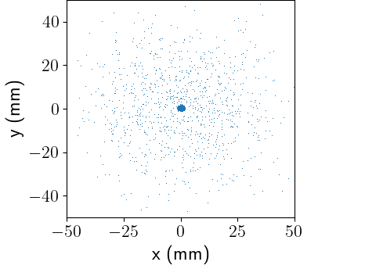
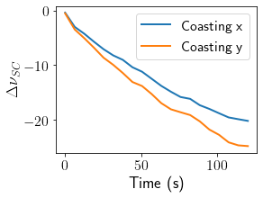
Simulations in JSPEC
Cooler parameters
Electron source: CW 1.36 kV, 10 mA, 𝟇12 mm, 1 V jitter, 1400 K
Solenoid: 0.1 T, 0.7 m, flatness: 2 x 10⁻⁴
JSPEC simulations
Only electron cooling and Intra-Beam Scattering.
Halo formation due to IBS.
No space charge!
Phase space scatter plots at t = 2 min.
Very dense core.
Diffuse halo at an intensity of 0.001.
Tune shift at core reaches -20!

Slide 8
Inclusion of Electron Cooling in PyORBIT
Space charge forces will limit the equilibrium core density.
PyORBIT is an extendible particle tracking code with a PIC space-charge model. Implemented an electron cooler extension to enable cooling simulations with space-charge.
Ion SC kick
Symplectic Solenoid transport
Solenoid field, space-charge, electron cooling, IBS
Smaller segments
Cooling and EL kick
XY coupling
Static space charge of the electron beam.
Dynamic space charge of ion beam.

Slide 9
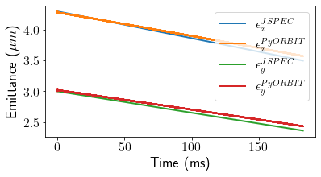
Benchmarking
Use the Parkhomchuk cooling force model for a magnetized cooler.
Verified results between JSPEC without IBS and PyORBIT without space charge.
Parkhomchuk

Slide 10
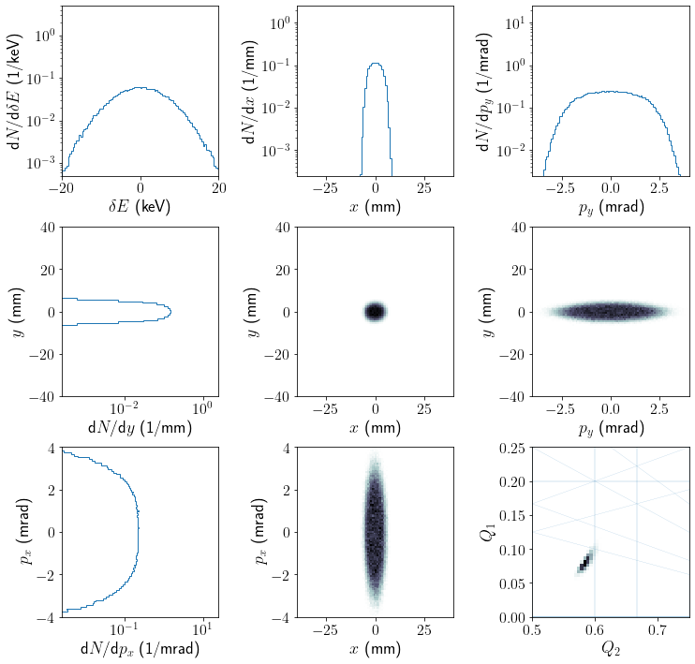
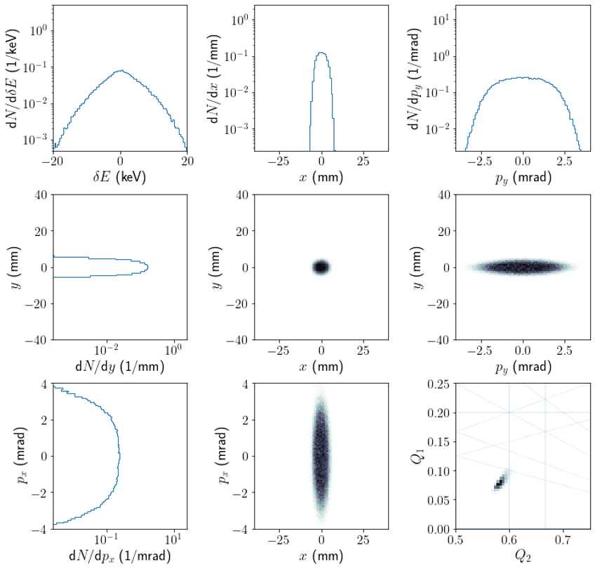
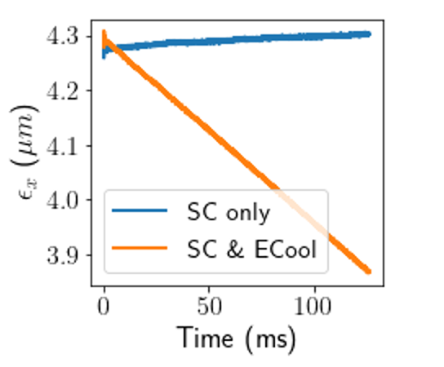
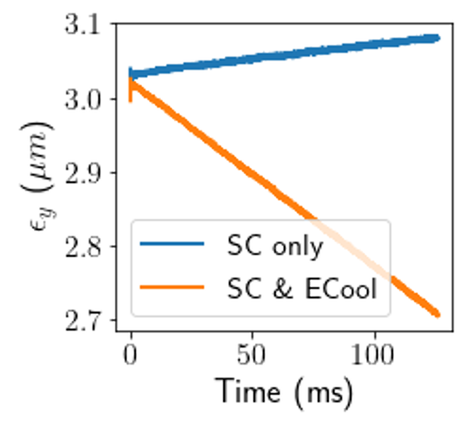
Preliminary Results
Simulated cooling with space charge for the IOTA lattice at $Δν_{y}=−0.1$
Cooling can compensate for space charge forces. Long term simulations required!
SC Only
SC and ECool

Slide 11
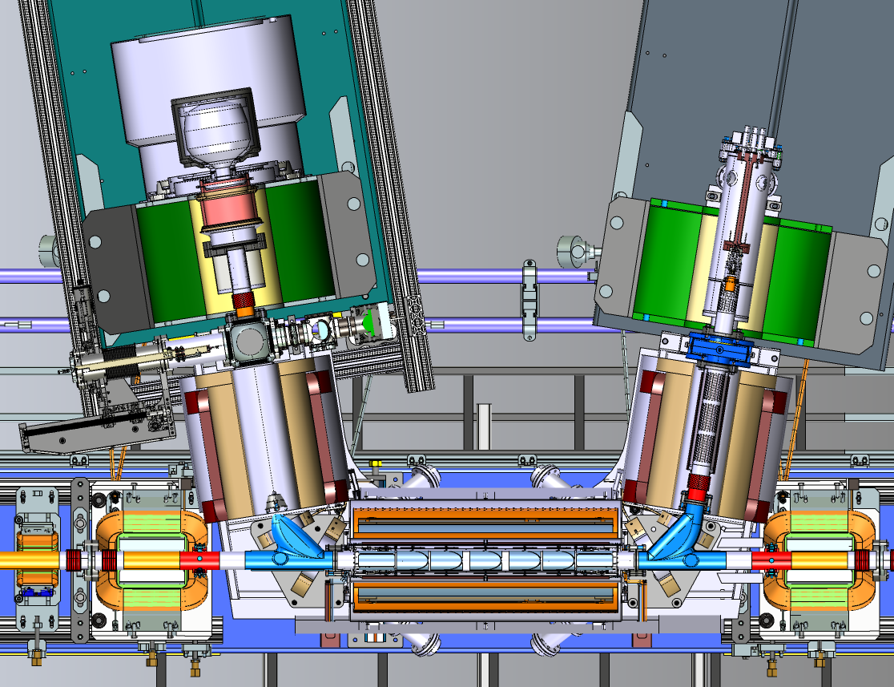
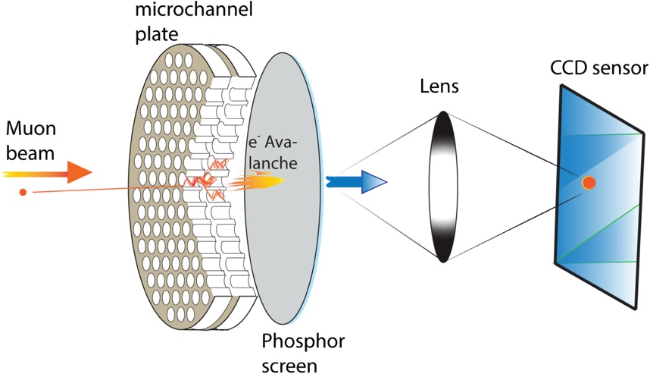
Hardware
Electron cooler is part of the e-lens program at IOTA and shares all hardware except for the gun.
Diagnostics:
Protons
Beam Position Monitors
DCCT
Recombination Monitor
Electrons
Faraday Cup
Profile monitor
e⁻ source
e⁻ beam
p
H⁰
M4R
Bongho Kim et al., NIM A, Volume 899,
Pages 22-27, 2018, ISSN 0168-9002

Slide 12
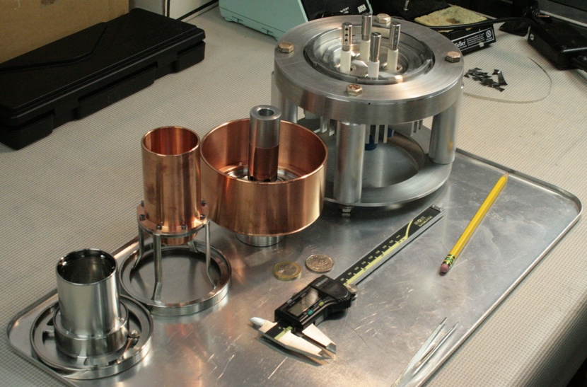
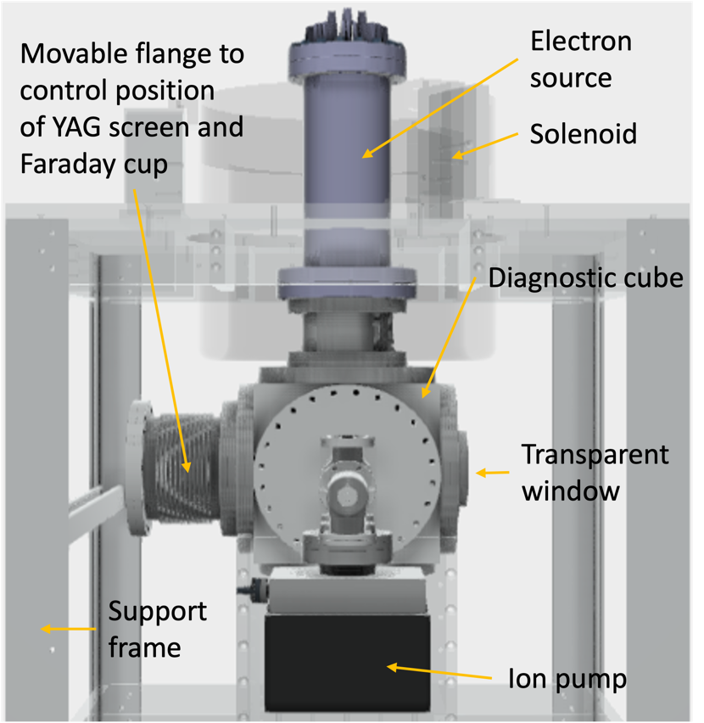
Electron Source
cathode
anode
Gun under design
Based on CERN Hollow Gun 1-in design.
Modify cathode shape to create flat beam.
Cross check design using WARP and TRAK.
Will be manufactured at UChicago.
University of Chicago Test Stand
Test vacuum and thermal performance.
Measure beam current and profile at low voltage.
profiler
MaryKate Bossard and John Brandt, UChicago

Slide 13
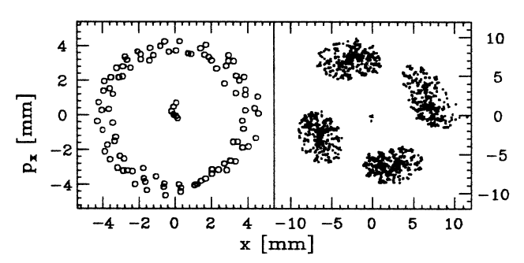
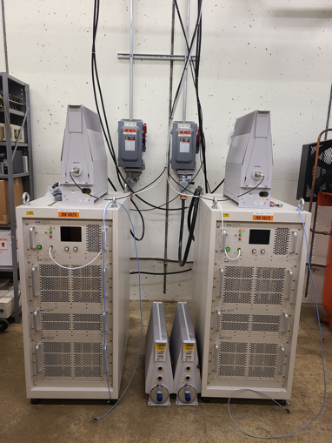
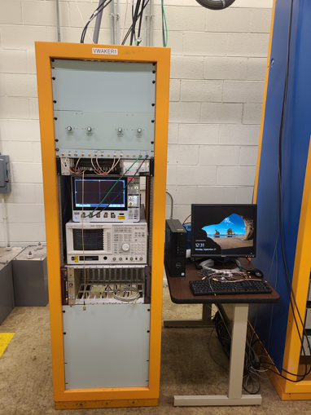
Plans
Commission electron lens.
Test electron source, solenoids, collector.
Demonstrate cooling at low intensity.
Adjust voltage, solenoid currents, proton orbit.
Detect beam size variations, beam current.
Explore non-linear dynamics at low current.
TBT maps with small energy spread.
Remove NL magnet. Explore high intensity.
Install anti-damper and study instabilities.
S. Y. Lee et al., Phys. Rev. Lett. 67, 3768, 1991
Rob Ainsworth, ICFA HB 2021

Slide 14
Conclusion
Electron cooling at IOTA will increase proton lifetime and create low energy spread. Goal to explore large incoherent tune shift, study instabilities and NIO in the multi-particle regime.
Implement using the e-lens setup with dedicated thermionic source for cooling. Operate with zero dispersion at the e-cooler. Space charge and Intra Beam Scattering (IBS) are main emittance growth drivers for 2.5 MeV proton operations.
Simulations with electron cooling and IBS indicates the formation of a very dense core and a diffuse halo, not seen in practice. Developing simulations using PyORBIT which incorporates space charge, electron cooling and x-y coupling. Ongoing studies.
Plan to establish electron cooling at low proton currents. Take turn-by-turn measurements of non-linear dynamics. Remove aperture restrictions and commission to high current, study instabilities and NIO in the multi-particle regime.

Slide 15
Acknowledgements
MaryKate Bossard, John Brandt and Young-Kee Kim at The University of Chicago.
Brandon Cathey, Sergei Nagaitsev, Giulio Stancari and the IOTA/FAST collaboration at Fermilab.
Chad Mitchell, Runze Li and IOTA Physics collaboration members.
Questions?

