Slide 1
μ Storage Ring for ν beam
1980 - ??
VLENF
David Neuffer
Fermilab f
December 2011

Slide 2

Previous work
1980 intensity guess
    Acceptance is ~10% (δp/p) 100 mrad (θ)
  0.0014 π/p injected in acceptance
  ~0.0002 μ/p stored
  ~0.00006 ν_{e}, ν_{ΰ} /beamline
Proceedings of the
Telemark Workshop on Neutrino Mass:
Cosmological, Theoretical and Experimental Considerations
October 2-4, 1980
Cable, Wisconsin
SLAC eConf C801002
Editors: V. Barger & D. Cline, U. Wisconsin

Slide 3
π → μ Injection
Injection of π into straight section, accept μ in ring acceptance.
  “stochastic injection”
    stochastic was popular in 1980
    stochastic cooling, stochastic extraction, …
Could also inject into target inside ring
For 2 GeV/c, C=~200m
  inject with ~3 GeV/c π
p
π
p

Slide 4
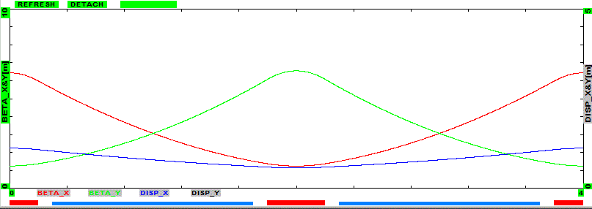
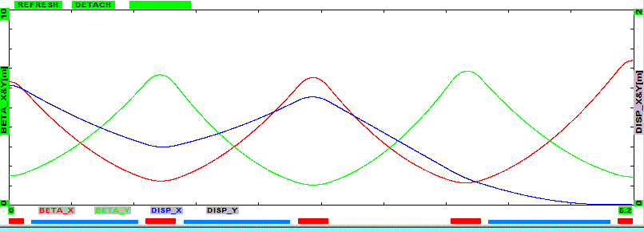
Lattice parameters – 2 GeV
Circulating P_{μ} is 2 GeV/c
  half-cell length - 2m
  Decay length is 168m for 3 GeV/c –π
  Decay length of 2GeV/c–μ
    12500m - ~600 turns -44 μs
  Missing magnet dispersion suppressor
    η > 1m
24m arc
72m straight section

Slide 5
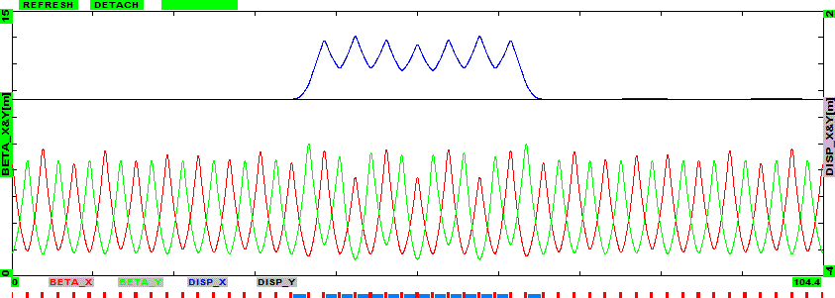
Lattice Acceptances
Parameter | Symbol | Value | Unit
Cell length | L | 4 | m
Max β | β_{max} | 6 | m
Dispersion | η_{max}, | 1.2 | m
Quad | B’, L | 12T/m | 0.4m
Dipole | B | 1T | 1.4m
Arc quads would have r<0.15m
  ε_{acc}= 0.15²/6=0.003
  ε_{acc,N}= ~0.06m
    ε_{acc,N,rms}= ~0.01m
  δp/p = ±10%
  θ_{rms} = ~0.02
  Angle from π-decay
    30 MeV/3000 -~0.01
Low-Field (<2T) magnets

Slide 6
Overview of injection
π’s are in injection orbit
  separated by chicane
μ’s are in ring circulating orbit
  lower energy - ~2GeV/c
~30cm separation between orbits
~2 GeV/c μ
3 GeV/c π

Slide 7


Racetrack Storage ring
Inject ~3GeV π into Straight section to produce μ’s from decay
  30% of 3GeV π decay in 72m SS
Neutrino opening angle ~1/γ ~0.05
  beam transport angles ~0.02
  π-decay ~0.01
Arc straight section could be a bit weaker focusing
  decay channel must keep π beam confined to capture μ’s from decay
72m straight section
24m arc
$$μ^{−}→e^{−}+{\overline{ν}}_{e}+ν_{μ}$$
π
$$π^{−}→μ^{−}+{\overline{ν}}_{μ}$$

Slide 8
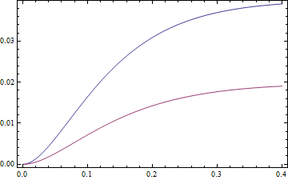
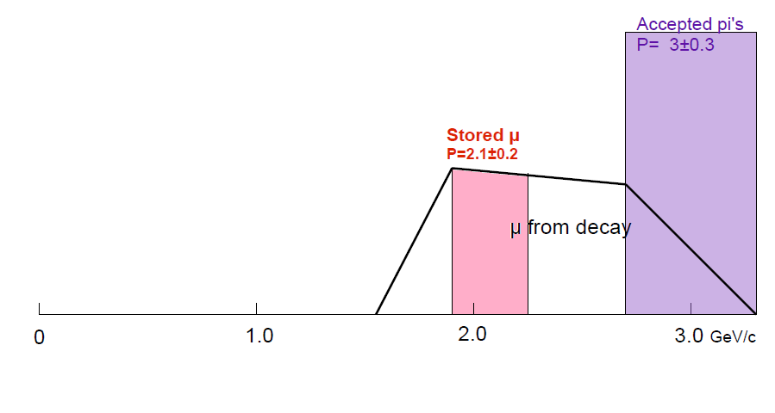
8GeV p → 3 GeV/c π
Intensity estimate
If acceptance is ±10%, θ<100mrad
  0.0165 π⁺/p (Str ex 0.017)
  0.0072 π⁻/p (Str ex 0.011)
Capture Inefficiency
  interacting p/p - 0.5
  decay in SS - 0.3
  decay acceptance – 0.2
Resulting stored ~2 GeV/c μ/p
  0.0005 μ⁺/p
  0.0002 μ⁻/p
π⁺
π/p
π⁻
θ_{acc}
Wang – 3GeV/c ±10% π from 8 GeV p

Slide 9
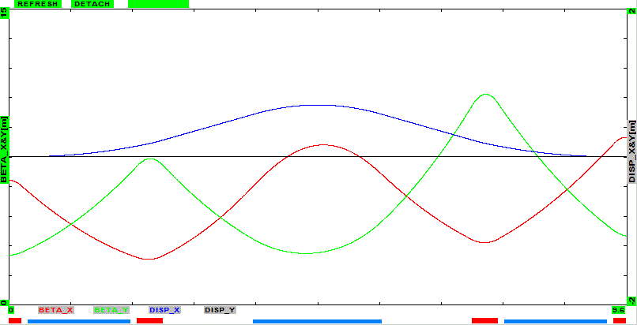
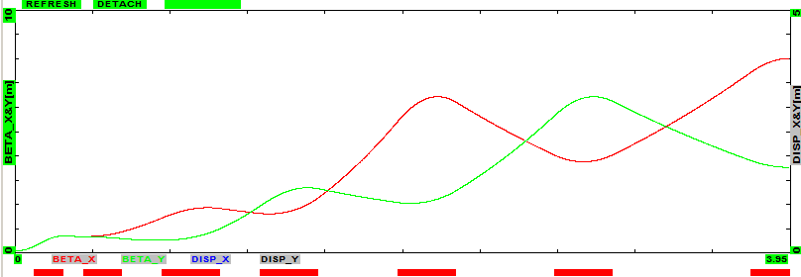
Target to Chicane optics
Match from target to injection chicane
  pi-beam
  ~AP-0 layout ?
Chicane – pion optics
Target to chicane transport – starting with 2cmLi lens – followed by quads

Slide 10
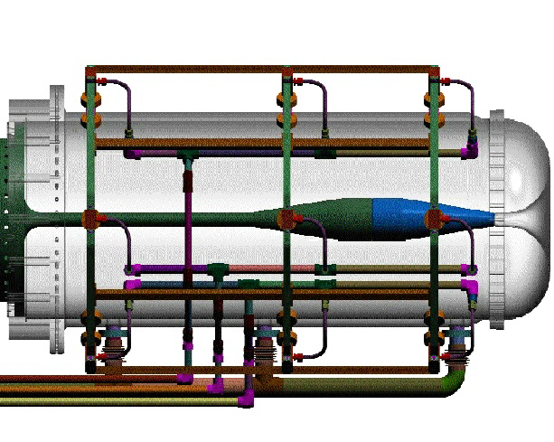
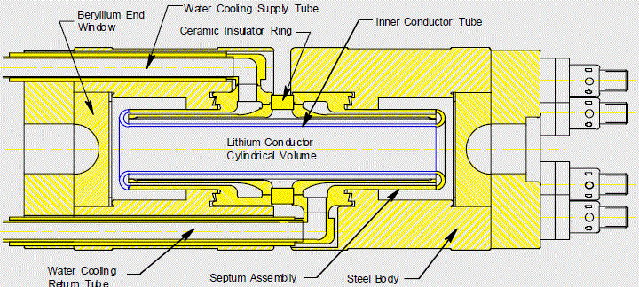
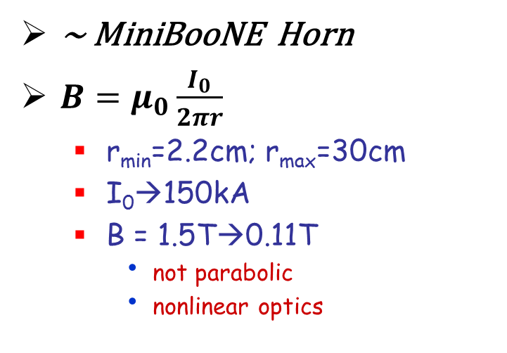
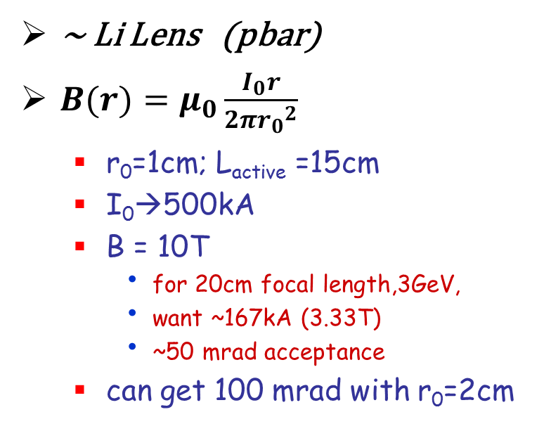
Li lens or magnetic Horn or?
~ Li Lens (pbar)
$B(r)=μ_{0}\frac{I_{0}r}{2π{r_{0}}_{}^{2}}$
  r₀=1cm; L_{active} =15cm
  I₀→500kA
  B = 10T
    for 20cm focal length,3GeV,
    want ~167kA (3.33T)
    ~50 mrad acceptance
  can get 100 mrad with r₀=2cm
~ MiniBooNE Horn
$B=μ_{0}\frac{I_{0}}{2πr}$
  r_{min}=2.2cm; r_{max}=30cm
  I₀→150kA
  B = 1.5T→0.11T
    not parabolic
    nonlinear optics

Slide 11
Intensity estimate
Start with 8 GeV Booster
  up to 5×10¹², 15Hz (100kW)
    7.5×10²⁰ 8GeV protons per 10⁷ s year
  initially ~3×10²⁰ p/year ?
    ~10¹⁷ stored μ/year
Could use Main Injector (upgrade)
  0.7—2 MW at 60—120 GeV
    compatible with stochastic injection
    ~10—100 times more muons
Could use Project X
  3 GeV cw, MW
    OK for ~1GeV storage
  8 GeV p 200kW +

Slide 12
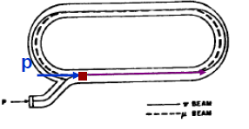
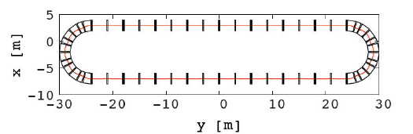
Variations
Injection
Use target inside ring
  circulating beam
  passes through target
Use fast kicker(s) for π injection
  proton pulse must be shorter than ring Circumference
  need very strong large aperture kicker
Ring Design
Use FFAG-style lattice
  must add injection
    dispersion bump + septum
could have better acceptance
  FODO probably not best …

Slide 13
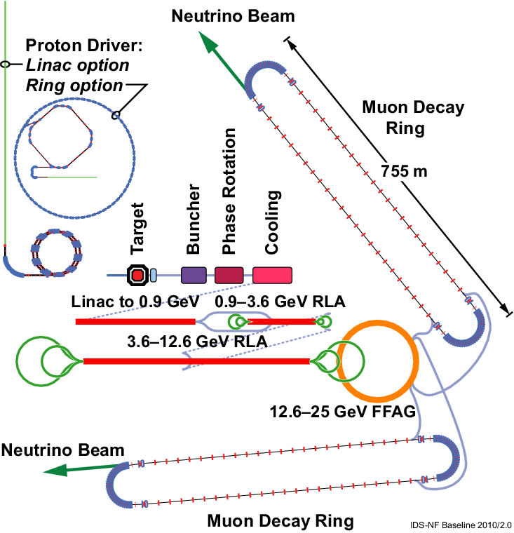
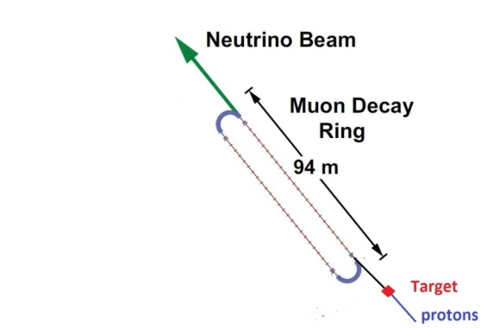
Comparison of facilities
IDS neutrino factory
Low-luminosity Neutrino Factory
“VLENF”

Slide 14
Comparison with Neutrino Factory
Does not use
  micro-bunched proton beam
  separate decay and phase-energy rotation
  muon cooling
  high-field magnets
  kickers
  rf for acceleration
  no muon linac, RLA
But: Lower intensity
  ~0.01 --- 0.001 ?
  only one μ sign at a time
Can use
  ~cw proton beam
  FFAG lattice for increased momentum acceptance
Must accept π→μ at full energy
  no acceleration

Slide 15
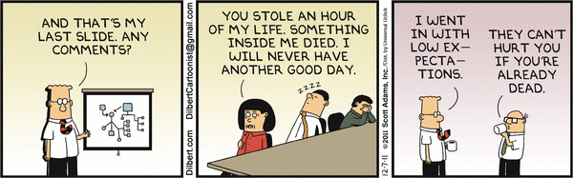
Summary
Presented a VLENF overview
“stochastic” Injection of muons into storage ring
Comments?
  today’s Dilbert:

Slide 16
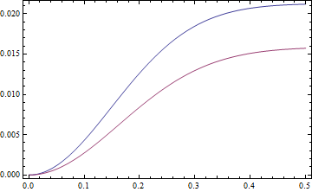
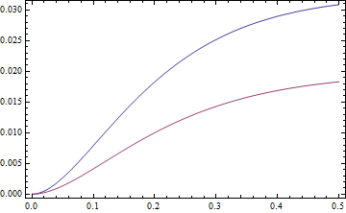
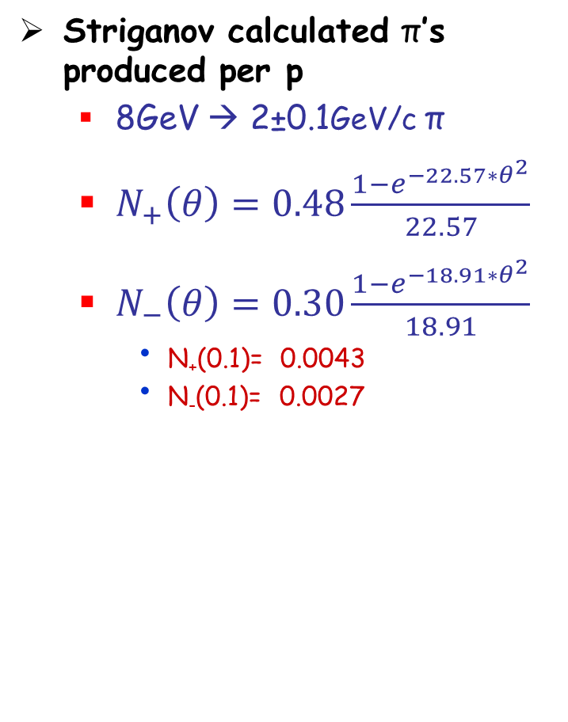
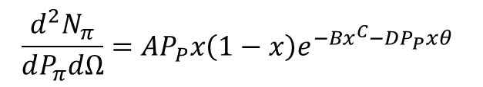
π production estimates
Striganov calculated π’s produced per p
  8GeV → 2±0.1GeV/c π
  $N_{+}\left(θ\right)=0.48\frac{1−e^{−22.57∗θ^{2}}}{22.57}$
  $N_{−}\left(θ\right)=0.30\frac{1−e^{−18.91∗θ^{2}}}{18.91}$
    N₊(0.1)= 0.0043
    N₋(0.1)= 0.0027
Compare with
Wang estimate:
$$\frac{d^{2}N_{π}}{dP_{π}dΩ}=AP_{P}x\left(1−x\right)e^{−Bx^{C}−DP_{P}xθ}$$
π/sr/GeV/c/interacting proton
x=P_{π}/P_{P}
for π⁺: A=2.385, B=5.732, C=1.333, D=4.247
for π⁻: A=1.572, B=3.558, C=1.333, D=4.727
Wang-PRD 10, 3876 (1974)
N₊(0.1)=0.0079, N₋(0.1)=0.0041
π/p (all)
π/p (interacting)
π⁺
π⁺
π⁻
π⁻

