Slide 1
LBNF Target PI/PM Report to IB
24th August 2021
Chris Densham, Peter Loveridge
(STFC Rutherford Appleton Laboratory)

Slide 2
US LBNF/DUNE project status update
(as of 23rd June 2021)
DoE funding guidance anticipated for US project (schedule assumes by end of August)
New subproject strategy being implemented
Beamline + Near Site Conventional Facilities now a separate subproject from Far Site subprojects
P6 schedule files being merged, including UK Phase 2 (construction) project
CD-1RR Director’s ‘Reaffirm’ Review: expected January 2022
CD-1RR DoE Independent Project Review: expected April 2022
Timing of subproject CD2/3 reviews still TBD
Target Station Integration Building (TSIB) included by name in the Presidential Budget with $15.5M allocated as requested
Crucial for integration of UK components – good news

Slide 3
US DoE feedback on beamline presentations to IPR Ref. presentation by Densham on the day of the last IB meeting 11th Jan

Slide 4
UK Project Management and Reporting since last IB
Reports and presentations to LBNF target Oversight Committee
26th January 2021 (feedback received 3rd March)
24th June 2021 (feedback received 9th July)
Reports to STFC Project Review Committee (PRC)
PM (Loveridge) has updated monthly reporting format
To align reporting requirements for the PRC with the Oversight Committee, additional requests from the LBNF/DUNE PM and streamline the reporting process overall
Project Planning Document:
US revised version of PPD (Part 2) returned to UK PI to incorporate scope revisions in Phase 2 proposal
Phase 2 (construction) project proposal
Status report at end

Slide 5
LBNF Target and Associated Equipment: Project Phases
Currently funded project
(4 yrs, starting Apr 2018)
2018
2019
2020
2021
2022
2023
2024
2025
2026
2027
2028
Phase 2 Proposal * (5 yrs, starting Apr 2022)
DESIGN
FEATURE PROTOTYPING
DEFINE UK COST/SCOPE
PHASE-2 PROPOSAL
Phase 1 (Design Phase)
Anticipated Future Request
(2027 - onwards)
PRODUCTION DRAWINGS
MATERIALS RESEARCH
PROCURE/MANUFACTURE/SUPPLY
TARGET/HORN INTEGRATION
Phase 2 (Construction Phase)
M&O (Operations Support)
TARGET STATION COMMISSIONING
FIRST BEAM
PRODUCTION OF REPLACEMENT COMPONENTS
Builds on the presently funded Phase-1 project. Envisaged as a direct follow-on, i.e. no funding gap.

Slide 6
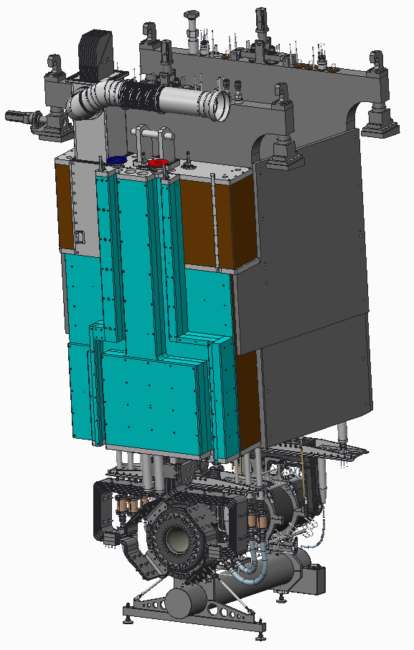
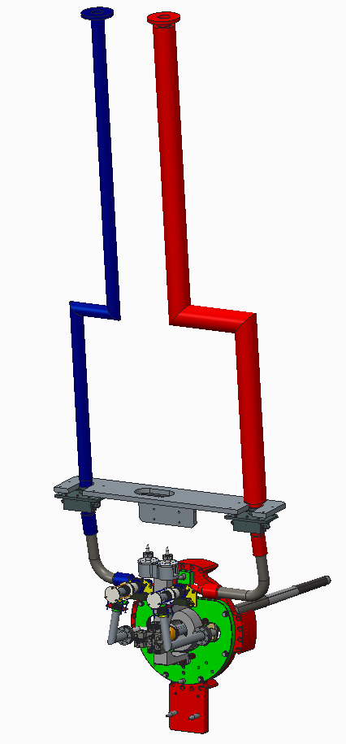
Definition of US/UK Scope
Many interfaces to take care of
Between UK Workpackages
UK/US
Between LBNF Neutrino Beamline WBS elements (Targetry, Horns, Remote Handling, …)
US responsibility
UK responsibility

Slide 7
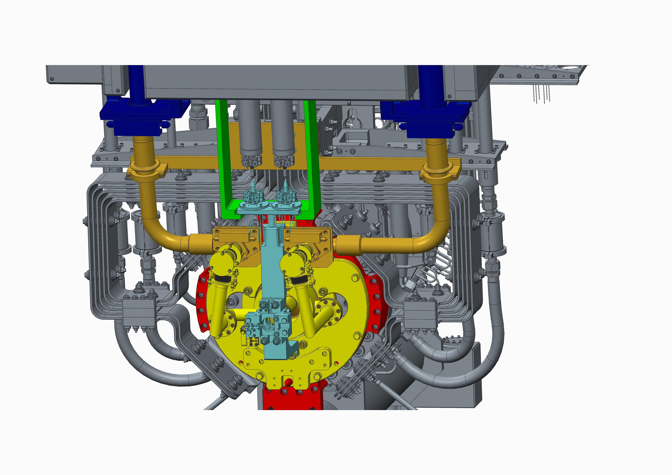
UK project interfaces - functional subassemblies
Helium assembly
Instrument connection bracket
Target Supports
Removed when exchanging a horn
Target Module
Removed when exchanging a target,
Removed when exchanging a horn
Hylen Device
Not part of UK contribution
Red docking plate

Slide 8
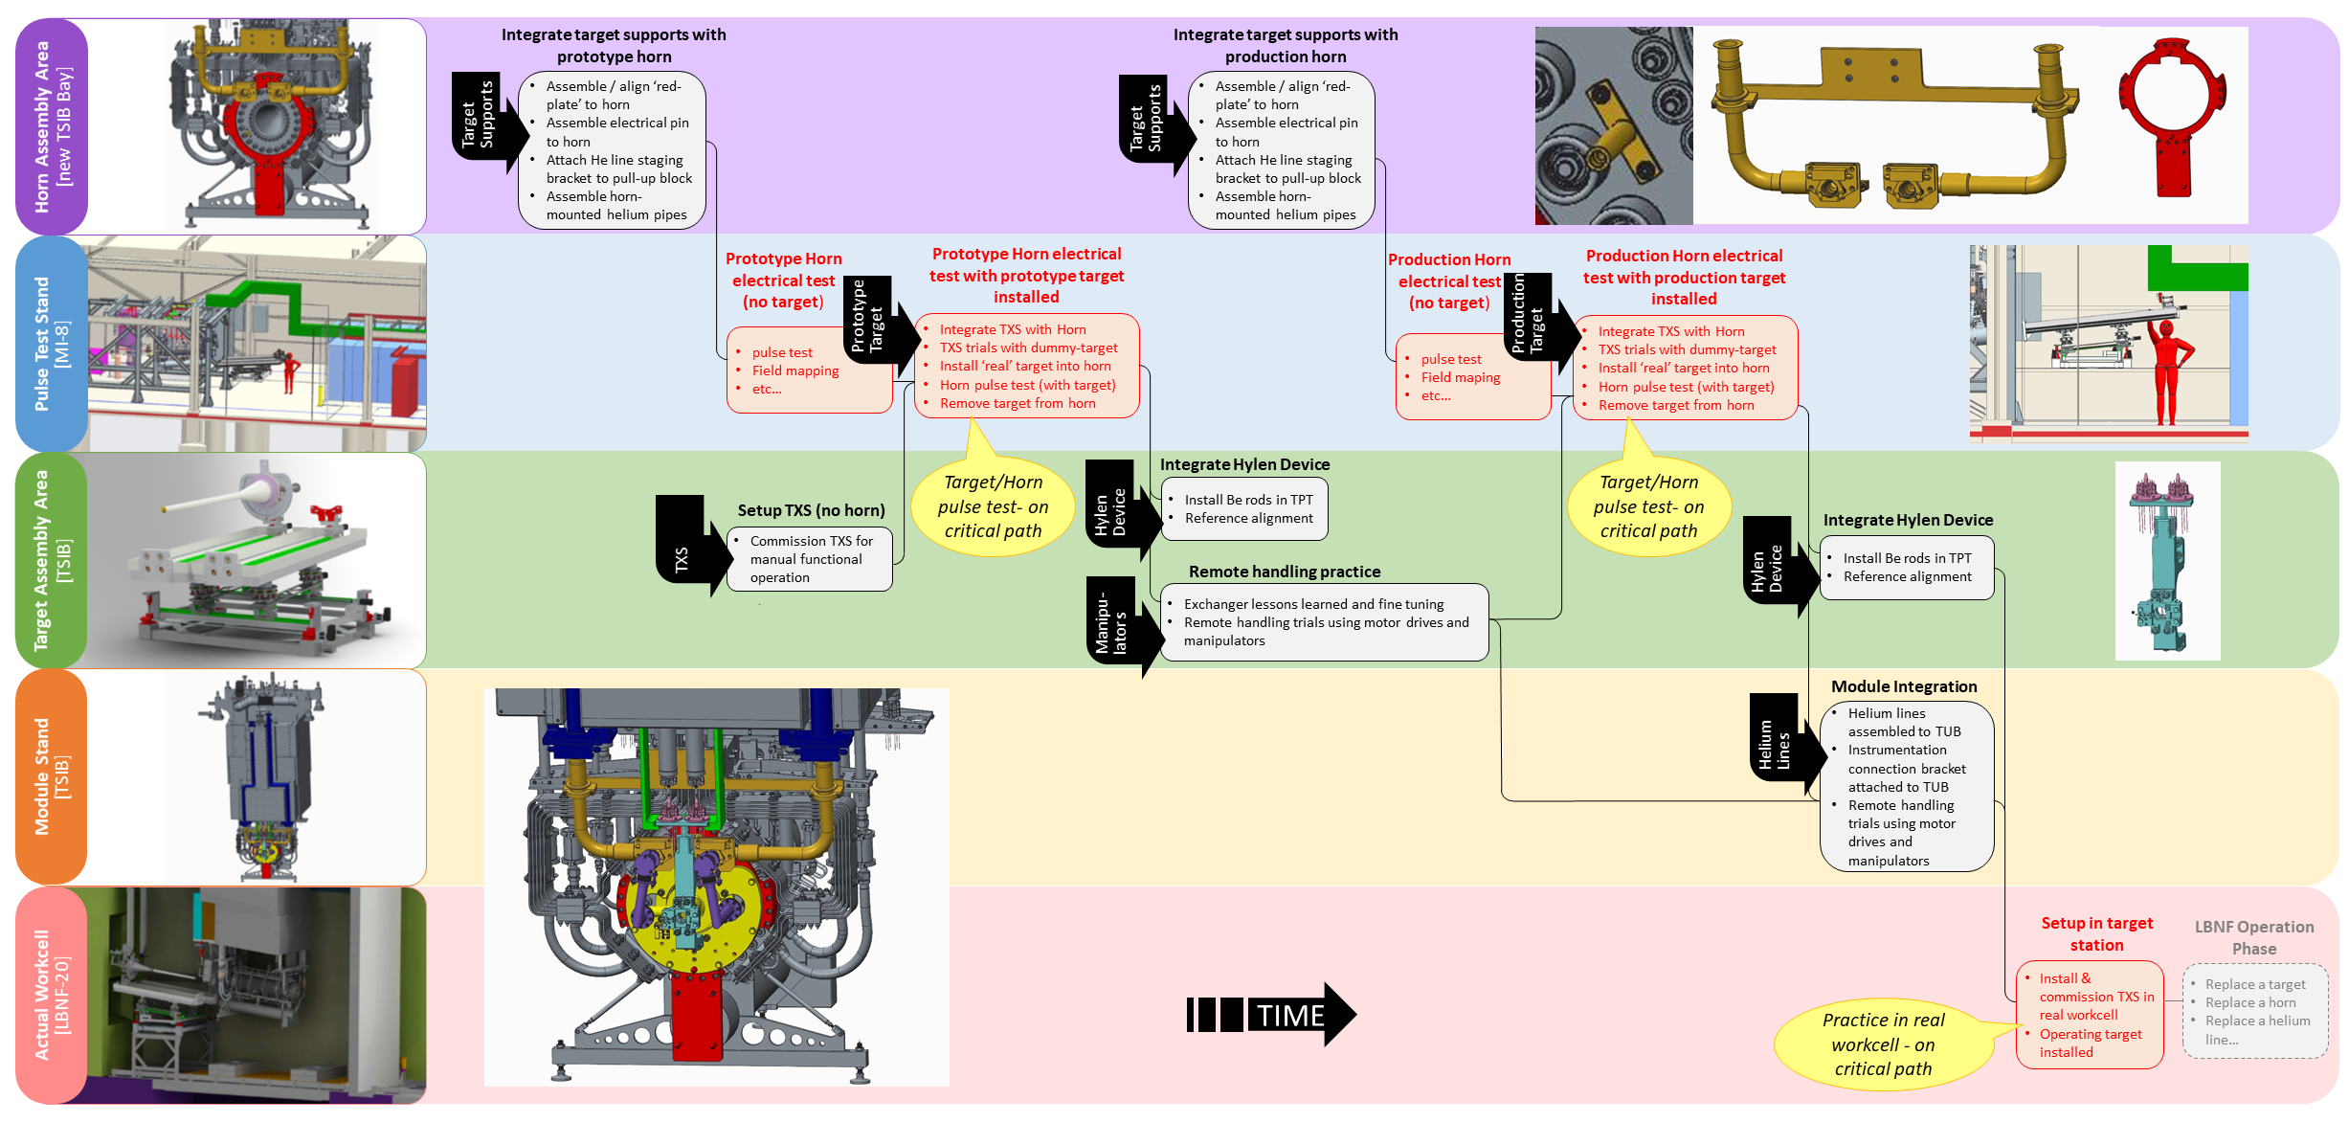
Targetry Integration Scheme across 5 locations at Fermilab

Slide 9
Beamline Interface Matrix Chart
Documents interfaces between the LBNF beamline WBS elements via a numbered Interface Control Document (ICD) for each individual interface

Slide 10
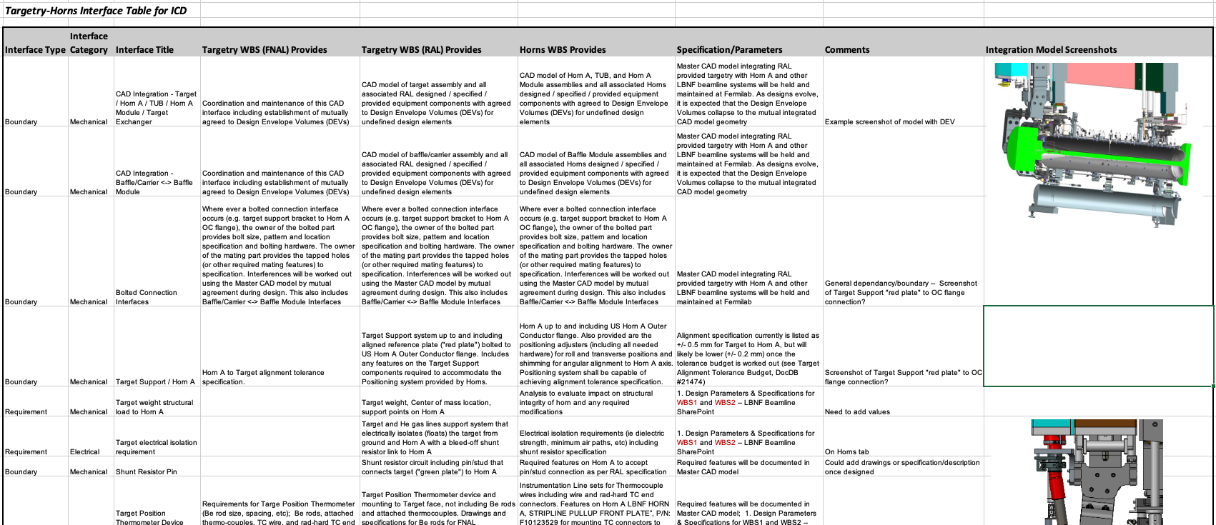
Interface Control Documents
ICD17 between target (RAL) and horns (Fermilab)
Beamline Parameters and Specifications
Interface Matrix
Interface Control Document
LBNF Beamline Requirements
Target Alignment Tolerance Budget

Slide 11
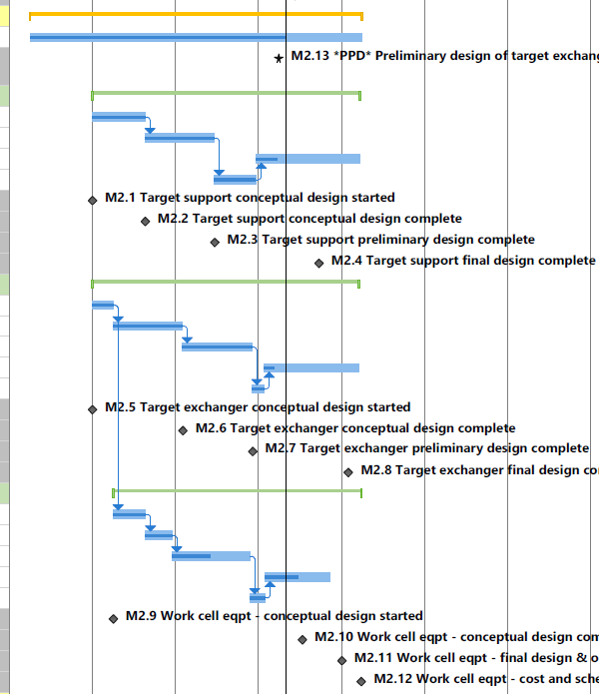
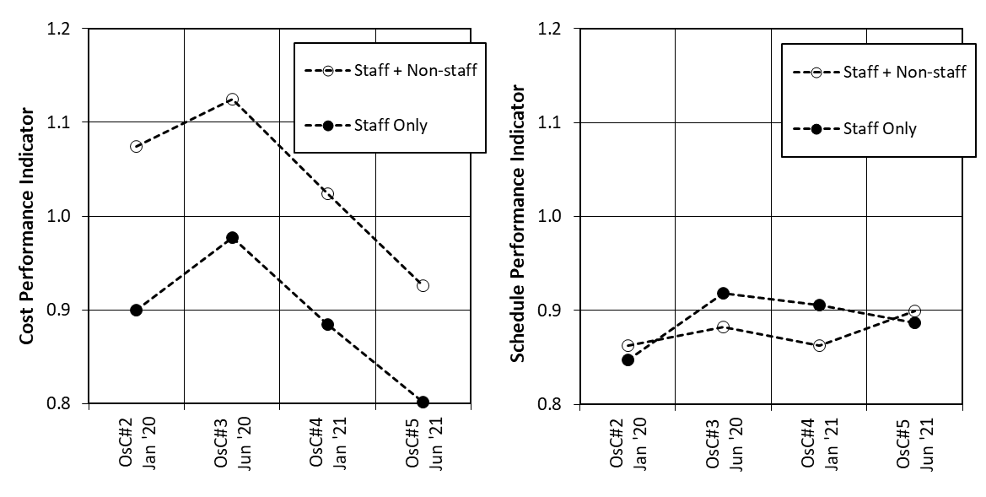
LBNF-UK Target Project - Earned-Value Assessment
In the Phase-1 (design phase) project we have implemented an earned-value tracking process using a resource-loaded gantt
Has proved to be a useful project monitoring tool, e.g. to inform on COVID impacts
Intend to take this forward into phase-2 project
Status date
Note: %complete estimates by task shown on Gantt
Example earned-value data from phase-1 project
A screenshot from the phase-1 gantt

Slide 12
LBNF Target: Staff Budget and Spend
Costs in this phase-1 project are dominated by staff resource
PM tracking monthly staff bookings and staff cost against the funded profile
We project a staff overspend of £166k at end of March 2022 (but is within approved sum)
Cumulative staff time very close to proposal plan ☺
Cumulative staff cost presently exceeds proposal plan by £88k: no pay rate escalation in STFC grant award ☹

Slide 13
Extract from UK LBNF/DUNE Project Board Report Authored, owned and approved by C. Townsley Submitted to PB 3rd March 2021, provided to sub-projects 20th April (7 weeks later!)
“For the Targets sub-project an unfortunate compromise has been reached for the remainder of phase 1 whereby their PRC will be modified slightly report (with help from the PRC secretary) to be more quantitative. This was deemed a necessary compromise since the sub-project uses the PRC report as their central management tool in-between OsC meetings, rather than the requested issues/risk logs and schedule. However this near-term management approach will not be adequate for the larger phase 2. Our request to increase the frequency of catch-ups to fortnightly has been supported by the Oversight Committee.
“The root-cause of these communication problems is that the engineering sub-projects consider themselves to be standalone projects and do not yet fully see the benefit for them in a unified project approach. As a result they sometimes find it difficult to engage with the change control process and centralised management. Overcoming this has sucked a lot of energy from the project which would otherwise lead to beneficial improvements and reduce overall risk.
“We appreciate the help from Programmes Directorate in ensuring that the change control process cannot be bypassed; and in reminding the project participants that the process covers many aspects of project control beyond merely access to working allowance.”

Slide 14
Feedback from UK OsC received on 3rd March 2021
‘The OsC expressed concern that PPRP would be likely to reject the Phase-II proposal without clear evidence of additional resource request to increase the project management and reporting activity, particularly given its stronger emphasis on project management in recent years. Consequently, the OsC recommended that the collaboration consider the possibility of delaying the initially proposed April PPRP date to allow time for the above procedures to take place…’
In our defence:
PM & PI effort allocation awarded via PPRP for Phase 1 project (2018 - 2022)
We had followed 2015/2016 PPRP instructions to reduce requested PI/PM effort
November 2015: full proposal for ‘LBNF/DUNE Beam and Target System’ submitted, defended, descoped through PPRP & VP
October 2018: informed ‘proposal does not fall within the remit or the rules of the scheme’
STFC Programmes declined our request for additional PM support for Phase 1 project from £5M resource allocation from BEIS
We are managing project according to our PMP approved by the OsC
We considered invitation to delay (would require 6 months bridge funding)
Decided to submit Phase 2 proposal to expedited schedule (3 weeks from date of instruction by OsC)
Deliverables meet approved project scope within £6M budget allocation

Slide 15
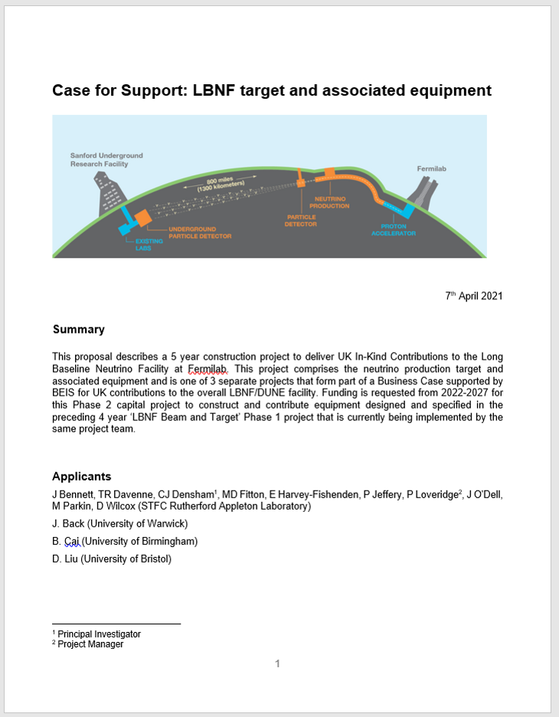
Phase 2 Project Proposal Submission
Feedback from former LBNF/DUNE PI Alfons Weber on day of submission into Je-S (7th April):
‘I am disappointed that only a few of my/our comments have been integrated into the documents. Especially about our regular bi-weekly meetings, the monthly reporting and the change management process. It is unlikely to pass PPRP review like this’
5 independent Peer Reviews received – all highly supportive
Feedback from PPRP ‘Project Management and Delivery Review’ (received 9th June)
‘The collaboration should be congratulated on this well presented and detailed submission. From the proposal it is clear that the team are in a world leading position in regards to accelerator target design and build, and that providing significant contributions to both LBNF and HyperK reinforces this. The Case for Support provides a comprehensive project management section giving a high degree of confidence in the leadership and management team in WP0.’

Slide 16
Phase 2 Project Proposal Timeline
24th March: pre-submitted to LBNF/DUNE PI and PM as required by OsC (with 3 weeks notice)
7th April: submitted to PPRP via Je-S
8th July: PI + PM presentation to PPRP
12th August: feedback received from PPRP
20 questions to answer by project team
14th October: Visiting Panel

Slide 18
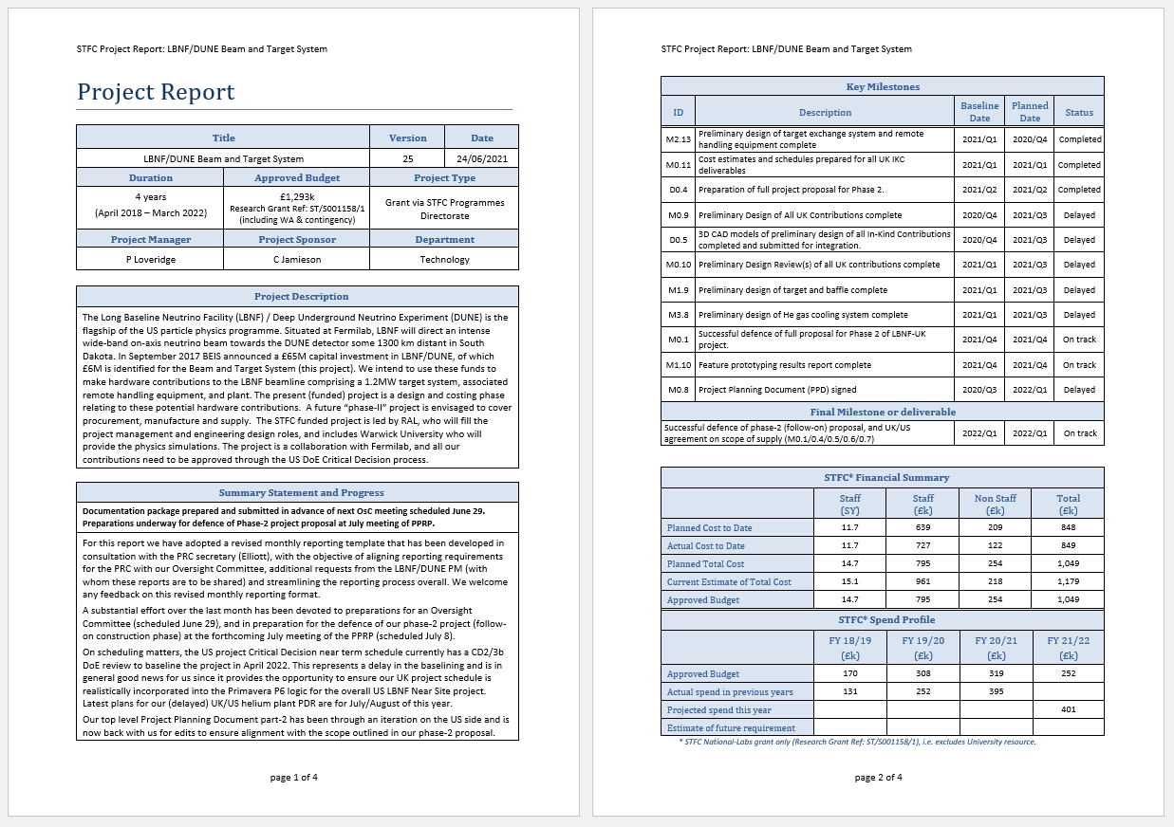
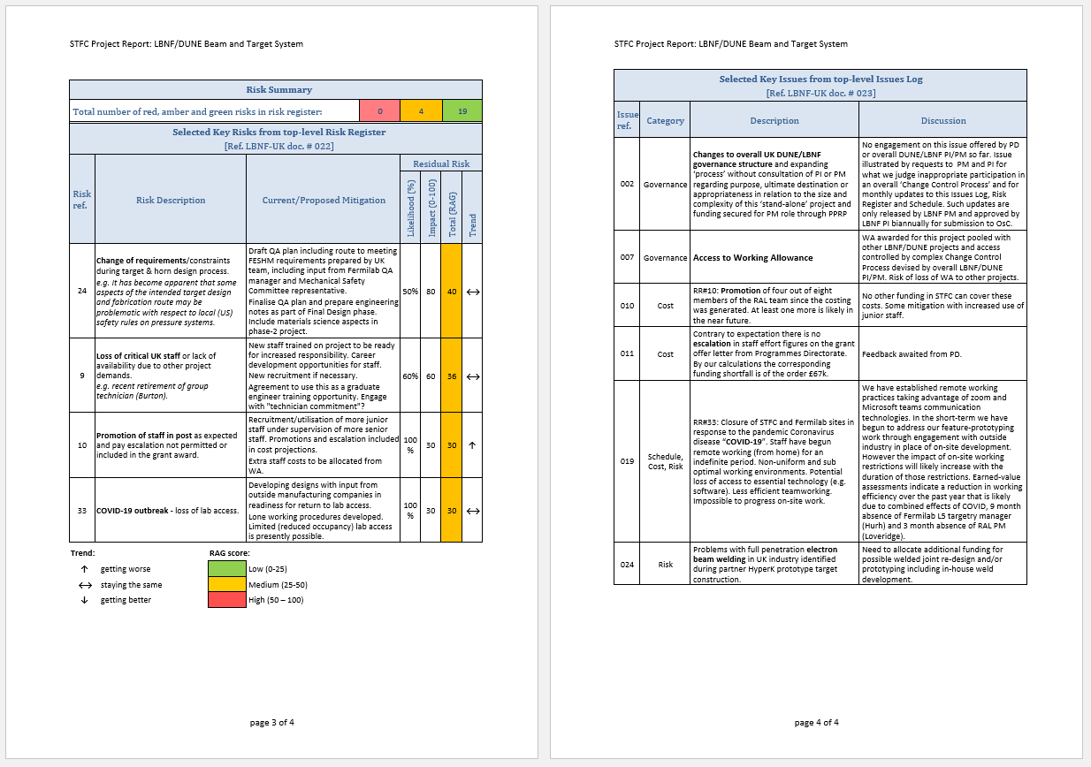
Monthly Reporting
An updated (improved?) monthly reporting format has been developed with the objective of aligning reporting requirements for the PRC with this Oversight Committee, additional requests from the LBNF/DUNE PM and streamlining the reporting process overall.
Next report presently in draft (right)
Narrative on progress since last report
Key milestones with dates
Financial summary (data from ORACLE OBI)
Key risks from top-level RR (amber or red)
Narrative on key issues from top-level issues log

Slide 19
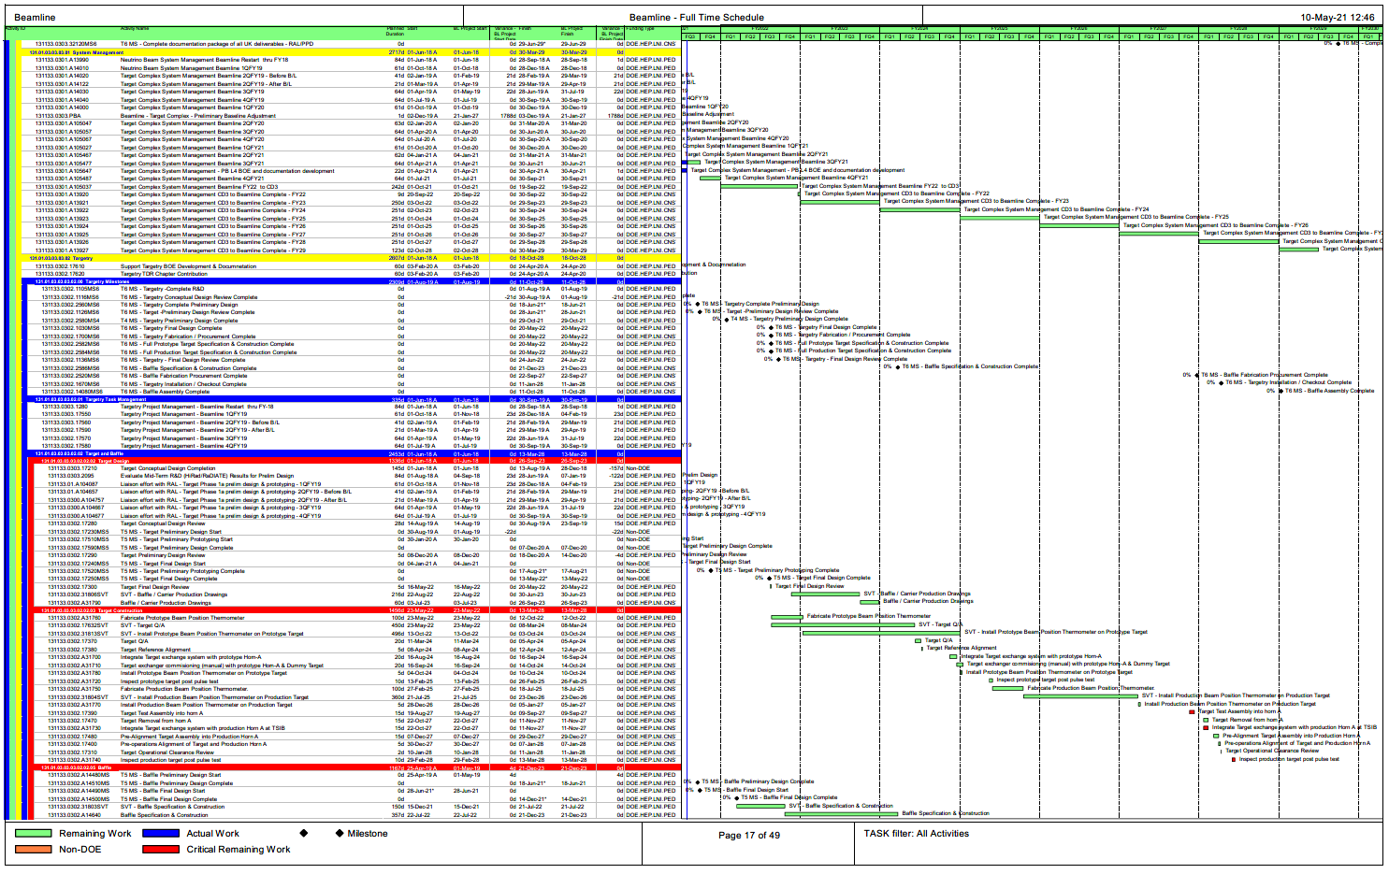
UK/US Schedule Integration
Schedule revisions underway so that each major UK deliverable, milestone and task including duration is correctly integrated into the Primavera P6 logic for the US project.
US funding approved for a Target Station Integration Building (TSIB) on Fermilab site.
will enable us to integrate our UK hardware contributions with the US supplied components and infrastructure before beneficial occupancy of the Target Station becomes available after the conclusion of the UK Phase 2 project
Targetry hardware integration plans adjusted accordingly
LBNF Beamline Full Project Schedule Update (P6) screenshot (Updated monthly at DUNE doc-db-964)
…49 pages of gantt (tiny font!) in .pdf….

