Slide 1
PIP-II
Project Management Perspective
Jon Lewis – Project Manager
LBNF/DUNE IB Meeting
24 Aug 2021
Notes:
The abstract pattern can be removed or repositioned if required. Be careful to ‘Send to Back’ so that it does not obscure any important information.

Slide 2
Agenda
1 Recap – Project Goals
A brief reminder of PIP-II’s outputs & make-up
2 The rules of engagement
How the project feels 2+ years in
3 Change Requests
4 Successes & Challenges
Image © STFC Alan Ford
Notes:
To replace photo with one of your own. 1) Send the geometric shape overlay to the back – Right-Click > Send to Back > Send to Back. 2) Replace image – use the guides provided to correctly position it. 3) Send your image to the back so that the geometric overlay re-appears over the image. Remember to delete the image credit if using your own image.

Slide 3
1. Project Goals
We are…. Working within an international collaboration to deliver 3 high beta superconducting RF cryomodules to FNAL.
FNAL is…. Building a new 1.2 MW
Proton beam accelerator & upgrading
infrastructure to provide the concentrated
Neutrino beam to ‘drive’
LBNF/DUNE
Design of the β=0.92 SRF cryomodule
UK Project Start: April 2019
STFC delivers by: Dec 2025*
*CV-19 impact
3

Slide 4
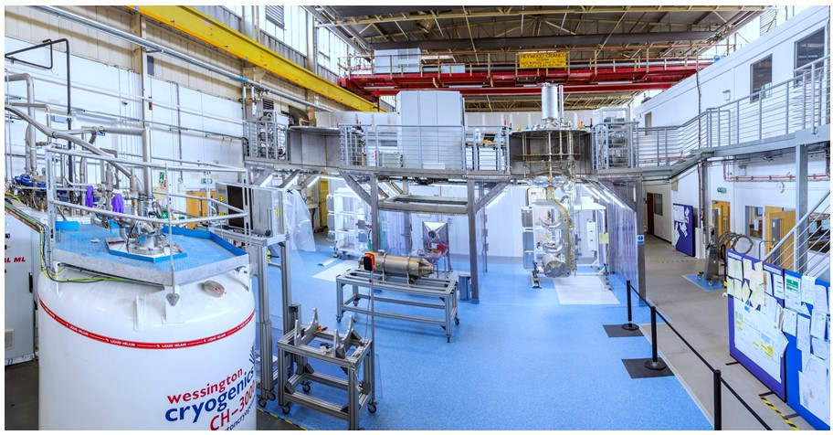
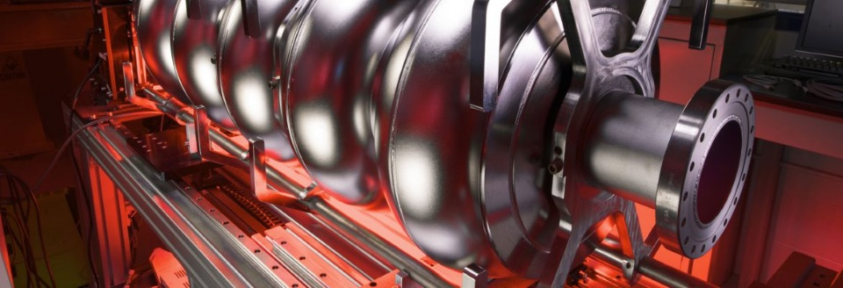
1. Project Goals – Work Packages
WP1 – SRF Infrastructure
Mark Pendleton
WP3 – Cavity Qualification
Anna Shabalina
WP 0 Project Management
Jon Lewis
WP2 – UK Industry Dev.
Anthony Gleeson
WP4 – Cryomodule Integration
Shrikant Pattalwar
Project Engineer
Alan Wheelhouse
4
Notes:
Replace this guidance text with your own bullet pointed content.
For further guidance please see https://www.bdadyslexia.org.uk/advice/employers/creating-a-dyslexia-friendly-workplace/dyslexia-friendly-style-guide

Slide 5
2. Delivering in a Collaboration
‘The rules of engagement’
The ‘who’
The ‘what’
A
Requirements
Project
Hardware
(Capability)
A
t
The ‘when’
View on A-A
A collaboration is a new way of working for Fermilab.
Sustained effort is required to work out the ‘how’.
The ‘how ’

Slide 6
2. The ‘How’
Key documentation
PMP;
QAMP;
R&I MP;
Schedule;
Change mngt;
PPD
Key Meetings
All Partners’
Exec. Board
1-2-1
SPM – SPC technical mtgs
“Shelf-ware” ?
No. Firm requirement set by DOE for CD-3

Slide 7
3. Change Requests
PIP-II is considered a ‘sub-project’ of LBNF-DUNE.
2 processes – PIP-II SharePoint based; LBNF-DUNE paper based
PIP-II’s dashboard tracks live status of change.
Significant changes escalated to L-D
Average cycle time ~ 3 mnths
L-D CRs: Additional Machining;
Etch Facility for TWI;
Project Extension & Funding

Slide 8
4. Successes, Challenges & Time Machines
What is going well?
UK first to sign PPD;
Investing in Daresbury Lab;
Excellent working relationships with Fermilab and IKCs.
What have been our major challenges?
Covid & schedule disruption;
Project governance – rolling out the road before we can walk down it;
Changing a laboratory into a factory.
What would I change?
PM control of finances & change;
Contracting for outputs with UK supply base;
8

Slide 9
Acknowledgements
PI Peter McIntosh
PE Alan Wheelhouse
WP1 Mark Pendleton
WP2 Anthony Gleeson
WP3 Anna Shabalina
WP4 Shrikant Pattalwar
Science and Technology Facilities Council
@STFC_matters
Science and Technology Facilities Council
Notes:
The abstract pattern can be removed or repositioned if required. Be careful to ‘Send to Back’ so that it does not obscure any important information.

