Slide 1
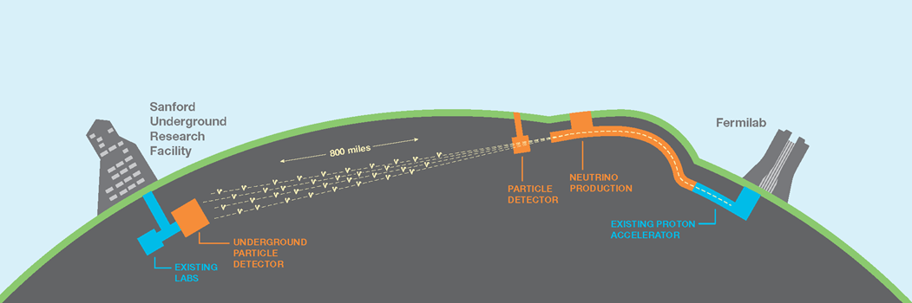
DUNE UK Project Report
Prepared by A Papanestis
Presented by M O Wascko

Slide 2
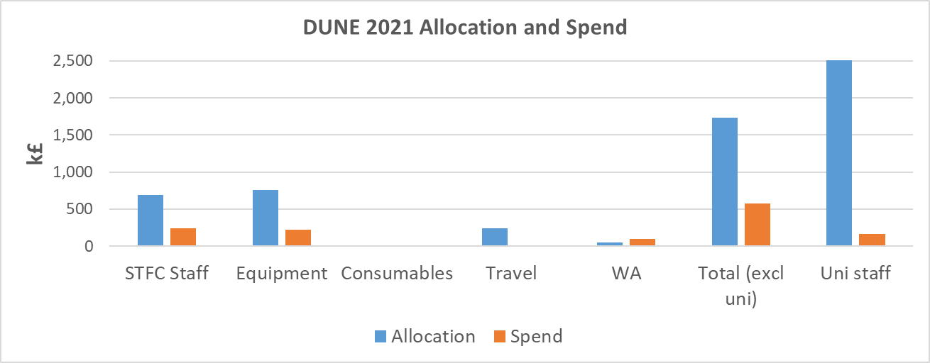
Finances – Allocation and Spend 2021

Slide 3
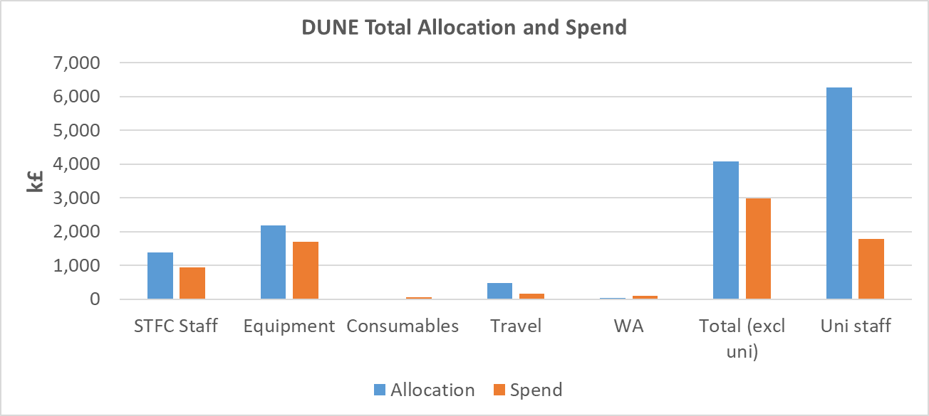
Finances – Allocations and Spend (so far)
Allocation is not the original proposal for equipment
It has been adjusted for each FY

Slide 4
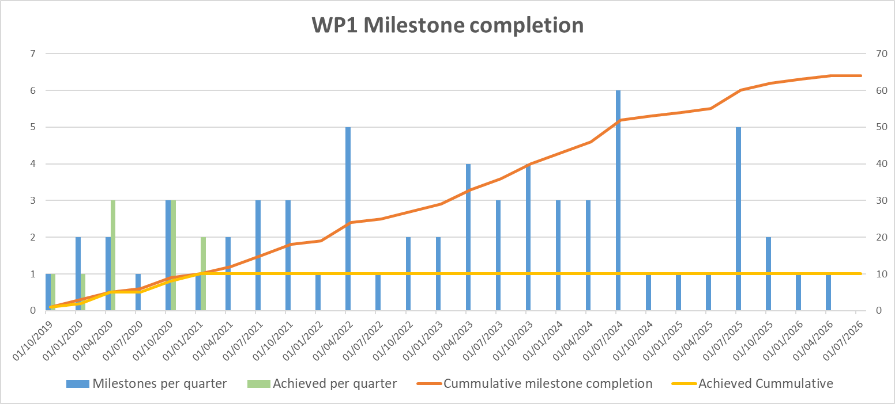
Milestones – WP1 (Physics/software)

Slide 5
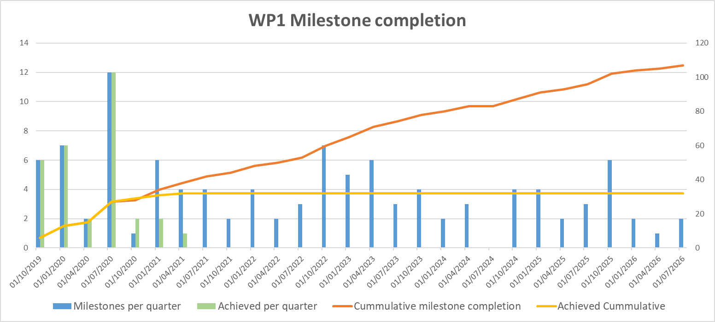
Milestones – WP2 (DAQ)[after change request]
WP2

Slide 6
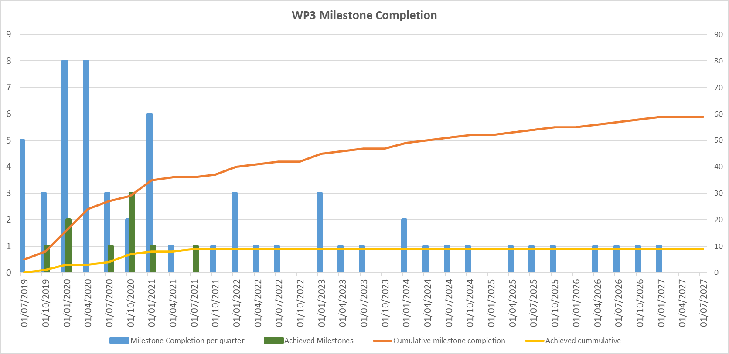
Milestones – WP3 (APAs)

Slide 7
Current challenges
WP2:
  Ongoing effort to establish ethernet solution
WP3:
  Identifying APA overspends
  Calculating savings from 20 APAs

