Slide 1
Update Since HPT Lab Conceptual Design Review
Frederique Pellemoine
HPT Lab Preliminary Design Review
01 October 2021

Slide 2
Outline
Requirement Update
60 % TSIB design review
Requirement register
HVAC System Requirement
Shielding simulations
Procurement plan
Path Forward

Slide 3
Requirement Update
Charge 1
Initial requirement carefully reviewed during 60% design review of TSIB Building with CannonDesign
Few Requirements were adjusted and clarified
New requirements were added
All requirements are recorded and labeled in a requirement register
The requirement validation plan is under development and is recorded in the same register
A 3rd Party CxAgent independent from owner, designers, general contractor will follow and coordinate the commissioning plan including all the requirement verifications
R #3
R #4

Slide 4
CxAgent Overview
TSIB Commissioning (AECOM)
3rd Party CxAgent independent from owner, designers, general contractor
Commissioning services include the following systems:
Mechanical
Plumbing
Electrical
Building Automation Systems
Deliverables:
Commissioning Plan
Commissioning Specifications
Equipment submittal review reports
Field activity reports
Completed Pre-Functional Checklist
Completed Functional Performance Test
Notes:
Even with reorg and month delay. Critical path items for LBNF will be funded

Slide 5
CxAgent Overview
TSIB Commissioning (AECOM)
Design Phase Services
Coordinate commissioning work and integrate commissioning requirements into the documents.
Review and comment on the Owner’s Project Requirements (OPR).
Maintain the OPR through the design process.
Review the Basis of Design (BOD) and report any discrepancies.
Prepare commissioning specifications.
Develop a Master Equipment List.
Prepare a commissioning plan.
Notes:
Even with reorg and month delay. Critical path items for LBNF will be funded

Slide 6
CxAgent Overview
TSIB Commissioning (AECOM)
Construction Phase Services
Conduct & document commissioning meetings on site
Coordinate commissioning work with contractors and/or construction manager and integrate commissioning activities into the master schedule.
Observe component and system installations, start-up and initial check-out of equipment, piping pressure testing, and duct leakage testing.
Maintain an Action Item Log to track deficiencies and resolution.
Review commissioning related RFI’s, change orders, and submittals for OPR and BOD compliance.
Develop project and equipment specific pre-functional checklists (PFCs) and review completed checklists for accuracy and completeness.
Develop project and equipment specific functional performance Test (FPT) procedures.
Perform functional testing during two (2) two-day site visits with the assistance of the contractors.
If necessary, perform seasonal testing on equipment and systems
Notes:
Even with reorg and month delay. Critical path items for LBNF will be funded

Slide 7
Requirement Review Process during the TSIB 60 % Design Review
Charge 1
We were using BlueBeam software to review CannonDesign documents and added comments and corrections directly on the drawings
Area of review
Layout of the lab
Plumbing/draining system
Electrical utilities
Design details of interface with Hot Cell Suite (K. Anderson’s presentation)
All requirements in CannonDesign Document and requirement register aligned

Slide 8
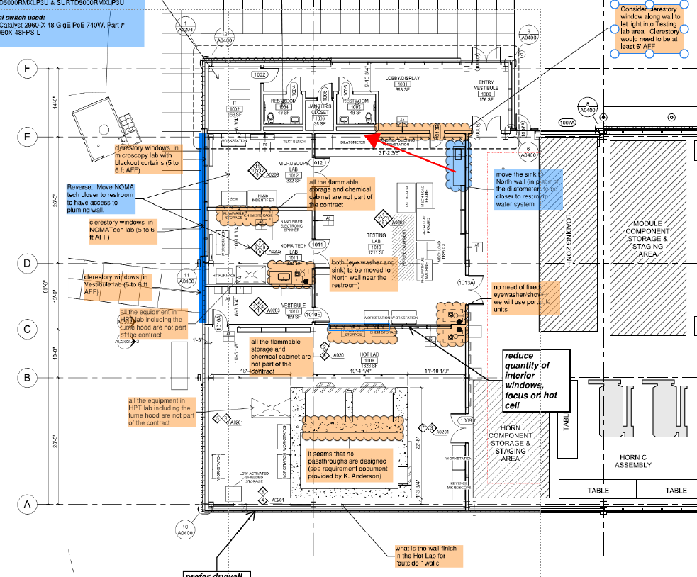
Review of the General Layout

Slide 9
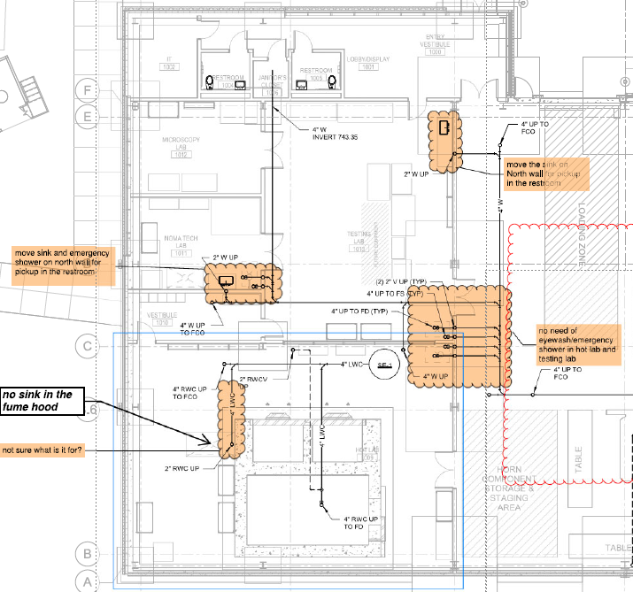
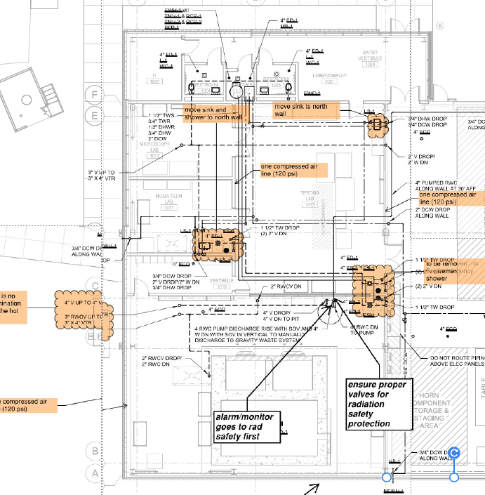
Review of the Plumbing (underground and Level 01)

Slide 10
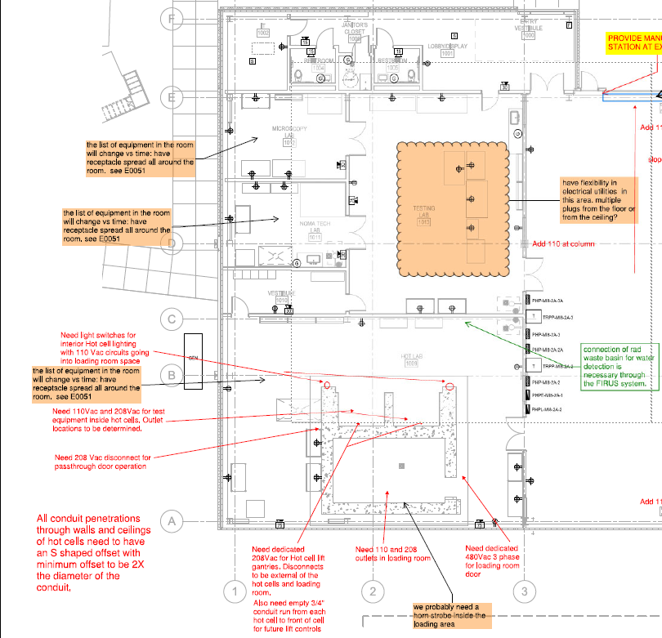
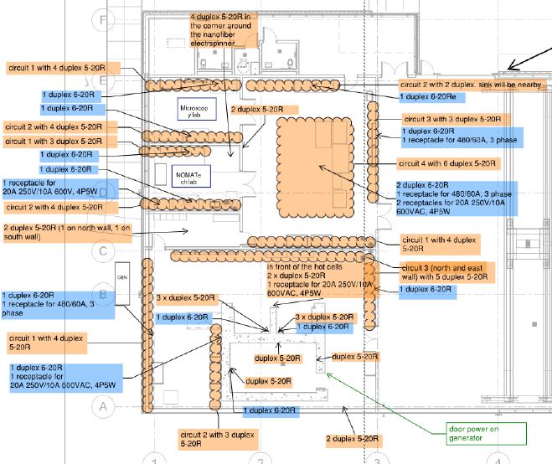
Review Electrical Utilities

Slide 11
Requirement Register
Charge 1
Verification Plan
Unique Requirement ID
Room
Door
Reviews
Requirement Type
Requirement description
Criteria/value
R #3
R #4

Slide 12
HVAC System Requirement Standard
Charge 1
R #2
HVAC System Requirement defined based on the definition from Standard ISO 17873:2004(E) - Nuclear facilities — Criteria for the design and operation of ventilation systems for nuclear installations other than nuclear reactors

Slide 13
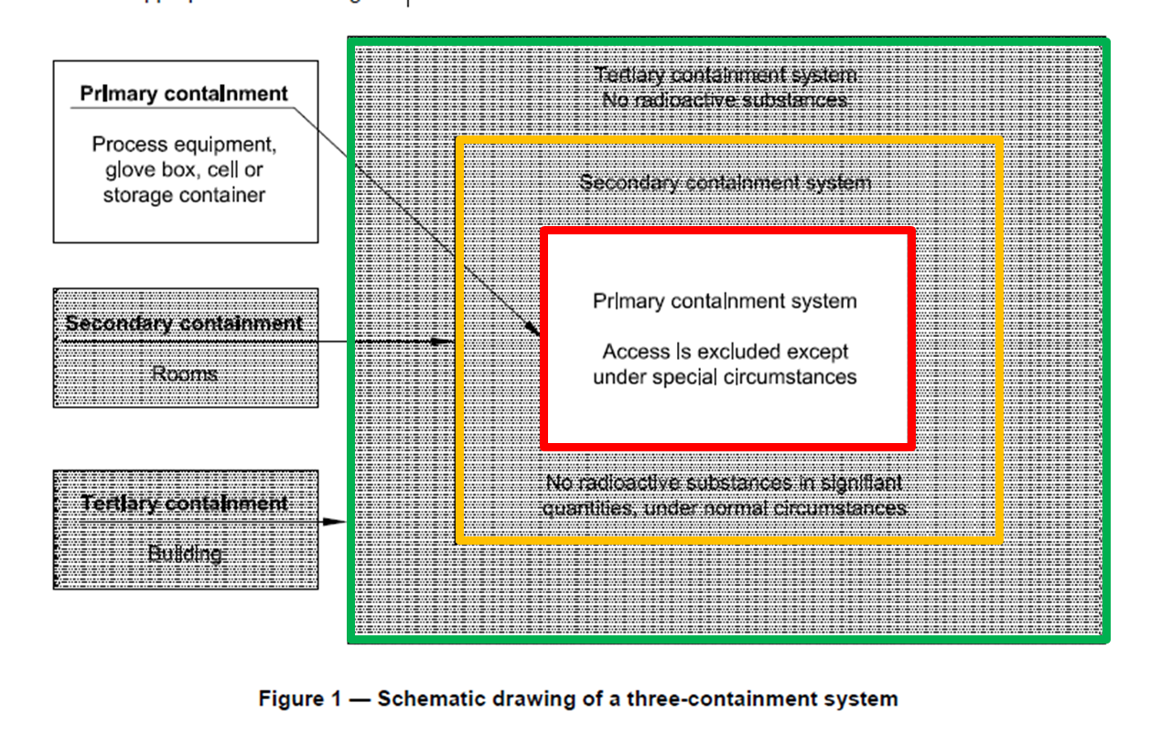
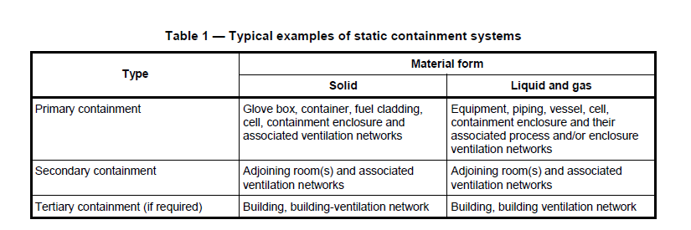
HVAC System Definitions [1]

Slide 14
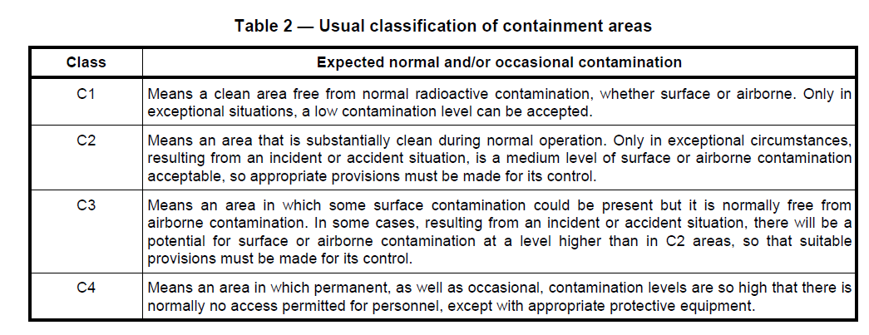
HVAC System Definitions [2]

Slide 15
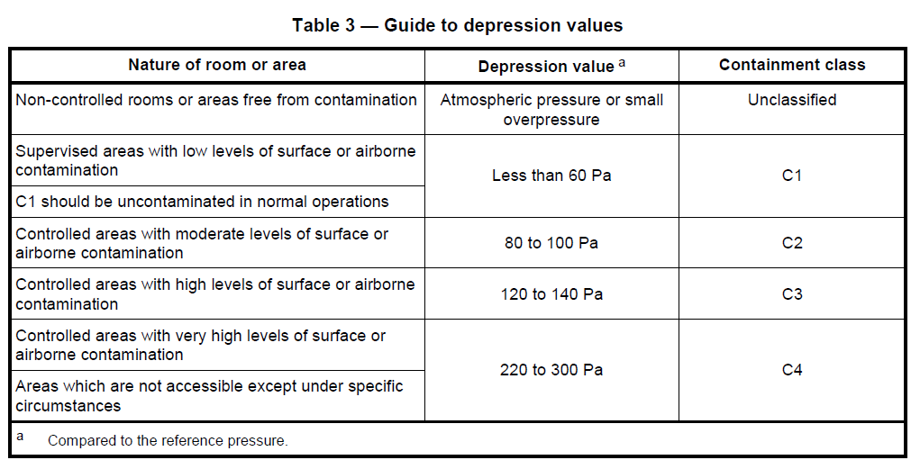
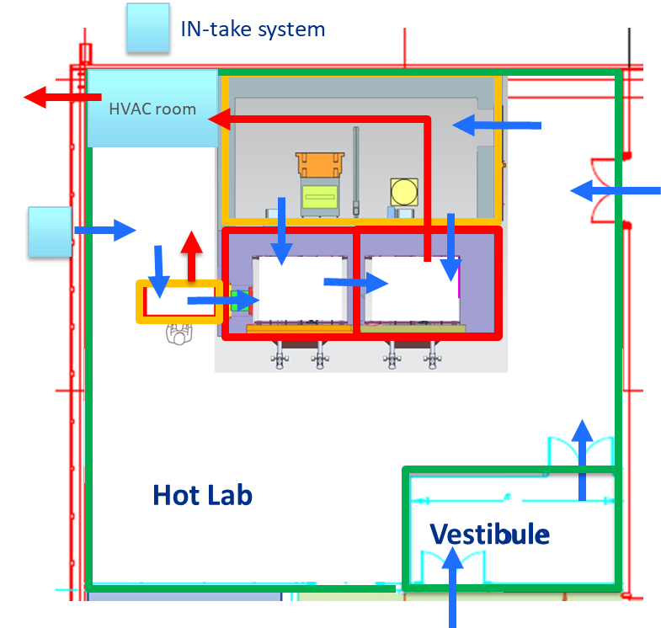
HVAC Zone
C1
Hot Lab, Vestibule
R #1
C2
Load Area, Fume hood
C3
Prep HC, Testing HC
R #5
C1-C0~ - 0.1”
C2-C1~ - 0.2”
C3-C2~ - 0.2”
C3~0.5” depression value compared to atmosphere

Slide 16
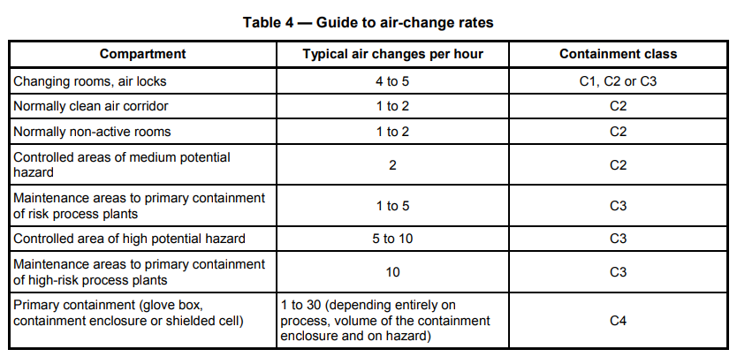
HVAC System Requirement
Charge 1
C1
Hot Lab, Vestibule
C2
Load Area, Fume hood
C3
Prep HC, Testing HC

Slide 17
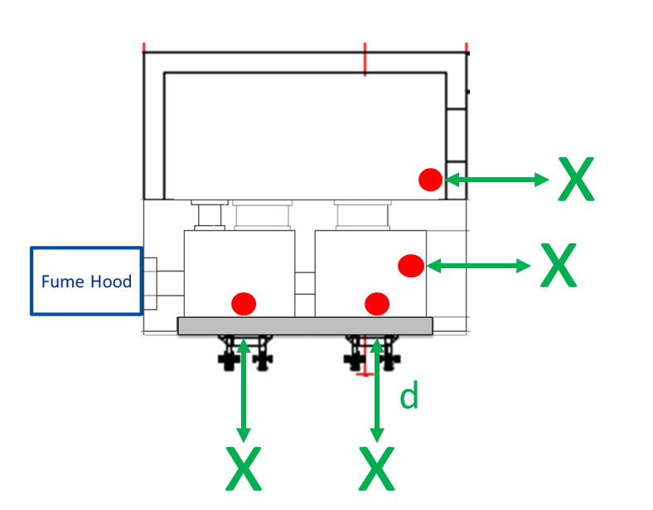
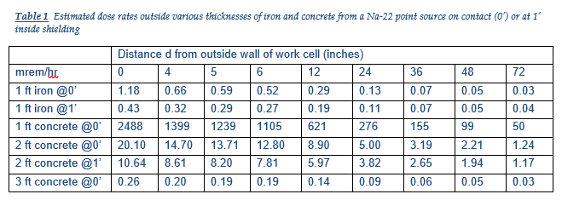
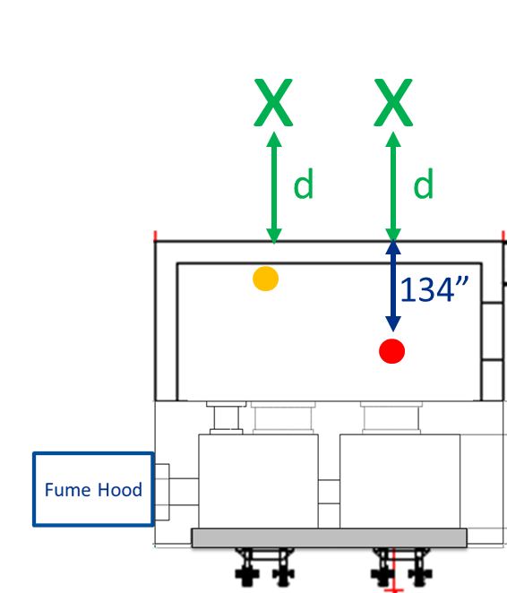
Shielding Requirement
Charge 2
Hot cell suite wall thickness unchanged and based and previous estimation
Worst case scenario
hypothetical 3.14 Ci Na-22 point source was used to approximate the dose rate of the 40 rem/hour at 1 foot maximum dose rate expected for the sample container
Although the sample materials themselves are presently unknown, such a source has an average photon energy of 1 MeV is a reasonable proxy for many longer-lived radionuclides, such as Na-22, Mn-54 and Co-60, commonly found in irradiated metals.
Scenario 1
Scenario 2

Slide 18
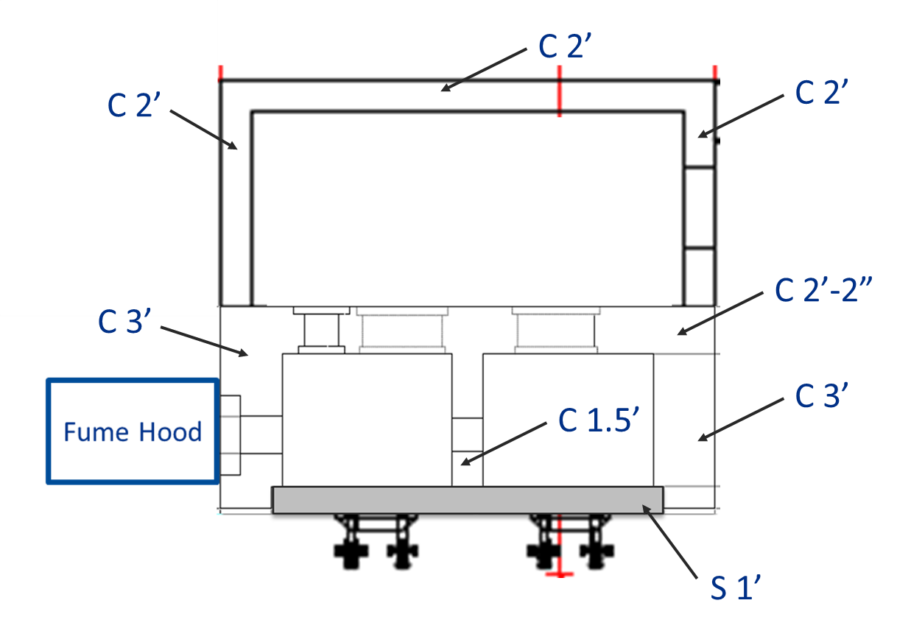
Shielding Requirement
Charge 2

Slide 19
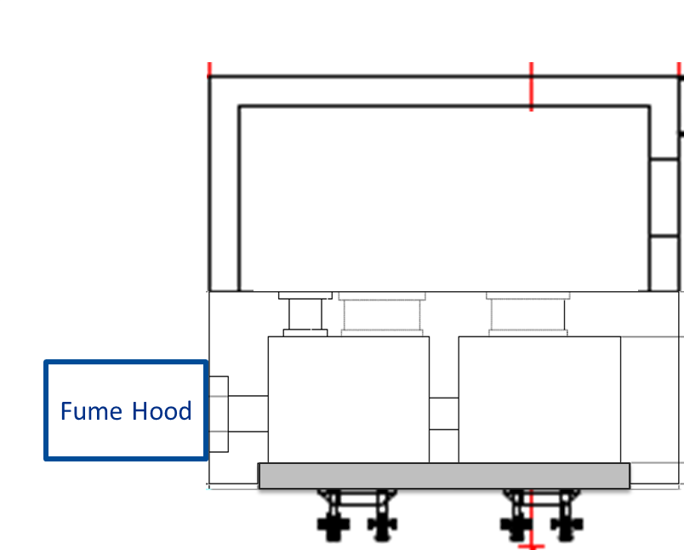
Scenario 3 – Results
Charge 2
Passthrough closed
Passthrough open
✓
Scenario 3(a) = 0.22 mrem/hour
This is the dose rate through the 10” iron passthrough shield and 3 feet into the Fume Hood. Since this is the radiation field accessible to someone standing in front of the hood, this extremity dose rate will be the most limiting. The whole body dose rate outside of the hood would not be much lower without additional shielding.
Scenario 3(b) = 160 mrem/hour
This is the dose rate at same location as Scenario 3(a), but with 10” iron shield removed and sample container placed near back corner of test cell (at angle of ~45 degrees from passthrough axis) to remove line-of-sight. Therefore, the source container would be limited to 63 mrem/hour to remain below 0.25 mrem/hour near center of Fume Hood.
2’
x
x

Slide 20
Scenario 4 - results
Passthrough closed
Charge 2
Passthrough open
Scenario 4(a) = 362 mrem/hour
This is the dose rate directly outside unshielded 2’ x 2’ test cell passthrough in the loading room. It assumes the source container is 4 feet from the passthrough axis at an angle of 60 degrees.
Scenario 4(b) = 120 mrem/hour
This is the dose rate directly outside unshielded 2’ x 2’ prep cell passthrough in the loading room. It assumes the source container is 5 feet from its axis at an angle of 75 degrees.
Only small passthrough open
x
x

Slide 21
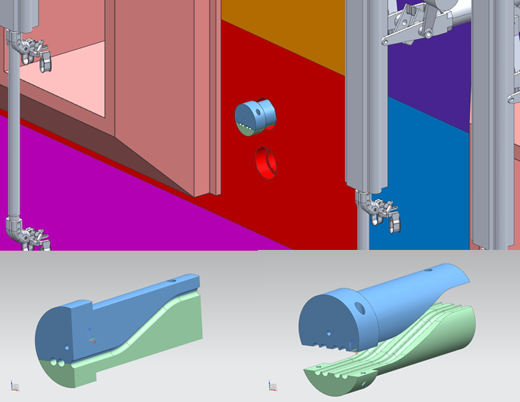
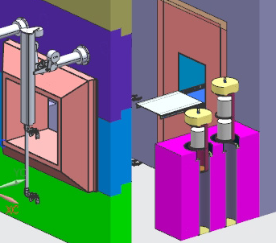
Future simulations
Charge 2
Remaining simulations will be performed when the design details will progress
Rotation passthrough design information was sent recently
Penetrations for utilities and HVAC System
Local storage

Slide 22
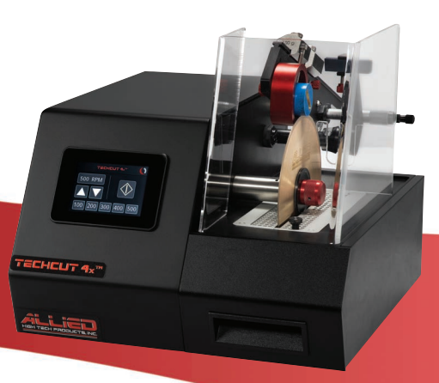
Acquisition/Procurement Plan
Since last year new equipment were procured to increase the characterization capability of HPT group that will be transferred in the future HPT Lab
Last year procurement
Mechanical load frame (Shimadzu 5kN)
installed this year
High resolution digital microscope (Keyence VHX-7000)
installed this year
KLA ​iMicro Nano-Indenter
installed this year
Polisher
Installation near complete
This year procurement
Load cell upgrade (10kN) for Shimadzu tensile tester
Differential Scanning Calorimeter (DSC) for thermal analysis
Laser Doppler Vibrometer for thermal shock and vibration study
Precision cutting saw
Flammable safety cabinet
digital microscope
Tensile tester
Nano-indenter

Slide 23
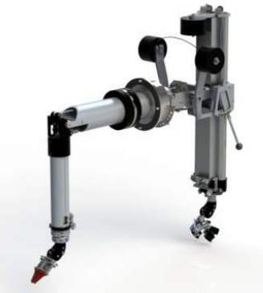
Acquisition/Procurement Plan
HPT lab equipment (Pb glass windows, telemanipulator, passthrough, fume hood, etc…) will be funded by contingency spend down
Strategy needed to anticipate procurement and saving cost when possible
Telemanipulator procurement has a long lead time (~ 1 year)
One arm spare (model G-LDC) is available at C-zero hot cell on site
Strategy to procure identical arm to form a pair
Capacity to develop new end of arm tools and fixture ahead of HPT Hot cell operation
Capacity to develop equipment (ex. cutting saw) adapted for remote handling operation in hot cell
Develop procedure ahead of Hot Cell operation
Train personal ahead of Hot Cell operation
Strategy for lead-glass windows covered by Keith Anderson’s presentation

Slide 24
Path Forward
Continue to develop the list of operational scenario to support FMEA study and consider the needs for loss of power contingencies
A generator will be installed for HPT Lab operation
Continue to develop the requirement validation plan with independent commissioning agent
Continue to validate design details through simulations as needed (penetrations, storage, passthrough,…)
Work closely with CannonDesign and ES&H to develop
fire protection
the HVAC System
the Control system
Prepare the list of existing procedure relevant to HPT Lab operation
Develop missing procedures relevant to HPT Lab operation
R #6
R #4

Slide 25
Backup Slides

Slide 26
HVAC System – preliminary air volume [CFM]
S = supply air flow
R = return air flow
E = exhaust air flow
T = transfer air flow across a partition or classification area

Slide 27
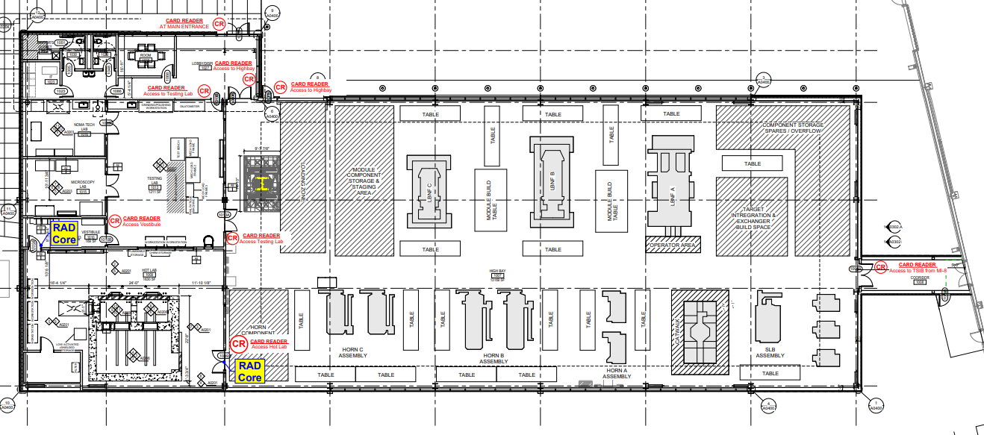
Card Reader for Controlled Access

