Slide 1
TSIB HOT CELL SUITE– DESIGN
Keith Anderson
TSIB Hot Cell Suite Preliminary Design Review
01 Oct 2021

Slide 2
Outline
Parameters
Material Selection
Functional Layout
Pass Throughs
Equipment Selection
Internal Storage

Slide 3
PARAMETERS
Charge 3
Hot cell suite must fit within the footprint designated for the hot lab.
Hot cell shielding must provide sufficient shielding to reduce a 40R/h source at 1 foot down to 0.25mrem/h
Ability to manipulate equipment and samples for testing
Long term storage for radioactive samples
Pass throughs for moving equipment and materials in and out of cells and between cells.
Contain contamination to the interior of hot cell suite.
Provide systems to ensure dose to worker is as low as reasonably achievable.

Slide 4
SHIELDING CONSIDERATIONS
Though any material can be used for radiation shielding, if it is thick enough, the usual materials are concrete, lead and steel.
Due to the hazardous nature of lead, it has not been considered for this project
Concrete and steel have been chosen as the primary shielding materials
Most of the walls and the ceiling will be made from concrete.
Concrete is less than 1/10th the cost of steel for the same amount of shielding.
The main working wall will be 12” steel plate.
Puts worker closer to the work being performed.
Easier mounting for Tele-Manipulators and Lead glass windows

Slide 5
SHIELDING CONSIDERATIONS (cont.)
Calculations have determined that 12” of steel and 36” of concrete will provide the necessary shielding required.
Lead glass thickness for the viewing windows has been calculated to be between 22” and 28” depending on density on combinations of density.
Steel has been chosen for pass through door shielding.

Slide 6
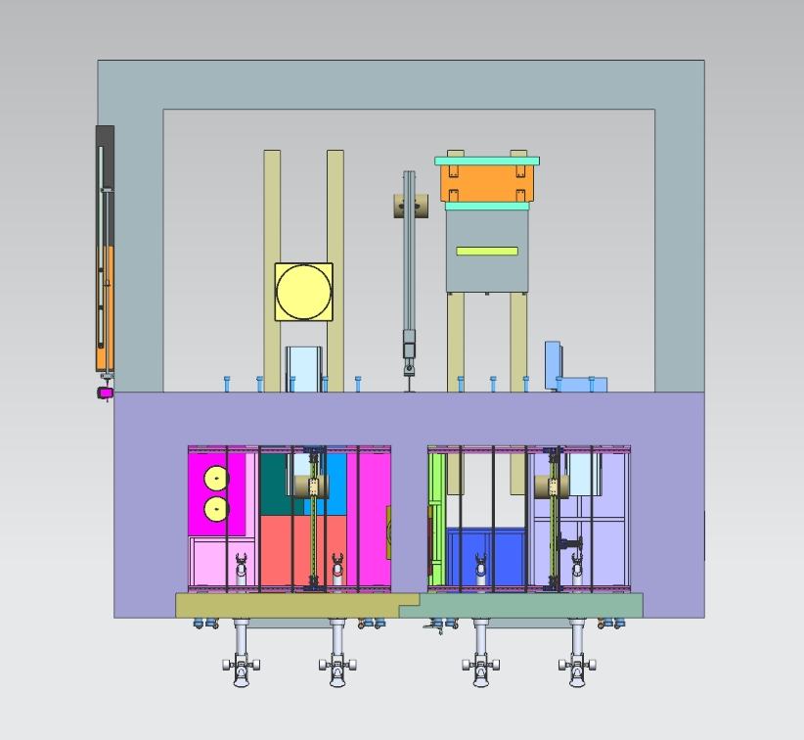
FUNCTIONAL LAYOUT
After several iterations, the layout pictured has been determined to be the most efficient use of space.
Hot cells side by side for easy transfer of materials
Shielded loading room on back of hot cells to provide for movement of materials and equipment in and out of hot cells.
The loading room provides a buffer zone to prevent the spread of contamination.
Loading Room
Prep Cell
Test Cell

Slide 7
HOT CELL SUITE SIZE
Each hot cell has an internal footprint of 8’ W x 6’ D x 12’ H
Placing these side by side and including a shield wall of 1.5’ of concrete between them and exterior concrete walls of 3’ gives a total width of 23.5’ (3” was added to the interior of each cell to make a uniform width of 24’)
With a front wall thickness of 12” of steel and a back wall thickness of 26” of concrete the depth of the hot cells is 9’-2”
The loading room has an internal footprint of 20’ W X 11’ D x 12’ H
Adding 2’ thick concrete walls gives a total footprint of the loading room of 24’ W X 13’ D (fourth wall is a shared wall with hot cells)
Combining the hot cells with the loading room gives a total footprint of 24’ W X 22’-2” D
Adding 3’ concrete shield on the ceiling to protect the mezzanine give a total height of 15’

Slide 8
PASS THROUGHS AND SHIELD PLUGS
All pass throughs and shield plugs have been designed to meet or exceed the shielding provided by the walls in which they reside.
To eliminate shine through gaps in the shielding, a stepped design has been implemented and the overlap of shielding has been set at 10 times the gap width.
Each small pass through will be equipped with a double door air lock that will only allow one door to be opened at a time to eliminate airflow from one space to another.
The large removable shield plugs will only be sealed on the exterior side. (Prior to opening these, a decontamination procedure of the interior of hot cell will be implemented.)

Slide 9
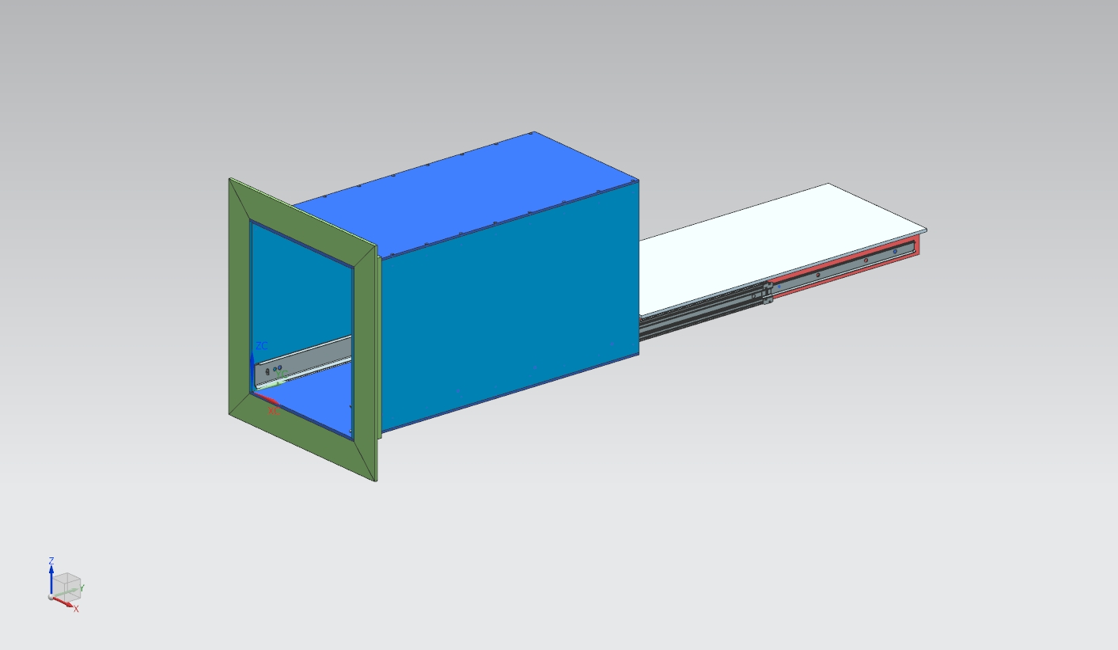
PASS THROUGHS AND SHIELD PLUGS (Cont.)
The small pass throughs at the rear of cells have been designed with pass through drawers that can extend out in both directions. This assists maintaining distance and shielding requirements while transferring materials in and out of the cells.

Slide 10
PASS THROUGHS AND SHIELD PLUGS (Cont.)
The small pass through for the prep hot cell has been incorporated into the shield plug to reduce costs and conserve space.
The shield plug is designed using steel and concrete for cost and shielding requirements.
Both shield plugs will travel on hardened steel plates embedded in the concrete.
Hardened plates embedded in concrete
R #8

Slide 11
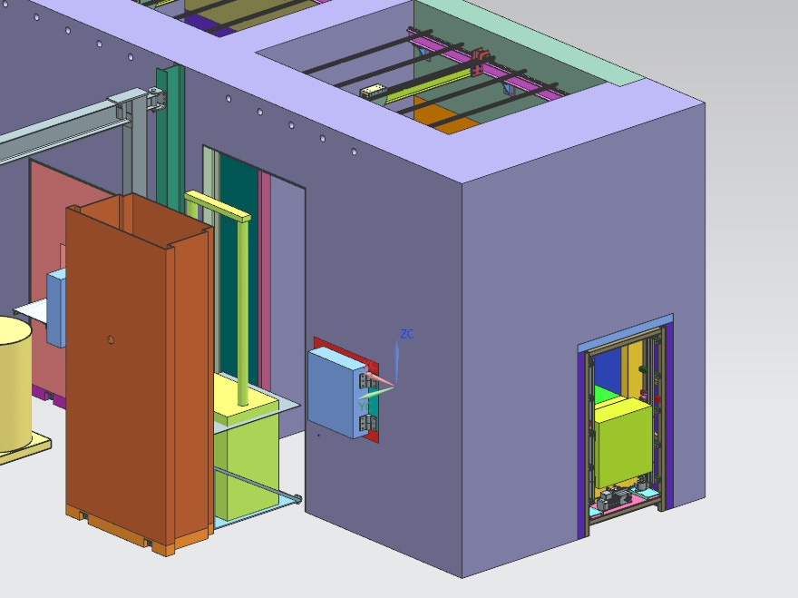
PASS THROUGHS AND SHIELD PLUGS (Cont.)
The test cell has three penetrations to the outside.
A small pass through on the rear wall for transferring specimens and small equipment.
A large plug door that has a machine carrying base for installing large machines into the test cell.
A medium sized pass through on the side for transferring materials and equipment into the fume hood

Slide 12
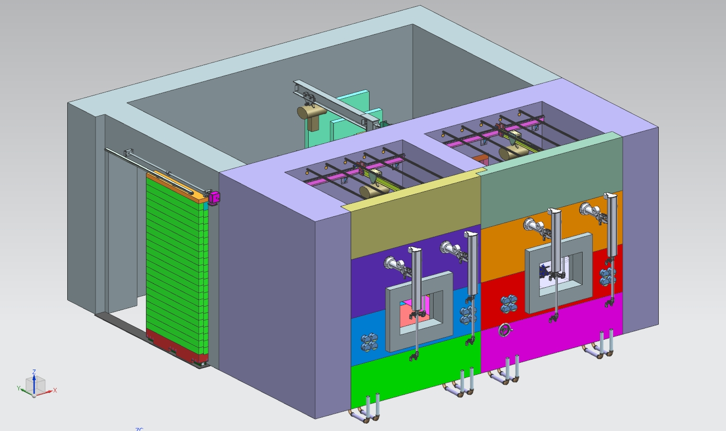
SLIDING DOOR
The Large opening on the side of the loading room will have a large sliding shield door and a swinging interior door for air control.

Slide 13
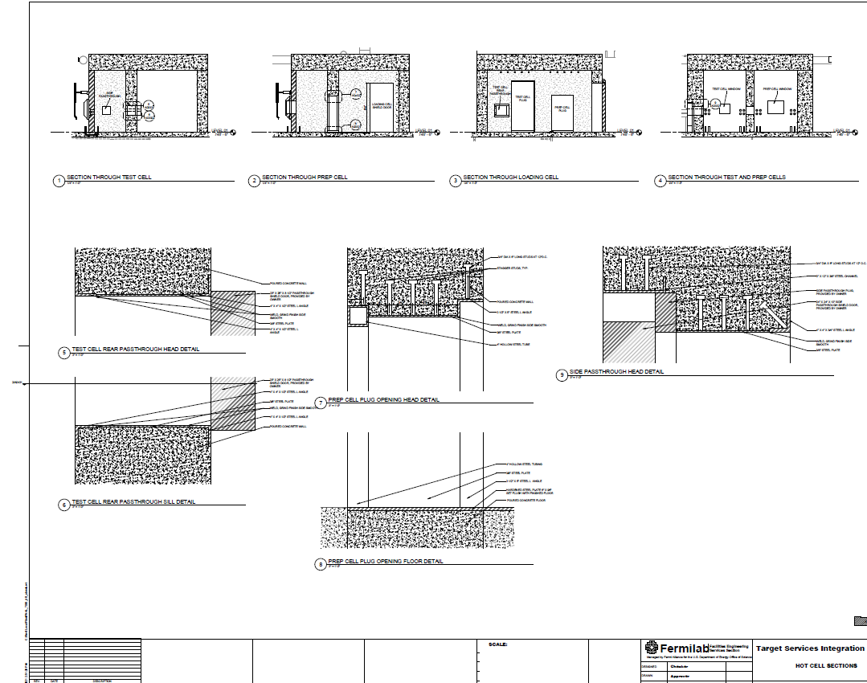
PASSTHROUGH FRAMES AND EMBEDS
The Architecture and design firm is incorporating embedded steel frames and plates to provide for support of passthroughs and shield plugs

Slide 14
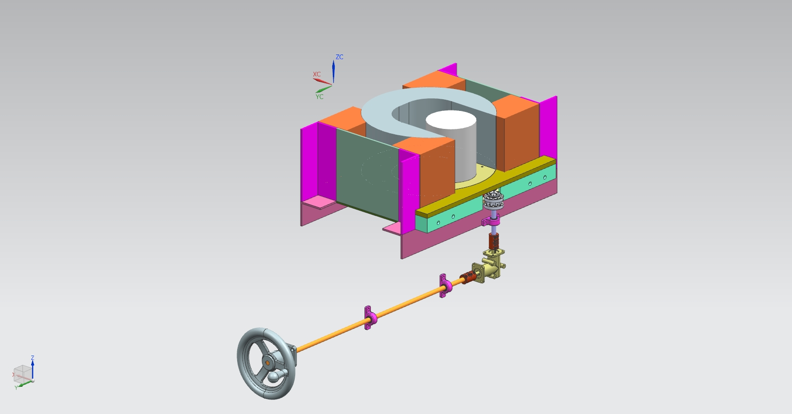
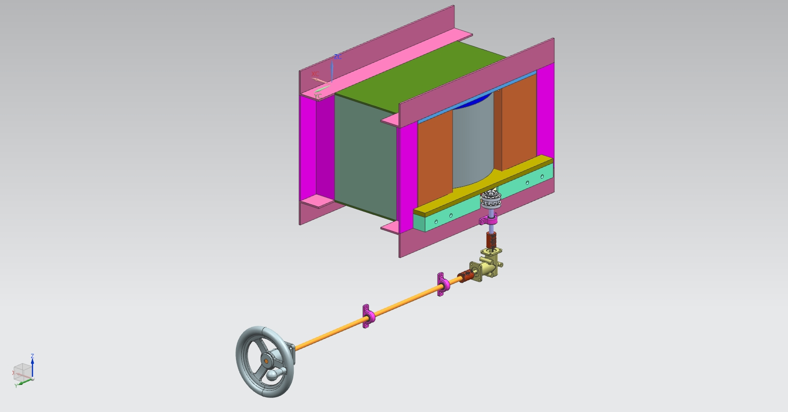
ROTATING PASS THROUGHS IN HOT CELLS
A rotating passthrough has been developed for passing items between cells
This design provides for constant shielding between cells
When in closed position the shielding is equivalent to the 18” concrete wall.
When open to one cell it is about half.
The design increases useable workspace in each cell by eliminating shield doors.
A thin sliding door on each side will provide for air flow control between cells.

Slide 15
PASS THROUGHS AND SHIELD PLUGS (Cont.)
The small pass throughs currently are designed to be manual hinged for simplicity. (Both sliding and powered operation is being considered)
Current plan for opening and closing the large plug doors is to use hydraulics. Since this will happen infrequently, the plan would be to have one system that gets installed as needed.
The side passthrough for the test cell is designed as a powered unit that raises and lowers to cover the opening.

Slide 16
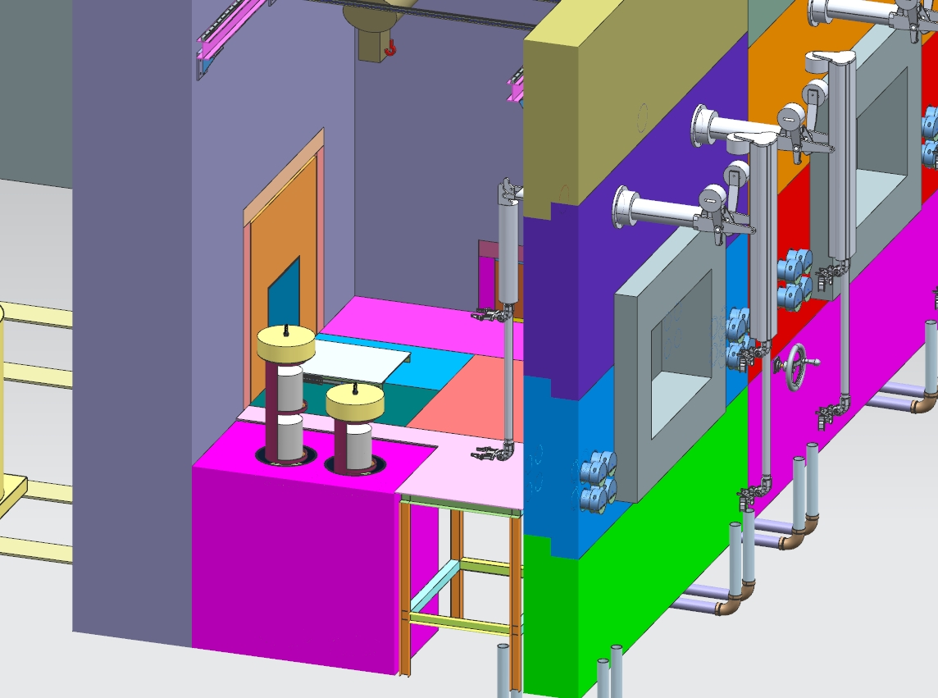
HOT CELL DESIGN – WORKTABLE
R #11
The work surface inside each cell will be made from aluminum plate supported by a welded aluminum box tube structure.
Each work surface will consist of several plates.
The empty space under the surface will be used for storage and covered openings will be added for access.
Adjacent to the plug door opening the work top will be hinged to fold down to allow for personnel access. A fold away structure will provide support for this.
A shielded hot storage container is envisioned for the prep cell and possibly for the test cell.

Slide 17
HOT HANDLING IN LOADING ROOM
ALARA Procedures will be developed for moving test specimens to and from hot cells and shipping containers.
Several options are under consideration to reduce dose to individuals.
Distance by using long handled tools.
Local shielding as shown in image with a spare manipulator.
A remote system which is proposed to be developed as a summer student project.
Procedures to be developed to overcome any failure of the engineered options.

Slide 18
TELE-MANIPULATORS
R #10
Model GHD manipulators from CRL have been chosen for the hot cells.
Lower cost and lighter duty than the model F that we have at our other facility.
Less fatigue on operator.
Have personnel trained in operation and repair of CRL models.
Manipulator reach has been specified so that they can reach to the far corner of the cells at work surface height.
Slave side has servo extenders, which provide a longer reach with shorter movement of the master side.

Slide 19
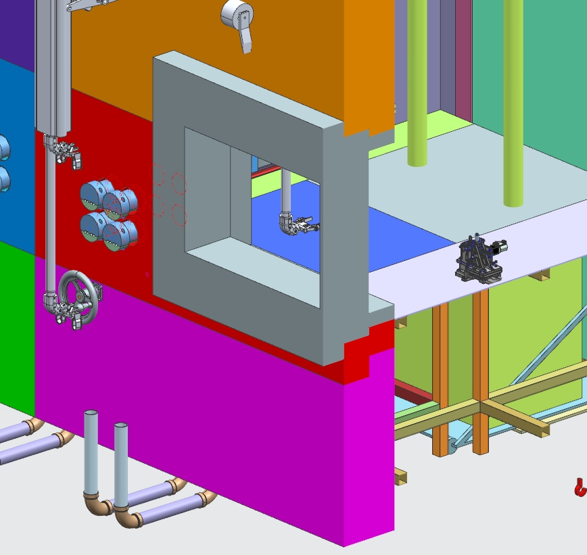
LEAD WINDOWS
Each cell will have a lead glass window that is 36”w X 24” t on the exterior and 38.5”w X 31”t on the interior side.
These windows will be made using reclaimed glass from salvaged windows from PLUTO.
Window dimensions were chosen based on the size of existing panes so cutting would not be necessary.
Design uses higher density glass, so windows are thinner than previous design.
Panes are dry set with special coating to prevent refraction. This process used on our other two windows at C-0 facility with no issues.
Window frames are set into steel wall with a stepped profile to prevent line of site gaps.
An interior alpha shield window will be installed that serves two purposes:
Shield Alpha particles (not likely needed)
Provide a contamination barrier if Lead windows need to be removed for maintenance or repair.

Slide 20
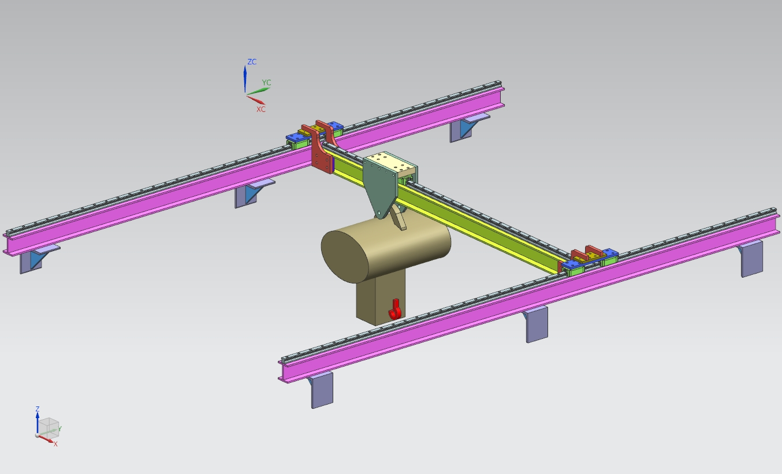
LIFTS INSIDE HOT CELL
A gantry style lift is in development for inside each hot cell
500-pound capacity
X-Y translation
Needed for opening internal storage and moving equipment around

Slide 21
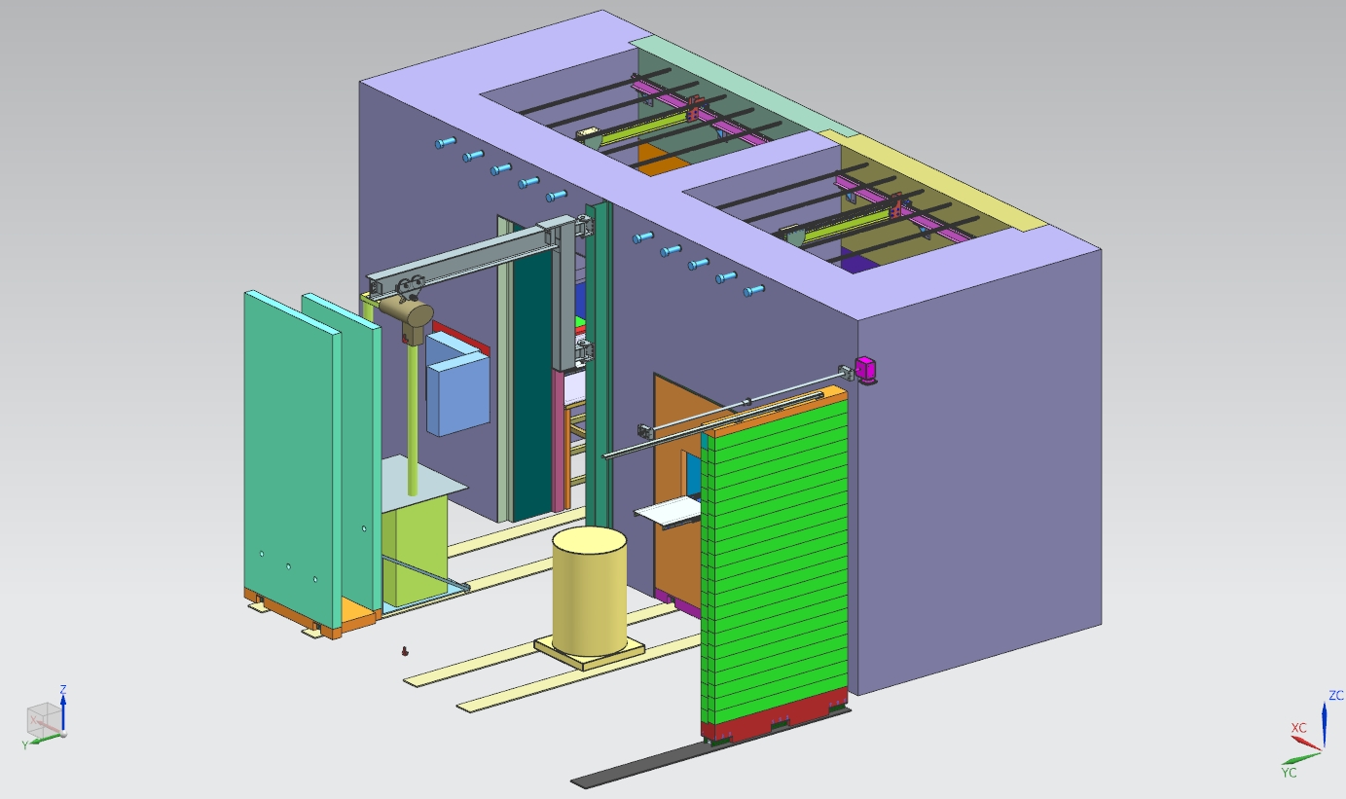
LIFT IN LOADING ROOM
A beam mounted jib crane is proposed for the loading room.
1 Ton capacity
Used to open shipping containers and to move large equipment.
Jib Crane

Slide 22
AIR HANDLING FOR HOT CELLS
R #5
Hot cell suite has a dedicated air handling system to control air flow and pressure to contain contamination within the suite.
An air filtration system with bag in and bag out capabilities will be located in a room adjacent to the hot cell suite to provide a containment zone in the event that the bag in/ bag out system fails while changing filters.
Air filtration will be a minimum of two stage with a pre filter and a primary filter down to 0.3 micron particle size.
Fan size and ducting to be sized appropriately for flow and pressure in each zone.
Ducting to be routed through hot cell ceiling.
Additional shielding to be provided where ducting is located in concrete to maintain the shielding parameters.
Filtration Room

Slide 23
INSTRUMENTATION PENETRATIONS
Each cell will be equipped with 8 penetrations in the front wall for instrumentation cables.
These will be stepped penetrations with removable and reconfigurable plugs.
Each cell will have 4 penetrations which will go under the front wall through the floor in a U-shape.
2” ID
For larger hoses and cables.
One designated for connecting a HEPA vacuum for cell clean up.

Slide 24
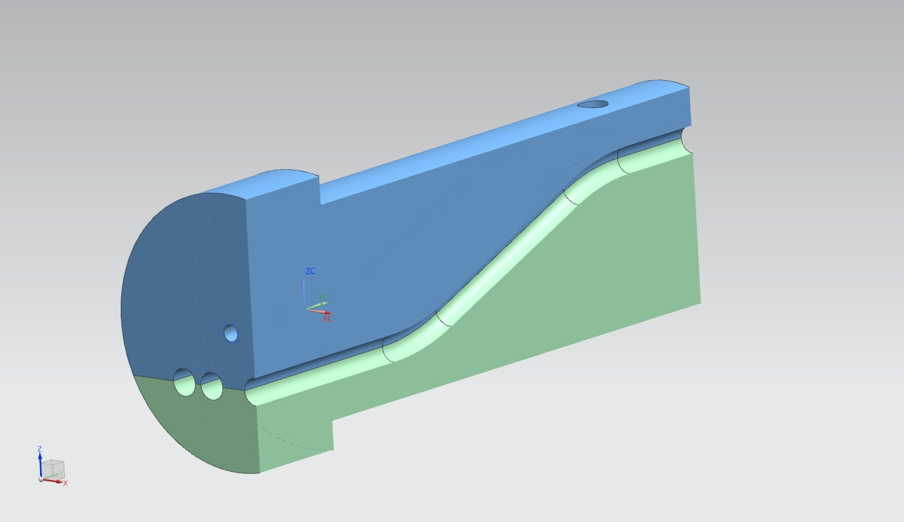
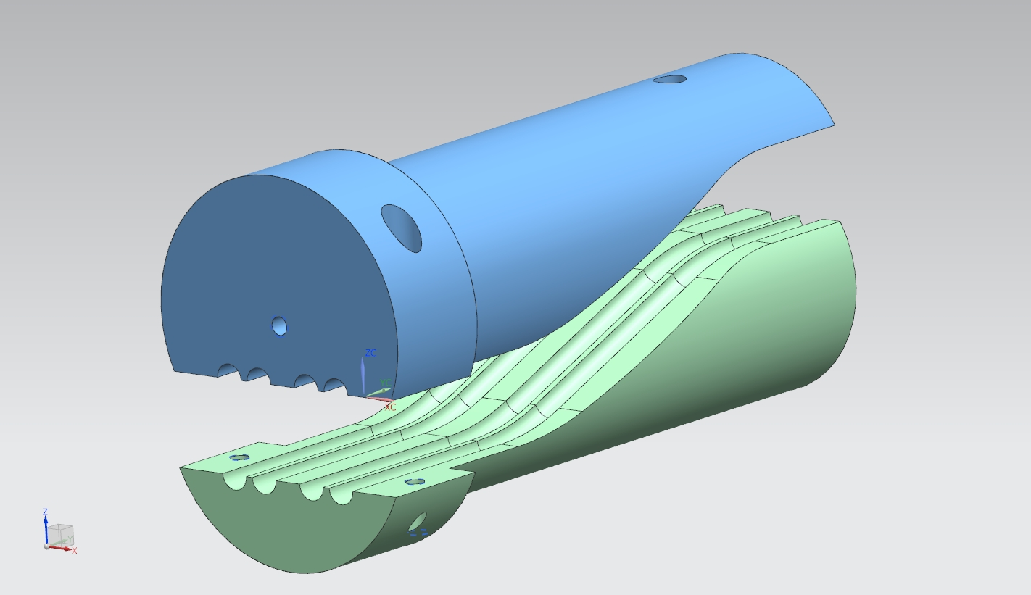
INSTRUMENTATION PENETRATIONS
Conceptual plan for instrumentation feed throughs in steel wall.
Stepped plug for overlapping joints.
Mating clamshell design
Either multiple designs for different cables or hoses
Or inserts that can be swapped for different configurations

