Slide 1
Target Service Integration Building (TSIB) – Work, Associated Risks, Previous/Current Experience at Fermilab, How They Will be Managed and How Any Mitigations Will be Incorporated into the Design of the Facility
Eric Schlatter
October 1st, 2021

Slide 2
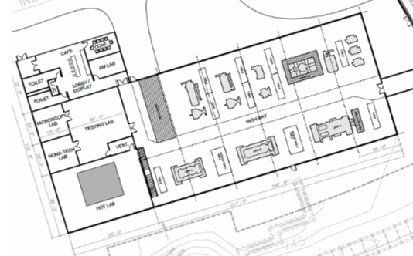
TSIB
High Bay red
HPT Lab green
  Cold Lab dark blue
    Testing Lab grey
    Microscopy Lab purple
    NOMA Tech Lab light blue
  Hot Lab pink
    Hot Cell orange
      Loading Cell 1
      Prep Cell 2
      Testing Cell 3
      Fume Hood 4
1
3
2
4
Exact layout may change, but general areas will remain the same.

Slide 3
Risk Spreadsheet and Evaluation
Charge 2
Work Intended to be Performed
Potential Risks Work Presents (beyond standard risks found in typical office/buildings)
Current Experience with Work/Risks
Different/New for TSIB?
Mitigations How We're Going to Work Together to Ensure that the Design of the Facility Understands and Addresses This Documentation

Slide 4
The Work Intended to be done in TSIB
Charge 2
Location |  |  |  | General Type of Work
High Bay |  |  |  | Component fabrication and assembly
HPT Lab | Cold Lab | Testing Lab |  | Accelerator/target material studies on non-activated material.
 |  | Microscopy Lab
 |  | NOMA Tech Lab
 | Hot Lab | Hot Lab Main Space |  | Accelerator/target material studies on activated material of higher dose rates and potential contamination.
 |  | Hot Cell | Loading Cell
 |  |  | Prep Cell
 |  |  | Testing Cell
 |  |  | Fume Hood
The facility at Fermilab will perform work on R&D samples that are ~66x below the Hazard Category 3 limits, and ~46,400x below the Hazard Category 2 limits, and will not be subject to the nuclear safety order. It will be managed under the Accelerator Safety Order (DOE O 420.2c) and 10 CFR 835 Occupational Radiation Protection.

Slide 5
Area Radiological Postings and Controls
Charge 2
Location |  |  |  | Postings | Controls
High Bay |  |  |  | None
HPT Lab | Cold Lab | Testing Lab |  | None
 |  | Microscopy Lab
 |  | NOMA Tech Lab
 | Hot Lab | Hot Lab Main Space |  | Controlled Area & Radioactive Material Area | General RWP for access. Dose & contamination limits on material in each sub-area. Job-Specific RWPs.
 |  | Hot Cell | Loading Cell
 |  |  | Prep Cell
 |  |  | Testing Cell
 |  |  | Fume Hood

Slide 6
Risks That Work Presents – Radiological
Charge 2
The general types of work planned involving the potential for radiological risk:
Radiological Work (by hand, using long handled tools, and remotely using remote manipulator arms)
  Dose to personnel
  Internal dose to personnel
  Spread of contamination
Mechanical Property Testing of Materials (i.e., tensile, dilatometer fatigue, etc.)
  Potential for generation of hot particles if/when material fails and breaks
  Low potential for outgassing radionuclides after heating of material

Slide 7
Risks That Work Presents – Industrial Type Hazards
Charge 2
The general types of work planned with industrial type hazards. Documented requirements in FESHM.
Lifting/rigging
Freight/truck (i.e., flatbed, fork truck, pallet jack, etc.)
Welding
Use of Tools (i.e., handheld and power)
Fire
Chemical
Electrical/High Voltage
Nanomaterials
Electro spinner used within the NOMA Tech Lab will produce nanofibers that do not meet the threshold for being considered nanoparticles due to their size (>100 nm).
The nanoparticle risk is only associated with the use of colloidal suspension during the polishing process in the testing Lab currently performed in APS-TD

Slide 8
Our Current Experience with Those Types of Risks – Radiological
Charge 2
Extensive experience performing radiological work at the Lab using established Policies and practices in FRCM
  RSO review of proposed work
  Implementation of RWPs to communicate requirements and/or restrictions
  RCT coverage where appropriate
RSOs review jobs for potential dose to personnel and spread of contamination and impose requirements/restrictions as needed
Experience transporting highly activated components through the Lab
  Packaging activated components into/from shielding/shipping containers
  Most notably for components transported to C-0 and NTSB
RCTs have experience covering work with contamination potential
  Implement mitigations and controls (contamination containment, PPE, etc.)
  Set-up areas for work as well as decontamination of areas when work is complete
  Extensive experience within beam enclosures and Hot Cells (C-0 and NuMI Workcell)
Experience with area and air monitoring and HEPA filter systems for contamination control, and is familiar with routine monitoring and maintenance
RPO Routine Monitoring Program to ensures no spread of contamination, areas are appropriately posted, and areas are monitored for dose to personnel

Slide 9
What’s Going to be Different About Those Hazards in TSIB
Charge 2
No activities were identified as “new” for TSIB.
The following activities have been identified as “somewhat new” at TSIB:
Mechanical property testing in Hot Cell using remote manipulator arms.
  Experience performing mechanical property testing outside of Hot Cells
  Experience using remote manipulator arms in Hot Cells (disassembly work at CZero Hot Cell)
  Somewhat new: Performing mechanical property testing with remote manipulator arms
Low potential of outgassing radionuclides during elevated temperature testing.
  Lab has experience with radionuclide outgassing and appropriate mitigating systems during accelerator operations (e.g., NuMI target facility)
  For TSIB, some mechanical property tests include heating of activated samples.
    Preliminary conservative calculations show no potential for outgassing above acceptable limits.
    Incorporation of a charcoal/absorbent filter into the HEPA filter system is easily added as an additional precaution.

Slide 10
Mitigations for Potential Risks that Impact Design of the Facility
Charge 2
The following mitigations for identified risks will be incorporated into the facility design.
Crane capacity, hook height, travel requirements
Fire, electrical & chemical protections
Locking mechanism on Loading Cell door and truck access door into the Hot Lab for ability to apply RPO Configuration Control locks when needed
Hot Cell shielding requirements
Smooth surfaces (floor & walls) and rounded edges within the Hot Cells
Adequate space within the vestibule/entrance into the Hot Lab for PPE station
HEPA filter system, with charcoal/absorbent filter, maintaining negative pressure on the Hot Cell suite
Appropriate penetrations and available power for air monitoring equipment
No water drains to the outside of the Hot Cell
Separate floor drain for Hot Lab to a separate monitored reservoir pit
Notes:
The following mitigations for identified risks will be incorporated into the facility design. These elements have been specified into either the Project Plan Document, Requirement Document/Risks and Mitigation document, and/or the Requirement Register list (provided to the AE firm). Additionally, TSIB stakeholders continuously communicate requirements with the AE firm via routine meetings, and design of the facility will be reviewed through the Lab’s CCR process to ensure requirements are incorporated.

Slide 11
WPC Process
Charge 2
All work conducted at TSIB is performed according to FESHM & FRCM requirements, ensuring all hazards are identified and addressed and any necessary documentation is created prior to the start of work.
ORCs to be performed for any new or significantly modified equipment that will be used in the HPT Lab.
A general RWP will be implemented for access into the Hot Lab space, describing general restrictions and requirements.
For each specific job, will have individual review via IMPACT
  RSO will determine what work is allowed on material and in what area, based on dose rate and contamination levels.
  RSO will generate a job-specific RWP describing the work authorized and any restrictions and/or requirements

Slide 12
WPC Process (cont.)
Charge 2
Transportation of activated items to the Hot Cell is planned to occur outside of normal business hours, consistent with current practices.
All material moved/worked on in the HPT Lab/Hot Cell would be dose rate dependent.
  Standard plan for Fermilab samples would be to have the usual hold time in the storage/morgue before moving to CZero, do disassembly at CZero to remove component/horn/harget and then move to TSIB. Typical hold time is typically > 1 year.
Radiological postings, controls & RWPs monitored and updated as required through life of facility.

Slide 13
Documentation
Charge 2
SAD Chapter
  A new SAD Chapter will be drafted describing the accelerator/target material studies. All work at TSIB will fall under the scope of DOE O 420.2c Safety of Accelerator Facilities.
Risk Register
  TSIB Project Director (AD) has created an Operations Hazards and GPP Risk Register that describes identified risks and ensures any necessary mitigations or design elements are communicated appropriately to the design firm.
  The Operations Hazards and GPP Project Risk Register has been transmitted to the GPP Project Manager (FESS) as a working document and will be updated to reflect any developments in the HPT Lab work scope.
Additional Analysis
  Shielding thickness requirements will be formally documented – they are currently understood and communicated to TSIB Stakeholders via email.
  Potential outgassing calculations will be performed based on isotope inventory for typical BLIP Ti alloy samples.
Procedures
  Material In Hot Cell Workflow document has been drafted to walk through the specific “flow” of work and material within the Hot Cell Suite. This document will include dose rate and contamination limits for material in each of Cell, as determined by the RSO.
  Specific procedures for use of equipment will be generated as needed.
Radiological Work Permits (RWPs)
  A general RWP will be implemented for access into the Hot Lab.
  Job-Specific RWPs will be generated for each specific job/work to be performed within the Hot Lab and Hot Cell Suite ensuring dose rate and contamination limits for material in each space is upheld and any additional restrictions/requirements are in place.

Slide 14
Waste Management
R #7
Radioactive Waste
  All radioactive waste at Fermilab is managed according to FRCM Chapter 4 Part 4. any waste generated during work that’s covered by an RCT will be taken care of by the RCT right away
    Waste generated during work: PPE, HVAC HEPA filter, material used for decontamination
  For other wastes, the waste generator will fill out and submit the “Radioactive Waste Certification and Pickup Request Form” to declare the material as radioactive waste and request a pickup for disposal
    Test specimens, Capsule and interior filler pieces, Contained fragments/dust from cutting saw
Chemical waste
  The nanoparticle waste generated during polishing process with the use of colloidal suspension is managed according to FESHM 4310: Nanomaterials
    Materials from cleaning up spills of UNP, or unwanted UNP, shall be placed in a closed container or sealed bag and marked as “Unbound Engineered Nanomaterial Waste.” Contact the Hazard Control Technology Team for disposal

Slide 15
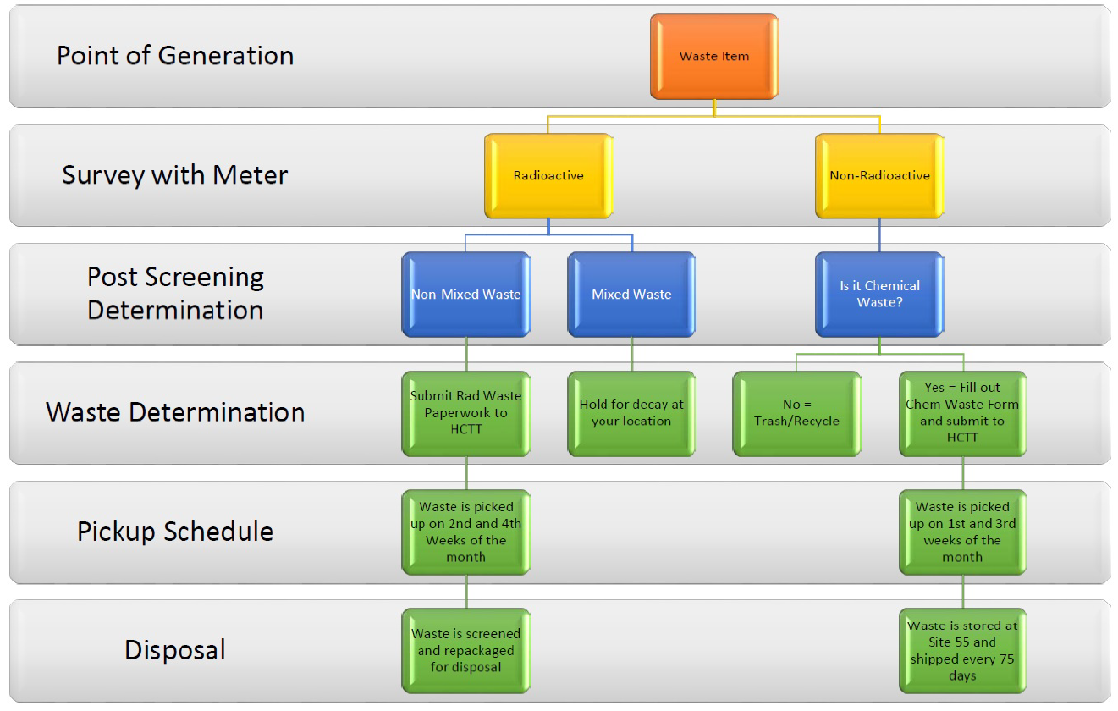
Fermilab’s waste handling procedures
R #7
All steps in the process are performed by the person generating the waste item up until the item is picked up by the Hazard Control Technology Team (HCTT).
*Fermilab Radiological Control Manual, Chapter 4 – Radioactive Materials, Rev. 07/2018

