Slide 1
Atmospheric Neutrino Zenith Angle Reconstruction —Truth Comparison
Muyuan He
Sep 2, 2021

Slide 2
Motivation
Check the atmospheric neutrino reconstruction performance and compare it against the value that were assumed in the atmospheric oscillation sensitivity.
Current (Pandora/PMX) reconstruction for atmospheric neutrino zenith angle.
Only 36% of the events are constructed correctly.
26% of the events are constructed in the wrong direction
The rest are not very well constructed in general
Muyuan He | Atmospheric Neutrino Zenith Angle Reconstruction —Truth Comparison

Slide 3
What I did
Extract numuCC, Quasi-elastic/elastic interactions with longest track that has length > 50 cm
Files used from samweb definition(vpec_NNBarAtm_hA_LFG_noCCTaus_dune10kt_1x2x6_ana)
Compare zenith angle between lep_dcosy_truth and trkstartdcosy_pandoraTrack for each particle in 2-D histogram for 14176 events.
Separate events that are correctly constructed, in wrong direction and random. For each category, check event display.
Muyuan He | Atmospheric Neutrino Zenith Angle Reconstruction —Truth Comparison

Slide 4
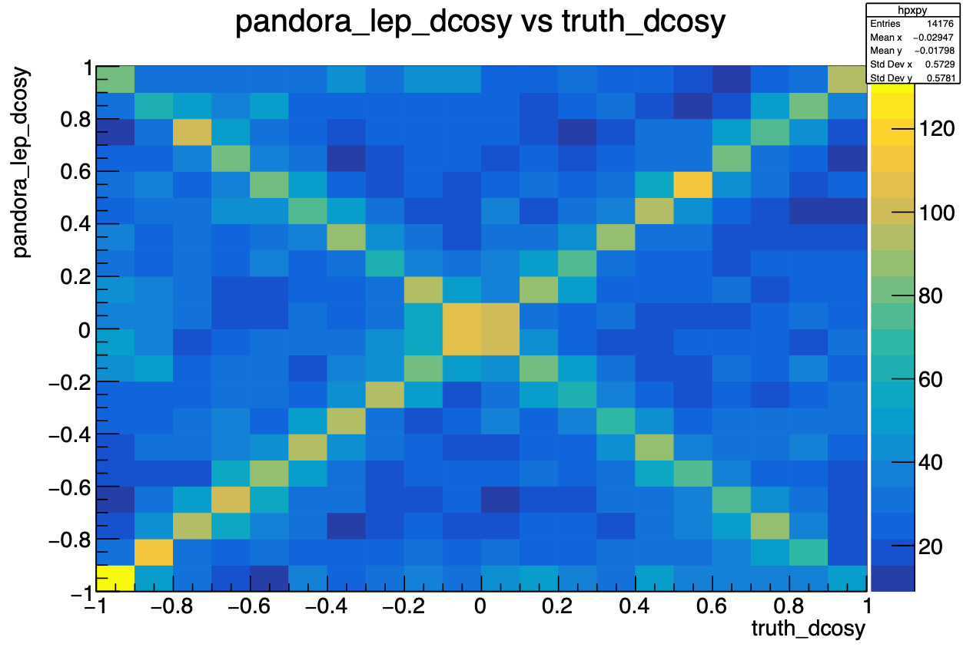
All events zenith angle comparison
trkstartdcosy_pandoraTrack vs lep_dcosy_truth
trkstartdcosy_pandoraTrack
lep_dcosy_truth
Muyuan He | Atmospheric Neutrino Zenith Angle Reconstruction —Truth Comparison

Slide 5
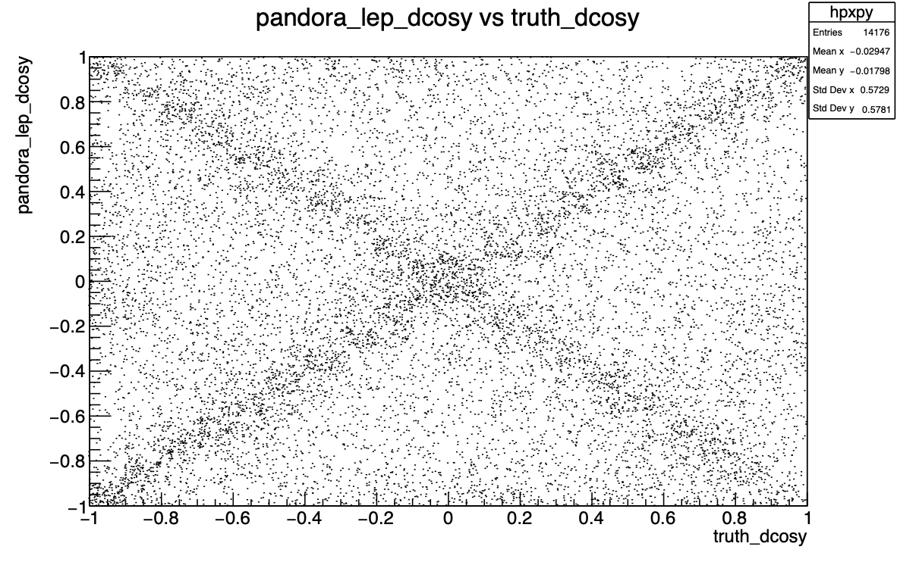
Without colz drawing option
trkstartdcosy_pandoraTrack vs lep_dcosy_truth
trkstartdcosy_pandoraTrack
lep_dcosy_truth
Muyuan He | Atmospheric Neutrino Zenith Angle Reconstruction —Truth Comparison

Slide 6
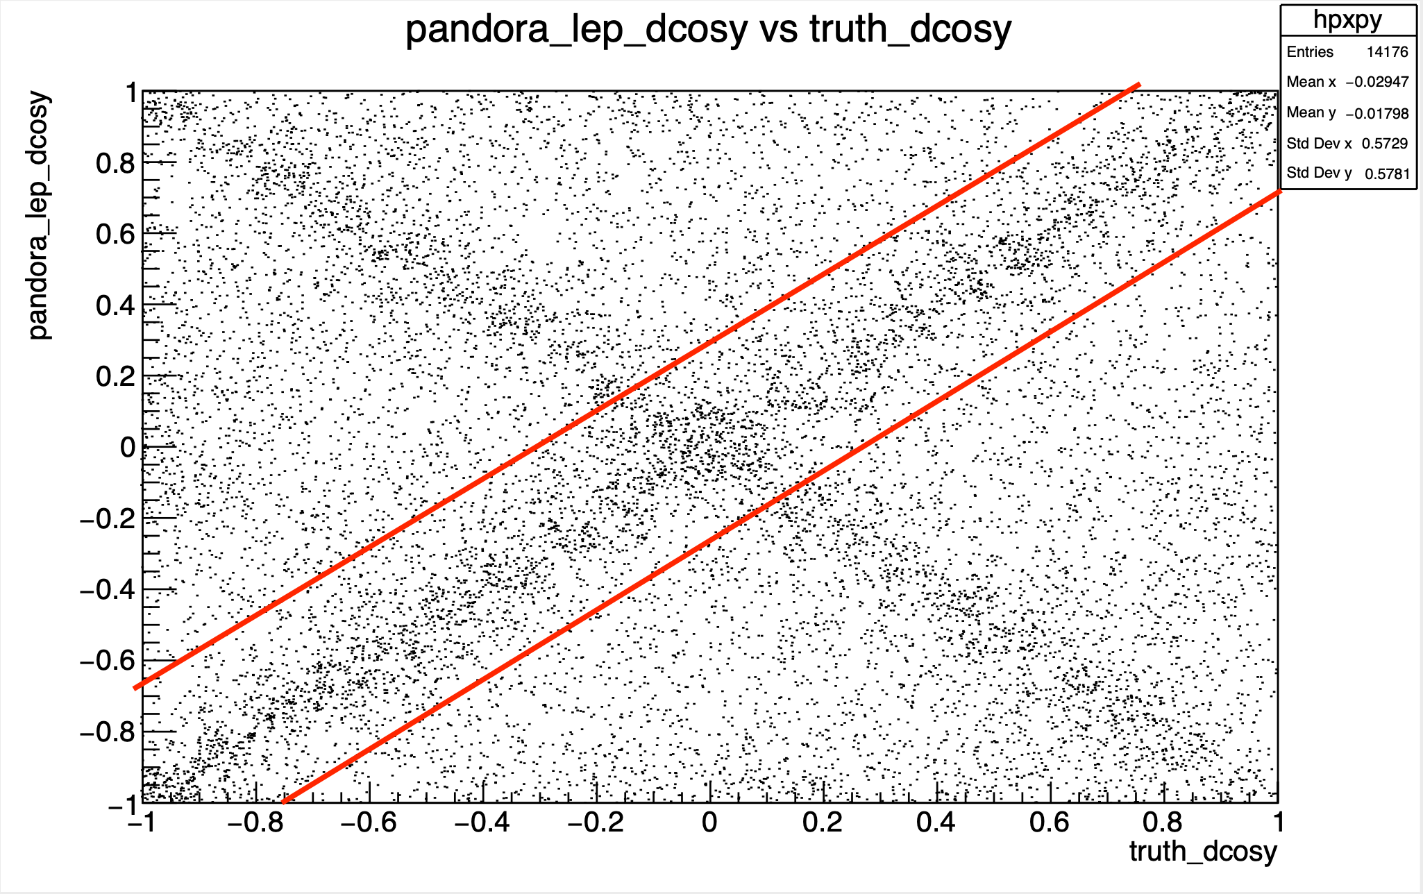
Right Axis
abs(pandora-truth)<0.3, 36% of total events
trkstartdcosy_pandoraTrack vs lep_dcosy_truth
trkstartdcosy_pandoraTrack
lep_dcosy_truth

Slide 7
Run: 30225945; Event: 214028
Exact location of event
lep_dcosy_truth vs trkstartdcosy_pandoraTrack: 0.7783671617507935 0.7461970448493958
trkstartdcosy_pandoraTrack vs lep_dcosy_truth
.
trkstartdcosy_pandoraTrack
lep_dcosy_truth
Muyuan He | Atmospheric Neutrino Zenith Angle Reconstruction —Truth Comparison

Slide 8
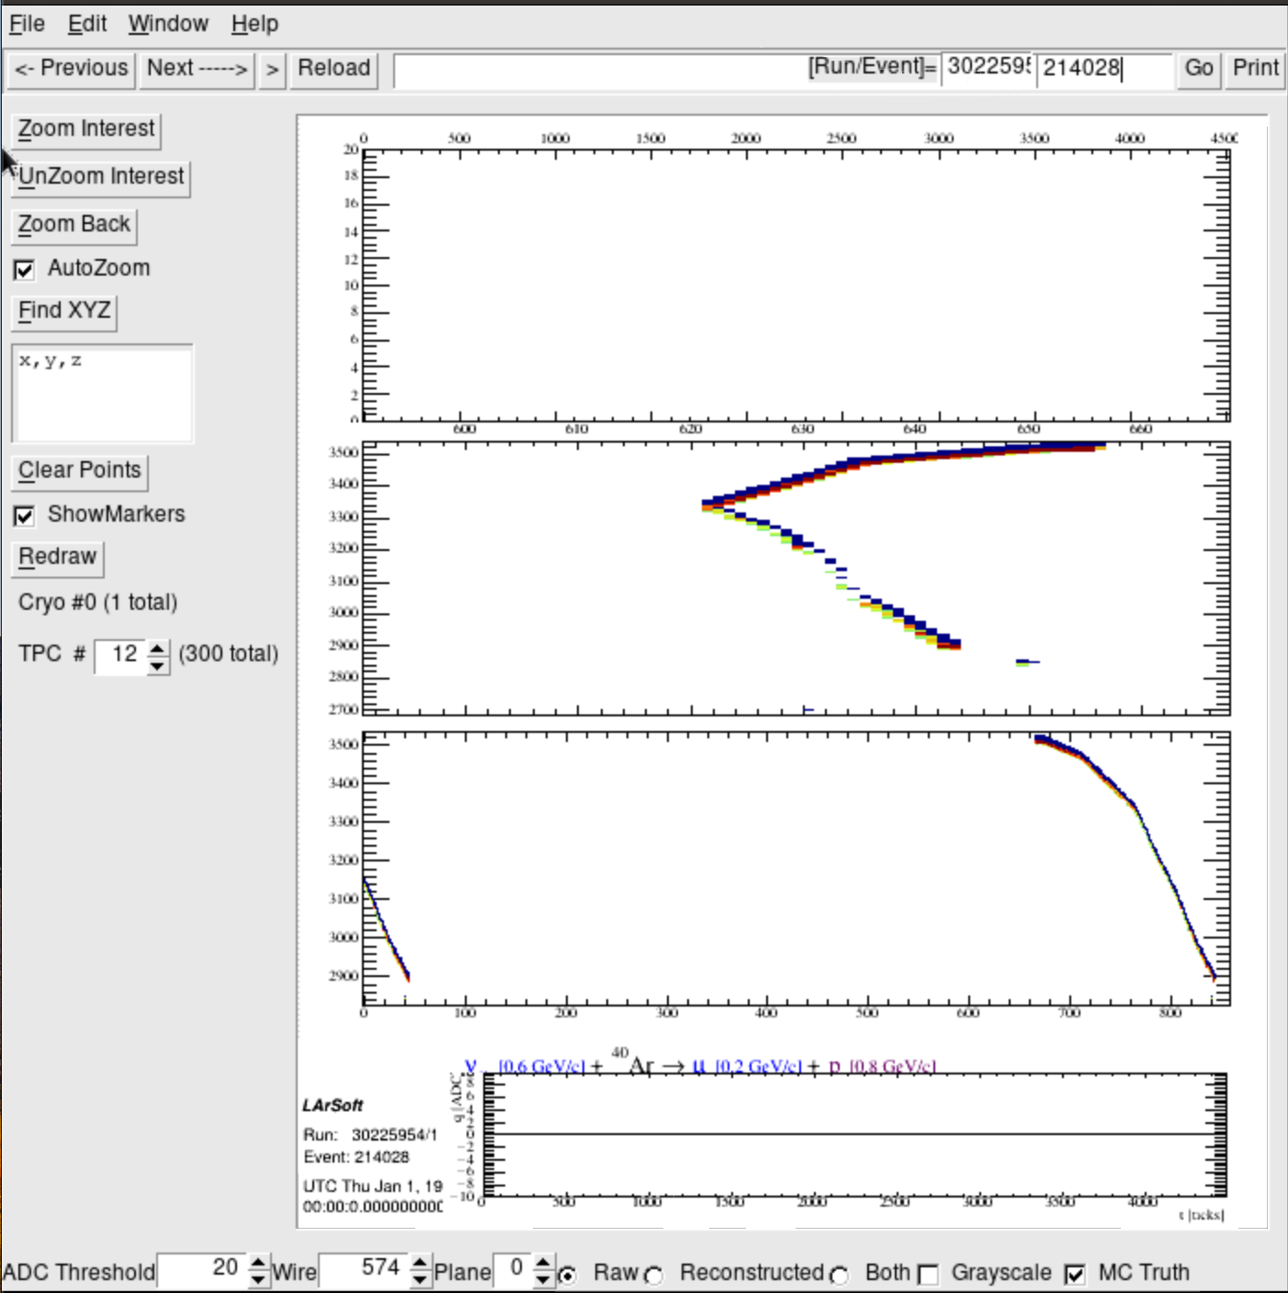
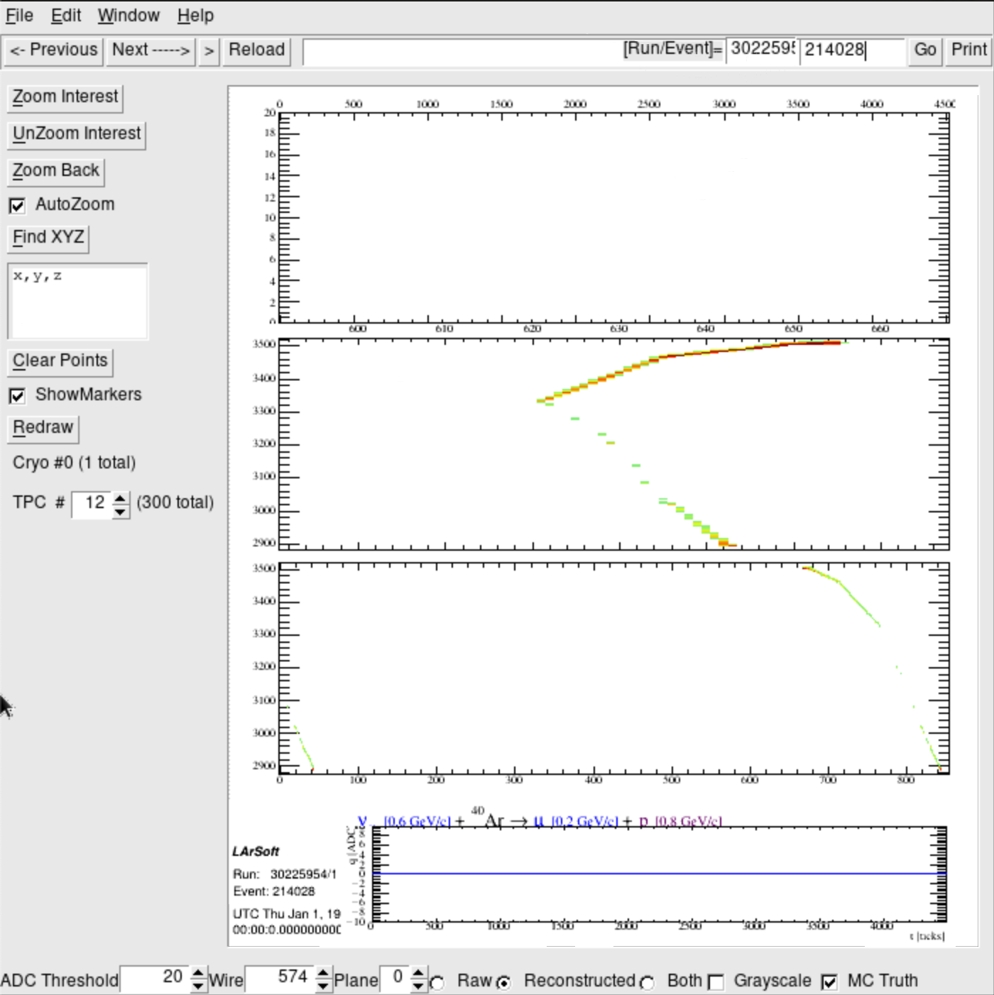
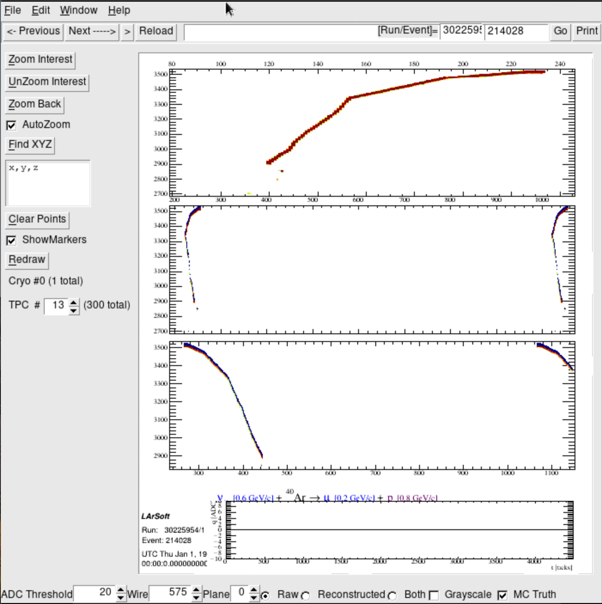
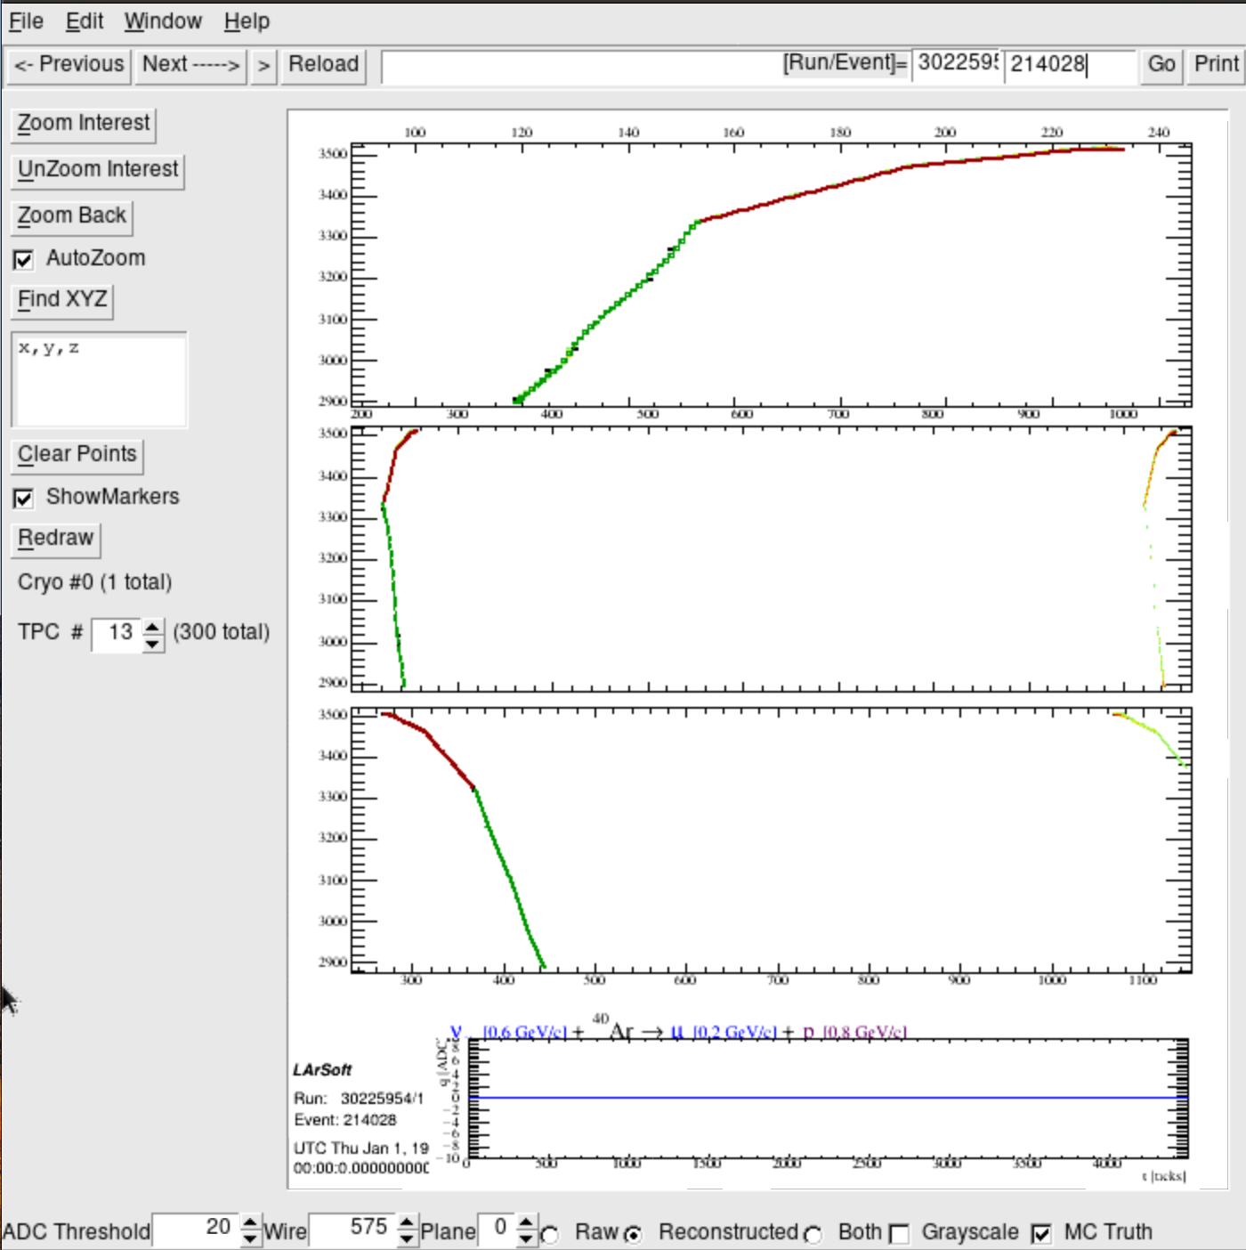
Track goes through 2 TPCs
TPC #12
Raw
v [0.6 GeV/c] + Ar $→$μ[0.2 GeV/c] + p[0.8GeV/c]
Reconstructed
Muyuan He | Atmospheric Neutrino Zenith Angle Reconstruction —Truth Comparison

Slide 9
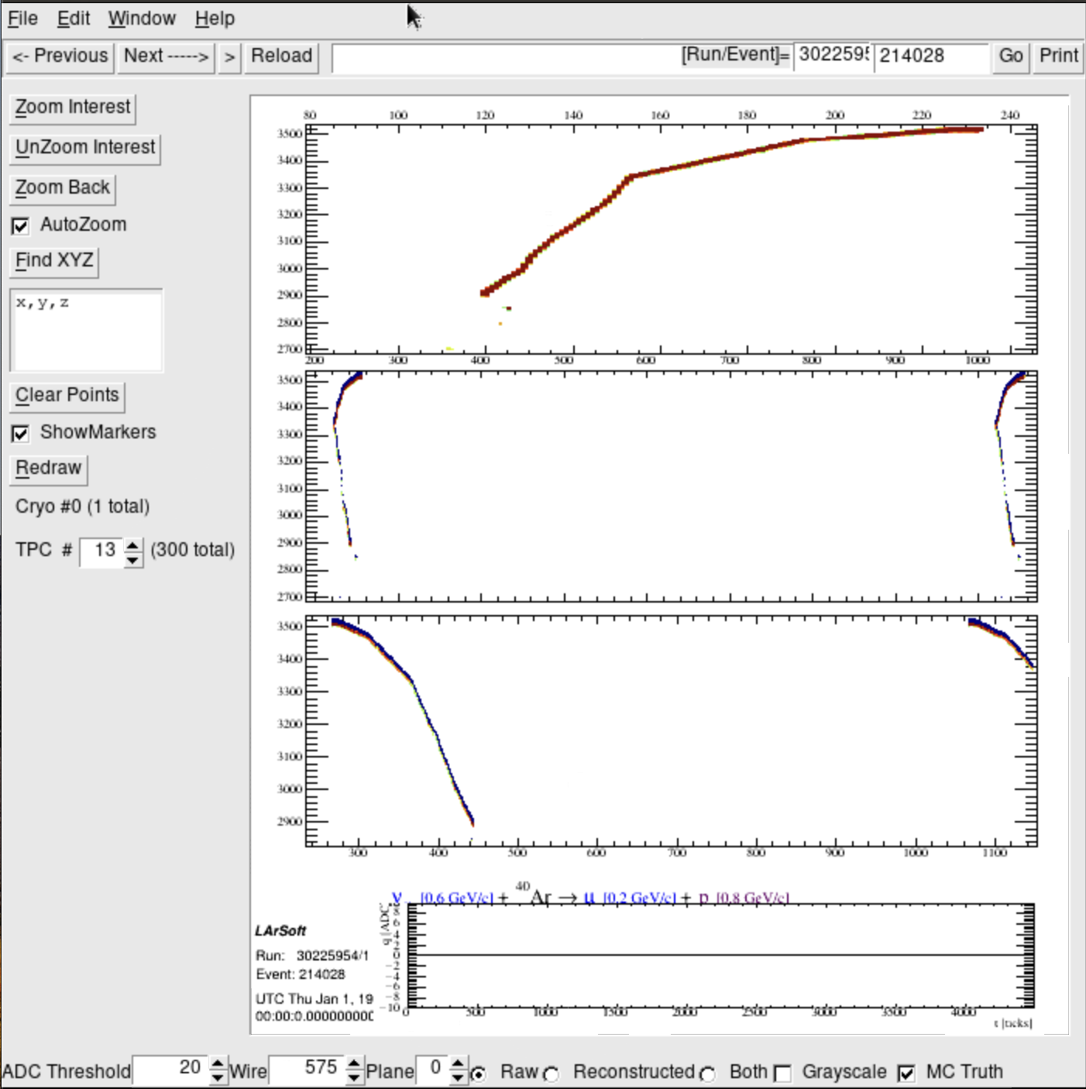
TPC #13
Raw
v [0.6 GeV/c] + Ar $→$μ[0.2 GeV/c] + p[0.8GeV/c]
Reconstructed
Muyuan He | Atmospheric Neutrino Zenith Angle Reconstruction —Truth Comparison

Slide 10
Run: 30225945; Event: 214124;
lep_dcosy_truth vs trkstartdcosy_pandoraTrack: -0.866, -0.951
trkstartdcosy_pandoraTrack vs lep_dcosy_truth
trkstartdcosy_pandoraTrack
.
lep_dcosy_truth
Muyuan He | Atmospheric Neutrino Zenith Angle Reconstruction —Truth Comparison

Slide 11
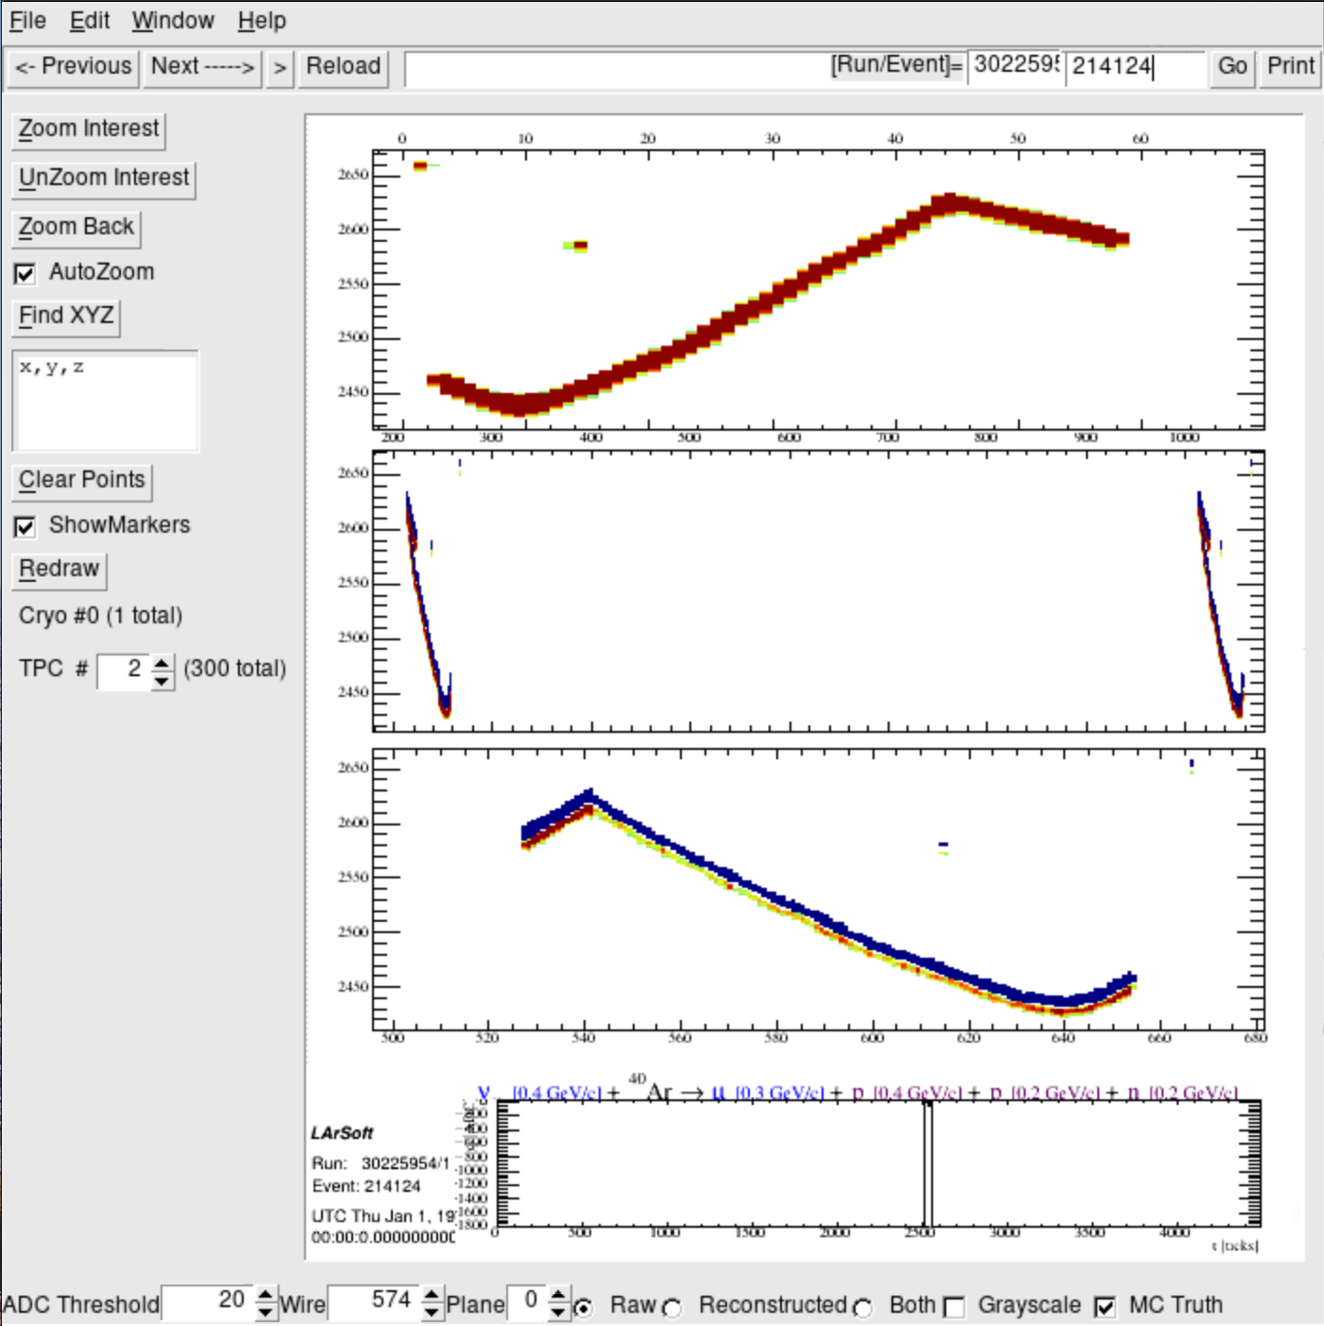
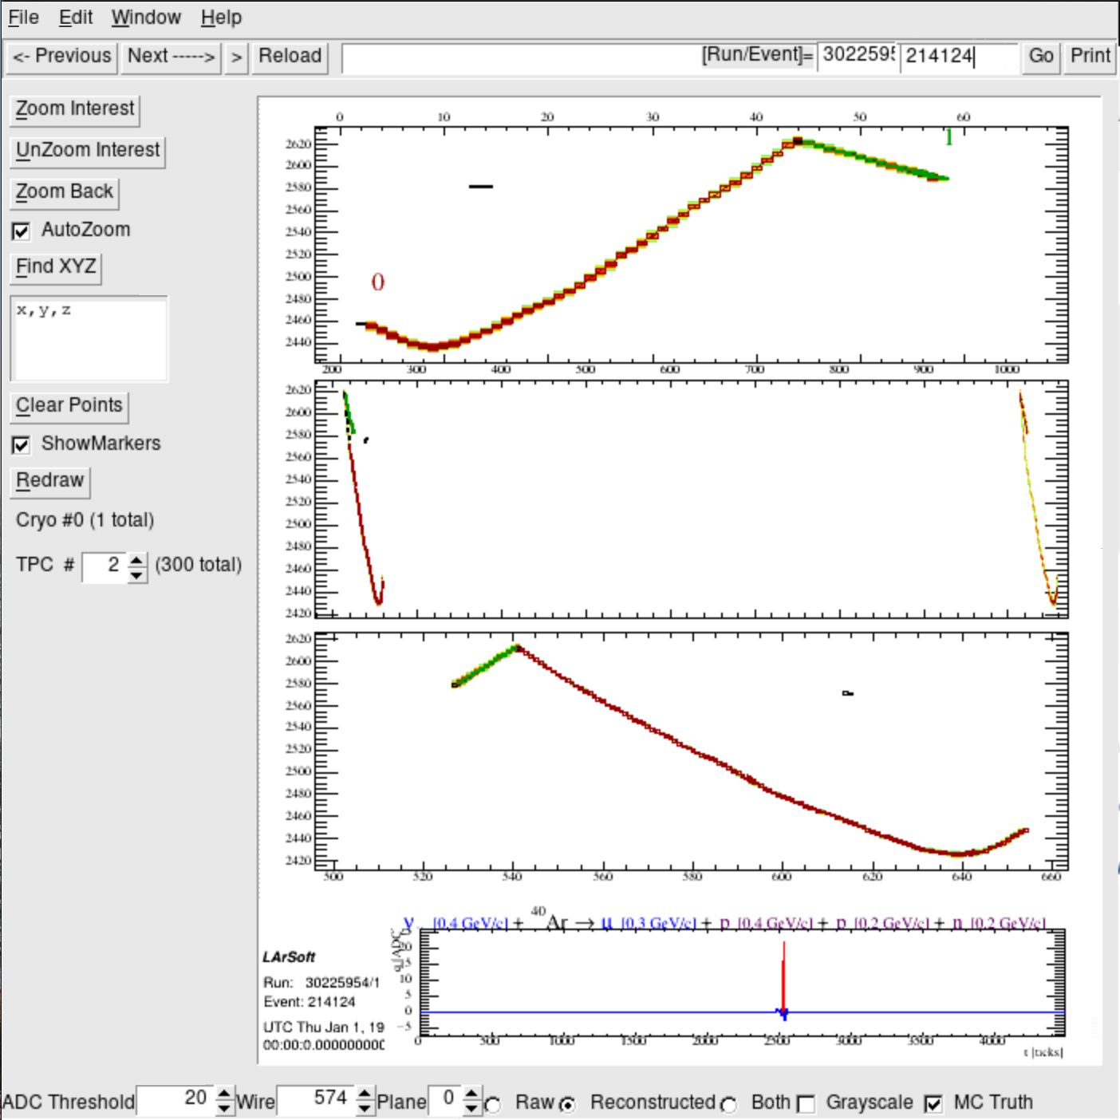
Track goes through 2 TPCs
TPC #2
Raw
v [0.4 GeV/c] + Ar $→$μ[0.3 GeV/c] + p[0.2GeV/c] + n[0.2GeV/c]
Reconstructed
Muyuan He | Atmospheric Neutrino Zenith Angle Reconstruction —Truth Comparison

Slide 12
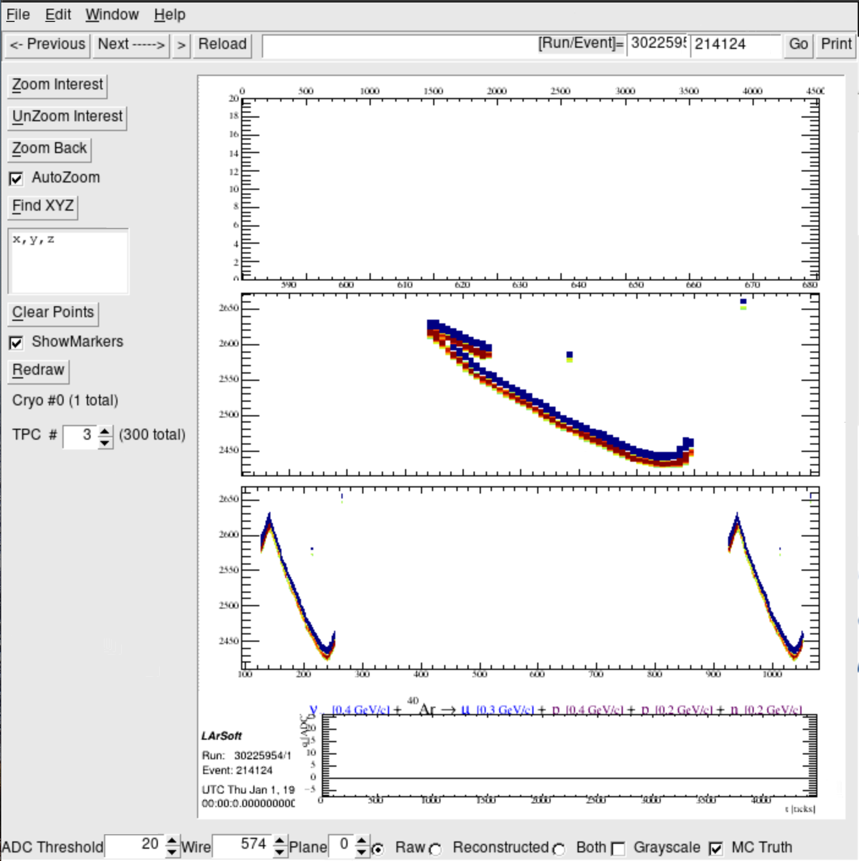
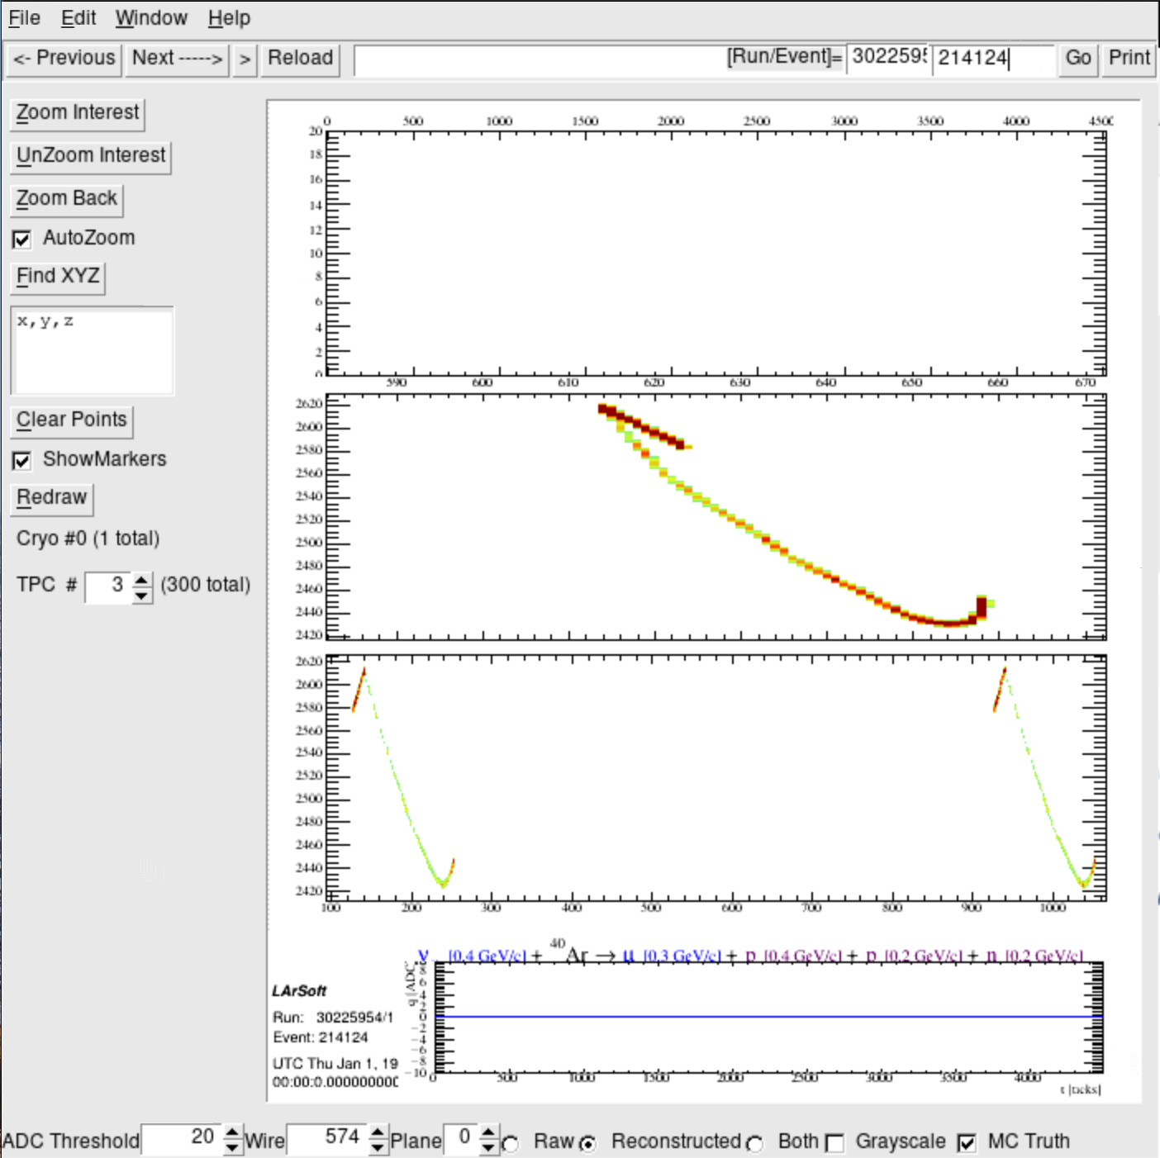
TPC #3
Raw
v [0.4 GeV/c] + Ar $→$μ[0.3 GeV/c] + p[0.2GeV/c] + n[0.2GeV/c]
Reconstructed
Muyuan He | Atmospheric Neutrino Zenith Angle Reconstruction —Truth Comparison

Slide 13
Run: 30225945; Event: 214233;
lep_dcosy_truth vs trkstartdcosy_pandoraTrack: -0.175, -0.025
trkstartdcosy_pandoraTrack vs lep_dcosy_truth
.
trkstartdcosy_pandoraTrack
lep_dcosy_truth
Muyuan He | Atmospheric Neutrino Zenith Angle Reconstruction —Truth Comparison

Slide 14
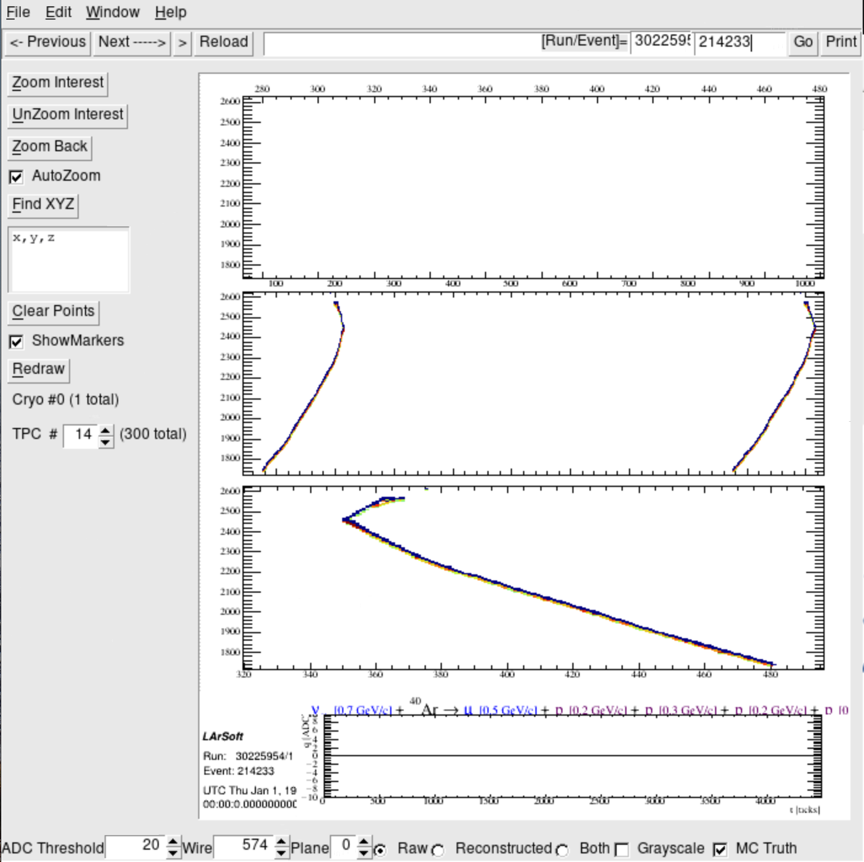
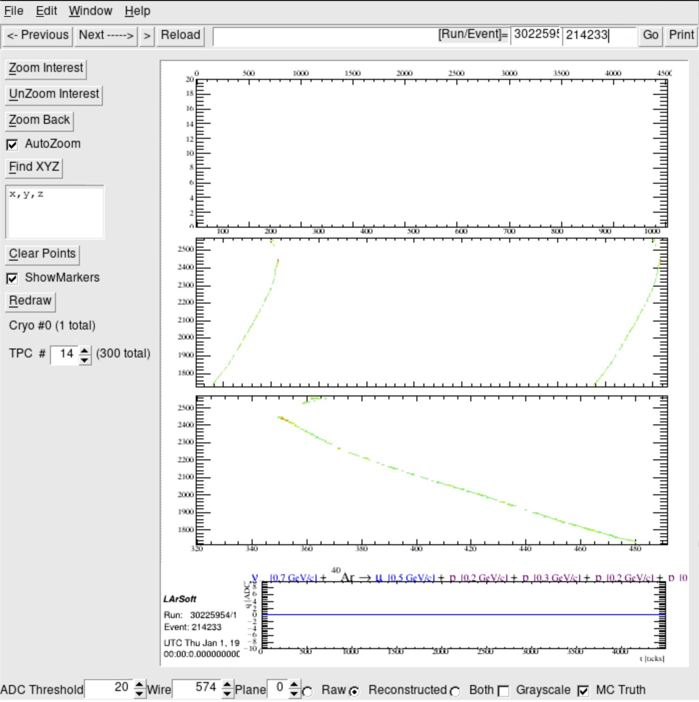
Track goes through 2 TPCs
TPC #14
Raw
v [0.7 GeV/c] + Ar $→$μ[0.5 GeV/c] + p[0.2GeV/c] + p[0.3GeV/c]+p[0.?]
Reco
Muyuan He | Atmospheric Neutrino Zenith Angle Reconstruction —Truth Comparison

Slide 15
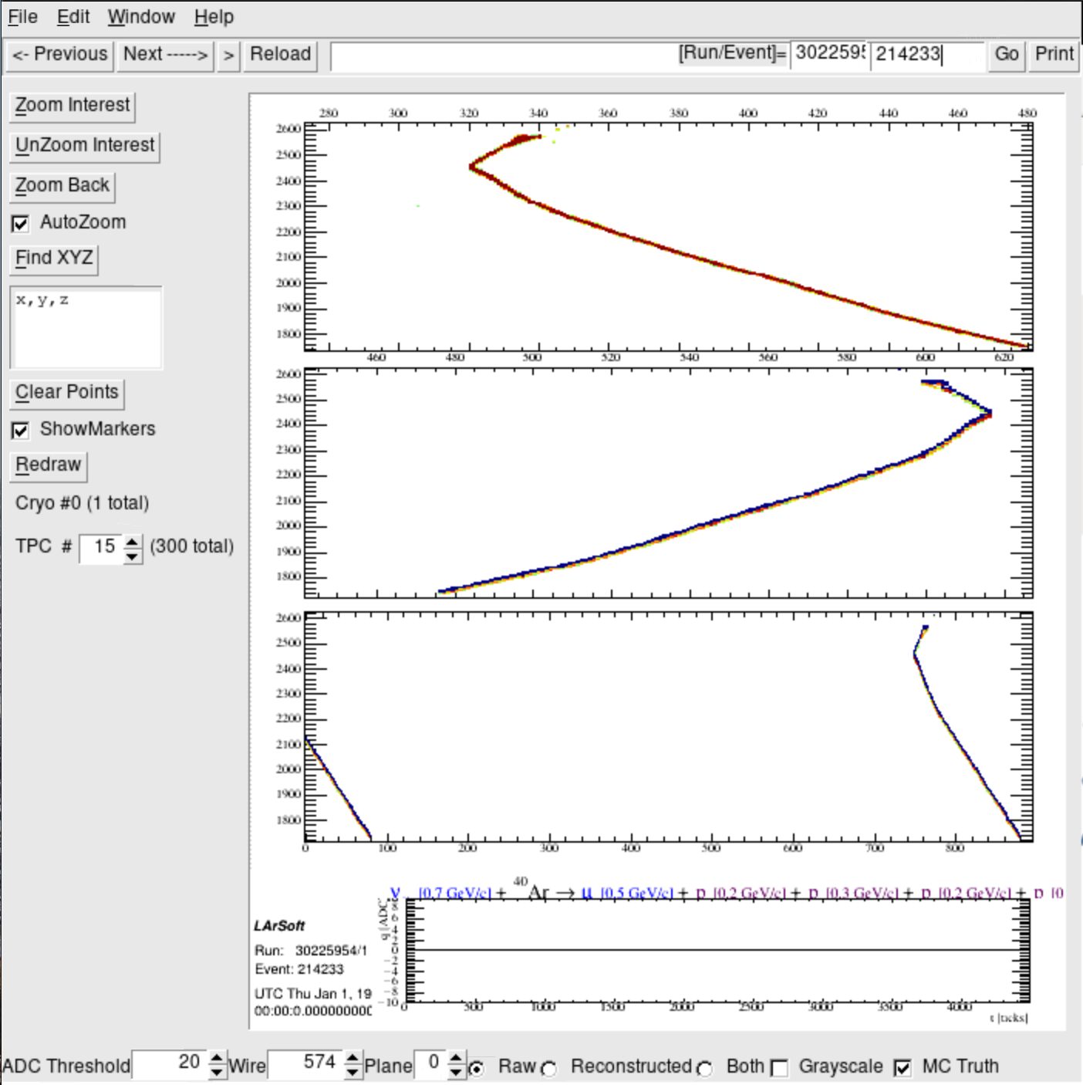
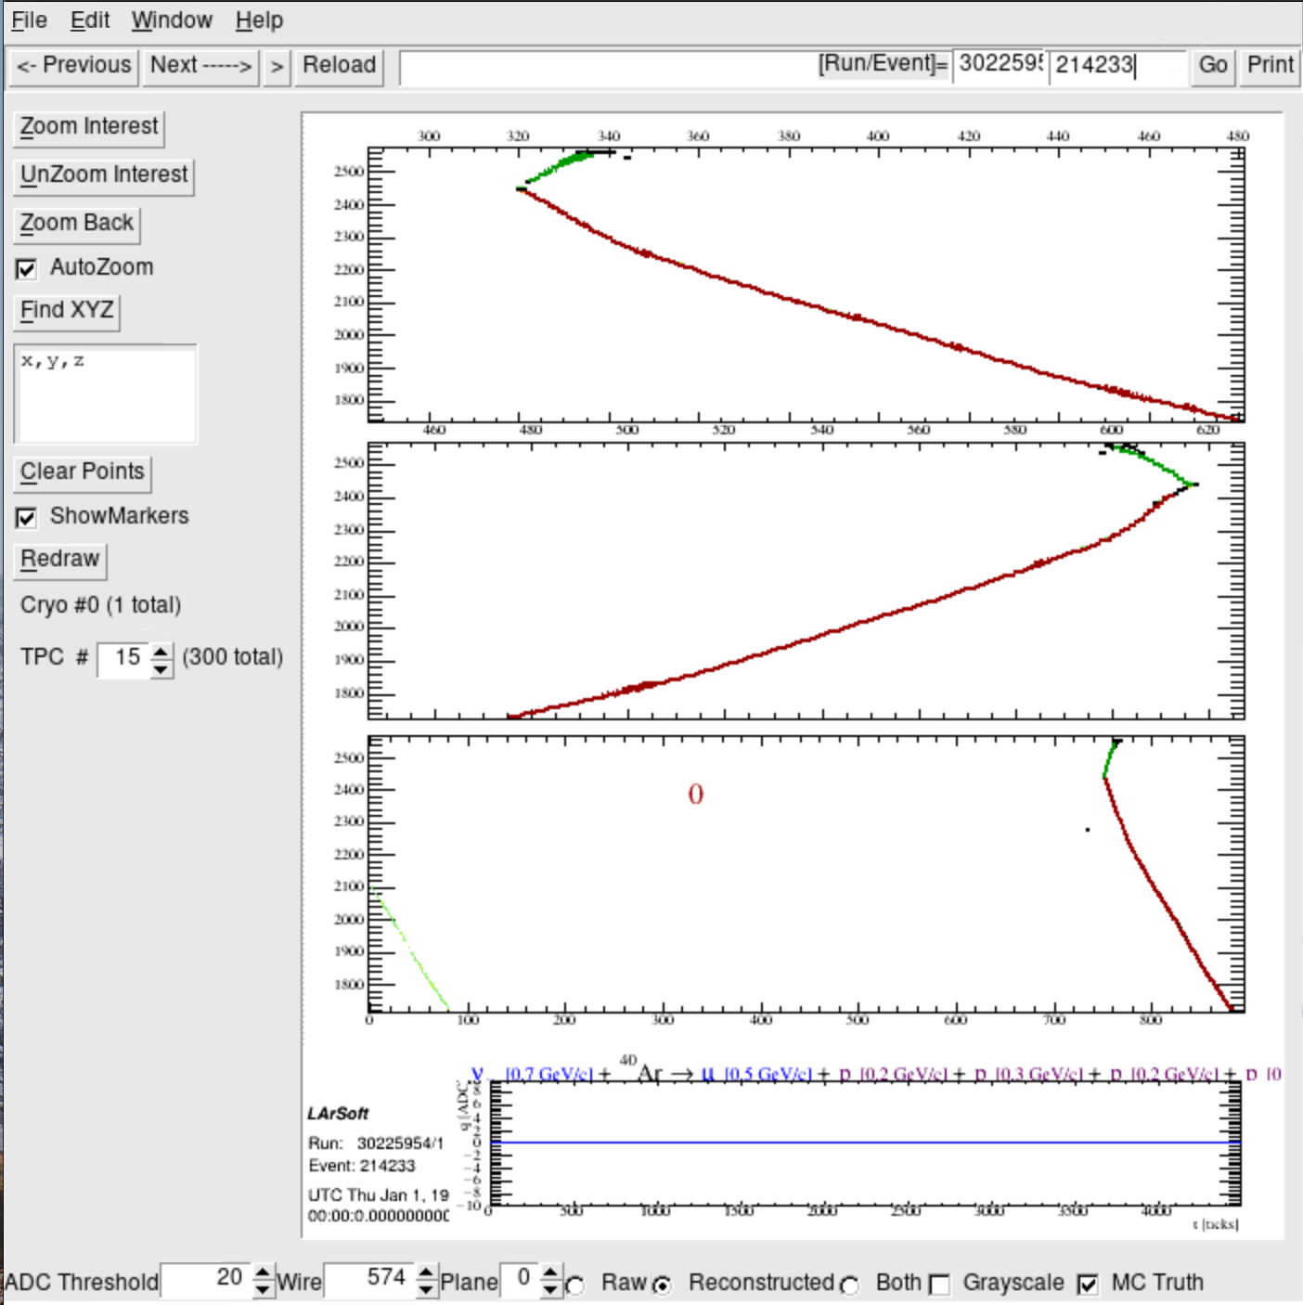
TPC #15
Raw
v [0.7 GeV/c] + Ar $→$μ[0.5 GeV/c] + p[0.2GeV/c] + p[0.3GeV/c]+p[0.?]
Reco
Muyuan He | Atmospheric Neutrino Zenith Angle Reconstruction —Truth Comparison

Slide 16
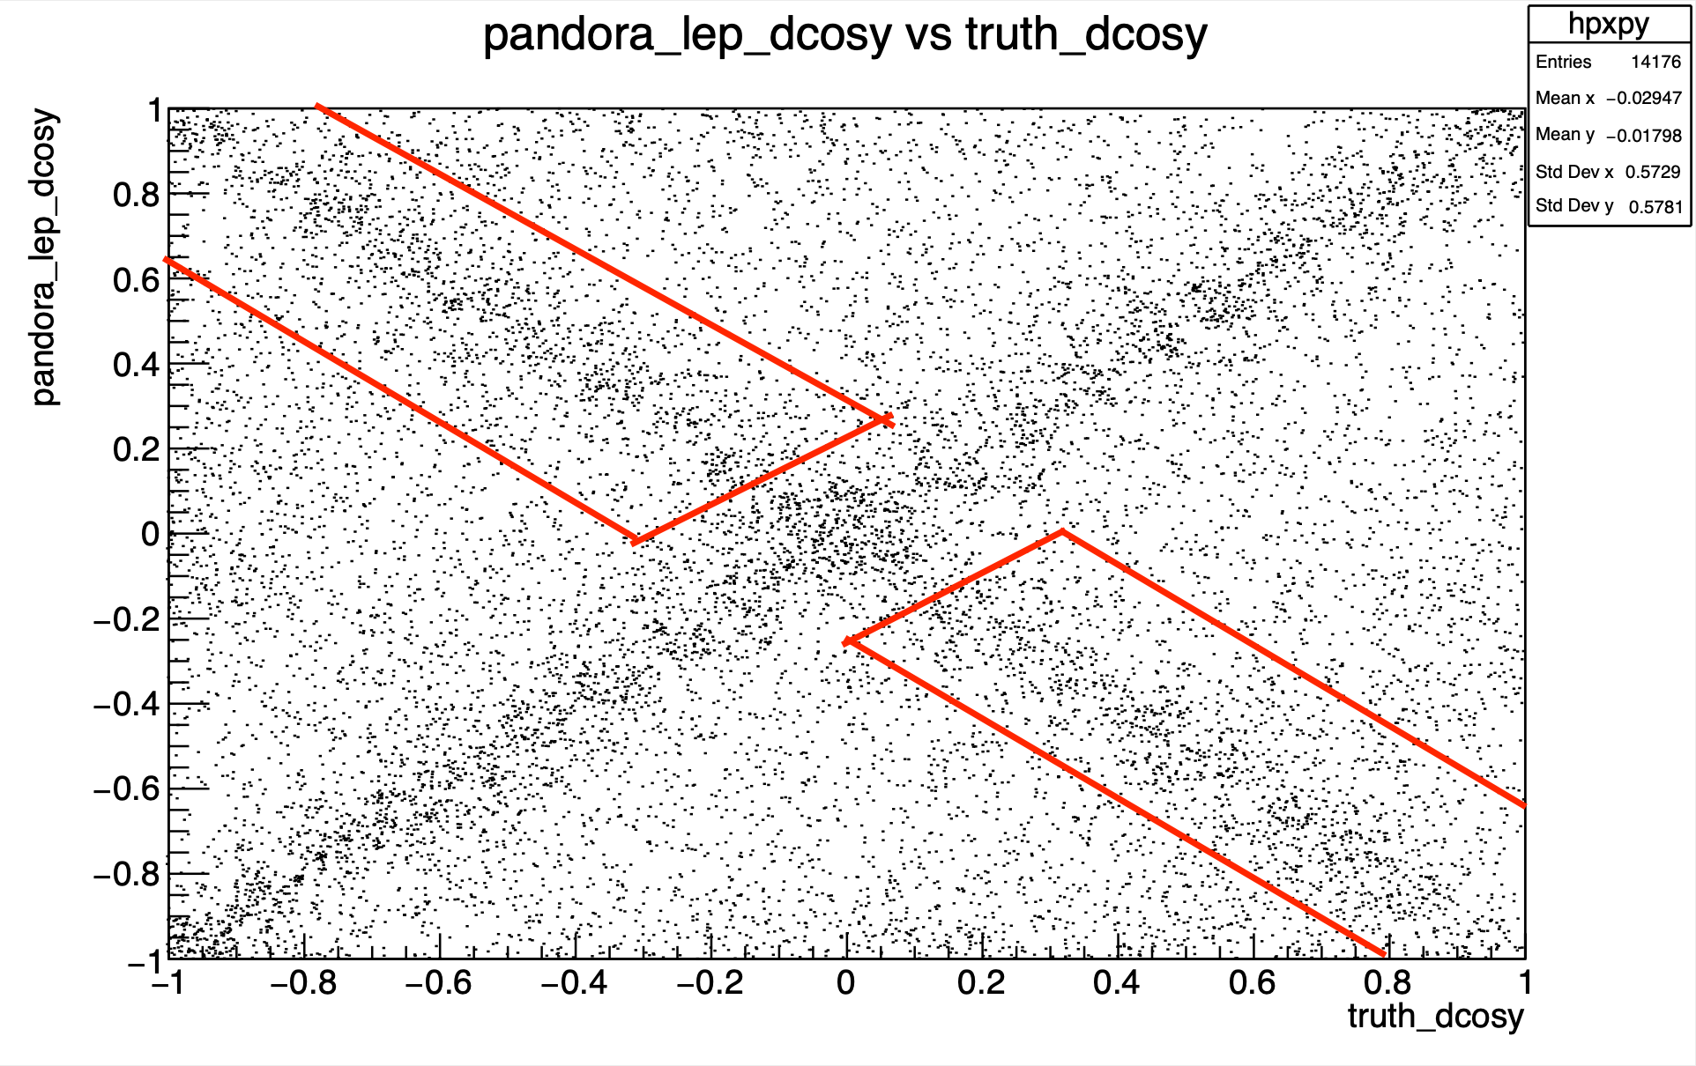
Wrong Axis
26% of total events
trkstartdcosy_pandoraTrack vs lep_dcosy_truth
trkstartdcosy_pandoraTrack
lep_dcosy_truth

Slide 17
Run: 30225945; Event: 214305;
lep_dcosy_truth vs trkstartdcosy_pandoraTrack: 0.779, -0.653
trkstartdcosy_pandoraTrack vs lep_dcosy_truth
trkstartdcosy_pandoraTrack
.
lep_dcosy_truth
Muyuan He | Atmospheric Neutrino Zenith Angle Reconstruction —Truth Comparison

Slide 18
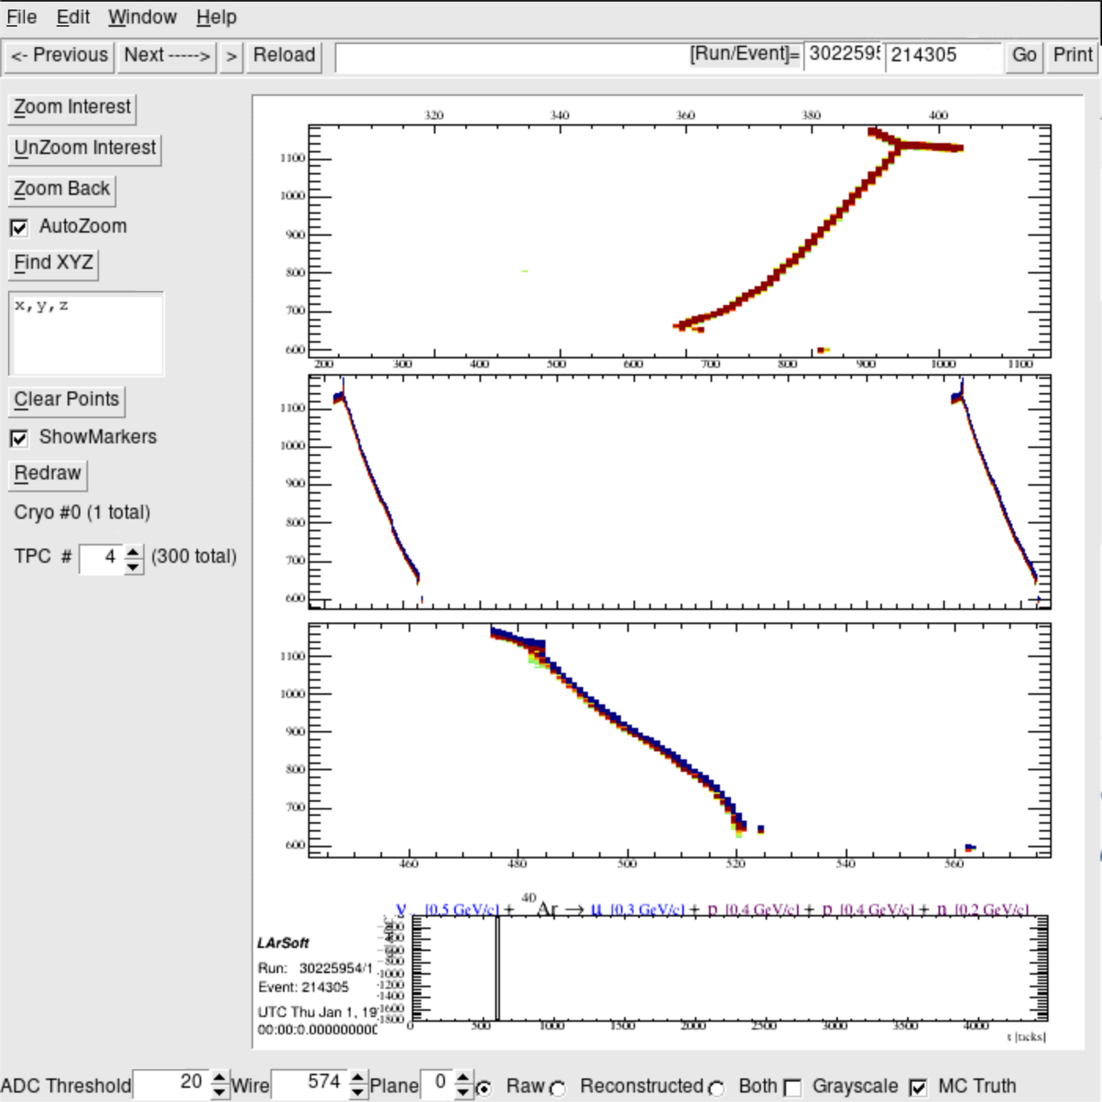
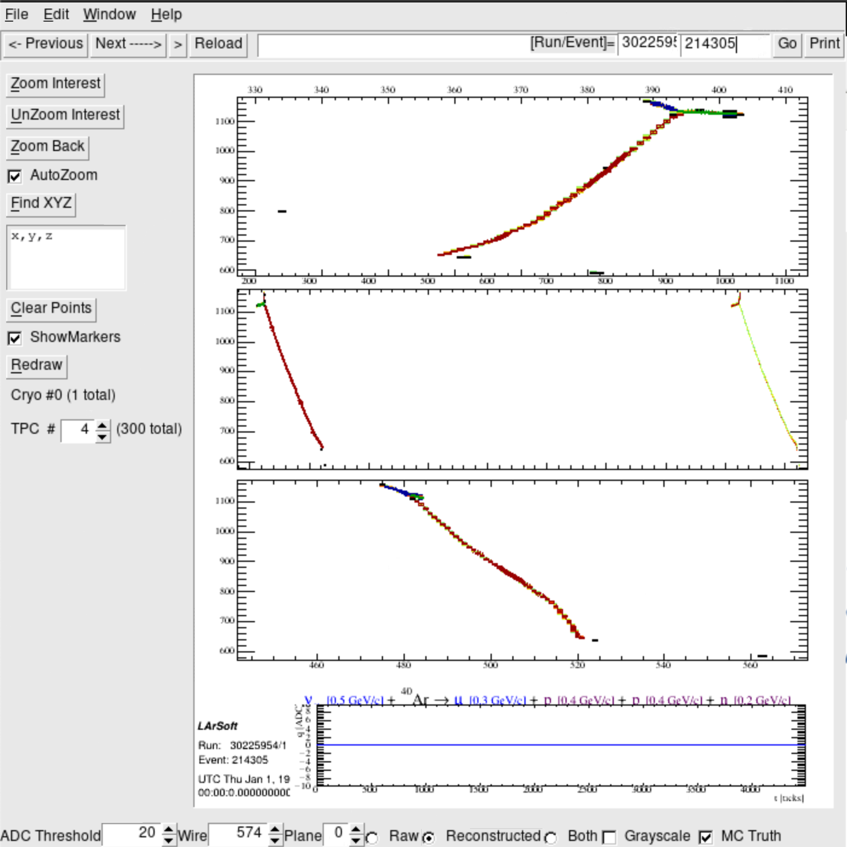
Track goes through 2 TPCs
TPC #4
Reco
Raw
v [0.5 GeV/c] + Ar $→$μ[0.3 GeV/c] + p[0.4GeV/c] + p[0.4GeV/c]+n[0.2GeV/c]
Muyuan He | Atmospheric Neutrino Zenith Angle Reconstruction —Truth Comparison

Slide 19
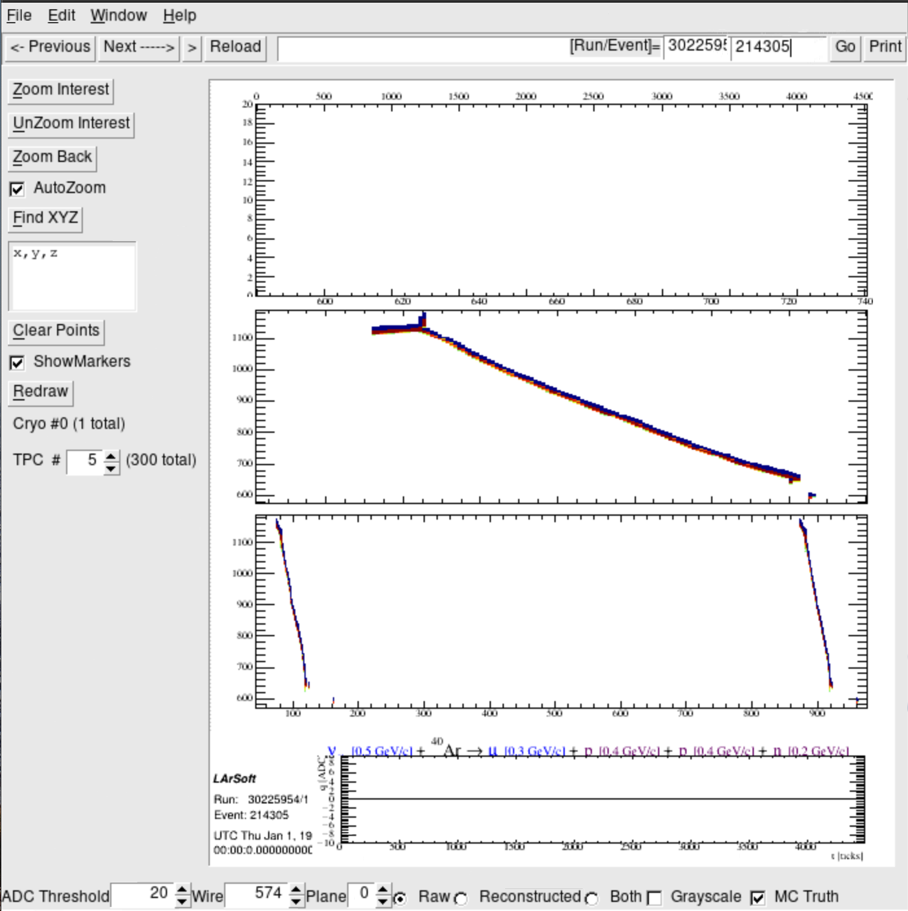
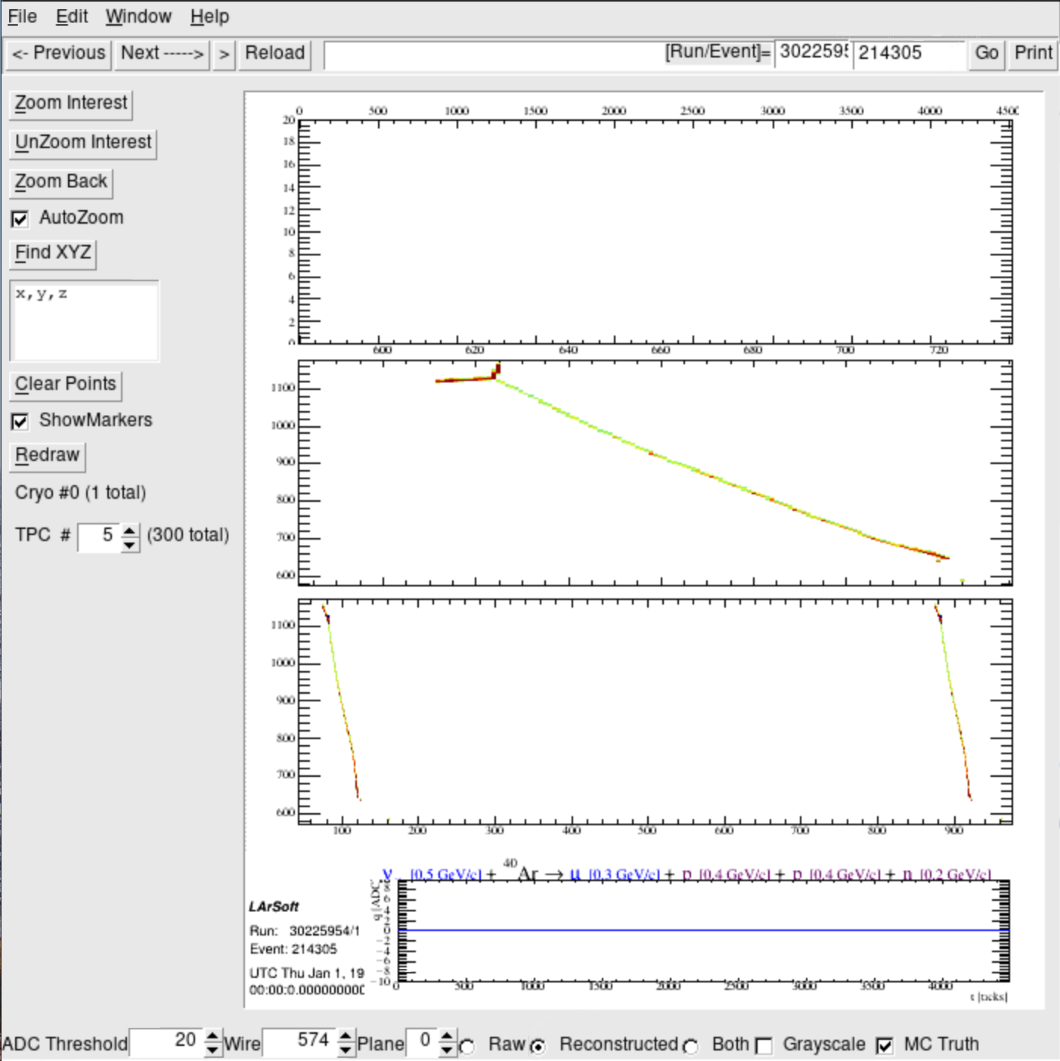
TPC #5
Reco
Raw
v [0.5 GeV/c] + Ar $→$μ[0.3 GeV/c] + p[0.4GeV/c] + p[0.4GeV/c]+n[0.2GeV/c]
Muyuan He | Atmospheric Neutrino Zenith Angle Reconstruction —Truth Comparison

Slide 20
Run: 30225945; Event: 365225;
lep_dcosy_truth vs trkstartdcosy_pandoraTrack: 0.247, -0.375
trkstartdcosy_pandoraTrack vs lep_dcosy_truth
trkstartdcosy_pandoraTrack
.
lep_dcosy_truth
Muyuan He | Atmospheric Neutrino Zenith Angle Reconstruction —Truth Comparison

Slide 21
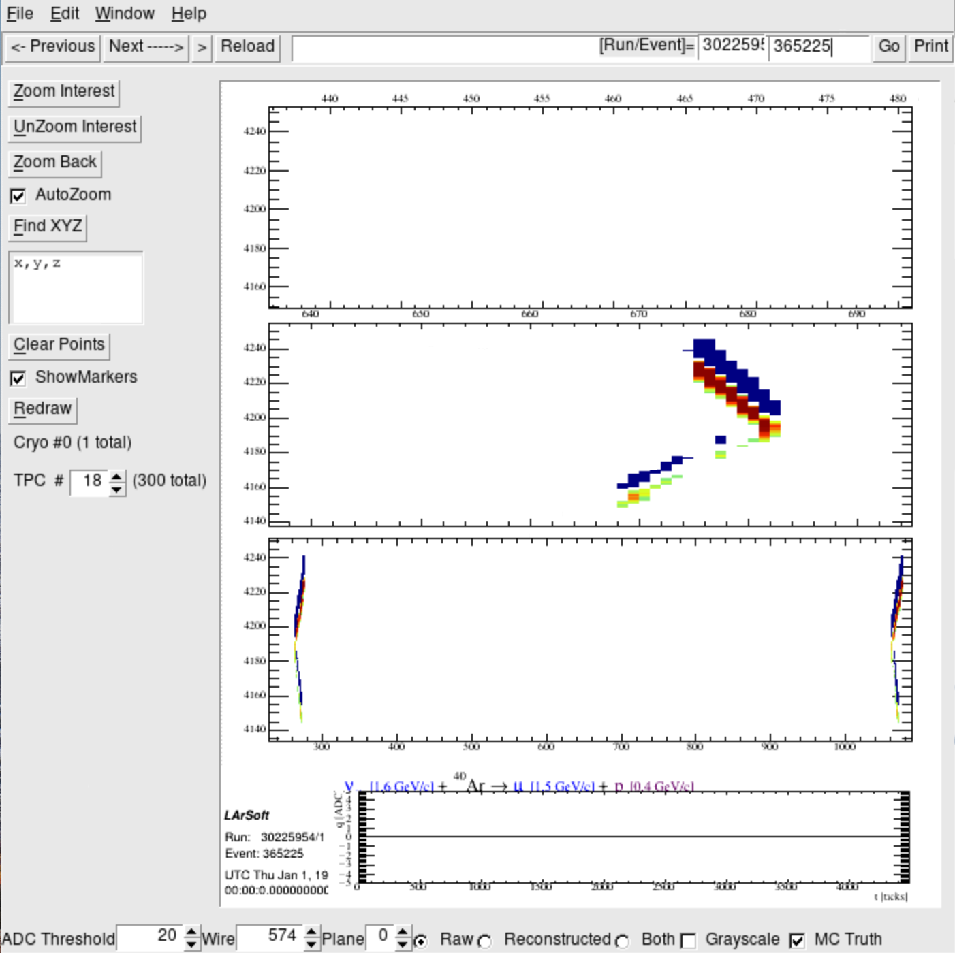
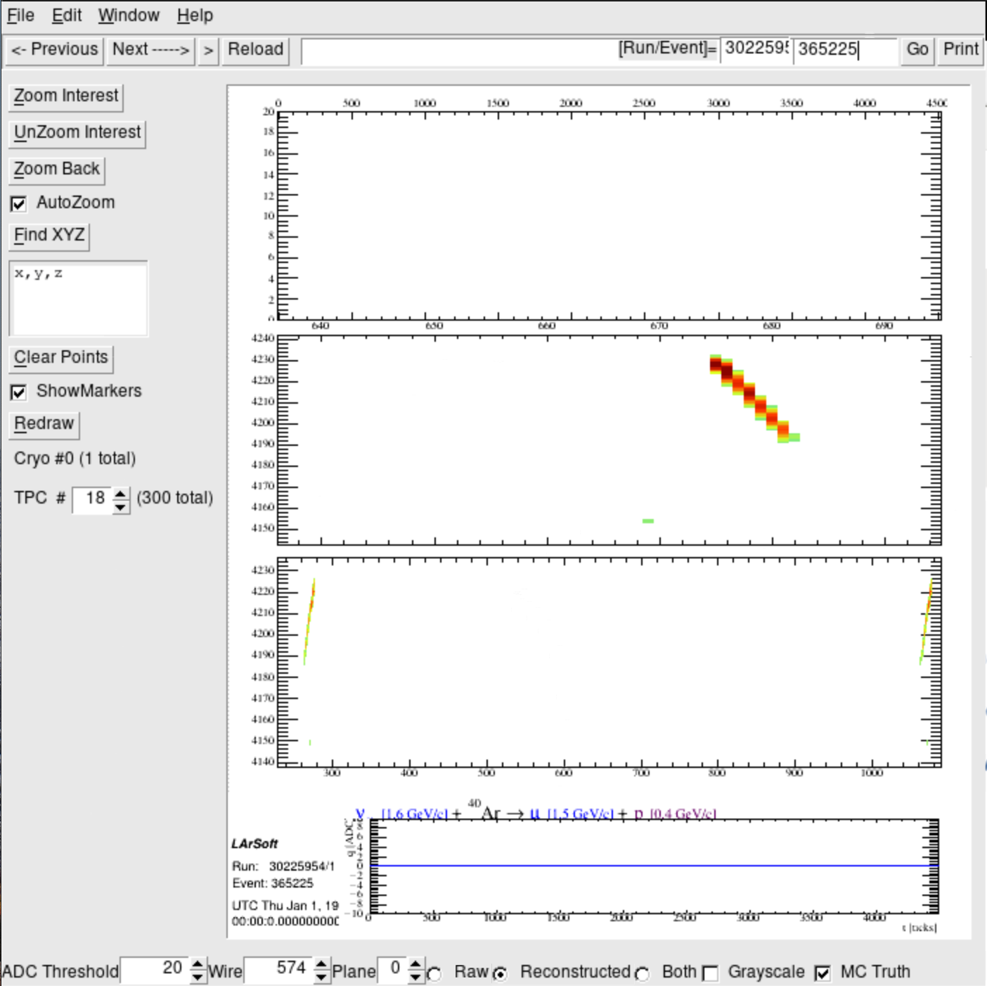
Track goes through 2 TPCs
TPC # 18
Raw
v [1.6GeV/c] + Ar $→$μ[1.5 GeV/c] + p[0.4GeV/c]
Reco
Muyuan He | Atmospheric Neutrino Zenith Angle Reconstruction —Truth Comparison

Slide 22
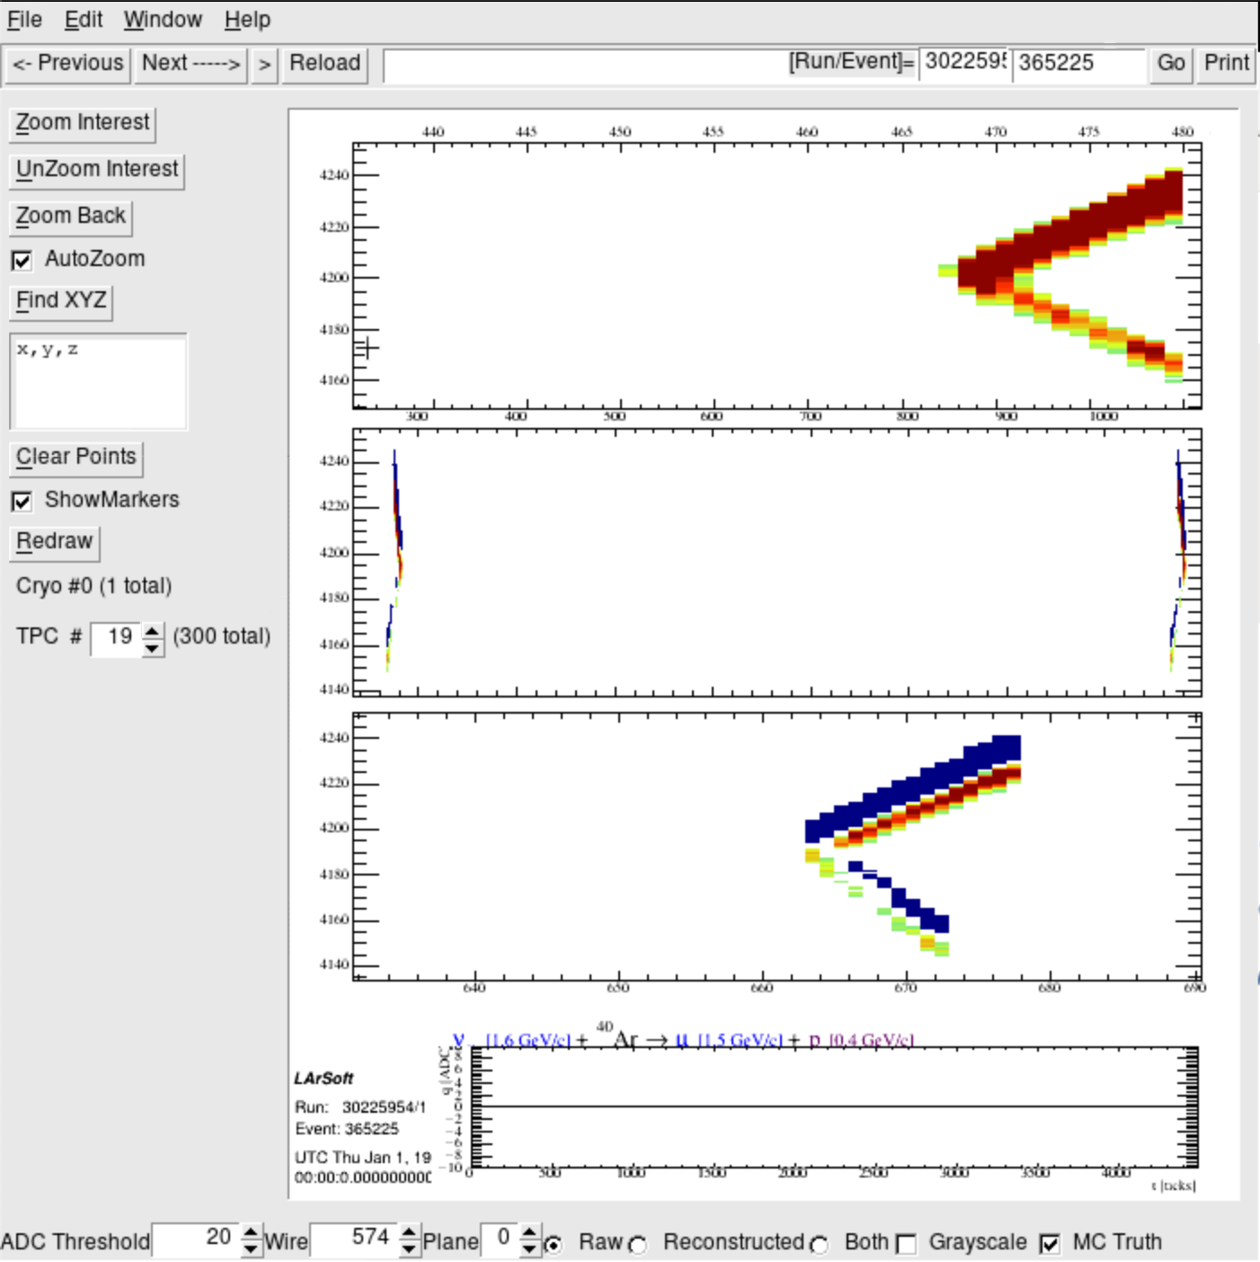
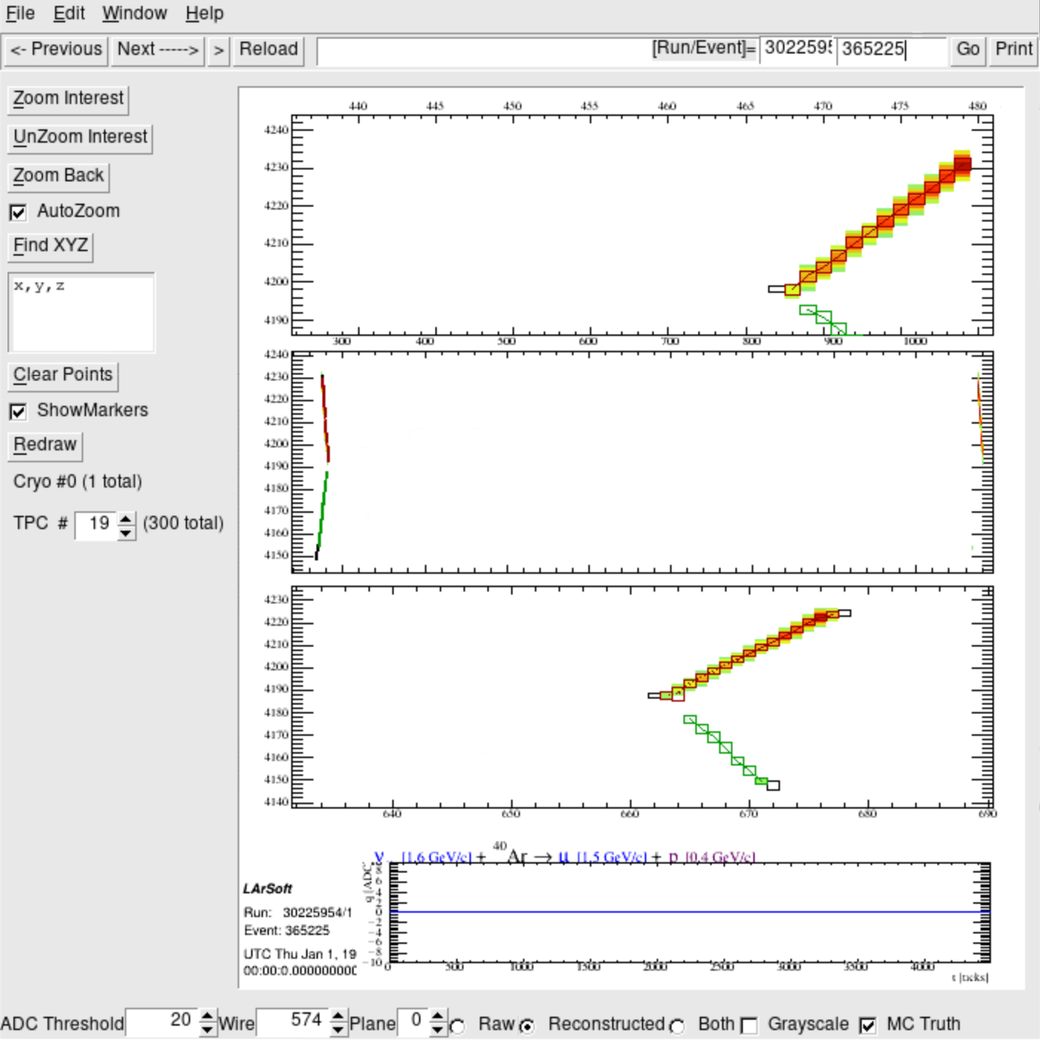
TPC # 19
Raw
v [1.6GeV/c] + Ar $→$μ[1.5 GeV/c] + p[0.4GeV/c]
Reco
Muyuan He | Atmospheric Neutrino Zenith Angle Reconstruction —Truth Comparison

Slide 23
Run: 30225945; Event: 365420;
lep_dcosy_truth vs trkstartdcosy_pandoraTrack: 0.630, -0.370
trkstartdcosy_pandoraTrack vs lep_dcosy_truth
trkstartdcosy_pandoraTrack
.
lep_dcosy_truth
Muyuan He | Atmospheric Neutrino Zenith Angle Reconstruction —Truth Comparison

Slide 24
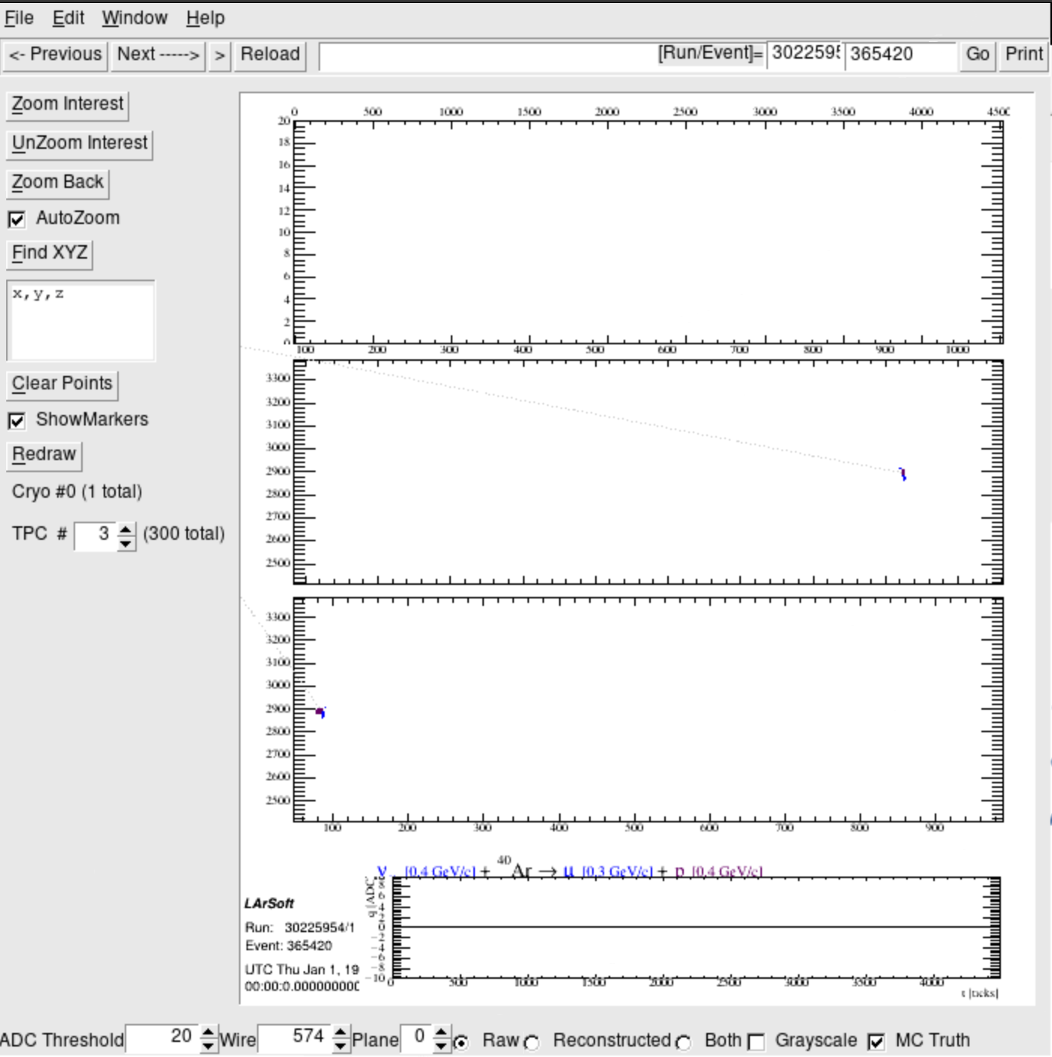
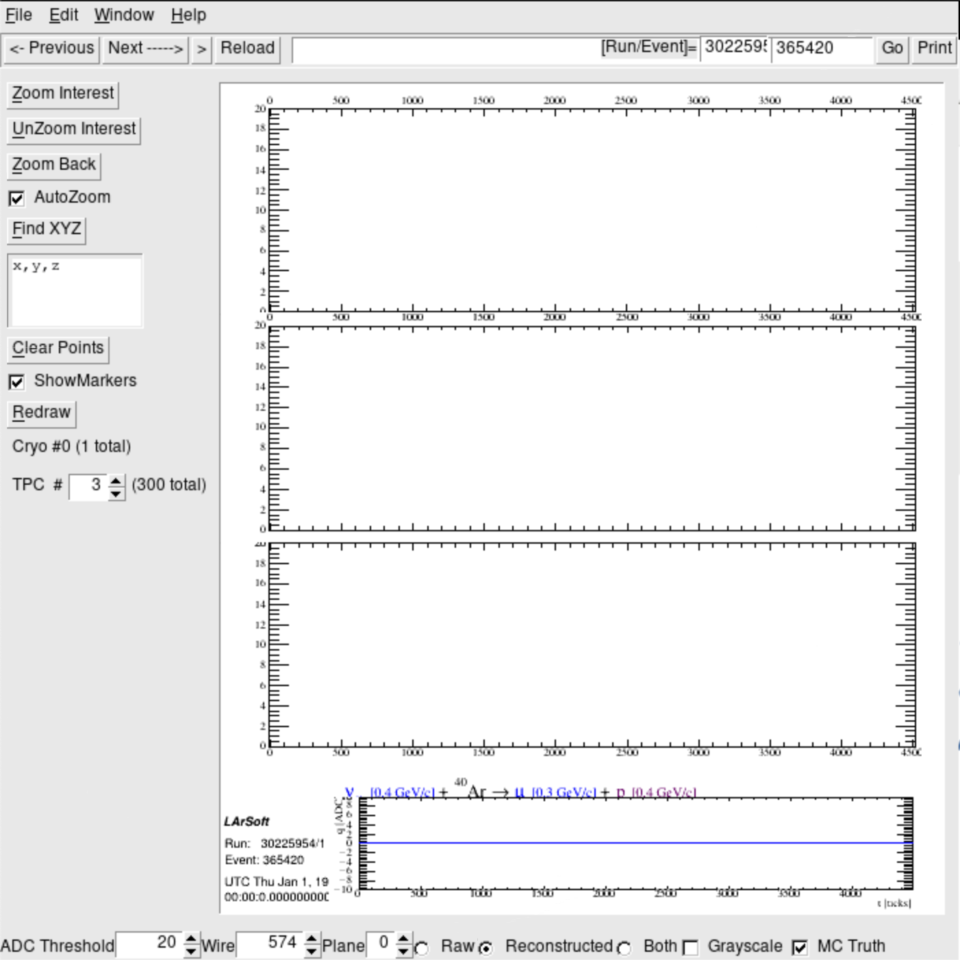
Track goes through 3 TPCs
TPC # 3
Raw
v [0.4GeV/c] + Ar $→$μ[0.3 GeV/c] + p[0.4GeV/c]
Reco
Muyuan He | Atmospheric Neutrino Zenith Angle Reconstruction —Truth Comparison

Slide 25
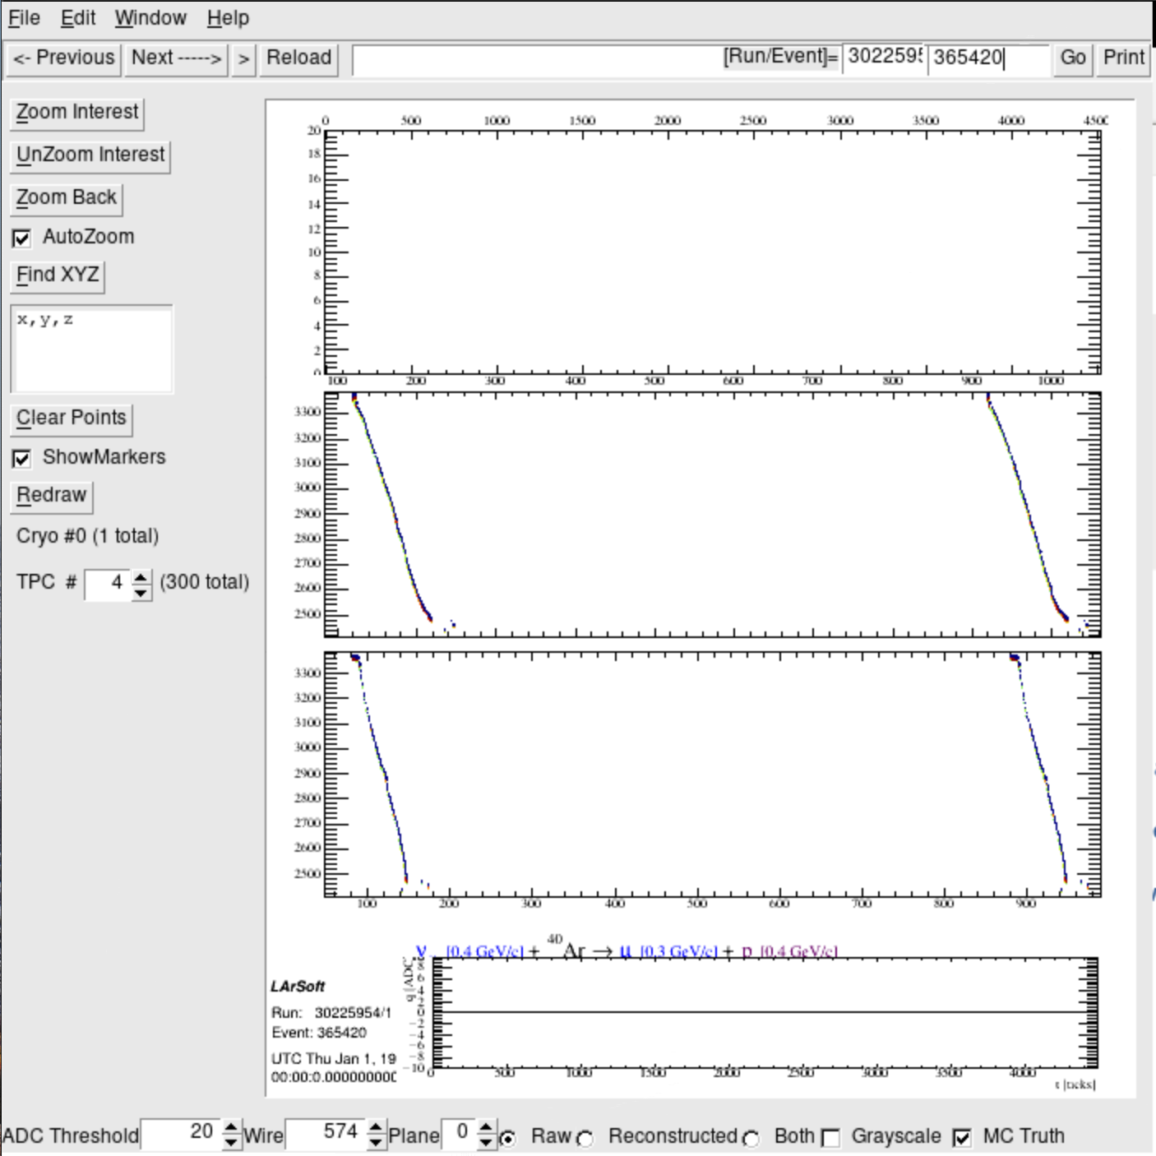
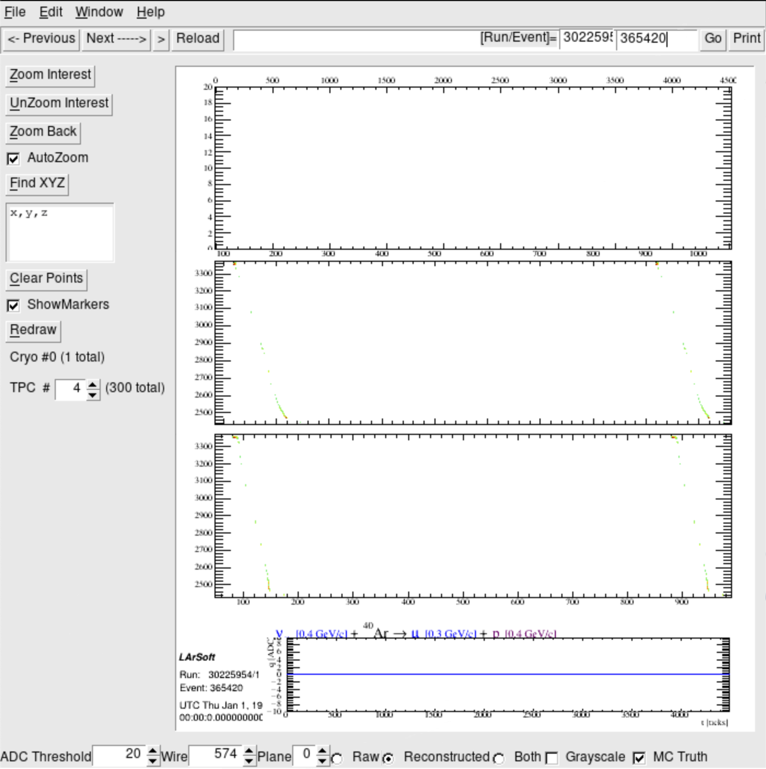
TPC # 4
Raw
v [0.4GeV/c] + Ar $→$μ[0.3 GeV/c] + p[0.4GeV/c]
Reco
Muyuan He | Atmospheric Neutrino Zenith Angle Reconstruction —Truth Comparison

Slide 26
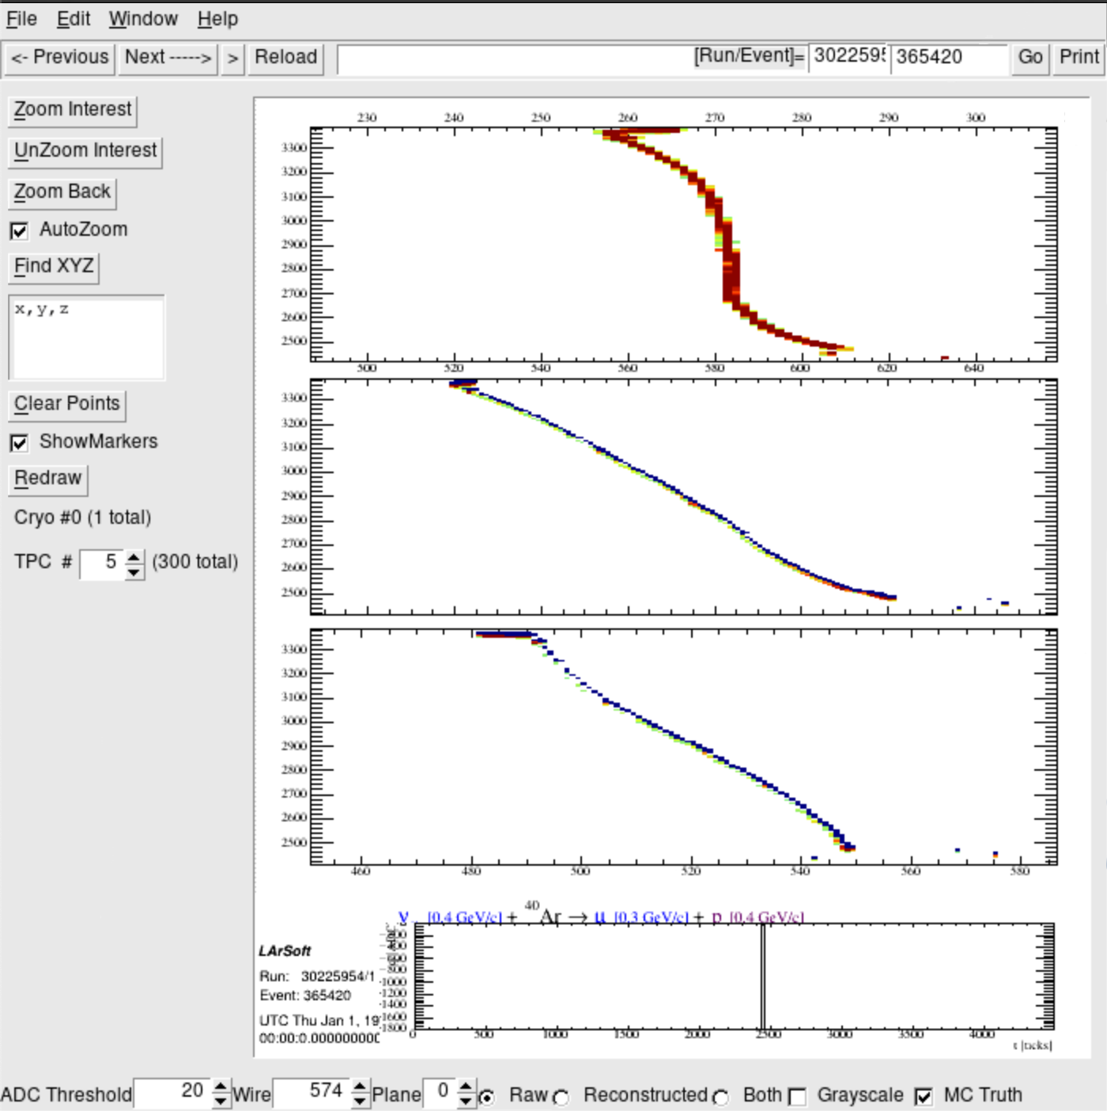
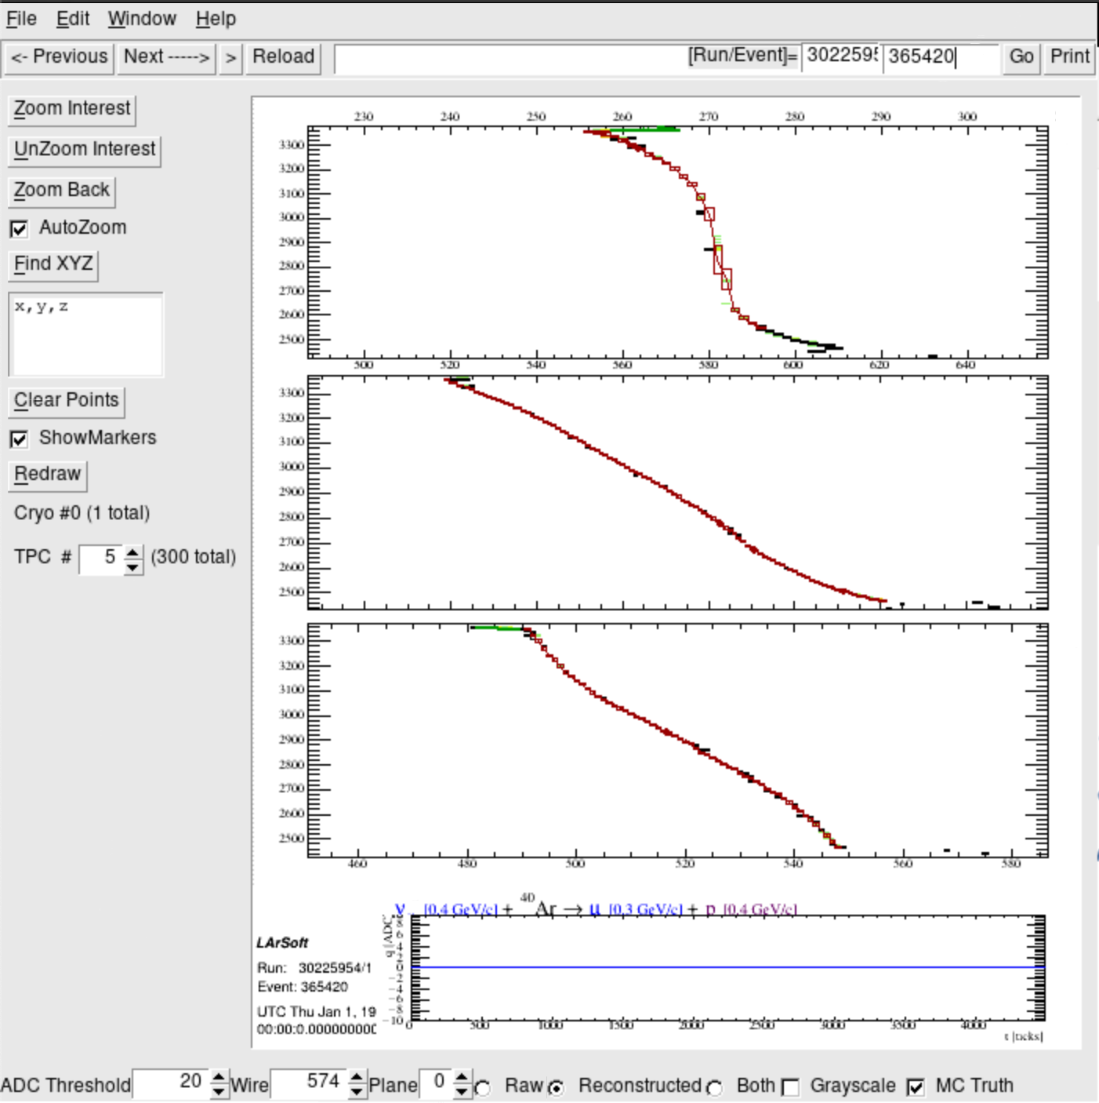
TPC # 5
Raw
v [0.4GeV/c] + Ar $→$μ[0.3 GeV/c] + p[0.4GeV/c]
Reco
Muyuan He | Atmospheric Neutrino Zenith Angle Reconstruction —Truth Comparison

Slide 27
Run: 30225945; Event: 498504;
lep_dcosy_truth vs trkstartdcosy_pandoraTrack: 0.895, -0.907
trkstartdcosy_pandoraTrack vs lep_dcosy_truth
trkstartdcosy_pandoraTrack
.
lep_dcosy_truth
Muyuan He | Atmospheric Neutrino Zenith Angle Reconstruction —Truth Comparison

Slide 28
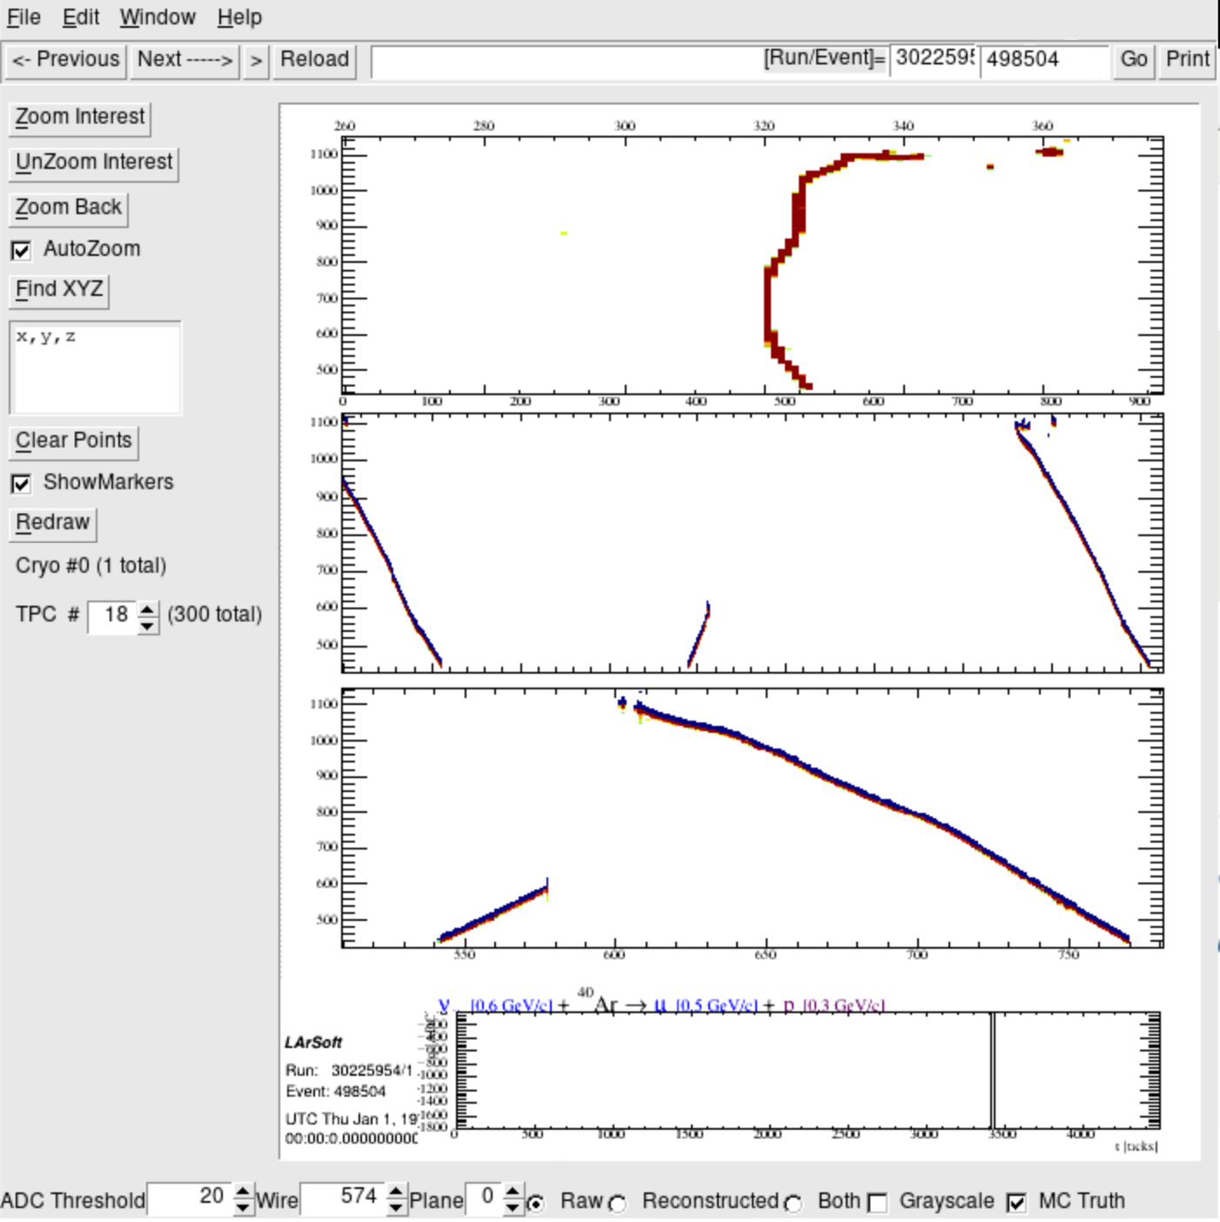
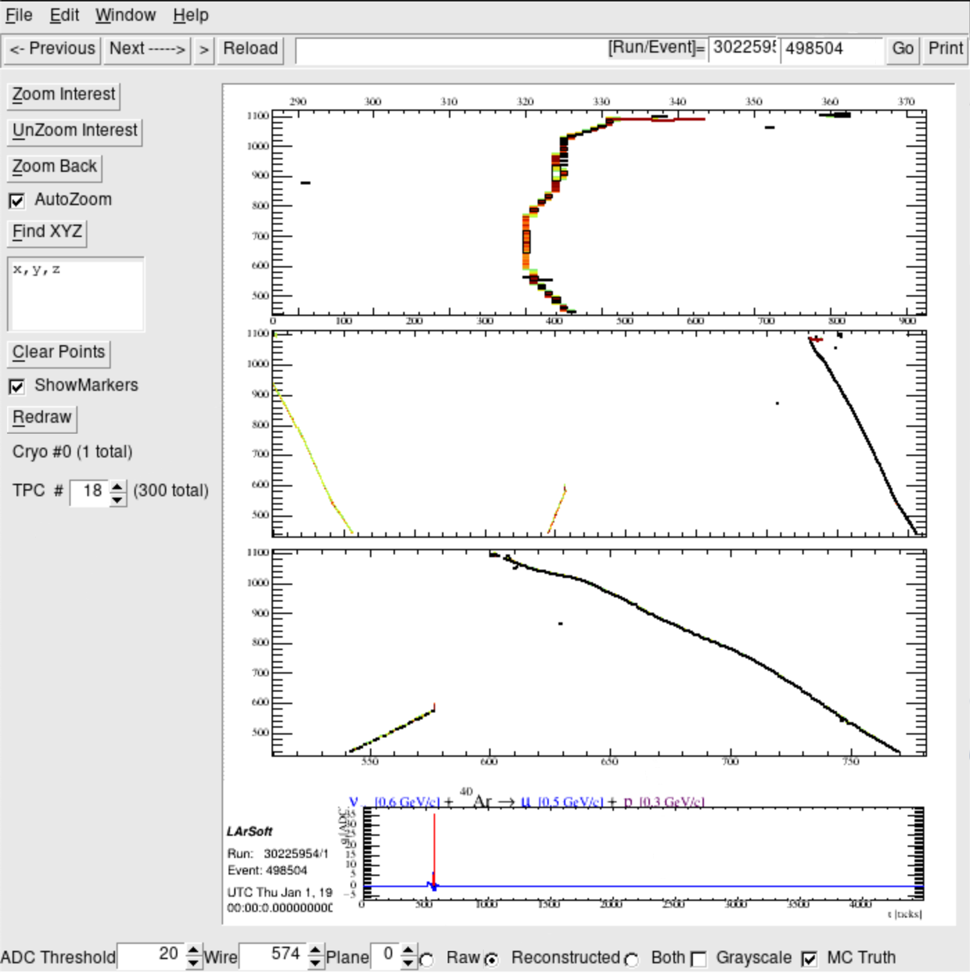
Track goes through 2 TPCs
TPC # 18
Raw
v [0.6GeV/c] + Ar $→$μ[0.5 GeV/c] + p[0.3GeV/c]
Reco
Muyuan He | Atmospheric Neutrino Zenith Angle Reconstruction —Truth Comparison

Slide 29
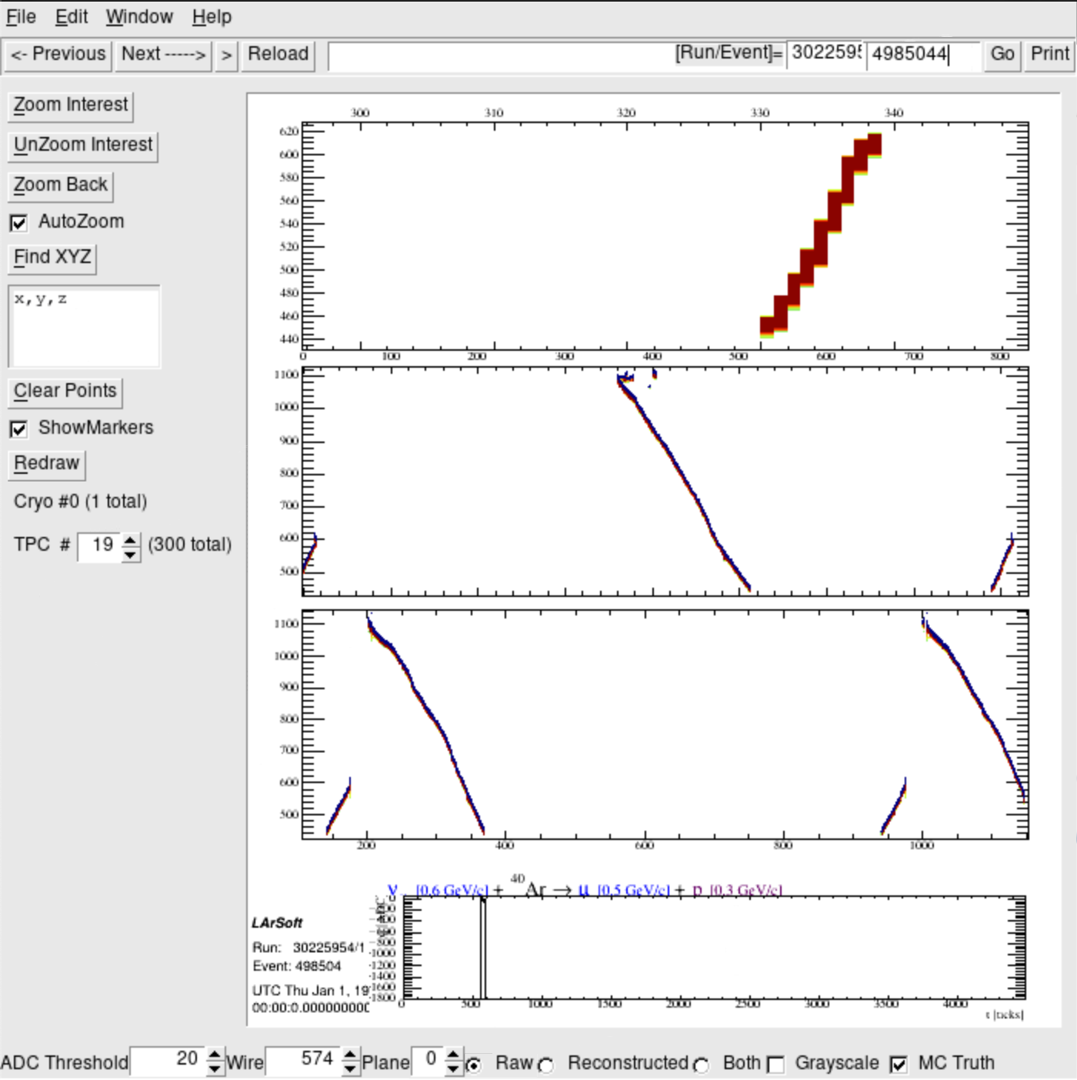
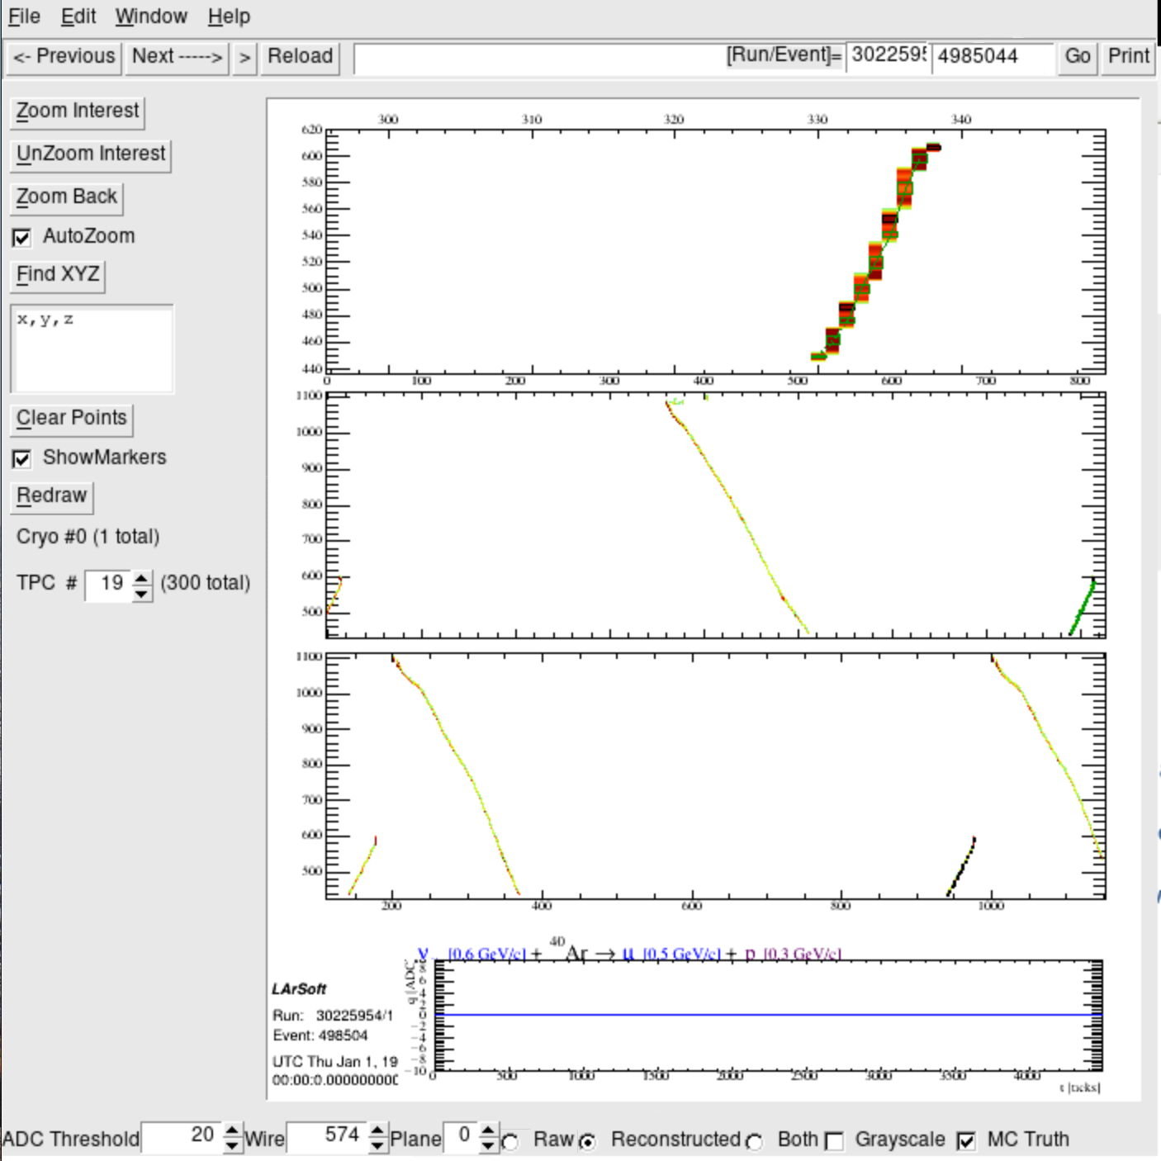
TPC # 19
Raw
v [0.6GeV/c] + Ar $→$μ[0.5 GeV/c] + p[0.3GeV/c]
Reco
Muyuan He | Atmospheric Neutrino Zenith Angle Reconstruction —Truth Comparison

Slide 30
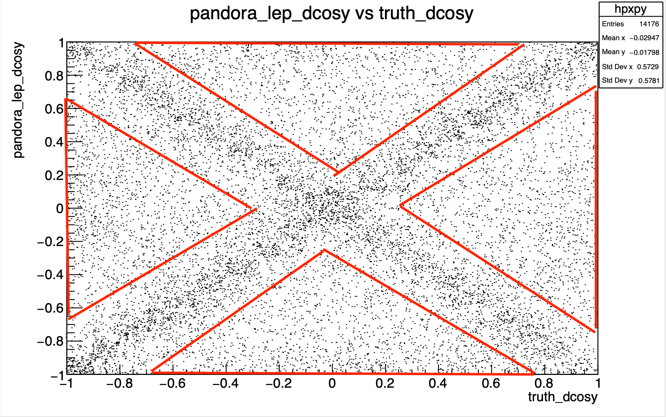
Elsewhere
38% of total events
trkstartdcosy_pandoraTrack vs lep_dcosy_truth
trkstartdcosy_pandoraTrack
lep_dcosy_truth

Slide 31
Run: 30225945; Event: 214151;
lep_dcosy_truth vs trkstartdcosy_pandoraTrack: -0.343, -0.735
trkstartdcosy_pandoraTrack vs lep_dcosy_truth
trkstartdcosy_pandoraTrack
.
lep_dcosy_truth
Muyuan He | Atmospheric Neutrino Zenith Angle Reconstruction —Truth Comparison

Slide 32
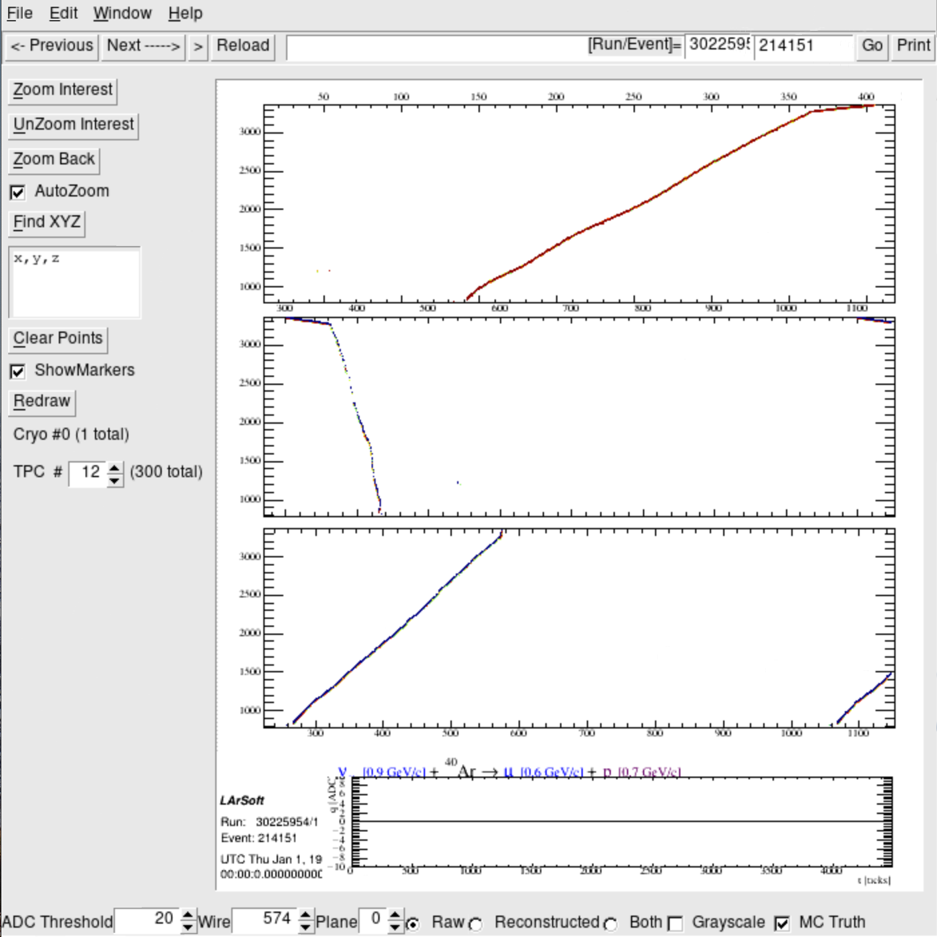
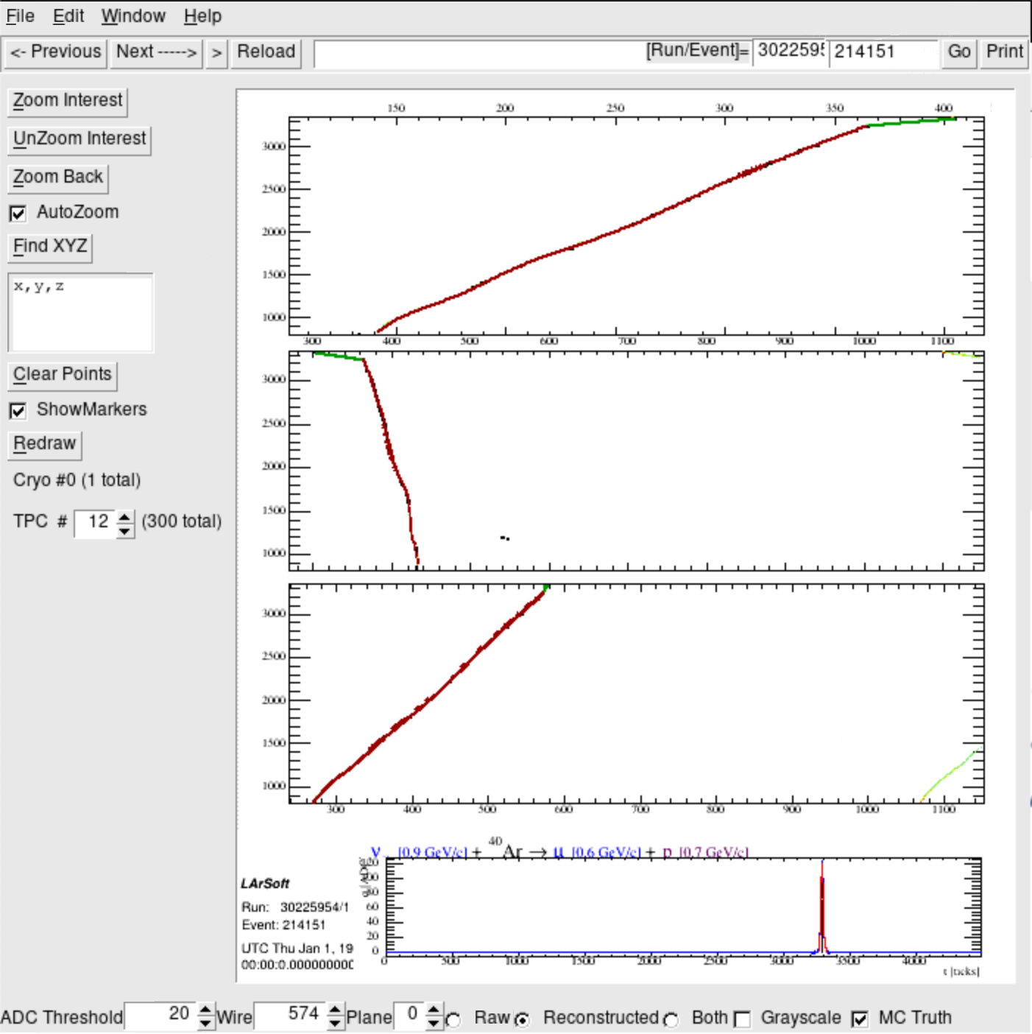
Track goes through 2 TPCs
TPC #12
Raw
v [0.9GeV/c] + Ar $→$μ[0.6 GeV/c] + p[0.7GeV/c]
Reco
Muyuan He | Atmospheric Neutrino Zenith Angle Reconstruction —Truth Comparison

Slide 33
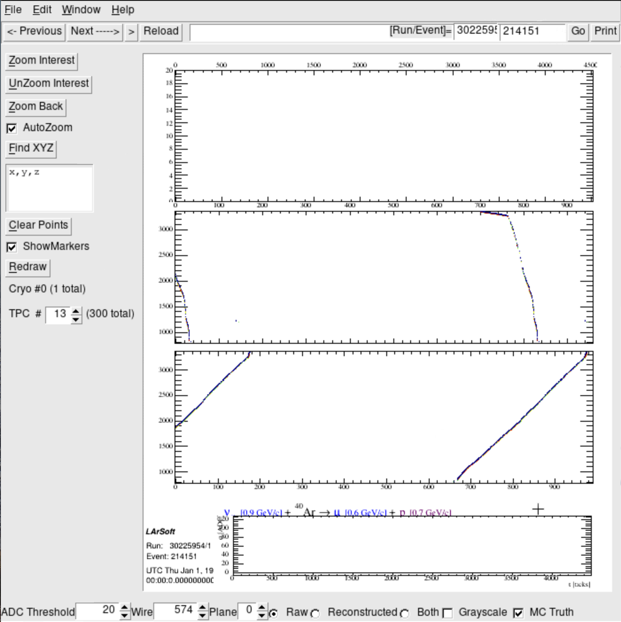
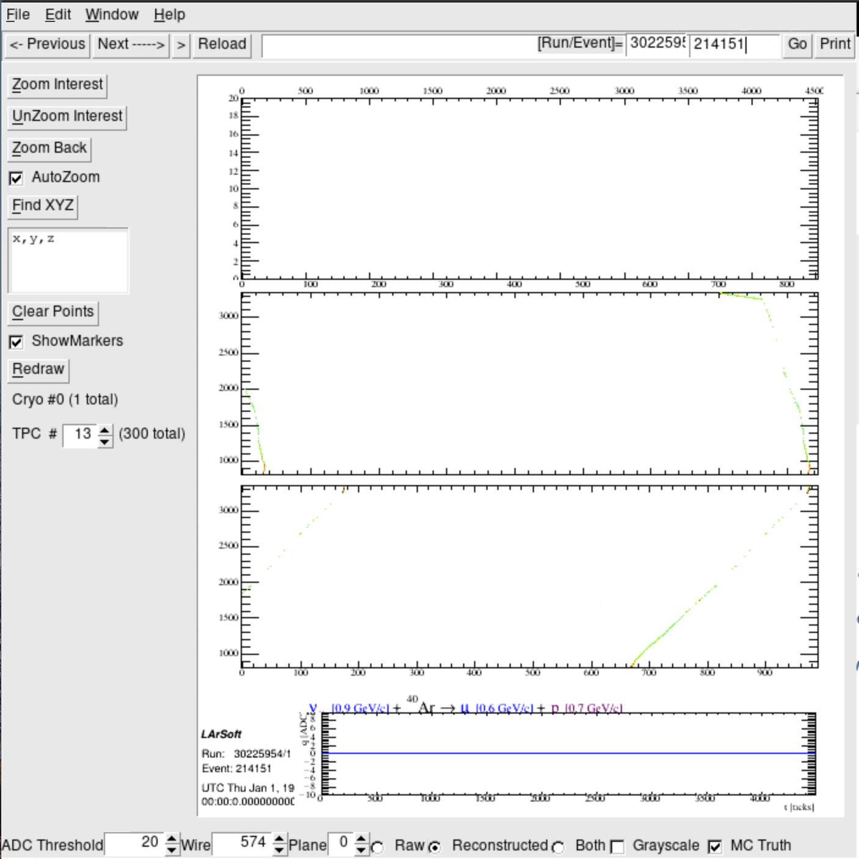
TPC #13
Raw
v [0.9GeV/c] + Ar $→$μ[0.6 GeV/c] + p[0.7GeV/c]
Reco
Muyuan He | Atmospheric Neutrino Zenith Angle Reconstruction —Truth Comparison

Slide 34
Run: 30225945; Event: 214199;
lep_dcosy_truth vs trkstartdcosy_pandoraTrack: -0.343, -0.735
trkstartdcosy_pandoraTrack vs lep_dcosy_truth
trkstartdcosy_pandoraTrack
.
lep_dcosy_truth
Muyuan He | Atmospheric Neutrino Zenith Angle Reconstruction —Truth Comparison

Slide 35
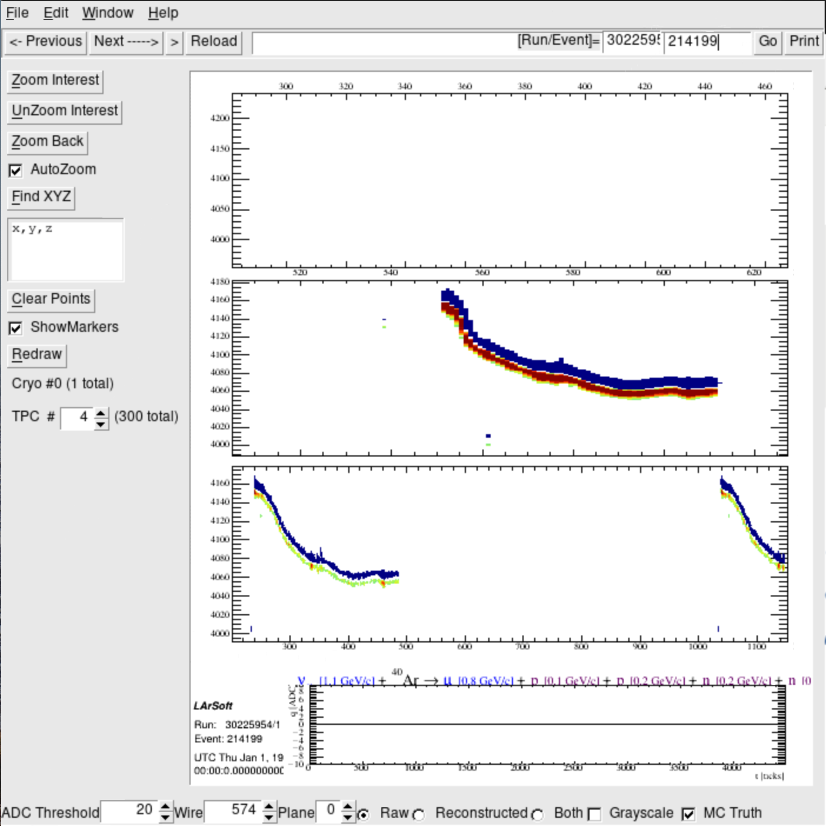
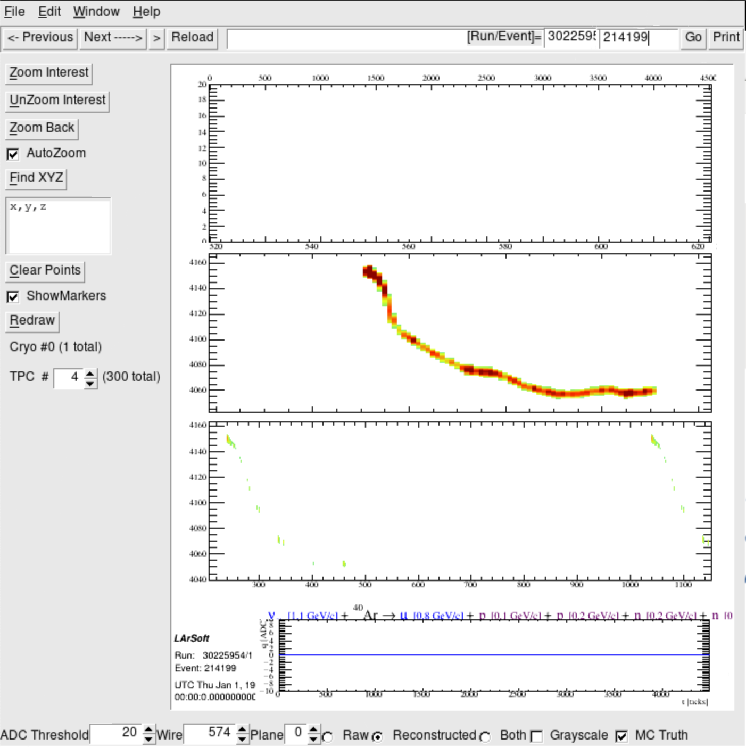
Track goes through 4 TPCs
TPC # 4
Raw
Reco
v [1.1GeV/c] + Ar $→$μ[0.8 GeV/c] + p[0.1GeV/c] + p[0.2GeV/c] + n[0.2 GeV/c] + n[?]
Muyuan He | Atmospheric Neutrino Zenith Angle Reconstruction —Truth Comparison

Slide 36
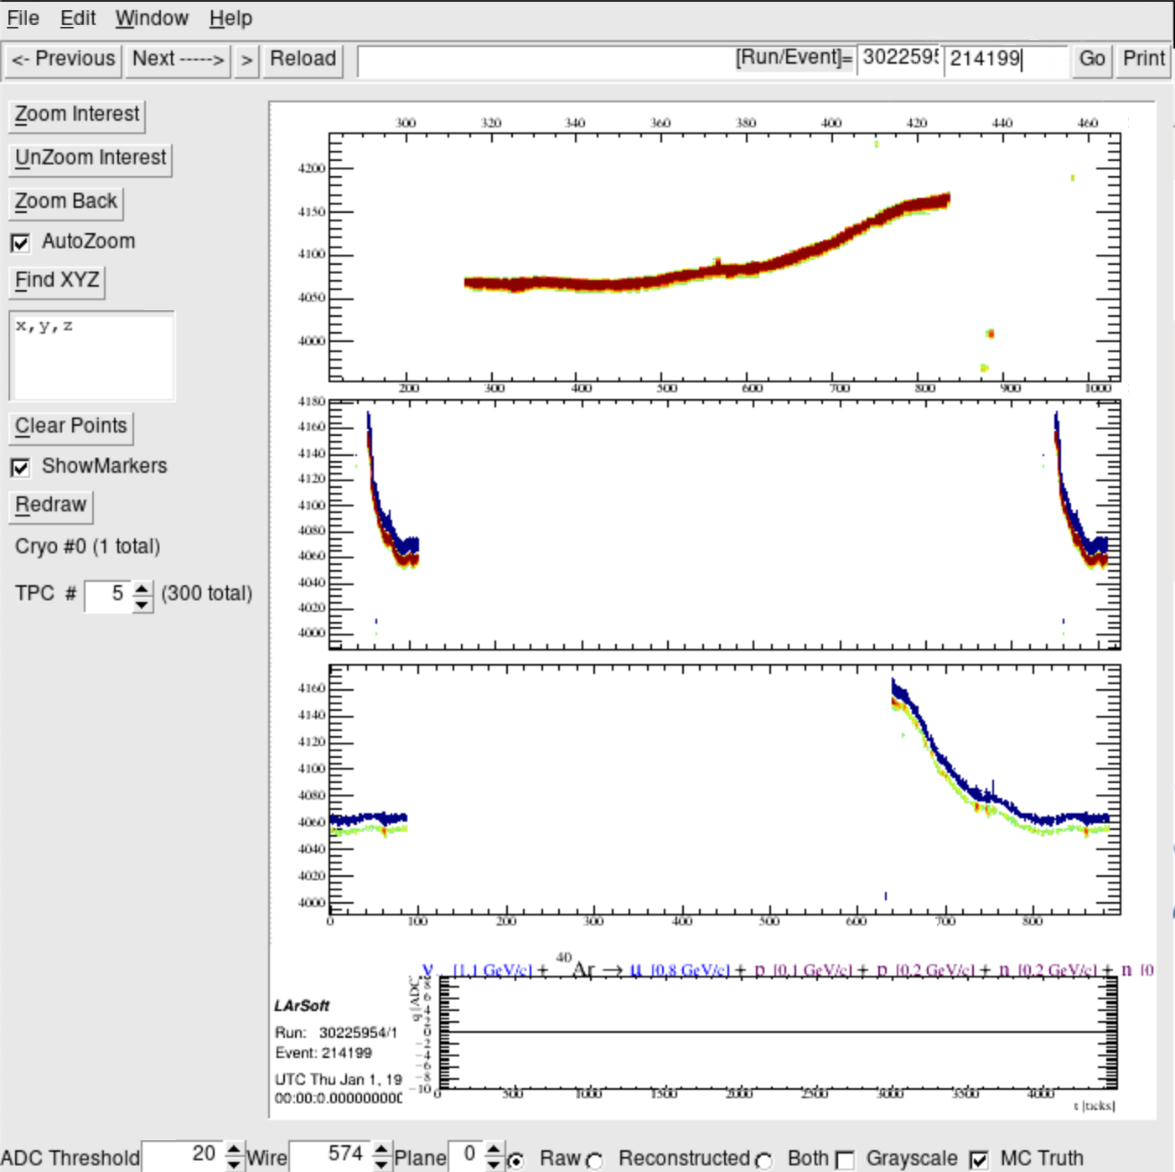
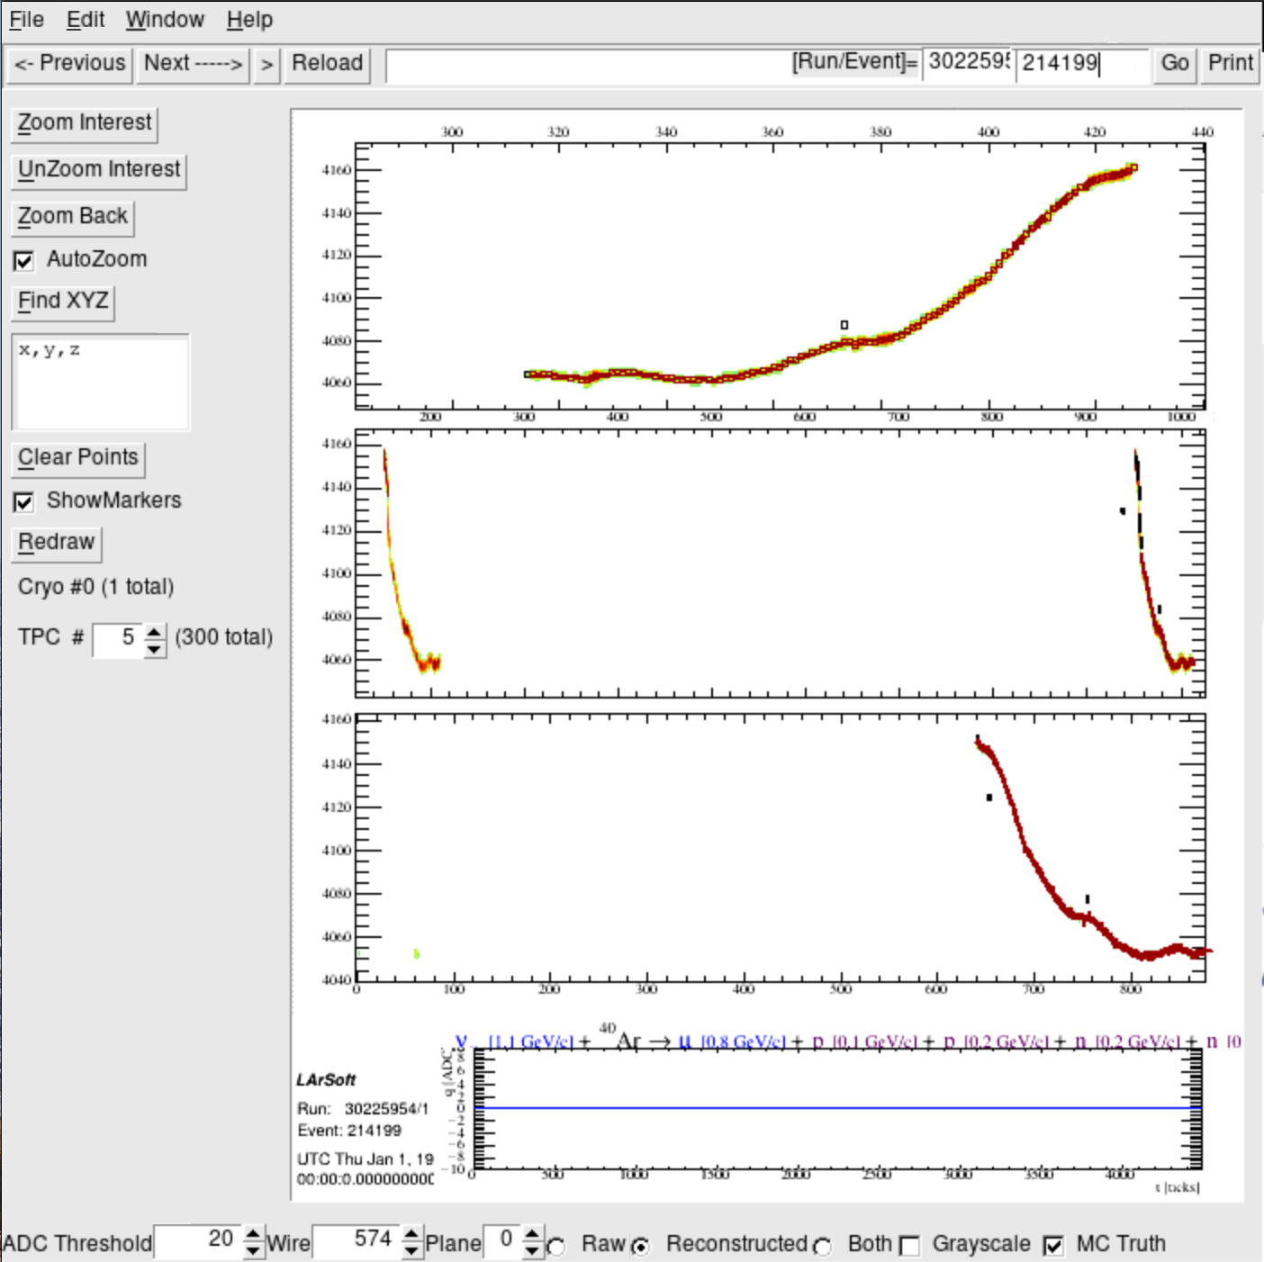
TPC # 5
Raw
Reco
v [1.1GeV/c] + Ar $→$μ[0.8 GeV/c] + p[0.1GeV/c] + p[0.2GeV/c] + n[0.2 GeV/c] + n[?]
Muyuan He | Atmospheric Neutrino Zenith Angle Reconstruction —Truth Comparison

Slide 37
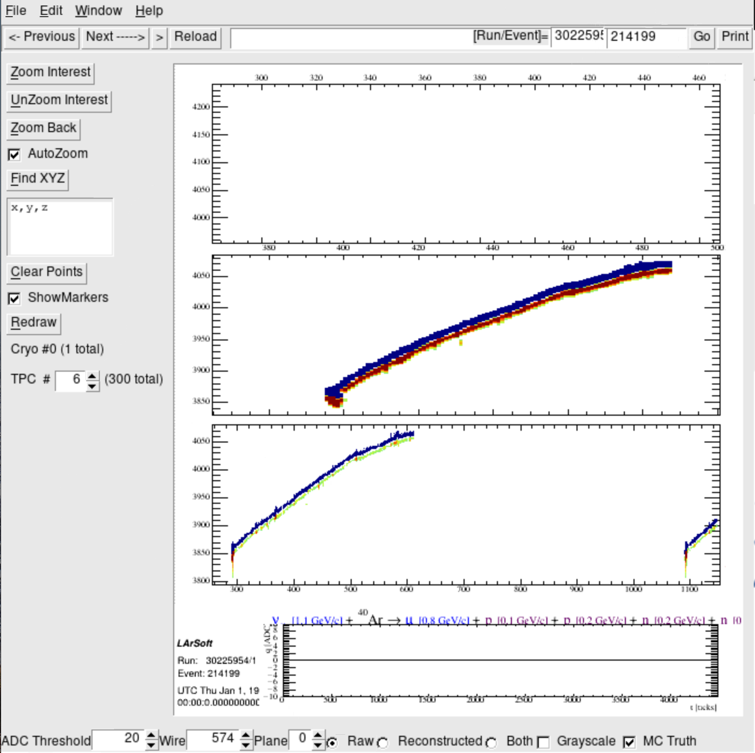
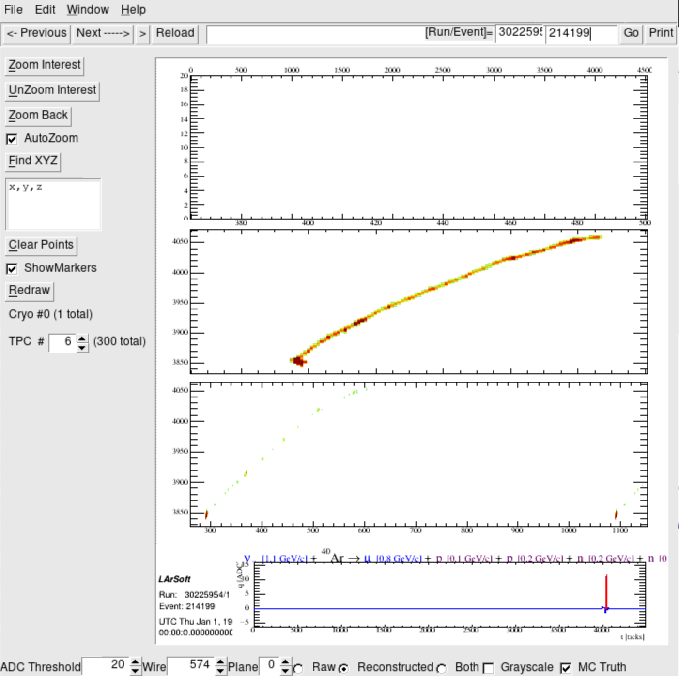
TPC # 6
Raw
Reco
v [1.1GeV/c] + Ar $→$μ[0.8 GeV/c] + p[0.1GeV/c] + p[0.2GeV/c] + n[0.2 GeV/c] + n[?]
Muyuan He | Atmospheric Neutrino Zenith Angle Reconstruction —Truth Comparison

Slide 38
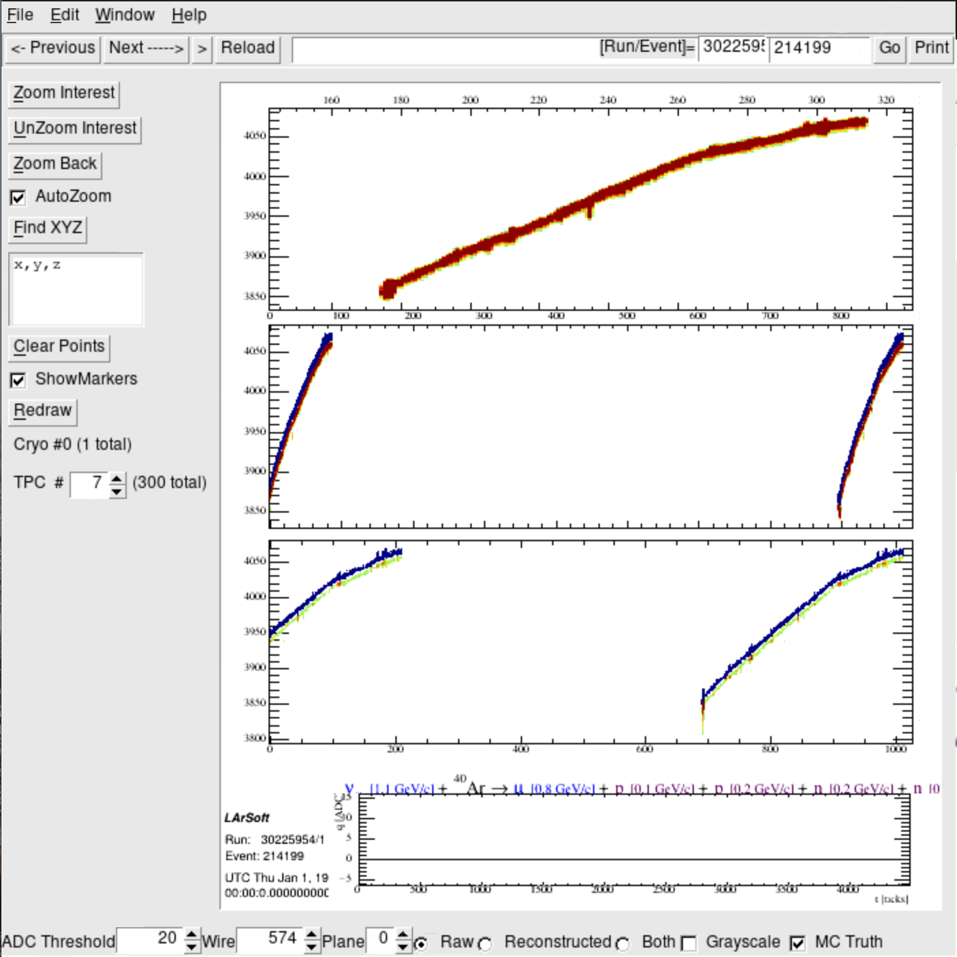
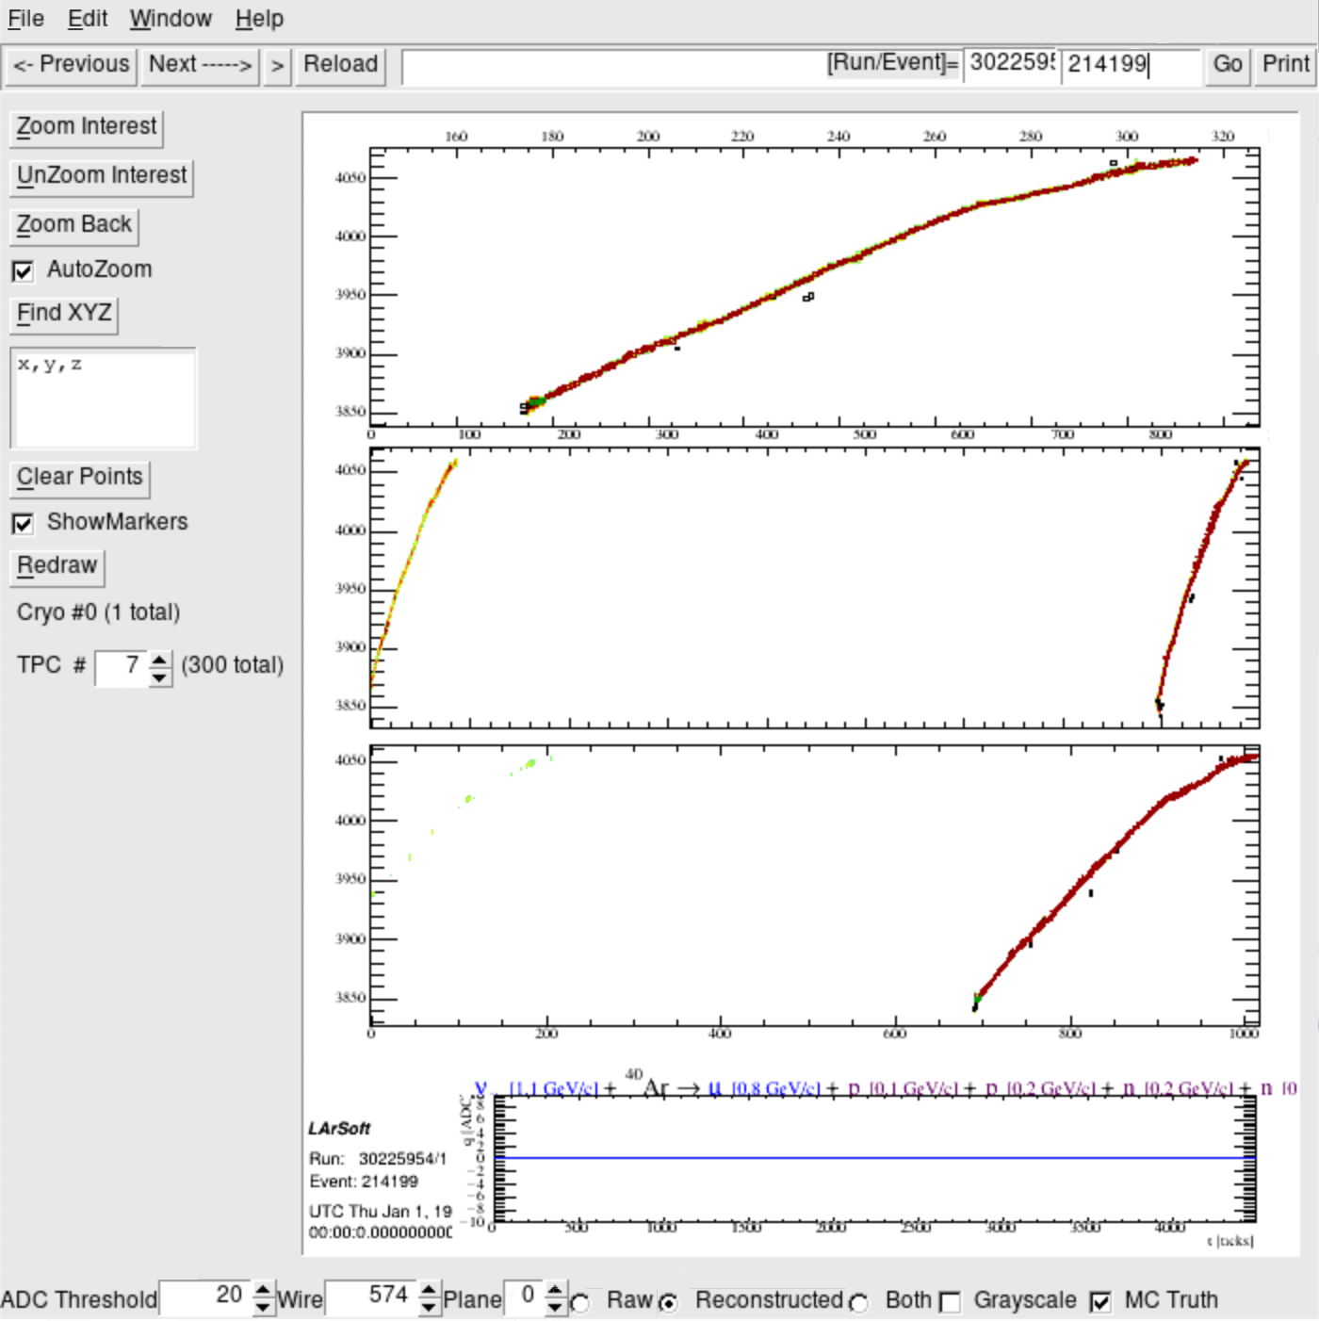
TPC # 7
Raw
Reco
v [1.1GeV/c] + Ar $→$μ[0.8 GeV/c] + p[0.1GeV/c] + p[0.2GeV/c] + n[0.2 GeV/c] + n[?]
Muyuan He | Atmospheric Neutrino Zenith Angle Reconstruction —Truth Comparison

Slide 39
Summary
Extract numuCC, Quasi-elastic/elastic interactions with longest track that have length > 50 cm
Compare between zenith angle of lep_dcosy_truth and trkstartdcosy_pandoraTrack for each particle in 2-D histogram for 14176 events.
Separate events that are correctly reconstructed, in wrong direction and random. For each category, checked several event displays.
Want help from expert to identify events that are not well reconstructed.
What information can we provide to help improve the zenith angle reconstruction?
Are we looking at the right info to judge the reconstruction?
Muyuan He | Atmospheric Neutrino Zenith Angle Reconstruction —Truth Comparison

