Slide 1
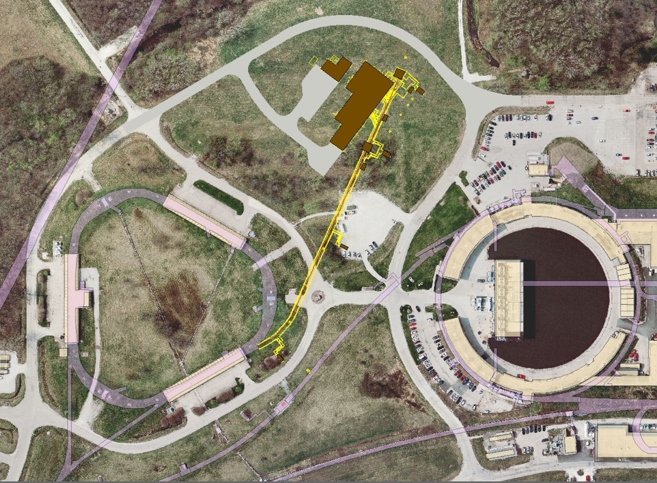
Accelerator Instrumentation & Controls for Mu2e and g-2
Brian Drendel
December 14, 2011

Slide 2
Today’s Talk
What we have done so far
Budgets and Changes
Pbar/Muon Beam lines and Rings Overview
Potential Schedule
Impact on Controls and Instrumentation
Homework
Supporting Material

Slide 3

Mu2e Conceptual Design Report
Accelerator portion of the Mu2e CDR is Mu2e document #1324.
Instrumentation Meetings are in Mu2e document #1348.

Slide 4

Mu2e Costing (BoEs)
475.02.03.04: Beam Line Instrumentation (Mu2e document #1577)
    Toroids – A. Ibrahim
    BPMs – P. Prieto
    BLMs – M. Olson
    SEMs/Multiwires – G. Tassotto
475.02.04.12: Storage Rings Instrumentation (Mu2e document #1573)
    DC Beam Measurement – A. Ibrahim
    Debuncher Tune Measurement – N. Eddy
    BPMs – P. Prieto
    BLMs – M. Olson
    SEMs/Multiwires – G. Tassotto

Slide 5
Mu2e Costing (BoEs)
475.02.03.03: Beam Line Controls (Mu2e Document #1572)
    Links and Camac
    Hot Rack Monitor upgrade
    Network
475.02.04.06: Storage Rings Controls (Mu2e Document #1468)
    Links and Camac
    Hot Rack Monitor upgrade
    Network

Slide 6
Mu2e Costing (BoE)
475.02.11.04: Operations Preparation (Mu2e Document #1639)
    Application codes
    Machine Protection – Beam abort system

Slide 7
What’s next?
Details from each of the mentioned BoEs are covered in supplemental sides at the end of this talk.
Thanks to everyone for all of your hard work!
So on to reviews and CD-1 approval!
Well, not quite yet!

Slide 8
Over Budget
Initial cost estimates for various parts of the Mu2e project were higher than anticipated…$350M overall, and $140M for accelerators.
The entire project would have to be trimmed down to around $200M or face the possibility of being canceled. The accelerator portion would have to be trimmed from ~$140M to $35M.

Slide 9
Trimming the Budget
A task force was created to determine how to get the project within an acceptable cost range.
Some of the changes include:
    Changing the beam delivery method.
      Eliminate the Accumulator.
        This means only running 1/3 or 1/6 the beam power.
    Move some costs off project that are shared other projects.

Slide 10
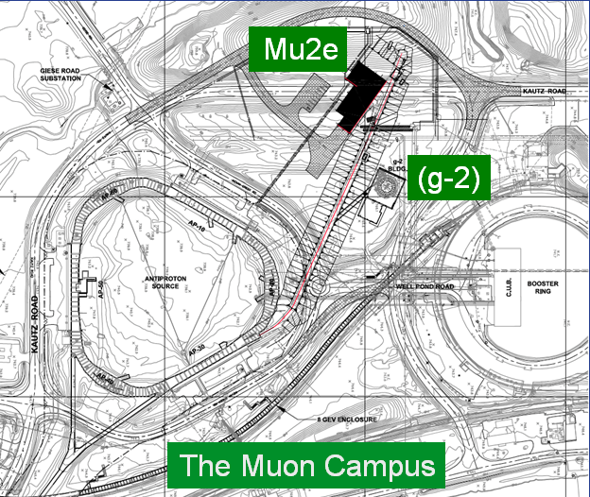
Muon Campus
Pbar Department changed to Muon Department
The Beam lines and Ring(s) may be combined into a “muon campus” that would serve multiple experiments
    Muon g-2
    Mu2e
    TApAS (?) - pbars

Slide 11
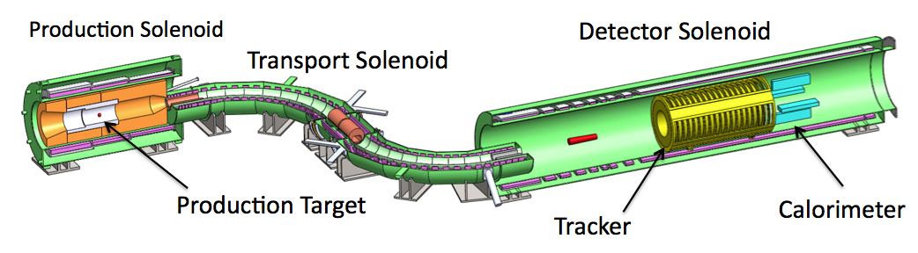
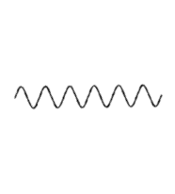
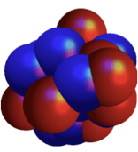



Mu2e for dummies
Protons
μ⁻
e⁻
X
Electrons
Muons
Coherent recoil of nucleus
8 GeV protons hit gold target
Production solenoid collects muons and pions
Transport solenoid filters charge sign and momentum
Muons get captured in aluminum atoms of target
If a Muon decays directly to an electron it will have an energy 104.96 MeV
Detector solenoid looks for these electrons
Bottom line…We need to use the former pbar beam lines and Debuncher to provide high intensity protons to the production solinoid.

Slide 12
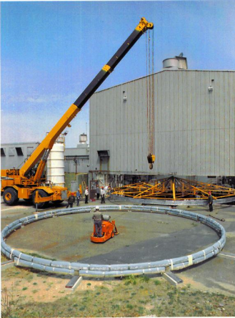
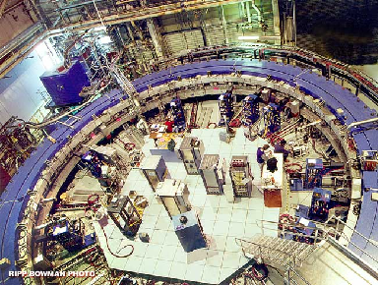
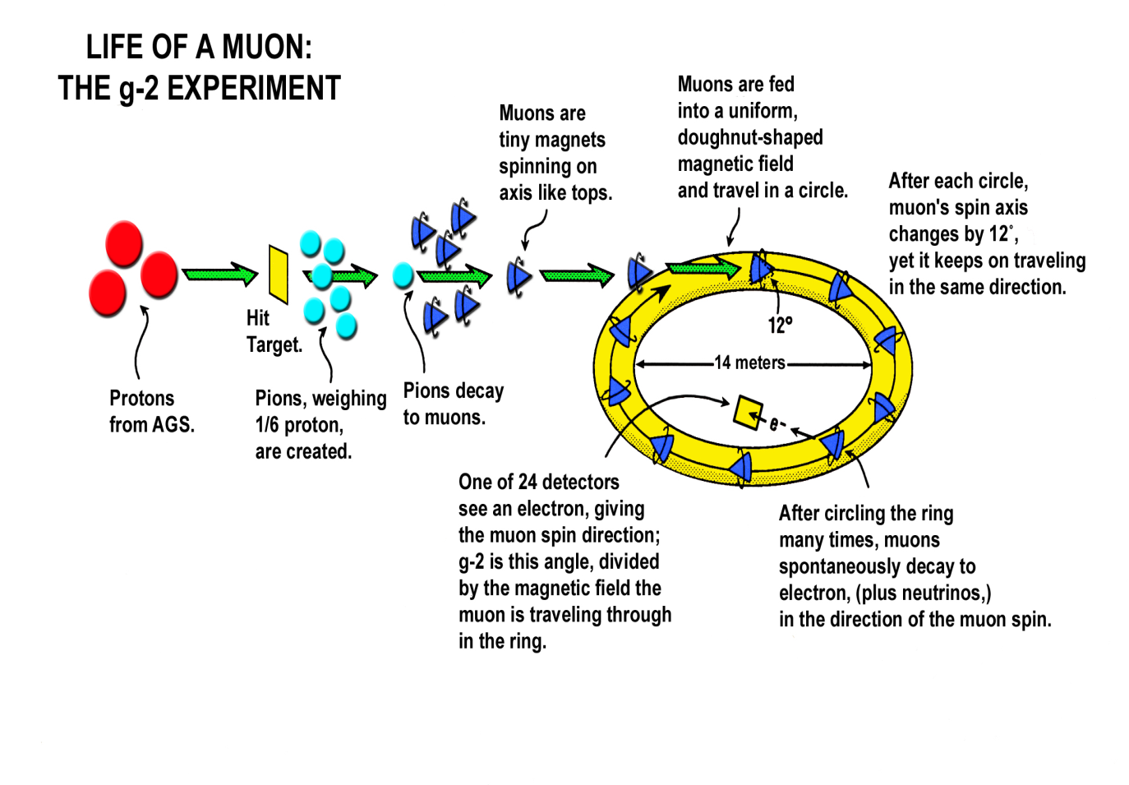
g-2 for Dummies
Moving an existing experiment from Brookhaven to Fermilab
8 GeV protons strike target at AP0.
We collect positive charged 3.1 GeV secondaries.
Pbar/Muon beam lines and Debuncher ring are used as a drift space for shorter lived particles to decay.
Send 3 GeV muons to the detector.
The bottom line is we need to provide protons on target at AP0 and transport muons through the former Pbar beam lines and Debuncher to the g-2 experiment.
AP2/AP3/
Debuncher/
Extraction Line
Recycler/
P1/P2/
AP1
AP0
Booster
http://www.g-2.bnl.gov/

Slide 13
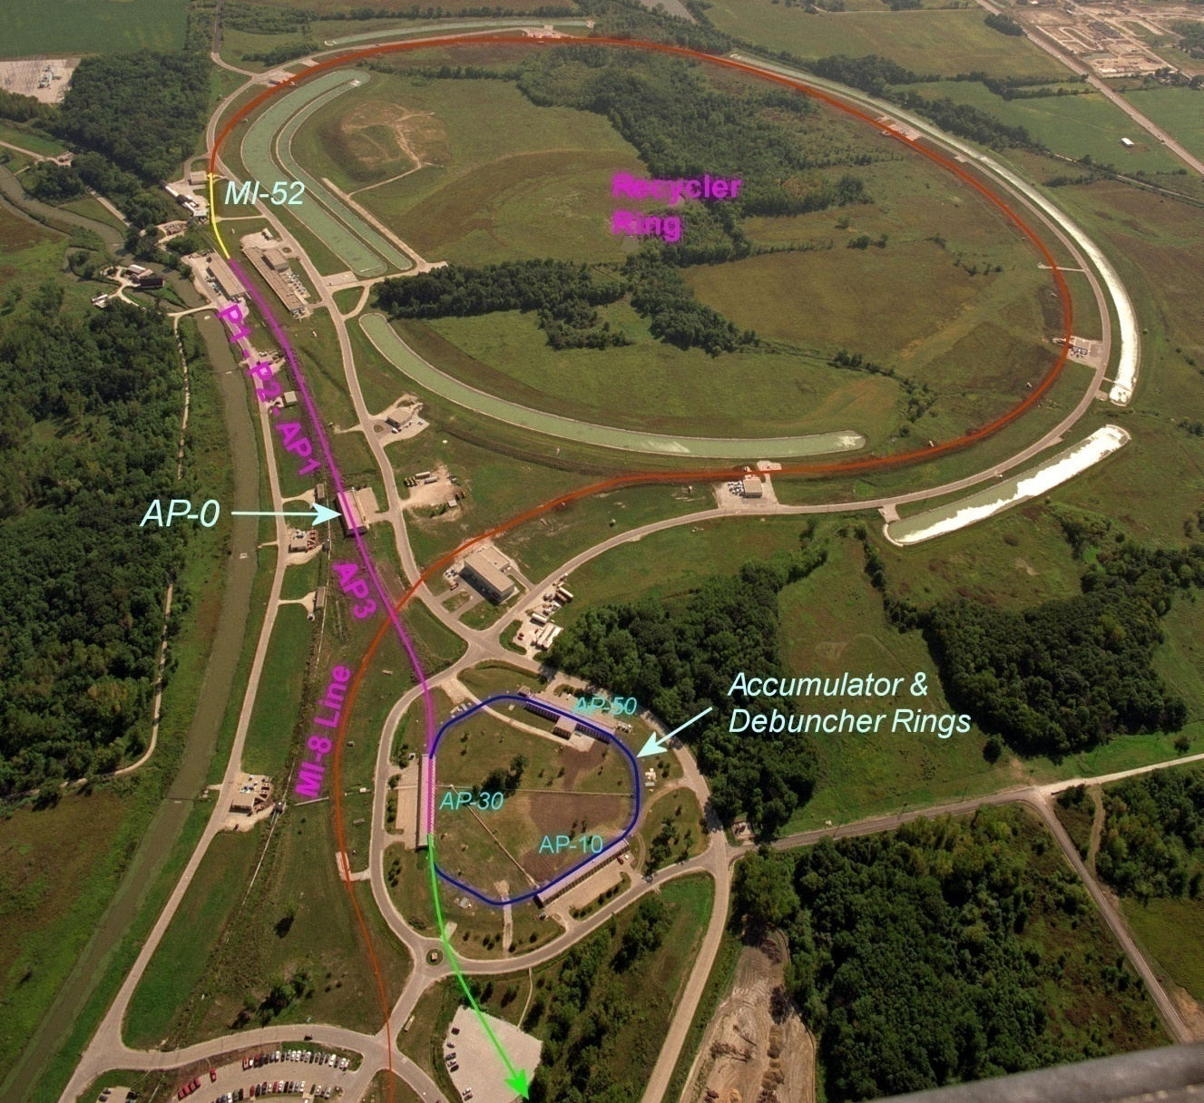
Beam path from Booster to the g-2 and Mu2e experiments
  A Booster batch of intensity ~4E12 is sent to the Recycler.
  The batch is divided into 4 2.5 MHz bunches, which are individually extracted to the Debuncher.
External beamline
J. Morgan

Slide 14
Beam path from Booster to the g-2 and Mu2e experiments
The bunches are transported to either the Target Station at AP0 or Debuncher via multiple beam lines
Extracted at MI-52 from Recycler to the P1 beam line (new)
g-2:
P1 → P2 → AP1 → Target Station → AP3 → Debuncher Ring
Mu2e:
P1 → P2 → AP1 → AP3 → Debuncher Ring
External beamline
J. Morgan

Slide 15
Beam path from Booster to the g-2 and Mu2e experiments
New AP-3 to Debuncher beam line connection for final 50 meters
Abort in 50 straight section can be used for:
  g-2: proton removal
  Mu2e: proton clean-up
Beam in Debuncher is extracted to the external beamline (new)
  g-2: entire pulse extracted at once
  Mu2e: Beam resonantly extracted.
External beamline
J. Morgan

Slide 16
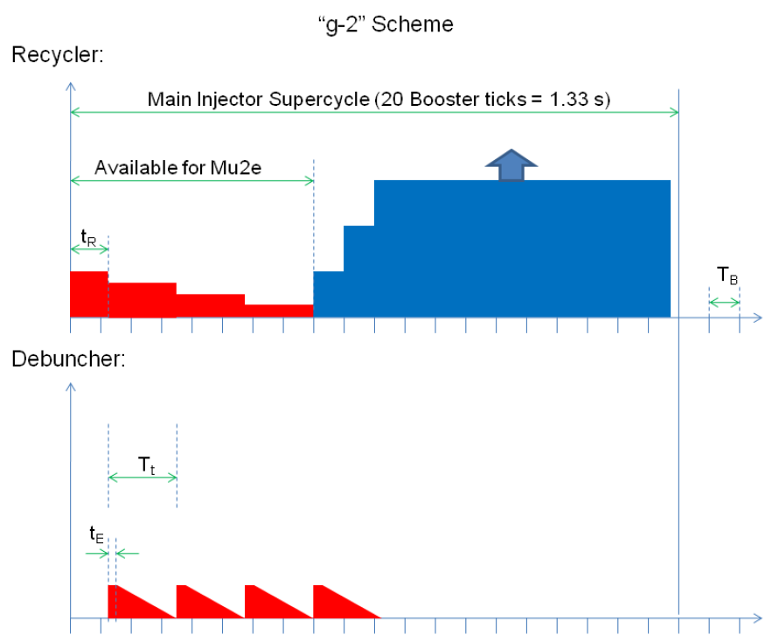
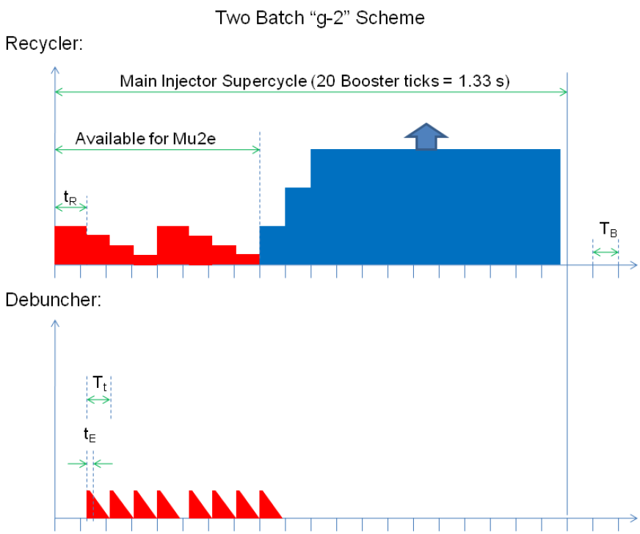
Mu2e Time Line
1 and 2 batch scenarios
E. Prebys
For each 1.33 sec Nova cycle, Nova uses 12 of the 15 Hz ticks, leaving eight for either g-2 or Mu2e.
Mu2e (pictured)
1 or 2 batches
2 is most likely
Resonantly extracted (Deb)
g-2 (not pictured)
4 to 6 batches
5 is most likely
Whole pulse extracted (Deb)

Slide 17
Recycler to P1 line connection
From Mu2e CDR
Recycler
Q523
Q522
Q521
Q520
ODH Barrier
Q901
RRLAM
Q903
Q902
0.7364 m
HBend
Q904
P1 line
Q706
Q705
Q704
Q703
Q702
Q701
I:LAM52
VBend
C
B
A
Main Injector
V700
Q527
Q526
Q525
Q524
Q523
Q522
Q521
Q520
New beam line connects Recycler to P1 line.
Meiqin Xiao

Slide 18
John Johnstone

Slide 19
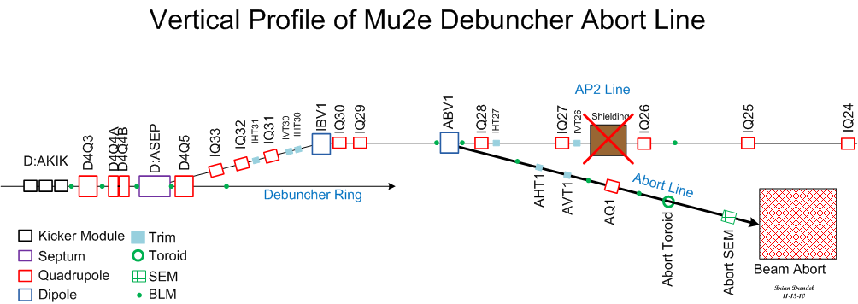
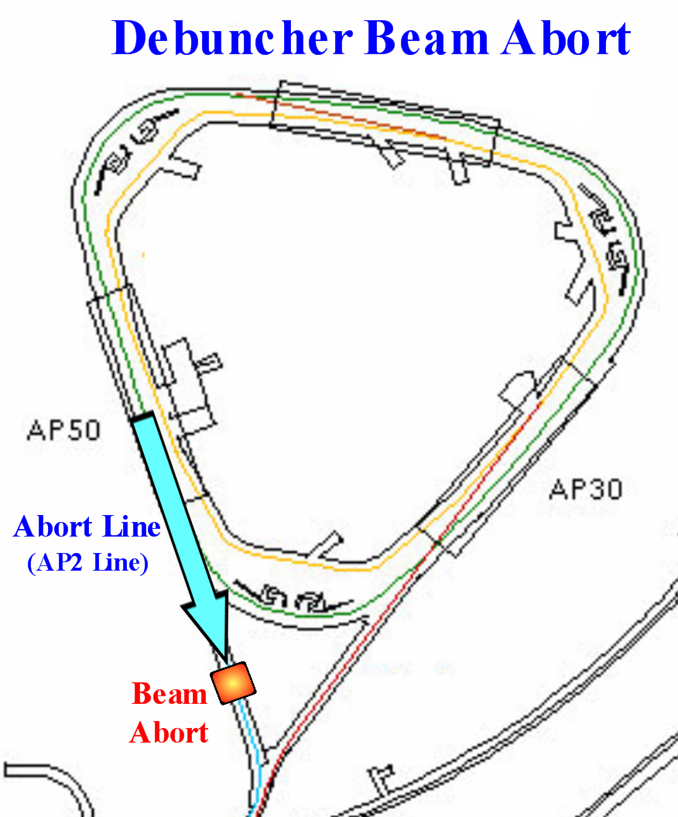
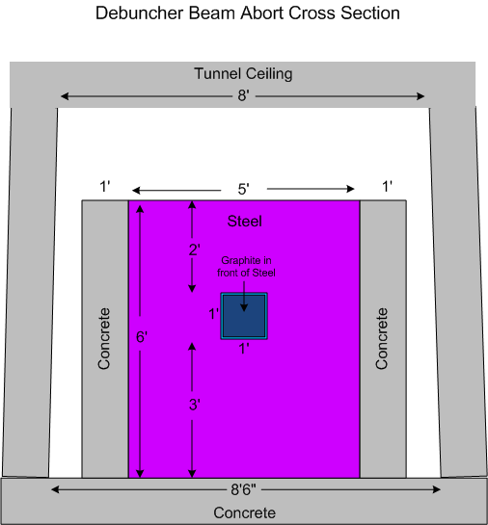
Beam abort/proton removal
D50
Transport

Slide 20
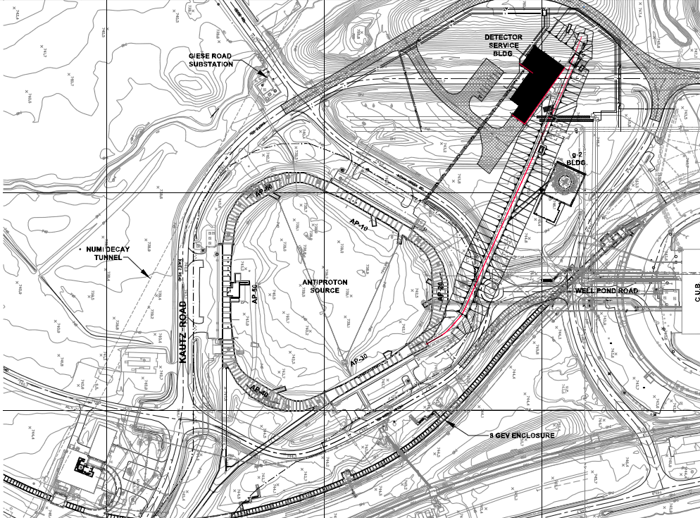
External beam line
Mu2e
g-2

Slide 21
Antiproton Source
Beam lines
  A 120 GeV/c proton beam is transported to the Target Station via AP-1 every 2.2 seconds
An 8.89 GeV/c negative secondary beam travels down AP-2 and is injected into the Debuncher
8.89 GeV/c antiprotons are bunch rotated and stochastically cooled in the Debuncher, then transferred to the Accumulator via the D/A line
Antiprotons are accumulated over hours, then transferred to MI via the AP-3 and AP-1 lines
8.89 GeV/c protons can be “reverse injected” or sent in the reciprocal direction of the antiprotons for tune-up
J. Morgan

Slide 22
Muon g-2
Beam lines
  An 8.89 GeV/c proton bunch, 120 ns long, is transported to the Target Station via AP-1 at an average rate of 15 Hz, with 100 Hz bursts (20 bunches, 10 ms interval)
A 3.1 GeV/c Positive secondary beam travels down AP-3 and is injected into the Debuncher in the 30 straight section with Lambertsons and a kicker
Some of the pions decay into 3.09 GeV/c muons as they travel down AP-3
Muons can circle the 550 meter Debuncher as many times as desired
The abort located in the 50 straight section can be used to remove protons
3.09 GeV/c muons are extracted into a beam line that transports them to the experiment
J. Morgan

Slide 23
Mu2e
Beam lines
  An 8.89 GeV/c proton bunch, 120 ns long, is transported to the Debuncher via AP-1 and AP-3 (bypassing the Target Station) at an average rate of 6 Hz with 18 Hz bursts
The 8.89 GeV/c bunch is injected into the Debuncher in the 30 straight section with Lambertsons and a kicker
A 2.5 MHz RF system maintains the short bunch as it circulates in the Debuncher
The proton bunch is resonantly extracted with an electrostatic septum and Lambertsons into the Extraction beam line, that transports them to an external Target Station to produce an intense muon beam
The remaining proton beam that is not resonantly extracted is aborted in the 50 straight section and transported to a dump
J. Morgan

Slide 24
Similarities and Differences
Between Muon g-2 and Mu2e
8 GeV Booster batches sent to Recycler and formed into 4 bunches
  The same 2.5 Mhz RF system will work for both experiments
  g-2 plans to get 5 Booster batches every NOvA cycle, Mu2e 2 Booster batches
  g-2 bunches will be sent every 10 ms (20 total), Mu2e every 56 ms (8 total)
Bunches are kicked out of the Recycler into the P1 line
  A new connection between the Recycler and P1 is required for both experiments
  The kicker requirements for g-2 are more demanding, so will also work for Mu2e
Bunches are transported through the P1, P2 and AP-1 lines
  Emittances are the same for both experiments, as are aperture requirements
  g-2 beam is sent to the Target Station at AP-0, a 3.1 GeV/C secondary beam enters a new beam line stub that connects to AP-3, for transport to the Debuncher
  8.89 GeV/c Mu2e beam bypasses the Target Station and continues to the Debuncher
  A new connection between AP-3 and the Debuncher is required for both experiments
Beam is injected into the Debuncher, then extracted to the experiments
  g-2 beam is only in the Debuncher for a few turns, then is kicked into the extraction line
  Mu2e beam is resonantly extracted over 10’s of ms into the extraction line
  A beam removal system is used to abort protons left at the end of the Mu2e cycle, or remove protons that have separated in time from the muons on the g-2 cycle
  The extraction line can be configured to send beam to the appropriate experimental hall
J. Morgan

Slide 25
Beam Requirements
Beam Line/Ring (Service Building) | g-2 | Mu2e
P1->P2->Ap1 (MI-60, F0, F1, F2, F23, F27, AP0) | 1.0E12 primary beam (protons) 2.5 MHz 120 nsec 8.89 GeV/c <rate>=15Hz burst up to 100Hz | 1.0E12 primary beam (protons) 2.5 MHz (no longer 53MHz) 120 nsec 8.89 GeV/c <rate>=6Hz burst up to 18Hz
Target (AP0) | AP0 | N/A
AP3 (AP0, F27, AP30) | Low intensity secondaries (μ⁺, π⁺, protons) ~1E7 π⁺ 3.1 GeV/c | Same as P1->P2->AP1
Accumulator | N/A | N/A
Debuncher (AP10, AP30, AP50) | 3.1 GeV/c Secondaries ~1E4 to 1E5 μ⁺, ~1E7 protons Circulates a few turns Kicked out | Same as P1->P2->AP1 Slow Resonant Extraction every 56 msec
Abort Line (old AP2) (AP50) | Low intensity 3.1 GeV/c protons 10msec burts | 3 to 5% of primary protons
Extraction Line (new) (AP30, Experimental Halls) | Low intensity 3.1 GeV/c μ⁺ Pulses every 10msec | 1.0E12 protons Slow spill every 56 msec

Slide 26
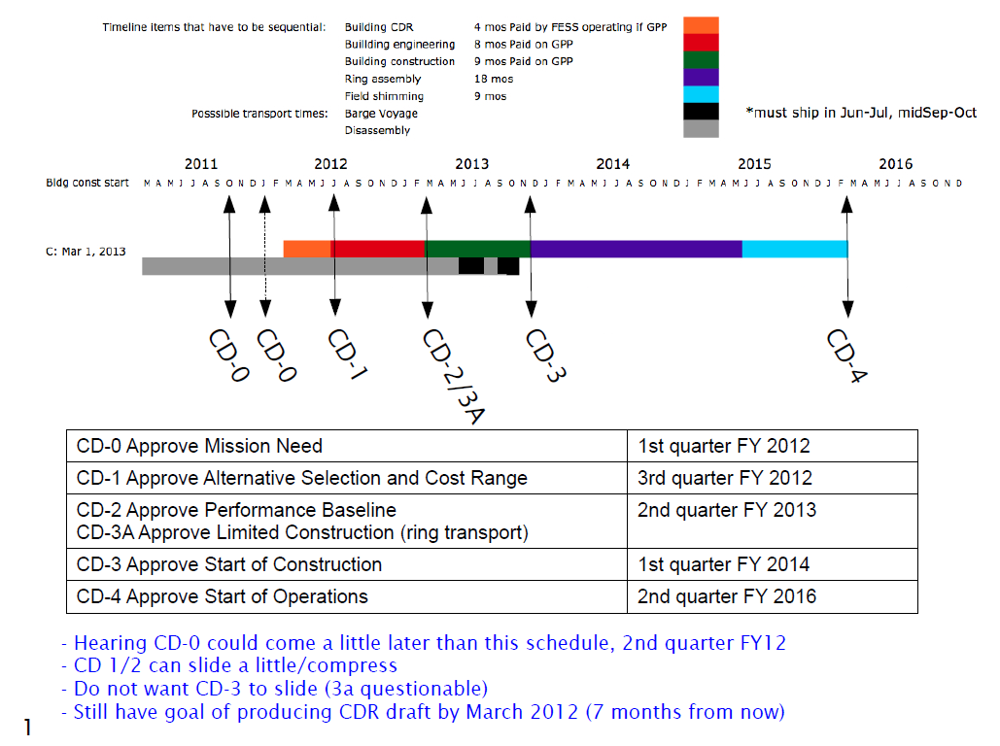
g-2 Schedule
C. Polly

Slide 27
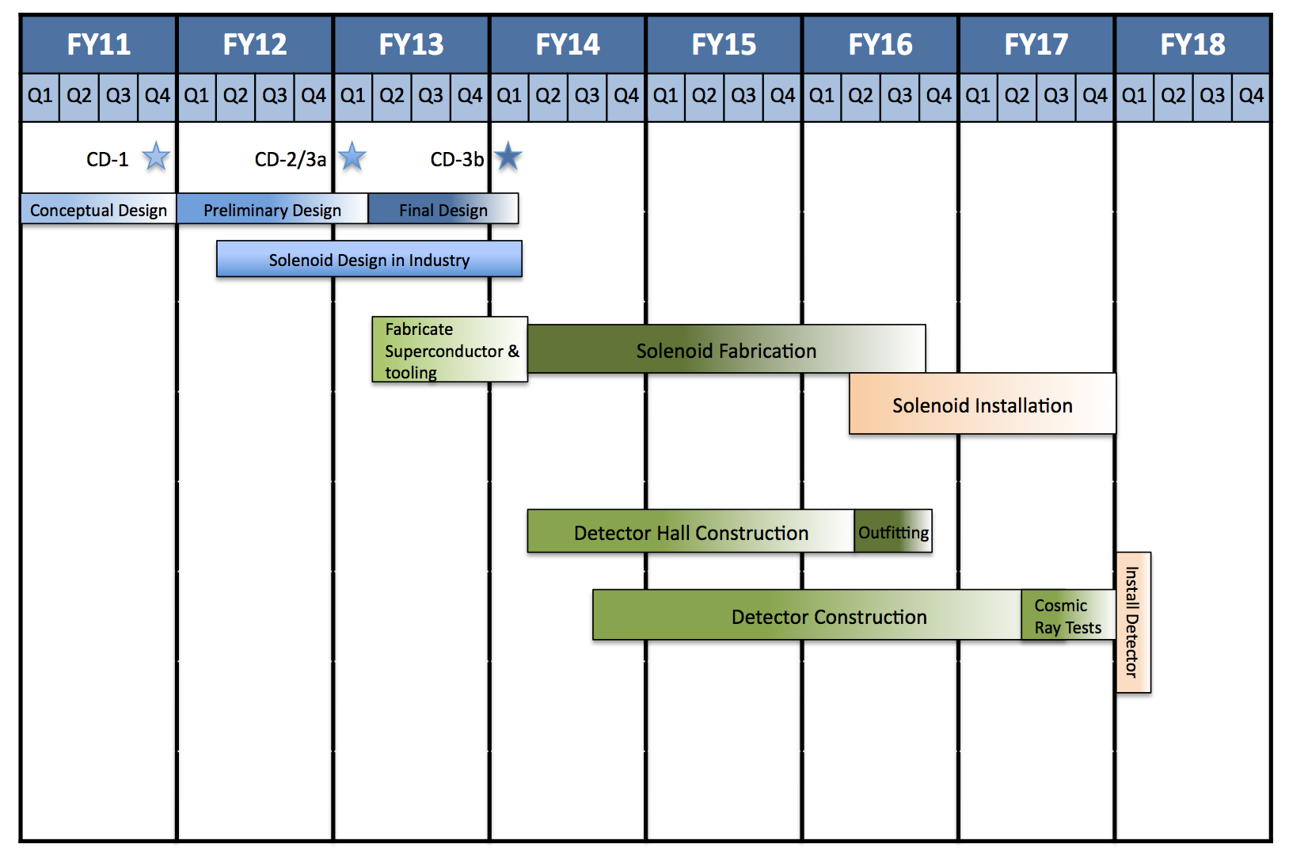
Mu2e Block Schedule
R. Ray

Slide 28
What areas does the Accelerator WBS cover?
The Accelerator portion of the WBS includes everything downstream of the Recycler and upstream of the new extraction line. Our areas of coverage are:
  Beam lines and Rings Covered: RR2P1 , P1, P2, AP1, Target Station, AP3, new AP3-to-Debuncher connection, Debuncher, Debuncher abort line.
  Service Buildings: MI52, MI60, F0, F1, F2, F23, F27, AP0, AP10, AP30 and AP50.
The scope change of this project means (unless pbar experiments return) we no longer have to worry about
  Accumulator, D/A line, Accumulator abort line.
Covered by other people
  Beam Lines and Rings not covered: Booster, MI8, Recycler, and new extraction line
  Buildings: New Mu2e experimental hall, new g-2 experimental hall, new cryo building.

Slide 29
Impact on Controls and Instrumentation
Instrumentation:
  P1 to AP1 have 120 nsec, 2.5MHz beam instead of 81 bunches of 53MHz beam.
    Are BPM, BLM, Toroid and SEM plans all ok?
  AP3 will have high intensity beam for Mu2e but low intensity secondaries for g-2.
    Do we need any configuration difference (like preamps) between g-2 and Mu2e running?
  Debuncher will be high intensity protons for Mu2e that are slow spilled, and g-2 will be low intensity secondardies that only do a couple of revolutions before being extracted.
    Will the Debuncher DCCT work for g-2? Can toroids work?
    Will we need two separate sets of BLM systems?
  How does elimination of the Accumulator and D/A line impact your plans?
  Extraction line will be pulsed low intensity secondaries for g-2 and slow spill for Mu2e.
    SEMs, BPMs?

Slide 30
Monitoring g-2 Secondaries
By the way, in the BNL experiment, the monitoring of the secondary pi/mu beam was done with 6 Segmented Wire Ion Chamber (SWICs) and three ionization chambers to monitor the total beam flux at critical locations.
O
\
\
\----------------------------------O\
\
\
O
The g-2 beamline at BNL had two bends. The first selected the pion momentum,
and the 2nd selected the muon momentum. The O's in the above ASCII art show
roughly where the ionization chambers were. Of course the ring only accepts a very
particular muon momentum so these bends were more about killing off unwanted
pions then about selecting the muon momentum.
You can imagine, we will want a similar setup here. SWICS distributed throughout
the beamlines to give us the profiles and ionization chambers to give us quick feed
back on flux at points where significant tuning is probably required.
Best,
Chris
C. Polly

Slide 31
Impact on Controls and Instrumentation
Controls:
  Network: Weak areas for network are F23, F27 and Ap0.
  HRM upgrade:
    Elimination of the Accumulator may mean less crates need to be upgraded.
  Is there any problem with the fiber links in the Mu2e radiation environment?
  Beam line service building (MI60, F0, F1, F2, F23, F27, AP0) network demands likely to be similar.
    Less demand at AP0 during Mu2e operations.
  Service Building demands and space:
    AP30 is likely to become more crowded with the addition of injection, extraction and extraction beam line devices.
    AP50 will have a new Debuncher beam abort but may become less crowded overall with the removal of RF systems and the Accumluator.
    AP10 may become less crowded due to removal of Accumulator and D/A devices.
  New controls will need to exist in the Mu2e experimental hall, the g-2 experimental hall and new fridge building.

Slide 32
Homework!!!
What I’d like each of you to do, it look at the BoE that was created in your area of expertise
    How does the change in Mu2e configuration impact your plan?
    How does the addition of g-2 impact your plan?
    Are there ways to further cut costs?
Summary slides at the end of this talk cover the current plan for each system.
Email drendel@fnal.gov any questions and areas that you think may be of concern.
Those who respond may be spared from giving talks at future meetings.

Slide 33
Post-Talk Discussion (1/2)
Beam Synch (G. Vogel):
    P1 and P2 will need multiple beam synch clocks. All clocks now are 53MHz. We will need to support SY120 extraction and g-2/mu2e.
    We may need new clocks, repeaters, decoders
    Instrumentation will have to be able to switch which clock they are looking at.
Instrumentation Budget (M. Wendt)
    Would like to know a approximate g-2 instrumentation budget for M&S only.
    C. Polly suggests maybe this is in the neighborhood of $100K-$400K.
Recycling Equipment (C. Polly)
    C. Polly informed us that the SWICs and ion chambers used in the BNL g-2 decay line would be available.
    M. Wendt said they would need to see their condition, etc… to see if they could be worked into our instrumentation.
    We can have the hardware shipped to FNAL after BNL decommissions the line (starts in February).
    G. Tassatto will examine the SWICs & Ion Chamber
    A. Sondgeroth will get information on the SWICs and Ion Chamber

Slide 34
Post Talk Discussion (2/2)
How will we measure the Debuncher intensity during g-2 operations?
    DCCT is not likely to work.
    SEM?
    Resistive Wall Monitor?
How will we flip back and forth between g-2 and Mu2e modes during commissioning?
    Question was not answered.

Slide 35
References
Werkema, et al, Mu2e Accelerator Conceptual Design Report, Mu2e Document #
Glenzinski, D., Status of the Mu2e Experiment, Mu2e Document #, December 2011
Polly, C., Bringing Muon g-2 to Fermilab, g-2 Document #115, October 2011.
Polly, C., G Minus 2 Experiment, g-2 Document 82, September 2011.
Morgan, J. , Debuncher Injection and Extraction, g-2 Document #148, November 2011.
Ray, R., Project Overview: Independent Design Review of Mu2e, Mu2e Document #1526, May 2011.
Werkema, S., Accelerator Division Impact Statement for the TAPAS Proposal, Beams Document #4012, December 2011.

Slide 36
Supplemental Material

Slide 37
Beam Line Toroids
Minimum: Use existing toroids and insulators, and do not add a second toroid to the P2 line. Three stands will be replaced, while the rest only have general maintenance performed on them. Signal cables replaced on three of the toroids, and calibration cables replaced on five. VME crate, controllers and timing cards will be repurposed from other locations.
Most Likely: Use existing toroids and insulators. Purchase a new toroid and insulator to add a second toroid to the P2 line. Eight stands will be replaced, while three will only have general maintenance performed on them. Signal cables replaced on eight of the toroids, switching four of them the Heliax. The calibration cables will be replaced on six of the toroids. VME crate, controllers and timing cards will be repurposed from other locations.
Maximum: Use existing toroids and insulators. Purchase a new toroid and insulator to add a second toroid to the P2 line. Eight stands will be replaced, while three will only have general maintenance performed on them. Signal cables replaced on eight of the toroids, switching four of them the Heliax. The calibration cables will be replaced on six of the toroids. Seven new VME crate, controllers and timing cards will be purchased.

Slide 38
Beam Line BPMs
P1, P2, AP1 And AP3 lines have an Echotek-based BPM system same as the one proposed for Accumulator and DeBuncher Rings. No new electronics or software is required for these lines.
For the A/D line (line between Accumulator and DeBuncher ring) Two 2.5 MHz transition boards to handle 8 BPMs and 2 Echotek digitizers will be enough for this line. We’ll need a 9 slot VME64X crate, a MVME5500 processor, timing board as well as the two transition boards from the Recycler BPM system and two echoteks (DDC boards) from the TeV BPM system.
Accumulator Abort Line BPMs will be based on the Accumulator BPMs. There will be 2 BPM’s used, which makes for a total of 4 pickups. The transition section needed for this system will be based on the new Accumulator BPM transition board capable of monitoring 2.5 MHz as well as 53 MHz. Only one transition board is needed, 1 echotek board, 1 VME64X 9 slot crate, 1 MVME5500 processor and one timing board.
The Debuncher Abort line has 8 BPM’s. It will require two 2.5 MHz recycler transition boards and two 8 channel echotek boards. It will need 1 VME64X 9 channel slot crate, one MVME5500 processor and one timing board.

Slide 39
Beam Line BLMs
Minimum: Assumes we repurpose eight BLM chassis from the Tevatron, have to assembly 41 integrators cards, and repurpose 55 ion chambers from the Tevatron.
Most Likely: Assumes we repurpose eight BLM chassis from the Tevatron, have to assembly 41 integrators cards, refurbish some of the ion chambers, and repurpose 55 ion chambers from the Tevatron.
Maximum: Assumes we purchase parts to build eight new BLM chasses with 86 new integrator cards, and purchase 55 new ion chambers.

Slide 40
Beam Line SEMs
Minimum: Assumes the motor assembly wire planes, top flange and kapton tape will be replaced. The SEM cans will be refurbished. The electronics will not be changed.
Most Likely: Assumes some additional motor assembly components will be replaced, some cans will be replaced and electronics will be upgraded to an Instrumentation standard.
Maximum: Assumes the motor assemblies will be replaced new, all vacuum cans replaced and all new electronics will be implemented.

Slide 41
Storage Rings DCCT
Debuncher
    Minimum: Existing system is sufficient; No Maintenance/repairs needed other than modification to detector's windings.
    Most Likely: Keep current VME environment (crate, digitizer, etc.); Current VME conditioning board and DCCT electronics need board-level kludges; Detector/cables need repair/maintenance.
    Maximum: New VME crate, digitizer, input conditioning board; DCCT electronics and detector need repair/maintenance in addition to modification to windings
Accumulator
    Minimum: Existing system is sufficient; No Maintenance/repairs needed..
    Most Likely: Keep current VME environment (crate, digitizer, etc.); Current VME conditioning board and DCCT electronics need board-level kludges; Detector/cables need repair/maintenance.
    Maximum: New VME crate, digitizer, input conditioning board; DCCT electronics and detectors need repair/maintenance.

Slide 42
Storage Rings BPMs
Removing old BPM electronics hardware from Accumulator and Debuncher. Removing BPM electronic hardware from Recycler Ring service buildings.
Modifying 30 existing Recycler BPM transition board hardware so it can handle the rings’ rotation frequency.
Design 60 4-channel BPM transition boards for the Accumulator ring based on the Main Injector transition boards so they can be used in the Accumulator Ring, and Accumulator beam dump.
Move VME64X crates from Recycler service buildings to Accumulator Ring and Debuncher,
Move 55 8-channel Echotek digital down converter boards from Recycler service buildings to Accumulator Ring and Debuncher.
Design timing boards with the event decoder PMC modules from Recycler to Accumulator Ring, Debuncher.
Purchase MVME5500 processor boards to be used as crate controllers or if any available from TeV BPM system use those.
Make # of Top Plates for the relay racks where the VME64X crates will be installed.

Slide 43
Storage Rings – Debuncher Tunes (1/3)
Destructive Kicker/BPM Measurement: The default method will be to measure using the turn-by-turn data from the Beam Position Monitor (BPM) system. Some type of pinger/exciter is needed - ideally for both planes. The candidates for this are the RF Kickout (RFKO) system or a dedicated system (could be a damper). This measurement is destructive to the excitation - will require spilling to the dump (hopefully close to normal spill operation). The BPMs should be able to measure almost the entire 100ms spill (2 order of magnitude for certain). Note the resolution will degrade with intensity but this can be compensated by the number of turns used for the measurement. Also, all BPMs are used with greatly increases the precision but also the readout and measurement time - all data will be read from the BPM front-ends and processed centrally. Should be able to provide 0.001 tune accuracy at >1KHz update rate.
Under this tune measurement scheme, we define the different cost ranges as follows:
Minimum: Use the existing BPMs and RFKO system to complete the measurement. The M&S cost will be minimal since we would be using existing electronics.
Most-Likely: Use a dedicated exciter separate from the RFKO. New cables would be purchased, but the stripline kicker, amplifier and electronics would be salvaged from Recycler.
Maximum: Implement a new kicker, amplifier, electronics and cables.

Slide 44
Storage Rings – Debuncher Tunes (2/3)
Schottky Tune Measurement: Feasibility still under study. Idea is to use a Schottky pickup to measure the tune during normal operation without additional excitation beyond the operational RFKO system. Looks very challenging to achieve accuracy and fast update rate. Target is 0.001 tune resolution at few 100Hz update rate.
Under this tune measurement scheme, we define the different cost ranges as follows:
Minimum: New cabling would be purchased, the pick-up would be salvaged from the Tevatron and electronics salvaged from the Recycler.
Most-Likely: New cabling would be purchased, the pick-up would be salvaged from the Tevatron and electronics salvaged from the Recycler.
Maximum: New cabling, pickup and electronics.

Slide 45
Storage Rings – Debuncher Tunes (3/3)
Transverse Damper System Tune Measurement: Requires BPM pickup and amplifier/kicker as well as electronics. Not clear if it is needed and if so how it would function in conjunction with the RFKO. It may be that there is concern about head-tail or other inter-bunch modes that the damper could deal with which could be decoupled from the RFKO. If there is strong motivation for it, would be best to integrate it along with the RFKO. If the damper system is installed, it can function as the dedicated exciter for the BPM tune measurement and/or the receiver for the Schottky tune measurement.
Under this tune measurement scheme, we define the different cost ranges as follows:
Minimum: New cabling and pickup would be purchased. Kicker would be salvaged. Amplifiers and electronics would be repurposed from the Recycler.
Most-Likely: New cabling and pickup would be purchased. Kicker would be salvaged. Amplifiers and electronics would be repurposed from the Recycler.
Maximum: New cabling, pickup, kicker, amplifier and electronics.

Slide 46
Storage Rings BLMs
BLMs will be the primary beam loss system in the Debuncher and Accumulator. The existing loss monitors hardware will need to be upgraded to handle the higher operational radiation levels for Mu2e operation. Labor and M&S numbers are taken from our BLM costing spreadsheets¹, and include both materials as well as contract electricians for cable pulls. M&S for the beam line BLMs is divided into minimum, most likely and maximum scenarios defined as follows:
Minimum: Assumes we repurpose six BLM chassis and 121 ion chambers from the Tevatron. To save costs, BLM chambers are not refurbished and existing service building to tunnel cable infrastructure will be reused.
Most Likely: Assumes we repurpose six BLM chassis and 121 ion chambers from the Tevatron. All 121 BLM chambers are refurbished. Existing service building to tunnel cable infrastructure will be reused.
Maximum: Assumes we purchase parts to build six new BLM chasses with BLM style backplanes. Each chassis will require six new Motorola processor boards, six new BLM controller cards, six new timing cards, six new abort cards, six new high voltage cards, and 36 digitizer cards. 121 new ion chambers will be purchased and built.

Slide 47
Storage Rings SEMs
SEMs and Multiwires will provide beam profile, position and intensity information during studies periods. This diagnostic cannot be used when there is circulating beam. Instead, these SEMs will only occasionally be put into the beam for troubleshooting, diagnostic reasons and beam studies.
Labor and M&S numbers are taken from our Multiwire/SEM costing spreadsheet¹, and include both materials as well as contract electricians for cable pulls. We have enough vacuum cans. Most motor assemblies should be replaced, and some parts can be reused. Estimates here include the construction of one spare. M&S for the beam line SEMs is divided into minimum, most likely and maximum scenarios defined as follows:
Minimum: Assumes the motor assembly wire planes, top flange and kapton tape will be replaced. The SEM cans will be refurbished. The electronics will not be changed.
Most Likely: Assumes some additional motor assembly components will be replaced, some cans will be replaced and electronics will be upgraded to an Instrumentation standard.
Maximum: Assumes the motor assemblies will be replaced new, all vacuum cans replaced and all new electronics will be implemented.

Slide 48
Beam Line Controls
Links and Camac: Estimate includes inventory of existing serial links and Camac crates¹ to determine if the current infrastructure can be repurposed for Mu2e operations, as well as constructing and implementing a plan to move CAMAC crates, cards and links for Mu2e operation. We have an ample supply of spare Camac cards and crates, and the current crate and link structure is believed to be adequate. A large portion of the implementation effort will involve technician time for moving crates and cards and computer professional time to update parameter database information.
Hot Rack Monitor (HRM): A number of Camac modules have become end of life and will be upgraded to a VME platform that talks to the controls system via Ethernet. Camac 190/290 cards will be replaced by HRM installations. Installing HRMs will provide 16 bit A/D readbacks, DAQ, I/O and clock channels. The minimum estimate will include one HRM installations, the most likely estimate will include 8 HRM installations and the maximum installation will include 10 installations.
Network: Estimate includes analysis of current network infrastructure to determine if the existing network equipment¹ is adequate for Mu2e operations, planning and implementing the upgrade of legacy equipment. The controls wireless networks at F23 and F27 and the shared 10MBps network at AP0 are believed to be inadequate and will need to be upgraded. The most economical solution would be to run fiber messenger cable attached to the existing struts that support the cryo pipe on the Tevatron berm. The cable would run from MI60 to AP0 and then to F23 and F27. New network switches will need to be installed in the buildings. A large portion of the implementation labor effort will involve technician time to make Ethernet connections from each end node to the central network switch in each service building.

Slide 49
Storage Ring Controls
Links and Camac: Estimate includes inventory of existing serial links and Camac crates¹ to determine if the current infrastructure can be repurposed for Mu2e operations, as well as constructing and implementing a plan to move CAMAC crates, cards and links for Mu2e operation. We have an ample supply of spare Camac cards and crates, and the current crate and link structure is believed to be adequate. A large portion of the implementation effort will involve technician time for moving crates and cards and computer professional time to update parameter database information.
Hot Rack Monitor (HRM): A number of Camac modules have become end of life and will be upgraded to a VME platform that talks to the controls system via Ethernet. Camac 190/290 cards will be replaced by HRM installations. Installing HRMs will provide 16 bit A/D readbacks, DAQ, I/O and clock channels. The minimum estimate will include six HRM installations, the most likely estimate will include 14 HRM installations and the maximum installation will include 29 installations.
Network: Estimate includes analysis of current network infrastructure to determine if the existing network equipment¹ is adequate for Mu2e operations, planning and implementing the upgrade of legacy equipment. A large portion of the implementation labor effort will involve technician time to make Ethernet connections from each end node to the central network switch in each service building.

Slide 50
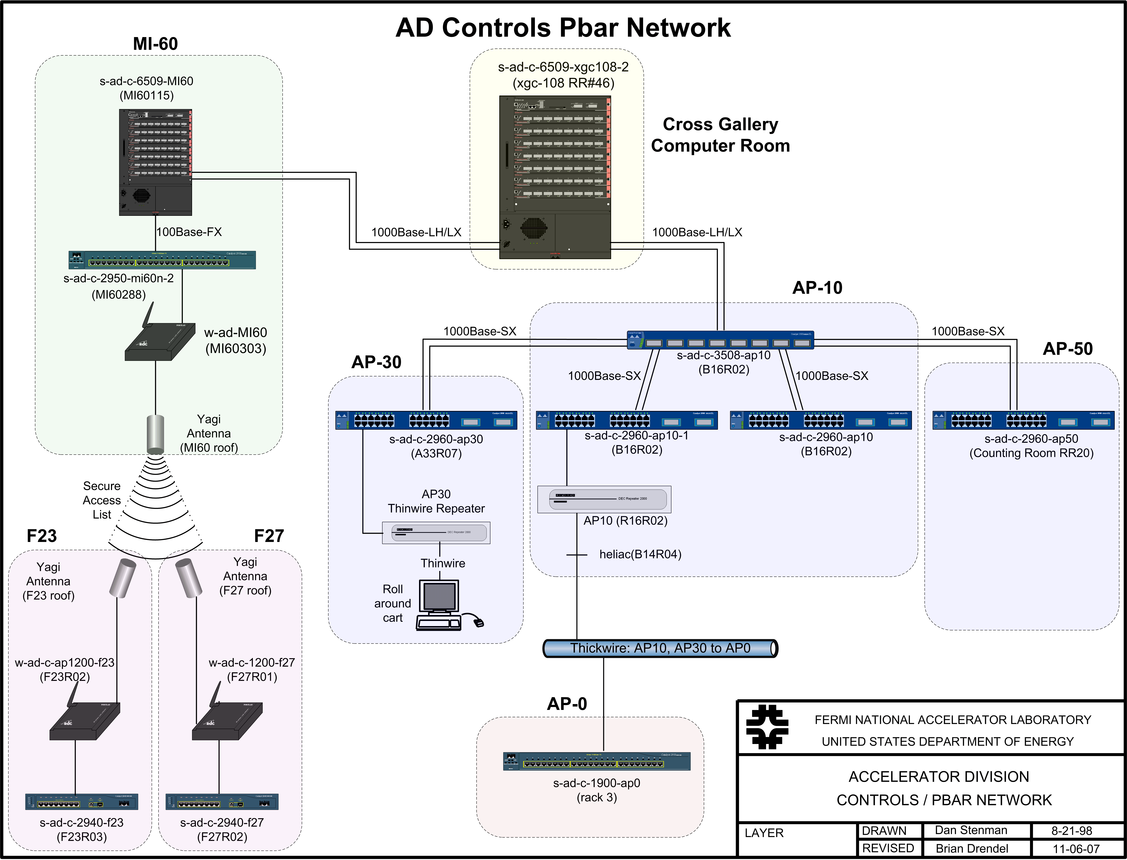

Slide 51
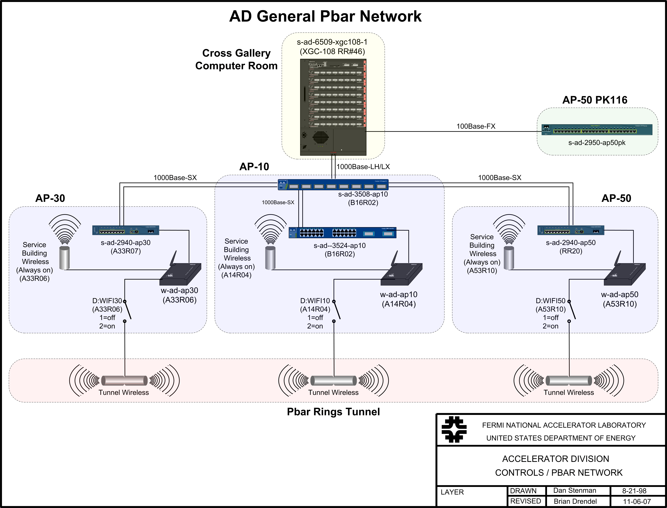

Slide 52
Application Codes
Significant controls software development will need to be undertaken prior to Mu2e operations. A detailed survey of existing ACNET applications will need to be completed in order to determine the required levels of application programming effort. Applications for Antiproton Source systems that are not needed for Mu2e operations, such as stochastic cooling programs, can be retired. Many applications, such as vacuum, diagnostics and power supply programs, can be reused or upgraded. There are also a number of applications that will need to be developed from scratch, such as those controlling the new RF systems and Debuncher resonant extraction. ACNET index pages will need to be reorganized to better reflect Mu2e operations. Controls experts estimate one month of full-time effort of an application programmer for each application that needs to be upgraded, on four months of full-time effort of an applications programmer for each application that needs to be written new.
Additional controls effort will include updating and creating database entries for parameters. Existing parameter pages will need to be restructured to reflect Mu2e operations. Parameter subpage names will need to be renamed in some cases. New parameter pages may need to be added. Software tasks requiring automation via OAC clients or ACL scripts will need to be determined and developed. Appropriate analog, digital and acknowledgeable alarms will need to be setup for Mu2e devices.
In addition, front end work will need to be done that controls experts estimate will take 2 or 3 FTE programmers at least two years to complete.
Labor and M&S numbers are taken from our costing documentation¹. Cost estimates are divided into minimum, most likely and maximum scenarios.
Minimum:
    Applications: 5 new applications, 30 updates. 2 FTEs for 2 years.
    Front End: 2 FTEs for 2 years
Most Likely:
    Applications: 20 new applications, 45 updates. 5 FTEs for 2 years.
    Front End: 3 FTEs for 2 years
Maximum:
    Applications: 46 new applications, 42 updates. 6 FTEs for 3 years.
    Front End: 3 FTEs for 3 years

Slide 53
Machine Proection – Beam Permits (1/2)
The Beam Permit system will consist of three beam permits:
AP1/AP3/Accumulator Permit
    Will use existing Pbar beam permit infrastructure.
      Beam permit loop goes MCR->AP10->AP30->F27->AP0 S->F23->AP0 N->AP50->AP10->MCR
      We may move the abort permit over to a fiber optic link. The costing for the installation of this fiber optic link is covered in the Storage Rings Controls BoE (475.02.04.06)² and Beam Lines Controls BoE (475.02.02.03)³.
    If we lose permit conditions, permit drops immediately and we send beam to Accumulator abort.
    This permit will provide the single input back to the BSSB. This means a single beam switch and single beam permit, with no BSSB hardware replacement costs.
    The Camac 201 module will need to be moved from the MCR to the location of the Accumulator abort kicker (AP50).
    Camac 479 card will also be located at AP50 to monitor clock events and fall of the abort permit.
Debuncher Permit:
    A second loop will be made for the Debuncher.
    New cabling will need to be pulled between service buildings...AP50->AP30->AP10->AP50.
      While new cabling is being pulled a spare set should also be pulled as it won't add much to the cost.
      We will also need to pull cable out to the new Mu2e experimental building.
      Cable runs will need to be copper due to expected radiation levels and the fact that some of the cable runs go through the tunnel enclosures.
      The costing for the cable pulls are covered in the Storage Rings controls BoE (475.02.04.06)², and Beam Lines Controls BoE (475.02.02.03)³. They are not part of this cost estimate.
    The Debuncher beam permit will provide a single input to the AP1/AP3/Accumulator beam permit.
    When the Debuncher beam permit goes away, we immediately abort the Debuncher beam, and pull the AP1/AP3/Accumulator permit.
    Camac 201 and 479 cards will need to be located near the abort kicker at AP50.
P1/P2 Permit:
    These two permits will be combined if we don't have need to send beam to the Tevatron.
    If this permit goes away, the Accumulator beam permit is dropped.

Slide 54
Machine Proection – Beam Permits (2/2)
Labor and M&S numbers are taken from our costing documentation¹, and include both materials as well as contract electricians for cable pulls. Cost estimates are divided into minimum, most likely and maximum scenarios defined as follows:
Minimum: Assumes we can split the costing for the BSSB evenly with LBNE, we can use existing multimode fiber optic cable between AP10, AP30 and AP50 for both abort links, can repurpose and refurbish Tevatron Camac 200 modules, and do not require any additional Camac 204 modules. Abort link cabling will still need to be pulled between AP30 and the Mu2e experimental hall.
Most Likely: Assumes we can split the costing for the BSSB evenly with LBNE, we can use existing multimode fiber optic cable between AP10, AP30 and AP50 for both abort links, can repurpose and refurbish Tevatron Camac 200 modules, and require one additional Camac 204 module per beamline building. Abort link cabling will still need to be pulled between AP30 and the Mu2e experimental hall.
Maximum: Assumes we can split the costing for the BSSB evenly with LBNE, we have to pull new multimode fiber optic cable between AP10, AP30, AP50 and the Mu2e experimental hall for both abort links, can repurpose and refurbish Tevatron Camac 200 modules, and require two additional Camac 204 module per service building.

Slide 55
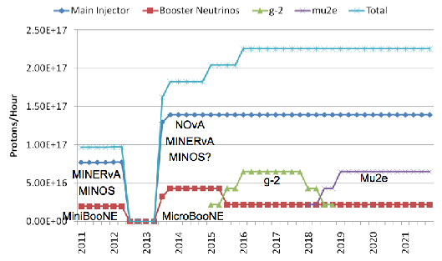
Beam Schedule

