Slide 1
Analysis of RF decay signal in vacuum RF cavity
K. Yonehara
APC, Fermilab

Slide 2
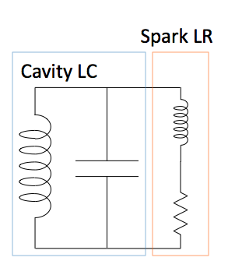
Idea of this analysis
Alvin made a new RF breakdown analysis by solving the equivalent resonance circuit
According to the theory, RF signal can be modulated by existing of plasma in a cavity
Plasma generates inductance and conductance that changes the RF Q factor and resonance condition
A. Tollestrup et al., FERMILAB-TM-2430-APC,
K. Yonehara et al., Proceedings of IPAC’10, WEPE069

Slide 3
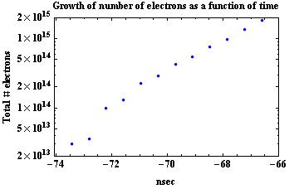
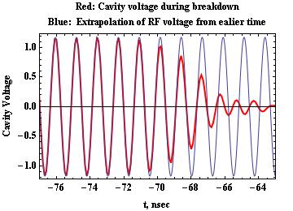
Example: HPRF cavity
RF frequency shift tells us a size of plasma and its dynamics
RF Q factor reduction tells us the change of shunt impedance
By combining spectroscopic measurement, we figured out the
BD plasma density in the HPRF cavity (10¹⁹ ~ 10²⁰ cm⁻³)

Slide 4
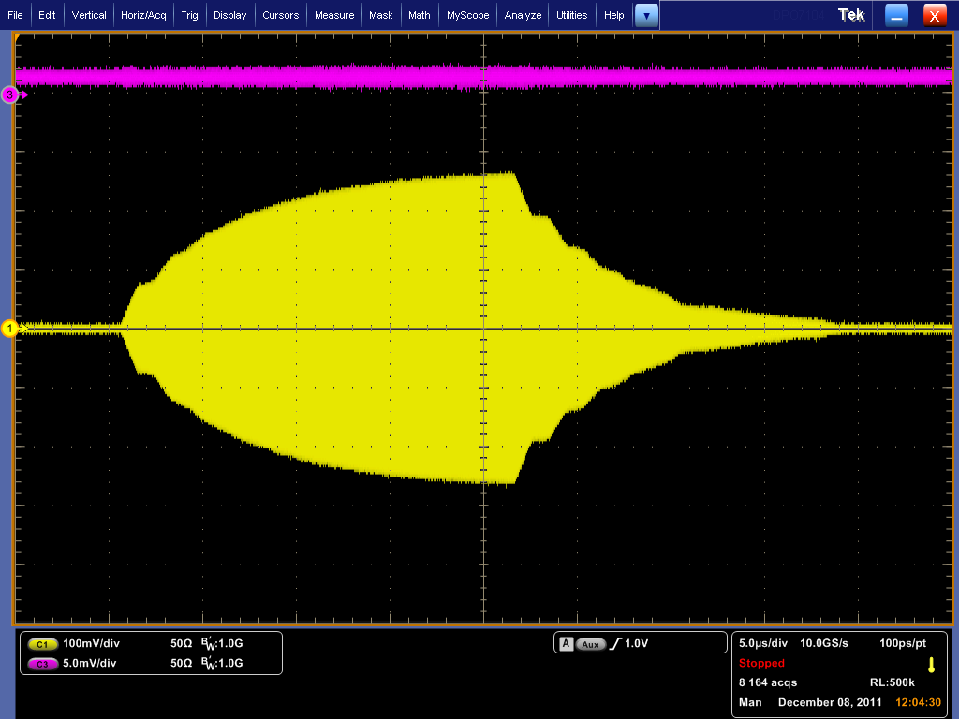
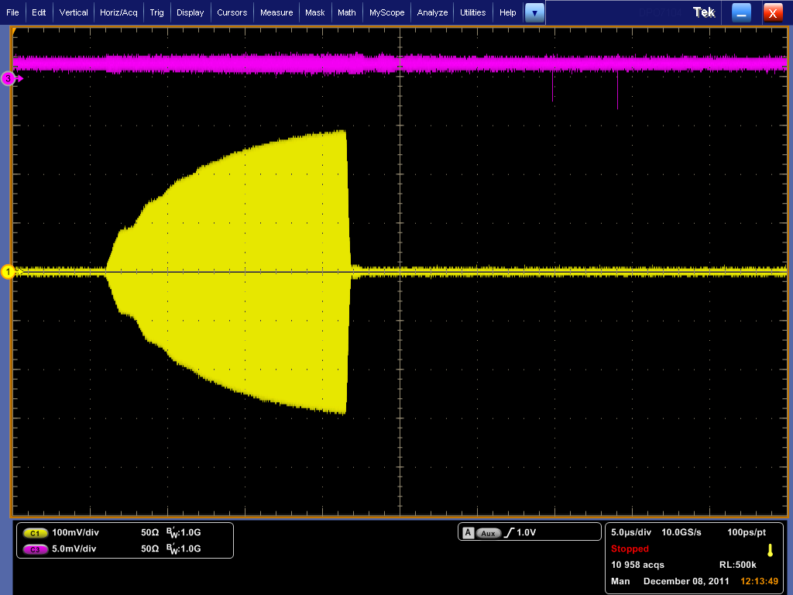
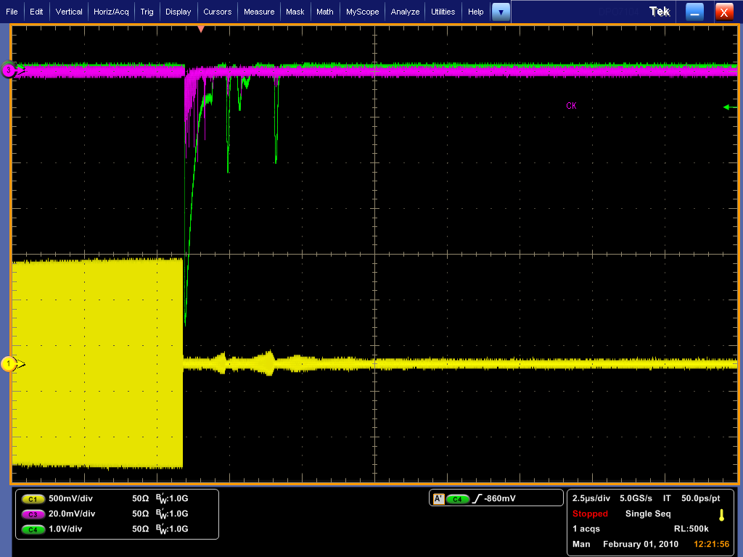
Let me look at vacuum cavity result and compare with HPRF one
436 nm (Be II line)
No BD
RF pickup
BD
RF pickup
Be button cavity (12/08/11)
Be button cavity (12/08/11)
656 nm (Hα line)
Trigger PMT
BD
RF pickup
HPRF cavity (2/11/10)

Slide 5
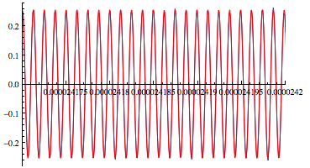
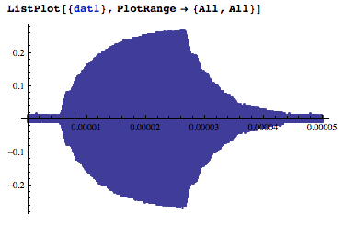
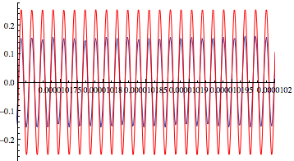
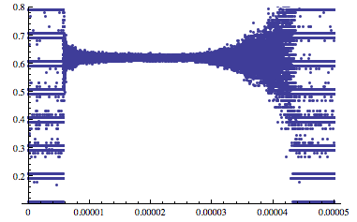
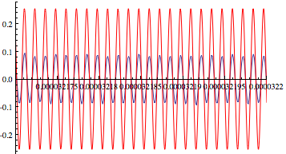
Case 1: No BD in vacuum cavity
Fig.3
Fig.4
Fig.3
Fig.5
Red: Fitting
Blue: Raw data
Fig.1
Fig.4
Use the same fitting curve
as in Fig. 3
Half period of RF
Fig.5
No RF modulation!
RF off
Fig.2

Slide 6
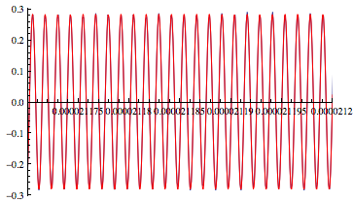
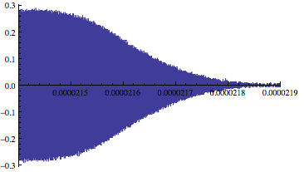
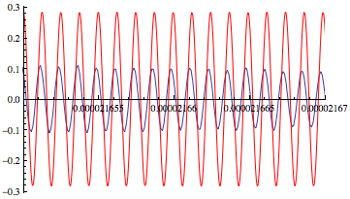
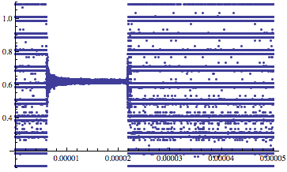
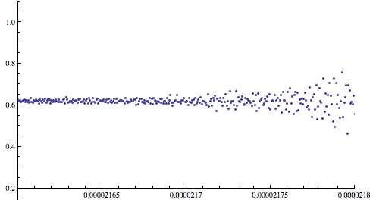
Case 2: BD in vacuum cavity
Fig.1
Fig.3
Fig.3
Fig.5
Red: Fitting
Blue: Raw data
Fig.5
Fig.4
Half period of RF
Fig.4
Fig.2
Fig.4: No (invisible) frequency shift
Fig.5: RF phase shift
Both are indistinguishable
Data scattered symmetrically

Slide 7
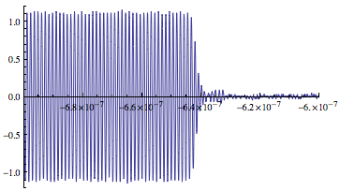
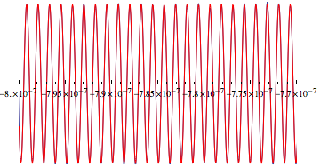
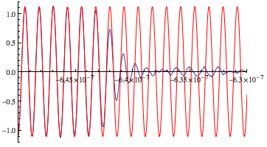
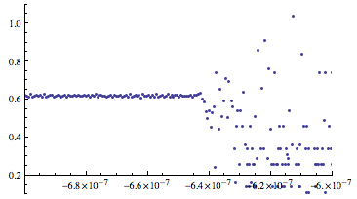
Case 3: BD in HPRF cavity
Fig.1
Fig.3
Fig.3
Fig.5
Red: Fitting
Blue: Raw data
Fig.5
RF frequency shifts to high pitch
Half period of RF
Fig.2
Fig.2: Frequency shift
Fig.5: Frequency shift

Slide 8
Summary
Compare BD in Be cavity with BD in HPRF one
RF modulation is observed in Be cavity
However, plasma density in Be cavity is thinner than HPRF one since time constant of BD is about 10 times longer in Be cavity than in HPRF one
Spectroscopic measurement in Be cavity was failed due to software problem
I guess that the BD light in Be cavity is too dim light
We may be able to measure the spectroscopic light with multiple BD

