Slide 1
Residual dose in the PS Hall after the Mu2e baseline run (and LDRD news)
Vitaly Pronskikh
Fermilab
09/15/21
Mu2e-II workshop

Slide 2
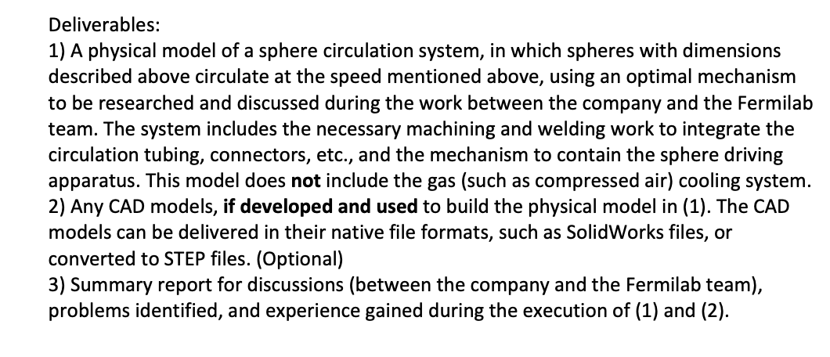
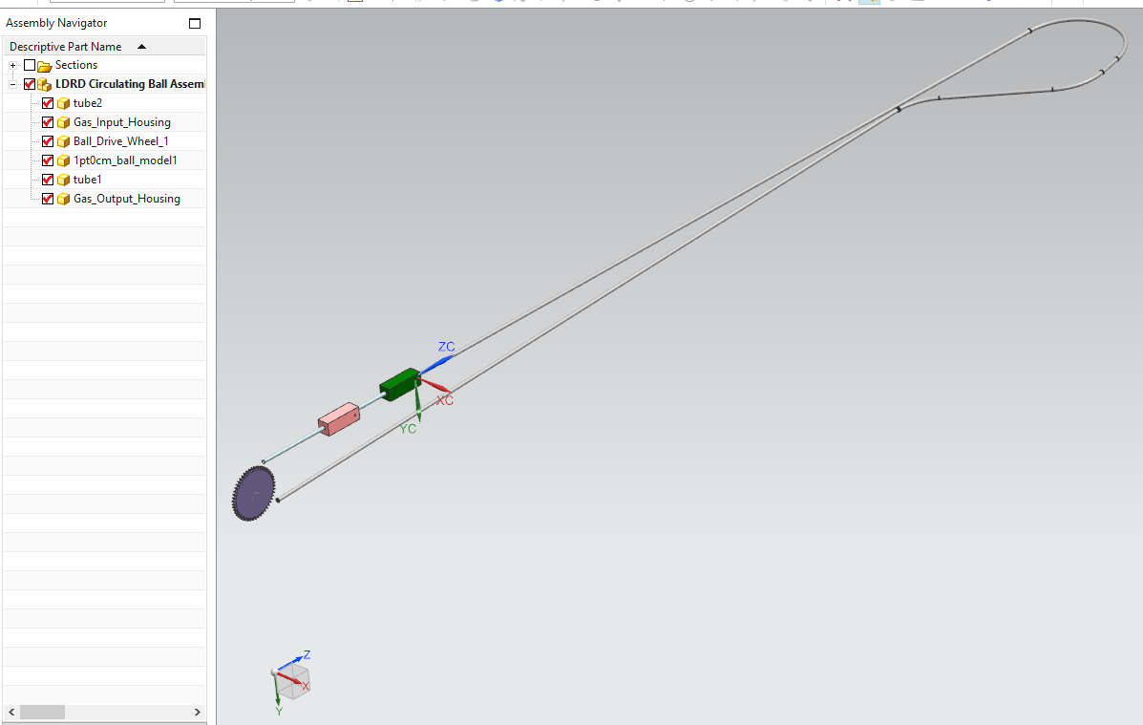
LDRD news. Prototyping: started
Statement of work for Euclid Techlabs:
Delivery date: 12 weeks ARO, or 11/30/2021,
whichever is later.
Purchase NO. 681387 order signed on 09/01/21
After receiving from the vendor, the prototype will
be mechanically tested at Fermilab by the LDRD team
If necessary and time and budget permit, we
can consider a prototype with a cooling scheme

Slide 3
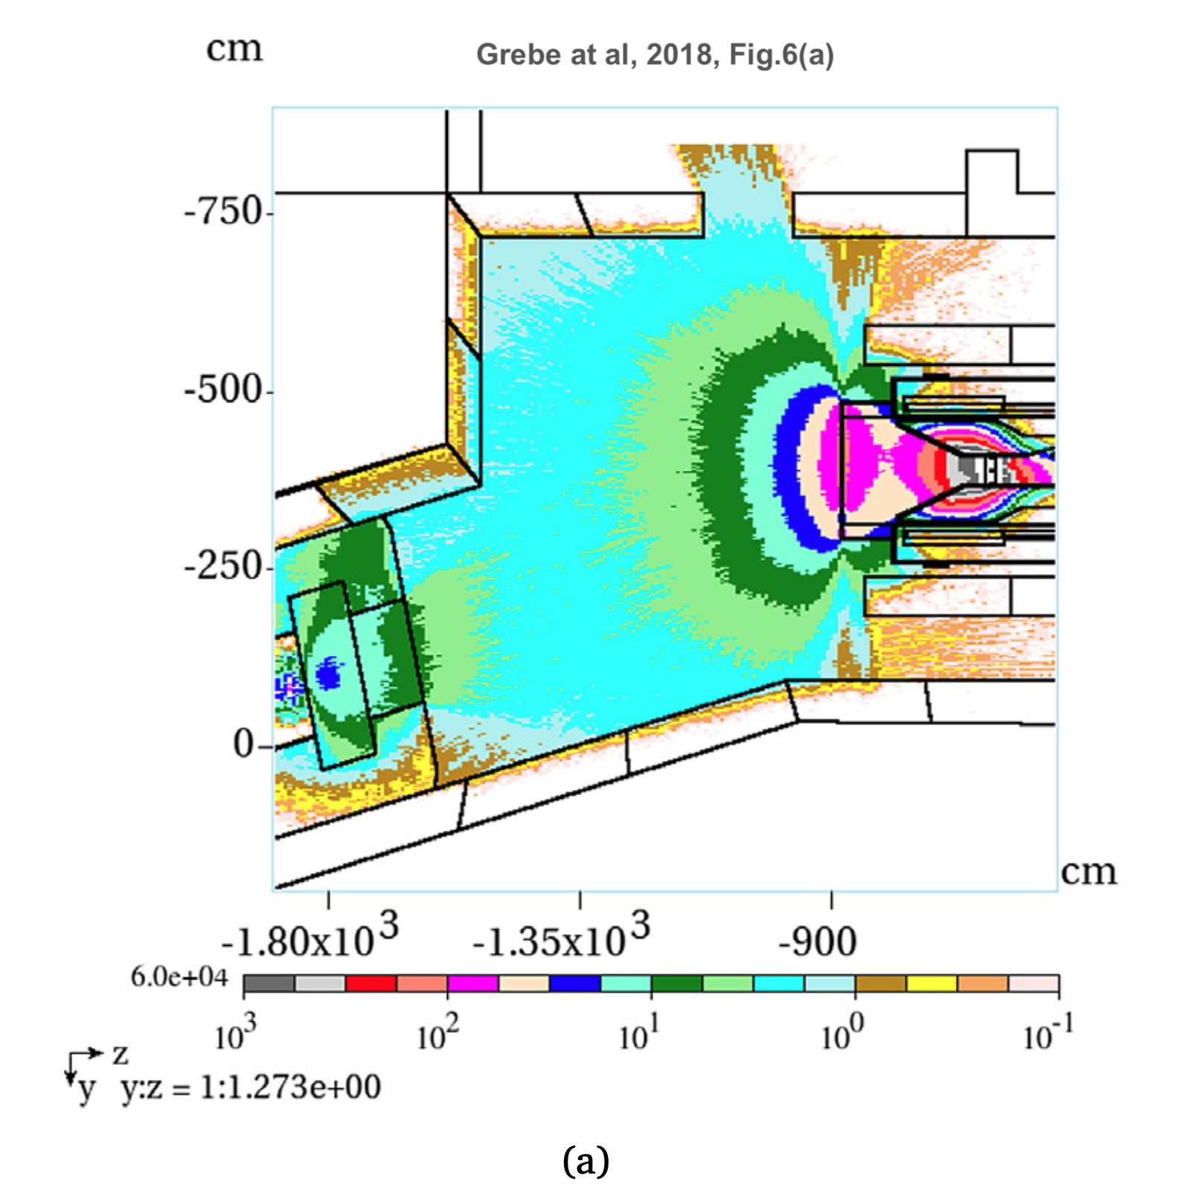
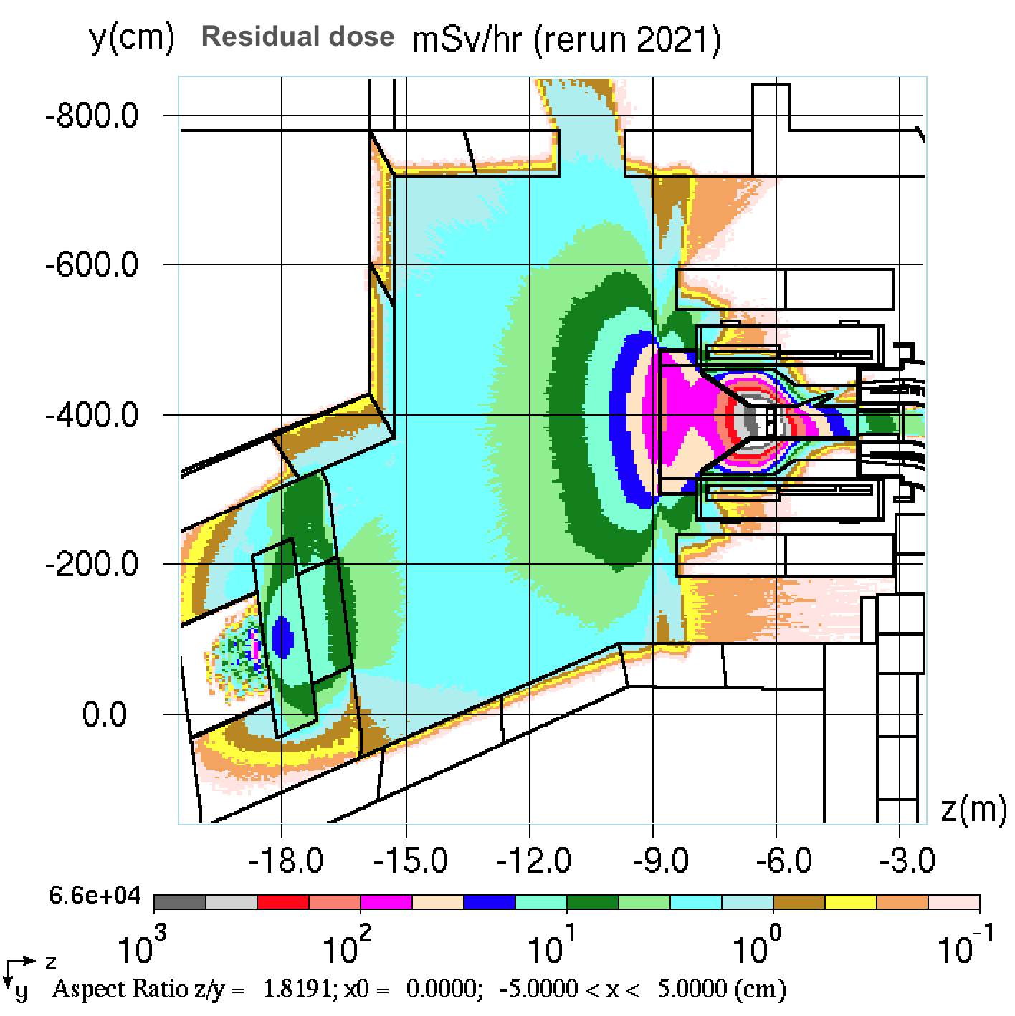
Residual dose in the PS Hall (runs 2017 and 2021)
100 mSv/hr =
10 Rem/hr
7 mSv/hr =
700 mrem/hr
365 days of irradiation and 7 days of cooling
MARS15+FermiCORD

Slide 4
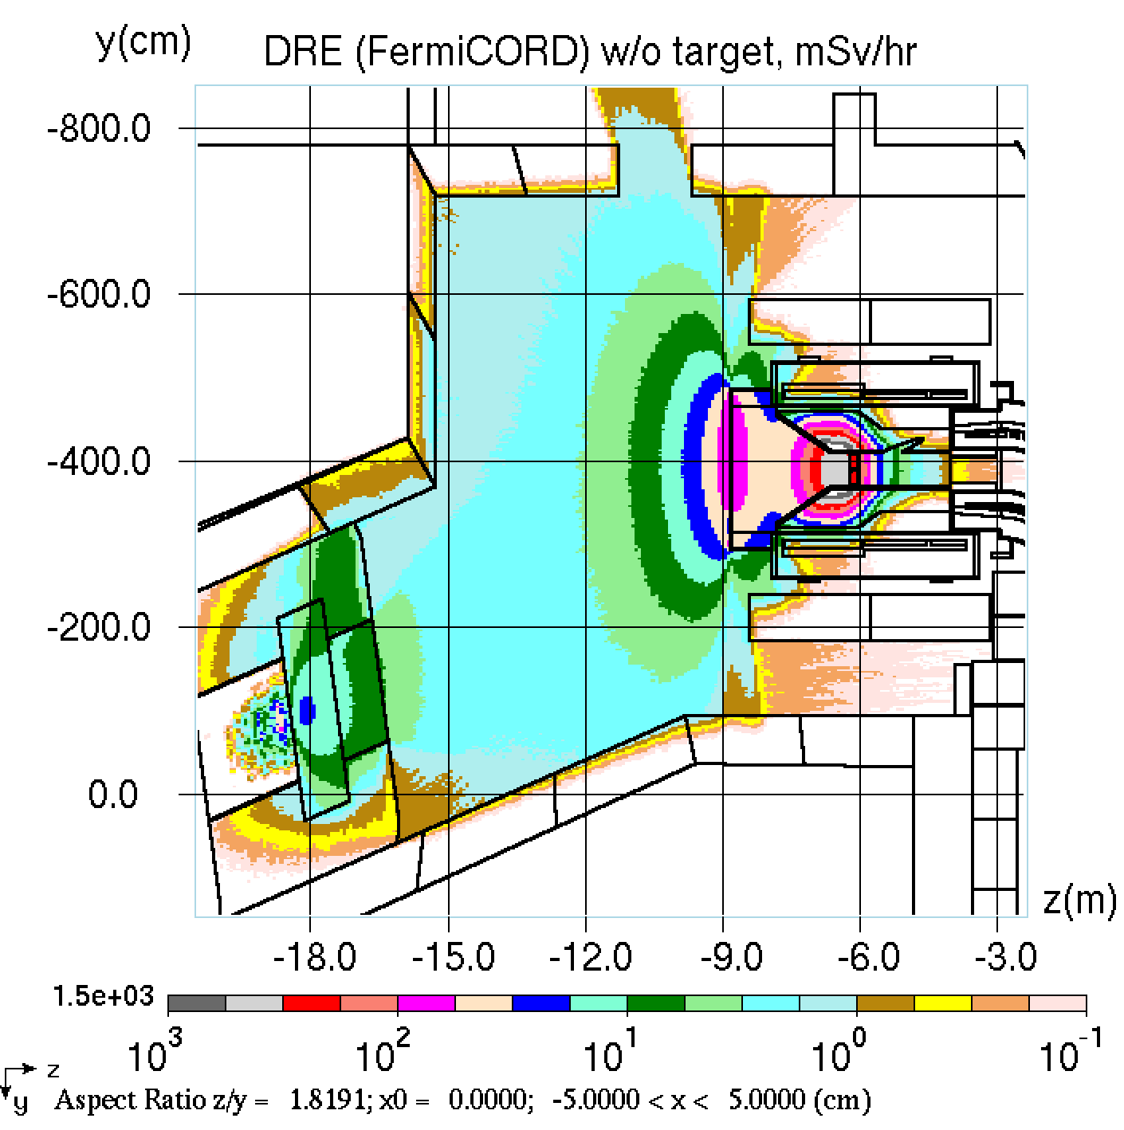
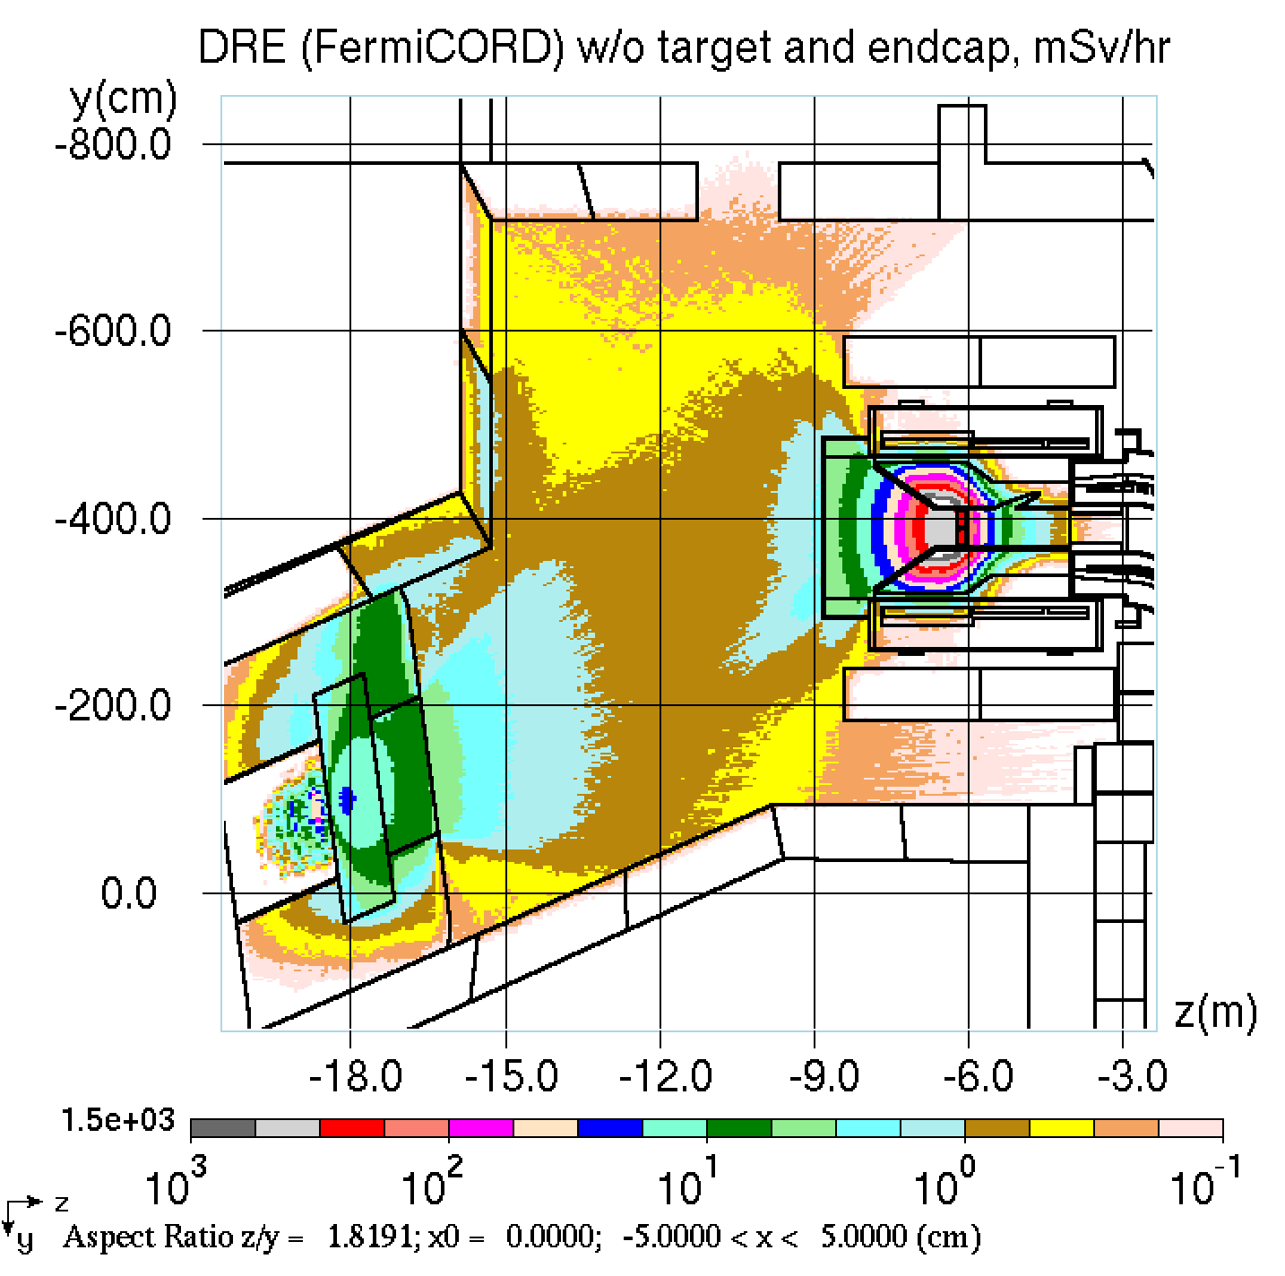
Residual dose after the target/endcap are removed
30 mSv/hr =
3 Rem/hr
1 mSv/hr =
100 mrem/hr
3 mSv/hr =
300 mrem/hr
0.7 mSv/hr =
70 mrem/hr
365 days of irradiation and 7 days of cooling
MARS15+FermiCORD

Slide 5
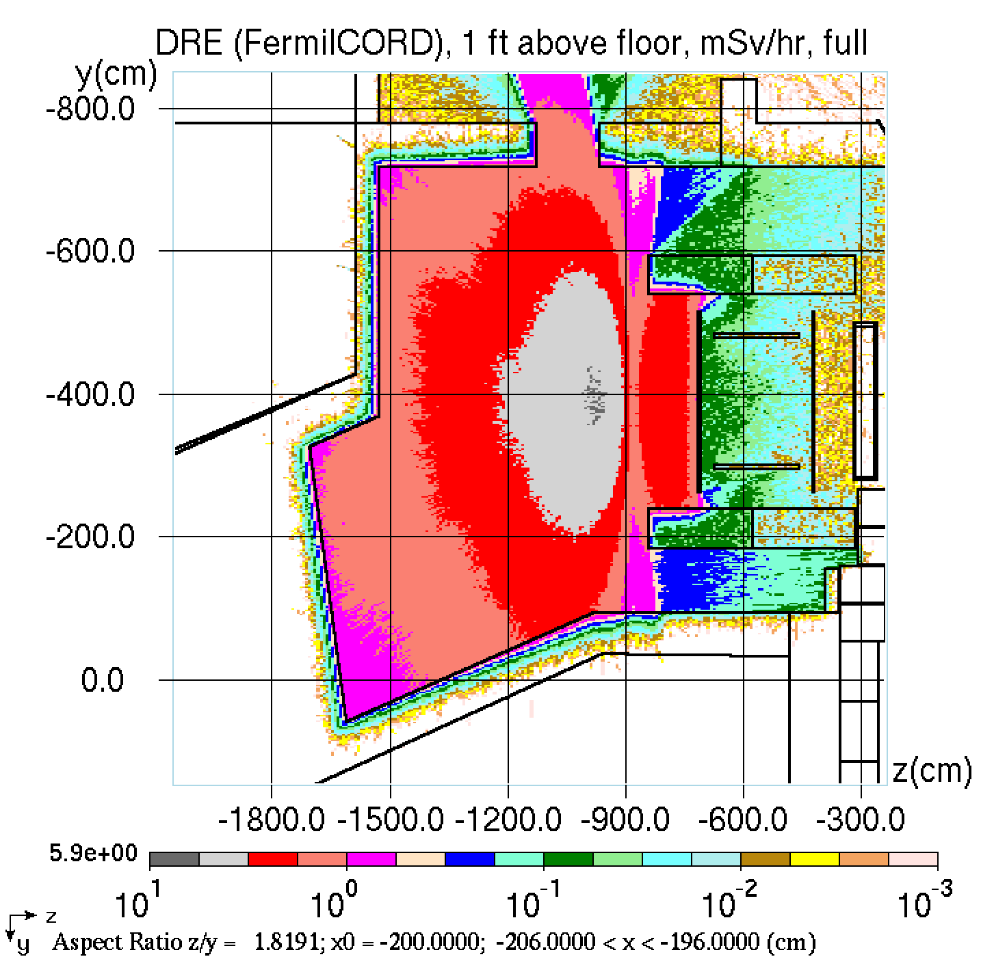
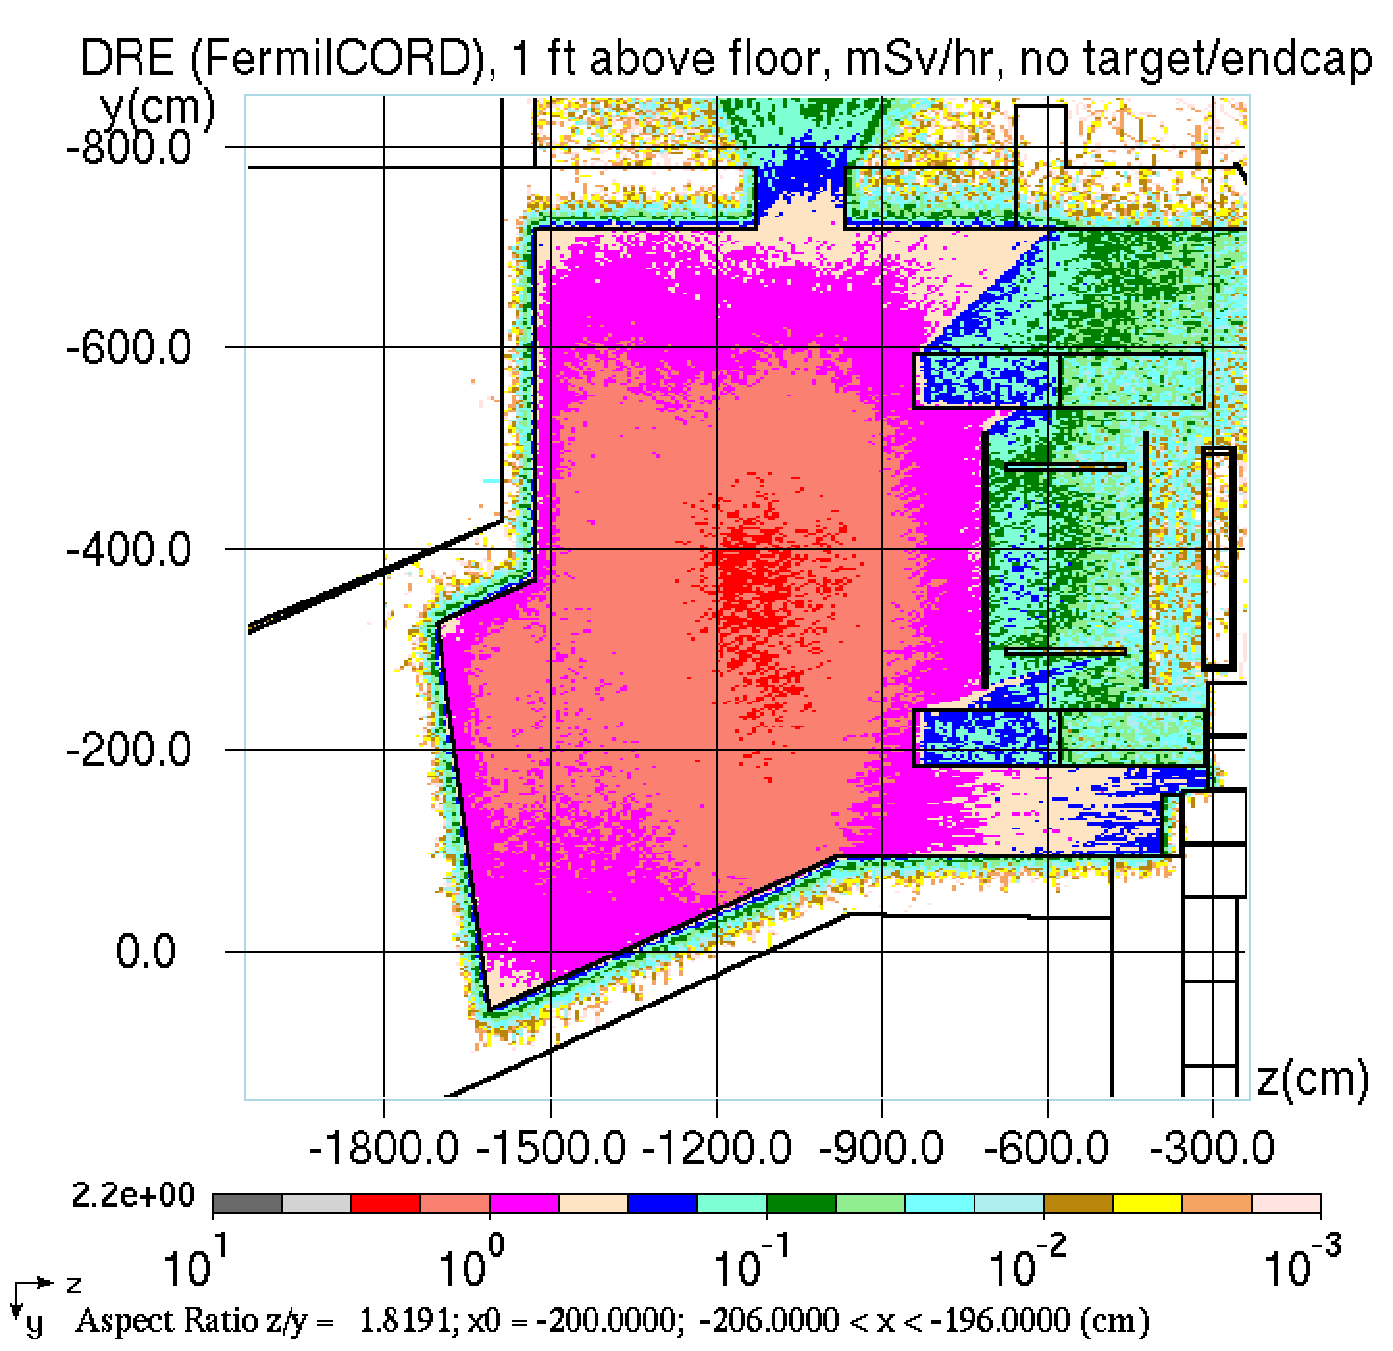
Residual dose 1 ft above the floor
7 mSv/hr =
700 mrem/hr
3 mSv/hr =
300 mrem/hr
365 days of irradiation and 7 days of cooling
MARS15+FermiCORD

Slide 6
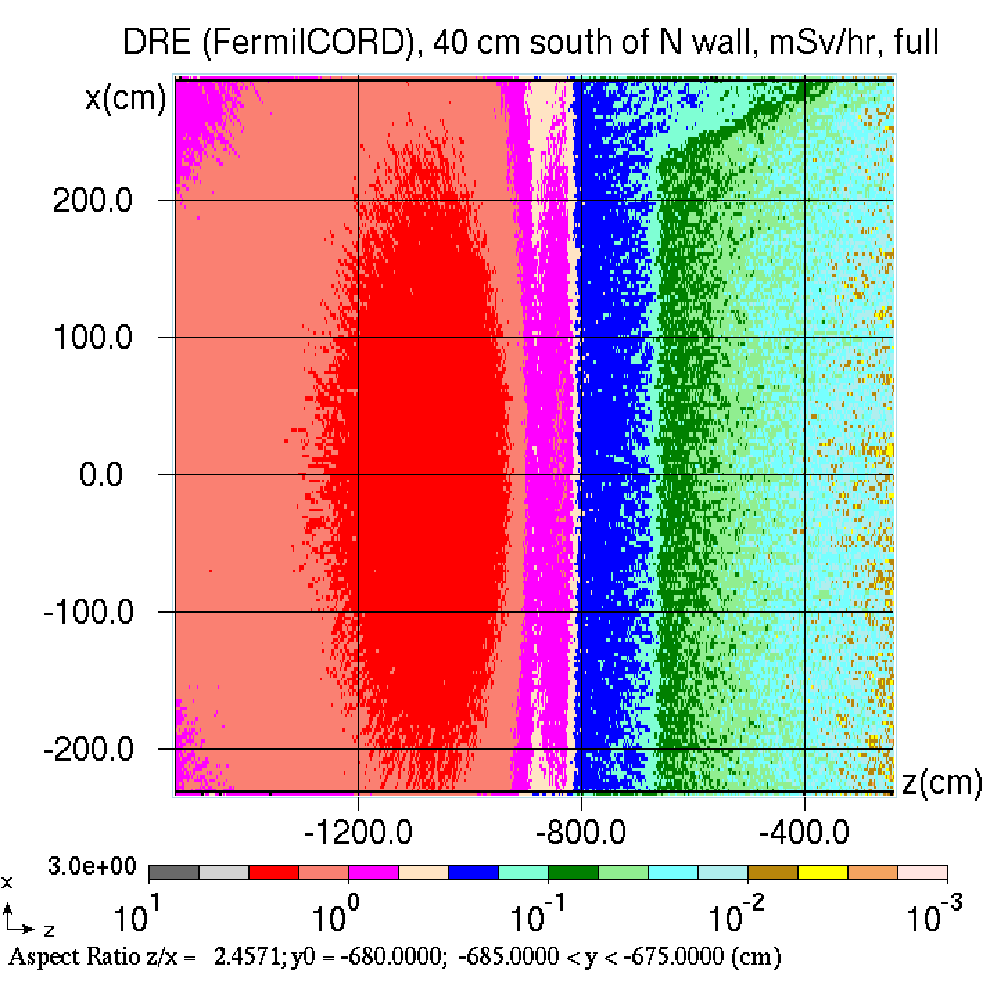
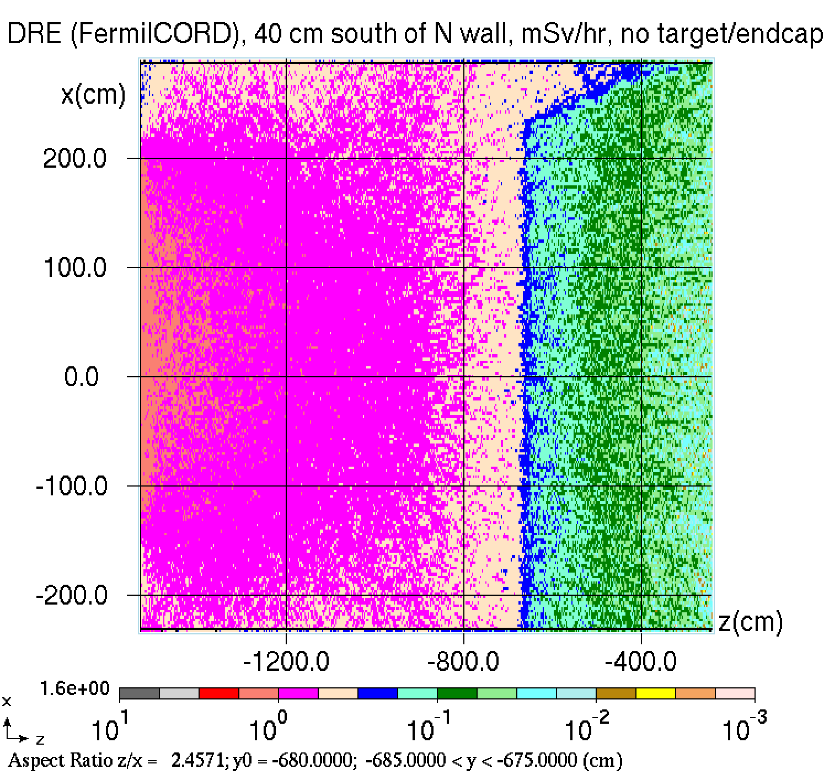
Residual dose at 40 cm south of North wall
3 mSv/hr =
300 mrem/hr
1 mSv/hr =
100 mrem/hr
365 days of irradiation and 7 days of cooling
MARS15+FermiCORD

Slide 7
Conclusions
Removal of the target reduces the dose sometimes by a factor of 2 but not sufficiently
Removal of the target AND endcap reduces the dose very significantly (from 10 Rem/hr down to 100 mrem/hr in front of PS).
To enable maintenance it makes sense to consider the removal of both the target and end cap
Also: LDRD in on track

