Slide 1
Mu2e-II Accelerator Group
Eric Prebys
mu2e-ii-accelerator@fnal.gov

Slide 2
White Paper Outline
Overview of PIP-II capabilities
Proton economics and Mu2e-II bunch formation
Beam switching options
Beam line design
Proton stripping
Extinction
Beam trajectory to target
Target design
Extinction Monitor

Slide 3
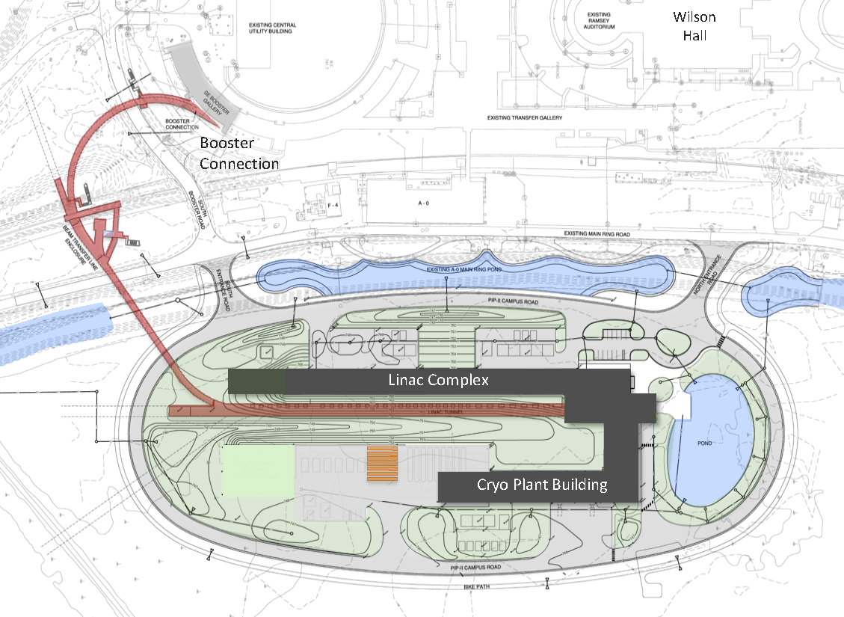
PIP-II Scope Overview
800 MeV H− linac
  Up to 165 MHz bunches
  Up to 2 mA CW
  Up 1.6 MW
Upgraded Booster
  20 Hz, 800 MeV injection
  New injection area
Upgraded Recycler & Main Injector
  RF in both rings
Protons for the High Energy Program
  .55 ms injection into Booster at 20 Hz
  ~1% of available beam!
Additional beam
  All the beam?
  3-way beam split?
To mu2e
The PIP-II scope enables the accelerator complex to reach 1.2 MW proton beam on LBNF target.

Slide 4
PIP-II and Next Generation Mu2e
PIP-II Features
  800 MeV beam will a selectable, arbitrary beam pattern up to 162.5 MHz
    Peak current up 5 mA (2.0x10⁸/bunch)
    CW average up to 2 mA (0.8x10⁸/bunch)
  High Energy (≧8 GeV) limited to ~1% of available beam
Mu2e-II
  Use PIP-II (800 MeV) as beam source
  Reuse as much as possible of the baseline Mu2e experiment
    Follow similar experimental scenario
    Improve if possible

Slide 5
Bunch Switching
The full bunch rate out of the PIP-II linac is 162.5 MHz
  Arbitrary pattern selectable on a bunch-by-bunch basis
The high energy (≧8GeV) program will use about 1% of the potentially available beam
  Limited by the 20 Hz rep. rate of the upgraded Booster
I’m assuming beam headed for the Booster will be switched by a 20 Hz switching magnet (not challenging)
If we’re the only other user, then we would access to the full 162.5 MHz; however
If we’re not the only user, our ~600 kHz bunch rate is certainly too fast for a pulsed kicker.
If there are multiple 800 MeV users, then the most likely solution is an RF beam separator.

Slide 6
RF Beam Splitting
The Beam will go through an RF deflector running at 162.5/4=40.625 MHz
Individual beam lines are selected by choosing which bunches to populate.

Slide 7
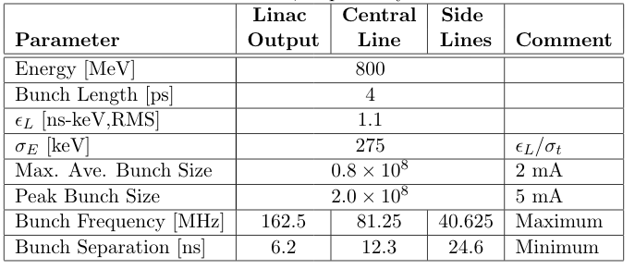
PIP-II Linac Beam Parameters
Up to ~100 μs or so
Limit for short bursts.
Cannot be changed quickly (we’ll be tied to this number during NOvA/LBNF operation!)

Slide 8
Input from PIP-II
We had a very productive meeting with Eduard Pozdaev from PIP-II
Important revelations:
  Bunch intensity cannot be changed quickly (minutes to hours)
    Injection into the Booster for LBNF will be subject to the 2 mA limit
    Luckily, in order to paint into the 53 MHz buckets, not every bunch will be populated, so bunch size will be 1.4x10⁸ rather than .08x10⁸
      Everything I presented before needs to be scaled by 1.4/2.0 = .7
        Power 70% or pulses 40% longer or somewhere in between
  Space charge effects will lead to significant longitudinal shearing, meaning either the RF separator would either have to go right after the Linac (as Eduard usually draws it) or we would need additional RF to rebunch the beam

Slide 9
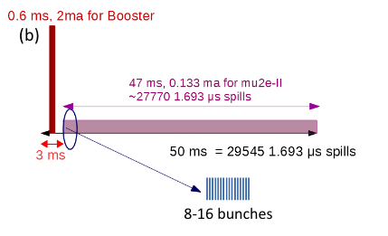
Mu2e-II Beam formation* (changes in red)
Possible beam structure (100 kW):
  (10) bunch burst @ 600 kHz
  1.4x10⁸ protons/bunch
  600 kHz repetition rate
  = 100 kW
  3% duty factor
  0.12 mA
  These numbers are
  independent from the
  instantaneous bunch rate!
    ie, which line we’re in
The bunch rate only affects the pulse width
  162.5 MHz = 60 ns
  81.25 MHz = 120 ns
  40.625 MHz = 240 ns
All of these numbers would double for 200 kW
~275 162.5 MHz buckets
That’s all that would be needed from the accelerator end!
*https://www.snowmass21.org/docs/files/summaries/AF/SNOWMASS21-AF5_AF0-RF5_RF0_Prebys-204.pdf

Slide 10
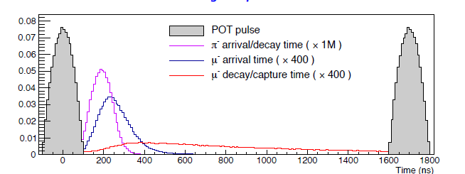
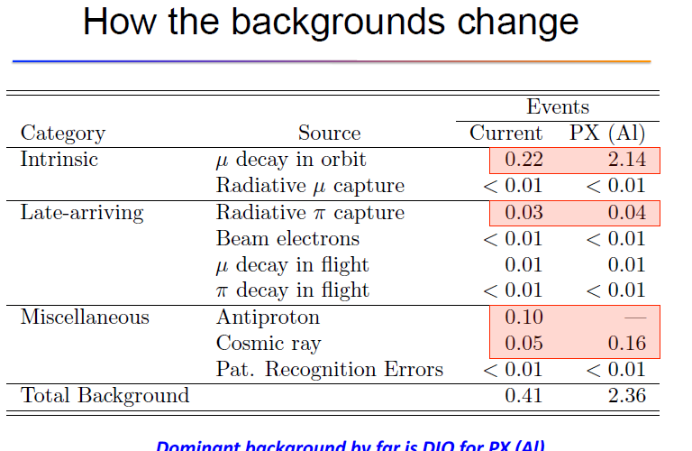
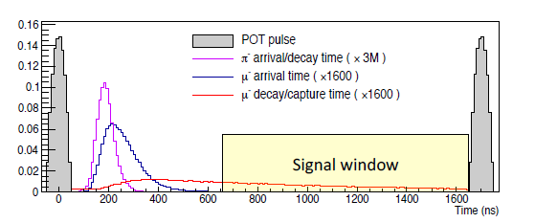
mu2e→mu2e-II
mu2e →mu2e-II
  shorter pulses @
  100 kW
Timing comparison
  K. Knoepfel et al.
Still dominated by
beam straggling

Slide 11
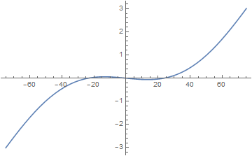
Extinction comments
could use Mu2e AC dipole extinction
  Beam size of PIP-II 0.8 GeV and current 8 GeV beam are similar
    Bρ: 29.84 → 4.91 T-m
  Use magnets and fields at ~1/6 strength
PIP-II beam length is ~2× smaller
  reduce window a factor of 2 by changing h, f, and Kick strength
  Kick ~ sin(πx/t_{o})-f sin(πhx/t_{o})
    K=2.5/6, h=21, f=0.055 (from h=15, f=0.084)
But - Extinction monitor must change
  No 4.2 GeV/c beam …
Kicker
Collimator
120 ns

Slide 12
Shortening the Transmission Window
With the same transmission window, the extinction dipoles will need ~1/6 the field for an 800 MeV beam, HOWEVER
If we shorten the transmission widow, both the frequency of the higher harmonic and the amplitude of both fields will scale as the inverse
Limit?
Assumes the same emittance, which won’t be the case -> Not this bad

Slide 13
Extinction Questions
Our current system assumes
  Need 10⁻¹⁰
    10⁻⁵ from bunch formation in Recycler/Delivery Ring
    10⁻⁷ from AC Dipole
    Factor of 100 safety margin
Mu2e-II
  Need 10⁻¹¹
    Assume 10⁻⁴ from chopper
      Upper limit, probably better
    Would need 10⁻⁹ to get the same safety margin
      AC dipole system should work much better with a lower energy, smaller emittance beam, but…

Slide 14
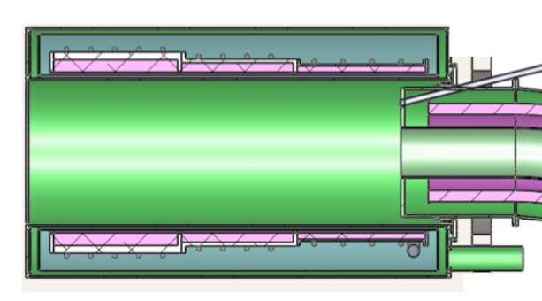
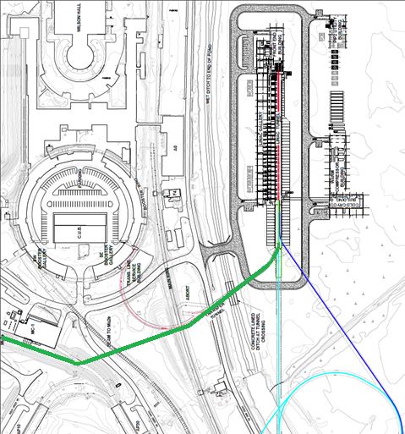
PIP –II delivery on target
PIP-II Linac is H⁻
  beam enters ~4T field
    14º → ~0.9 T transverse
    H⁻ stripping time (W. Chou)
    P=1.463 GeV/c
    βγcτ = ~12cm
  Beam should be stripped upstream
    orbit bump onto stripper foil could add to extinction (Roberts ….)

Slide 15
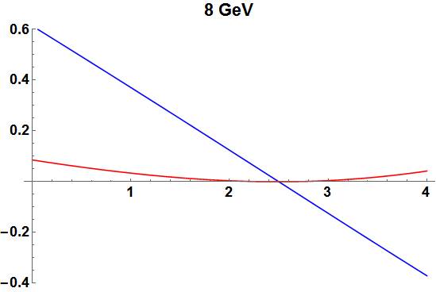
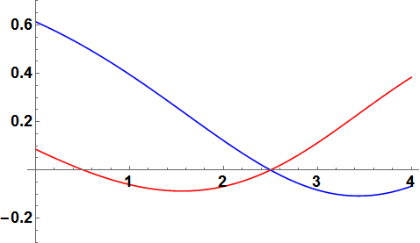
Beam Deflection 8 GeV vs 800 MeV
x
y
8 GeV
x
x
800 MeV
y

Slide 16
Accelerator Issues Approximately Ordered by Difficulty
Beam transport into and through the PS – How do we hit the target, dump, and extinction monitor?
  Changing input angle to hit target changes exit angle toward dump; extinction monitor must change
Target upgrades required for 100 kW 800 MeV beam.
  Active cooling + material/geometry change
Replace Production Solenoid ? Change if replaced?
  HRS shielding upgrade
Extinction – Can chopper + beamline extinction system achieve the required 10⁻¹¹ extinction?
Where to strip H⁻ to p⁺?
Radiological issues – shielding for 100 kW mu2e ?

Slide 17
To be done for white paper (along with primary responsible)
Update beam delivery numbers in light of PIP-II revelations
  Prebys
Finalize beam line design, including location of RF splitter and stripping foil
  Neuffer
Complete preliminary target design
  Pronskikh
Update extinction modeling with correct longitudinal model
  Prebys
Updated extinction monitor
  ??

Slide 18
Targetry Workshop
There will be a mini-workshop Thursday, September 23, 10AM-noon CDT to discuss common targetry issues among neutrinos, dark sector searches, muons, etc
  https://indico.fnal.gov/event/50719/
  Subscribe to list: TARGETRY-WORKSHOP@LISTSERV.FNAL.GOV if you’re interested

