Slide 1


Quench Protection of Long Nb₃Sn Quads
Giorgio Ambrosio
Fermilab
BNL - FNAL - LBNL - SLAC
2nd LARP / HiLumi Collaboration Meeting
FNAL
May 7-9, 2012
With contributions by:
H. Felice , A. Ghosh, R. Hafalia, L. Rossi

Slide 2
Outline
Long Quadrupole quench protection design
Long Quadrupole test results
LHQ quench protection design
Thoughts about Nb₃Sn IR Quads
Disclaimer: Preliminary analysis; check of data and “old files” still in progress.

Slide 3
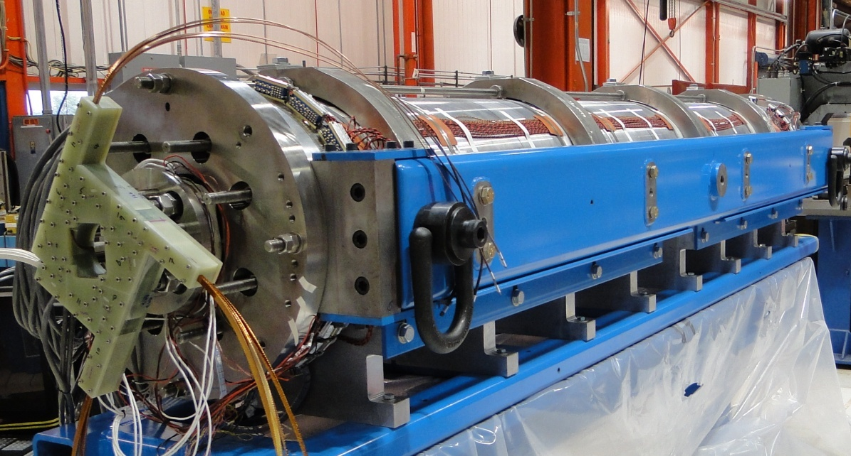
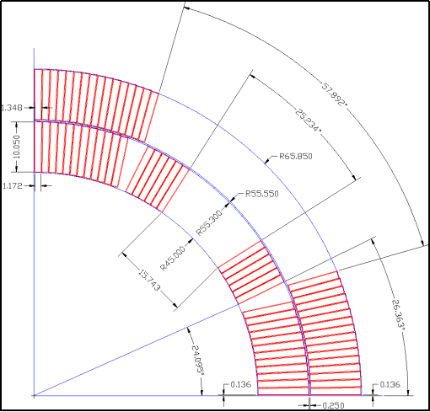
Long Quadrupole
Main Features:
Aperture: 90 mm
magnet length: 3.7 m
LQS01 SSL | 4.5 K
Current | 13.7 kA
Gradient | 240 T/m
Peak Field | 12.25 T
Stored Energy | 460 kJ/m
Parameter | Unit | LQ
N of layers | - | 2
N of turns | - | 136
Coil area (Cu + nonCu) | cm² | 29.33
Coil Length | m | 3.3
LQ Design Report available online at:
https://plone4.fnal.gov/P1/USLARP/MagnetRD/longquad/LQ_DR.pdf

Slide 4
Temperature (MIITs) Limit
Impact on quench performance of high-MIITs quenches (TQS01c)
+ 4% after 8 MIITs
- 3% after 8 MIITs
  T = 400 +/- 10 K
- 7.4% after 8.7 MIITs
  T = 480 +/- 10 K
- 18.4 after 9.5 MIITs
  T = 530 +/- 10 K
Small bumps at 7.5 MIITs
  T = 350 +/- 10 K
During TQC01 test, one QI vs. T measurement
I: 5000 A , QI: 9.05 MIITs, Peak Temp: 340 K

Slide 5
Quench Pro I
Analytical code
Adiabatic approximation
Temperature computed from Quench Integral
  Field is constant (average); different values for hot spot and bulk
  Epoxy included in QI
  Strand non_Cu = 2/3 Nb₃Sn, 1/3 bronze
Longitudinal propagation by QP velocity
Quench starts under heaters
  after detection time + heater delay time
Temperature is uniform (given by QI) in normal zone of each cable
  Different between Hot-spot and bulk

Slide 6
Quench Pro II
Current decay
  Magnet can be switched to a dump resistance (after detection) or leads are short-circuited
  Current decay is computed based on the instantaneous time constant (computed from the growing resistance and the inductance)
  Inductance is an input, or can be computed based on position of each turn (inductance matrix)
Voltages
  Computed based on current, resistance, dI/dt, inductance matrix, (at dI/dt max)
  Turn to ground
  Turn to turn

Slide 7
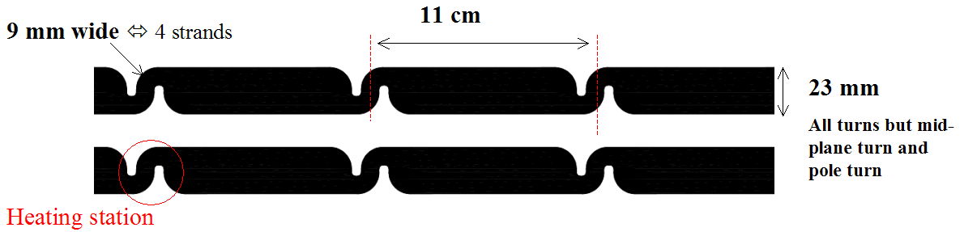
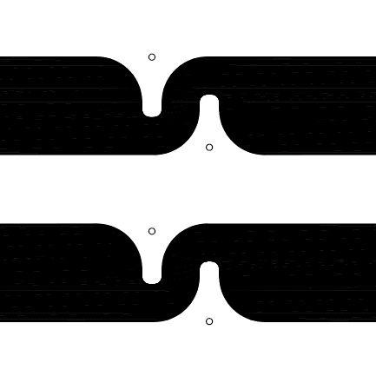
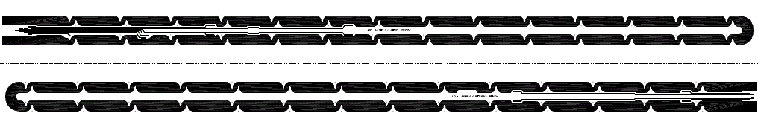
LQ Inner Layer Heater
Spacing parameters
Holes / Vtaps = 1.5 mm
Holes / heaters = at least 3.5 mm
Coil mid-plane / heaters = at least 3.5 mm
Vtaps / heaters = at least 3.5 mm
Vtaps/Vtaps = at least 1.5 mm
No sharp angle = minimum radius of curvature 2 mm
Heating stations and holes for epoxy
Lifting holes
Spot heater cutout
Lifting holes

Slide 8
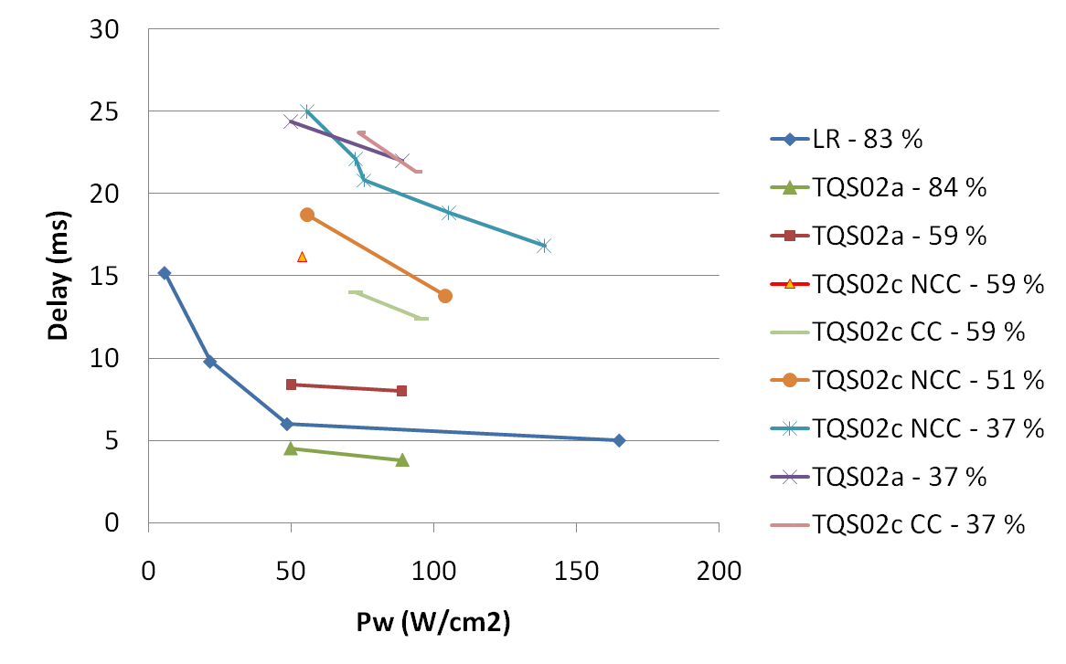
Quench Protection
Very challenging!
J in copper = 2900 A/mm²
at 13.9 kA (4.3 K SSL)
Goal:
  MIITs < 7.5 ⬅➔ Temp ~ 370 K (adiabatic approx; RRR 100)
Quench protection param. (4.5 K) – conservative hypothesis
  Dump resistance: 60 mΩ (extract ~1/3 of the energy; V_{leads} ~ 800 V)
  100% heater coverage (➔ heaters also on the inner layer)
  Detection time: ~5 ms based on TQs with I > 80% ssl
  Heater delay time: 12 ms based on TQs with I > 80% ssl
LARP Collab. Mtg 10 – Port Jefferson, Apr. 23-25, 2008
Long Quadrupole Overview – G. Ambrosio
8
Notes:
8

Slide 9
Measurement vs. Computation
Tests showed that there is margin:
  MIITs lower than computed,
    With one exception: quench in midplane block at 11.3 kA
  RRR higher than value used in computations.
  ➔ Hot spot temperature lower than computed values
 | COMPUTED |  |  | MEASURED
Current (A) | MIITs | RRR | Temp (k) | MIITs | RRR | Temp (k)
13500 | 7.5 | 100 | 376
12590 | 7.0 | 100 | 326 | 5.6 | 270 | 197
11703 | 6.4 | 100 | 268 | 6.5 | 293 | < 247
Detailed comparison of measured/computed current decay in progress
Work started by Lidia Rossi

Slide 10
LQ ➔ LHQ
Rough scaling, some numbers may need to be adjusted
 |  | LQ | LHQ | ratio
Energy SSL 1.9 K | MJ/m | 0.56 | 1.31 | 2.34 | Assuming 2800 A/mm²
Aperture diam. | Mm | 90 | 120 | 1.3
Cable width | mm | 10.1 | 14.8 | 1.5
Coil X-section | mm² | 5700 | 11160 | 2.0 | Including pole and wedges
Energy/~coil_vol. | J/cm³ | 98 | 117 | 1.2 | ➔ Small increase of bulk temperature
Current SSL at 1.9K | kA | 15.2 | 18.9 | 1.2 | Assuming 2800 A/mm²
Dump resistance | mohm | 66 | 53 | 0.8 | V_leads < 1 kV
Inductance at SSL | mH/m | 4.9 | 7.0 | 1.4 | LQ was overestimated; L_{d} used for LHQ*
Time constant of I decay at dump ins. | ms | 240 | 400 | 1.7
Copper in strand | % | 47 | 52 | 1.1 | ➔ Less generation and more enthalpy
*Dynamic effects appear to decrease significantly inductance during current decay

Slide 11
LQ QP ➔ LHQ QP
Protection parameters |  | LQ | LHQ
SSL Current at 4.5 K | kA | 13.5 | 17.7
Coil length | m | 3.6 | 3.1 | LHQ based on magnetic length
Detection delay | ms | 5 | = | Based on TQ measurements
Dump switch | ms | 0.01 | 1 | LHQ based on LQ current decay
Heat diffusion time | ms | 6 | 12 | LHQ has more insulation
Heater coverage IL/OL | % | ~100/100 | = | Using heating stations
Delay for propagation between heating stations | ms | 6 | = | 11 cm between stations
RRR |  | 100 | =
Ave. field in coil bulk IL/OL | T | 2/1 | 3.5/3.5 | Conservative approx in LQ
Hot spot temperature | K | 376 | 379
Note:
similar hot-spot temperature,
with fewer conservative approx.
LHQ heaters similar to LQ heaters,
installed on both layers

Slide 12
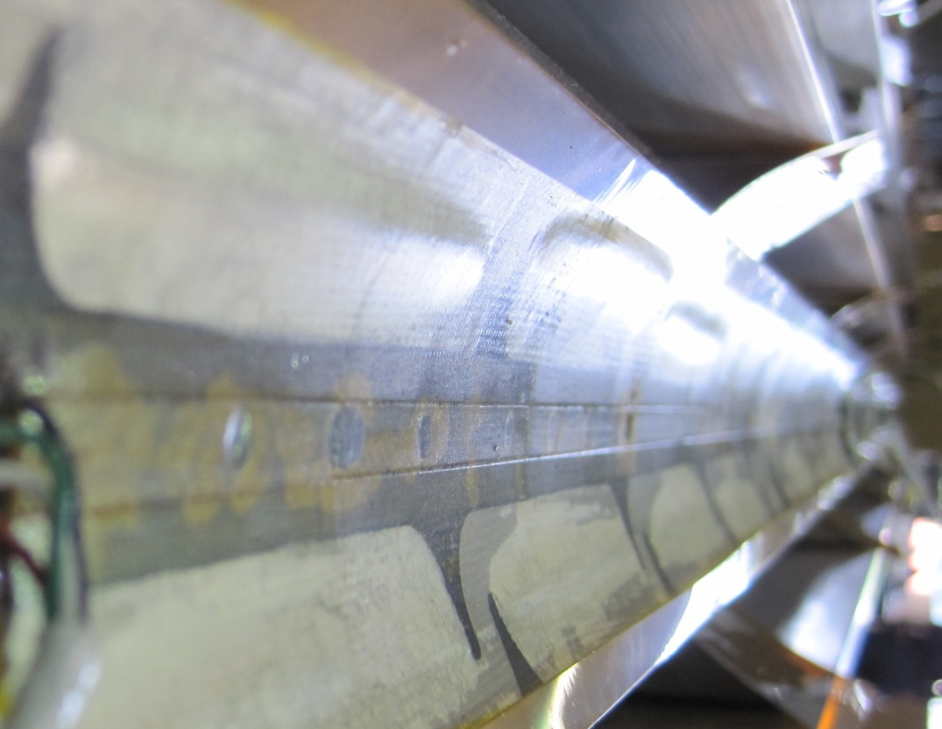
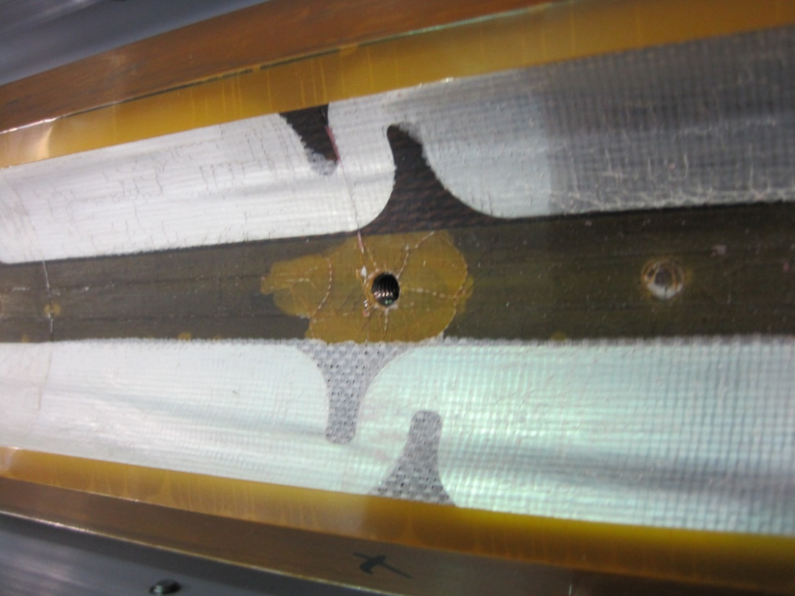
LQ Coils after Test
Delamination on coils Inner layer
  Heater – coil
  Insulation – heater
  Insulation – coil
  Also one heater-coil short
Possible causes:
  Superfluid helium + quench
    Seen in TQ coils
  Heat from heaters on ID
    Not done in TQ coils
Options:
  Strengthen insulation
    Not good for cooling
  Change heater location
    Best solution

Slide 13
Thoughts for next steps
Complete comparison between test results and code simulations for code fine-tuning
  LQ and HQ test results
Design protection w/o heaters on inner layer
  tests on HQ, LQ and LHQ
  design of MQXF
Try to avoid the dump
Remember that we need to design the QP for the “worst case”
  It may be a quench in mid field at high current

Slide 14
Additional slides

