Slide 1
Long Term Planning
Eric Prebys

Slide 2
From the last review (June, 2011)…
LARP management should provide a detailed plan, including budget profile, to DOE on transitioning from LARP R&D into HL-LHC by Feb 1, 2012*.
Provide to DOE by Feb 1, 2012, a prioritized list of LARP R&D activities indicating which will be emphasized and which will be reduced.
*review report didn’t come out until March. We interpret this to mean “by the 2012 review”. This also puts it after the aperture decision.

Slide 3
General Landscape
Future funding is uncertain.
DoE has asked us to plan for “between $100-$200M” for LHC accelerator upgrades.
Since this will include ongoing R&D and commissioning work ($6M/year?), the range available for projects is very large.
Priorities (bit $$ items)
Magnets: LARP and the US have committed to playing a major role in the development and construction of Nb3Sn quadrupoles for the HL-LHC upgrade (~2022). In lower funding scenarios, that may be the only large project we can commit to.
Crab cavities: LARP has played a big role in establishing crab cavities as a baseline technology for the upgrade, but involvement in the ultimate construction project remain uncertain and depend on funding.
High bandwidth feedback for the SPS: there’s a great deal of interest in this, and the exact scope of US involvement is still being determined.

Slide 4
Strategic Plan
The DOE has asked LARP to formulate a strategic plan for the future, which includes all US contributions to the LHC accelerator
LARP activities
Follow-on projects for magnets, crab cavities, etc
11T dipole!

Slide 5
Proposed Outline (Stuart Henderson)

Slide 6
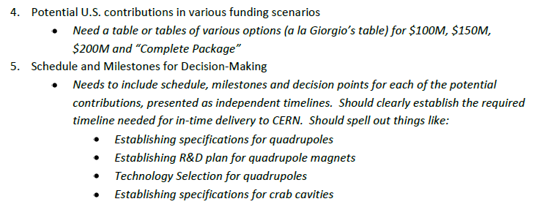
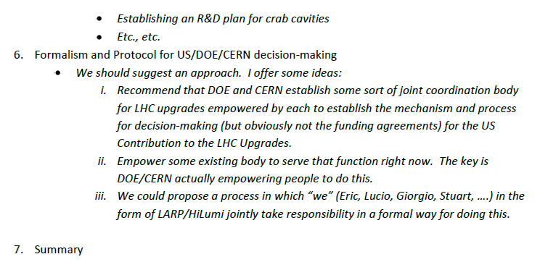
Outline (cont’d)

Slide 7
Writing Strategic Plan
Goal is to generate a draft by the July (9-10) review.
Will form a working group soon to start producing the draft.
Stay tuned…

Slide 8
Final words
Thanks to every one for coming
Particularly the Toohig candidates and CERN folks
Thanks to Margie Bruce for arranging everything!

