Slide 1
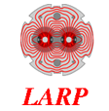

HQM04 Test Results
(preliminary)
LARP CM-18/HiLumi LHC Meeting
Fermilab, May 7-9, 2011
Guram Chlachidze

Slide 2
HQM04/coil 15 test in a mirror structure
Coil 15 – the first HQ coil of “finalized” design to be tested in a mirror structure at Fermilab
  0.778-mm diameter Nb₃Sn RRP strand of 108/127 sub-element design (all previous coils were made of 0.8-mm RRP 54/61 or 108/127 strands)
  Additional space was provided in the tooling cavity in the azimuthal and axial directions
  Improved coil and heater insulation
  25-µm thick, 8-mm wide Stainless Steel (SS) core
HQM04/coil 15 test currently in progress
  Quench training and ramp rate study completed at 4.6 K
  Training at lower temperature (2.2 K), temperature dependence study and protection heater study will follow

Slide 3
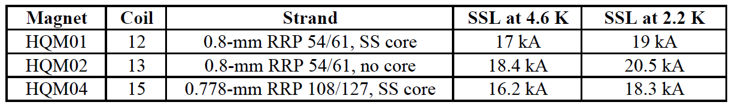
HQ coils in a mirror structure
HQ coils 12 and 13 already tested in a mirror structure (2011)
  Coil 12 (HQM01) with a SS core reached 85% of SSL (~11T) at 4.6 K and 81% (~ 12T) at 2.2 K (SSL was updated recently)
  Coil 13 (HQM02) reached 91% and 89% at 4.6 K and 2.2 K respectively
Coil 14 (HQM03) did not pass the preliminary electrical checkout
  RRP 108/127 strand, no core
  Planned as a reference coil for HQM04/coil 15 test

Slide 4
HQM04 Shim System
HQM04 Shim system breakdown (warm):
+ 75 um coil oversize
+ 50 um 2 mil extra ground wrap at midplane
+ 38 um from 50um extra radial ground wrap
+ 267 um for 375m extra kapton on shell
+ 325 for 13 mil kapton shim at midplane
- 0 um G-10 shim oversize (.188 vs .188 mils)
+112 um effective from 3 mil (75 um) radial kapton
“bending” shim near midplane.
- 353 um effective midplane shim reduction
from 500 um above control spacer
= 514 um Total midplane “gap” size
Rodger Bossert

Slide 5
HQM04 pre-stress
Rodger Bossert
-159 MPa
Coil pre-load after assembly in HQM01: -130 MPa, HQM02: – 132 MPa

Slide 6
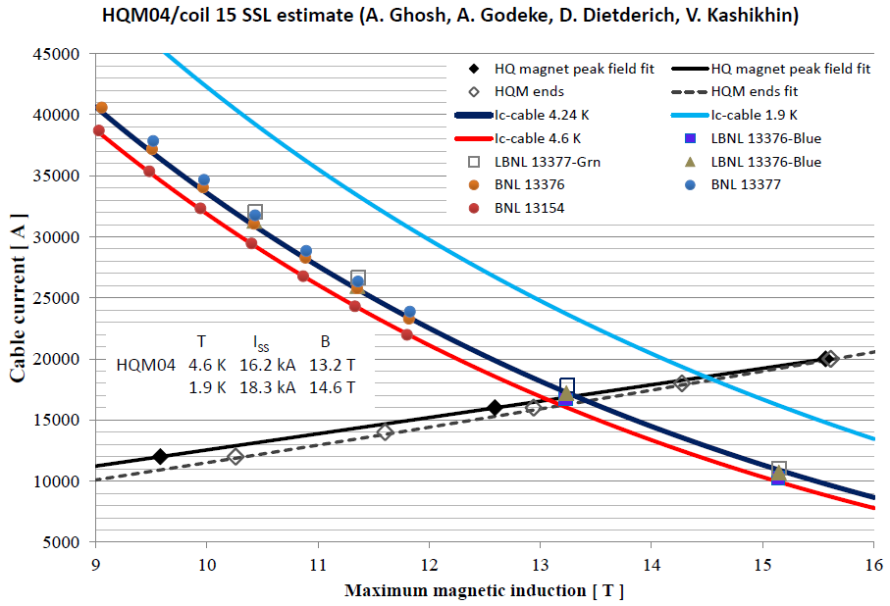
Short Sample Estimate
Short sample limits are based on extracted witness sample test results, including a self-field correction and assuming zero strain in the strand
SSL: 16.2 kA at 4.6 K, 18.3 kA at 2.2 K

Slide 7
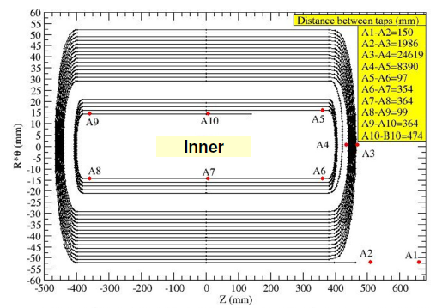
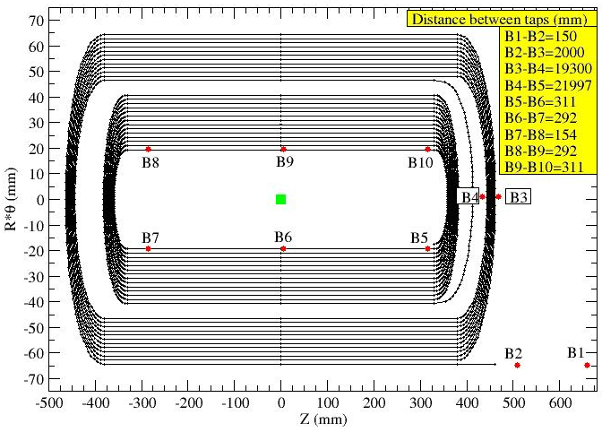
HQ coil in a mirror structure
Vadim Kashikhin
Pos. Lead
HQ mirror cross section with flux
distribution at 20 kA. Peak field at inner pole is 14.9 T
Outer
Neg. Lead

Slide 8
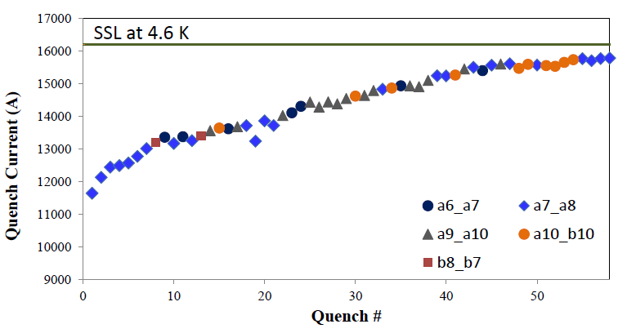
HQM04 quench training at 4.6 K
All training quenches at a ramp rate of 20 A/s
97% of SSL

Slide 9
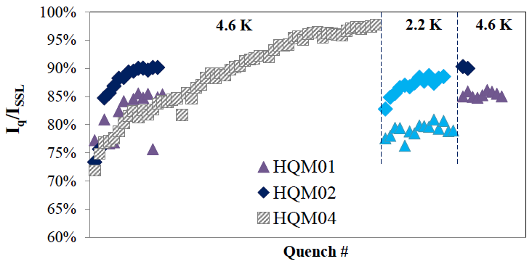
HQM04 vs. HQM01/02

Slide 10
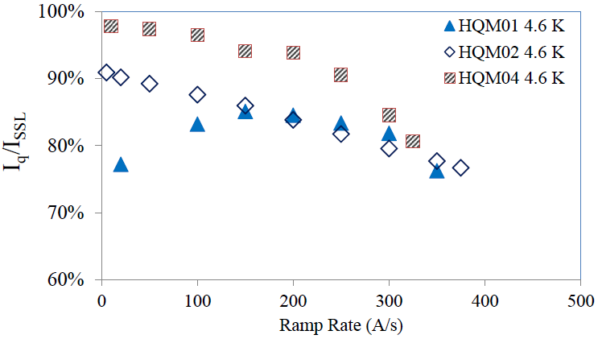
Ramp rate dependence

Slide 11
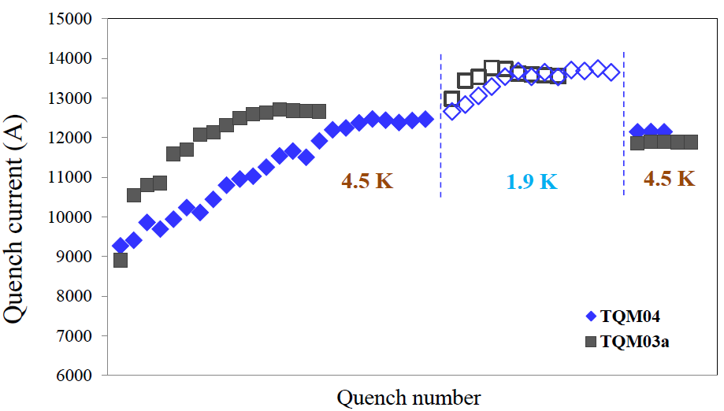
TQ coils in a mirror structure
TQM03a: coil 34, 0.7-mm RRP 108/127 strand, no core
TQM04: coil 35, 0.7-mm RRP 108/127 strand, SS core

Slide 12
“Instead of” summary (test still in progress)
HQM04/coil 15 reached 97% of SSL at 4.6 K, although with a slow training
HQM04 cold test in progress
  Quench training and ramp rate dependence study at 4.6 K
  Quench training and ramp rate dependence at 2.2 K
  Temperature dependence
  Protection heater tests at 4.6 K
  RRR measurements

Slide 13
Backup Slides

Slide 14
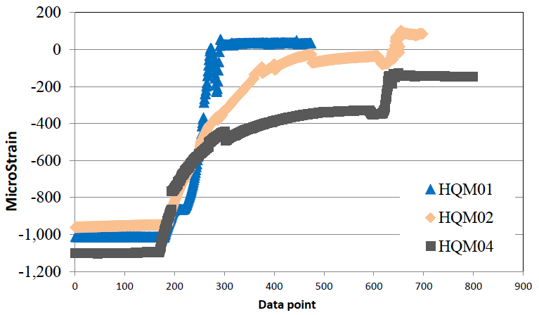
Coil Az. SG data: cool-down

Slide 15
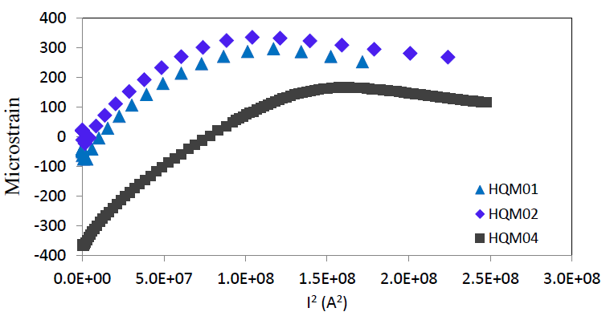
Coil Az. SG data: excitation

Slide 16
Final pressing of HQM01 with coil #12
R. Bossert

Slide 17
Final pressing of HQM02 with coil #13
130 MPa
154 MPa
R. Bossert

Slide 18
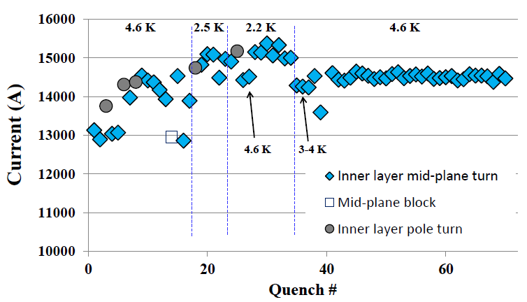
HQM01 Quench History

Slide 19
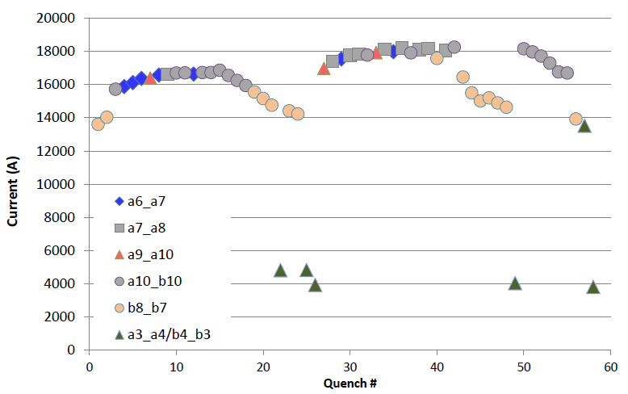
HQM02 Quench History
91% of SSL
89% of SSL
4.6 K
2.2 K
4.6 K

Slide 20
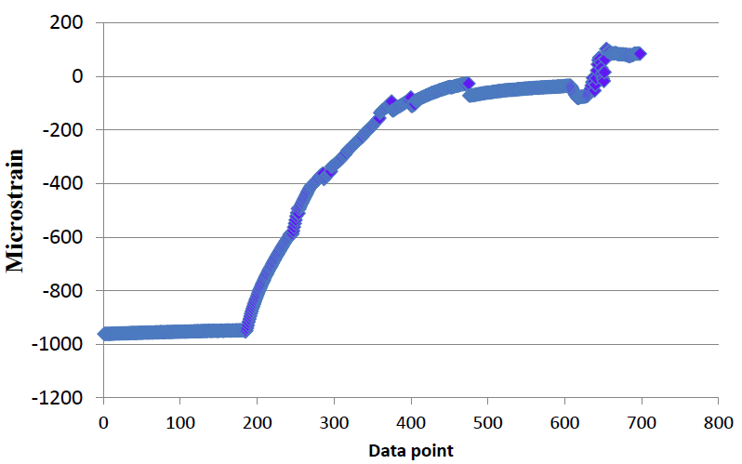
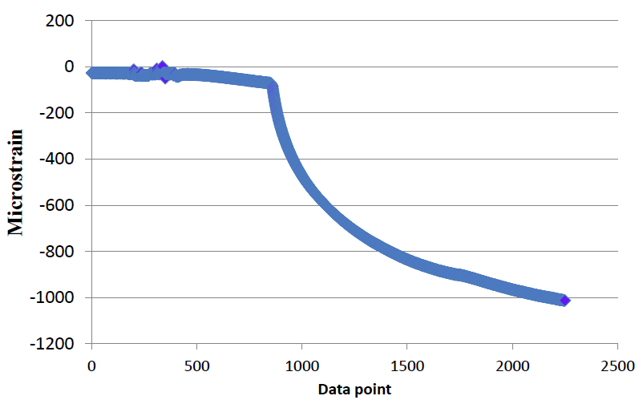
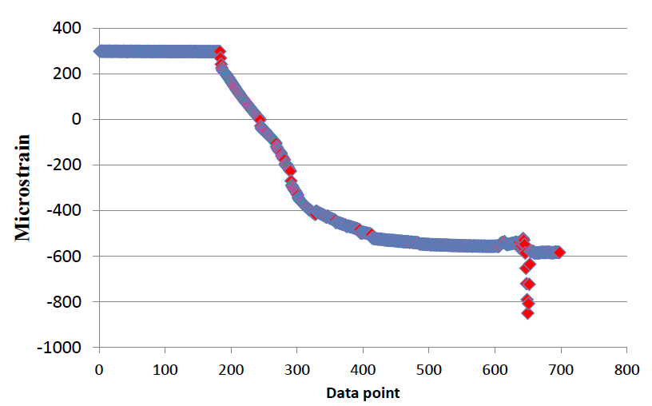
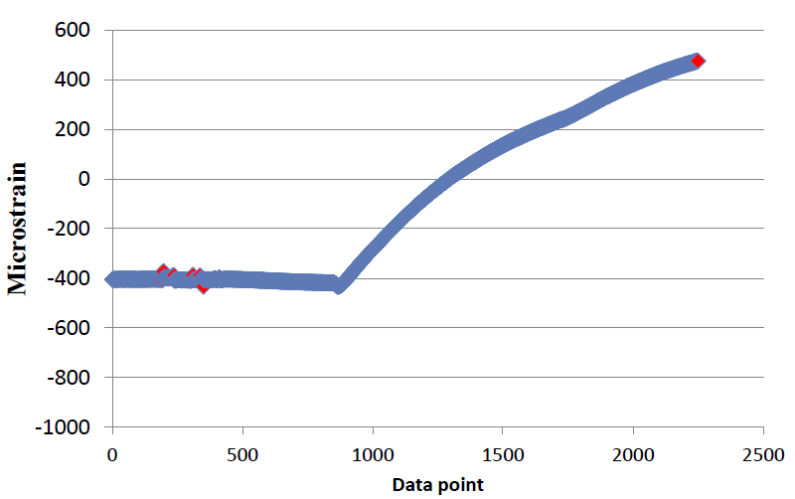
Coil SG: cool-down & warm-up
Coil Azimuthal SG
Coil Axial SG

Slide 21
Shell Azimuthal SG
90
60
Upper Shell
Lower Shell
60
90

Slide 22
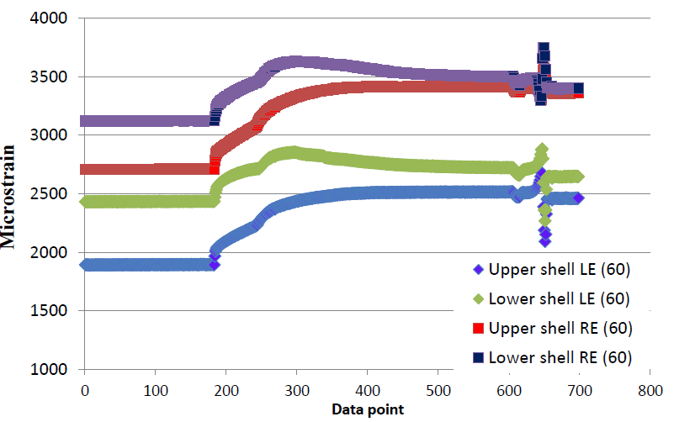
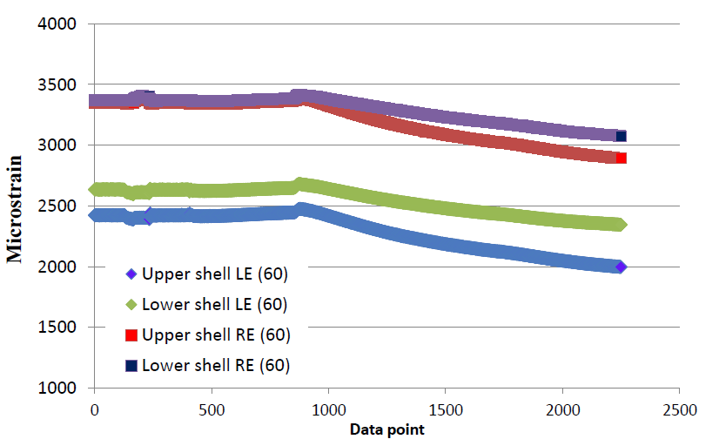
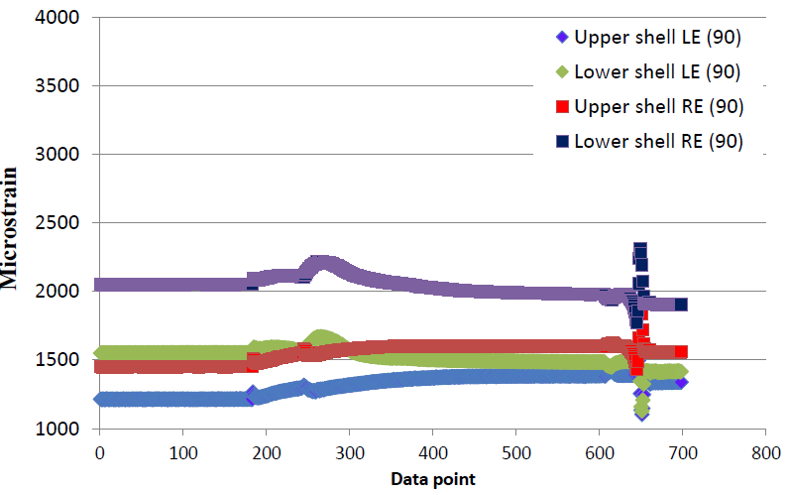
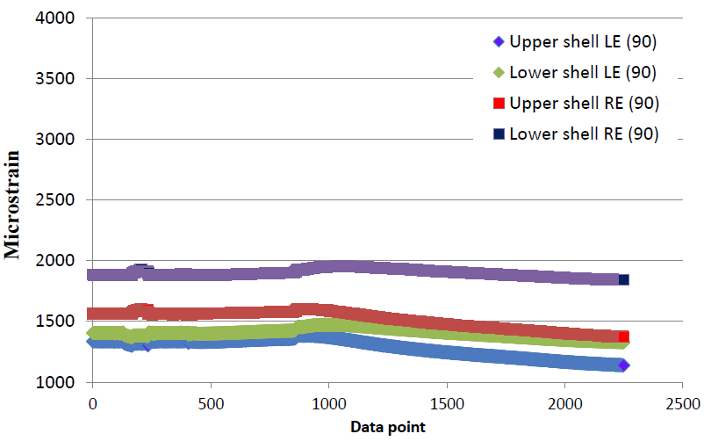
Shell Azimuthal SG: cool-down & warm-up
Shell SG at 60 Deg.
Shell SG at 90 Deg.

Slide 23
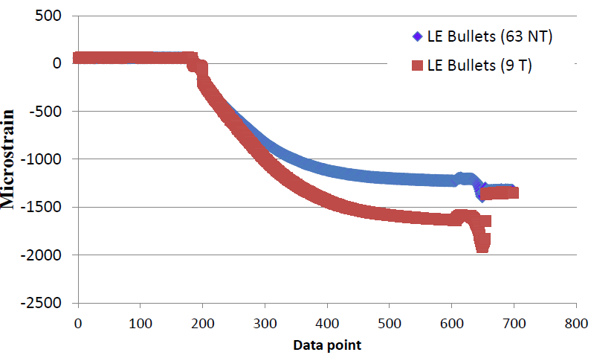
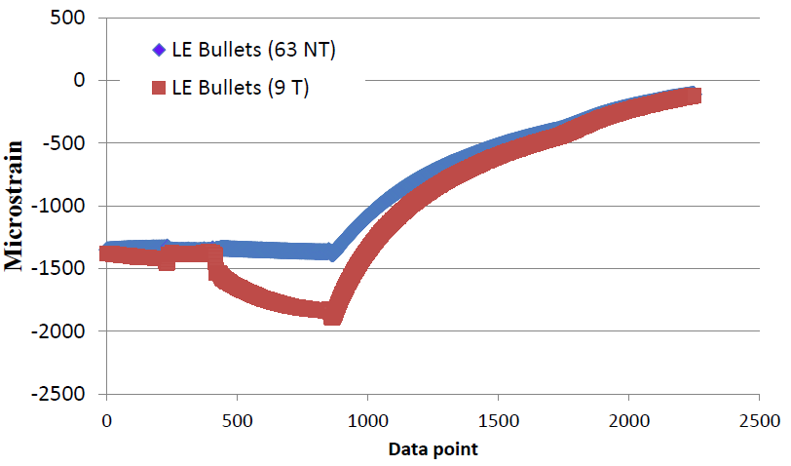
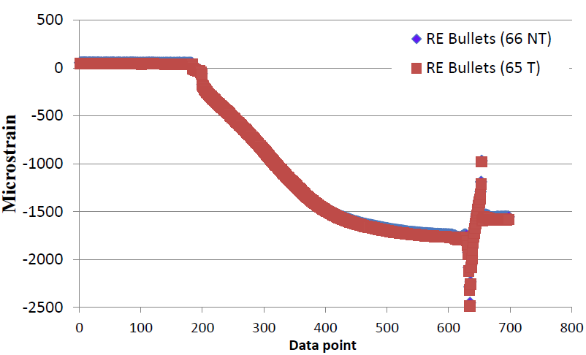
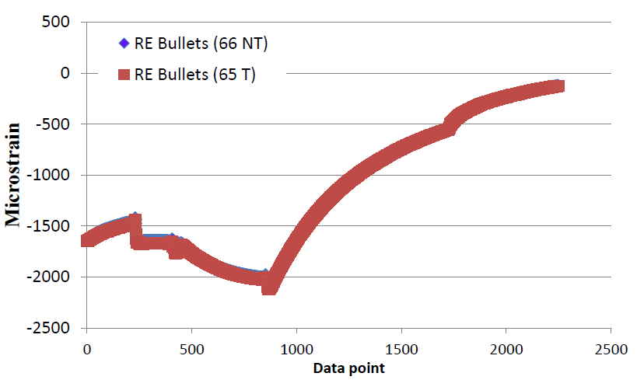
Bullet SG: cool-down & warm-up
Axial Bullet SG LE
Axial Bullet SG RE

