Slide 1
Recent results of HQ01e magnetic measurements
L. Fiscarelli, CERN team
X. Wang, LARP team

Slide 2
CERN data reduced and provided by L. Fiscarelli
Test made possible by
  CERN magnetic measurement team: G. Deferne, O. Dunkel , L. Fiscarelli, S. Russenschuck, L. Walckiers
  CERN power test team: H. Bajas, M. Bajko, M. Charrondiere, A. Chiuchiolo, J. Feuvrier, C. Giloux, E. Todesco, P. Viret
  LARP collaboration

Slide 3
HQ01e magnetic measurements
History:
  07/2011, LARP measurement at LBL. 160 T/m and 14 kA (80% SSL) reached at 4.4 K.
  03/2012, CERN measurement at SM18. 13.5 kA at 4.4 K and 14 kA at 1.9 K reached.
Here we present:
  Observations at CERN.
  Comparison with LARP data (4.4 K).
    One magnet, two independent measurements.
    Converged behavior vs. requirement.

Slide 4
Measurements performed at CERN
4.4 K
  * pre-cycle test (variable minimum current; no plt; up to 13.5 kA);
  * std-cycle (plt at 950 A; up to 13.5 kA);
  * stair-step test (1 kA step, plt 300 s, up to 13.5 kA)
1.9 K
  pre-cycle test (variable minimum current; no plt; up to 14 kA);
  variable ramp-rate test (variable ramp rate; no plt; up to 8 kA);
  std-cycle variable plt (variable plt; up to 14 kA);
  ** repeatability of std-cycle (plt at 950 A; up to 14 kA; 3 times)
* without voltage divider for improving of the compensation;
** with noise due to vibration of the shaft.

Slide 5
Magnetization study: current profile
Preceded by quench
Various minimum currents (0.1, 0.95, ), no plateau
I.max = 13.5 kA at 4.2 K (14 kA at 1.9 K)
13 A/s ramp rate.

Slide 6
Magnetization study: main field
The field spikes at 4.4 K can be correlated to the magnet flux jumps.
Pronounced spikes at 4.4 K no longer obvious at 1.9 K.

Slide 7
Magnetization study: b₆
Constant difference in % between 1.9 K and 4.4 K.
May be related to the different compensation procedures.

Slide 8
Standard cycle
13 A/s ramp rate.
Min current 100 A, injection level 950 A (1000 s)
Peak current 13.5 kA at 4.2 K (14 kA at 1.9 K)
TF ~1.6 % decay during injection
b6 ~5 units decay during injection
Injection plateau

Slide 9
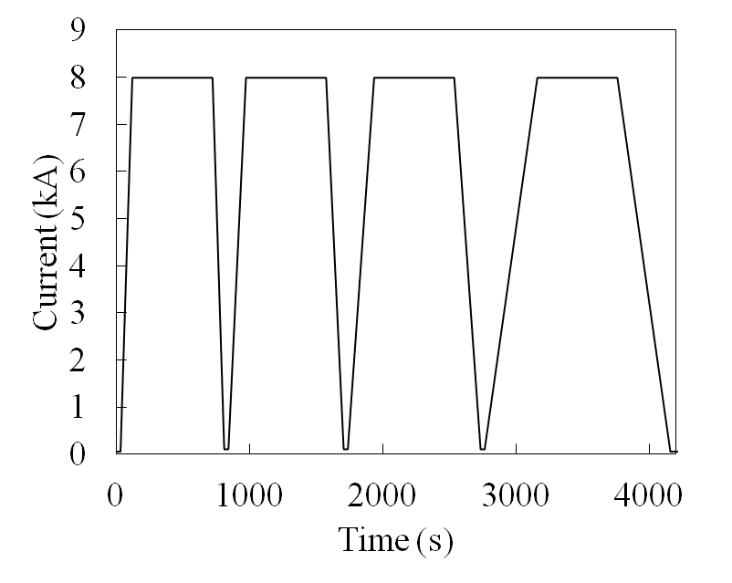
1.9 K ramp-rate study
Ramp rate: 90, 60, 40, 20 A/s
Min current 100 A
Peak current 8 kA
2 unexpected quenches before (the cycle at 90 A/s without pre-cycle)
The difference between the up- and down- ramp proportional to the ramp rate
Strong ramp-rate dependence observed

Slide 10
Repeatability (only 1.9 K)
std-cycle repeated 3 times
Main field contaminated by the mechanical issue (noise of 0.2 %).
b₆ reproduced within 0.2 units (level of noise)

Slide 11
Stair-step (only 4.4 K)
1 kA step, 300 s dwell at each step
Ramp rate 13 A/s
Exponential decay of main field and field error seen at various current levels.
Amplitude decrease with increasing current.

Slide 12
Qualitative summary of the CERN data
Extensive and successful measurements at 4.4 K and 1.9 K were performed. Large amount of valuable data obtained.
  Temperature dependence
  Static and dynamic behavior
Field spikes confirmed at 4.4 K; found to be much less pronounced at 1.9 K
Strong dynamic behavior confirmed
Good reproducibility of main field and field error observed at 1.9 K
More analysis to be completed
Repeatability and stair-step at 4.2 K not carried out because of a problem with the measuring shaft (vibrations and irregular rotation)
Under investigation the cause, inspection after warm up foreseen

Slide 13
CERN - LARP data comparison
4.4 K accelerator cycle measurement as the starting point.
Measurement condition
  Different hardwares
  Different current profiles
 | CERN | LARP
Probe diameter (mm) | 92 | 43
Probe length (mm) | 250 | 100, 250
Probe temperature (K) | 4.4 (in LHe) | 273 – 290
Rotation speed (Hz) | 1 | ≤ 0.5

Slide 14
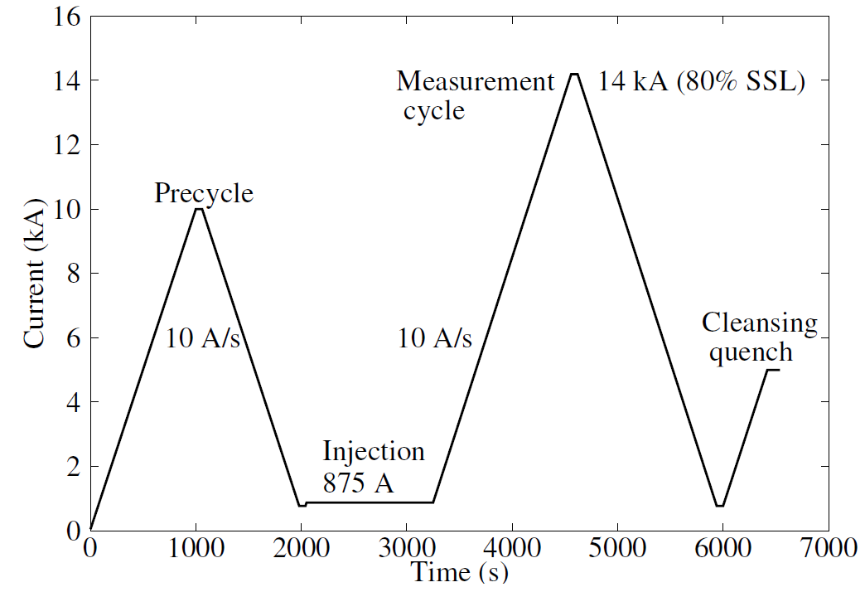
Current profiles: LARP vs. CERN
LARP
CERN
Ramp rate: 10 A/s vs. 13 A/s
Precycle peak current: 10 kA vs. 13.5 kA (14 kA at 1.9 K).
Minimum current before the injection level: 775 A vs. 100 A.
Injection current: 875 A vs. 950 A.

Slide 15
Main field
LARP
CERN

Slide 16
b₆

Slide 17
b₆ zoom in
4 – 4.5 units measured b₆ at 13.5 kA (up ramp).
~ 0.5 units difference at 13.5 kA (up ramp).

Slide 18
b₃
Different behavior between CERN and LARP data
LARP: ~ 5 units b₃ at 13.5 kA (up ramp).
CERN: ~ -7 units at 13.5 kA (up ramp).

Slide 19
a₃
Different behavior between CERN and LARP data
LARP: 5 units b₃ at 13.5 kA (up ramp).
CERN: -7 units at 13.5 kA (up ramp).

Slide 20
Requirements from the beam physics
See S. Fartoukh’s talk:
  “… IT harmonics of a few 10-5 at 7 TeV to be compatible with the b* range of HL-LHC…”
  “… demonstrate rapidly that the 0.5-1 unit FQ level (at 2/3 of the aperture) is within reach at 7 TeV, with good hope for further improvement…”
1.9 K results encouraging (E. Todesco’s talk).
What’s next?
  Working group on mag. meas. to discuss the details and plans for the field quality issues.

Slide 21
Topics for discussion
Comparison between CERN and LARP results. Confirmed results. Discrepancies to be investigated.
Field quality of HQ01e compared to the requirements from the HL-LHC.
  Transfer function.
  Field error (allowed and non-allowed, low-order multipoles)
  Issues and needs:
    Measurement uncertainty and accuracy (probe size vs. aperture, modeling)
    Coil end field quality
    Multipole control at injection
Future measurements and plans.
  What are the next magnets to be tested? LQS03, HQ02 (with cored cable), short model magnets with 140 - 150 mm aperture?
  Hardware and measurement preparation: spike characterization, probe resolution improvement, and etc. Collaboration.
  Measurement standardization (measurement sequence, precycle, peak current, ramp rate and etc.)
  Field quality database on LARP magnets for data sharing and analysis.

Slide 22
Backup slides

Slide 23
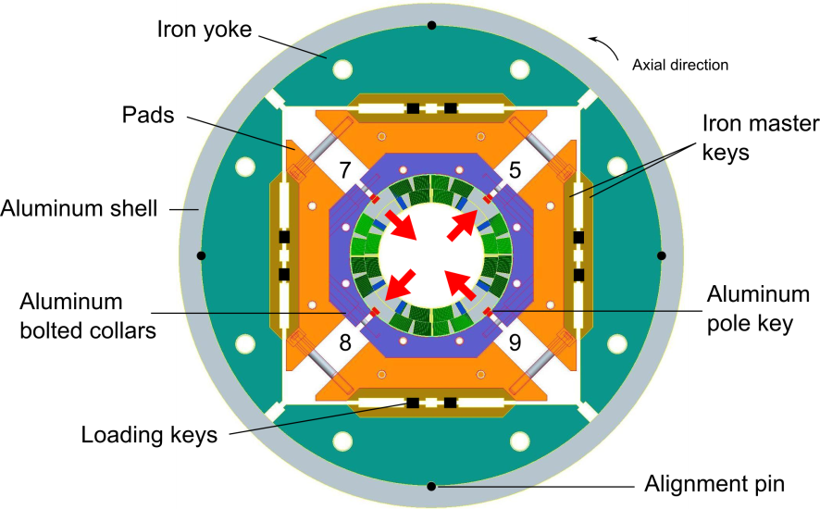
LARP HQ01e magnet
1-m long, 120-mm aperture Nb₃Sn quadrupole magnet
Non-uniform conductor
  Coil 5 and 7: 108/127; coil 8 and 9: 54/61, RRP.
SSL limit:
  4.4 K: 17.3 kA, 195 T/m

Slide 24
b₄

Slide 25
a₄

Slide 26
b₅

Slide 27
a₅

Slide 28
a₆

