Slide 1
ODU-SLAC Compact Crab Cavity RF Study
Zenghai Li, Lixin Ge (SLAC)
Jean Roger Delayen, Subashini D. Silva (ODU)
LARP CM18, Fermilab May 7-9, 2012

Slide 2
Outline
The Parallel Bar/Ridged Design
Deflecting mode RF parameters
HOM damping coupler – preliminary
Cavity MP analysis

Slide 3
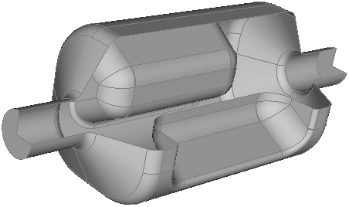
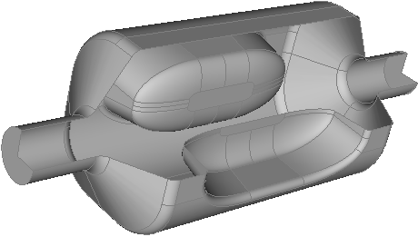
Cavity Parameters
Parameters | Model-1 | Model-2
Operating mode Frequency | 400 MHz | 400 MHz
Operating Mode | TE11 like mode | TE11 like mode
Lowest acc mode Frequency | 731 MHz | 714 MHz
Lowest vertical HOM Frequency | 784 MHz | 757 MHz
Lowest horizontal HOM Frequency | 594 MHz | 612 MHz
Iris aperture (diameter) | 84 mm | 84 mm
Transverse dimension | 295 mm | 281 mm
Vertical dimension | 295 mm | 288 mm
Longitudinal dimension | 620 mm | 638
Transverse Shunt Impedance | 323 ohm/cavity | 339 ohm/cavity
Required deflecting voltage per cavity | 5 MV | 5 MV
Peak surface magnetic field | 84 mT | 89 mT
Peak surface electric field | 54 MV/m | 46 MV/m
Geometry fits both H and V crabbing schemes

Slide 4
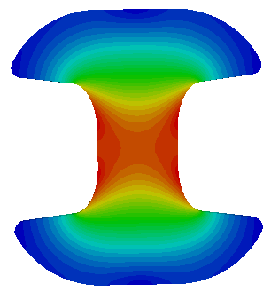
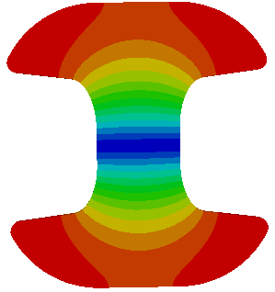
Deflecting Voltage Uniformity
E and B
at center cross section
Perform multipole analysis of the deflecting Voltage

Slide 5
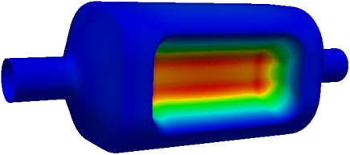
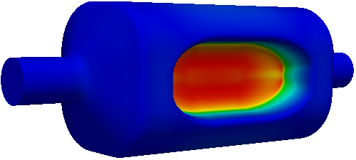
Deflecting Voltage Uniformity
Model 1
Model 2
Pole profile can be shaped to improve
Need specification of requirements

Slide 6
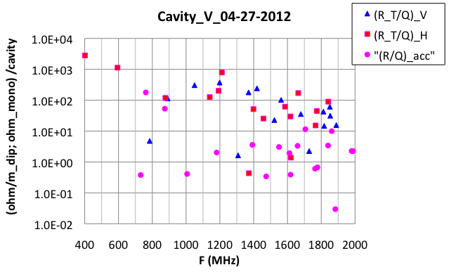
Impedance (R/Q)

Slide 7
Impedance
Transverse impedance referred in this file is R_{T}

Slide 8
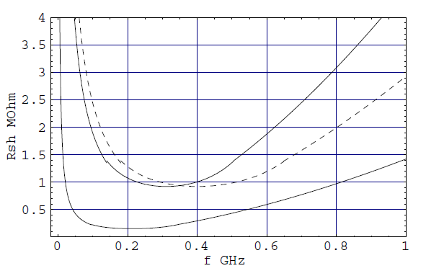
Impedance budget: frequency dependence
E. Shaposhnikova
2.5 eVs in 400 MHz @ 7 TeV, Nnom,
16MV and 8 MV
0.7 eVs in 200 MHz @ 450 GeV, Nnom
200kohm

Slide 9
Transverse impedance budget
E. Shaposhnikova
For nominal intensity at 450 GeV threshold determined by the damping time of 60 ms is 2.5 MOhm/m. With margin for particle distribution - 0.6 MOhm/m
Approximate frequency dependence
0.6 /(1-f_{r}/1.6) MOhm/m for f_{r} [GHz] < 0.8
1.2 (0.5+f_{r}) MOhm/m for f_{r} [GHz] > 0.8
→ 0.8 MOhm/m at 0.8 GHz for ultimate intensity and
0.4 MOhm/m for 2 identical cavities
Additional factor proportional to local beta-function β/‹ β ›

Slide 10
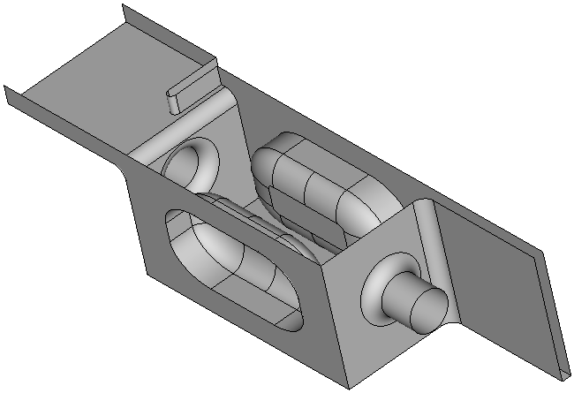
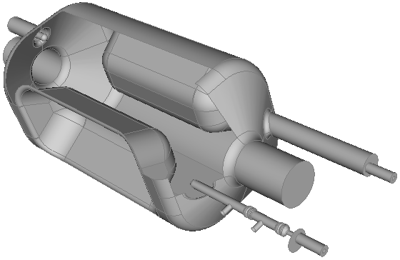
HOM Damping
OR
Waveguide to damp H/V dipole and accelerating HOMs
No filter needed
One WG in each plane is enough for damping. WG stub maybe needed to symmetrize field
Coaxial high-pass filter coupler
Next HOM ~200MHz higher than operating mode. A two-stage high-pass filter maybe adequate
Compact

Slide 11
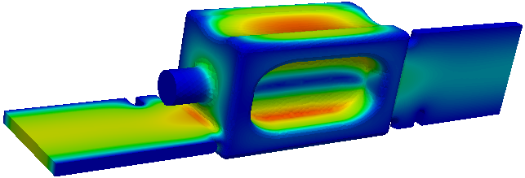
HOM Damping
Waveguide to damping
Coaxial high-pass filter coupler

Slide 12
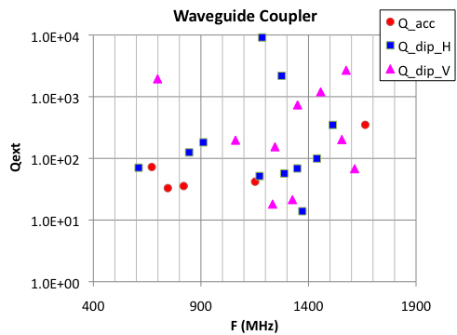
Qext with Waveguide Coupler
Strong damping achieved with waveguide couplers

Slide 13
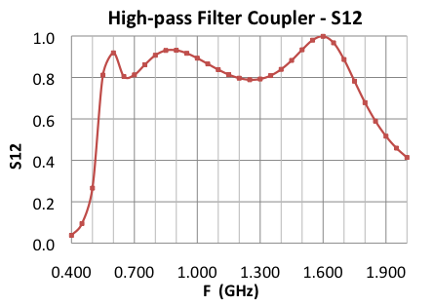
High-Pass HOM Damper
Two-stage high-pass coupler

Slide 14
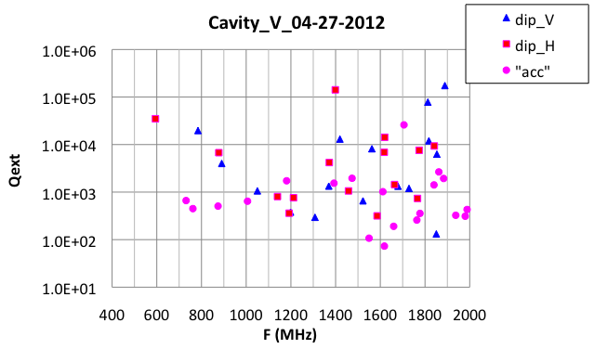
HOM Damping With High-pass Filter

Slide 15
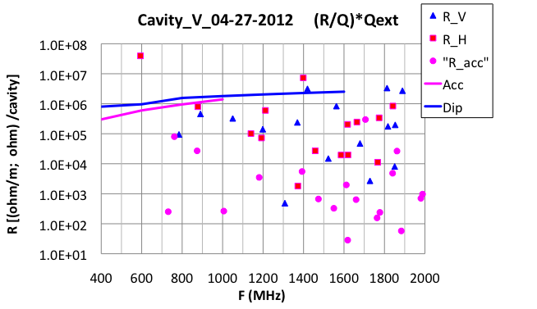
Impedance - (R/Q)*Q_{ext}
Solid lines: LHC-CC10 requirement

Slide 16
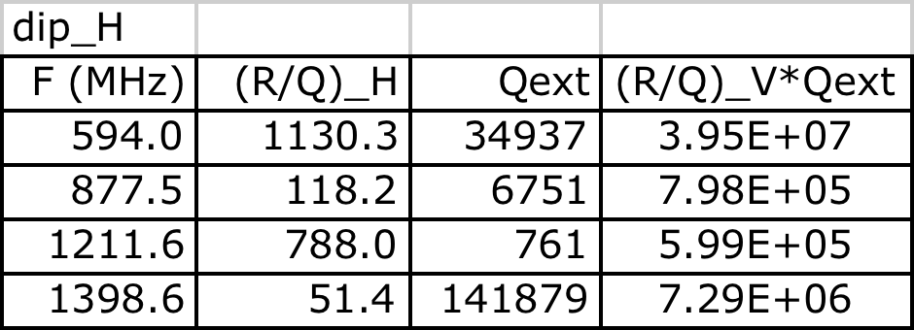
Dip_H Impedance - (R/Q)*Q_{ext}
0.594
0.877
1.211
1.398
Solid lines: LHC-CC10 requirement

Slide 17
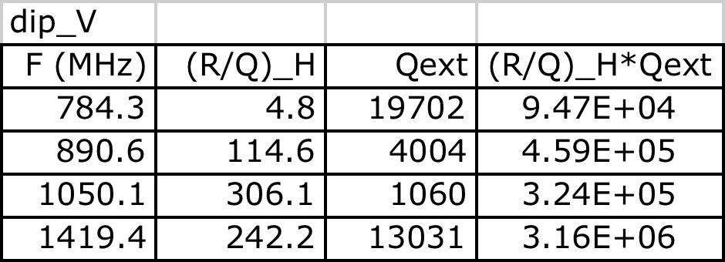
dip_V Impedance - (R/Q)*Q_{ext}
0.784
0.890
1.050
1.419
Solid lines: LHC-CC10 requirement

Slide 18
acc Impedance - (R/Q)*Q_{ext}
0.761
0.872
1.705
Solid lines: LHC-CC10 requirement

Slide 19
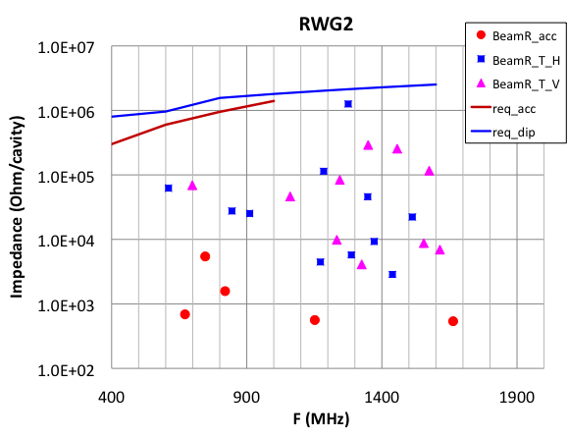
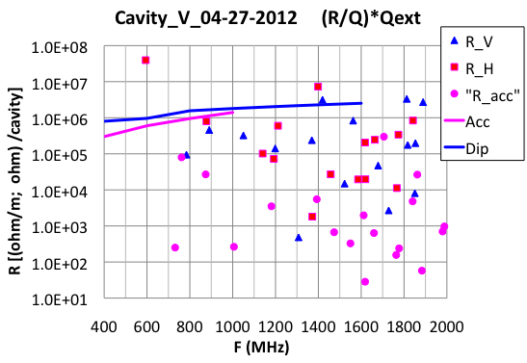
Waveguide vs Coaxial Coupler
Preliminary designs
A few modes in the coaxial coupler design above the LHC-CC2010 requirement
Optimization in progress

Slide 20
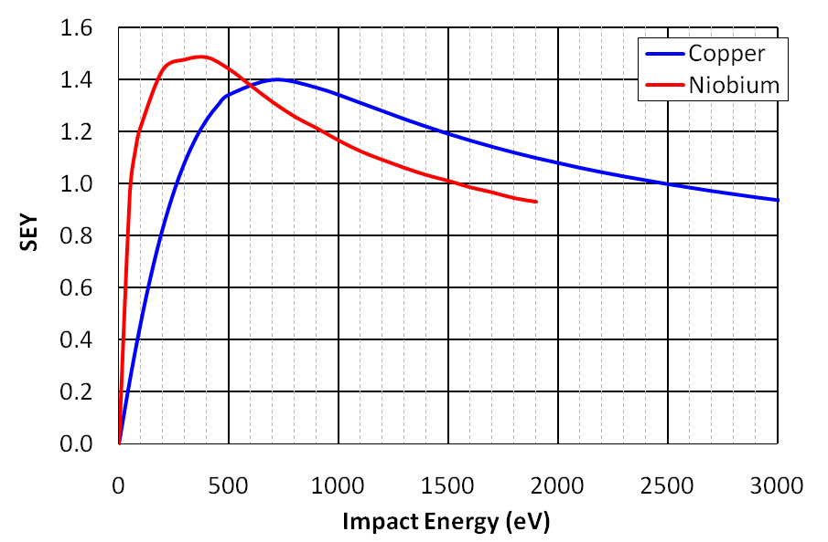
MP Simulation Using Track3P
Launch electrons on exterior surfaces with different RF phase and initial energy
Determine “resonant” trajectories by consecutive impact phase and position
Stable resonant MP: trajectories impact at same locations with same energies - Calculate MP order (#RF cycles/impact) and MP type (#impacts /MP cycle)
Run-away resonant MP: trajectories started resonant with RF and slowly slip away from resonance location and RF phase. Maximum enhancement counter calculated based on given SEY curve

Slide 21
Multipacting Simulation Using Track3P
Field level scan:
0.050 MV – 6.0MV, interval 0.025 MV
Initial Particles distributed on all exterior surface (using quarter symmetry)
Each field level ran 50 RF cycles.
Determine resonant trajectories – impact energy and type

Slide 22
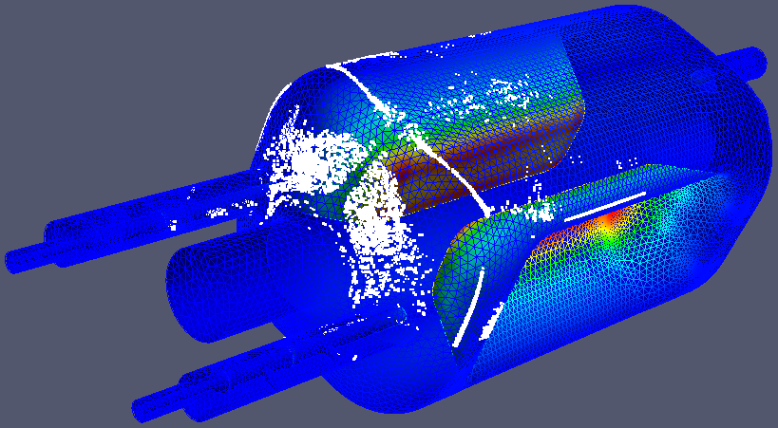
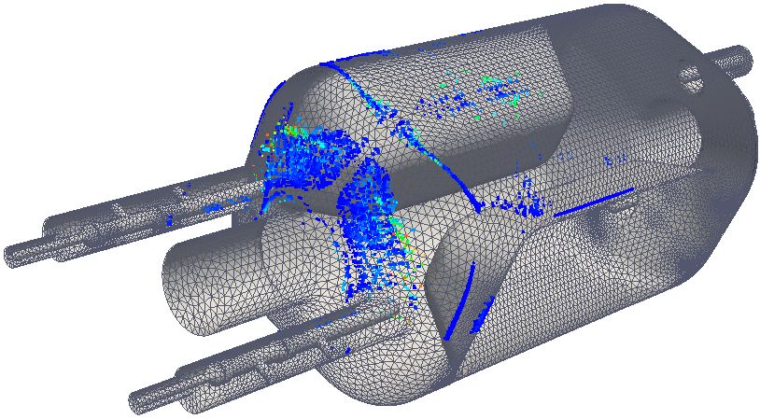
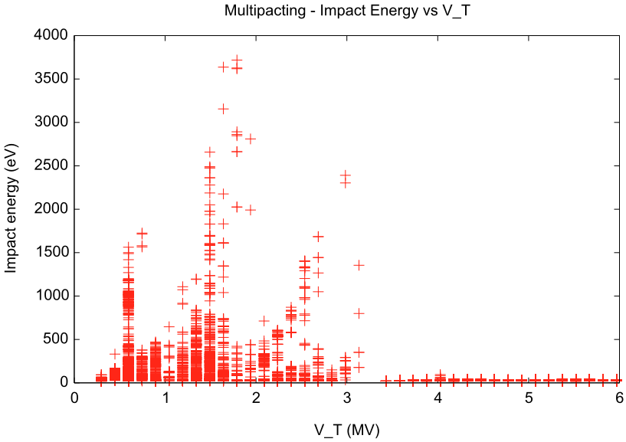
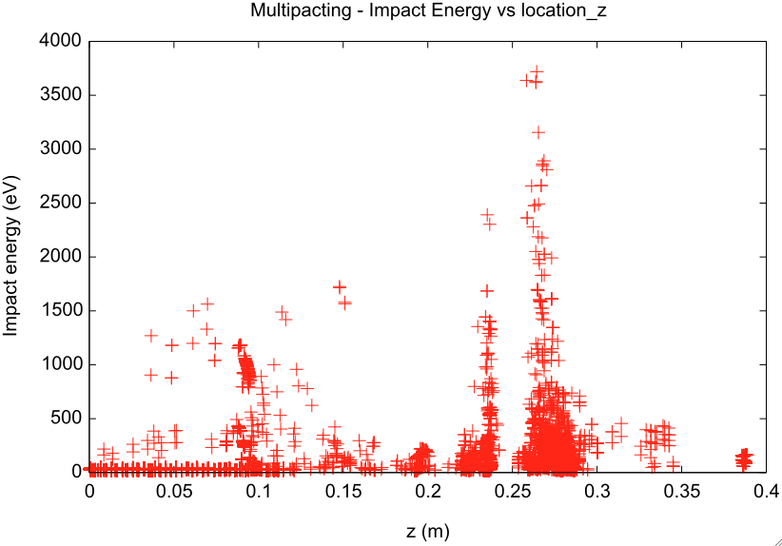
MP Resonant Particles

Slide 23
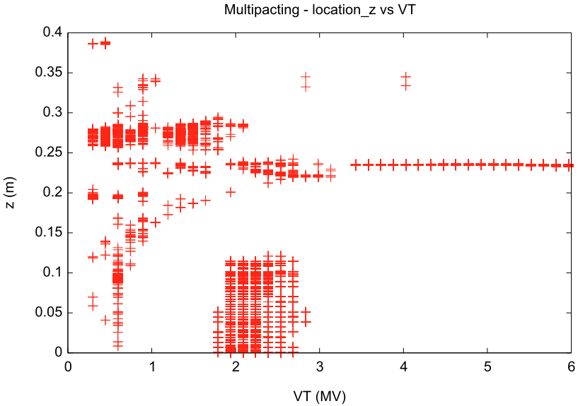
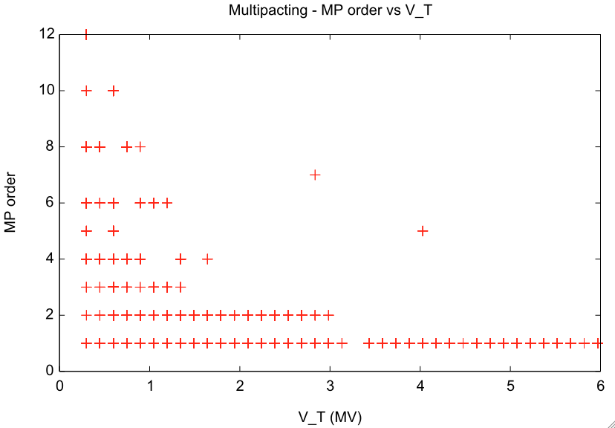
MP Resonant Particles
MP band at deflecting voltage 0.5-2.6MV
in cavity rounding corners & on end-plate
with various MP orders
MP at 3-6MV deflecting voltage
in end-plate rounding corner
first order with low impact energies
No significant MP found in coupler

Slide 24
Summary
ODU/SLAC compact cavity design is being optimized
Preliminary coaxial high-pass filter coupler and waveguide coupler being developed. Effective damping achievable with both schemes
Further coupler improvements
Coupler geometry
Pass-band RF parameters
Analyze multipacting due to beam excited modes (e.g. acc mode)
Multipacting being analyzed for the deflecting mode
MP band from 0.5-2.6MV – impact energy in range of high SEY
Resonant trajectories from 3-6MV - low impact energy (low SEY)
No significant MP found in coupler
Cavity shape around the MP region could be improved to minimize MP resonances

