Slide 1
Field Quality Specifications for Triplet Quadrupoles of the LHC Lattice v.3.01
Option 4444 and Collimation Study
Yunhai Cai
Y. Jiao, Y. Nosochkov, M-H. Wang (SLAC)
R. Assmann, R. Bruce, S. Fartoukh, M. Giovannozzi, R. De Maria, E. McIntosh, F. Schmidt (CERN)
LARP CM18/HiLumi LHC Collaboration Meeting
Fermilab, 7 – 9 May 2012

Slide 2
Outline
Dynamic aperture study for the proposed LHC high luminosity lattice as a function of the IP triplet multipole field errors.
Specification of the field quality for the proposed large aperture triplet quadrupoles.
Collimation study and benchmarking of beam loss map calculation.
Lattice: LHC v.3.01, collision option “4444” with β*=15/15 cm at IP1 and IP5, Nb-Ti superconducting triplet quadrupoles with 120 mm coil diameter, beam energy of 7 TeV.
Code: SixTrack.

Slide 3
Features of the High Luminosity Lattice
The LHC v.3.01 collision lattice has lower than nominal β* at IP1 (ATLAS) and IP5 (CMS) crossing points resulting in higher β-functions in the IP triplet quads. A dedicated large β-modulation in the adjacent arcs is used for local cancelation of the triplet chromaticity. Large aperture triplet quads (d_{c}=120 mm) are proposed to accommodate larger beam size.
Impact: Higher β-functions in the triplet and adjacent arcs amplify the effects of triplet errors and sextupole aberrations causing reduction of dynamic aperture. New tolerances on triplet field quality need to be specified for an acceptable dynamic aperture in collision.

Slide 4
Beta Functions: Nominal LHC versus v.3.01 “4444”
Nominal LHC
β* = 55/55 cm
β_{max}~ 4.5km
Dedicated β modulation in arcs 81,12,45,56 for IR chromaticity correction
v.3.01 “4444”
β* = 15/15 cm
β_{max}~ 21.5km
IP5
IP1

Slide 5
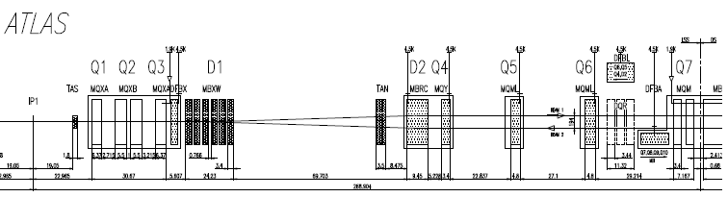
Interaction Region: Nominal LHC versus v.3.01 “4444”
Nominal LHC
β* = 55/55 cm
v.3.01 “4444”
β* = 15/15 cm
β_{max}~ 21.5km
β_{max}~ 4.5km
Triplet
Separation dipoles D1/2
Matching section Q4/5/6
Proposed large aperture Nb-Ti superconducting triplet quadrupoles Q1,Q2,Q3 with coil diameter of d_{c} = 120 mm.
L*=23 m
L_{FFS}=268m

Slide 6
Achromatic Telescopic System (ATS) for Correction of IP Triplet Non-linear Chromaticity at Low β*
Peak beta functions in the IP triplets increase as β_{max} ~ 1/β* and yield higher triplet chromaticity at low β* which requires stronger correcting sextupoles. A dedicated beta modulation is created in the arcs adjacent to IP1 and IP5 in order to raise beta functions at the sextupoles (β_{sext} ~ 1/β*) and increase their effect thus avoiding exceeding their field limit. In addition, these sextupoles are arranged in -I pairs to minimize their geometric aberrations and have a proper phase advance relative to the triplets for a local correction of non-linear triplet chromaticity.
β*=15/15cm
v.3.01 “4444”
β_{arc} ~ 700 m
Arc 81
IP1
Arc 12
Arc 81
IP1
Arc 12

Slide 7
Multipole Field Scaling in a SC Quadrupole
where n=1 is for a dipole, etc. B_{ref} is main quad field at r₀
Note: the a_{n},b_{n} coefficients are defined in 10⁻⁴ units.
The a_{n} and b_{n} values in the multipole field tables represent Gaussian sigmas used to generate random errors. Furthermore, they are split in two components: the“uncertainty” term (deviation from systematic) and the “random” term.
Scaling with reference radius r₀ does not change the multipole field B_{x,y} and does not affect dynamic aperture. Nominal r₀ = 17 mm → new triplet quad r₀ = 50 mm.
Scaling with coil diameter d_{c} in a SC quad (P. Ferracin, et al, Phys. Rev. ST Accel. Beams 3, 122403 (2000)). Nominal d_{c} = 70 mm → new triplet quad d_{c} = 120 mm.
Scaling with peak beta function in triplet β_{max} to keep the triplet resonance driving terms constant (SLHC Project Report 0038 by S. Fartoukh). Nominal β_{max} = 4.5 km → new β_{max} = 21.5 km in lattice v.3.01 “4444”.

Slide 8
Multipole Field Correctors in the Triplet
The correctors compensate the resonance driving terms. Due to correction, the a3, b3, a4, b4, b6 coefficients are expected to be more relaxed.
IP
a3, b3, a4, b4, b6 correctors
On the other side of IP the x-y beta functions are exchanged due to anti-symmetry, hence the correctors sample both x and y large betas

Slide 9
Measured Multipoles for the Nominal Triplet Quadrupoles with d_{c}=70 mm at r₀=17 mm
skew | uncertainty | rms |  | normal | uncertainty | rms
a1 | 0.0000 | 0.0000 |  | b1 | 0.0000 | 0.0000
a2 | 0.0000 | 0.0000 |  | b2 | 0.0000 | 0.0000
a3 | 0.5235 | 0.6354 |  | b3 | 0.4135 | 0.7873
a4 | 0.4432 | 0.3883 |  | b4 | 0.1552 | 0.1563
a5 | 0.0874 | 0.1423 |  | b5 | 0.1142 | 0.2171
a6 | 0.2306 | 0.2637 |  | b6 | 0.2098 | 0.3088
a7 | 0.0254 | 0.0411 |  | b7 | 0.0311 | 0.0374
a8 | 0.0140 | 0.0280 |  | b8 | 0.0060 | 0.0096
a9 | 0.0127 | 0.0078 |  | b9 | 0.0085 | 0.0116
a10 | 0.0094 | 0.0179 |  | b10 | 0.0303 | 0.0086
a11 | 0.0046 | 0.0028 |  | b11 | 0.0084 | 0.0106

Slide 10
Multipole Table “Target3” Scaled from the Measured Table to r₀=50 mm and d_{c}=120 mm
skew | uncertainty | rms |  | normal | uncertainty | rms
a1 | 0.0000 | 0.0000 |  | b1 | 0.0000 | 0.0000
a2 | 0.0000 | 0.0000 |  | b2 | 0.0000 | 0.0000
a3 | 0.5239 | 0.6359 |  | b3 | 0.4139 | 0.7879
a4 | 0.7611 | 0.6667 |  | b4 | 0.2664 | 0.2683
a5 | 0.2574 | 0.4191 |  | b5 | 0.3365 | 0.6396
a6 | 1.1655 | 1.3328 |  | b6 | 1.0603 | 1.5608
a7 | 0.2203 | 0.3564 |  | b7 | 0.2701 | 0.3244
a8 | 0.2087 | 0.4162 |  | b8 | 0.0889 | 0.1423
a9 | 0.3238 | 0.2003 |  | b9 | 0.2165 | 0.2971
a10 | 0.4137 | 0.7838 |  | b10 | 1.3256 | 0.3755
a11 | 0.3457 | 0.2116 |  | b11 | 0.6340 | 0.7965
a12 | 0.1863 | 0.1863 |  | b12 | 0.1863 | 0.1863
a13 | 0.1164 | 0.1164 |  | b13 | 0.2328 | 0.1164
a14 | 0.4366 | 0.1455 |  | b14 | 0.5821 | 0.1455
Expected values for multipoles n = 12,13,14 are added from table “ITD1_errortable_v2” (SLHC Project Report 0040)

Slide 11
SixTrack Tracking Set-Up
60 random seeds for final tracking, 20 seeds for intermediate multipole scan
30 particle pairs per aperture step (2σ)
11 angles
100,000 turns
7 TeV beam energy
assumed beam emittance (normalized) 3.75 um
initial Δp/p = 2.7e-4
tune = 62.31, 60.32
triplet multipole correction, arc errors and corrections are included
arc errors are always included
arc errors only is benchmarked against our CERN colleague’s simulation

Slide 12
Dynamic Aperture for Multipole Table “Target3”
The line shows average aperture for 60 seeds and the error bars show the spread between the minimum and maximum aperture for 11 angles
DA_{min} = 5.07σ
Aperture is too small

Slide 13
Multipole Table “Target31” Scaled from Table “Target3” to β_{max} = 21.5 km
skew | uncertainty | rms |  | normal | uncertainty | rms
a1 | 0.00000 | 0.00000 |  | b1 | 0.00000 | 0.00000
a2 | 0.00000 | 0.00000 |  | b2 | 0.00000 | 0.00000
a3 | 0.05016 | 0.06089 |  | b3 | 0.03963 | 0.07545
a4 | 0.03334 | 0.02920 |  | b4 | 0.01167 | 0.01175
a5 | 0.00516 | 0.00840 |  | b5 | 0.00674 | 0.01281
a6 | 0.01069 | 0.01223 |  | b6 | 0.00972 | 0.01431
a7 | 0.00092 | 0.00150 |  | b7 | 0.00113 | 0.00137
a8 | 0.00042 | 0.00080 |  | b8 | 0.00015 | 0.00027
a9 | 0.00029 | 0.00019 |  | b9 | 0.00019 | 0.00024
a10 | 0.00018 | 0.00030 |  | b10 | 0.00054 | 0.00018
a11 | 0.00007 | 0.00007 |  | b11 | 0.00015 | 0.00015
a12 | 0.000016 | 0.000016 |  | b12 | 0.000016 | 0.000016
a13 | 0.000004 | 0.000004 |  | b13 | 0.000009 | 0.000004
a14 | 0.000008 | 0.000003 |  | b14 | 0.000010 | 0.000003

Slide 14
Dynamic Aperture for Multipole Table “Target31”
DA_{min} = 14.94σ
The aperture exceeds the target.
The multipole coefficients can be relaxed somewhat.

Slide 15
Option-1: Individual Scan of a_{n} Random Values
Each multipole coefficient is scanned individually between “target3” and “target31” values while other multipoles are at “target31” values.
Note the a3, a4 do not affect aperture due to the triplet multipole correctors

Slide 16
Option-1: Individual Scan of a_{n} Uncertainty Values

Slide 17
Option-1: Individual Scan of b_{n} Random Values
The aperture is not sensitive to b3, b4 due to the triplet multipole correctors, but the b6 still has impact on the aperture.

Slide 18
Option-1: Individual Scan of b_{n} Uncertainty Values

Slide 19
Option-1: Final Multipole Scaling for Target Aperture
All coefficients are set to correspond to the same value of dynamic aperture in the individual scans (aperture cut). After a few iterations of the aperture cut, the target aperture can be reached. In this case, it corresponds to the aperture cut of 14.8σ, i.e. quite close to the “target31” table.
“target31”
target
aperture

Slide 20
Final Multipole Table “Target39” in Option-1 at r₀=50 mm
skew | uncertainty | rms |  | normal | uncertainty | rms
a1 | 0.00000 | 0.00000 |  | b1 | 0.00000 | 0.00000
a2 | 0.00000 | 0.00000 |  | b2 | 0.00000 | 0.00000
a3 | 0.28701 | 0.34839 |  | b3 | 0.22675 | 0.43166
a4 | 0.39722 | 0.34797 |  | b4 | 0.13905 | 0.14002
a5 | 0.13129 | 0.02945 |  | b5 | 0.09018 | 0.07111
a6 | 0.41458 | 0.02698 |  | b6 | 0.53501 | 0.38921
a7 | 0.11063 | 0.02557 |  | b7 | 0.01031 | 0.01215
a8 | 0.10452 | 0.00820 |  | b8 | 0.02766 | 0.00557
a9 | 0.15817 | 0.01044 |  | b9 | 0.00911 | 0.00844
a10 | 0.09435 | 0.00924 |  | b10 | 0.01872 | 0.00674
a11 | 0.07756 | 0.00700 |  | b11 | 0.00820 | 0.00998
a12 | 0.05541 | 0.00354 |  | b12 | 0.00456 | 0.00363
a13 | 0.03679 | 0.00442 |  | b13 | 0.00396 | 0.00268
a14 | 0.01892 | 0.00364 |  | b14 | 0.00611 | 0.00364
In addition to the described option-1 procedure, in this table we limited the least sensitive coefficients to be not larger than the mid-value between “target3” and “target31” tables in order to help relaxing the other more sensitive coefficients. In this case, the aperture cut is 14.7σ.

Slide 21
Comparison of “Target3”, “Target31” and “Target39” Tables
(Normalized to “Target3” Values)
21

Slide 22
Dynamic Aperture for Multipole Table “Target39”
DA_{min} = 12.35σ

Slide 23
Option-2: The Coefficients Are Scaled with the Same Factor
As a starting point (named “target31_p3” table), all coefficients are set to a mid-value between “target3” and “target31” tables. Then the coefficients are scaled together in 10 steps from “target31” to “target31_p3” table. The target aperture was obtained when the setting is about 1 step from “target31” table.
“target31”
target
aperture
The last digit in the legend shows the step number from “target31” table

Slide 24
Final Multipole Table “Target31_p3_1” in Option-2 at r₀=50 mm
skew | uncertainty | rms |  | normal | uncertainty | rms
a1 | 0.00000 | 0.00000 |  | b1 | 0.00000 | 0.00000
a2 | 0.00000 | 0.00000 |  | b2 | 0.00000 | 0.00000
a3 | 0.07387 | 0.08962 |  | b3 | 0.05837 | 0.11113
a4 | 0.06969 | 0.06109 |  | b4 | 0.02437 | 0.02453
a5 | 0.00879 | 0.02891 |  | b5 | 0.02324 | 0.04414
a6 | 0.06836 | 0.07837 |  | b6 | 0.06226 | 0.09155
a7 | 0.01190 | 0.01923 |  | b7 | 0.01465 | 0.01740
a8 | 0.01068 | 0.02174 |  | b8 | 0.00458 | 0.00725
a9 | 0.01669 | 0.01001 |  | b9 | 0.01097 | 0.01526
a10 | 0.02086 | 0.03934 |  | b10 | 0.06676 | 0.01907
a11 | 0.01714 | 0.01043 |  | b11 | 0.03204 | 0.04023
a12 | 0.00931 | 0.00931 |  | b12 | 0.00931 | 0.00931
a13 | 0.00582 | 0.00582 |  | b13 | 0.01164 | 0.00582
a14 | 0.02183 | 0.00728 |  | b14 | 0.02910 | 0.00728
Compared to option-1, the option-2 results in more relaxed high order multipoles, but tighter low order multipoles.

Slide 25
Comparison of “Target3”, “Target31” and “Target31_p3_1” Tables
(Normalized to “Target3” Values)

Slide 26
Dynamic Aperture for Multipole Table “Target31_p3_1”
DA_{min} = 11.75σ

Slide 27
Comparison of Dynamic Aperture
option-1
option-2

Slide 28
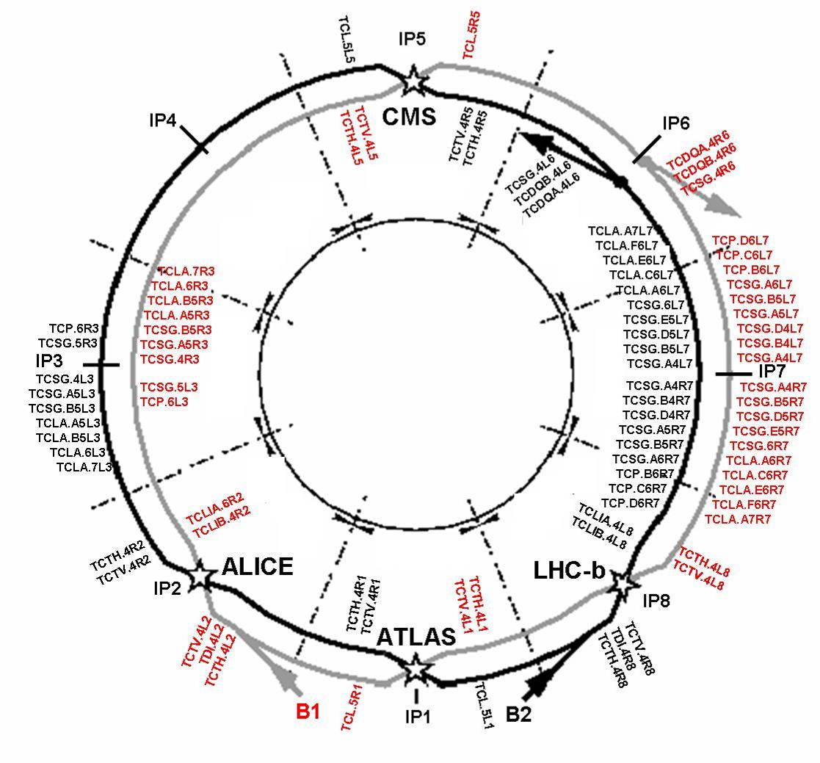
LHC Collimation System
Momentum
Collimation
Betatron
Collimation
“Phase 1”
“Final” system: Layout is 100% frozen!
C. Bracco

Slide 29
Beam Loss Map for LHC Collimation System
Loss map of beam-1 at β*=1.5 m with horizontal halo, sheet beam. This is a statistical result of 1000 random seeds with 64*100 particles per seed. This calculation is to benchmark against similar calculation by R. Bruce at CERN (see next page).

Slide 30
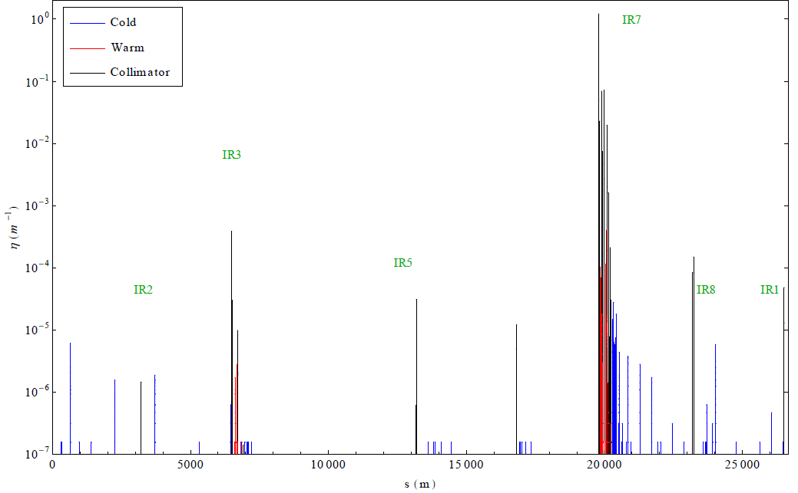
Original Loss Map Calculation by Roderik Bruce at CERN

Slide 31
Summary
Dynamic aperture has been studied as a function of multipole field errors in the proposed 120 mm aperture triplet quadrupoles for the LHC lattice v.3.01, collision option “4444”.
As a starting point, the study used the measured field for the nominal triplet quads which was then re-scaled for the new reference radius, larger quad coil diameter and higher triplet peak beta function.
The target minimum dynamic aperture of 12-13σ has been reached by scanning the triplet multipole field coefficients.
Two versions of the triplet field specification table have been obtained using two methods for the multipole field scan. These tables are fairly close to the prediction based on the analytical scaling of the nominal triplet table.
Calculation of beam loss maps has been successfully benchmarked against a similar calculation at CERN for the nominal lattice.

