Slide 1
LHC-4R crab cavity status update
Graeme Burt, Lancaster University
May 9, 2012

Slide 2



Acknowledgements
Cockcroft
Ben Hall
Chris Lingwood
Daniel Doherty
Philippe Goudket
Clive Hill
Peter McIntosh
CERN
Rama Calaga
Erk Jensen
Ed Ciapala
JLAB
Hiapeng Wang
Bob Rimmer

Slide 3
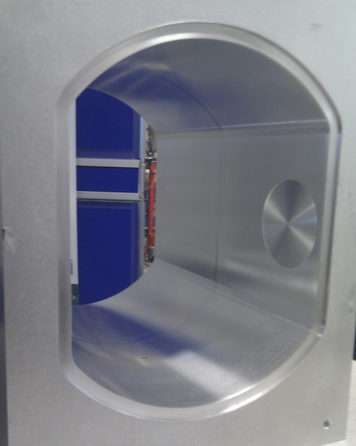
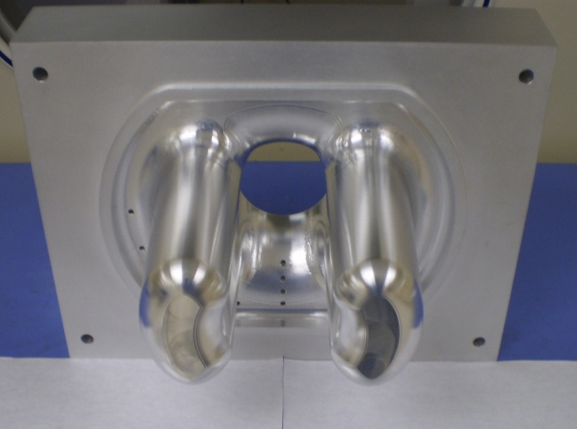
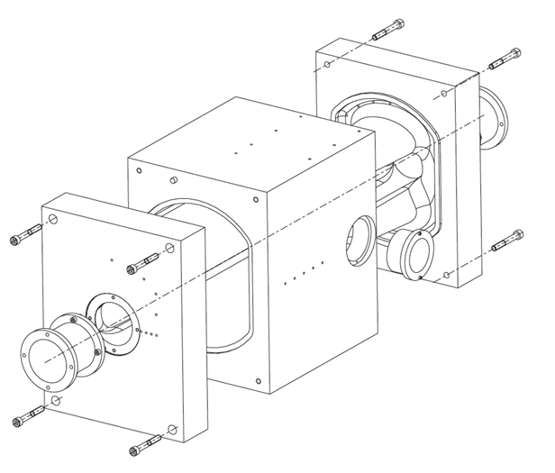
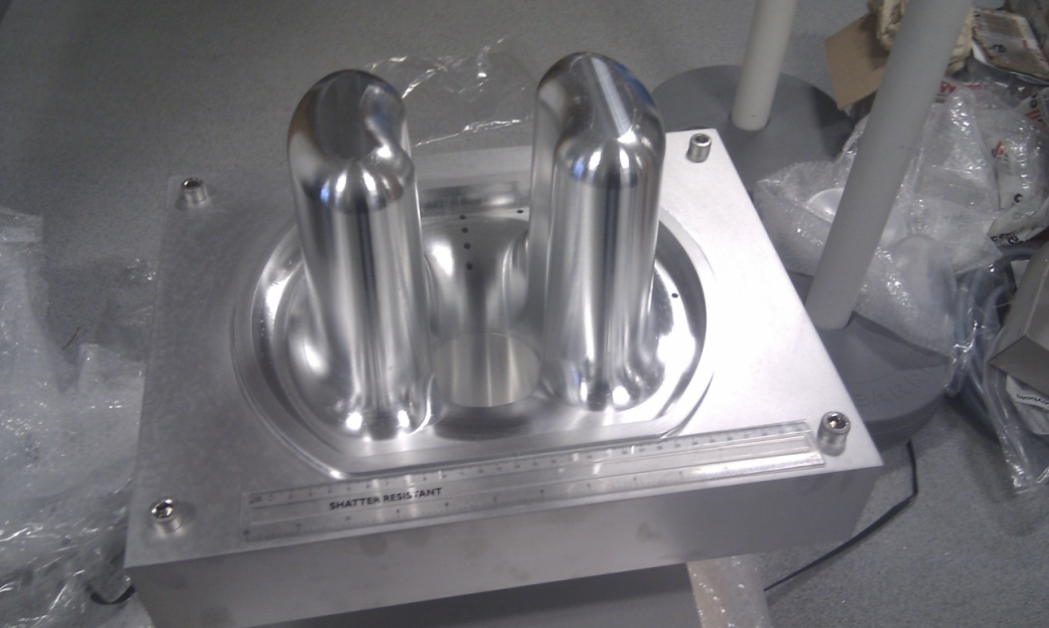
Aluminium cavity

Slide 4
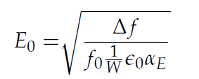
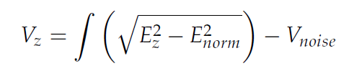
Bead Pull
Bead pull of aluminium cavity carried out at Daresbury labs.
Transverse E and B fields also perturb the frequency hence this is removed by doing an on axis measurement
Squaring signal means the noise doesn’t average out and hence we use two on axis measurements to get a dc noise voltage which we can subtract.
On axis measurement
B field shift
Transverse component
Noise component
E field shift

Slide 5
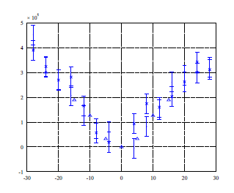
Bead pull results
Vz from bead pulls compared to simulation from CST.
Good agreement with simulation.
Linear voltage variation due to new rod shape is verified experimentally.
V_{z}-V/m at U =1J
Offset / mm

Slide 6
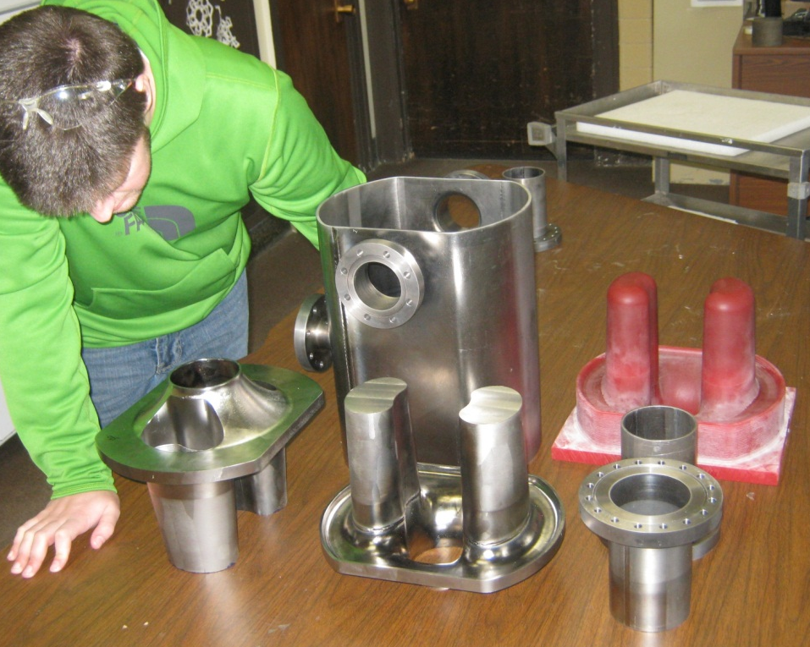
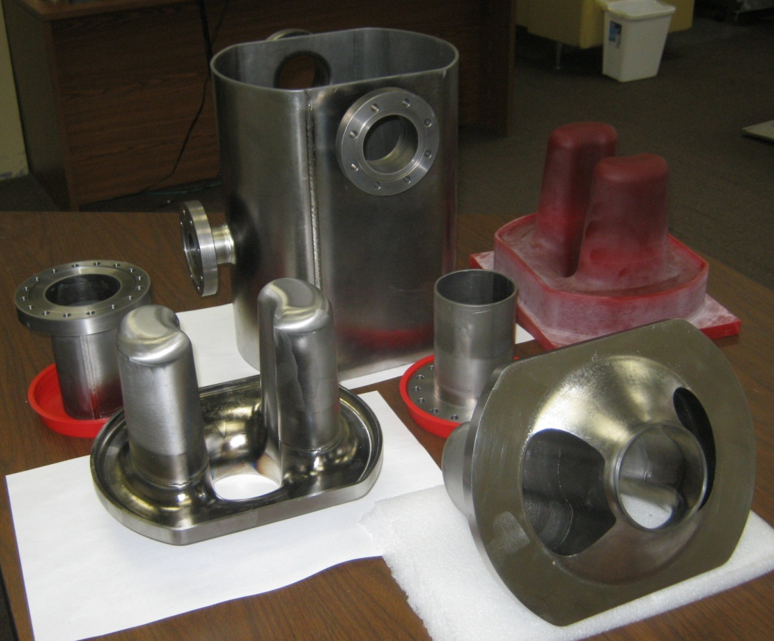
Nb Cavity
Pictures courtesy of Niowave

Slide 7
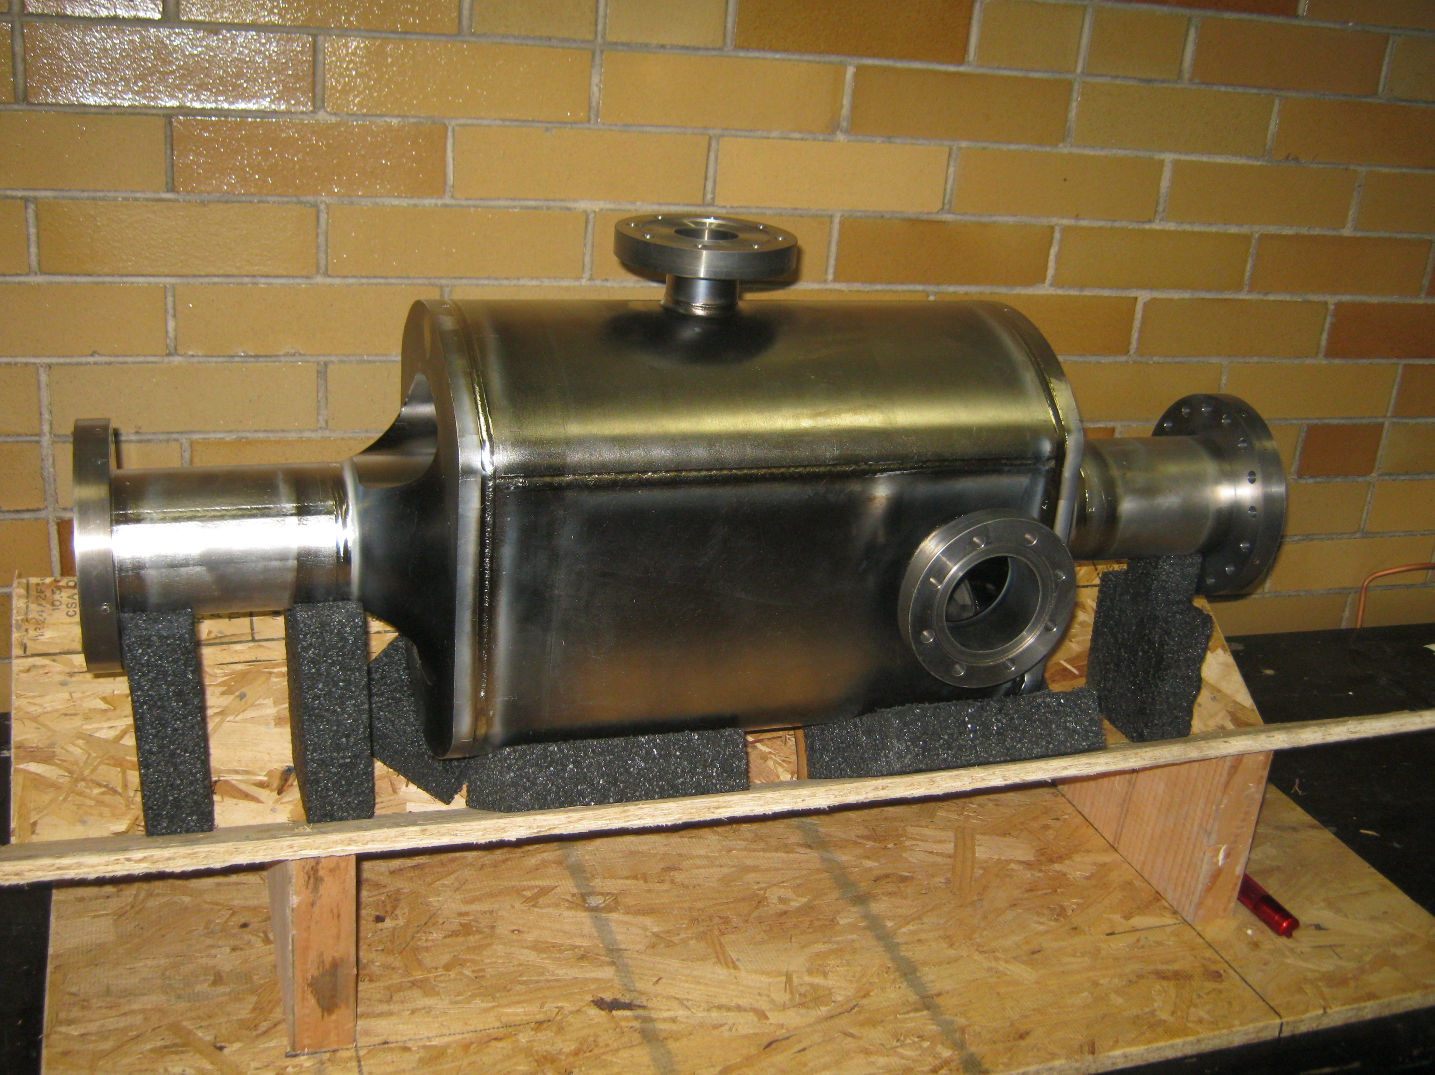
Courtesy of Niowave

Slide 8
Bead-pull field profiles
Bead-pull field profiles with metal (dark blue) and dielectric (pink) bead were performed
1 – LOM
3 – 1st HOM
4 – 2nd HOM
2 – Operation mode
Courtesy of Niowave

Slide 9
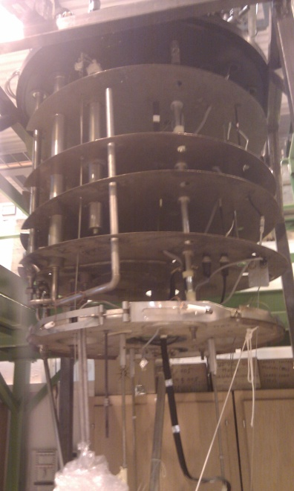
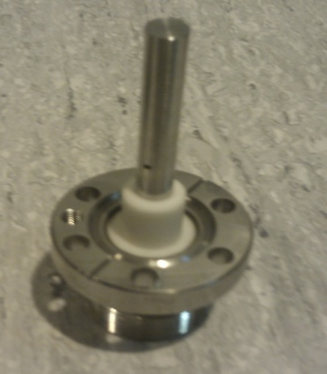
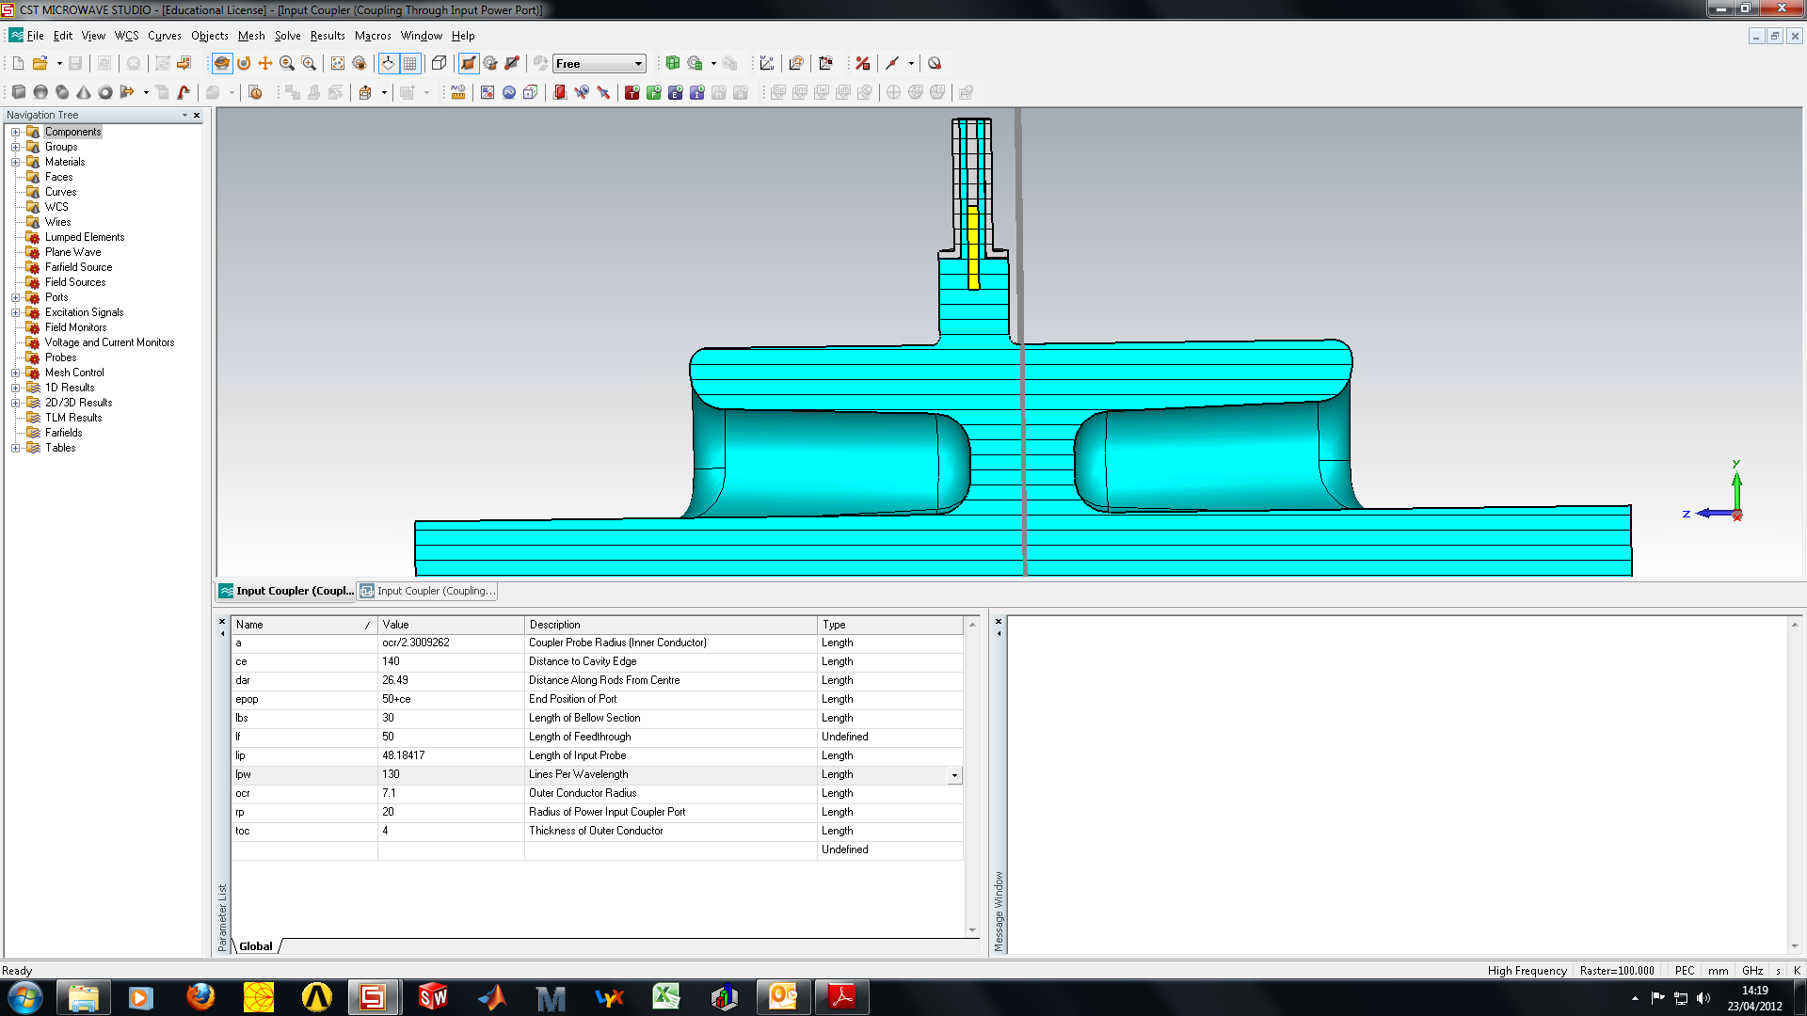
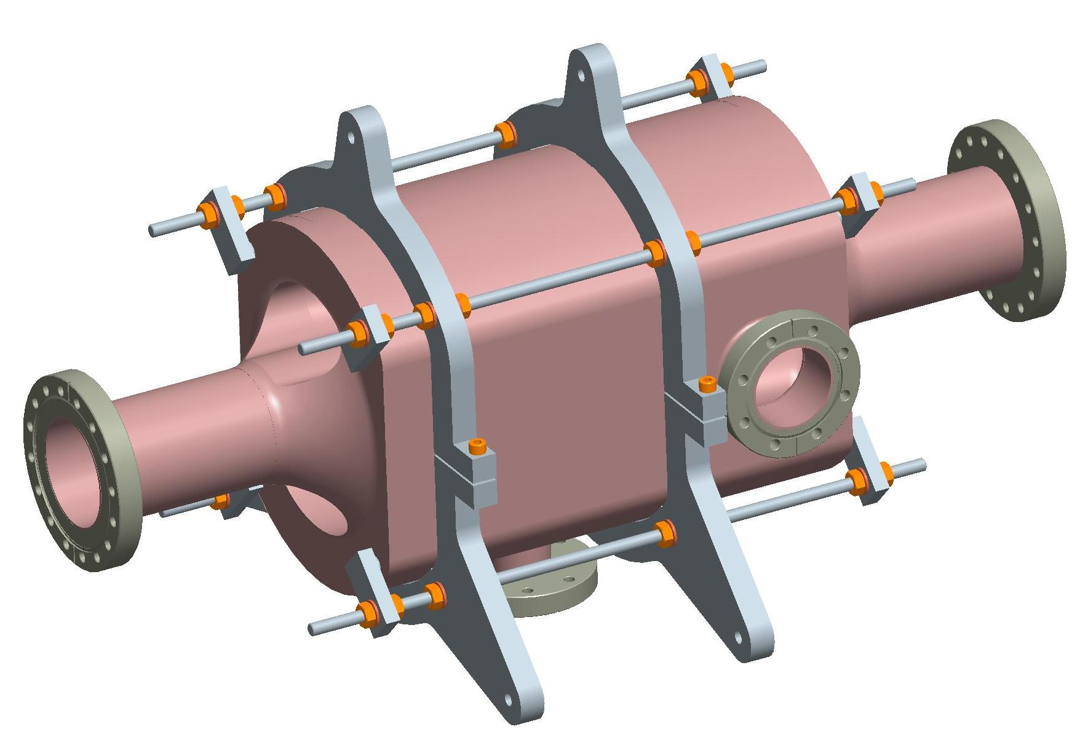
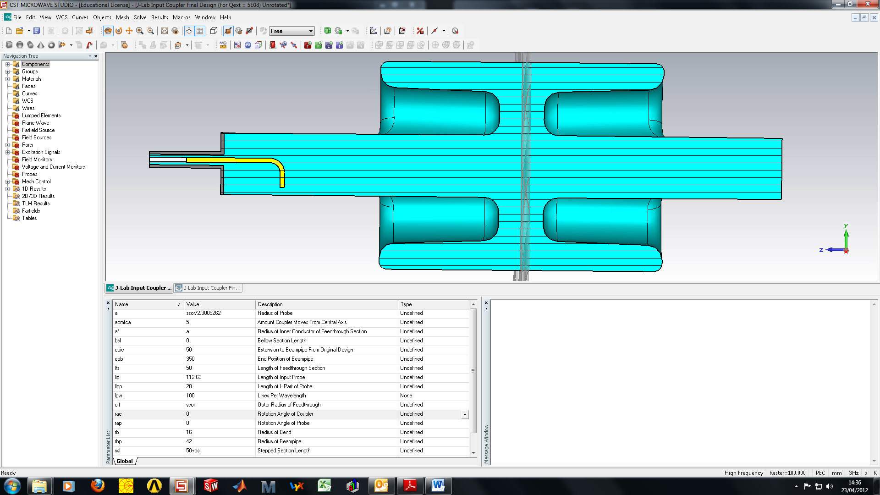
Cavity Testing
Plans are being made to test the cavity at CERN this summer.
Plan to use infrastructure at SM18.
CERN chemistry experts are preparing for BCP, bake and HPR
SM18 cryo upgrade schedule may postpone testing to early 2013.

Slide 10
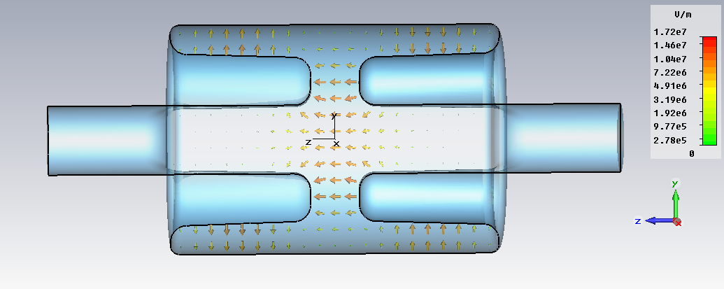
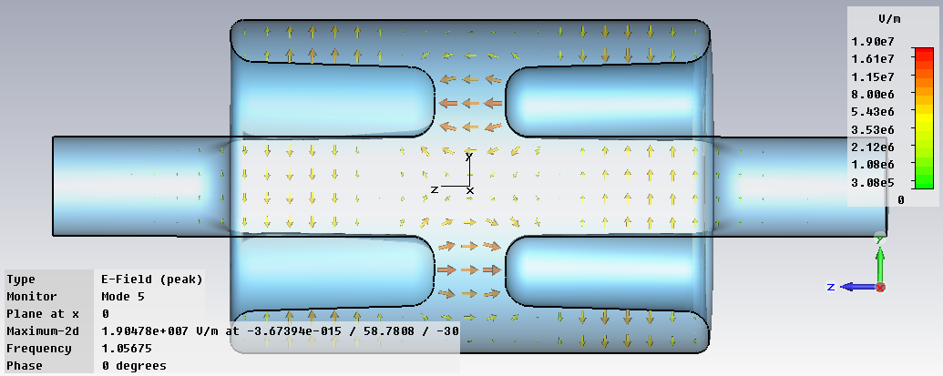
Higher Order Modes
We have some TEM HOMs.
As the cavity is compact in the vertical plane most of the TM modes are at higher frequencies, and the TE modes have low shunt impedances.
Monopole 3π/4 resonator
Dipole 3π/4 resonator

Slide 11
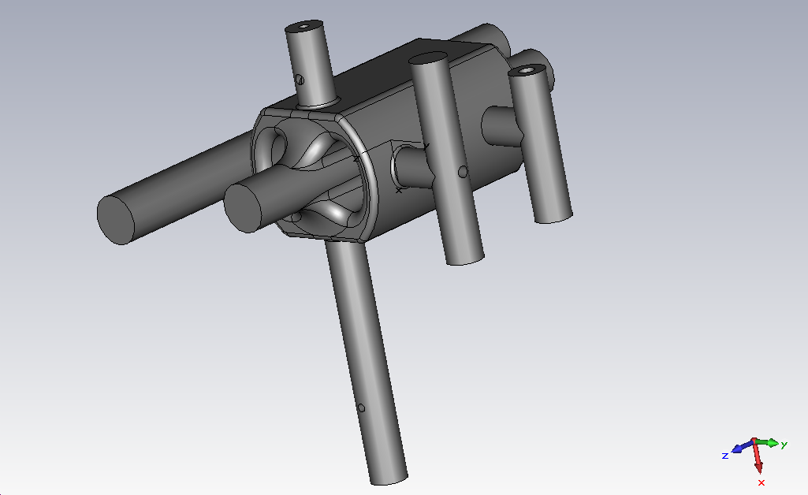
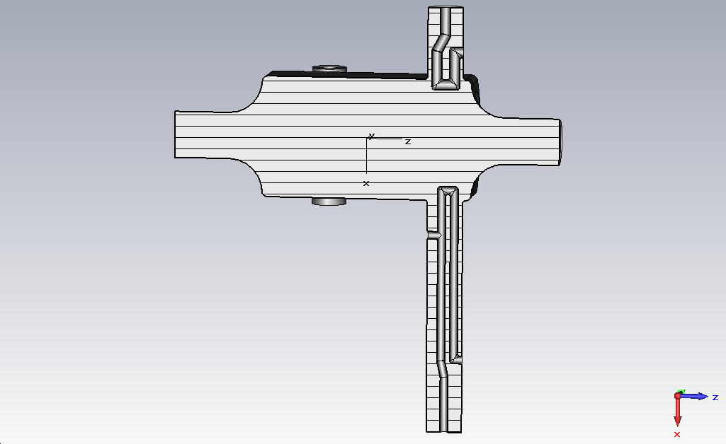
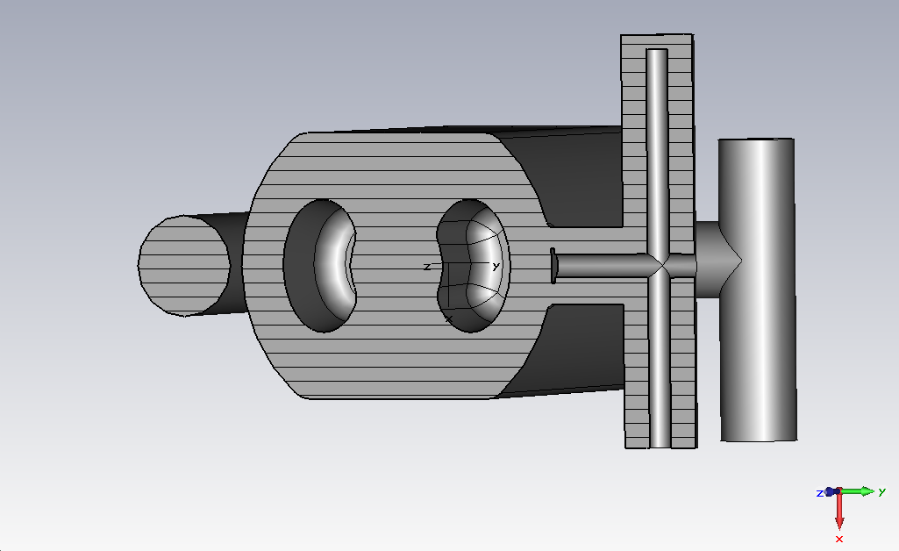
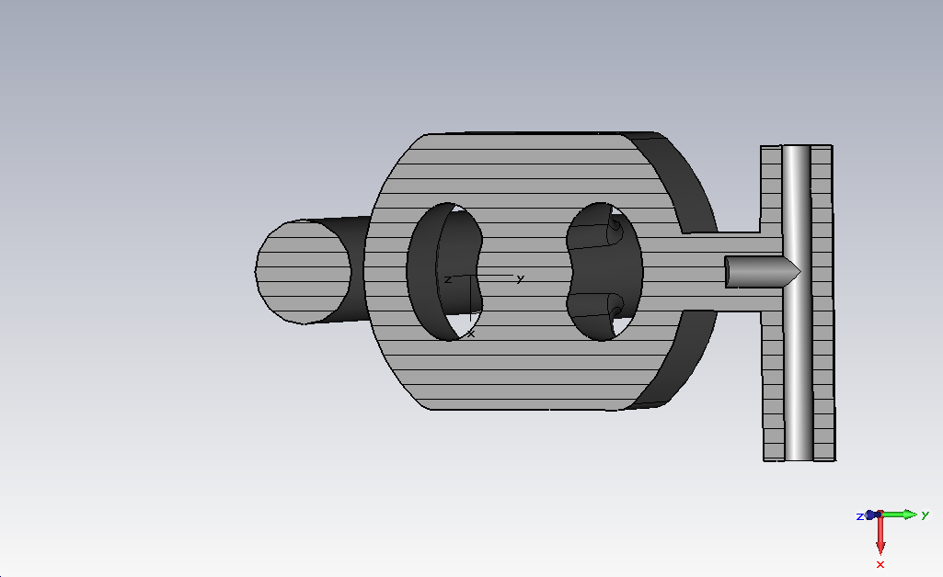
Crab Cavity and Couplers
Broadband Loop HOM Coupler
LOM Coupler
HOM Probe Coupler
(preliminary)
Input Coupler

Slide 12
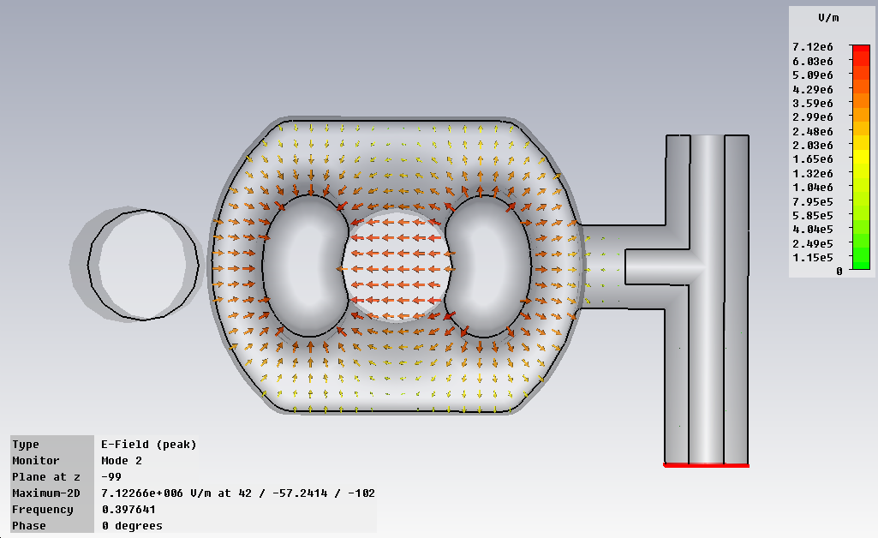
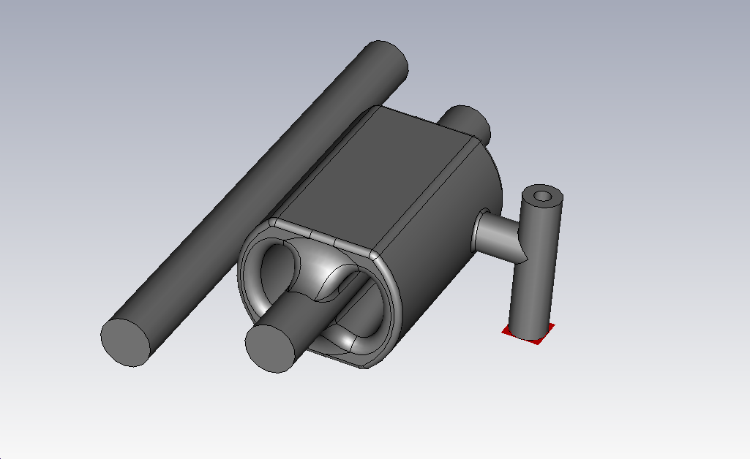
Input coupler
Due to space constraints in the LHC the power coupler must penetrate vertically.
However fields are small in the vertical plane and coupling is weak.
A T-section is required to extract the coupler vertically hence fitting in the required space.

Slide 13
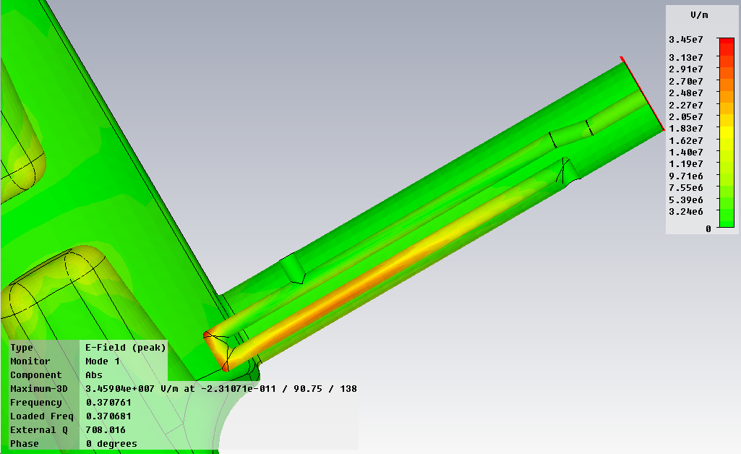
LOM Coupler
Coupler requirements
The accelerating mode couples strongly to the beam and power could be as much as 6 kW.
Beam stability requires an external Q of ~120 to meet impedance specs.
High power means we need to be careful of field enhancement and may need a power coupler type structure.
Complex cavity shape will require a demountable coupler to aid cleaning of the rods.
We use a resonant loop to damp the LOM at 370 MHz
External-Q’s down to 109.6 and 115.6 have been achieved
Crabbing mode does not couple due to symmetry
Type | Frequency (MHz) | R/Q | Qext | (R/Q).Qext
Monopole | 371.8 | 56.9 | 109.7 | 6237.542
Monopole | 378.9 | 75.7 | 115.6 | 8745.14

Slide 14
Conclusion
Aluminium cavity has been built and tested.
  Data agrees with simulation
Niobium prototype has been produced.
  Initial measurements agree with simulations.
  Hope to get preliminary cold tests this summer.
Coupler designs are on-going.
The LHC4R cavity shows no major issues at present and is a strong contender for use in HL-LHC.

