Slide 1
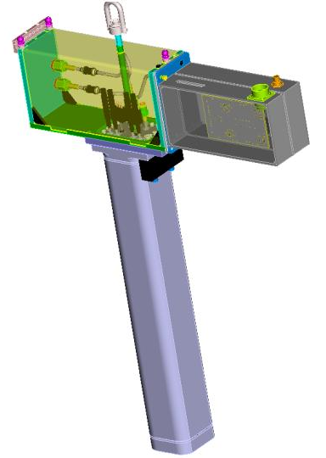
Fluka Modeling of the Interaction Region
H. Matis, S. Hedges, M. Placidi, A. Ratti, W. Turner
[+several students] (LBNL)
R. Miyamoto (now at ESSS)

Slide 2
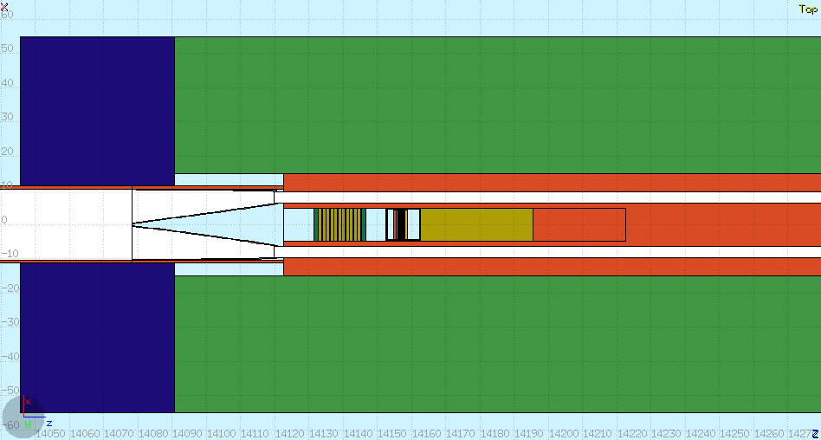
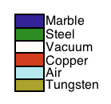
Overview of Simulations
Using FLUKA with IR1 and IR5 geometry implemented by CERN
We have added a detailed model of the TAN including forward detectors and BRAN

Slide 3
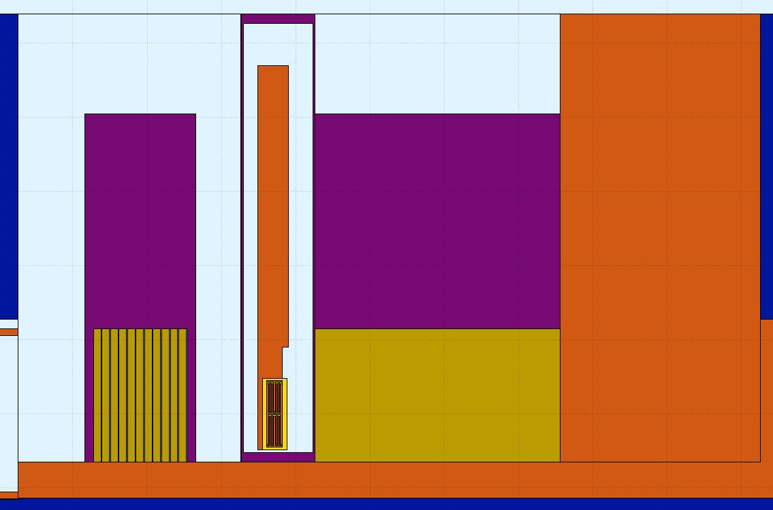
FLUKA model of ATLAS IP1
IP model developed at
CERN
TAN Model developed by LBL
2011 Version
ATLAS
ZDC
BRAN

Slide 4
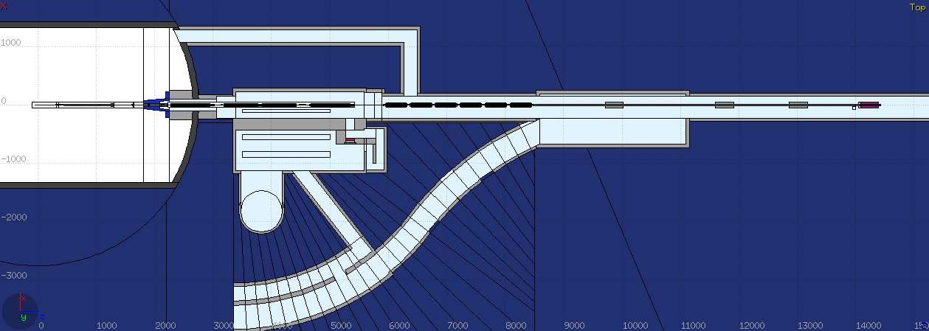
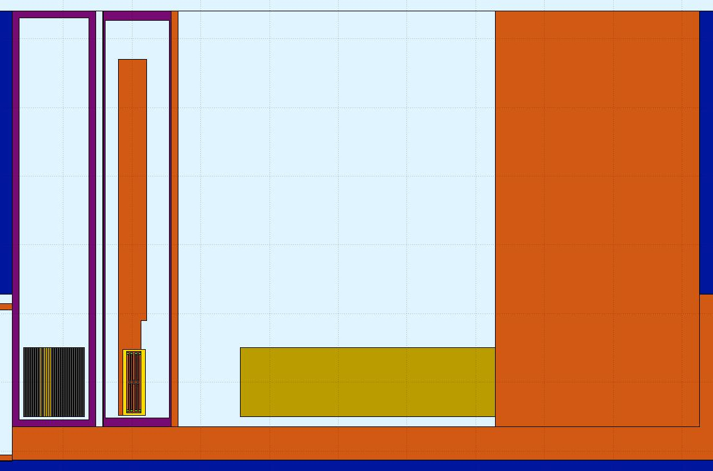
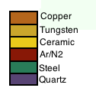
FLUKA model of CMS IP5
ZDC Detector
BRAN

Slide 5
2011 CMS Tan (side view)
Air

Slide 6
How we do simulations
Use geometry for ATLAS and CMS
Collide beams in the center of IR
Transport fragments through the Experimental Magnets and focusing dipoles to the TAN
Measure ionization deposited in the TAN/interacting particle
We can then scale this number to number of interacting collisions/bunch

Slide 7
ATLAS Simulation (p-p)
Fluence at BRAN
Energy Deposition at BRAN

Slide 8
Momentum Distribution at BRAN
Large difference in # of particles allows the BRAN to detect PbPb collision
Even though there is significantly reduced luminosity

Slide 9
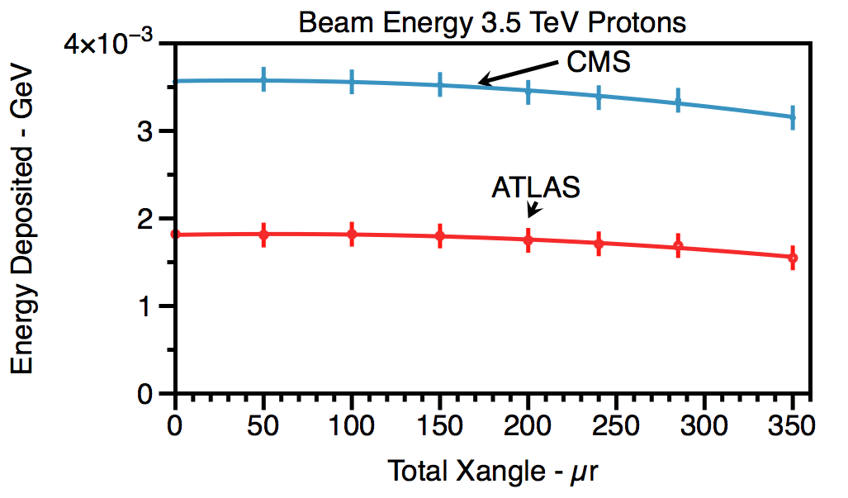
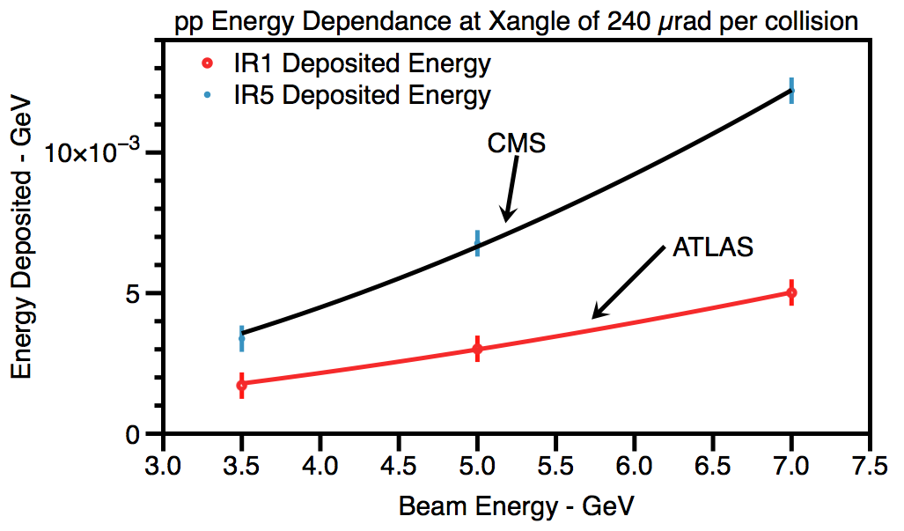
Average Energy Collected/pp interaction
Difference of energy between ATLAS and CMS due to different absorbers
Total energy deposited decreases with increasing crossing angle
Missing part of the shower
Mapped energy response from 3.5 to 7.0 TeV beam energy with varying crossing angle
Plot at 240 µrad
If BRAN starts to saturate with increased intensity or luminosity
can lower pressure and/or
add attenuators.

Slide 10
Crossing Angle Asymmetry
Define Crossing angle asymmetry ratio as
BRAN is sensitive to the crossing angle OF THE MACHINE
Ratio becomes steeper as energy of LHC increases
Full Crossing Angle

Slide 11
Two methods of readout
All four quadrants read out for each bunch and turn
Data is processed in two ways
Counting Mode (currently recorded for left side of each IP)
Each bunch is counted as a “1” if exceeds a certain threshold
Software integrates over a specific number of turns
At lower luminosity this is linear as BRAN has a low acceptance
At higher luminosity can saturate
Pulse Height Mode (currently recorded for right side of each IP)
The signal voltage for each bunch is collected and summed for a number of turns
This higher statistical fluctuations but linear up to maximum digitization of the ADC (There are several ways to reduce the signal)

Slide 12
Simulated Counting Mode with Pileup
Counting mode with thresholds of 10, 15, 20, 25 mV (value includes attenuators and cable lengths)
Counting mode is linear but starts to saturate as rate increases
One can reach a linear region by increasing threshold
10 mV
% of bunches that trigger
25 mV
# of collisions/bunch
10 mV
# of collisions/bunch
% of bunches that trigger/
interacting bunches

Slide 13
Updating to Higher Lumi Configuration (2012+)
ATLAS 2011
ATLAS 2012

Slide 14
CMS Update
CMS 2011
CMS 2012

Slide 15
Work in Progress
How does the detector respond to Heavy Ion Collisions?
Demanding CPU requirements
New regime of physics for FLUKA
In collaboration with FLUKA group at CERN

Slide 16
How does the detector respond to Ion Collisions (fluence)?
208 pp collisions
1 Pb collision

Slide 17
Difference in Crossing Angle PbPb
0 µrad
240 µrad

Slide 18
Asymmetric Collisions for 2012
Very Preliminary results
LHC will be running p-Pb collisions later this year
Define p-Pb as p beam heading toward to the BRAN
Pb-p as Pb heading toward the BRAN
Results show that there will be a 10³ asymmetry for left and right side
Depending on the luminosity probably will only be able to use one of the BRANs/IP
ATLAS at 1.38 TeV/A

Slide 19
Goals for the Summer Student
Integrate latest models of the IP from CERN
Run simulations for 2012 data configuration
Compare PbPb and pp results

Slide 20
Summary
We have done a detailed study of the BRAN for pp in the 2011 configuration
Working closely with CERN FLUKA group to incorporate the BRAN in their configuration and to develop the PbPb models
Implementing PbPb collisions
Preparing for LHC runs with p-Pb collisions
Detector responses will be different for left and right sides
Need to be prepared
Decide BRAN configuration before this Asymmetric Ion Run

