Slide 1
Large aperture
IR Quadrupole
(MQXF) development plan
Paolo Fessia
MQXF analysis by P. Ferracin
Based on the discussions with
Giorgio Ambrosio, Michael Anerella, Marc Kaducak, Joseph Rasson, GianLuca Sabbi, Frederic Savary, E. Todesco, Peter Wanderer
Luca Bottura, Lucio Rossi
within the MDT section (N. Bourcey, J. Mazet, P . Ferracin, J. C. Perez, E. Todesco,…).

Slide 2
Summary
MQXF few technical remarks
For information: the CERN framework
The MQXF model
  Objectives of the MQXF (140-150 mm) quadrupole model program
  Main program features
  Proposal of plan and milestones of a possible CERN-LARP integrated model program
  LARP and CERN contributions to the model program
MQXF prototype and pre-series
  Objectives of the MQXF quadrupole prototype and pre-series program
  A preliminary proposal of plan and related resources at CERN
Possible risks
Not conclusion but open issues:
  Urgent
  Other

Slide 3
MQXF few technical remarks
Courtesy of P. Ferracin

Slide 4
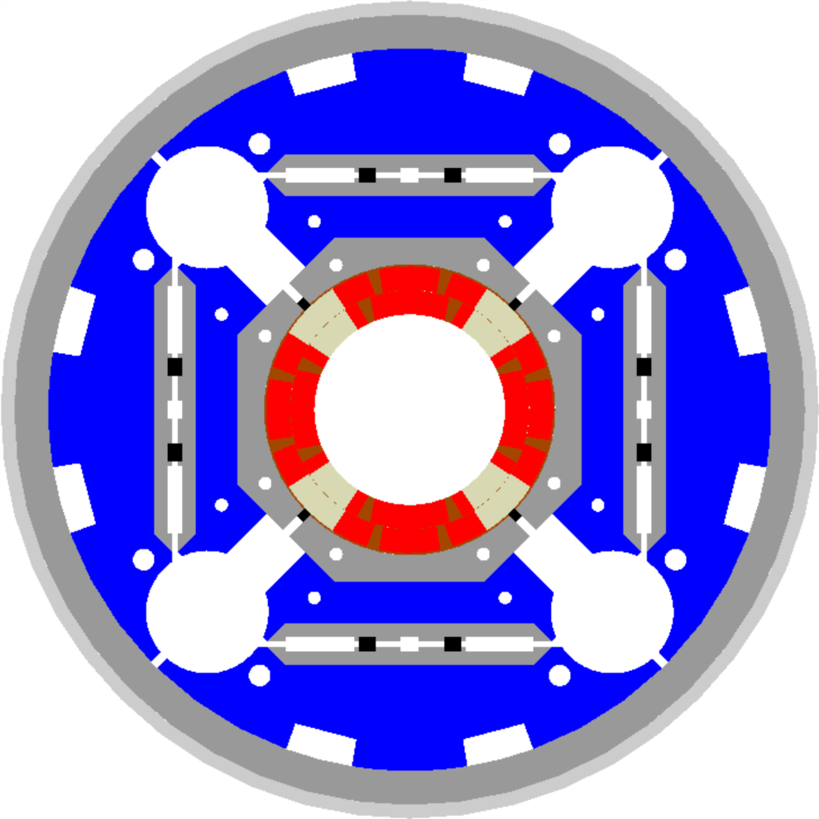
How MQXF may look like?
140 mm aperture
17 mm cable
OD: 600 mm
25 mm aluminum shell
10 mm stainless steel vessel
Bus bar slots: 50 x 20 mm
Cooling holes: 90 mm diam.
Maximum tensile stress in iron yoke < 200 MPa
Bladder pressure: 25 MPa
Stresses in support structure within elasticity limits
Same coil stresses as in HQ

Slide 5
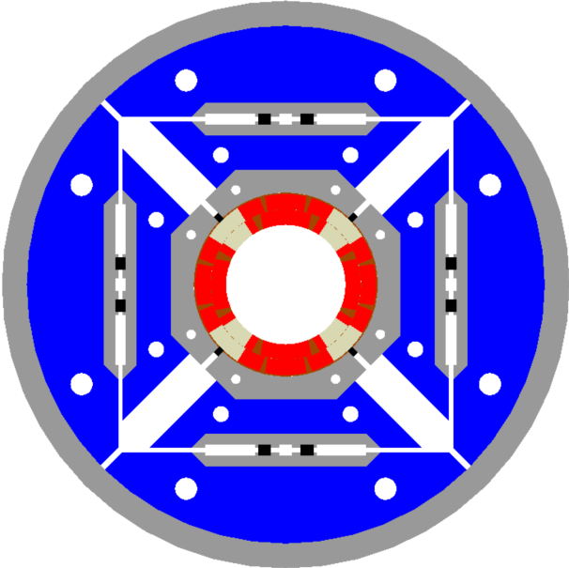
HQ (120 mm aperture, 15 mm cable) vs.
MQXF (140 mm aperture, 17 mm cable)
HQ
MQXF_17mm
Same scale

Slide 6
Some (few non exhaustive) considerations HQ vs. MQXF
Technical characteristic | HQ | MQXF
Collars | - Bolted 50 mm thick collars - Alignment with pad provided by trapezoidal profile | - Laminations - Round shapes with alignment keys (collar-pads) on the mid-plane - Dipole-type collars
Pads and yokes | Bolted 50 mm thick blocks | Laminations packs
He vessel | None | - 10 (?) mm stainless steel half shells welded together - Issues : - Welding in contact with the aluminum shell or not ? - Effect on alignment (transfer function feet-> magnetic axis)
Axial support | Aluminum rods with end-plates Easy to pre-load and to predict cool-down effect Can be implemented in short model | End plates welded to stainless steel vessel Increase rigidity but some uncertainty on cool-down effect (Can be simulated with 3D FEM model)

Slide 7
The CERN framework

Slide 8
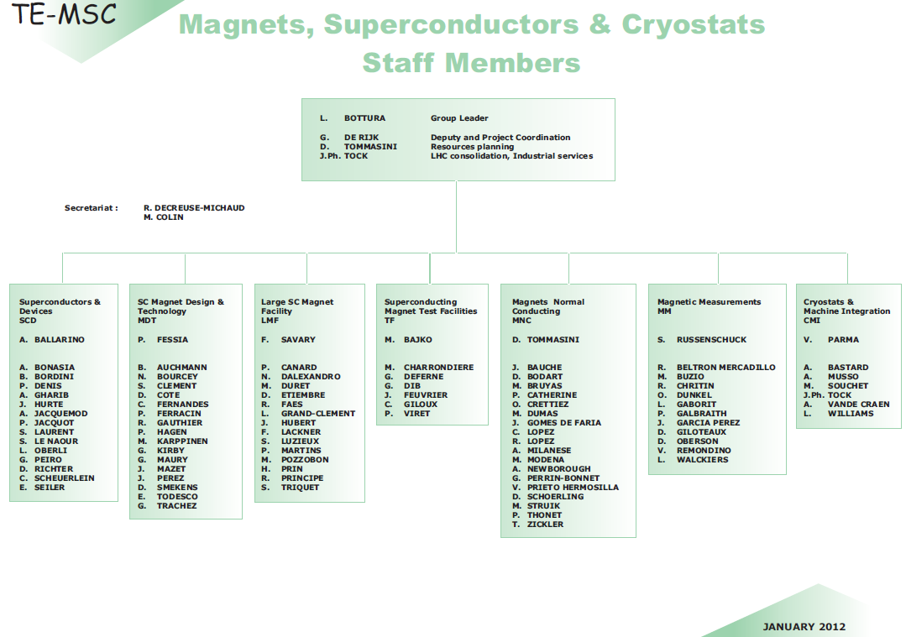
The present CERN framework
MQXC
SMC,RMC ,FRESCA2
11 T dipole
Isolde solenoids
CLIC wiggler
Fidel, Wise
HL-LHC
LHC magnet repair and reconstruction
(MB,MQ, other units)
11 T dipole
SIT
Train work
5
--
7
3
--
13
14
--
15
2.5
--
16
8
--
19
Long Shutdown 1 (LS1) January 2013->March 2014

Slide 9
MQXF model

Slide 10
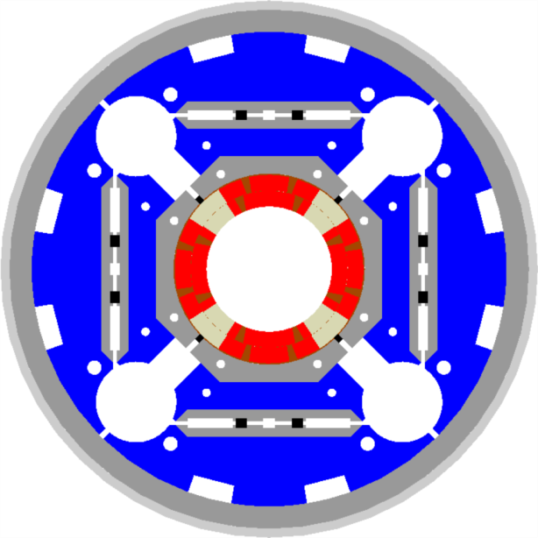
Objectives of the MQXF model program
Demonstrate that the technologies and techniques used for the 120 mm aperture can be successfully adopted for the 140-150 mm aperture
Extend the applicability of the LHQ result to 140-150 mm aperture to open directly the path to full length prototype (8 meter)
Tests as many as possible of the long magnet features (in particular iron yoke design) if it does not delay the test plan
Demonstrate that the coil fabrication technology is well mastered allowing to use all the produced coils for magnet assembly
  RRP and PIT can be efficiently and successfully managed in the same production

Slide 11
Main features in the program
12 poles: 6 RRP+6 PIT
4 coils model 1
(2practice + 2 production)
4 coils model 2
2 coils model 3
2 coils model 4
Option A
Option B
Accelerator features 1st set
Mechanical structure V1
Model 0
Model 2
Model 0
Model 2
Copy 1
Mechanical Structure
Mechanical Structure
Model 1
Model 3
Accelerator features 2nd set
Mechanical structure V2
Series like
Copy 2
Model 1
Model 3

Slide 12
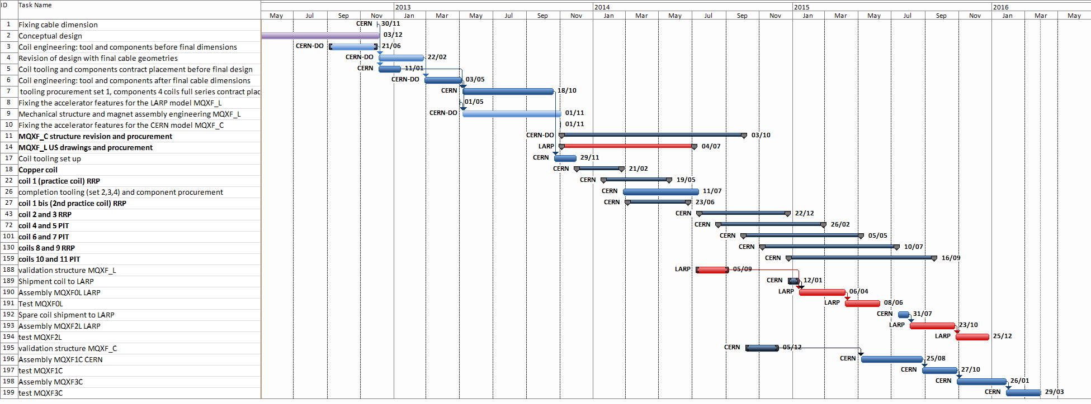
CERN-LARP proposed integrated model program
Design and coil engineering
Tooling procurement and mechanical structure engineering
Coil tooling set up and practice coils
Coil production
Magnet assembly and test line 1
Magnet assembly and test line 2

Slide 13
LARP and CERN integration for MQXF model program, a 1st proposal
TASK | LARP | CERN
Cable parameter definition RRP | X
Verification parameter PIT | X | X
Conceptual design | X (protection and mechanical analysis) | X (magnetic analysis and mechanics)
Engineering coil and tooling | X | X
Engineering mech. structure | X | X
Procurement LARP version mech. structure | X (translation in US format of drawings)
Procurement CERN version mech. structure |  | X
Coil production |  | X
Assembly and test of 2 models | X | X

Slide 14
MQXF prototype and pre-series

Slide 15
Objectives of the MQXF prototype and pre-series program
Prototype: optional step, managerial choice (son of the simplified structure V1) | Pre-series: mandatory step (son of the complete structure V2)
A prototype A simplified unit targeted to validate specific technical choices Aimed to mitigate technical risk. Completion shall be early enough to provide a go ahead for further steps. Technical content as a compromise between technical features completeness and time schedule. Not for free in terms of money, resource and plan impact | A pre-series are 1-2 cryostated magnets that can be successfully used in the machine To demonstrate the successful extension of production and assembly techniques to the final chosen configuration, providing consistent and repeatable results fulfilling the specification Equipped with all the final ancillaries (Cold bore and shielding ,Heat exchanger tube, Bus bar, Cold mass envelope including end covers, Cold support posts, Instrumentation + instrumentation feed through, Bellows) Submitted to the complete QC procedures (Alignment, extremity cartography, full geometry characterization, Magnetic measurement )QA Other QA (electrical measurements, pressure test, leak test, ) Integrated in an horizontal cryostat featuring (Final support posts, al the cryo-services necessary for the exploitation in the machine (lines, phase separator, thermometers, heaters,…), Necessary instrumentation and instrumentation feed through, safety valves and pumping ports Alignment features) Components and tooling (i.e. mandrels, molds, .. )shall be produced in technology suitable for the foreseen series production, therefore production techniques and production methodology have to be completed revised respect to model In case of the series would be produced in industry, the pre-series phase shall Demonstrate to companies that the industrial risk is manageable Allow technology transfer
A prototype is a cryostated magnet that can be successfully used in the machine
A prototype shall demonstrate the successful extension of production and assembly techniques to the final chosen magnet, providing consistent and repeatable results fulfilling the specification
A prototype is equipped with
  Cold bore and shielding
  Heat exchanger tube
  Bus bar
  Cold mass envelope including end covers
  Cold support posts
  Instrumentation + instrumentation feed through
  Bellows
The prototype shall be submitted to the following QC procedures
  Alignment, extremity cartography, full geometry characterization
  Magnetic measurement QA
  Other QA (electrical measurements, pressure test, leak test, )
The prototype is integrated in an horizontal cryostat featuring
  Final support posts
  All the cryo-services necessary for the exploitation in the machine (lines, phase separator, thermometers, heaters,…)
  The necessary instrumentation and instrumentation feed through, safety valves and pumping ports
  Alignment features
Components and tooling (i.e. mandrels, molds, .. )shall be produced in technology suitable for the foreseen series production, therefore production techniques and production methodology have to be completed revised respect to model
In case of the series would be produced in industry, the prototype phase shall
  Demonstrate to companies that the industrial risk is manageable
  Allow technology transfer

Slide 16
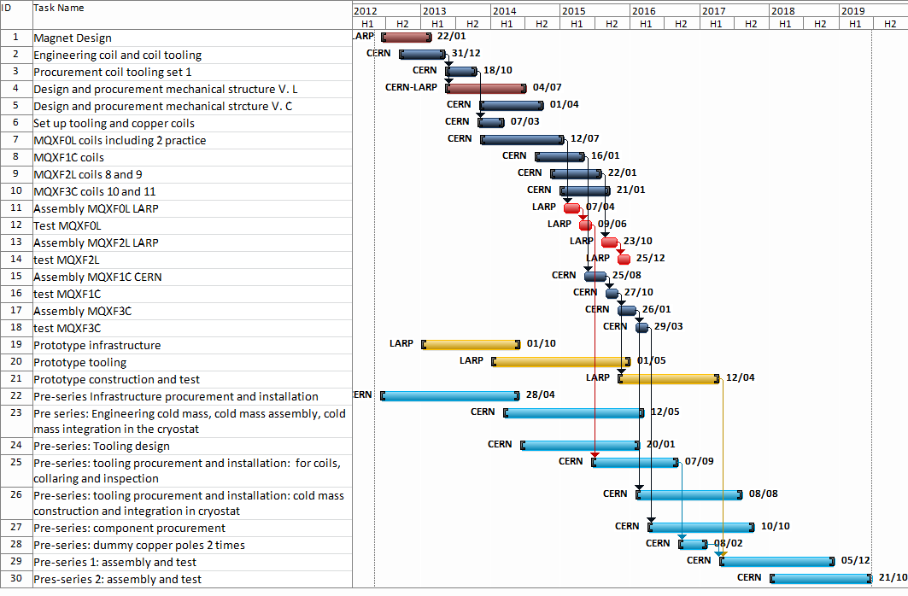
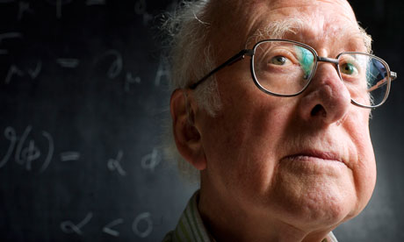
A 1st proposal for the prototype / pre-series plan

Slide 17
Prototype/pre-series CERN resource view
What is starting now
  M.S. for the furnace is out. In few months green light to purchase 2 furnaces
  1) 6.5 m long unit 11T dipole targeted ( possible delivery June 2013)
  2) 8+ m long unit MQXF targeted (possible delivery January 2014)
  Impregnation system. Targeting one system fulfilling 11T and MQXF project. We will need to go through MS and IT. Optimist expected delivery September 2013
Resources short term
In LMF efforts are being done to free some resources from LS1 (Fellow 40 %, Technician for tooling development 30%, Technician for development of manufacturing procedures 30% ), Just enough to
  Follow up the main infrastructure procurement and installation
  Participate in the model tooling development and start to extend the tooling to long length
Resources medium term
A very large task is the all the cold mass finishing and tunnel integration. For this task CERN is ready to take the lead, but the activity can only be fully staffed as mid 2014 (end LS1).
Decision cost
Already TODAY the decision to go for a 8 meters coil length has an immediate cost impact increasing the dimension and therefore the costs of the infrastructures being procured

Slide 18
Possible risks and Fall back (painful) “strategies”

Slide 19
Risks, possible actions and consequences I
Date | Event | Reaction | Consequence | Details | Possible mitigations
End 2014 | Impossibility to get consistent quality on long cable lengths (8 m coils) or too high cost | Go back to half length units | 9 months delay | Tooling re-procurement | Follow up of cable production for the 11 T (11 T 600 m vs. 840 m for the MQXF)
December 2015 | Systematic model failure: quench performance | Redesign magnet | 2 years delay | New 2 models, modification proto | Models is already a mitigation action for the proto and pre-series
 |  | Modify operational gradient | Revision of optics-> new layout with increased length
 |  | Back to the 120 mm if aperture issue | 1 year delay | No model, redesign of long tooling
December 2015 | Systematic model failure: electrical integrity | Redesign insulation | 1 year delay of the short model (if no new coils are needed down to 6 months) 6 months delay on long magnet | 1 short model reassembly | Well defined electrical QC on components from beginning with decreasing voltages to target assembly soundness for final design voltage

Slide 20
Risks, possible actions and consequences II
Date | Event | Reaction | Consequence | Details | Possible mitigations
February 2016 | Systematic model failure: field quality | Coil modifications inside the coil envelope | 1 year delay | 1 extra short model, procurement of new component for the long proto with financial impact | Manageable issue
 |  | Actions on the yoke or other structural components | 6 months delay | Extra cost, no model, delayed proto, new components with financial impact
 |  | Change of strand | ? | ?
Mid 2018 | Failure of the pre series because of length | Back to half length | 1.5 years extra from the moment of decision | Design to be scaled down, short tooling but very large economical impact on component procurement of series that has already started (i.e. cryostats, bus bars, all long components) | Introduction of prototype to be tested mid 2017
 |  | Modification of specification if possible | Probable delay of 3-6 months | Impact on machine performance

Slide 21
Open issues

Slide 22
Urgent Open issues
Aperture: choice of between 140 and 150 mm shall be done as soon as possible. Impact of 150 not negligible (work already done, even larger cold mass, ...)
Model development: resource wise the critical phase is in the next 1.5 years. For this phase for the model we are lacking 1 engineer and 1 technical engineer. CERN top management has started to look for resources outside the group, but the lack of this personnel will impact the plan.
Final cable dimensions :it is assumed that the dimensions are available as November 2012 and that they will be suitable also for PIT strands.
Cable and strand procurement: procurement plan to be assessed
Prototype/pre-series phase. At the present status CERN cannot engage to place more resources on short term (before end LS1) on the prototype work. As consequence a detailed LARP-CERN integrated plan is necessary

Slide 23
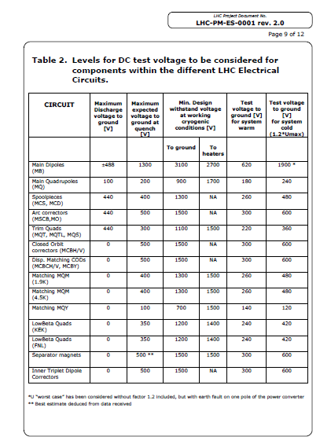
Other Open issues
Align technical requirements for declaration model success I.E.
  Common base for quench and field quality
  Electrical test level
  All other QC procedures

Slide 24
Extra slides

Slide 25
Objectives of the MQXF model program
Demonstrate that the technologies and techniques used for the 120 mm aperture can be successfully adopted for the 140-150 mm aperture
Extend the applicability of the LHQ result to 140-150 mm aperture to open directly the path to full length prototype (8 meter)
Demonstrate that the coil fabrication technology is well mastered allowing
  To use all the produced coils for magnet assembly (choosing and even sorting for the 8 meter long unit is not an option so the coils shall meet specification or the specification shall be revised)
  Demonstrate that RRP and PIT conductors can be efficiently and successfully managed in the frame of the same production
Tests as many as possible of the long magnet features (in particular iron yoke design) if it does not delay the test plan

Slide 26
Main features in the model program
Coils:
  12 poles produced (2 with tooling set n. 1, 10 with all the 4 sets of tooling necessary to fulfil the plan)
  6 coils with RRP, 6 coils with PIT
Models:
  2 models for each assembly line out of 6 poles
  Two options for the structure design
    Option A: all accelerator features are known in May 2013. We introduce all of them and we perform in one go the procurement of twice the same structure (probably by LARP).
    Option B: we have 2 structures just slightly different (as more complex option it is this, the one assumed in the plan)
      Model V1 (to be assembled by LARP): 1st package of accelerator features as known as 01/05/2013
      Model V2 (to be assembled by CERN): 2nd package of accelerator features as known as 01/11/2013

Slide 27
Some milestones in the model plan
Mil. n. | Description | Start Date | Completion date
1 | Fixing final cable dimensions for tooling | NA | 30/11/2012
2 | Engineering coil and coil tooling | 01/10/2012 | 03/05/2013
3 | Delivery coil tooling set 1 | NA | 18/10/2014
4 | Engineering mech. structure and procurement structure LARP version | 01/05/2013 | 04/07/2014
5 | Engineering mech. structure and procurement structure CERN version | 01/11/2013 | 03/10/2014
6 | Copper coil | 1/12/2013 | 21/02/2014
7 | Practice coil n. 1 | 20/01/2013 | 19/05/2014
8 | Delivery tool set 2,3,4 after modifications from copper coil experience | NA | 11/07/2014
9 | Completion 1st 4 coils including 2 practices | NA | 20/12/2014
10 | Assembly MQXF0L | 13/01/2015 | 06/04/2015 (start test)
11 | Assembly MQXF1C | 06/05/2015 | 25/08/2015 (start test)
12 | Assembly MQXF2L | 03/08/2015 | 23/10/2015 (start test)
13 | Assembly MQXF3C | 28/10/2015 | 26/01/2016 (start test)

Slide 28
Objectives of the MQXF prototype program
A prototype is a cryostated magnet that can be successfully used in the machine
A prototype shall demonstrate the successful extension of production and assembly techniques to the final chosen magnet, providing consistent and repeatable results fulfilling the specification
A prototype is equipped with
  Cold bore and shielding
  Heat exchanger tube
  Bus bar
  Cold mass envelope including end covers
  Cold support posts
  Instrumentation + instrumentation feed through
  Bellows
The prototype shall be submitted to the following QC procedures
  Alignment, extremity cartography, full geometry characterization
  Magnetic measurement QA
  Other QA (electrical measurements, pressure test, leak test, )
The prototype is integrated in an horizontal cryostat featuring
  Final support posts
  All the cryo-services necessary for the exploitation in the machine (lines, phase separator, thermometers, heaters,…)
  The necessary instrumentation and instrumentation feed through, safety valves and pumping ports
  Alignment features
Components and tooling (i.e. mandrels, molds, .. )shall be produced in technology suitable for the foreseen series production, therefore production techniques and production methodology have to be completed revised respect to model
In case of the series would be produced in industry, the prototype phase shall
  Demonstrate to companies that the industrial risk is manageable
  Allow technology transfer

Slide 29
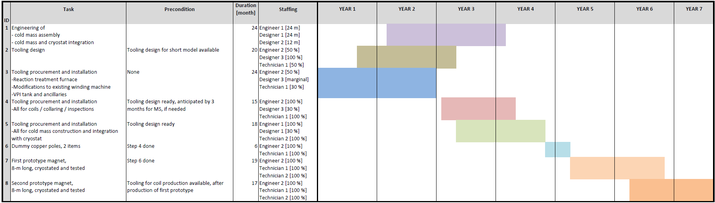
CERN estimated prototype activity: hypothesis, sequences, durations issues
We need to advance the prototype construction independently from the cold test feed back of the model program or we will be too late. The connections between the 2 programs will be technical
(availability of complete and possibly validated design from the model program)
The tooling procurement shall be linked to the tooling test on the short models and the components procurement to the model test
But we need the people to work on the preparation phases and these people will become fully available only at the LS1 end April-May 2014. LMF will TRY (see later) to leave a small group of people on surface to keep ongoing the projects preparation, but at a reduced speed not the one foreseen here above

Slide 30
MQXF model personnel
development
 | required | Available | Stop other activities | Not identified
Eng-phys | 2.5 | 0.7 (0.4+0.2+0.1) | 1.4 (0.7+0.5+0.2) | 0.4
Tech eng | 1 | 0 | 0 | 1
Fellow | 1 | 0.5 from recr. | 0.5 | 0
Designers | 2 | 2 from recr. | 0 | 0
production
team | CERN staff [n] | External field support [n] | Envelope occupation time | CERN staff FTE | FSU FTE | CERN costs | FSU costs
Winding team | 2 | 1 | 1.5 years | 3 | 1.5 | 600 kCHF | 160 kCHF
Reaction team | 0.5 | 2 |  | 0.75 | 3 | 150 kCHF | 330 kCHF
Impregnation team | 0.5 | 2 |  | 0.75 | 3 | 150 kCHF | 330 kCHF
Instrumentation team | 1 | 1 |  | 1.5 | 1.5 | 300 kCHF | 160 kCHF
Assembly team | 2 | 2 | 1 year | 2 | 2 | 400 kCHF | 220 kCHF

Slide 31
Coil production
Phases | LARP estimated time [working days] courtesy G. Ambrosio | CERN assumed time [working days]
Coil Wind / Cure | 15 | 20
Coil React | 23 | 22
Coil Impreg | 25 | 23
Coil Instrumentation | 10 | 9
Due to the furnace dimension we plan to react 2 coils at the same time
As consequence the tooling will multiplied in 4
Estimated cost 1 full winding-> impregnations tooling line 230.000 CHF
Estimated cost for 4 sets 430.000 CHF. This action reduce the apparent coil production time from about 70 working days down to 25

Slide 32
Objectives of the MQXF prototype and pre-series program
Prototype: optional step, managerial choice (son of the simplified structure V1) | Pre-series: mandatory step (son of the complete structure V2)
A prototype is a simplified unit that is targeted to validate specific technical choices and it can answers to the need to mitigate technical risk. In this frame its construction and test shall be performed early enough to provide a go ahead for further steps. Its technical content should be a compromise between technical features completeness and time schedule. It is not for free in terms of money ,resource and plan impact | A pre-series are 1-2 cryostated magnets that can be successfully used in the machine A pre-series shall demonstrate the successful extension of production and assembly techniques to the final chosen configuration, providing consistent and repeatable results fulfilling the specification A pre-series is equipped with all the final ancillaries (Cold bore and shielding ,Heat exchanger tube, Bus bar, Cold mass envelope including end covers, Cold support posts, Instrumentation + instrumentation feed through, Bellows) The pre-series shall be submitted to the following QC procedures (Alignment, extremity cartography, full geometry characterization, Magnetic measurement QA Other QA (electrical measurements, pressure test, leak test, ) The pre-series is integrated in an horizontal cryostat featuring (Final support posts, All the cryo-services necessary for the exploitation in the machine (lines, phase separator, thermometers, heaters,…), The necessary instrumentation and instrumentation feed through, safety valves and pumping ports Alignment features) Components and tooling (i.e. mandrels, molds, .. )shall be produced in technology suitable for the foreseen series production, therefore production techniques and production methodology have to be completed revised respect to model In case of the series would be produced in industry, the pre-series phase shall Demonstrate to companies that the industrial risk is manageable Allow technology transfer
A prototype is a cryostated magnet that can be successfully used in the machine
A prototype shall demonstrate the successful extension of production and assembly techniques to the final chosen magnet, providing consistent and repeatable results fulfilling the specification
A prototype is equipped with
  Cold bore and shielding
  Heat exchanger tube
  Bus bar
  Cold mass envelope including end covers
  Cold support posts
  Instrumentation + instrumentation feed through
  Bellows
The prototype shall be submitted to the following QC procedures
  Alignment, extremity cartography, full geometry characterization
  Magnetic measurement QA
  Other QA (electrical measurements, pressure test, leak test, )
The prototype is integrated in an horizontal cryostat featuring
  Final support posts
  All the cryo-services necessary for the exploitation in the machine (lines, phase separator, thermometers, heaters,…)
  The necessary instrumentation and instrumentation feed through, safety valves and pumping ports
  Alignment features
Components and tooling (i.e. mandrels, molds, .. )shall be produced in technology suitable for the foreseen series production, therefore production techniques and production methodology have to be completed revised respect to model
In case of the series would be produced in industry, the prototype phase shall
  Demonstrate to companies that the industrial risk is manageable
  Allow technology transfer

Slide 33
How MQXF may look like?
140 mm aperture
17 mm cable
OD: 600 mm
25 mm aluminum shell
10 mm stainless steel vessel
Bus bar slots: 50 x 20 mm
Cooling holes: 90 mm diam.
Maximum tensile stress in iron yoke < 200 MPa
Bladder pressure: 25 MPa
Stresses in support structure within elasticity limits
Same coil stresses as in HQ

Slide 34
HQ (120 mm aperture, 15 mm cable) vs.
MQXF (140 mm aperture, 17 mm cable)
HQ
MQXF_17mm
Same scale

Slide 35
Some considerations….
Collars
  Current design
    Bolted 50 mm thick collars
      Alignment with pad provided by trapezoidal profile
  Other options
    Laminations
    Round shapes with alignment keys (collar-pads) on the mid-plane
    Dipole-type collars
140 mm aperture
17 mm cable

Slide 36
Some considerations….
Pads and yokes
  Current design
    Bolted 50 mm thick blocks
  Other option
    Laminations
140 mm aperture
17 mm cable

Slide 37
Some considerations….
Axial support
  Current design
    Aluminum rods with end-plates
      Easy to pre-load and to predict cool-down effect
      Can be implemented in short model
  Other option (long lengths)
    End plates welded to stainless steel vessel
      Increase rigidity but some uncertainty on cool-down effect
        Can be simulated with 3D FEM model
140 mm aperture
17 mm cable

Slide 38
Some considerations….
Lhe vessel
  10 mm stainless steel half shells welded together
  To be determined
    Welded in contact with the aluminum shell
      How can we weld without damaging the aluminum shell?
    Welded with a radial gap wrt the aluminum shell
      How do locate/fix the cold mass inside the vessel?
140 mm aperture
17 mm cable

