Slide 1
Development of the ODU/SLAC Compact Cavity Design
LARP CM-18, Fermilab
7-9 May 2012

Slide 2
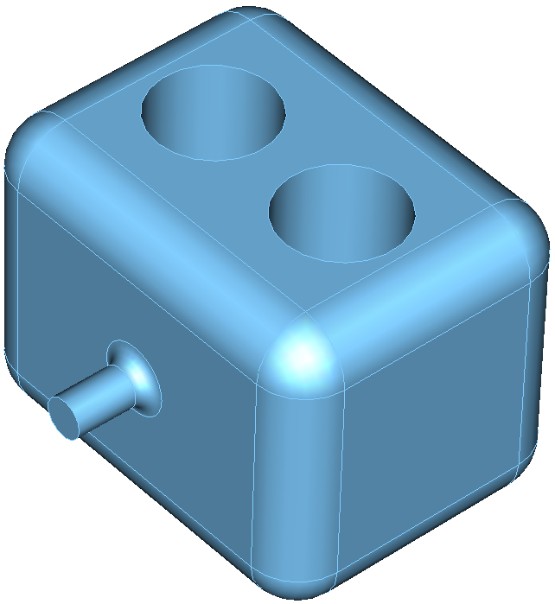
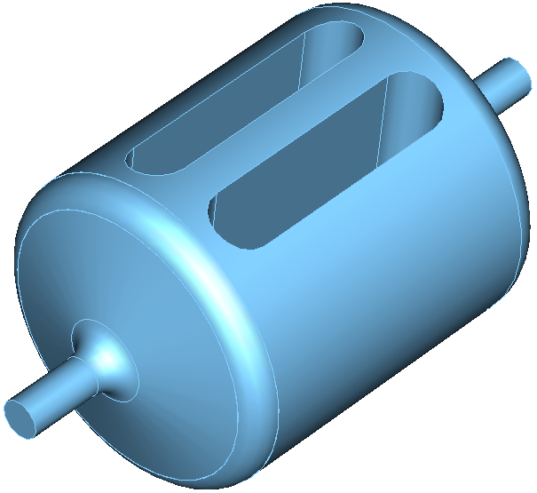
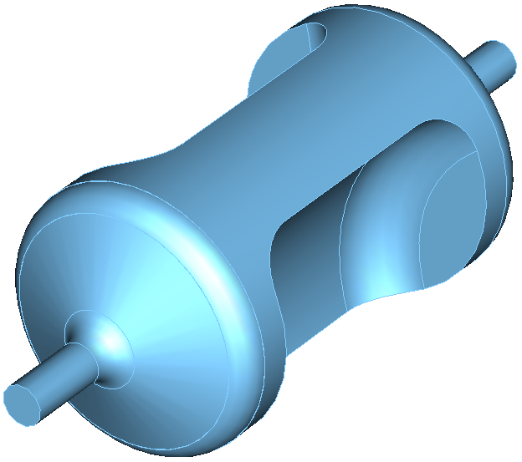
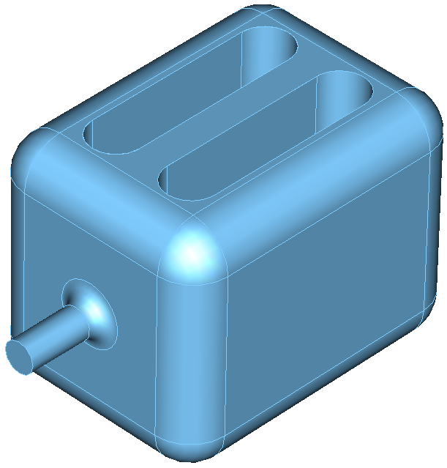
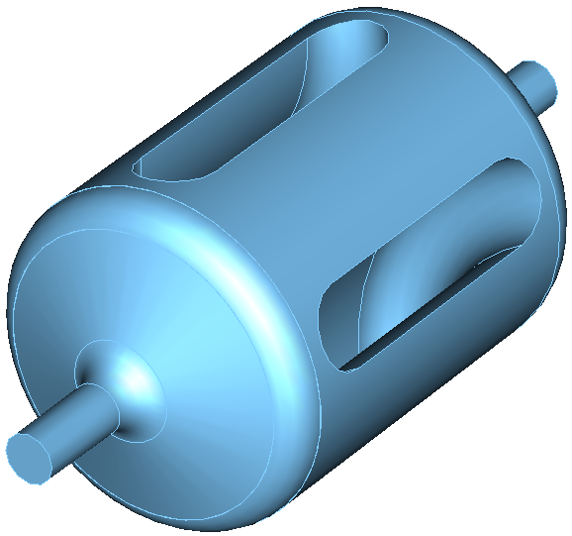
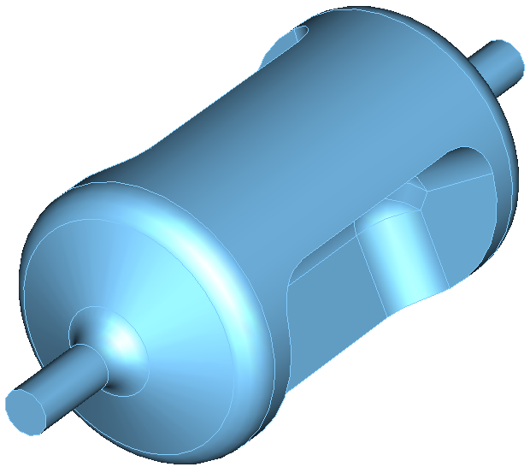
Parallel-Bar Cavity (ODU)
Aspects of optimization
  Lower and balanced peak surface fields
  Stability of the design
    Cylindrical shape is preferred to reduce flat surfaces
  Cavity processing
    Curved end plates for cleaning the cavity
  Multipacting
  Wider separation in Higher Order Mode (HOM) spectrum

Slide 3
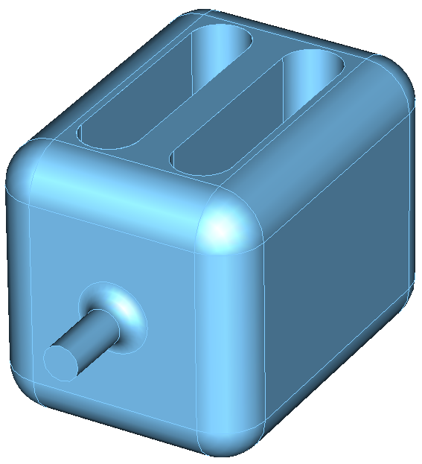
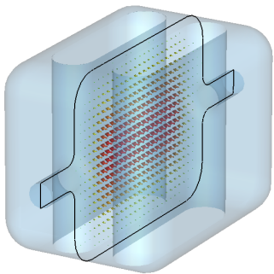
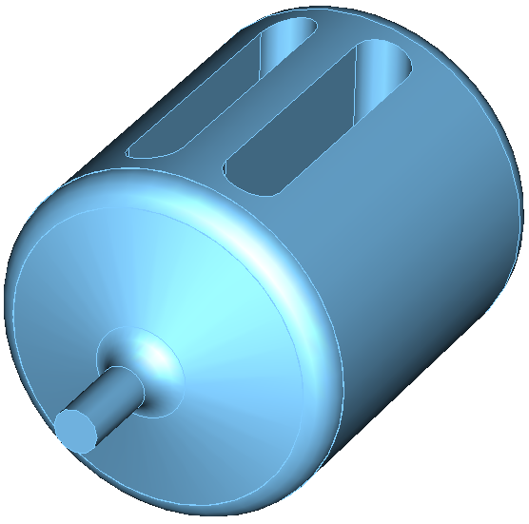
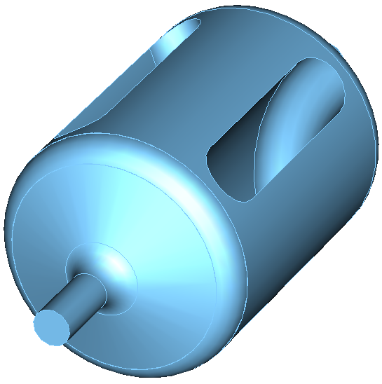
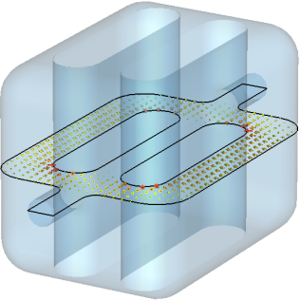
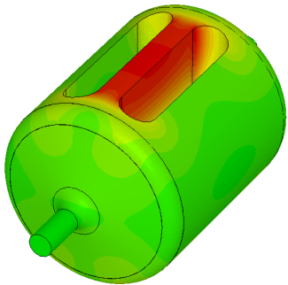
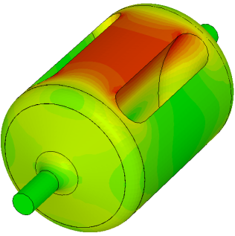
Design Evolution – 499 MHz
To increase mode separation between fundamental modes
~18 MHz → ~ 130 MHz
To improve design rigidity → Less susceptible to mechanical vibrations and deformations
To lower peak magnetic field
Reduced peak magnetic field by ~20%

Slide 4
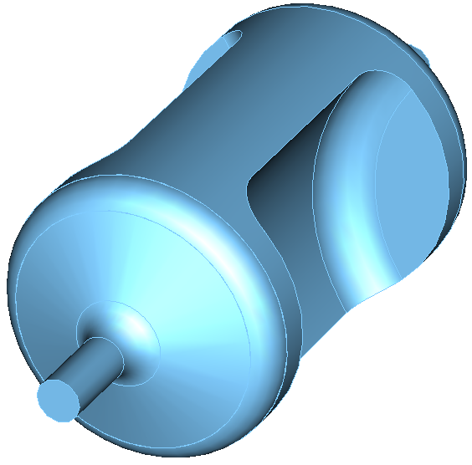
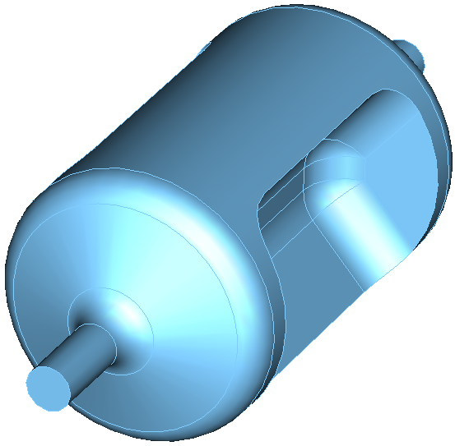
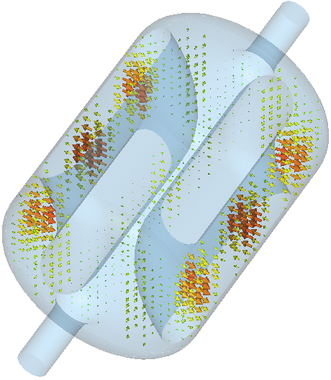
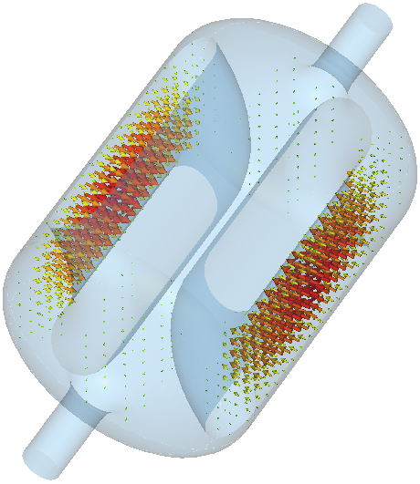
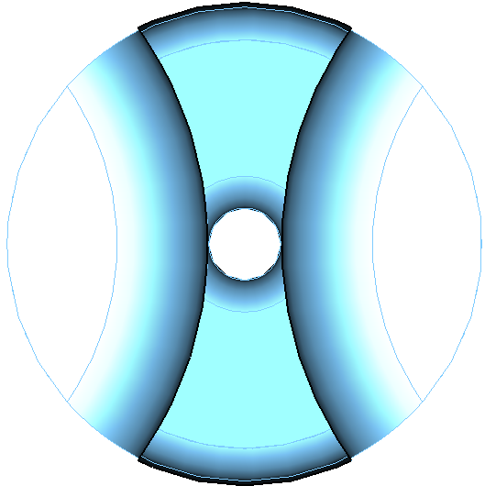
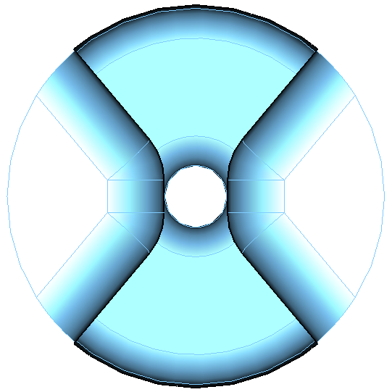
Design Evolution – 499 MHz
To remove higher order modes with field distributions between the cavity outer surface and bar outer surface
Eliminate multipacting conditions
To lower peak magnetic field
Reduced peak magnetic field by ~25%
To achieve balanced peak surface fields of

Slide 5
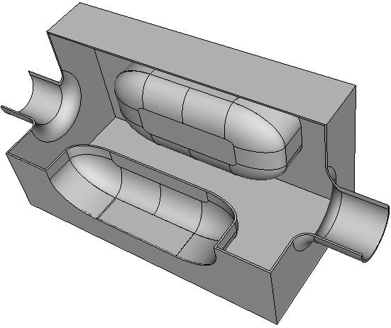
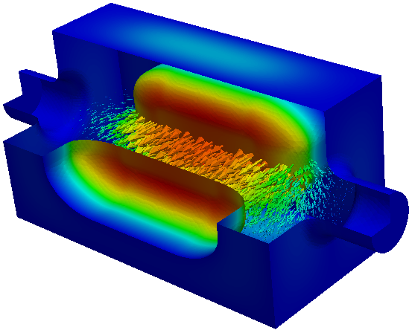
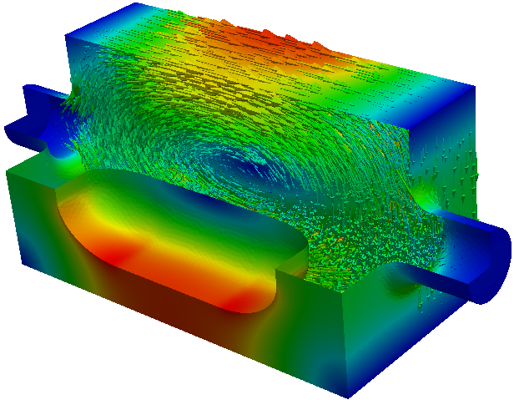
Ridged Waveguide Cavity (SLAC)
400 MHz LHC Crabbing System – Zenghai Li

Slide 6
ODU/SLAC Cavity Properties
Compact design
  Supports low frequencies
Fundamental deflecting/crabbing mode has the lowest frequency
  No LOMs, no need for notch filter in HOM coupler
  Nearest HOM widely separated ( ~ 1.5 fundamental)
Low surface fields and high shunt impedance
Good balance between peak surface electric and magnetic field
Good uniformity of deflecting field due to high degree of symmetry

Slide 7
Parallel Bar Cavity Activities at ODU/JLab
Deflecting Cavity
  Jefferson Lab 12 GeV Upgrade (499 MHz)
  (DOE-NP, ODU-Niowave P1 STTR completed)
  Project-X (365.6 MHz)
  (ODU-Niowave P1 STTR completed)
Crabbing Cavity
  LHC Luminosity Upgrade (400 MHz)
  (LARP, ODU-Niowave P2 STTR)
  Medium Energy Electron-Ion Collider (750 MHz)
  (ODU-Niowave P1 STTR completed, P2 STTR)

Slide 8
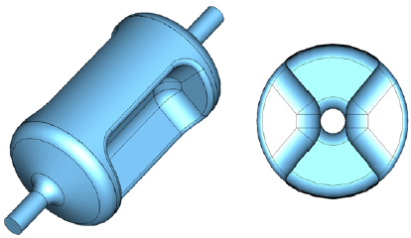
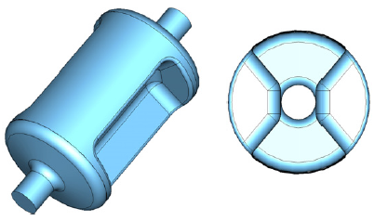
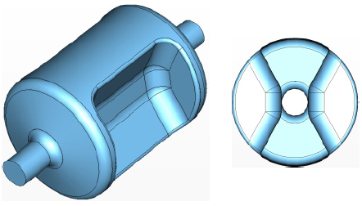
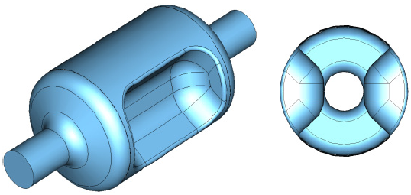
Current Status
499 MHz JLab Upgrade Deflector
Fabrication under way
400 MHz LHC Crabbing System
Fabrication completed
In preparation for testing
750 MHz MEIC Crabbing System
Fabrication underway
365 MHz Project X Deflector

Slide 9
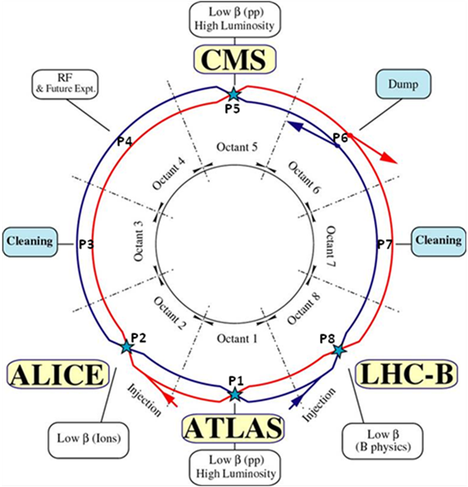
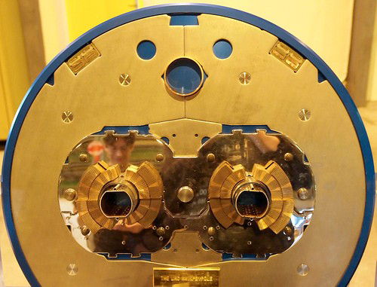
LHC Crabbing Cavity Requirements
Local scheme - Operating rf frequency – 400 MHz
Requires vertical and horizontal crabbing at the two interaction points (IP1 and IP5)
Transverse voltage requirement - 10 MV per beam per side
<150 mm
42 mm
<150 mm
B₁
B₂
194 mm
Cavity length < 1 m

Slide 10

JLab Applications
JLab 12 GeV RF Separator
JLab–MEIC Crabbing Cavity
Operating RF Frequency – 499 MHz
Operating frequency – 750 MHz
Crabbing cavities for both
  Proton beam = 60 GeV
  Electron beam = 12 GeV
V_{T}
  Proton beam = 8 MV
  Electron beam = 1.5 MV
No dimensional constraints
60 mm beam aperture
4th Pass Beam Line
450 mm
300 mm
R = 20 mm
5th Pass Beam Line
680 mm
Hall A
V_{T}
Hall B
Hall C
Deflecting Angle = 506 µrad
V_{T} at peak = 5.6 MV

Slide 11
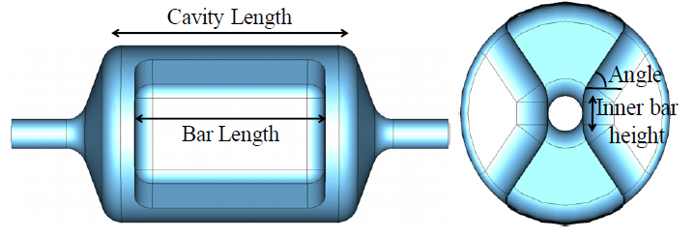
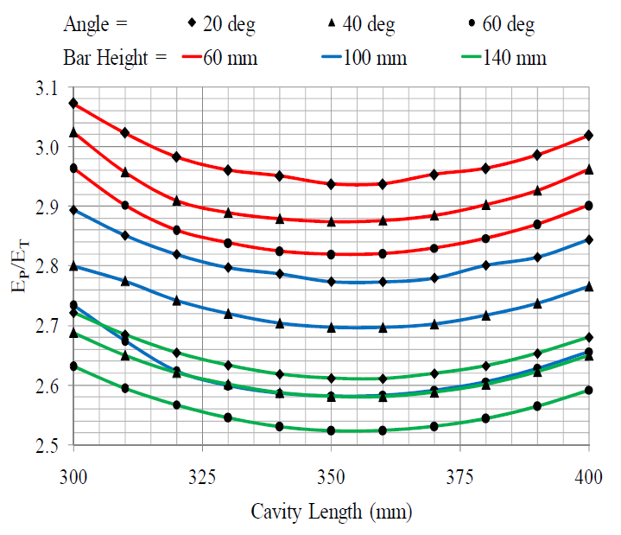
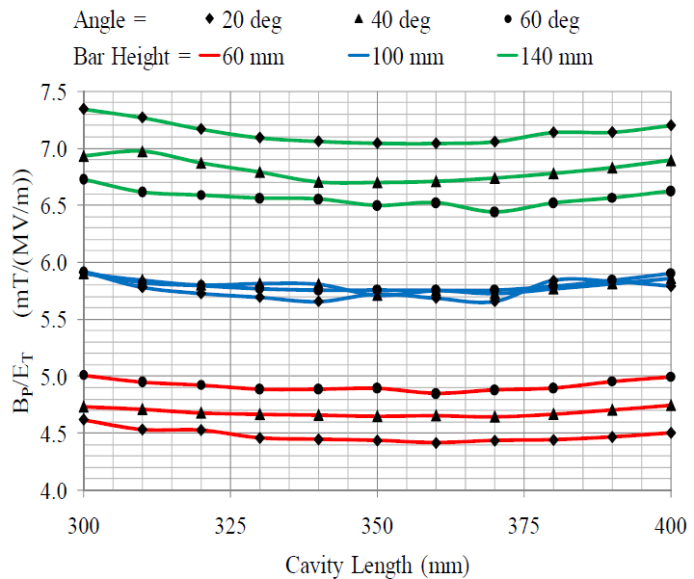
Design Optimization – 499 MHz

Slide 12
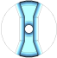
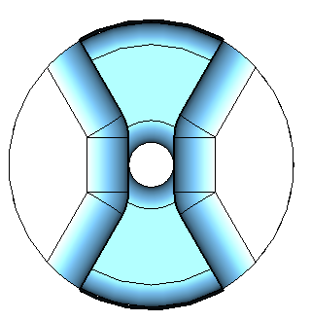
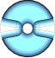
Optimization of Bar Shape – 499 MHz
θ
[30 MV/m, 45 mT]

Slide 13
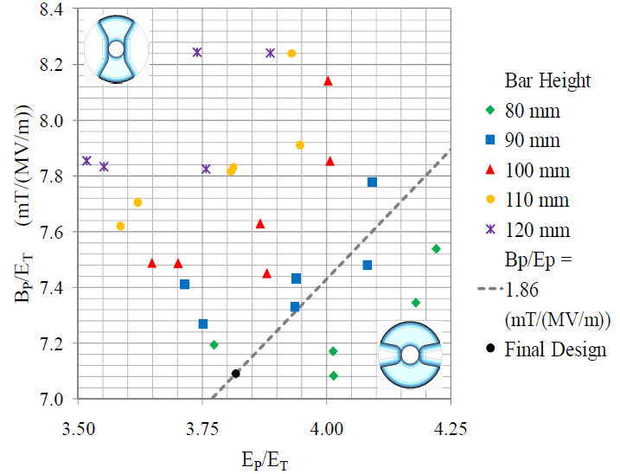
Design Optimization – 400 MHz
[35 MV/m, 65 mT]

Slide 14
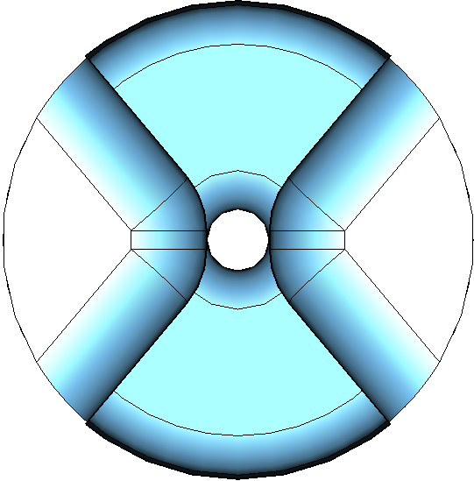
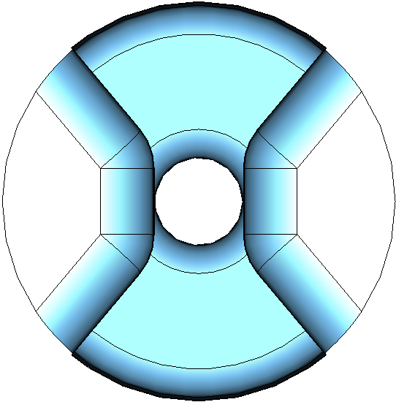
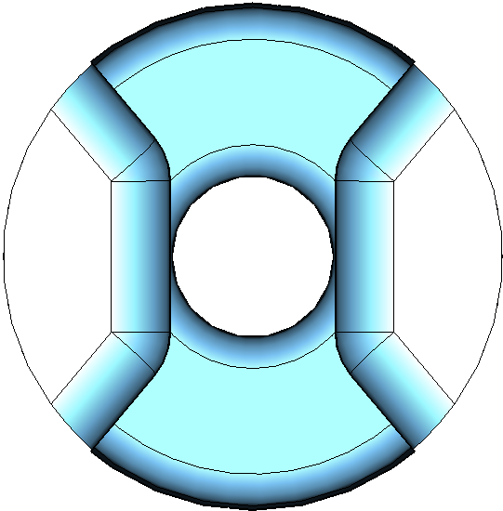
Dependence of Beam Aperture
At 499 MHz

Slide 15
Beam Aperture Dependence
At 499 MHz

Slide 16
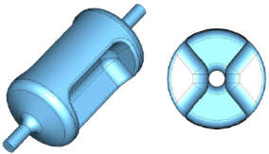
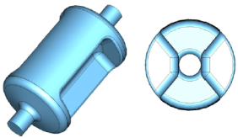

Parallel-Bar Cavity Properties
Parameter | 499 MHz | 400 MHz | 750 MHz | Unit
λ/2 of π mode | 300.0 | 375.0 | 200.0 | mm
Frequency of 0 mode | 1036.1 | 887.0 | 1376.7 | MHz
Nearest mode to π mode | 777.0 | 589.5 | 1062.5 | MHz
Cavity reference length | 440.0 | 527.2 | 270.0 | mm
Cavity diameter | 241.2 | 339.9 | 95.1 | mm
Bars length | 260.0 | 350.0 | 200.0 | mm
Bars inner height | 50.0 | 80.0 | 63.0 | mm
Angle | 50.0 | 50.0 | 45.0 | mm
Aperture diameter | 40.0 | 84.0 | 60.0 | mm
Deflecting voltage (V_{T}*) | 0.3 | 0.375 | 0.2 | MV
Peak electric field (E_{P}*) | 2.86 | 3.9 | 4.29 | MV/m
Peak magnetic field (B_{P}*) | 4.38 | 7.13 | 9.3 | mT
B_{P}* / E_{P}* | 1.53 | 1.83 | 2.16 | mT / (MV/m)
Geometrical factor (G = QR_{S}) | 105.9 | 138.7 | 136.0 | Ω
[R/Q]_{T} | 982.5 | 287.2 | 125.0 | Ω
R_{T}R_{S} | 1.0×10⁵ | 4.0×10⁴ | 1.7×10⁴ | Ω²
At E_{T}* = 1 MV/m

Slide 17
HOM Properties of 499 MHz Cavity
No Lower Order Modes

Slide 18
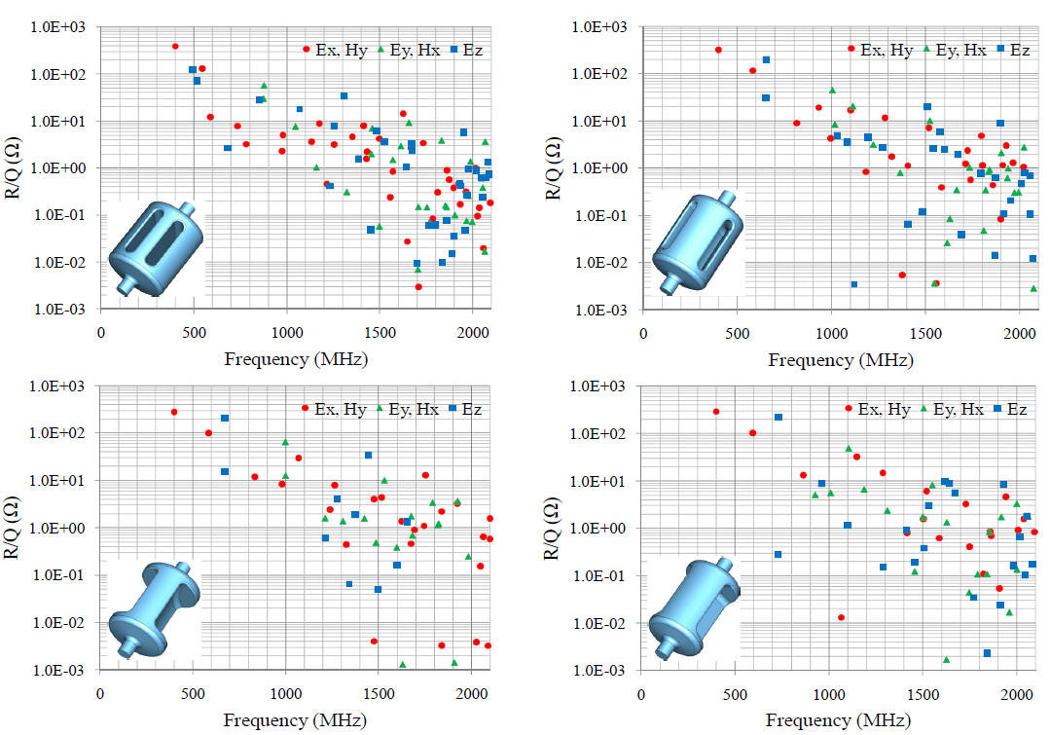
HOM Properties of 400 MHz Cavity

Slide 19
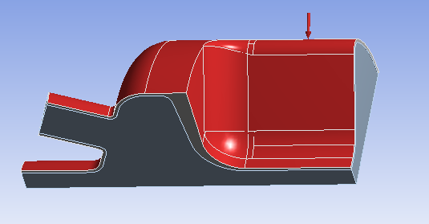
Pressure Sensitivity – 499 MHz
Mechanical analysis - ANSYS
Fixed support at the beam pipe ends
Varying external pressure up to 1 atm
Inside vacuum is deforming by the cavity deformation
Deformed vacuum is extracted and the frequency is solved by ANSYS high frequency eigen solver
Frequency is not 499 MHz before the deformation because the cavity is oversized anticipating the thermal shrink at 2-4K
Pressure sensitivity -212 Hz/torr
HyeKyoung Park

Slide 20
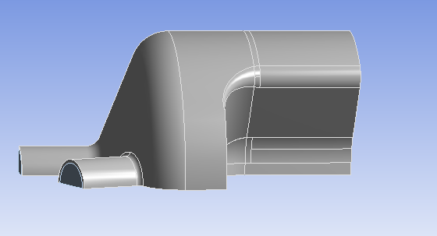
Pressure Sensitivity – 499 MHz
Effect of surface’s deformation to the frequency shift
One surface is artificially fixed (no deformation) at a time and the vacuum load is applied
Mechanical stability of the cap is most helpful to decrease the frequency change
The ‘Bar’ needs to be constrained against the pressure
The surfaces ‘slope’ and ‘OC’ seem to compensate each other, constraining one against the other does not help
OC
Cap
Slope
Bar
Fixed surface | F1 (Hz) | F2 (Hz) | F2-F1 (Hz) | Hz/Torr | Deformation (mm)
 |  |  |  |  | Bar | OC | Slope | Cap
Bar | 498031682 | 498139282 | 107601 | 141 | 0 | 0.073 | 0.060 | 0.02
Cap | 498031682 | 498026821 | -4861 | -6 | 0.0017 | 0.040 | 0.100 | 0
OC | 498031682 | 497959878 | -71804 | -94 | 0.0028 | 0 | 0.100 | 0.02
Slope | 498031682 | 498076554 | 44872 | 59 | 0.0036 | 0.045 | 0 | 0.02
Bar and Cap | 498031682 | 498112353 | 80671 | 106 | 0 | 0.055 | 0.066 | 0
Cap and Slope | 498031682 | 498064828 | 33146 | 44 | 0.0037 | 0.038 | 0 | 0
F1: Frequency before the deformation
F2: Frequency after the deformation

Slide 21
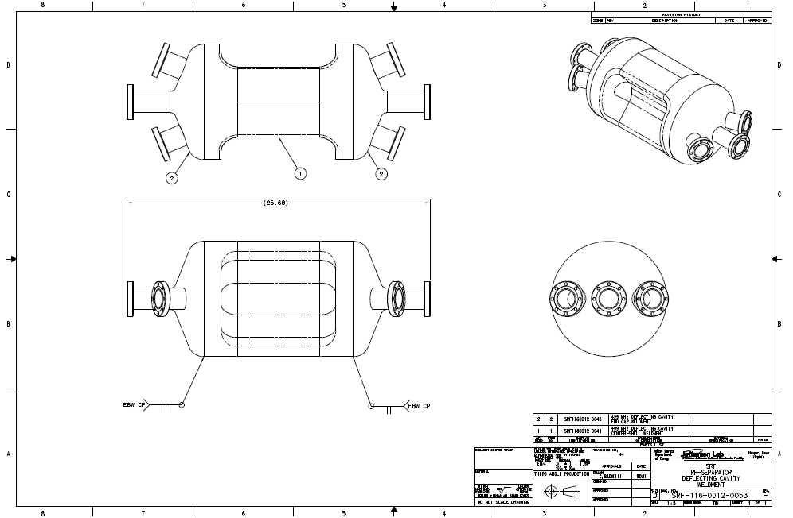
JLab Deflecting Cavity – 499 MHz

Slide 22
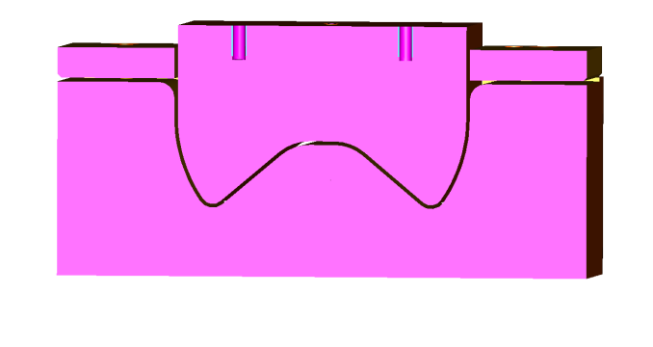
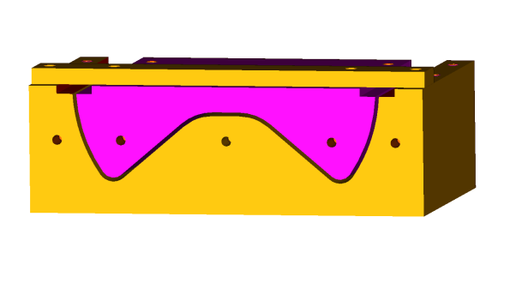
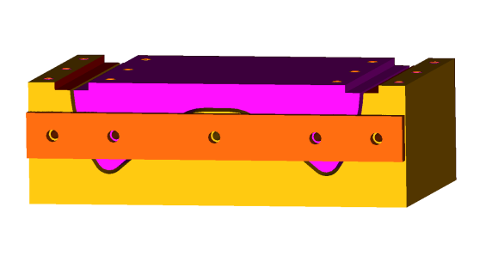
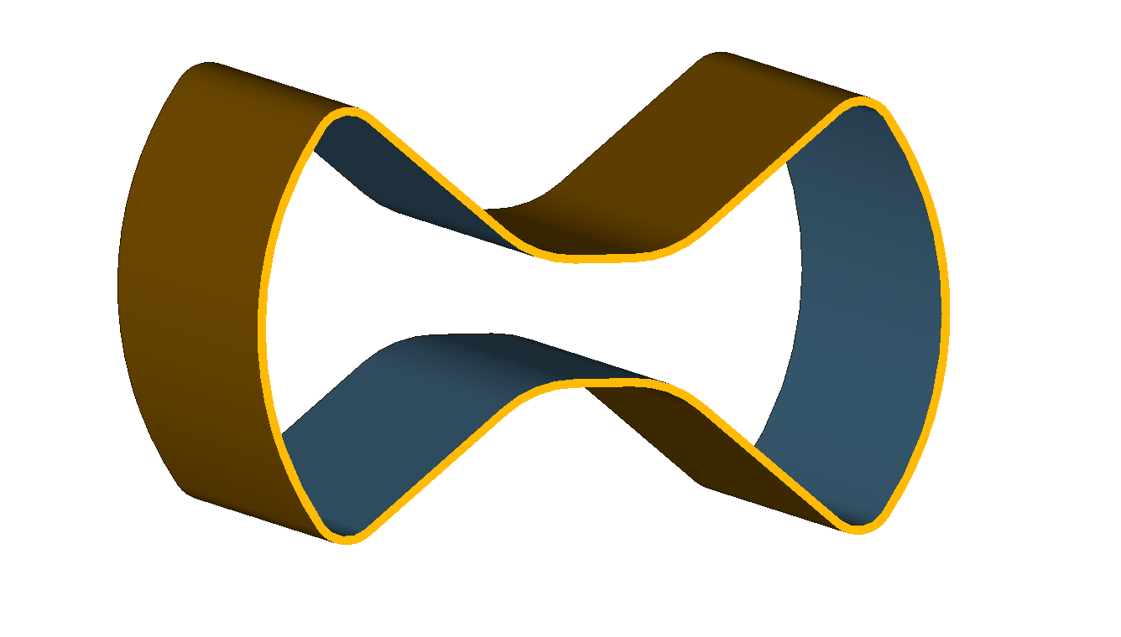
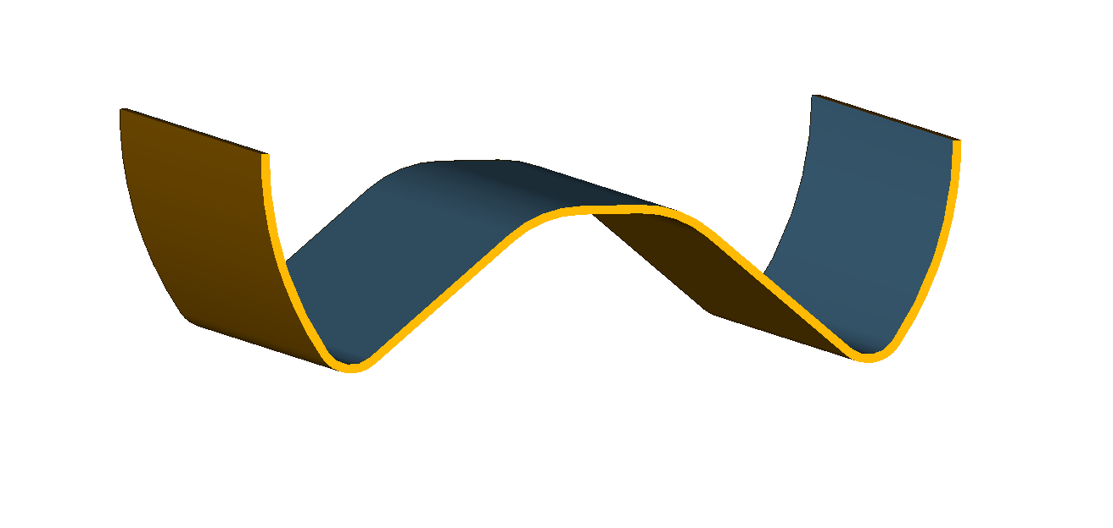
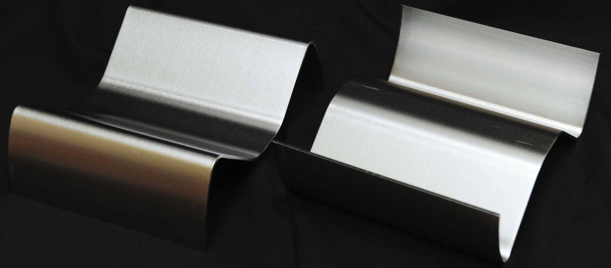



Body Weldment – 499 MHz
Center shell machining
Weld margin included
Center shell forming
(Die cross section)
EBW seams: 40% pre-pass, 50kV 48mAmp 6 in/min beam speed
Welding will be both sides to ensure the smooth surface inside

Slide 23






Center Block – 499 MHz
Machined cavity shoulder
Welding cavity shoulder and center shell
End cap side
Center shell side

Slide 24


Niobium Beam Ports with Nb-Ti Flanges
Al-Mg gaskets for final assembly
For tunings and measurements Indium seal will be used

Slide 25






End Cap Weldment – 499 MHz

Slide 26
LHC Crabbing Cavity – 400 MHz

Slide 27




End Cap Fabrication – 400 MHz

Slide 28


Fabrication of the Body – 400 MHz

Slide 29

Room Temperature Measurements

Slide 30
Frequency Measurements – 400 MHz
0.5* f₀ separation

Slide 31




499 MHz and 400 MHz Cavity Plan
Work in progress to start testing in July
499 MHz Design
  Electropolishing of parts
  Weld preparation and assembly welding
  Final light BCP and high pressure rinse
  LLRF system exist
400 MHz Design
  Completed EB welded cavity @ JLab
  Bulk BCP and high pressure rinse
  LLRF system is required
600⁰ C baking in the furnace
In-situ baking at 120⁰ C in vacuum
500 W rf amplifier: 300-800 MHz
rf testing at 2K and 4K
Variable power coupler

Slide 32


750 MHz Crabbing Cavity
Crabbing cavity for proposed Medium-Energy Electron-Ion Collider (MEIC)
Desired net deflection
  e⁻ beam: 1.5 MV
  p beam: 8 MV
Fabrication
  Beam ports are finished
  Center body fabrication - started
Parameter | 750 MHz | Unit
Nearest mode to π mode | 1062.5 | MHz
Deflecting voltage (V_{T}*) | 0.2 | MV
Peak electric field (E_{P}*) | 4.29 | MV/m
Peak magnetic field (B_{P}*) | 9.3 | mT
Geometrical factor (G = QR_{S}) | 136.0 | Ω
[R/Q]_{T} | 125.0 | Ω
At E_{T}* = 1 MV/m
* Work in progress by; Alex Castilla
32

Slide 33






ODU/SLAC 400 MHz Square Cavity Options
Designs are fairly similar in structure and properties
  Final design depends on final specifications
  Field uniformity
  Impedance budget

Slide 34








Field Distribution / Surface Fields
E Field
H Field
Peak E Field
Peak H Field

Slide 35




400 MHz Square Cavity Design Properties
Parameter |  |  |  |  | Unit
Nearest mode to π mode | 593.4 | 593.2 | 581.8 | 612.5 | MHz
Cavity reference length | 520.0 | 597.2 | 597.2 | 597.2 | mm
Cavity diameter | 339.8 | 295.0 | 295.0 | 295.0 | mm
Bars length | 345.0 | 350.3 | 350.3 | 350.3 | mm
Bars height | 80.0 | 85.0 | 85.0 | 136.0 | mm
Angle | 50.0 | 30.0 | 30.0 | 11.0 | deg
Aperture diameter | 84.0 | 84.0 | 84.0 | 84.0 | mm
Deflecting voltage (V_{T}*) | 0.375 | 0.375 | 0.375 | 0.375 | MV
Peak electric field (E_{P}*) | 3.82 | 3.86 | 4.23 | 3.75 | MV/m
Peak magnetic field (B_{P}*) | 7.09 | 6.9 | 7.69 | 6.85 | mT
B_{P}* / E_{P}* | 1.86 | 1.79 | 1.82 | 1.83 | mT / (MV/m)
Non-Uniformity at 15 mm offset in x | 2.06 | 2.91 | 0.3 | 2.08 | %
Non-Uniformity at 15 mm offset in y | 2.23 | 3.04 | 1.1 | 2.19 | %
Stored Energy (U*) | 0.19 | 0.18 | 0.17 | 0.17 | J
Geometrical factor (G = QR_{S}) | 119.7 | 115.0 | 108.5 | 152.9 | Ω
[R/Q]_{T} | 312.2 | 315.7 | 336.4 | 331.1 | Ω
R_{T}R_{S} | 3.7×10⁴ | 3.6×10⁴ | 3.7×10⁴ | 5.1×10⁴ | Ω²
At E_{T}* = 1 MV/m

Slide 36



Field Non-Uniformity
(A)
(B)
(C)
(D)

Slide 37
HOM Properties
Impedance Budget (LHC-CC10):- Longitudinal – 20 kΩ / Transverse – 0.4 MΩ/m

Slide 38
Power Dissipation
Surface resistance of Nb at 400 MHz
  4.5K: 95 nΩ→105 nΩ
  2K: 1.3 nΩ→10 nΩ
Parameter |  |  |  |  | Unit
Deflecting voltage (V_{T}*) | 0.375 | 0.375 | 0.375 | 0.375 | MV
Peak electric field (E_{P}*) | 3.82 | 3.86 | 4.23 | 3.75 | MV/m
Peak magnetic field (B_{P}*) | 7.09 | 6.9 | 7.69 | 6.85 | mT
B_{P}* / E_{P}* | 1.86 | 1.79 | 1.82 | 1.83 | mT / (MV/m)
E_{P} at 3 MV | 30.6 | 30.9 | 33.8 | 30.0 | MV
B_{P} at 3 MV | 56.7 | 55.2 | 61.5 | 54.8 | mT
E_{P} at 5 MV | 51.3 | 51.5 | 56.4 | 50.0 | MV
B_{P} at 5 MV | 94.5 | 92.0 | 102.5 | 91.3 | mT
R_{T}R_{S} | 3.7×10⁴ | 3.6×10⁴ | 3.7×10⁴ | 5.1×10⁴ | Ω²
P at 4.5K at 3 MV / 5 MV | 25.5 / 70.9 | 26.3 / 72.9 | 25.5 / 70.9 | 18.5 / 51.5 | W
P at 2K at 3 MV / 5 MV | 2.4 / 6.8 | 2.5 / 6.9 | 2.4 / 6.8 | 1.8 / 4.9 | W
At E_{T}* = 1 MV/m

Slide 39
Cryomodule for LHC Crab Conceptual Design
Niowave and ODU have received an SBIR Phase-I project dedicated for design and construction of a cryomodule for testing LHC crabbing cavity
Goal is to accommodate all considered options of the crabbing cavity for the HiLumi LHC upgrade
Phase-I includes the comparative design of the proposed device, the Phase-II will include manufacturing and testing of the selected option
Proposed cryomodule would include:
  Prototype cavities that meet the LHC electromagnetic, mechanical, and dimensional requirements
  Power couplers
  HOM couplers
  Frequency tuners
  Realistic tunnel geometry and accommodate the twin beam chambers (84 mm diameter) in close proximity (194 mm center-to-center)
  Allow positioning of the cavity in both, horizontal and vertical deflection configurations
  Adequate thermal and magnetic shielding for 4 K or 2 K operation

Slide 40


Cryomodule for LHC Crab Conceptual Design

Slide 41
Next Steps
Test “proof of concept” cavity
Design and testing of prototype beam line suitable cavity and ancillary
  rf design
    Appropriate dimensions
    Use genetic algorithm
  Fundamental power coupler and higher order mode couplers
  Thermal/Mechanical analysis and engineering design
  Multipacting analysis
  Beam dynamics study, multipole expansion
  Frequency tuners (coarse and fine)
  LLRF and microphonics
  Fabrication and testing
  Cryostat design

Slide 42
Publications
PRST-AB
  Beam Dynamics Studies for Transverse Electromagnetic Mode-type RF Deflectors – Phys. Rev. ST Accel. Beams 15, 022001 (2012) - S. Ahmed, et.al.
PAC 2011 – NewYork, USA
  Design of Superconducting Parallel-bar Deflecting/Crabbing Cavities with Improved Properties – J.R. Delayen, S.U. De Silva
  Fundamental and HOM Coupler Design for the Superconducting Parallel-Bar Cavity – S.U. De Silva, J.R. Delayen
  Multipacting Analysis of the Superconducting Parallel-bar Cavity – S.U. De Silva, J.R. Delayen
  Beam Dynamics Studies of Parallel-Bar Deflecting Cavities – S. Ahmed, et.al.
SRF 2011 – Chicago, USA
  Compact Superconducting Cavities for Deflecting and Crabbing Applications – J.R. Delayen – Inivted Talk
  Designs of Superconducting Parallel-Bar Deflecting Cavities for Deflecting/Crabbing Applications – J. R. Delayen, S.U. De Silva
  Analysis of HOM Properties of Superconducting Parallel-Bar Deflecting/Crabbing Cavities – S.U. De Silva, J.R. Delayen
  Mechanical Study of Superconducting Parallel-Bar Deflecting/Crabbing Cavities – H. Park, S.U. De Silva, J. R. Delayen
IPAC 2011 – San Sebastián, Spain
  Design of Superconducting Parallel-bar Deflecting/Crabbing Cavities – J.R. Delayen, S.U. De Silva
  Crab Crossing Schemes and Studies for Electron Ion Collider – S. Ahmed, et.al.

Slide 43
Publications in Preparation
PRST-AB
  Evolution and Properties of Parallel-Bar Deflecting/Crabbing Cavities – S.U. De Silva, J.R. Delayen
IPAC 2012 – New Orleans, USA
  Design and Development of Superconducting Parallel-bar Deflecting/Crabbing Cavities – S.U. De Silva, J.R. Delayen
  Characteristics and Fabrication of a 499 MHz Superconducting Deflecting Cavity for the Jefferson Lab 12 GeV Upgrade – H. Park, S.U. De Silva, J. R. Delayen
  Engineering of a Superconducting 400 MHz Crabbing Cavity for the LHC HiLumi Upgrade – D. Gorelov, T. Grimm (Niowave, Inc., Lansing, Michigan), S.U. De Silva, J.R. Delayen
  RF Modeling Using Parallel Codes ACE3P for the 400-MHz Parallel-Bar/Ridged-Waveguide Compact Crab Cavity for the LHC HiLumi Upgrade – Z. Li, L. Ge (SLAC, Menlo Park, California), J.R. Delayen, S.U. De Silva
  Simulation of a TEM-mode Crab Cavity in the SPS – H.J. Kim, T. Sen (Fermilab, Batavia), K. Li (Stony Brook University, Stony Brook)
  Impedance Budget for MEIC Electron Ring – S. Ahmed et.al.
LINAC 2012 – Tel Aviv, Israel
  Compact Superconducting Crabbing and Deflecting Cavities – S.U. De Silva – Invited Talk
  Multipole Field Effects of Parallel-Bar Deflecting/Crabbing Cavities – S.U. De Silva, J.R. Delayen

Slide 44
Parting Words
ODU-SLAC collaboration in place and is fruitful
  Electromagnetic design
  Multipacting analysis
  HOM analysis
  Coupler design
ODU-Niowave collaboration on a number of projects has been beneficial (Spoke Cavities, Deflecting/Crabbing Cavities, Small Accelerators)
  Cavity engineering and fabrication
  Cryomodule development
Three deflecting/crabbing structures are under fabrication and testing (499 MHz, 400 MHz and 750 MHz)
LARP is funding a postdoc at ODU (Julius Nfor, started April 1st, 2012) to support LHC High-Lumi program
We are ready to design and develop next cavity and cryomodule
  Need for a list of parameters and specifications

Slide 45
Acknowledgements
HyeKyoung Park (JLab/ODU)
Zenghai Li (SLAC)
Lixin Ge (SLAC)
Terry Grimm (Niowave)
Dmitry Gorelov (Niowave)
Alejandro Castilla (ODU/JLab)
ස්තූතියි

Slide 46
Pressure Measurements
Frequency measurement with cavity evacuation

