Slide 1
Deflecting cavity as kicker option for the SPS intra-bunch feedback system
A. Gallo, f. marcellini – infn/lnf
"The research leading to these results has received funding from the European Commission under the FP7 project HiLumi LHC, GA no. 284404, co-funded by the DoE, USA and KEK, Japan."
LARP CM 18 - FERMILAB

Slide 2
Outline
Consideration on the system bandwidth
First simulations of the cavity kicker

Slide 3
High order beam instabilities in SPS can be damped with a system kicking different portions of each bunch.
From a first analysis of these instabilities a system with a continuous frequency response from DC to about 1 GHz seems to be necessary.
We propose to use narrower bandwidth kickers on the base of the following considerations.
The deflecting voltage to be applied to the beam to kick portions of a bunch without interfering with the following bunches could be a function composed of two terms:
a periodic term with fundamental angular frequency ω₀=2π/ τ_{b} (τ_{b} ≈ 2.5 ns in the SPS, bunch total duration),
a damping term, with a decay time sufficiently shorter than the bunch separation (25 ns in the SPS).

Slide 4
Fourier transform of the previous signal
frequency response is a sequence of harmonics of ω₀
confined by a Gaussian form factor
much lower spectrum occupancy compared to the continuous one, but many resonances.
For practical reasons one should limit a real system to few of them.
For instance if we consider only the first 3 resonances the response in time domain is slightly deformed.

Slide 5
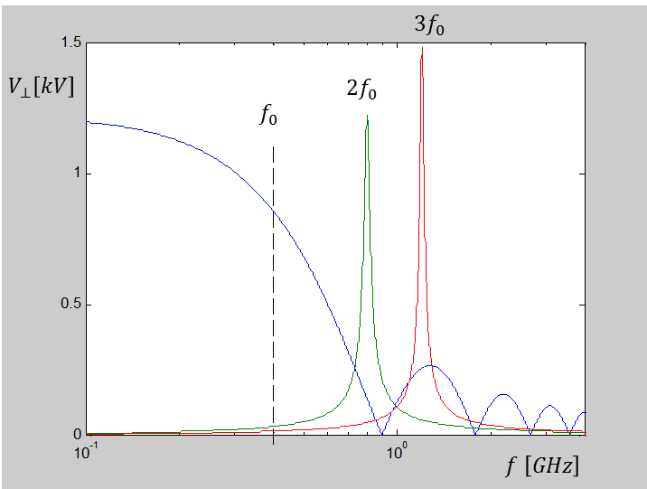
To damp rigid coupled bunch instabilities, the system must provide adequate frequency response also at DC and in a low frequency band.
The overall required system bandwidth could be built by combining:
a stripline kicker, covering the range from DC to the fundamental frequency ω₀=2π/ τ_{b}
2 transverse cavities centered at the 2nd and 3rd harmonics with bandwidths of the order of the bunch repetition frequency.
 | Kicker #1 | Kicker #2 | Kicker #3
Type | Stripline | Cavity, TM110 defl. mode | Cavity, TM110 defl. mode
3-dB bandwidth | DC – 400 MHz | 800 ± 16 MHz | 1200 ± 16 MHz
Length | 17 cm | 15 cm | 10 cm
Filling time | 0.6 ns | 10 ns | 10 ns
Q_{L} | --- | 25 | 38
Shunt Impedance | ≈ 1.5 kΩ (@ DC) | ≈ 1.5 kΩ (@ 800 MHz) | ≈ 2.2 kΩ (@ 1200 MHz)
Proposed system
Resulting transverse voltage transferred to the beam as a function of the frequency, assuming the system of kickers driven by a 1 kW source.

Slide 6
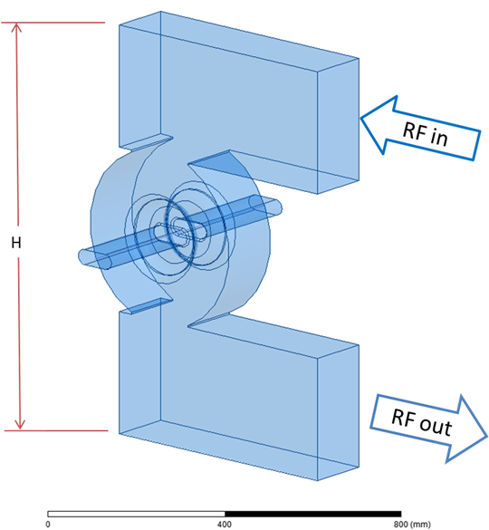
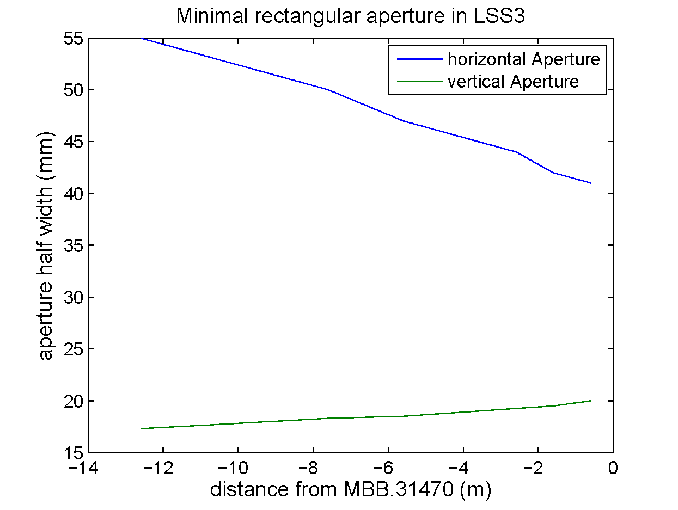
Supposing to adopt this solution, it would be possible to use deflecting cavities with higher loaded Q, easier to design and more efficient as they need less RF power to get the same deflecting voltage.
Verify with simulations that the wanted cavity parameters (frequency, Q and shunt impedance) are feasible.
Simple geometry considered:
single cell cavities
input/output wgs coupled by means of 2 identical and large apertures
working mode: TM110
Rectangular beam pipe (100x36 mm^2) assumed.
from Wolfgang Hoefle

Slide 7
Simulation results
 | Kicker #2 | Kicker #3
Frequency | 0.8 GHz | 1.2 GHz
Q | 23 | 38
Shunt imp | 2.1 kΩ | 3.3 kΩ
H | ≈ 100 cm | ≈ 60 cm
Pipe dimensions | 100x36mm^2 | 100x36mm^2
WG standard | WR-1150 | WR-650
Transmission between input and output ports for the 2 cavities
Considerations
In the simulations both the waveguides are ideally matched. Possible mismatchings should be taken into account and the coupling aperture size re-adjusted in order to get the desired Q.
Design optimizaton to increase the cavity performances still to be done.
This is just one possible geometry to realize the cavity kicker. Different shapes and criteria would be certainly possible and should be considered.

