Slide 1
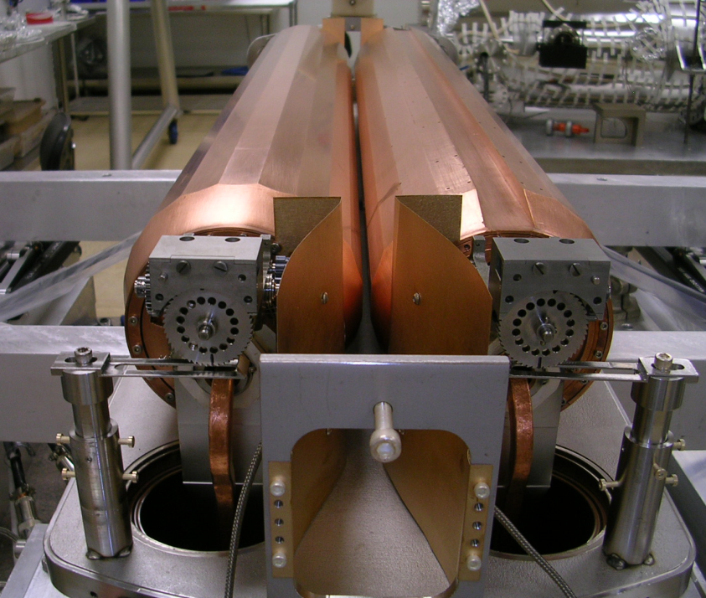
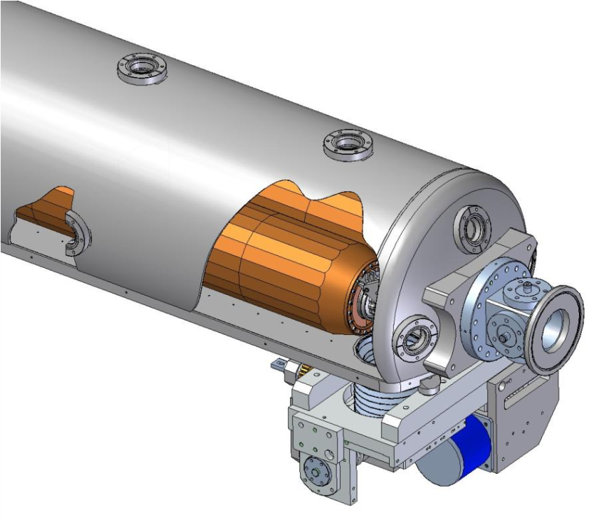
LARP Rotatable Collimator Prototype
Rotation Drives
BPM
Assembly completed and all mechanical tests successful:
Cooling tubes twist, under vacuum, as jaws turn, with R~1 mΩ & align well
In April 2011, discovered after tank welded that the cooling tube of each of the two jaws had been damaged
First jaw, the thermal performance prototype, was wound with non-OFE Cu magnet conductor, 3/8” square with ¼” round cooling channel
Failed after multiple braze cycles
Second jaw was wound with 10mm square, 1.5mm wall OFE Cu tubing
Thinner wall damaged by tack welds to mandrel and perhaps when assembly machined for concentricity

Slide 2
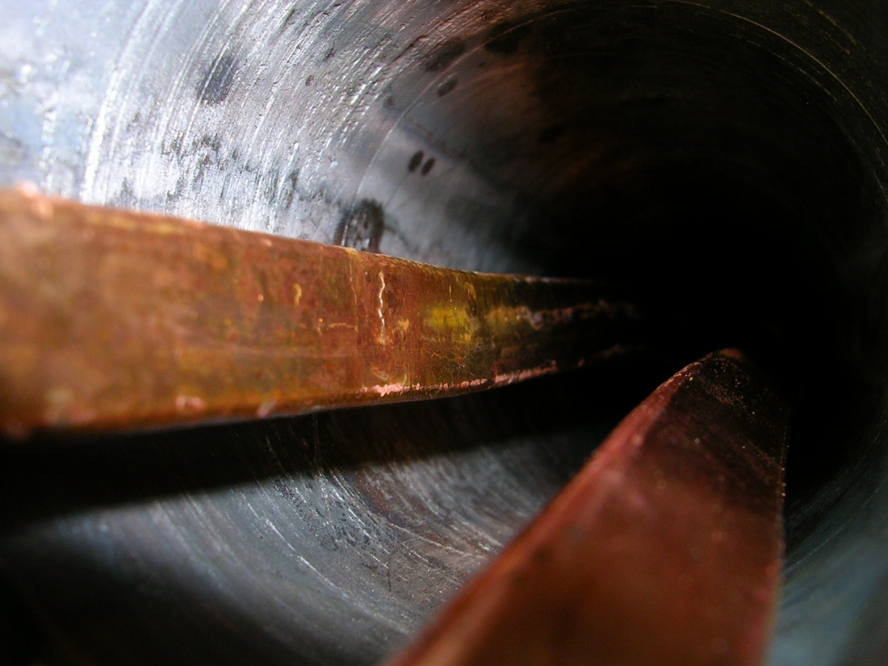
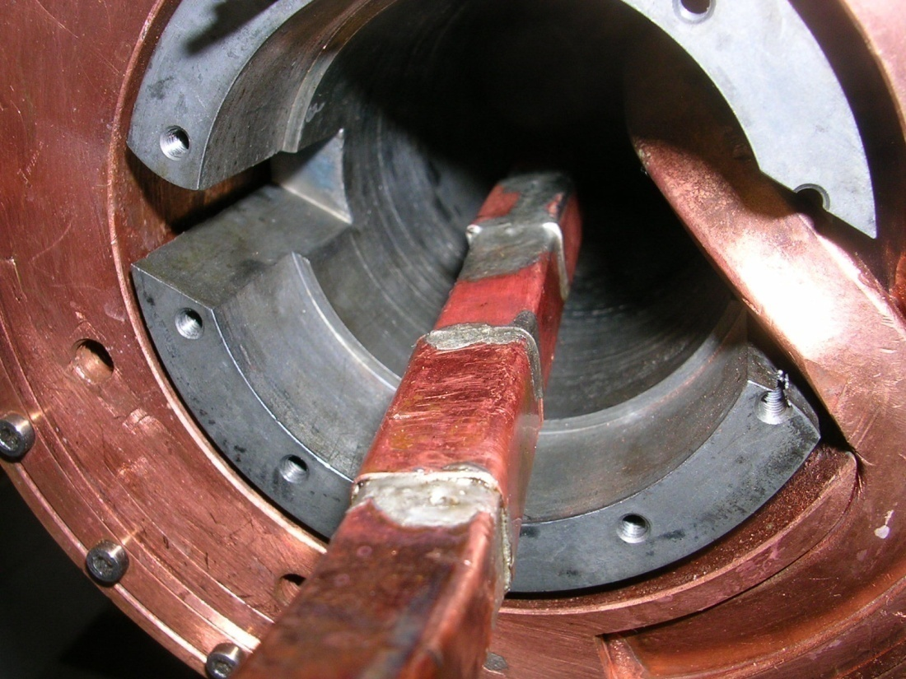
Crack in Copper Magnet Conductor Used for Winding First Prototype Jaw
Suspect weakening in non-OFE Cu tubing at crystal grain boundaries after last of many high temperature firings
Repair with solder patch hold pressure

Slide 3
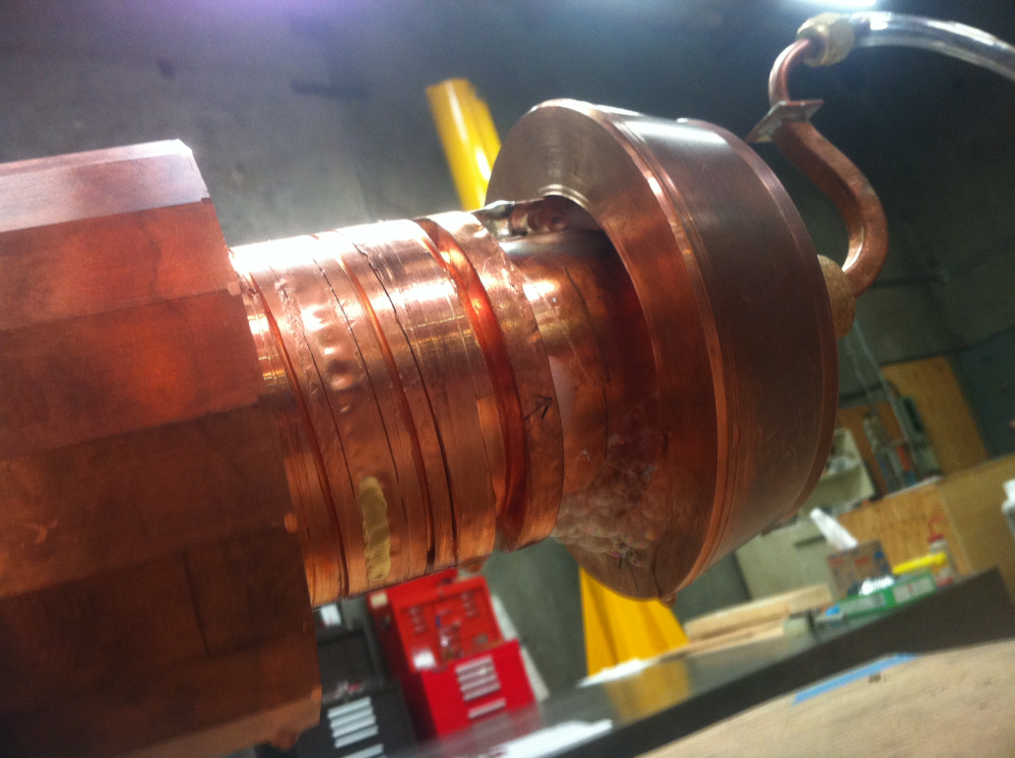
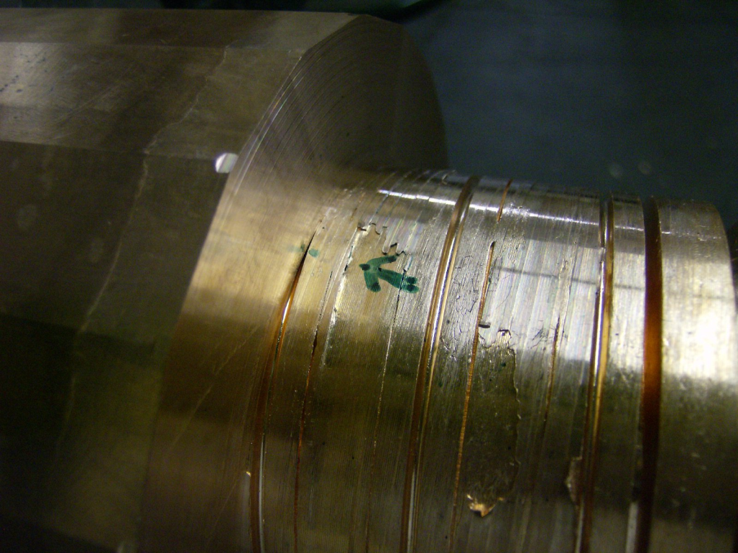
Leaks at Tack Welds and Perhaps at Thinned Points in Thinner Walled Tubing Used for Winding 2nd Prototype Jaw
Tube walls thinned to 0.030” in places when mandrel prepped for jaw braze
Repaired with “CuSil” [possibility this leak introduced during diagnostic cutting]
“SNOOP” bubbles at tack welds used to secure tubing: 5 leak points
Neither of these FAILURES are fundamental: bad material & inadequate assembly
New assembly process being developed to avoid these two procedures
Testing after each step in the assembly process

Slide 4
Other Lessons Learned During Prototype Testing
After 5 weeks of bakeout (with the leaking cooling tubes sealed & inside surface of tubes pumped through their leaks) tank & jaws reach P=4.4E-9 torr with clean RGA
Rotation mechanism tested after bakeout and works
Other “Less important” lessons learned that will be improved in the next prototype
Replace problematic free floating RF bearings with race-constrained bearing
Capture main bearing so cannot slide off shaft during bakeout
Replace W-S2 440 Stainless coated main bearing with ceramic bearing
1 of 4 main bearings froze to race during bakeout (W-S2 316 SS bearings all fine)
Replace 1 of 2 molybdenum rotation drives that cracked when spot welded
Non-fundamental issues that will not be changed
Impedance dominated by tank size & simplified 1-dimensional RF transitions
We will not develop BPMs that move with jaws will not be implemented

Slide 5
Despite Early Desires to Complete a Test Cycle with the Existing Damaged Parts, It has been Decide To……
Replace both jaws & reinsert into existing base plate with existing vacuum bellows and motion system
We have major parts in-house for 2 complete new jaws
Need to
Modify jaw assembly procedure to guarantee cooling tube integrity
Improve the so-called “less-important” lessons learned
Reassemble with rotation drives & test
Re-weld vacuum tank, bake & vacuum test
Need to deliver to CERN as soon as possible
DOE has demanded project be finished as soon as possible
Activity supported by SLAC and carry-forward funds (no new DOE $)
Beam and destructive HiRadMat testing schedule will be determined once RC actually arrives at CERN

Slide 6
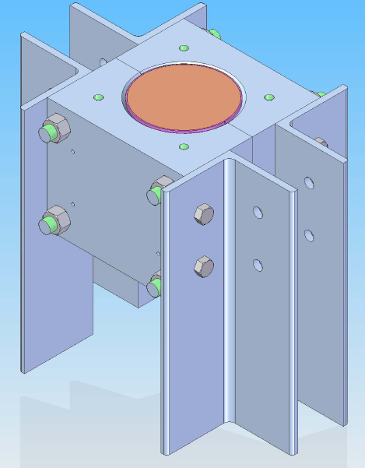
First Attempt at a New Assembly and Braze Procedure to Guarantee Integrity of Cooling Coil
Proposed Procedure:
Wrap a 1mm thick OFE copper sheet around the mandrel with its wound cooling tube
Braze material between sheet and OD of mandrel
Braze in 316 SS Compression Fixture to lock down tubes without spot welds
Tubes not touched during machining to true mandrel OD for jaw braze
Outcome
1mm sheet brazes to TUBES but NOT to the MANDREL
Better procedure required to make sure tubing stays BELOW surface of mandrel

Slide 7
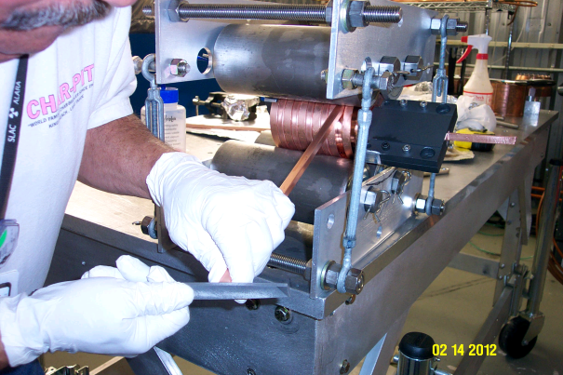
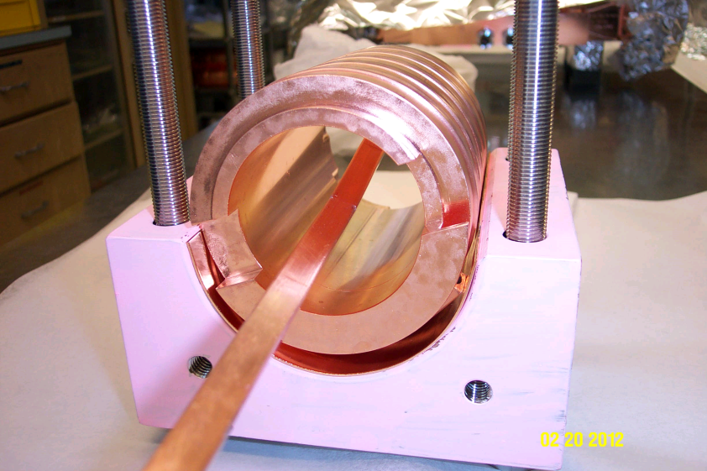
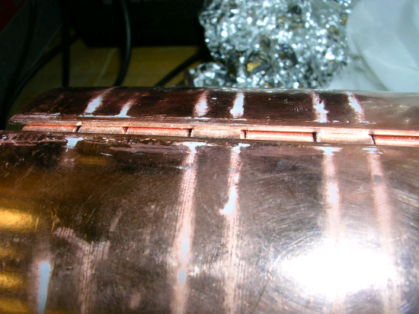
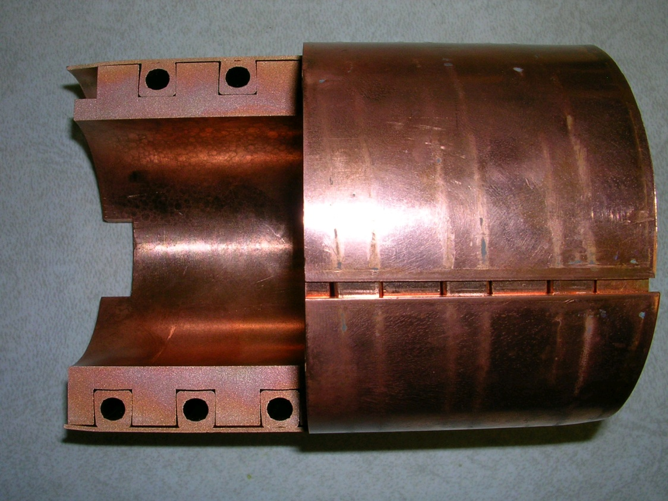
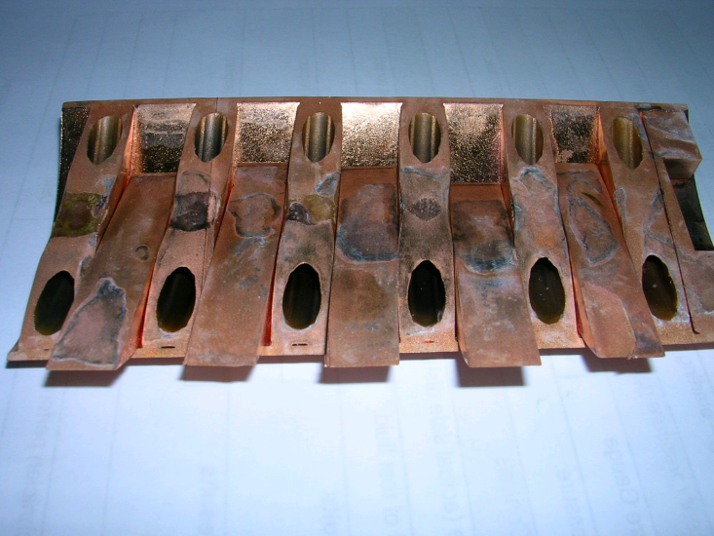
Test Procedure with 20cm Prototype
Gaps
After section cut via EDM, mandrel pieces floating

Slide 8
Lessons Learned from this Prototype
Keystoning an issue
Understand size of the effect & make sure grooves in mandrel match to “braze tolerance”
Need to “stake” mandrel each ¼ turn to make sure cooling tube stays BELOW surface of mandrel THEN built up a protective layer by BRAZING 1mm strips to copper to the coils only
Use more braze material
Braze wire should be put on each edge of cooling coil spiral (as was done for 2 previous prototypes) PLUS sheet braze material to bond 1mm sheet to tops of mandrel AND cooling coil
1mm thick sheet IS adequate to protect against later machining for jaw braze
KLY braze shop advises us to keep 1mm sheet but to abandon the 316SS clamp, returning to the method use to braze the previous mandrels: moly wire
Decide that a 2nd prototype required before risking the two (ready & waiting) cut & grooved full length mandrels

Slide 9
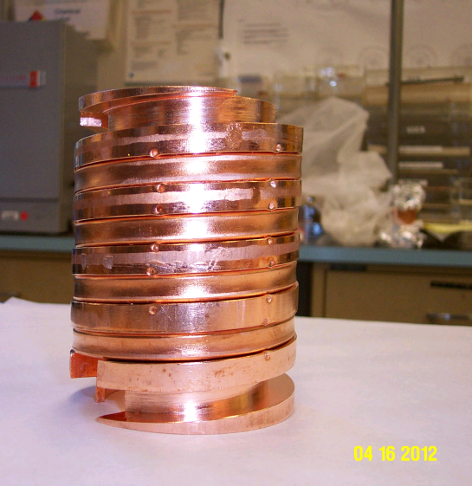
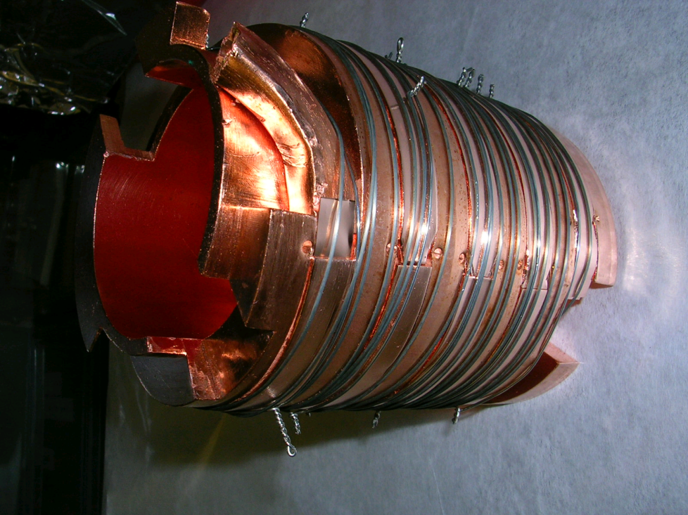
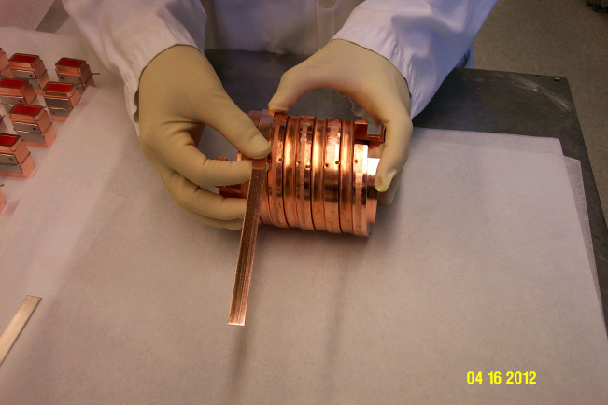
2nd Prototype was prepared Brazed 27 April 2012
Stake points
Tubing stays below mandrel
Strips bound with Nichrome and Molybdenum wire
And ready for brazing
1mm thick OFE Cu strips
Laying strips over tubing

Slide 10
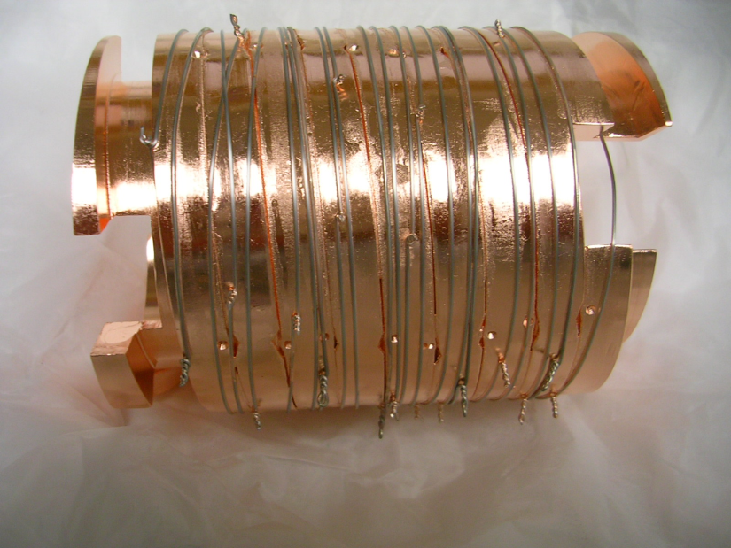
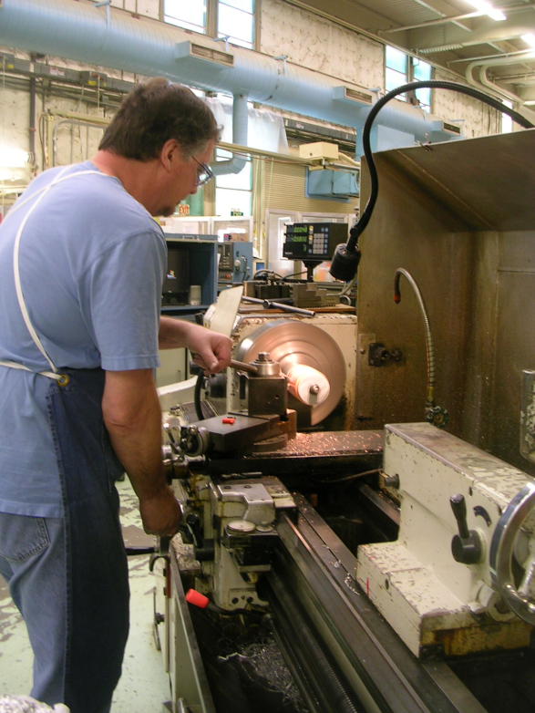
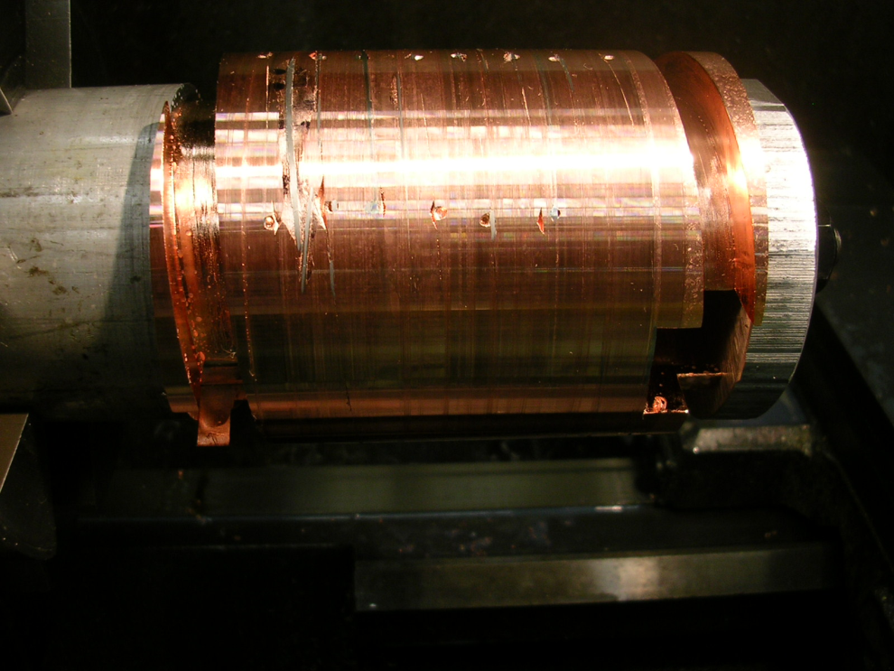
Post Braze and Machining
Out of the furnace
Machine outer diameter to be concentric with axis of test mandrel

Slide 11
EDM Joints to test Braze Quality
Corners need more braze wire (no problem)
Braze at INNER DIAMETER of mandrel groove is incomplete but not an issue
Good braze at OUTER SURFACE where jaw will be brazed
We believe this procedure is finalized & will apply it to the final parts

Slide 12
Steps After New Coil Braze Procedure Finalized
Braze the two new shaft assemblies
Parts IN shop; will be done immediately after the test braze
Fine tune the groove dimensions in the already cut full length mandrels
Wind the mandrels, prepare them with 1mm strips, as per the prototype and braze
GLIDCOP jaw material is in house and is being cut to the required lengths and drilled out
Process of matching ID of GLIDCOP to OD of mandrel tedious but straightforward
Cut features into end pieces of glidcop to hold bearings to which the RF shields mount
BRAZE total assembly
Cut the 20 facets into each jaw and ensure rotation axis is centered on jaw axis
Again, tedious but straightforward
Mount new blocks that will hold the new “main rotation bearings”
In fabrication now
Bearings identified and soon to be ordered
Temporarily mount the existing rotation drives and test rotation & RF contacts
Prepare baseplate to accept the two new jaws
Must mill out the feedthroughs through which the tubes of the previous jaws passed
Must prepare a spacer to account for the kerf from when the vacuum tank cover was sawn off
Mount jaws, test, weld pipes to feedthroughs, weld tank cover to baseplate
Rotation test, vacuum bakeout test
Ship to CERN
Test as appropriate (lab, SPS, HiRadMAT, ..) given arrival date & LHC/SPS schedules

