Slide 1
EU Nb3Sn conductor R&D
L. Bottura, A. Ballarino, L. Oberli
and the MSC-SCD
US-LARP meeting, FNAL
May 7th-9th, 2012

Slide 2

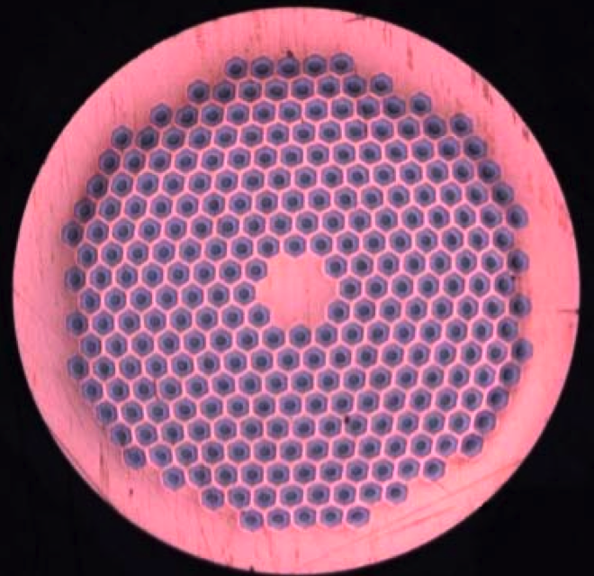
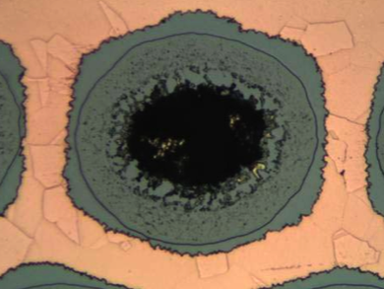
NED - PIT strand
Strand diameter: 1.25 mm
Cu:non-Cu: 1.2
Filament diameter: 50 μm
Number of filaments: 288
Ternary (NbTa)₃Sn
  Precursors:
    NbTa tubes
    Nb₂Sn powder
  HT schedules:
    650 C/120 h
    625 C/300 h

Slide 3
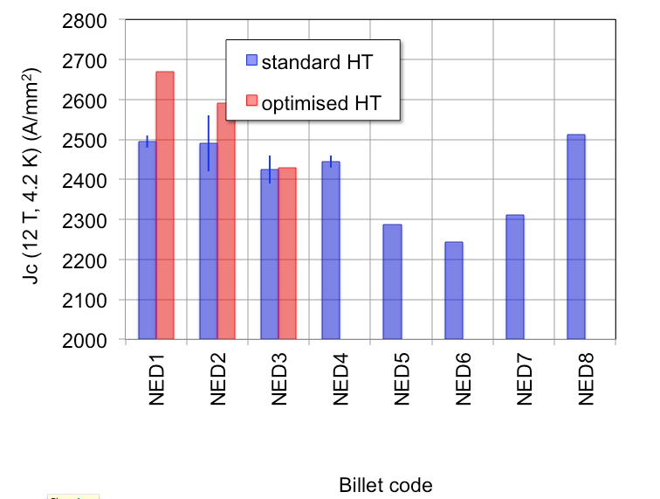
NED program results – 1/3
Jc of PIT wire produced within the scope of the NED R&D
Best performance was achieved optimizing the heat treatment for low plateau temperature (625 °C) and long times (320 hrs) – fine grains
The production has gone through a technology transfer process clearly visible in the measured performance
Clear improvement with present stable manufacturing conditions

Slide 4
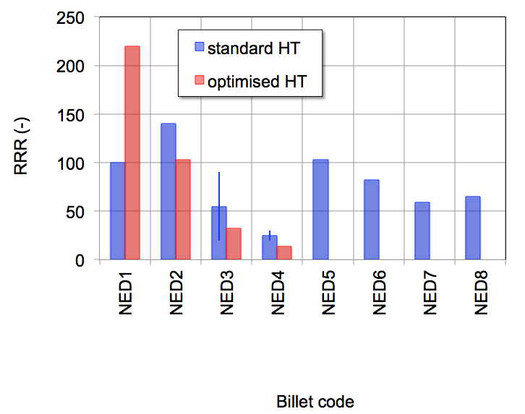
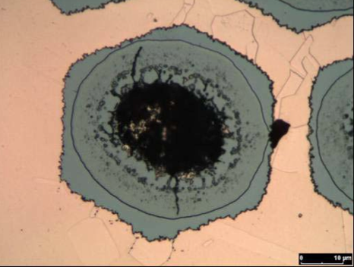
NED program results – 2/3
Excellent RRR values at the beginning of the R&D, much degraded at later times
Optimization of Jc leads to a marked decrease of RRR
This has been traced to the presence of hot-spots in the strand

Slide 5
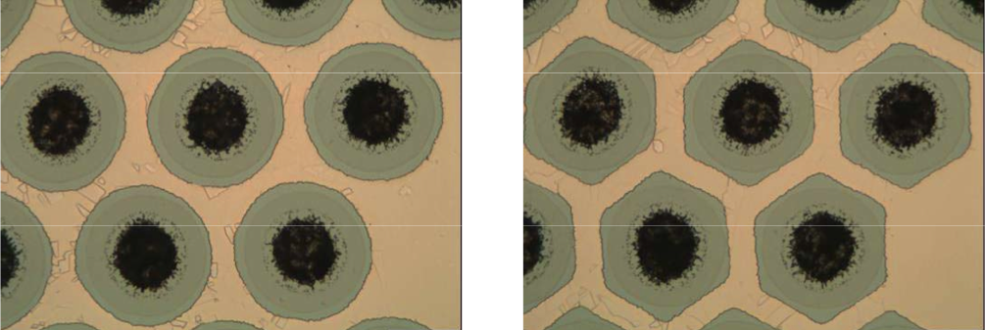
NED program results – 3/3
Modified strand architecture to improve the use of the real estate, and increase the optimization margin for J_{C} at acceptable RRR
For any given strand architecture based on react-able barriers there is an intrinsic limit in the maximum RRR achievable

Slide 6
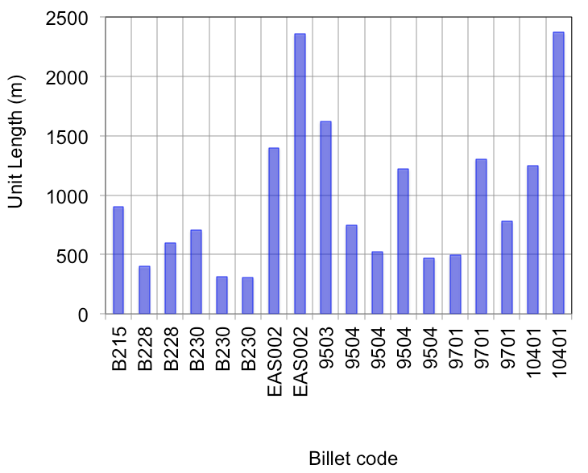
Unit lengths and total length
Initial billets were small size (about 10 kg) R&D, total length 1 km
Billets B230 to 10401 comprise a complete transfer of technology from SMI to EAS, scale up and initial production ramp-up
Typical length < 1 km
Total material delivered 17 km

Slide 7


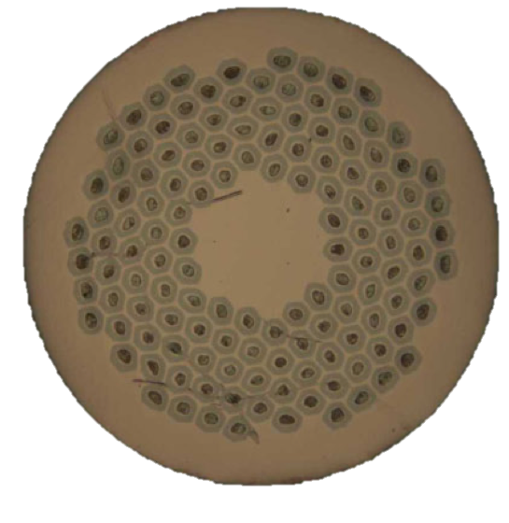
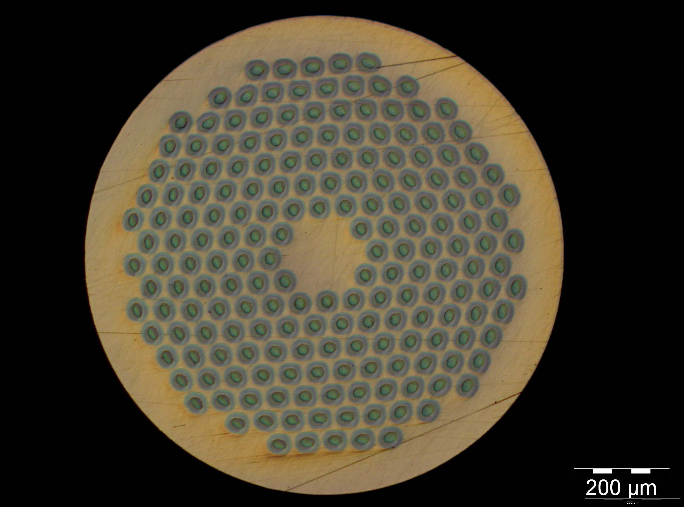
Beyond NED – HFM strands
Strand diameter: 1.0 mm
Cu:non-Cu: 1.25
Filament diameter: 58 μm
Number of filaments: 132
J_{C} (15 T. 4.2 K) > 1575 A/mm²
RRR > 150
UL > 400 m … 800 m
Strand diameter: 1.0 mm
Cu:non-Cu: 1.25
Filament diameter: 48 μm
Number of filaments: 192
J_{C} (15 T. 4.2 K) > 1350 A/mm²
RRR > 150
UL > 400 m … 800 m

Slide 8
Main characteristics of the FRESCA2 strand
 |  | FRESCA2 specification | PIT | RRP
Strand diameter | (mm) | 1.00 | 1.00 | 1.00
Strand layout | - |  | 192 filaments | 132/169 stack
Sub-element diameter | (μm) | < 50 | ~ 48 | ~ 57
Copper to non-Copper volume ratio | - | 1.25 +/- 0.1 | 1.25 +/- 0.1 | 1.30 +/- 0.1
J_{C}(12 T, 4.2 K) | (A/mm²) | 2500 | 2450 | 3100
J_{C}(15 T, 4.2 K) | (A/mm²) | 1250 | 1350 | 1575
n-value @15 T and 4.2 K | - | > 30 | Ok, n > 35 | Ok, n > 34
RRR (after full reaction) Pilot order Production order | - | > 150 > 150 | ok | ok
Piece length Pilot order Production order | (m) | > 150 m (target 400 ) > 800 m | Accepted | Accepted

Slide 9
Nb₃Sn Strand Procurement Status 1/2
13 km of PIT strand ordered by CERN in March 2010.
used for the cable development work and for the fabrication of the SMC cable.
30 km of PIT strand ordered by CEA and CERN to Bruker-EAS.
delivered and available for the fabrication of the first unit lengths
25 km of RRP strand ordered by CEA and CERN to OST.
10 km will be received beginning of May and the remaining quantity
is expected to be delivered in June 2012
An option for 10 km of RRP strand will be taken by CEA as the performances of the RRP strand fabricated for CERN are quite good.
40 km of strand will be ordered by CEA in April 2012.
45 km of strand to be ordered by CERN in November 2012.

Slide 10
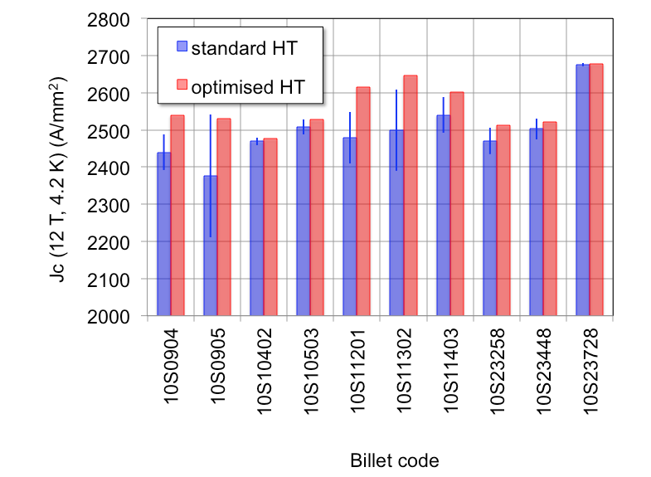
HFM program results – 1/2
Jc of PIT wire produced within the scope of the HFM procurement
Best performance is achieved optimizing the heat treatment for double step plateau temperature (e.g. 620 °C/120 hrs + 620 °C/120 hrs ) – why ?
The production is stabilizing, and seems to be improving in values and homogeneity. NOTE: the variability in a billet is mainly due to optimization.

Slide 11
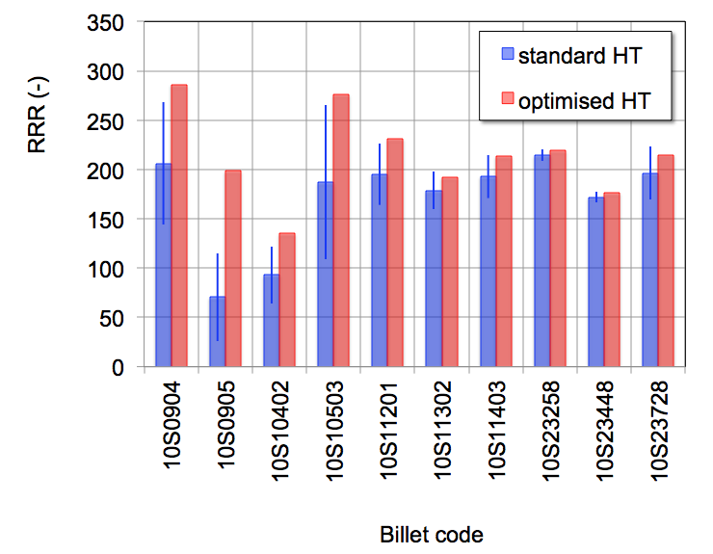
HFM program results – 2/2
Excellent RRR values throughout the production, apart for two billets (10S0905 and 10S10402) built using HEX tubes
Optimization of J_{C} can lead to a loss of RRR, but values are well above 150
HEX

Slide 12
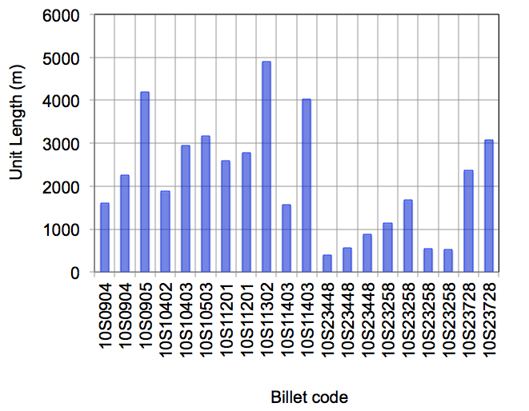
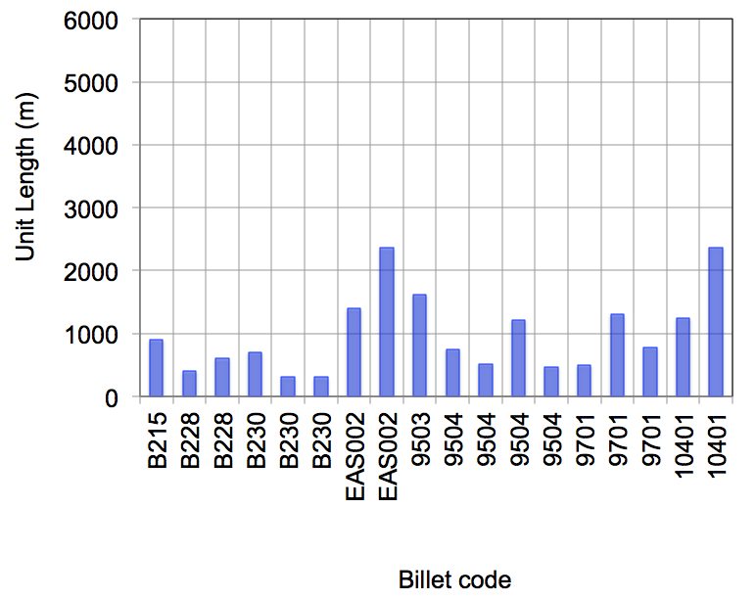
Unit lengths and total length
Most lengths above 1 km, apart for some recent deliveries (we saw some 500 m lengths)
It is not clear whether this is a production issue, or a side effect of the specification
NED

Slide 13
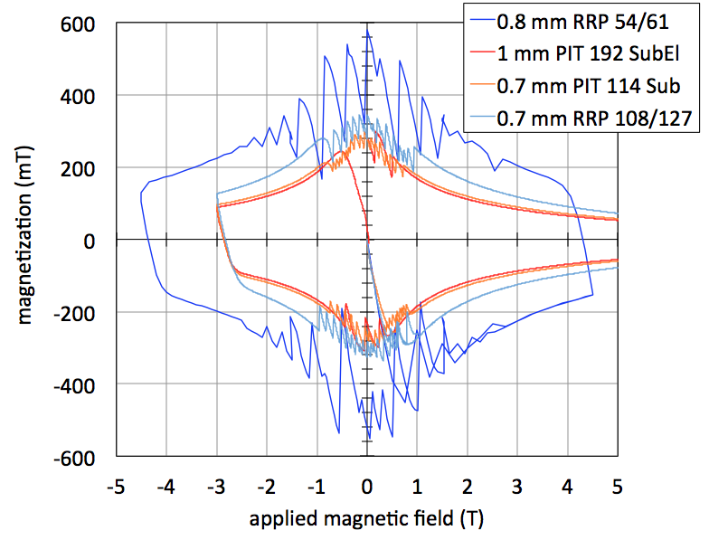
Magnetization
54/61: 75 μm
108/127: 46 μm
114: 45 μm
192: 48 μm

Slide 14
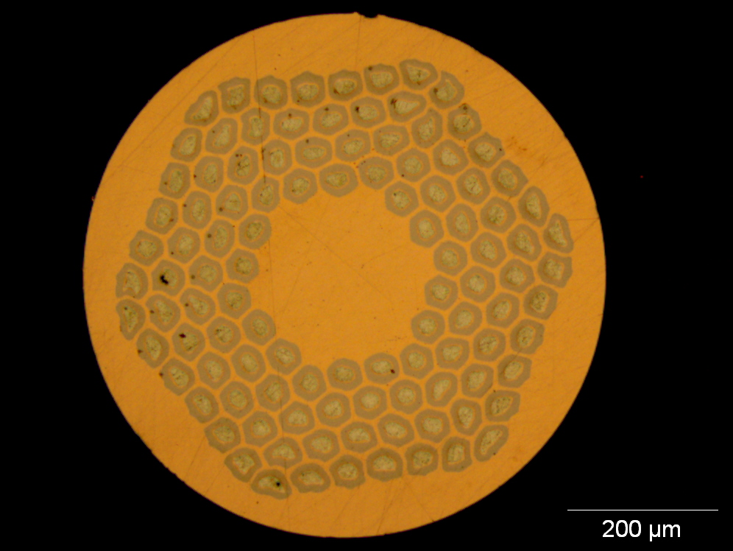
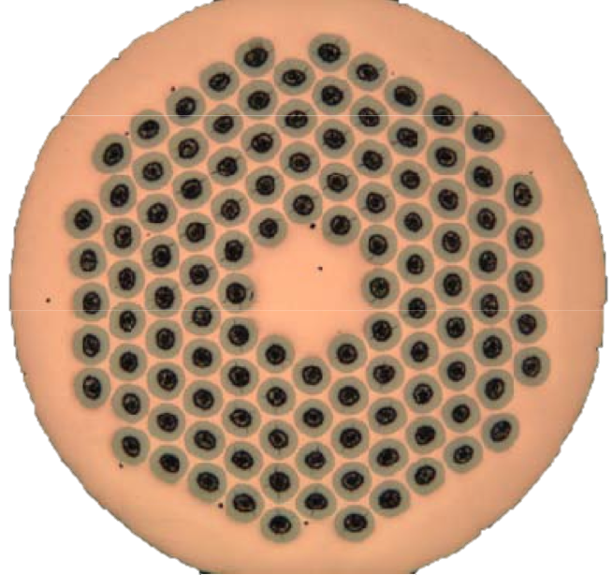
DS-11 T project
Strand diameter: 0.7 mm
Cu:non-Cu: 1.15
Filament diameter: 46 μm
Number of filaments: 108
J_{C} (12 T. 4.2 K) > 2650 A/mm²
RRR > 60
UL > 350 m
Strand diameter: 0.7 mm
Cu:non-Cu: 1.15
Filament diameter: 45 μm
Number of filaments: 114
J_{C} (12 T. 4.2 K) > 2500 A/mm²
RRR > 100
UL > 200 m … 400 m

Slide 15
Pushing further
R&D work for smaller Dfil (< 30 μm), other parameters on a best effort basis
Trade PIT material for the delivered RRP
  0.8 mm, 2500 A/mm², RRR > 150, Dfil 40…50 μm
  Architecture to be proposed by Bruker-EAS
  50 kg total material quantity
New PIT material for IR quadrupole model at 140/150 mm aperture
  0.85-ish mm, 2500 A/mm², RRR> 150, Dfil < 40 μm
  First trial length of 5 km

Slide 16


Procurement strategy (August 2010)
3 EU contracts for 1.25 mm, 3000 A/mm², 50 μm srand
NED program
1.25 mm
3000 A/mm²
40 μm
Test procurement (9 km)
HFM program for FReSCa-II
1 mm
2500 A/mm²
40 μm
Qualification orders (10 km)
Pilot productions (10 km)
Full production (46 (23+23) km)
+
Qualification order (30 km)
DS-MB program
0.7 mm
2650 A/mm²
50 μm
Pilot production (100 km)
Full production (1200 km)
2010
2011
2012
2013
2014

Slide 17
Procurement strategy (September 2011)
3 EU contracts for 1.25 mm, 3000 A/mm², 50 μm strand
NED program
1.25 mm
3000 A/mm²
40 μm
Test procurement (9 km)
Bruker
Qualification orders (10 km)
Bruker
OST
HFM program for FReSCa-II
1 mm
2500 A/mm²
50 μm
Option PIT (5 km)
Bruker
Bruker
Pilot productions (18 km)
OST
Full production (25 km)
+
R&D material (30 km)
OST
Bruker
DS-MB program
0.7 mm
2650 A/mm²
50…30 μm
Qualification order (45 km)
OST
Pilot production (150 km)
Full production (≈ 2500 km)
2010
2011
2012
2013
2014

Slide 18
Procurement strategy (April 2012 – approximate lengths)
3 EU contracts for 1.25 mm, 3000 A/mm², 50 μm strand
NED program
1.25 mm
3000 A/mm²
40 μm
Test procurement (9 km)
Bruker
Qualification orders (10 km)
Bruker
OST
HFM program for FReSCa-II
1 mm
2500 A/mm²
50 μm
Option PIT (5 km)
Bruker
Bruker
Pilot productions (≈ 20 km)
OST
Full production (≈ 45 km)
+
R&D material (30 km)
OST
Bruker
30 μm
Bruker
DS-MB program
0.7 mm
2650 A/mm²
50…30 μm
Qualification order (45 km)
OST
Pilot production (150 km)
Full production (≈ 2500 km)
2010
2011
2012
2013
2014

Slide 19
FRESCA2 cable development
Work started in 2010 with hard Cu wires to fabricate a cable with the aim to optimize the tooling and the cabling parameters.
Depending of the cable width, the transposition pitch of the cable has to be adapted to get a cable mechanically stable and having no gaps between the strands.
Smaller is the width of the cable, larger could be the transposition pitch.
The best results in terms of mechanical stability were obtained with a cable width of 20.9 mm and 20.4 mm.
Different values for the width, the mid-thickness and the transposition pitch of the cable were tried to minimize the degradation of the Ic during cabling.

Slide 20
Summary of the work carried out to develop
the FRESCA2 cable
9 km of PIT strands used for all the cabling tests performed to develop the cable
Billet number | Cable width | Transposition pitch Mid-thickness | Ic Degradation | Packing Factor
PIT 0905 PIT 0904 | 21.4 mm | 120 mm / 1.82 mm 130 mm / 1.82 mm 120 mm / 1.82 mm 110 mm / 1.86 mm | 19 % 18 % 10.7 % 18 % | 85.6 % 84.9 % 85.6 % 84.7 %
PIT 10402 | 20.9 mm | 120 mm / 1.82 mm 140 mm / 1.82 mm | 15 % 18.5 % | 87.5 % 86.2 %
PIT 10402 | 20.4 mm | 120 mm / 1.806 mm 160 mm / 1.806 mm 120 mm / 1.86 mm 150 mm / 1.86 mm | 14.7% 12.9 % 9.6 % 9.7 % | 89.9 % 88.0 % 87.3 % 85.8 %

Slide 21
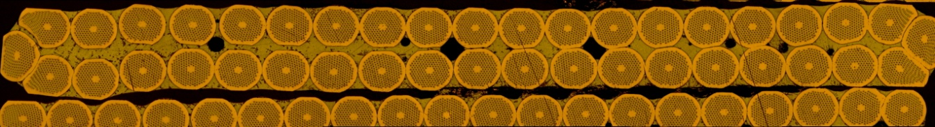
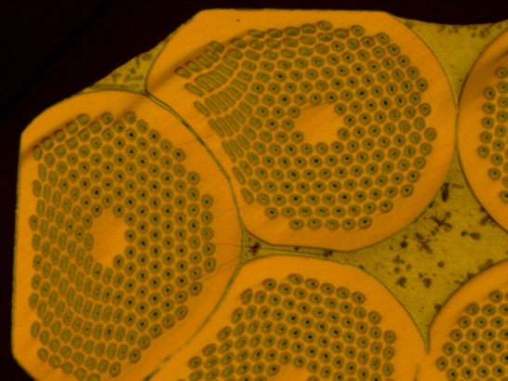
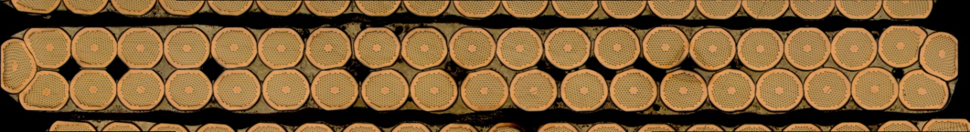
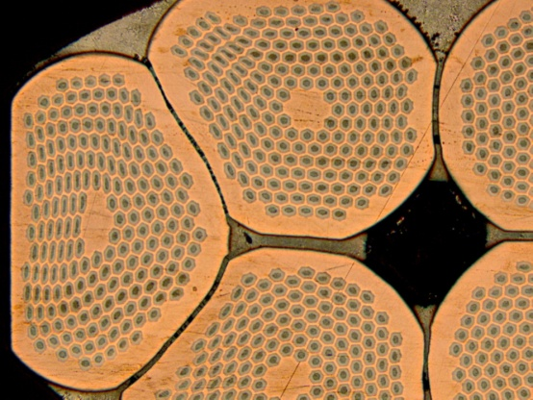
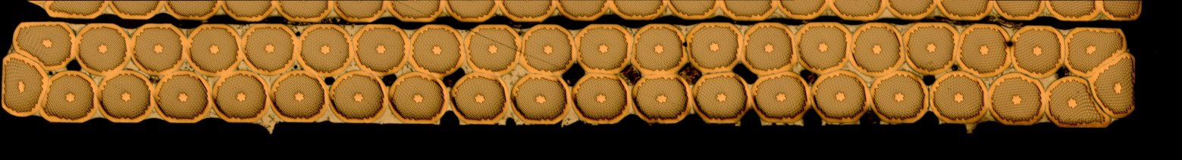
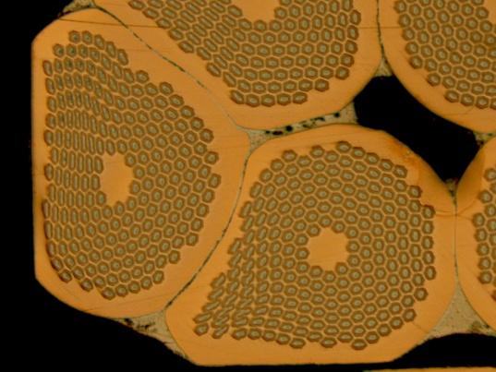
Comparison of different cable cross-section
for a mid-thickness of 1.82 mm
Width of 21.4 mm Total compaction 85.6 %
Width of 20.9 mm Total compaction 87.5 %
Width of 20.4 mm Total compaction 89 %

Slide 22
Conclusion on the cable development
With the results obtained up to now, we already have a cable meeting the required critical current at 15 T. Further decrease of the degradation below 10 % will give us more margin.
To decrease further the degradation below 10%, the best candidate is the cable with a width of 20.9 mm. A new cabling run was carried out to fabricate a cable with a width of 20.9 mm using PIT strands and playing with the width of the mandrel.
(The results obtained recently with the fabrication of a cable with a width of 21.4 mm giving an average degradation of 10.7 %, indicates that such a degradation can also be achieved with a width of 20.9 mm)
Decision was taken to fix the width of the cable for the FRESCA2 magnet to 20.9 mm and to continue the development of the cable to reduce the degradation by trying in particular to increase the cable mid-thickness.
The development of the FRESCA2 cable will also continue with the fabrication of a cable with the RRP strand.

Slide 23
Material Properties
Experimental material data provided by C. Scheuelein’s tensile tests
Multilinear Isotropic Hardening (MISO) material curves extrapolated to high strains
Replace former Bilinear (BISO) material curves with actual material data
This approach not straightforward, never used before
E_{Cu} = 128 GPa
E_{Nb} = 110 GPa

Slide 24
Baseline Model
Strand diameter: 1.0 mm
8.9 µm sub-element spacing
Sub-element width
  45 µm sub-element width (hex)
  47.6 µm sub-element dia. (circular)
  Areas kept constant between the two to maintain Cu:non-Cu
Cu:non-Cu ratio: 1.30 for both shapes

Slide 25
Preliminary Results
Deformed results
  Circular models experience no sub-element merging
  Lower spacing yields thinner Nb layers
Spacing factor 1
Spacing factor 2
Spacing factor 3

Slide 26
Preliminary Results
Deformed results
  Hexagonal models experience sub-element merging for spacing factor 2 and below
Spacing factor 1
Spacing factor 2
Spacing factor 3
Spacing factor 1

