Slide 1
LQ mechanical performances
Status and lessons learned
Collaboration Meeting 18
May 7th to 9th 2012, FNAL
Helene Felice

Slide 2
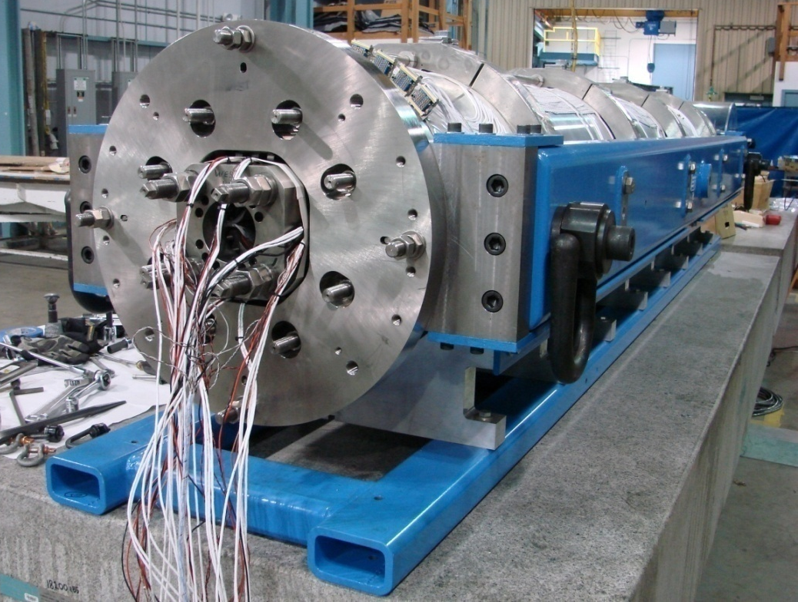
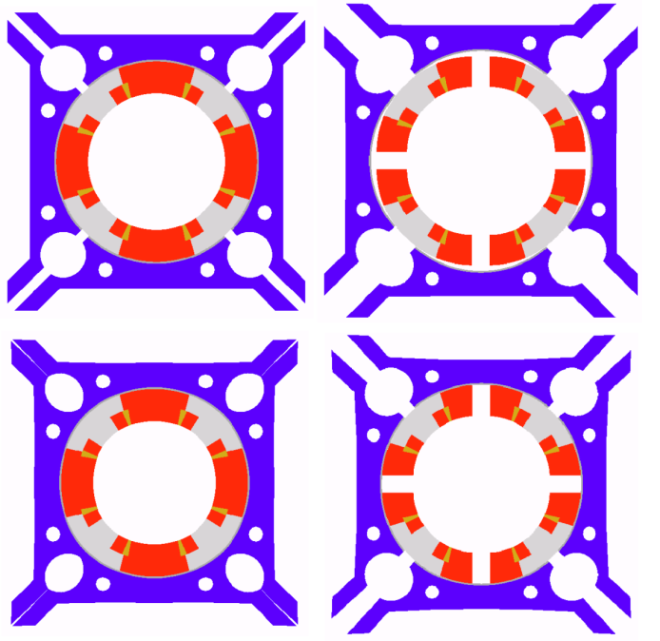
Overview
Magnet overview
LQ assemblies summary:
from LQS01a to LQS03
Lessons learned

Slide 3
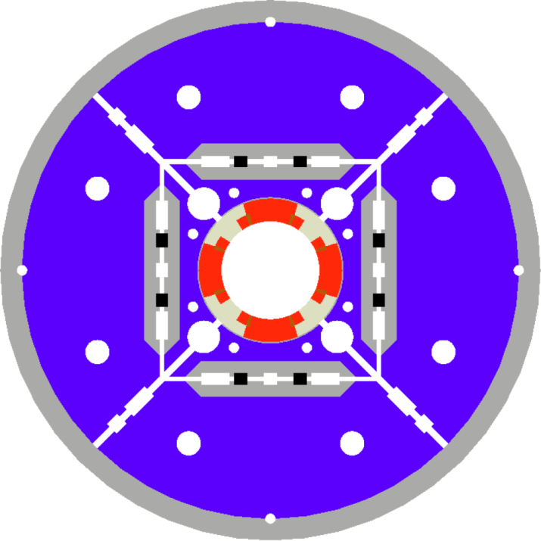
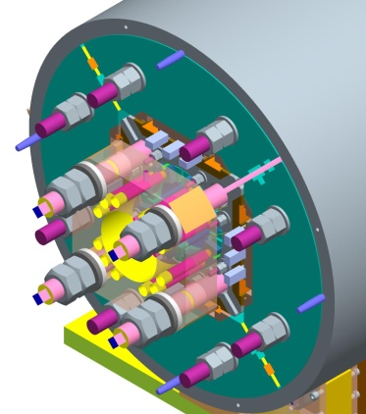
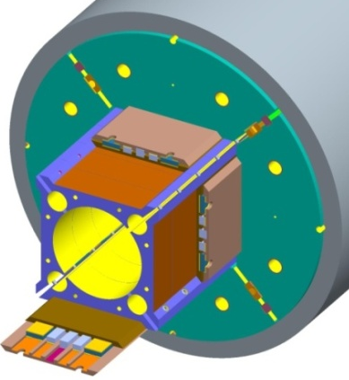
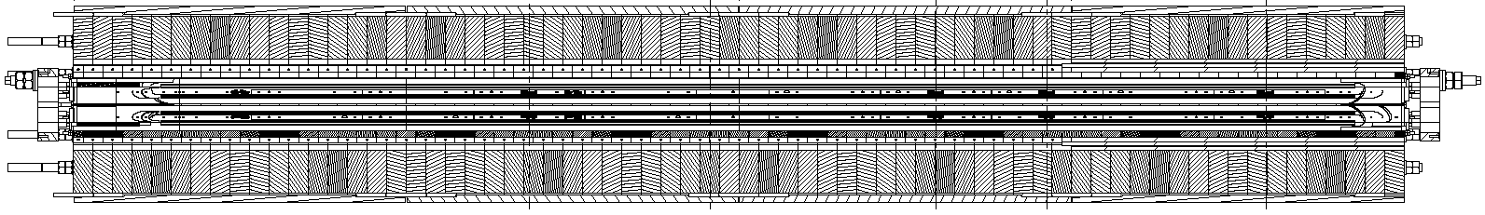
LQ Design overview
90 mm aperture coils with Ti poles
Iron pads, masters, yokes, Al shell
Pre-load with bladders and keys
Short-sample limits (4.5 K – 1.9 K)
  G_{ss}: 240 T/m – 267 T/m
  I_{ss}: 13.8 kA – 15.4 kA
  Peak field: 12.3 T - 13.6 T
End support: plate and rods
Magnet/coil length: 3.7/3.4 m

Slide 4
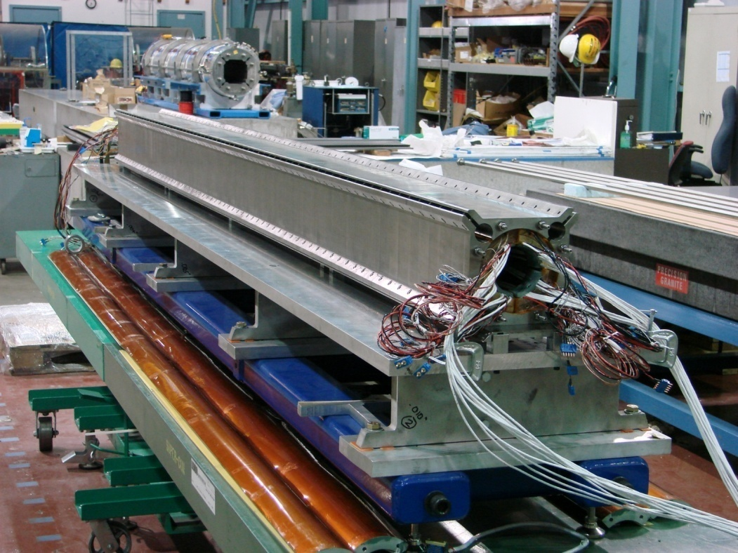

LQ assembly
Total of 60 gauges mounted (θ and z)
20 on shell, 32 on coil poles, 8 on rods
Four axial locations along coil length

Slide 5
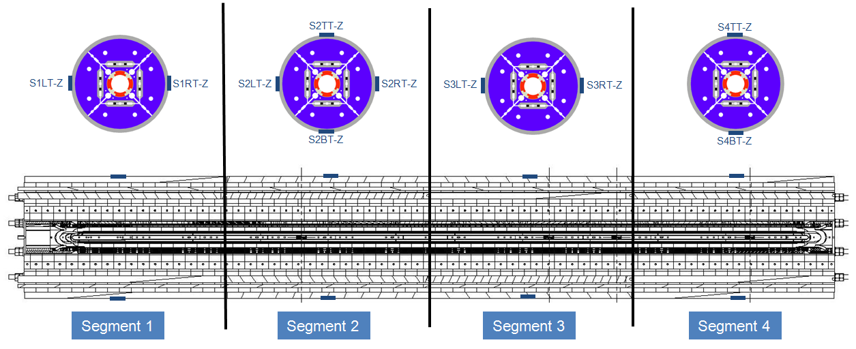
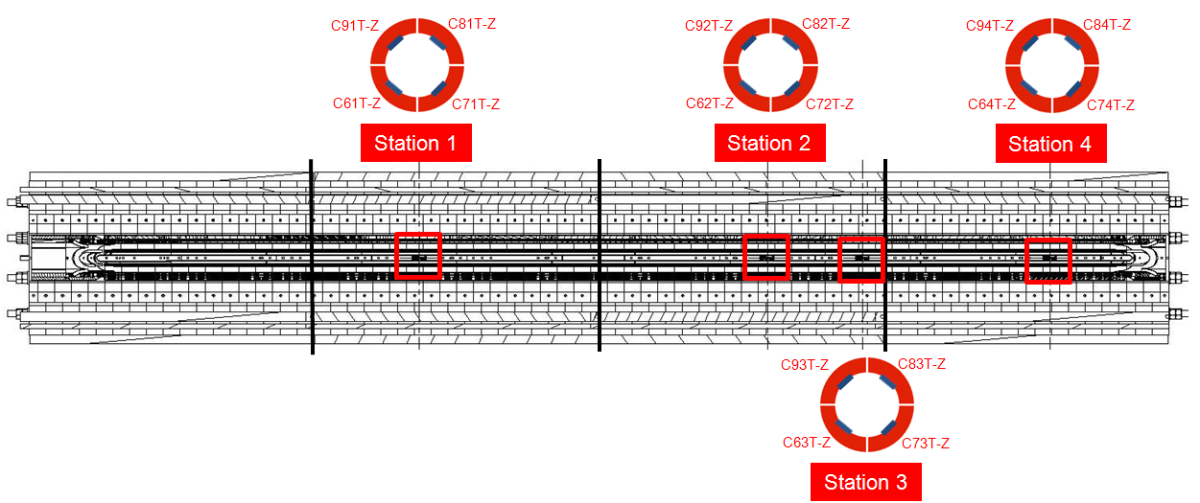
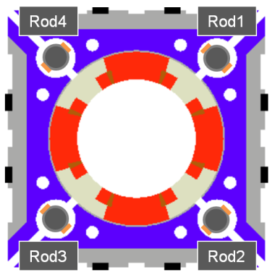
LQ strain gauges
Shell and coil stations
  θ and z gauges thermally compensated
  10 shell stations
  4 stations per coil
2 gauges/rod => 1 signal/rod
Total of 60 gauges
Measurements presented here are averages of the various gauges

Slide 6
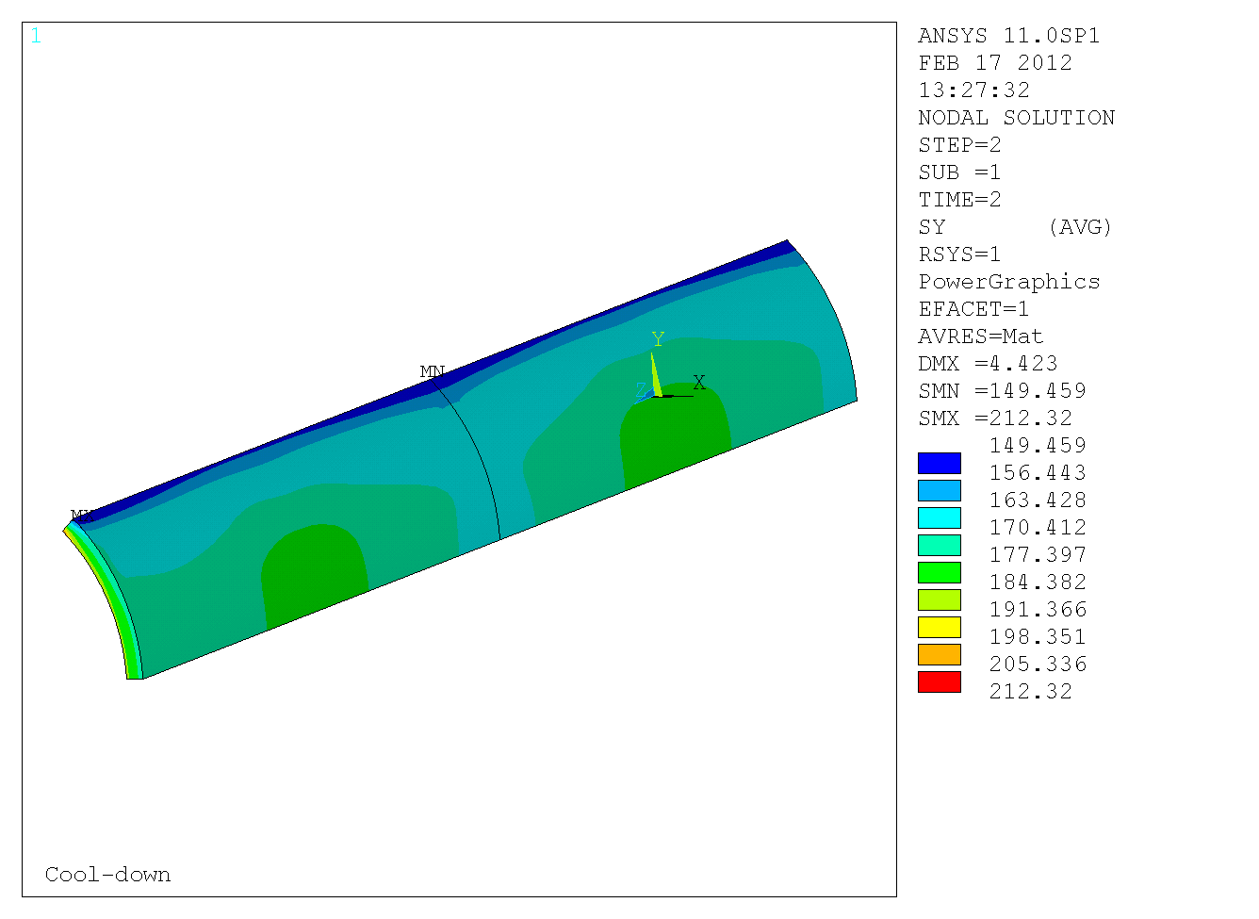
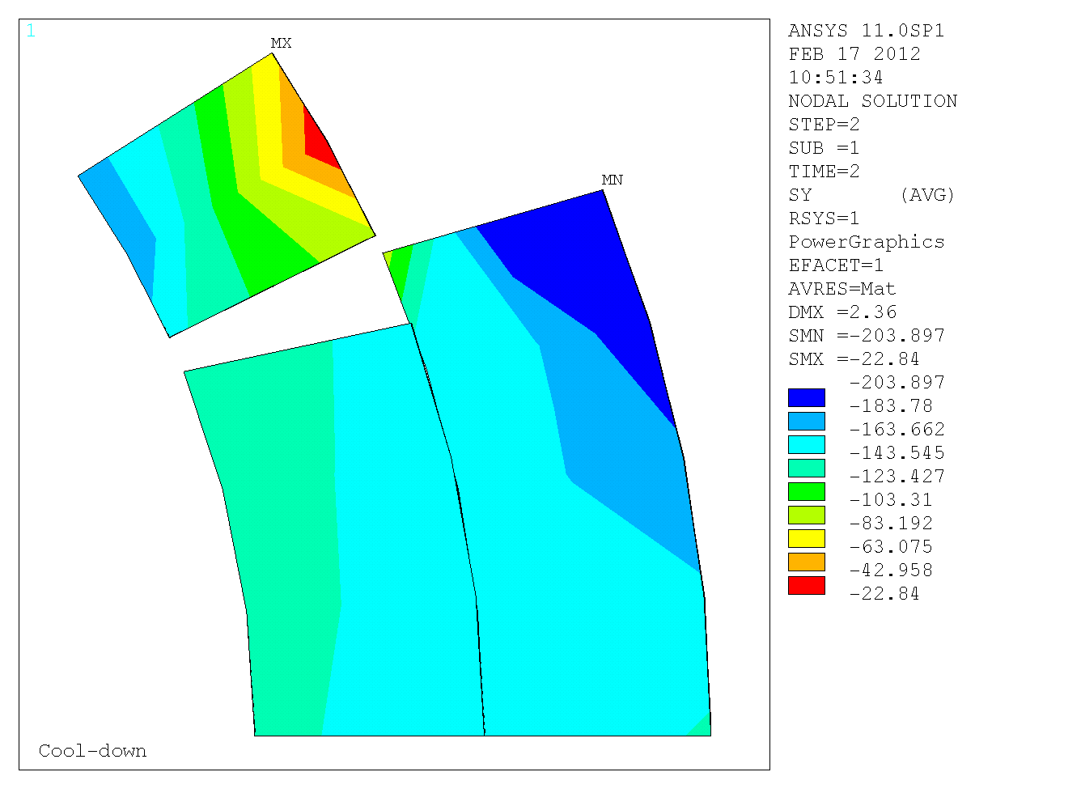
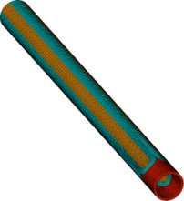
FEM analysis supporting LQ
Shell
Pole
Rod
Preload for 260 T/m
σ_{θ} and ε_{θ} at 300 K
target (3D): + 56 MPa
  + 750 με
σ_{θ} and ε_{θ} at 4.3 K
target (3D): + 183 MPa
  +2080 με
  σ_{θ} (MPa)
Preload for 260 T/m
σ_{θ} and ε_{θ} at 300 K
target (3D): -82 MPa
  -580 με
σ_{θ} and ε_{θ} at 4.3 K
target (3D): -157 MPa
  -1031 με
σ_{θ} (MPa)
Preload for 240 T/m: 471 kN
σ_{z} and ε_{z} at 300 K
target (3D): +88 Mpa (178 kN)
  +455 με
σ_{z} and ε_{z} at 4.3 K
target (3D): + 239 MPa
  + 1138 με
End Contact pressure (Mpa)
NO gap

Slide 7
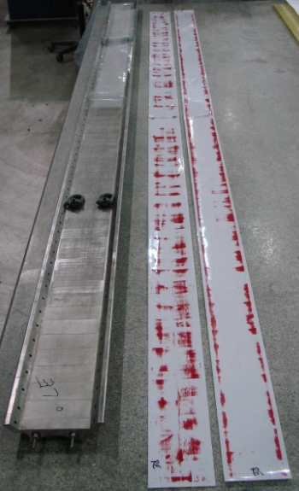
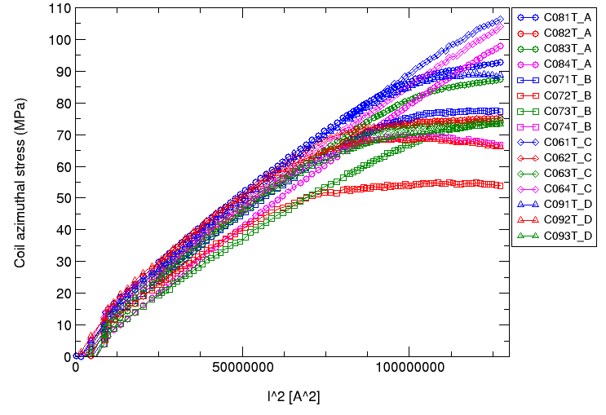
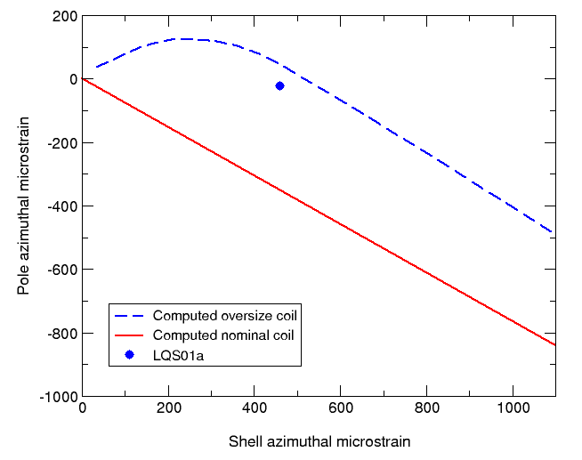
LQS01a loading conditions
LQS01a Gradient preload: 230-240 T/m
LQS01b
LQS01a
From LQS01a to LQS01b
Reduction of the radial shimming from 30 to 15 mils
Fuji Test to confirm
Some unloading of the pole suggested lack of preload
Nominal
Oversized

Slide 8
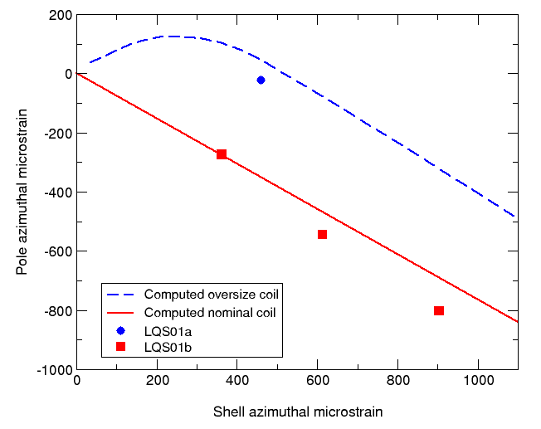
LQS01b azimuthal loading conditions
LQS01a Gradient preload: 230-240 T/m
LQS01b Gradient preload: 260-270T/m
LQS01b loading required a bladder pressure of 8000 psi

Slide 9
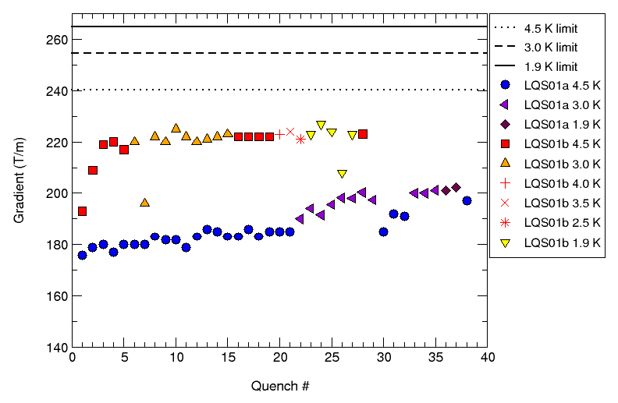
LQS02 300 K Loading conditions
LQS01b training performance
  Target gradient reached in 2 quenches
  Good memory - Improved training rate
  220 T/m reached in 4 quenches
LQS01b loading sequence used as reference scenario for LQS02
  Target LQS02 shell strain: 700 – 900 με
    Bladders pressurized one quadrant at the time
    Max. bladder pressure: 7000 PSI (Upper bound is 8000 psi)
  Target LQS02 Rods strain: 500 με
    Applied at the end of the azimuthal loading like in LQS01a and b

Slide 10
LQS02 loading conditions
LQS01a Gradient preload: 230-240 T/m
LQS01b Gradient preload: 260-270T/m
LQS02 Gradient preload: 260-270 T/m

Slide 11
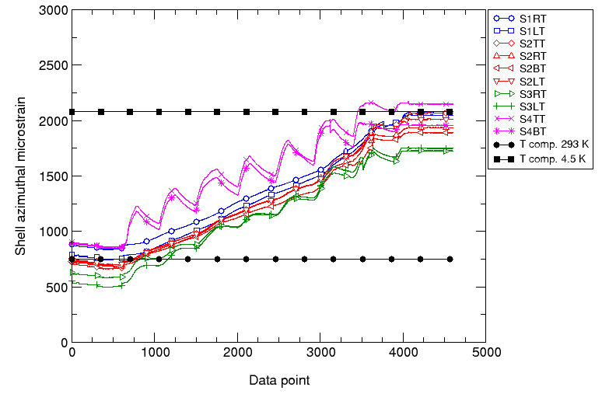
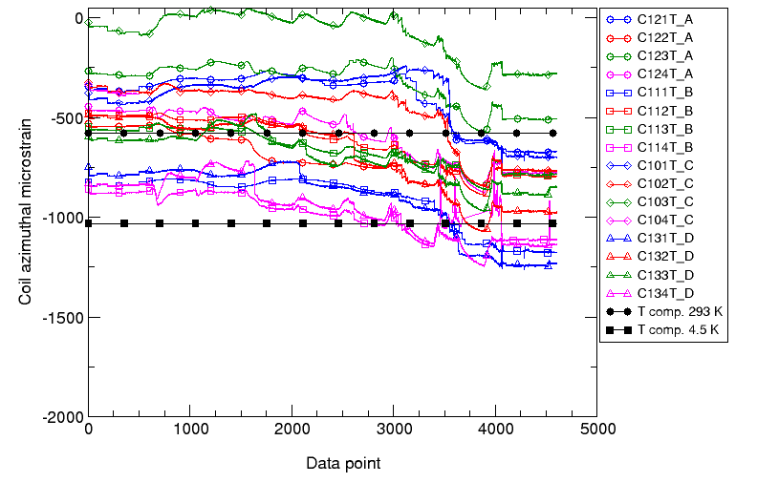
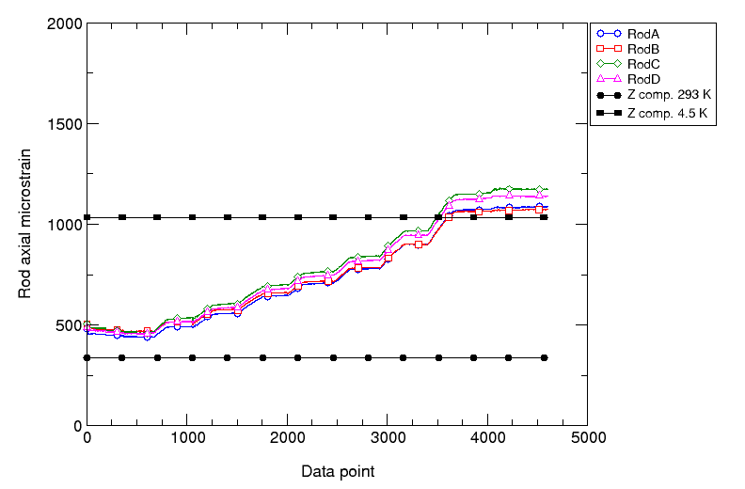
LQS02 Mechanical performance
Cool-down
Shell
Pole
Rod
σ_{θ} and ε_{θ} at 4.3 K
average: +183 ± 9 MPa
average: +1960 ± 119 με
4.3 K target 3D/2D:
+ 183/179 MPa
  +2080/2271 με
Coil pole σ_{θ} and ε_{θ} at 4.3 K
average: -133 ± 28 Mpa
average: -764 ± 372 με
4.3 K target (3D/2D):
- 157 / -178 MPa
  -1031 / -1371 με
Rod σ_{z} and ε_{z} at 4.3 K
average: +235 ± 10 Mpa
average: +1119 ± 47 με
4.3 K target (3D):
+ 239 MPa
  + 1138 με

Slide 12
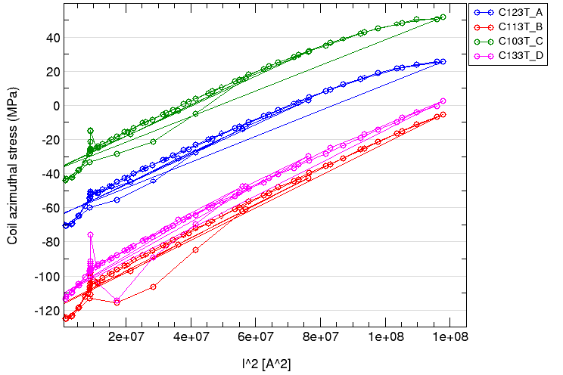
LQS02 Mechanical performance
Pole during excitation
From the measurements
some signs of unloading seen in LQS02
Δσ during unloading is 100 MPa
Consistent with expected unloading due to Lorentz forces at 11 kA
Behavior consistent with low preload seen in a few stations
Ramps of the 08/12/2011 Measurements up to 11kA

Slide 13
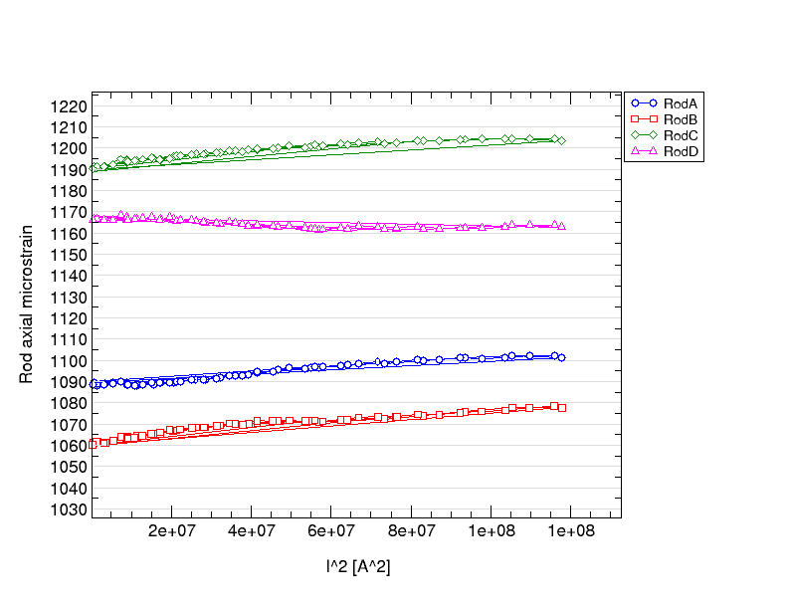
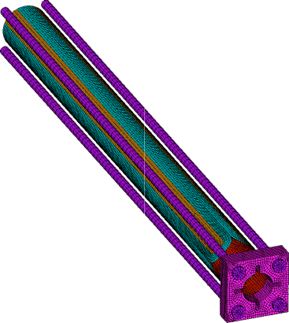
LQS02 Mechanical performance
Rods during excitation
Variation of rod axial strain at 11 KA
  - + 10 to 20 με
Elongation of the coil
    - 34 to 68 microns

Slide 14
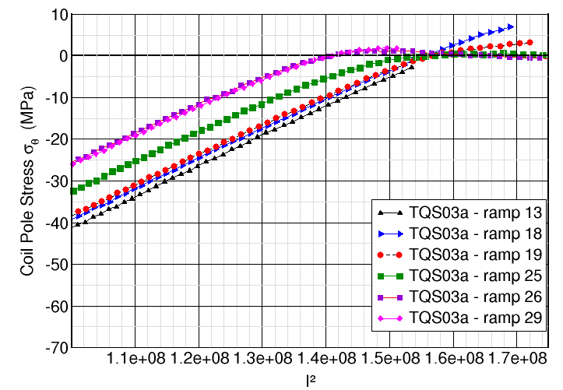
From LQS02 to LQS03
Some uncertainty about the reason behind the lack of performance of LQS02
Concern about mid-plane block quenches
  Conservative approach by keeping the same preload (not higher)
  1-to-1 comparison with LQS02 – only change of conductor
  Unloading of the pole can be handled by a “healthy magnet” => TQS03a
  Possibility to increase the preload in LQS03b
227 T/m
209 T/m
93% Iss

Slide 15
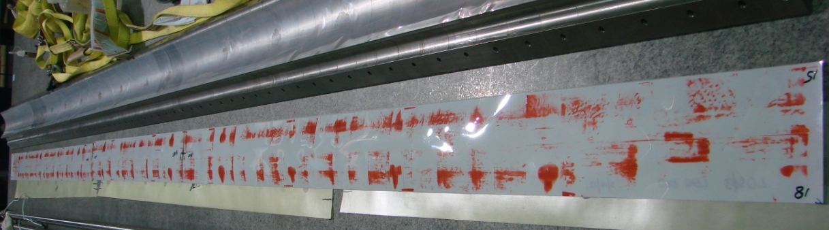
LQS03: Pressure sensitive film
The coils of LQS03 are similar in size to the LQS02 coils
Attempt to improve the cool-down:
  Decision to reduce the G10 shims between coil and pad from 15 (375 μm) to 10 mils (250 μm)
  Pressure sensitive film test to confirm

Slide 16
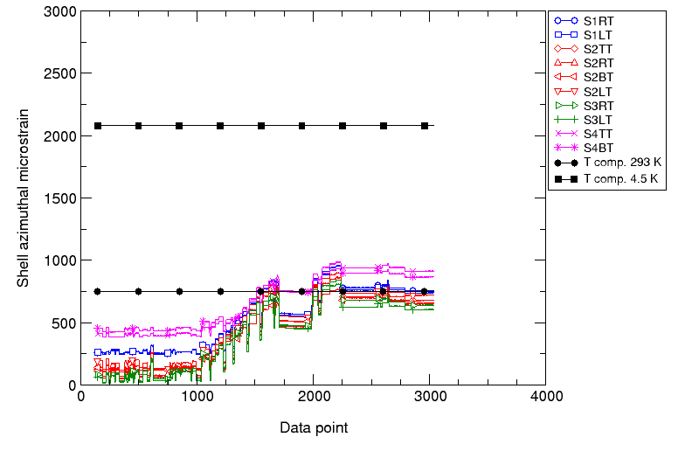
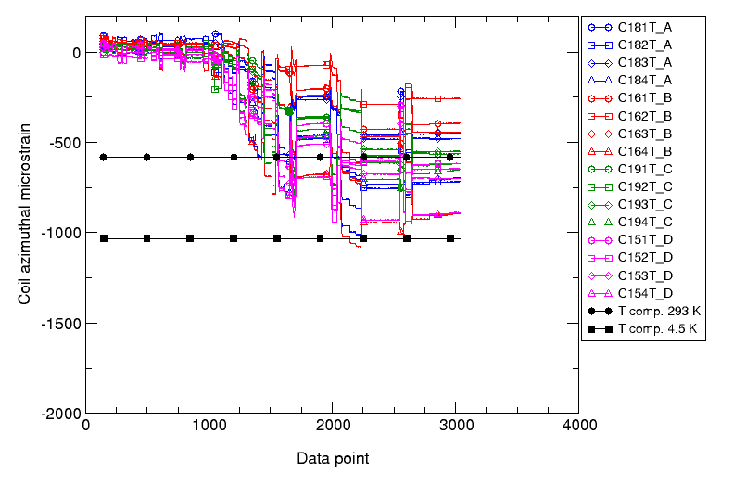
LQS03 Azimuthal loading
Identical target as LQS02
Shell
Target 4.4 K: 2100 με
Poles
Target 300 K: 750 με
-597 με +/- 170
724 με +/- 100
Target 300 K: -600 με
Target 4.4 K: -1000 με

Slide 17
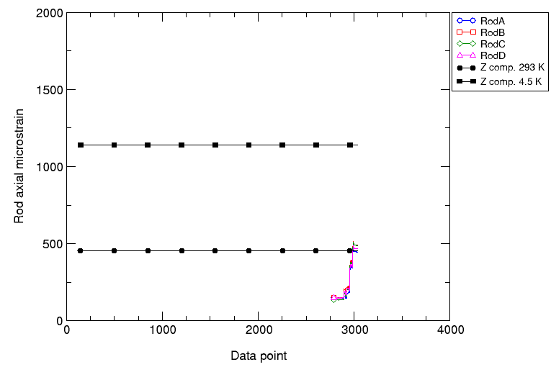
LQS03 axial loading
Target 4.4 K: 1150 με
472 με +/- 21
Target 300 K: 455 με
Max Piston pressure: 5900 psi (41 MPa)

Slide 18
LQ assemblies summary
56 MPa
-82 MPa

Slide 19
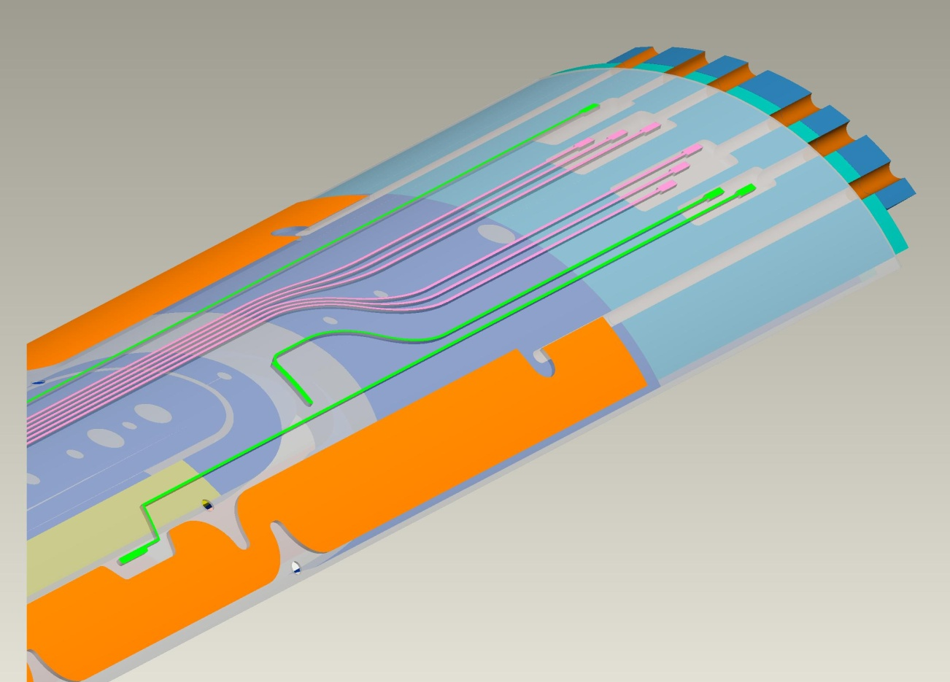
LQS03 Status – Electrical checks
Ohm-meter
LQ19 => R = 0.9 ohm
Typical coil => R=23 ohm which includes wires + ss trace and coil segment
Short detected during sequential R measurement in coil 19 between Vtaps B3 and B4
Hypertronic connector
AWG 28 wires
Traces: 25 microns thick and 0.635 mm wide
B3
Decision to unload axially the magnet
B4

Slide 20
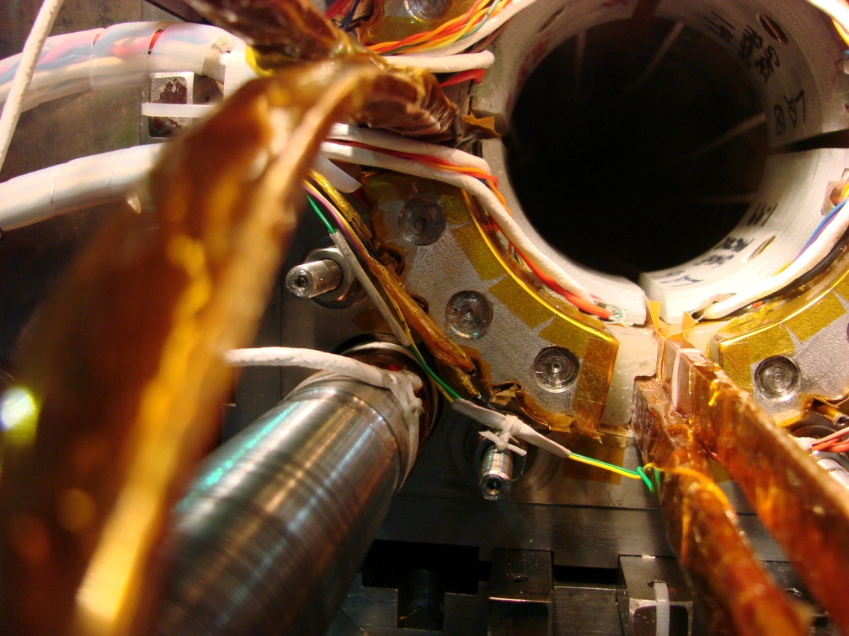
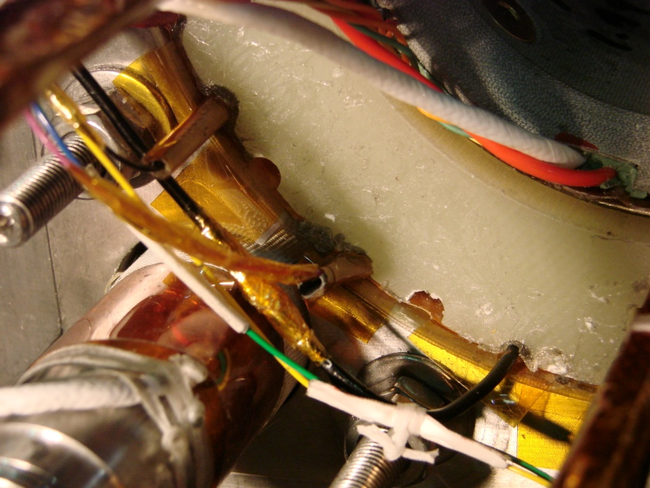
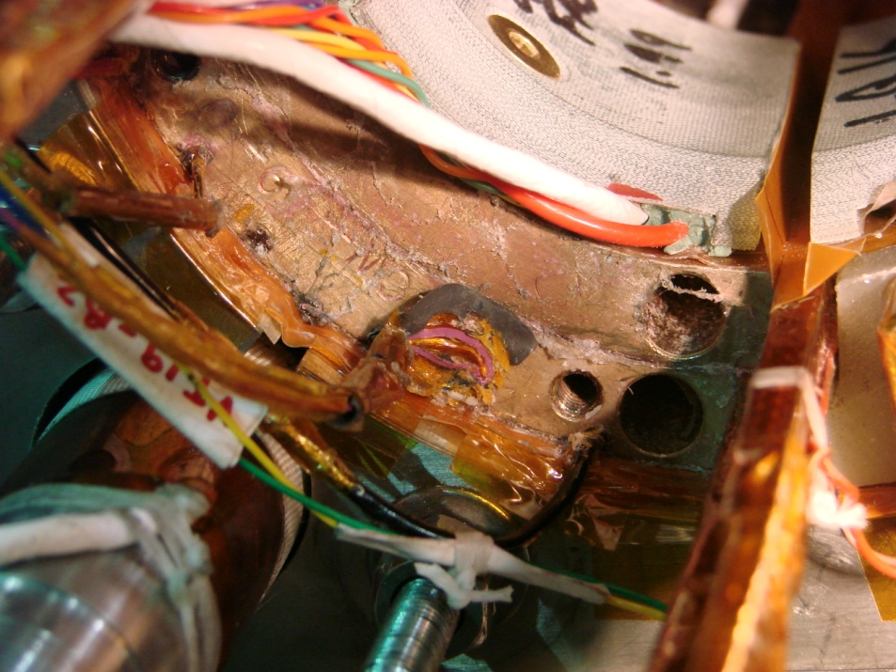
Investigation
After axial unloading and removal of the endplate
After removal of the stainless steel pusher
After removal of the G10 pusher

Slide 21
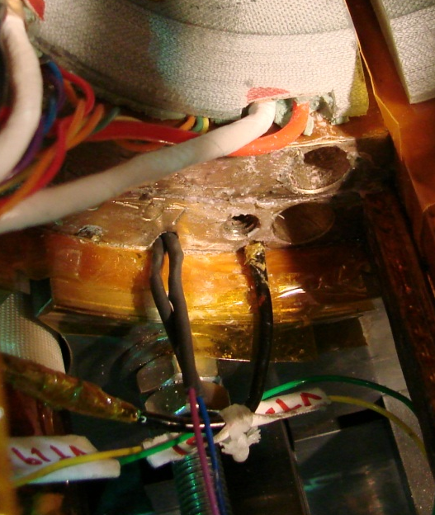
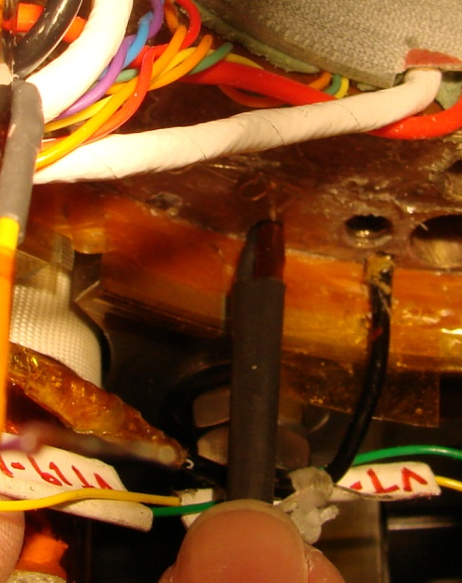
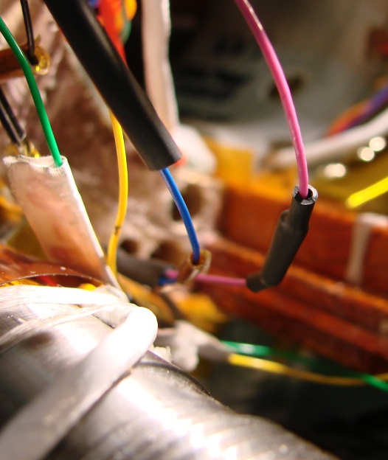
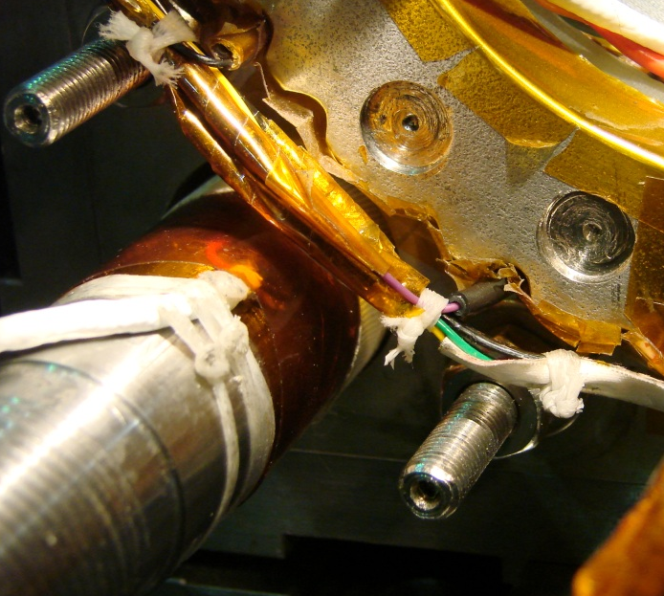
Status and Next steps
Repair completed
Preparation for axial loading ongoing
Axial loading will be performed at the end of the week while monitoring the status of B3 B4 vtaps
Shipment expected May 18th

Slide 22
Lessons learned toward LHQ
From LQS01 to LQS01b
  Importance of the matching between
  coil OD and pad/collar ID
  Assessment required before each assembly using
  pressure sensitive film
From LQS02 and LQS03 assemblies
  High risk of pinching vtap wires during assembly
  Need to protect better the instrumentation to avoid damage during assembly
Still to investigate
  Spread in the SG reading: related to parts tolerances?
  Preload gain during cool-down: still smaller than expected from computation

Slide 24
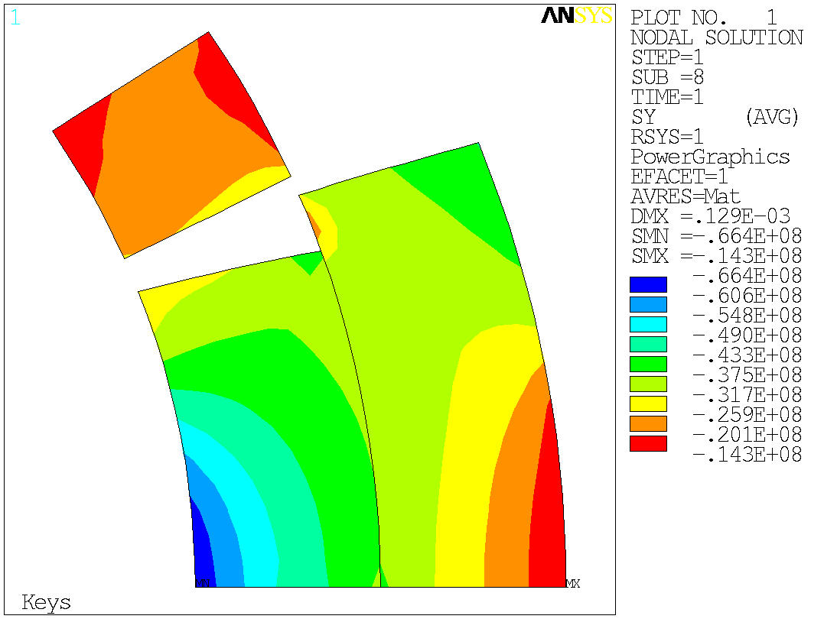
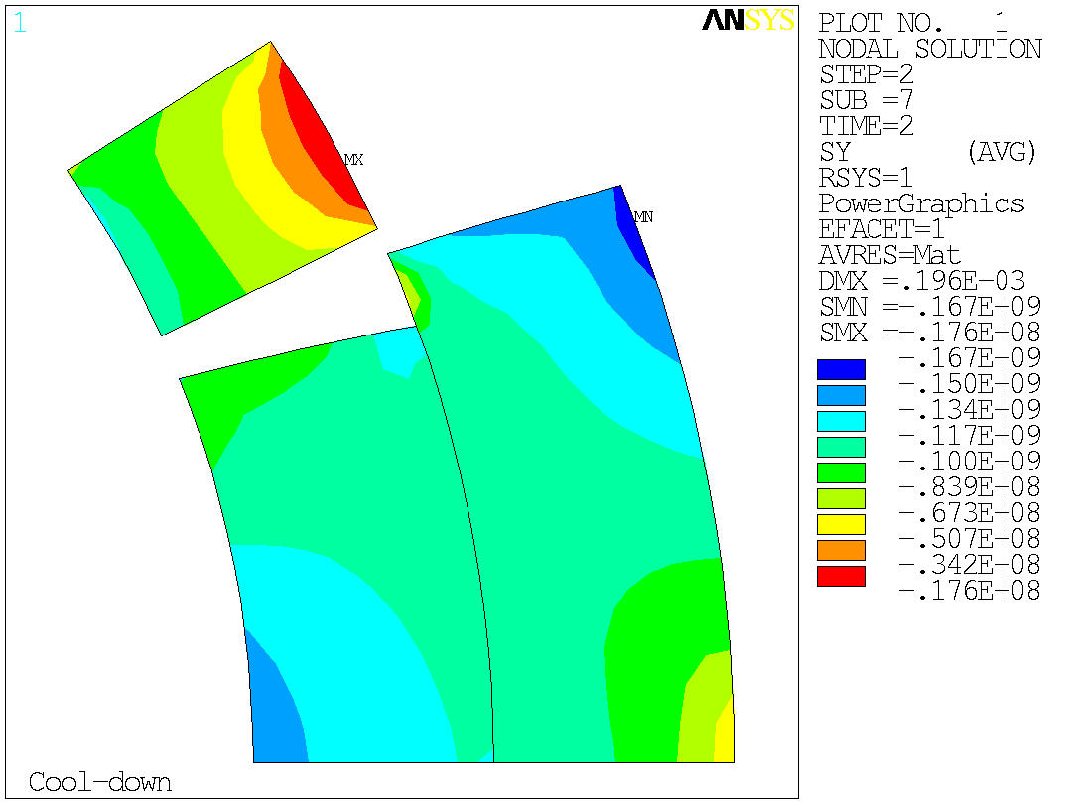
LQS01a Coil Stress distribution (FEM)
Shell stress: +148 MPa (2D) model
Pole stress: -59 MPa (2D) model
Coil pole tension: >20 MPa (inner layer)

Slide 25
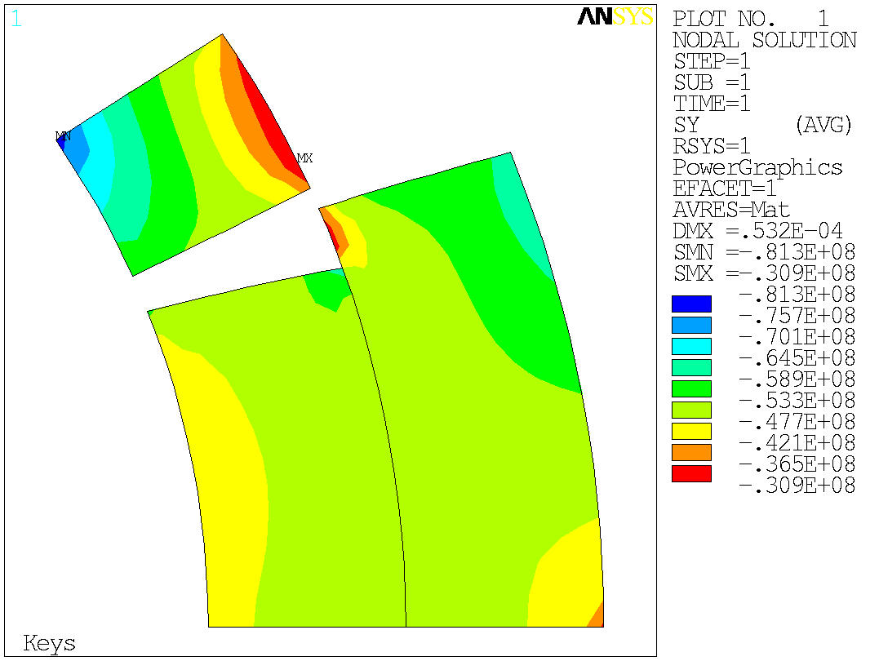
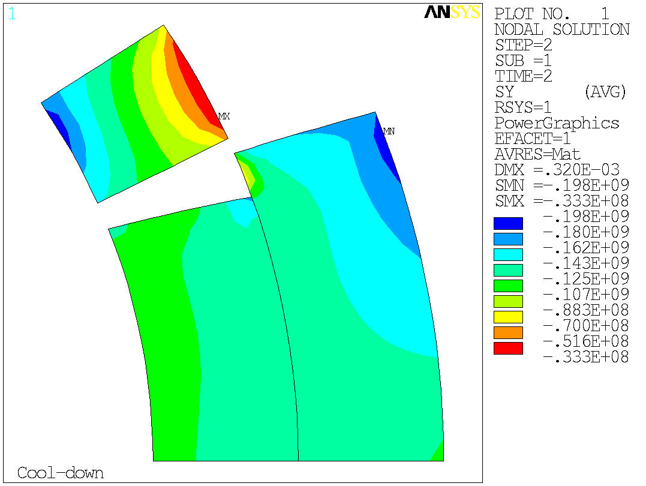
LQS01b Coil stress distribution (FEM)
Shell stress: +180 MPa (3D/2D) model
Pole stress: -160/-180 MPa (3D/2D) model
Coil pole compression

Slide 26
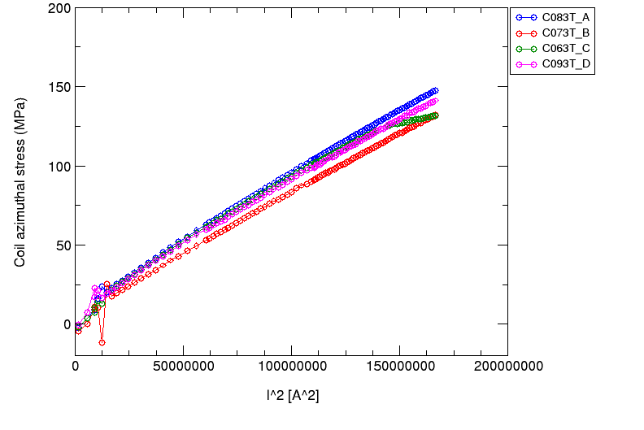
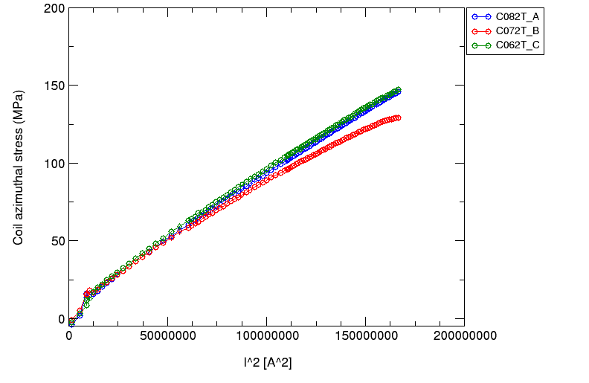
LQS01b Pole SG measurements

