Slide 1


QXFA221 Coil Review
Jesse Schmalzle
September 8, 2021

Slide 2
Outline
Coil Fab DRs
Additional Info
  Coil length, Pole gaps
  Reaction plots
  Electrical Data

Slide 3
QXFA221
Series coil under CD-3b.
After to change for B6 adjustment.

Slide 4
QXFA221 - DRs
DRs posted to interface traveler.
Critical = Affecting Form, Fit or Function
(as found)

Slide 5
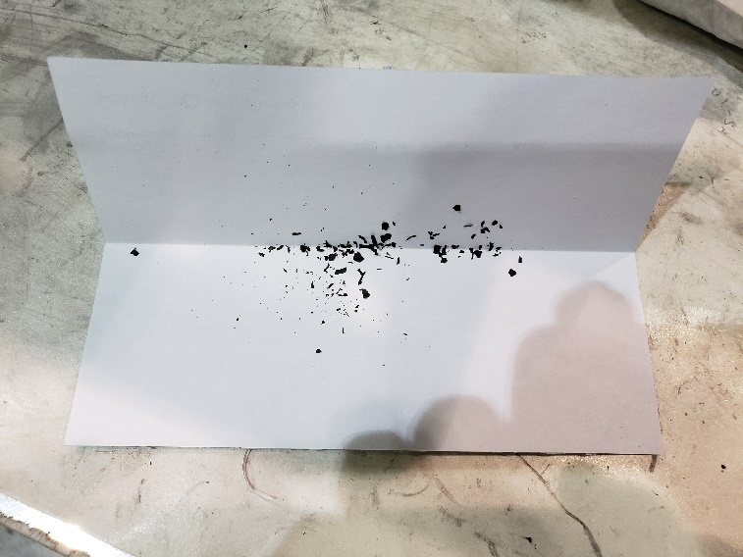
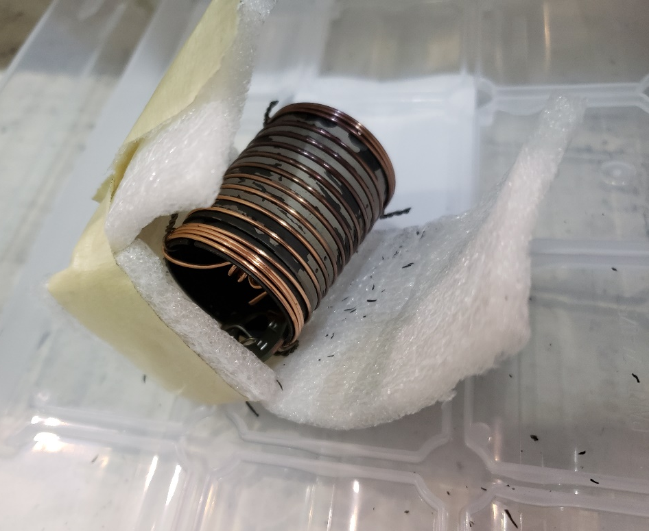
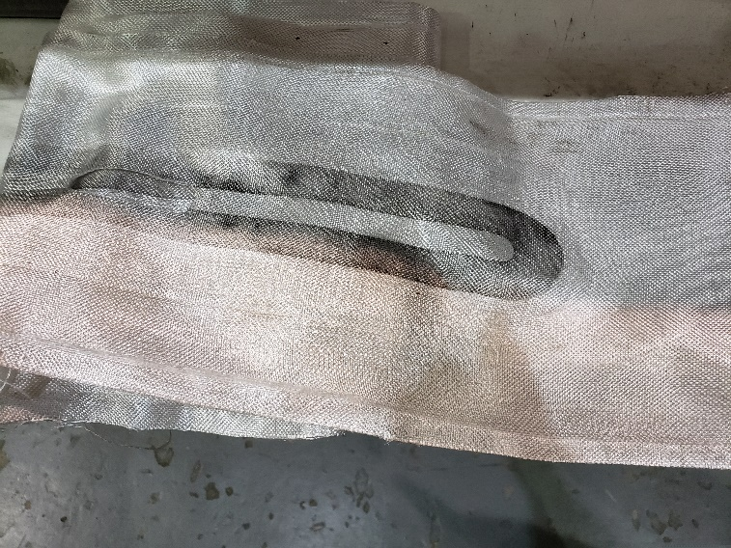
Witness sample barrel DR
Coating flaking off witness sample barrels:

Slide 6
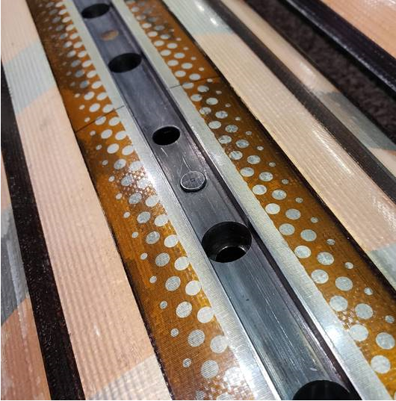
Pole Pin DR
Pole pin protruding into keyway by approx. 1.5 mm.
Pin is on the NL end of the 8th pole segment.
LBNL to accommodate by relieving key at assembly.

Slide 7
-
Additional Info…

Slide 8
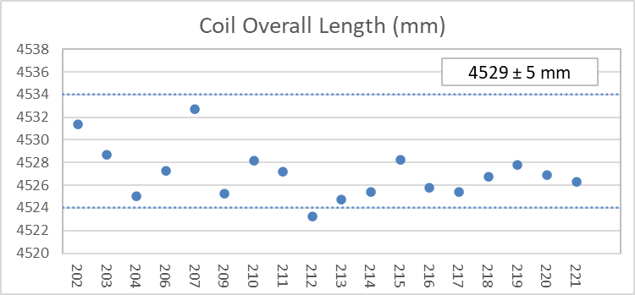
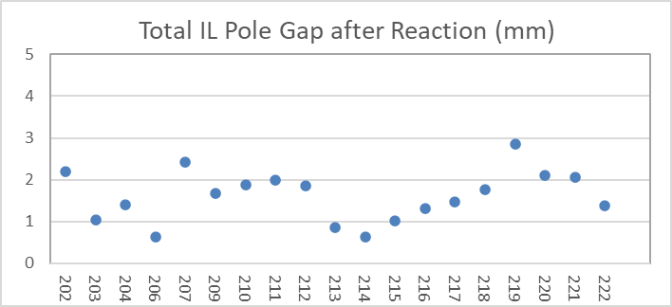
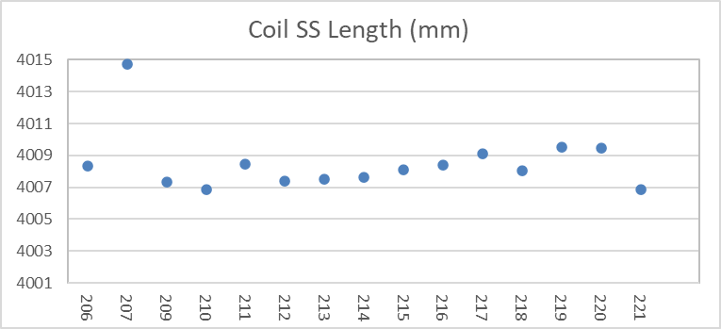
QXFA221 – Length, Gaps
Coil length within spec.
(207 error in initial pole gap setting)

Slide 9
QXFA221 - Reaction
Temperatures and dwell times all within spec.

Slide 10
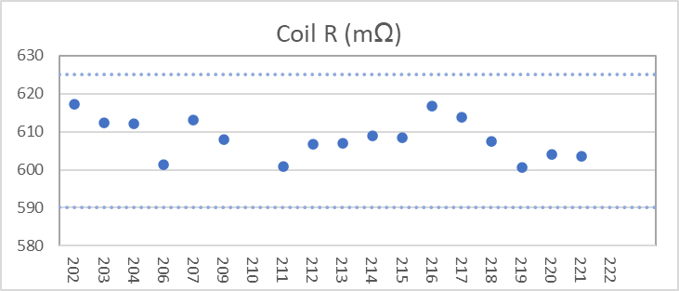
QXFA221 - Electrical
Final electrical checks – all passed

Slide 11
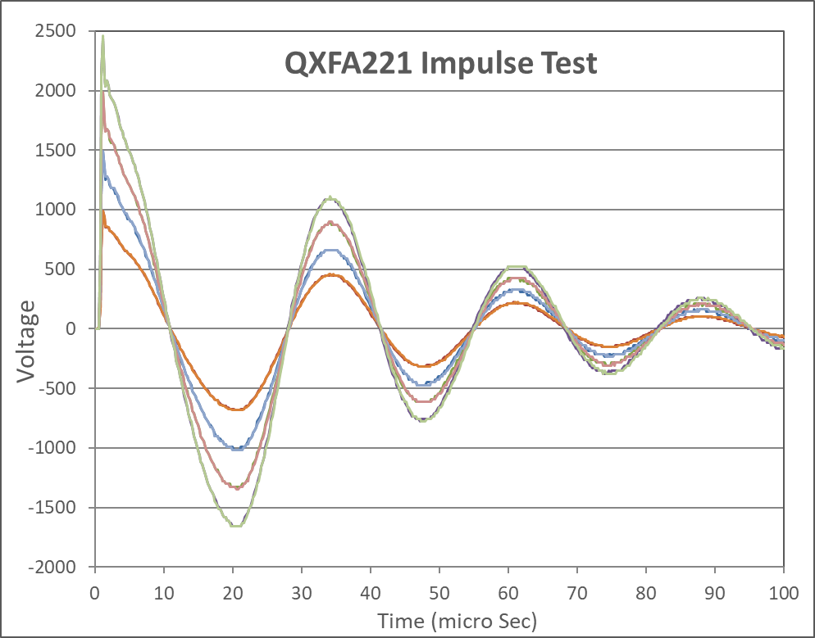
QXFA221 - Electrical

