Slide 1
MQXFA10 Coils Acceptance Review QXFA131, and QXFA132
Fred Nobrega, CAM/L3
Miao Yu, Deputy L3
Marcellus Parker, Electrical
Coil Fabrication at FNAL
U.S. HL-LHC Accelerator Upgrade Project
MQXFA10 Coils Acceptance Review
September 8, 2021

Slide 2
Overview
Discrepancy Reports for QXFA131 and QXFA132
Typically written against specific step in traveler which conforms to the following documents:
QXFA Series Coil Production Specification, US-HiLumi-doc-2986
MQXFA Final Design Report, US-HiLumi-doc-948
QXFA Series Coil Fabrication Electrical QC Plan, US-HiLumi-doc-521
No items to be addressed from the MQXFA09 Coils Acceptance Review
Appendix
Critical DR’s with subset of attachments (if applicable)
Coil data for magnet fabrication report

Slide 3
DR Summary
Legend
Noncritical DR
Critical DR
Critical DR – affects form/fit/function and needs L2 review
Coil # | Total DR’s | Critical DR’s
QXFA131 | 6 | 0
QXFA132 | 4 | 1
Coil # | W&C Prep | React | Impreg | CMM Interface | Electrical
QXFA131 | 0 | 1 | 2 | 0 | 3
QXFA132 | 0 | 1 | 2* | 0 | 1
Links to all DR’s: (VPN or FNAL services account required)
Discrepancy Reports – QXFA131
Discrepancy Reports – QXFA132
* Critical DR

Slide 4
QXFA131 DR’s
Legend
Minor DR
Critical DR
Critical DR – affects form/fit/function and needs L2 review
DR Number | Description | Disposition
12325 Electrical Testing | The B1-B2 values in the calculate table are out of spec. (traveler step 8.1) | DMM measurements were retaken at a later step (13.3) in the traveler with more reliable connections and the value were within range.
12387 Electrical Testing | voltage tap values are out of spec | VTA01 and VTA02 data were input incorrectly into the traveler
12388 Electrical Testing | voltage tap values are out of spec (traveler step 13.3) | DMM measurements were taken using cable terminals that were better equipped for accurate low-level resistance measurements.

Slide 5
QXFA131 DR’s
Legend
Minor DR
Critical DR
Critical DR – affects form/fit/function and needs L2 review
DR Number | Description | Disposition
12313 Reaction | Per the process capability plots attached to this traveler step, there were 7.6% of the individual thermocouple measurements which were above the upper spec limit for the 395C soak, and 0.6% below the lower spec limit in the 665C soak. | The coil reaction witness sample passes all requirements and is recorded in the coil interface traveler.
12448 Splice / Epoxy Impregnation | 1 layer of Hexcel 4522 (6 mil) was installed instead of 1 layer of BGF 6781 (10 mil thick) as designed. This DR also applies to coils QXFA129, 130, 131 and 132. | CERN has been notified and concurs that the material swap is minor and to use as is. They will write a NCR (level 1, concession). Coils 129 & 130 have passed the coil acceptance review and with coil 130 planned for magnet MQXFA09. The remaining coils are complete and at LBNL.
12348 Splice / Epoxy Impregnation | Using the cutting guide tool to cut the layer of epoxy from the pole of the coil, the tech mistakenly cut across 2 current blocks on his first pass of multiple passes. | Verified that the depth of cut was shallow and did not reach the cable via approved off-normal work plan.

Slide 6
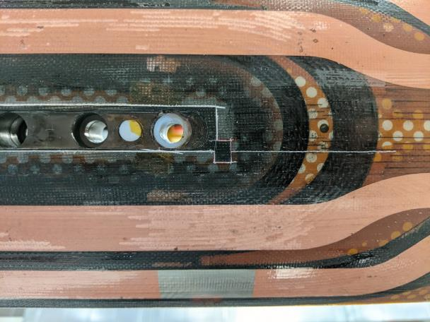
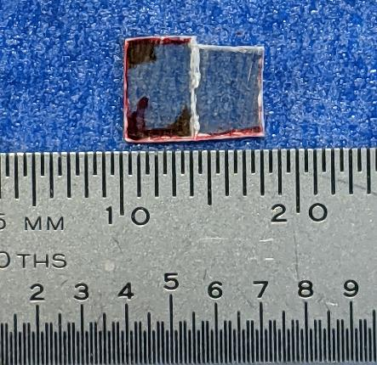
DR12348 QXFA131
Near side
Far side

Slide 7
QXFA132 DR’s
Legend
Minor DR
Critical DR
Critical DR – affects form/fit/function and needs L2 review
DR Number | Description | Disposition
12334 Reaction | As per the process capability plots attached to this step, the 665C soak had 0.9% of the data out of spec on the low side. | Witness samples are accepted, as indicated in the coil interface traveler. T/C #10 was recalibrated twice for confirmation, and when using the adjusted offsets the data were all in spec (see the 665C before/after reaction plots in the appendix).
12337 Splice / Epoxy Impregnation | A small section of the blanket was wedged between the mid plane shim and the last turn of the coil. | Installation of SS midplane shim during coil reaction prep pinched the OL S2 glass. A working group meeting agreed to proceed with coil fabrication as is. Presentation attached to DR. No repair is needed.

Slide 8
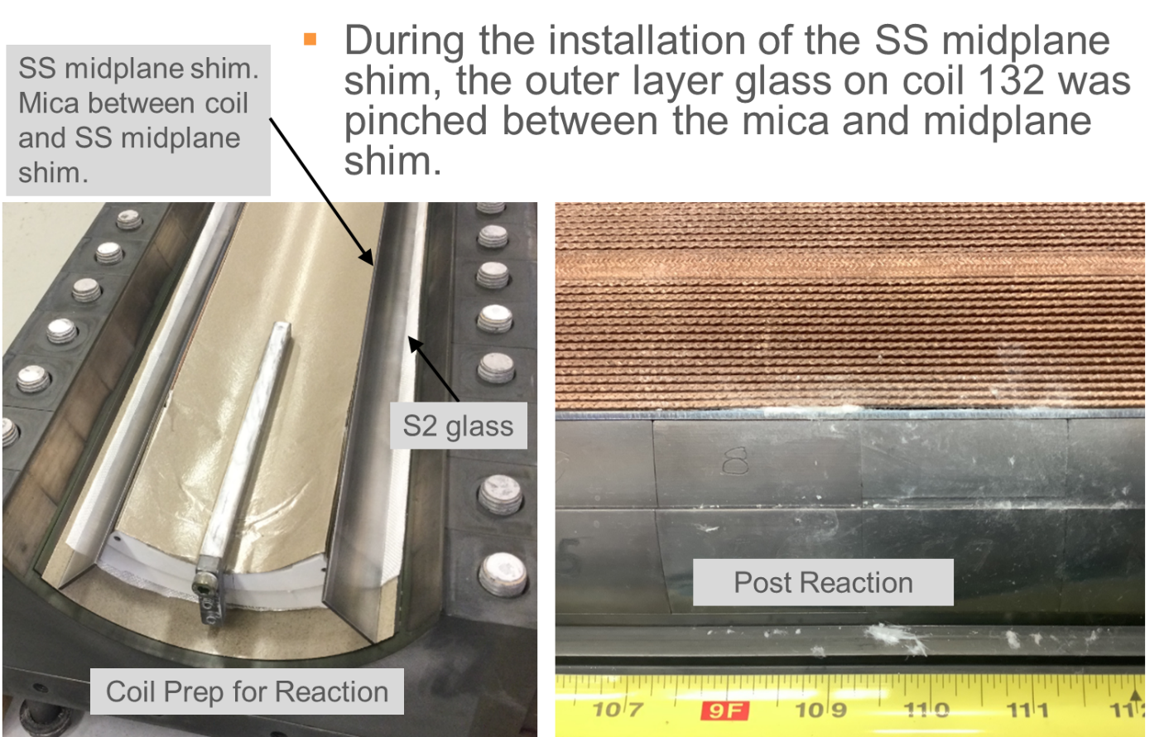
DR12337, QXFA132 Prep for Reaction; Midplane Shim Installation

Slide 9
QXFA132 DR’s
Legend
Minor DR
Critical DR
Critical DR – affects form/fit/function and needs L2 review
DR Number | Description | Disposition
12364 Reaction | Coil short to structure prior to impregnation | 4-wire measurements taken from the coil lead to several locations on the impregnation tooling indicate a ~5 Mohm short. After impregnation, the short did not exist.
12448 Splice / Epoxy Impregnation | 1 layer of Hexcel 4522 (6 mil) was installed instead of 1 layer of BGF 6781 (10 mil thick) as designed. This DR also applies to coils QXFA129, 130, 131 and 132. | CERN has been notified and concurs that the material swap is minor and to use as is. They will write a NCR (level 1, concession). Coils 129 & 130 have passed the coil acceptance review and with coil 130 planned for magnet MQXFA09. The remaining coils are complete and at LBNL.

Slide 10
MQXFA09 Coils Review Recommendations
No issues or recommendations to be address from the MQXFA09 Coils Acceptance Review

Slide 11
Appendix

Slide 12
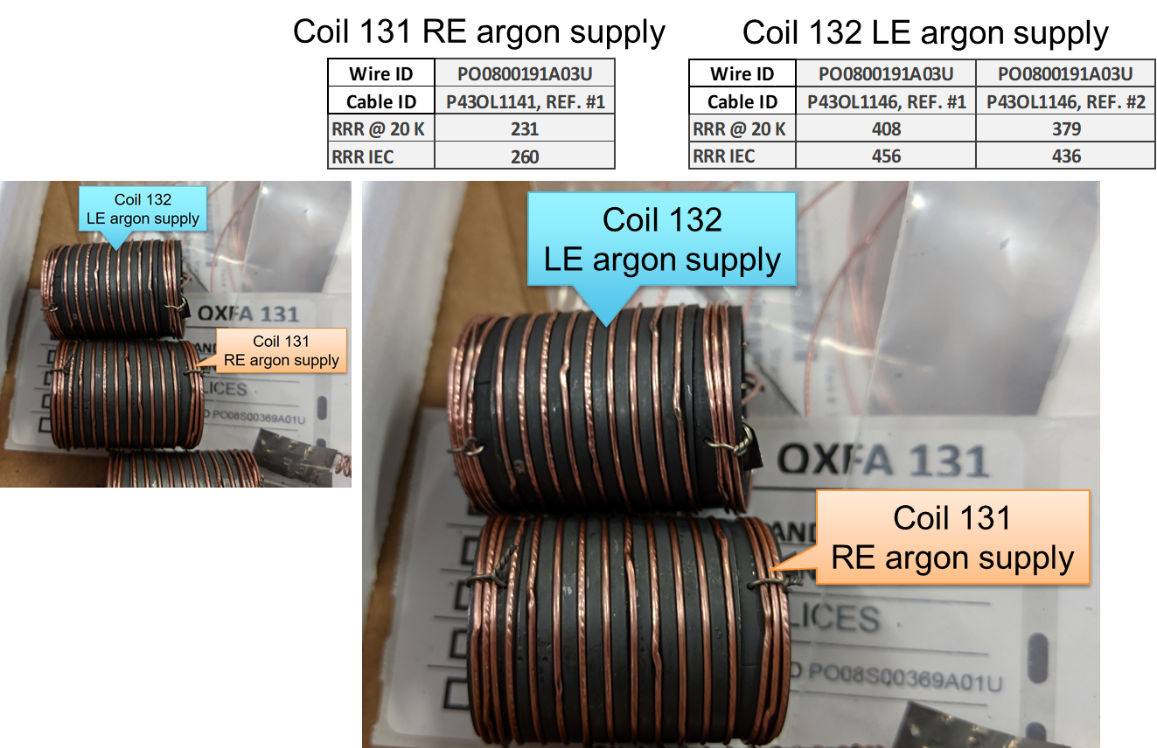
Witness Samples QXFA131 & 132
QXFA132 argon inlet moved to coil LE

Slide 13
QXFA131 Average Temperature & Dwell Time

Slide 14
QXFA131 210° C Plateau
T/C #4

Slide 15
QXFA131 395° C Plateau

Slide 16
QXFA131 665° C Plateau

Slide 17
QXFA132 Average Temperature & Dwell Time

Slide 18
QXFA132 210° C Plateau
T/C #4

Slide 19
QXFA132 395° C Plateau
T/C #4

Slide 20
QXFA132 665° C Plateau

Slide 21
QXFA132 665° C Plateau

Slide 22
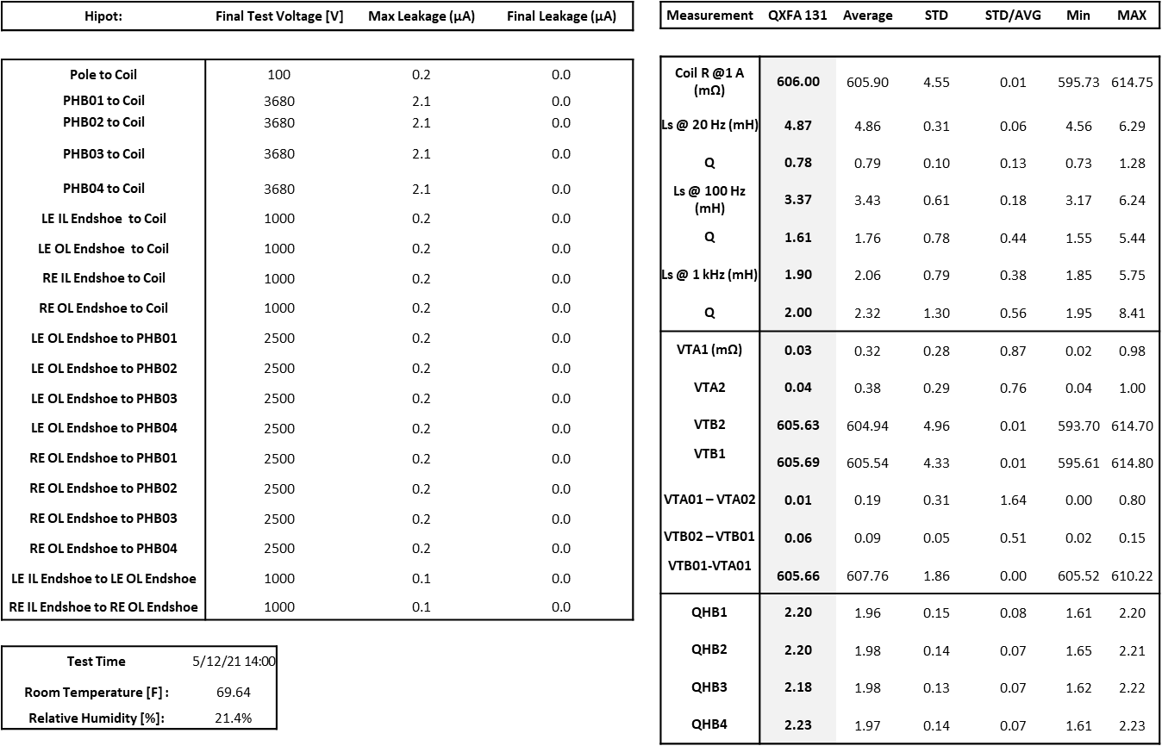
QXFA131 Hi-pot & Electrical Checks
← (revised 5/6/22)

Slide 23
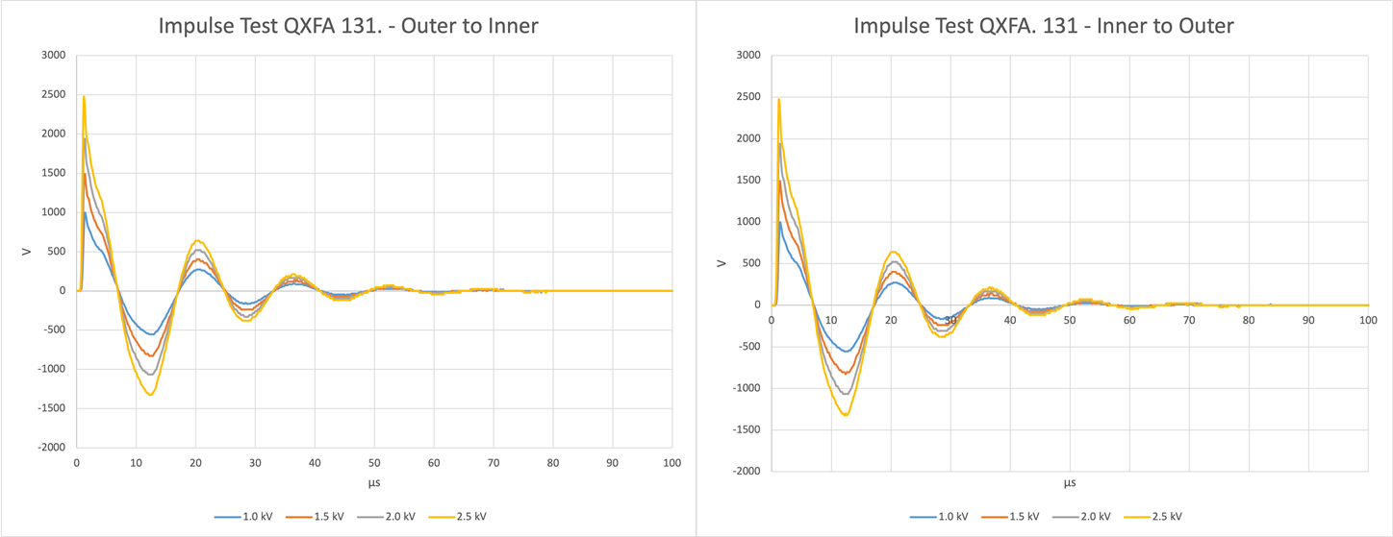
QXFA131 Impulse Test

Slide 24
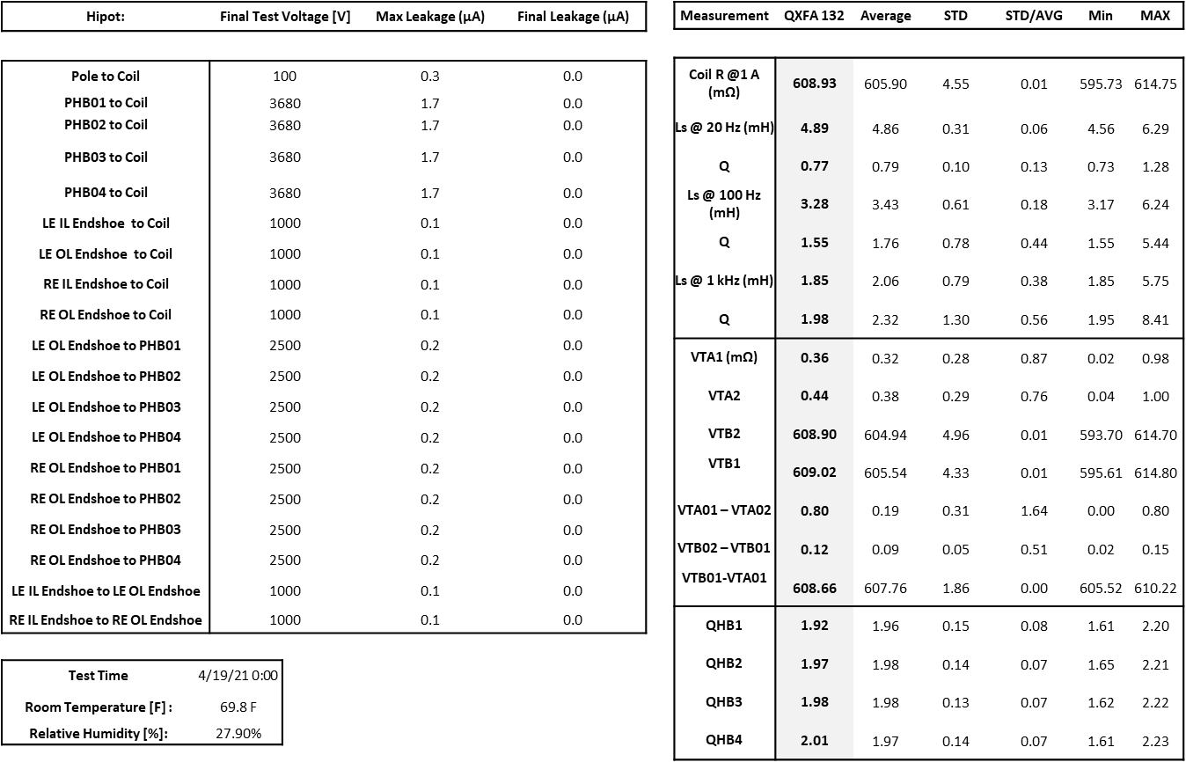
QXFA132 Hi-pot & Electrical Checks (original)
← (revised 5/9/22)

Slide 25
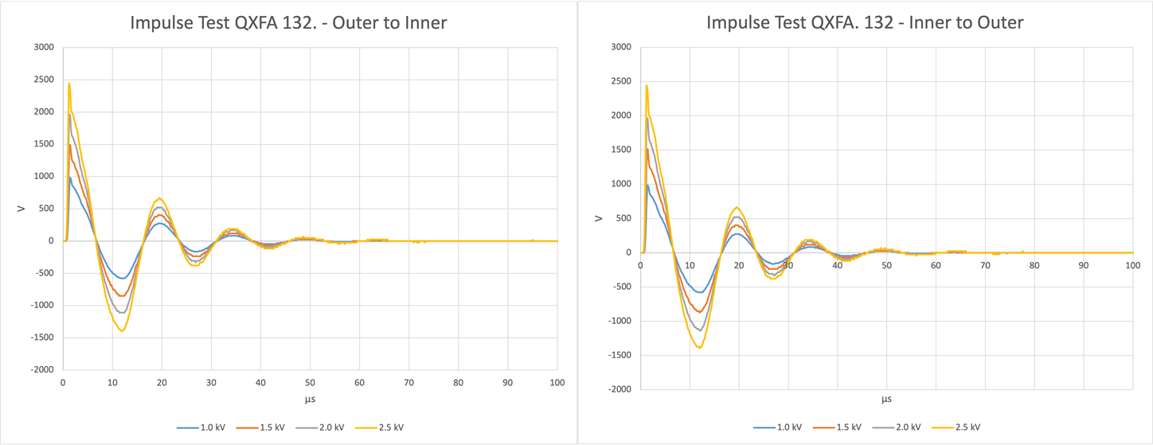
QXFA132 Impulse Test

Slide 26
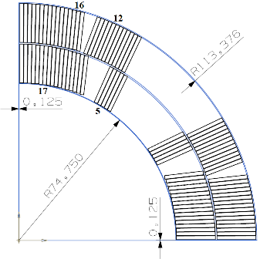
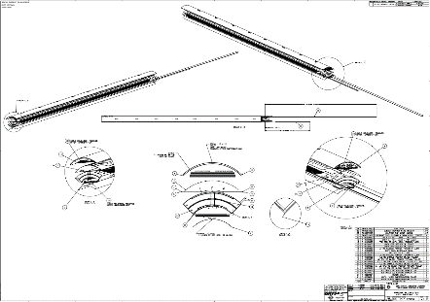
Coil Dimensional Specifications
MQXFA Final Design Report, US-HiLumi-doc-948
 | Dimension (mm) | Tolerance (mm)
Inner radius | 74.750 | ± 0.250
Outer radius | 113.376 | ± 0.250
Coil to midplane gap | 0.125 | ± 0.050
Keyway width | 14.00 | ± 0.25
Coil length | 4529 | ± 5
Coil tolerances per drawing F10115850.

Slide 27
Coil Reaction & Impregnation Specifications
MQXFA Final Design Report, US-HiLumi-doc-948
Coil Reaction | Step | Description | Average Rate | Time
Step 1 | Ramp | from 20 °C to 210 °C | 25 C/hour
Step 2 | Soak | 210 °C |  | 48 hours
Step 3 | Ramp | from 210 °C to 400 °C | 50 C/hour
Step 4 | Soak | 400 °C |  | 48 hours
Step 5 | Ramp | from 400 °C to 665 °C | 50 C/hour
Step 6 | Soak | 665 °C |  | 50 hours
Step 7 | Ramp | from 665 °C to 20 °C |  | ~ 80 hours
Coil Impregnation | Description | Average Rate | Time | Comment
Ramp | from 20 °C to 110 °C | 10 C/hour |  | Coil Degas
Soak | 110 °C |  | 8 hours
Ramp | from 110 °C to 55 °C | 1.7 C/hour
Soak | 55 °C |  | 4-6 hours | Epoxy Fill
Ramp | from 55 °C to 110 °C | 10 C/hour |  | Epoxy Cure
Soak | 110 °C |  | 5 hours
Ramp | from 110 °C to 125 °C | 10 C/hour
Soak | 125 °C |  | 16 hours

Slide 28
Coil Electrical Measurement Range
QXFA Coil Fabrication Electrical QA, US-HiLumi-doc-521
 | Measurement | Ref. Min-Max
 | Coil Resistance @ 1A | 577.31-614.75 mV
 | Ls @ 20 Hz | 4.56-6.29 mH
 | Q @ 20 Hz | 0.73-1.28
 | Ls @ 100 Hz | 3.16-6.24 mH
 | Q @ 100 Hz | 1.57-5.44
 | Ls @ 1 kHz | 1.77-5.75 mH
 | Q @ 1 kHz | 1.95-8.41

Slide 29
Coil Length
 | Overall Coil Length (mm)
Pre-Series Requirement | 4532 ± 5.0
QXFA 114 | 4530
Series Requirement | 4529 ± 5.0
QXFA 124 | 4531.1

Slide 30
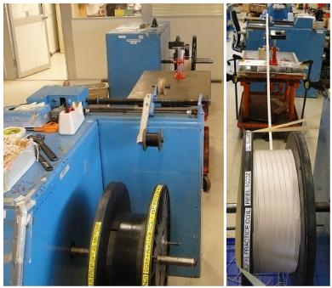
Cable Preparation
Re-spool the insulated cable to verify the total length (min. 441 m including the winding lead).
Split into two reels for L1 coil (min. 195 m) and L2 coil (min. 246 m).
Cable respooling
 | Cable ID | Total (m) | L1 (m) | L2 (m)
QXFA 131 | 1141 | 450.6 | 204.6 | 246
QXFA 132 | 1146 | 448.9 | 202.9 | 246
Cable length in coil
 | Cable ID | Total (m) | L1 (m) | L2 (m)
Average (QXFA 104-128) |  | 427.3 | 188.1 | 239.2
QXFA 131 | 1141 | 427.1 | 188.0 | 239.1
QXFA 132 | 1146 | 427.1 | 188.4 | 238.7

Slide 31
Wedge Length and Gap
QXFA 131 & 132
Wedge gap: 2 mm 3.75 mm 3.75 mm 3.75 mm 3.75 mm 3.75 mm 2 mm

Slide 32
Pole Gap

Slide 33
QXFA Production Coil Pole Gap

