Slide 1
MQXFA10 coil dimensions
P. Ferracin, Dan Cheng, Katherine Ray, Michael Solis
on behalf of the MQXF collaboration
MQXFA10 Coils Acceptance Review
September 7th, 2021
LBNL, Berkeley, CA, USA

Slide 2
Outline
Data taking and processing
Impregnated coil dimensional tolerances
Results (straight section)
Arc length excess
Outer radius profile deviation
Inner radial deviations (coil blocks)
Inner radial deviations (pole)
Key slot deviations
Best-fit outer radius
Appendix

Slide 3
Outline
Data taking and processing
Impregnated coil dimensional tolerances
Results (straight section)
Arc length excess
Outer radius profile deviation
Inner radial deviations (coil blocks)
Inner radial deviations (pole)
Key slot deviations
Best-fit outer radius
Appendix

Slide 4
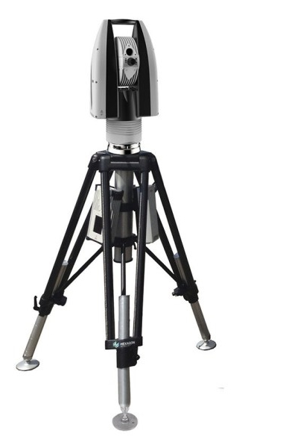
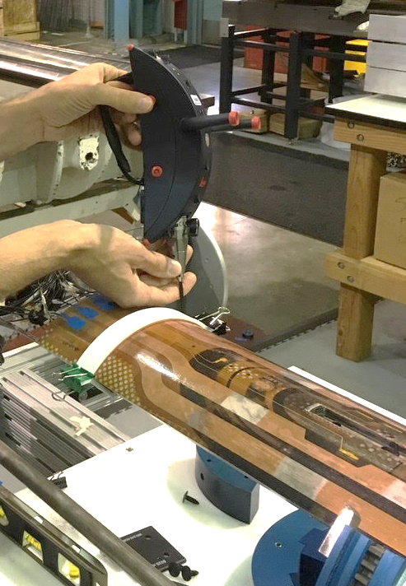
Data taking and processing
Leica System
AT960 with T-Probe
Data processed using
Spatial Analyzer

Slide 5
Post processing
Each cross section is treated separately.
Coils cross-sections are measured in 15 different locations along the coil length, from 70 mm close to the lead end to 4426 mm close to the return end.
The 12 so-called straight section locations, where the pole key slot is present, are from 465 mm close to the lead end to 4310 mm close to the return end.
The strain gauge is at location 3965 mm.

Slide 6
Outline
Data taking and processing
Impregnated coil dimensional tolerances
Results (straight section)
Arc length excess
Outer radius profile deviation
Inner radial deviations (coil blocks)
Inner radial deviations (pole)
Key slot deviations
Best-fit outer radius
Appendix

Slide 7
Impregnated coil dimensional tolerances (for series coils)

Slide 8
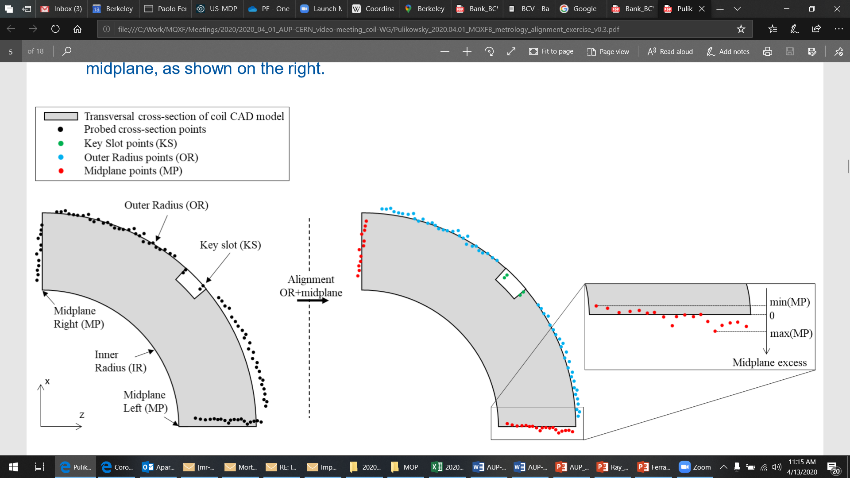
Impregnated coil dimensional tolerances Arc length excess
The impregnated coil is accepted for use in MQXFA if its arc length excesses along the straight section are within the following tolerances: +0.150/-0.250 mm
The arc length excess, which is difference between the measured coil arc length and the nominal one, is determined by fitting outer radius and mid-planes points with the nominal profile, with equal weighting and imposing as symmetrical the two mid-planes offsets. The sum of the two measured mid-plane offsets provides the arc length excess

Slide 9
Impregnated coil dimensional tolerances Outer radius profile deviation
The impregnated coil is accepted for use in MQXFA if its outer radius profile deviations along the straight section are within the following tolerances: +0.200/-0.250 mm
The outer radius profile deviation, which is given by the variation of each point on the outer radius with respect to the nominal outer radius, is determined by fitting outer radius and mid-planes points with the nominal profile, with equal weighting and imposing as symmetrical the two mid-planes offsets. Positive deviation indicates more material than nominal, negative indicates less material than nominal.

Slide 10
Impregnated coil dimensional tolerances “Coil blocks” inner radius profile deviation
The impregnated coil is accepted for use in MQXFA if its “coil blocks” inner radius profile deviations (E-F in next slide) along the straight section are within the following tolerances: +0.150/-0.250 mm
The “coil blocks” inner radius profile deviations, which is given by the variation of each point on the inner radius with respect to the nominal radius, is determined by fitting outer radius and mid-planes points with the nominal profile, with equal weighting and imposing as symmetrical the two mid-planes offsets. Positive deviation indicates more material than nominal, negative indicates less material than nominal.

Slide 11
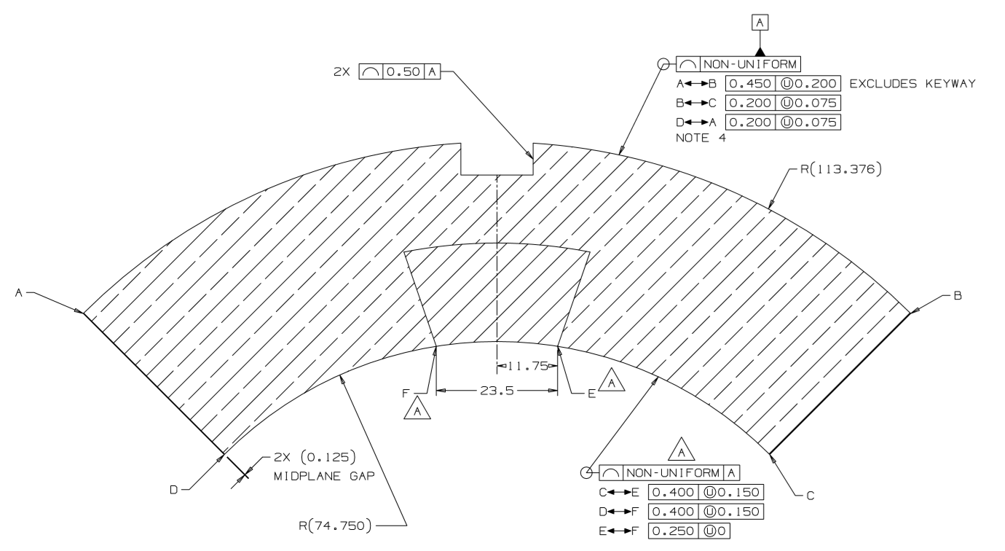
Impregnated coil dimensional tolerances

Slide 12
Impregnated coil dimensional tolerances “Pole” inner radius profile deviation
The impregnated coil is accepted for use in MQXFA if its “pole” inner radius profile deviations (C-E and D-F in next slide) along the straight section are within the following tolerances: +0.000/-0.250 mm*
The “pole” inner radius profile deviations, which is given by the variation of each point on the inner radius with respect to the nominal radius, is determined by fitting outer radius and mid-planes points with the nominal profile, with equal weighting and imposing as symmetrical the two mid-planes offsets. Positive deviation indicates more material than nominal, negative indicates less material than nominal.

Slide 13
Impregnated coil dimensional tolerances
* Cross-section measurements shall be taken close to all possible bumper locations. In addition, data shall be taken on the surface surrounding the pole holes where bumpers are inserted and projected on the closest measured cross-section.

Slide 14
Impregnated coil dimensional tolerances Pole key slot mis-alignment
The impregnated coil is accepted for use in MQXFA if its pole key slot mis-alignment along the straight section are within the following tolerances: +0.250/-0.250 mm
The pole key slot mis-alignment, which is the misalignment of the center of the pole key slot with respect to the nominal position, is determined by fitting outer radius and mid-planes points with the nominal profile, with equal weighting and imposing as symmetrical the two mid-planes offsets.
View from LE, positive shift towards left

Slide 15
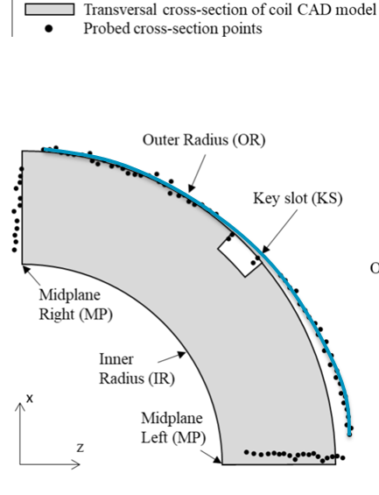
Best-fit outer radius
The best-fit outer radius is determined by best-fitting only the outer radius points.
No tolerance is specified
Used to monitor coil-to-collar contact surfaces (“LQ effect”)

Slide 16
Outline
Data taking and processing
Impregnated coil dimensional tolerances
Results (straight section)
Arc length excess
Outer radius profile deviation
Inner radial deviations (coil blocks)
Inner radial deviations (pole)
Key slot deviations
Best-fit outer radius
Appendix

Slide 17
Arc length excess

Slide 18
Arc length excess straight section

Slide 19
Arc length excess straight section

Slide 20
Arc length excess straight section
Conclusions
All coils within acceptable tolerances for arc length excess

Slide 21
Outline
Data taking and processing
Impregnated coil dimensional tolerances
Results (straight section)
Arc length excess
Outer radius profile deviation
Inner radial deviations (coil blocks)
Inner radial deviations (pole)
Key slot deviations
Best-fit outer radius
Appendix

Slide 22
Outer radius profile deviation

Slide 23
Outer radius profile deviations straight section (min-max)

Slide 24
Outer radius profile deviations straight section

Slide 25
Outer radius profile deviations straight section
Conclusions
All coils within acceptable tolerances for outer radius profile deviations

Slide 26
Outline
Data taking and processing
Impregnated coil dimensional tolerances
Results (straight section)
Arc length excess
Outer radius profile deviation
Inner radial deviations (coil blocks)
Inner radial deviations (pole)
Key slot deviations
Best-fit outer radius
Appendix

Slide 27
Inner radial deviations (coil blocks)

Slide 28
Coil blocks inner radial deviations straight section (min-max)

Slide 29
Coil blocks inner radial deviations straight section

Slide 30
Coil blocks inner radial deviations straight section
Conclusions
Coil 129 out of tolerance in position 1465 mm and 1865 mm
Coil 131 out of tolerance in position 1465 mm and 1865 mm
Coil 132 out of tolerance in position 465 mm and 3865 mm
Coil 220 out of tolerance in position 660 mm and 3865 mm

Slide 31
Outline
Data taking and processing
Impregnated coil dimensional tolerances
Results (straight section)
Arc length excess
Outer radius profile deviation
Inner radial deviations (coil blocks)
Inner radial deviations (pole)
Key slot deviations
Best-fit outer radius
Appendix

Slide 32
Inner radial deviations (pole)

Slide 33
Pole inner radial deviations straight section (min-max)

Slide 34
Pole inner radial deviations straight section

Slide 35
Pole inner radial deviations straight section
Conclusions
Several out of tolerance positions in coils
Coil bumper thickness to be corrected to compensate

Slide 36
Outline
Data taking and processing
Impregnated coil dimensional tolerances
Results (straight section)
Arc length excess
Outer radius profile deviation
Inner radial deviations (coil blocks)
Inner radial deviations (pole)
Key slot deviations
Best-fit outer radius
Appendix

Slide 37
Key slot deviations*
*View from LE, positive shift towards left

Slide 38
Key slot deviations

Slide 39
Key slot deviations

Slide 40
Key slot deviations
Conclusions
All coils within acceptable tolerances for outer radius profile deviations
*If pole key needs be machined to compensate, see LBNL note and Record of Decision in Docdb-2844

Slide 41
Outline
Data taking and processing
Impregnated coil dimensional tolerances
Results (straight section)
Arc length excess
Outer radius profile deviation
Inner radial deviations (coil blocks)
Inner radial deviations (pole)
Key slot deviations
Best-fit outer radius
Appendix

Slide 42
Best-fit outer radius deviations

Slide 43
Best-fit outer radius deviations

Slide 44
Out of tolerance
Arc length excess
None
Outer radius profile deviation
None
Inner radial deviations (coil blocks)
Coil 129 out of tolerance in position 1465 mm and 1865 mm
Coil 131 out of tolerance in position 1465 mm and 1865 mm
Coil 132 out of tolerance in position 465 mm and 3865 mm
Coil 220 out of tolerance in position 660 mm and 3865 mm
Inner radial deviations (pole)
Several out of tolerance positions
Coil bumper thickness to be corrected to compensate
Key slot deviations
None

Slide 45
Outline
Data taking and processing
Impregnated coil dimensional tolerances
Results (straight section)
Arc length excess
Outer radius profile deviation
Inner radial deviations (coil blocks)
Inner radial deviations (pole)
Key slot deviations
Best-fit outer radius
Appendix

Slide 46
Appendix

