Slide 1
MQXFA10 Coil Reception Electrical QC Measurements Coils 131, 132, 220, 221
MQXFA10 Coil Selection Review
Dan Cheng, Bob Memmo, Jordan Taylor
Sep 8, 2021
LBNL

Slide 2
Overview
QXFA Coil 129 had already been approved for MQXFA09 (see MQXFA05 Coil Selection Review Report in https://indico.fnal.gov/event/49436/ )
LBNL EQC Acceptance Data is available
Data has been uploaded;
Summarized in following slides
Now includes acceptance values reviewed by V. Marinozzi

Slide 3
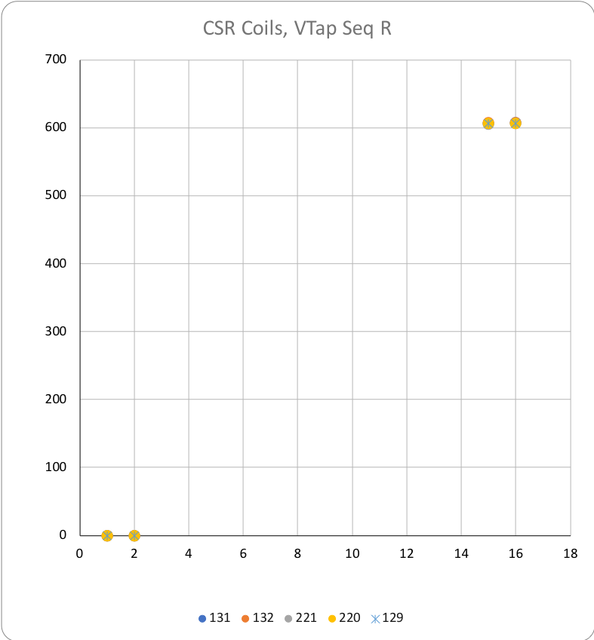
Coil Data
 |  |  | 131 | 132 | 221 | 220 | 129
See DocDB #956 / SU-1010-1903
RLQ
 | R | (mΩ) | 607 | 608 | 606 | 606 | 606
 | L_{s} (mH) | 20 Hz | 10.05 | 10.07 | 10.04 | 10.04 | 10.02
 |  | 100 Hz | 6.42 | 6.42 | 6.42 | 6.42 | 6.41
 |  | 1 kHz | 5.82 | 5.82 | 5.83 | 5.83 | 5.81
 | Q | 20 Hz | 1.28 | 1.27 | 1.29 | 1.28 | 1.29
 |  | 100 Hz | 5.51 | 5.49 | 5.56 | 5.55 | 5.52
 |  | 1 kHz | 8.59 | 8.61 | 8.49 | 8.62 | 8.61
QH R (Ω)
 | NT | A01 | N/A | N/A | N/A | N/A | N/A
 | T | A02 | N/A | N/A | N/A | N/A | N/A
 | T-P | B01 | 2.4 | 2.1 | 2.2 | 2.3 | 2.3
 | NT-P | B02 | 2.4 | 2.2 | 2.2 | 2.3 | 2.3
 | T-M | B03 | 2.4 | 2.2 | 2.2 | 2.3 | 2.3
 | NT-M | B04 | 2.4 | 2.2 | 2.2 | 2.3 | 2.3
VT R (mΩ) Individual coils
@1 Amp |  | A1 | 0.04 | 0.03 | 0.02 | 0.02 | 0.02
 |  | A2 | 0.09 | 0.09 | 0.07 | 0.07 | 0.07
Note: |  | A3
Some coils may |  | A4
still have full |  | A5
complement of VTs |  | A6
but measure only |  | A7
A1B1 and A2/B2 |  | A8
 |  | B8
 |  | B7
 |  | B6
 |  | B5
 |  | B4
 |  | B3
 |  | B2 | 606 | 608 | 605 | 606 | 606
 |  | B1 | 607 | 608 | 606 | 606 | 606.2
HIPOT |  |  | OK | OK | OK | OK | OK
IMPULSE |  |  | OK | OK | OK | OK | OK
All coils are Series, with limited voltage taps

Slide 4
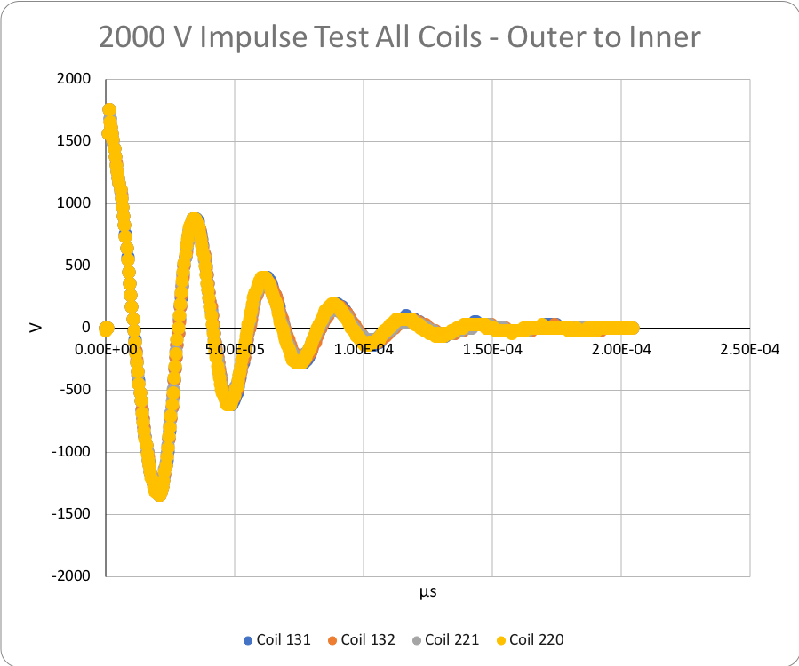
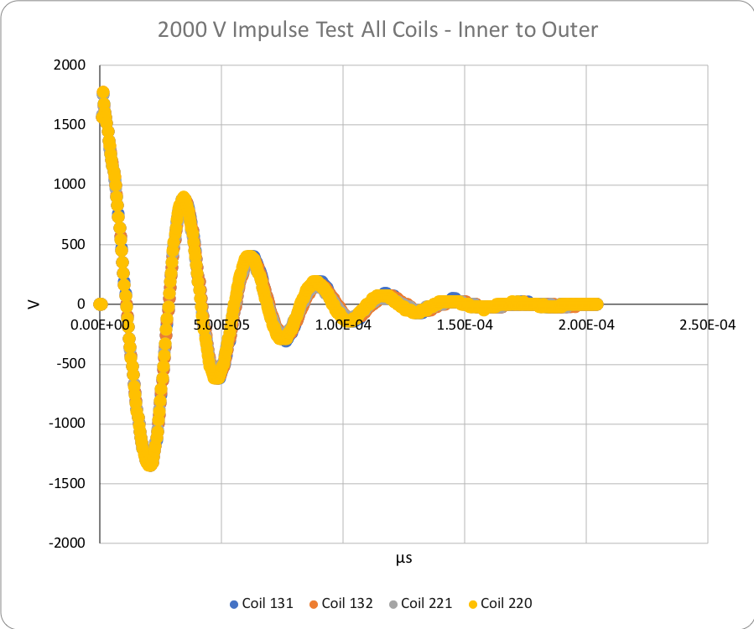
Hipot and Impulse tests
Hipot tests passed for all coils
See Coil EQC data workbook on Indico Page
Impulse tests 2000V data shown here
See data in EQC data workbook

Slide 5
Summary
All coil acceptance EQC tests were performed
Tests passed with all values within acceptance values
No issues observed

Slide 6
Appendix

