Slide 1


Magnets 302.2.02 and 03 –
Strand Procurement and Testing
Cable Fabrication
Lance Cooley – NHMFL/ASC (302.2.02 L3)
Vito Lombardo – FNAL (302.2.02 CAM)
Ian Pong – LBNL (302.2.03 L3 and CAM)
Elizabeth Lee – LBNL (302.2.03 CAM deputy)
Mike Naus – LBNL (302.2.03 L3 Deputy)
Jonathan Lee – LBNL Intern Student
HL-LHC AUP MQXFA10 Coil Acceptance Review – 08 Sept 2021

Slide 2
Outline
Cable & Coil Overview
Strand Summary
Cable DR Summary
Discrepancy Reports by Cable

Slide 3
Cable & Coil Overview
Coil # | Cable #
129 | P43OL1132
131 | P43OL1141
132 | P43OL1146
220 | P43OL1135
221 | P43OL1143
Previously Approved
All cables are 2nd generation QXF cables produced under AUP

Slide 4
Strand Summary
All strands ordered per the “HiLumi” specification
  AUP
    FNAL 646116 Shipment A
    FNAL 646116 Shipment B
    FNAL 646116 SA1 Shipment B
    FNAL 646116 SA1 Shipment C
    LBNL 7428700 Shipment A
    LBNL 7428700 Shipment B
  LARP
    FNAL 632982 D - Spec 0
Conductor Description:
  Ø0.85 mm, 108/127 stack, Ti-doped, Reduced-Sn

Slide 5
Cable QC Summary
All cables passed the required quality control testing per US-HiLumi-Doc. 74
Six (6) DRs reported across the four (4) cables

Slide 6
Cable DR Review

Slide 7

QXFA-131 / P43OL1141
No Discrepancy Reports for Cable P43OL1141

Slide 8
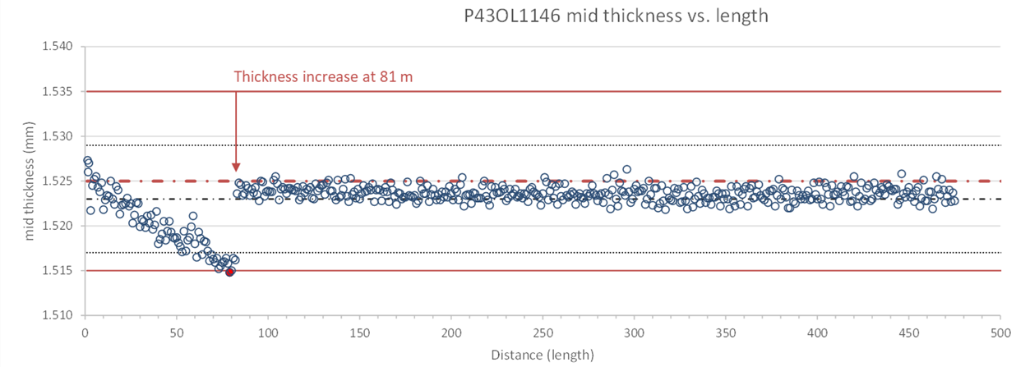
QXFA-132 / P43OL1146
Discrepancy Report #12104
(1 of 3)
Issue: One CME mid-thickness data point below spec by 0.2 µm at 81st meter
Cause: Late thickness adjustment
Acceptance Justification: Single point, only out by small amount and not expected to impact cable viability

Slide 9
QXFA-132 / P43OL1146
Discrepancy Report #12232
(2 of 3)
Issue 1: TCs outside of calibration window
Issue 2: TC values along the sample length during the heat treatment plateaus varied by more than 2 °C.
210C Plateau: Range = 3.1 °C
400C Plateau: Range = 4.1 °C
665C Plateau: Range = 6.4 °C
Cause 1: Unable to calibrate TC probes in RRR furnace as built
  Now fixed
Cause 2: TC drift coupled with the inability to calibrate.
Acceptance Justification:
  Quartz-encapsulated witness wire RRR was within normal range
    Temperatures were within historical norms
  Average temperatures were on target
  210C Plateau: Average = 209.4 °C
  400C Plateau: Average = 398.9 °C
  665C Plateau: Average = 665.3 °C

Slide 10
QXFA-132 / P43OL1146
Discrepancy Report #12158
(3 of 3)
Issue: Insulation thickness verification measurement 0.9 mm above spec at 0.159 mm
Cause: Operator error (suspected)
Acceptance Justification:
  Subsequent measurement of post-coiling cable drop lengths was on target at 0.145 mm
  Vendor measurement in-spec (0.149 mm)

Slide 11
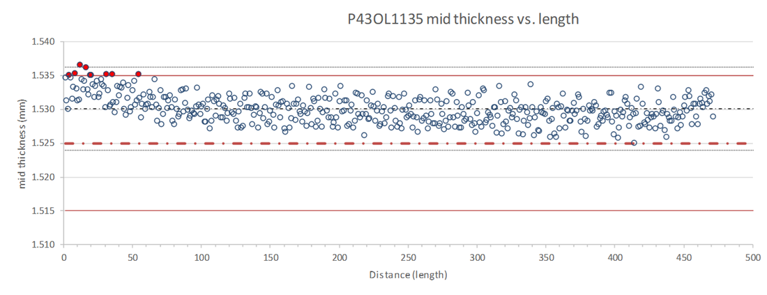
QXFA-220 / P43OL1135
Discrepancy Report #11915
(1 of 2)
Issue: Several mid-thickness data points above spec
  0.1 µm to 1.6 µm above USL
Cause: Measurement noise coupled with above target thickness
Acceptance Justification: Values are small and not expected to impact cable viability

Slide 12
QXFA-220 / P43OL1135
Discrepancy Report #11920
(2 of 2)
Issue: Insulation thickness average 0.2 µm above spec on LBNL verification sample
Cause: Measurement & raw material variation
Acceptance Justification:
  OOS by very small amount & not expected to impact cable viability.
  Vendor measurement average within specification (0.1493 mm)

Slide 13
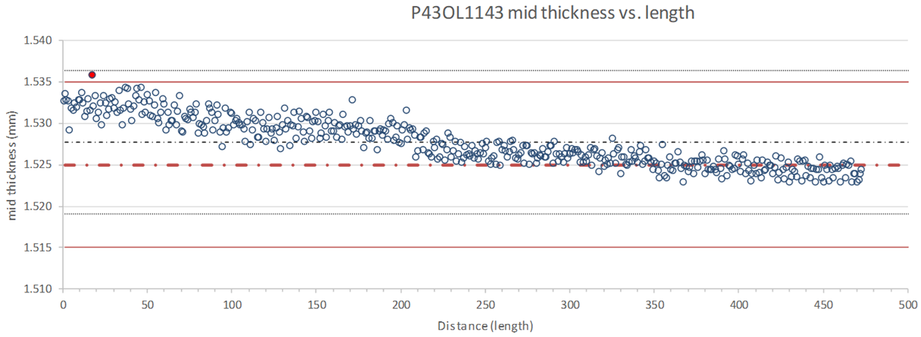
QXFA-221 / P43OL1143
Discrepancy Report #12038
(1 of 1)
Issue: One CME mid-thickness data point above spec by < 1 µm
Cause: Measurement noise coupled with slightly above target thickness
Acceptance Justification: Single point, only out by small amount and not expected to impact cable viability. Potentially within post-coil cable drops

Slide 14
END
[Back-Up Slides Below]

Slide 15
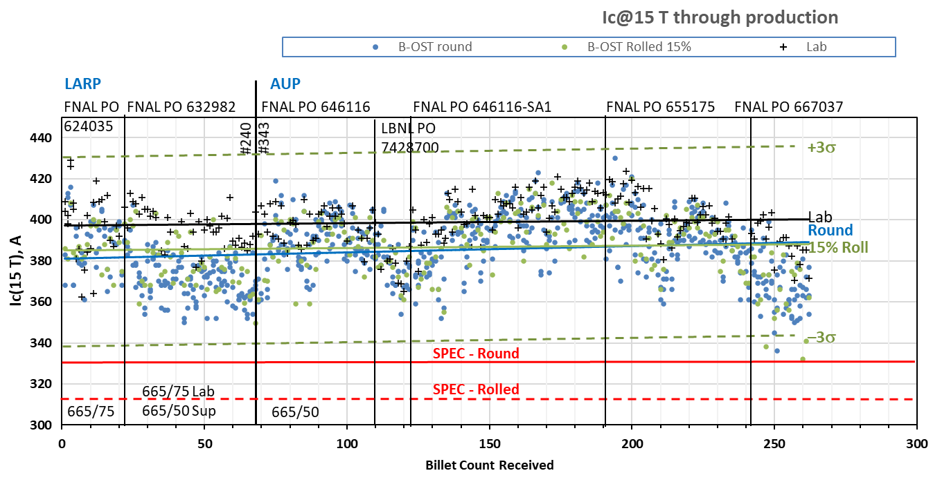
Present strand production data
S: 665°C/50h
V: 665°/75h
Both 665°C/50h
Both 665°C/75h

Slide 16
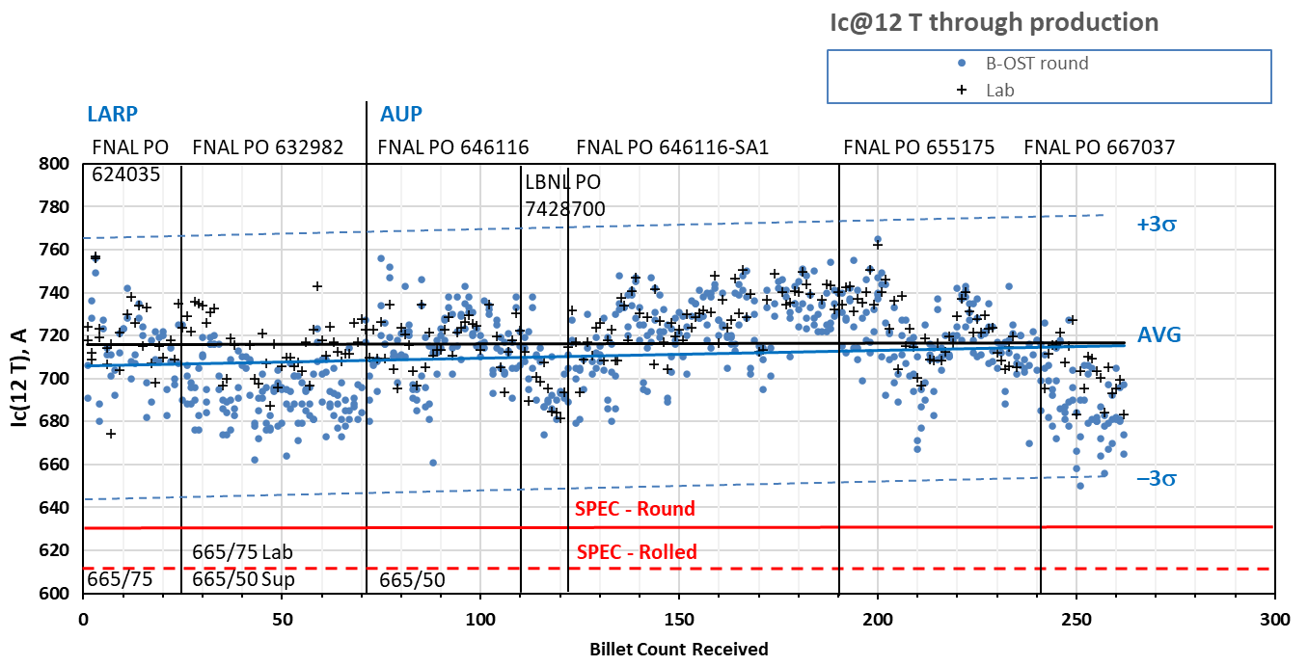
Present strand production data
Both 665°C/75h
S: 665°C/50h
V: 665°/75h
Both 665°C/50h

Slide 17
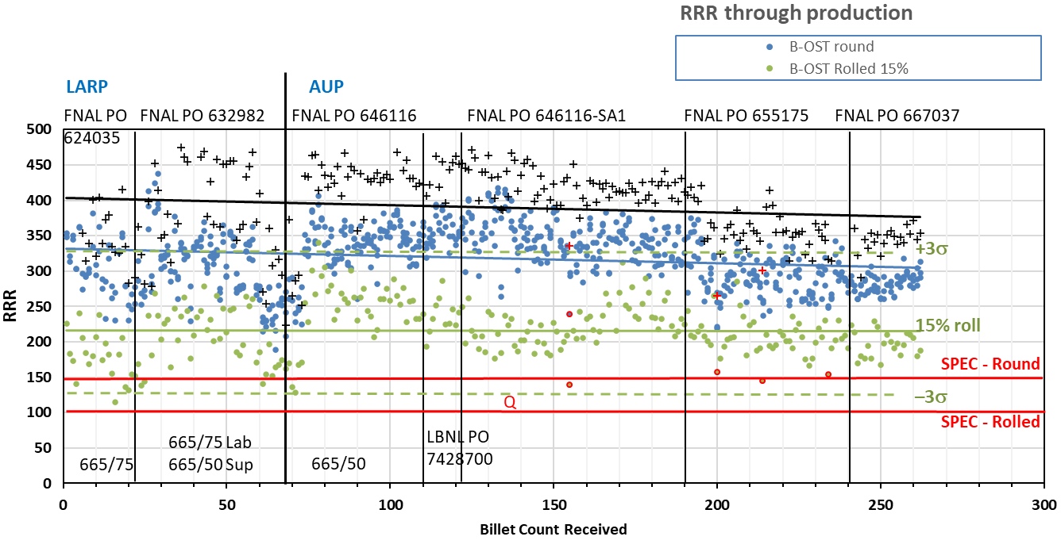
Present strand production data
Data for 15% rolled strand predicts the RRR at cable sharp bend
Lab: IEC method, Supplier: 20K method
Inter-lab comparisons have validated approaches (see QP)

Slide 18
P43OL1141 – Cable Date, Lengths
Cable Manufacture Date
  2019 01 07 (Production run)
Cable Length:
  468 m (LBNL, fabricated, including LBNL samples)

Slide 19
P43OL1141 – Strand and SS Core ID
Spool:
  PO08S00344A04U x 3 ULs,
  PO08S00355A02U x 2 ULs,
  PO08S00456A01U x 2 ULs,
  PO08S00457A05U x 2 ULs,
  PO08S00460A05U x 2 ULs,
  PO08S00461A03U x 1 ULs,
  PO08S00454A09U x 1 ULs,
  PO08S00236B01U x 2 ULs,
  PO08S00453A07U x 2 ULs,
  PO08S00454A08U x 4 ULs,
  PO08S00453A05U x 1 ULs,
  PO08S00369A01U x 8 ULs,
  PO08S00377A03U x 7 ULs,
  PO08S00453A02U x 3 ULs.
From 11 billets
Core:
  120L09A7322313
    Core width: 12.0 mm; material: 316L;
    Heat: 844979; Lot: 16-597;
    Chemical Properties CoT/CoC 172660-1: 0.14 wt% Co

Slide 20
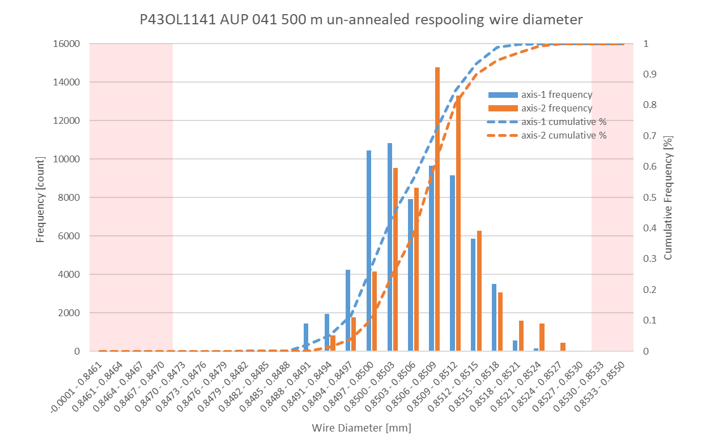
P43OL1141 Respooling Wire Diameter
Below LSL: 0.01%
Above USL: 0.01%

Slide 21
P43OL1141 – Cable QC Data Summary
CME:
Residual Twist:
  130°
10-stack:
  Qualification: 1.517 mm
  Production tail end: 1.522 mm
 | Pressure (MPa) | Angle (°) | Width (mm) | Thickness (mm)
Maximum | 17.2 | 0.409 | 18.169 | 1.526
Average | 17.0 | 0.364 | 18.156 | 1.523
Minimum | 17.0 | 0.321 | 18.149 | 1.519
Sigma | 0.02 | 0.010 | 0.003 | 0.001

Slide 22
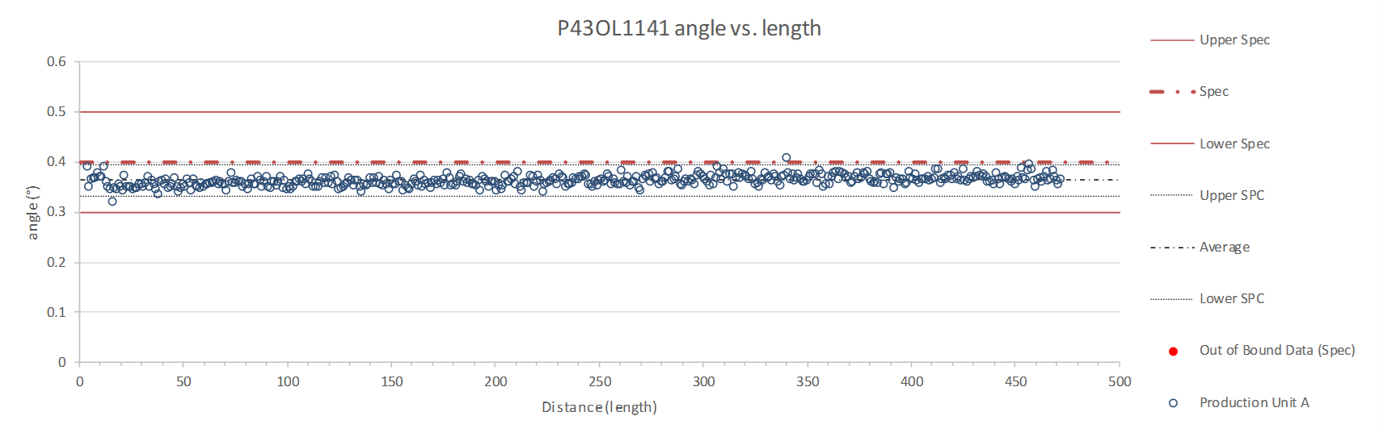
Rollers: P-95 (2019-12-02) and P-96 (2019-12-02)

Slide 23
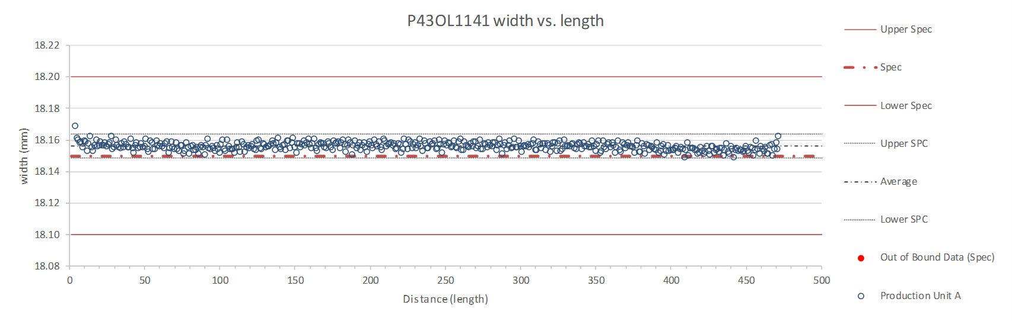
Rollers: P-95 (2019-12-02) and P-96 (2019-12-02)

Slide 24
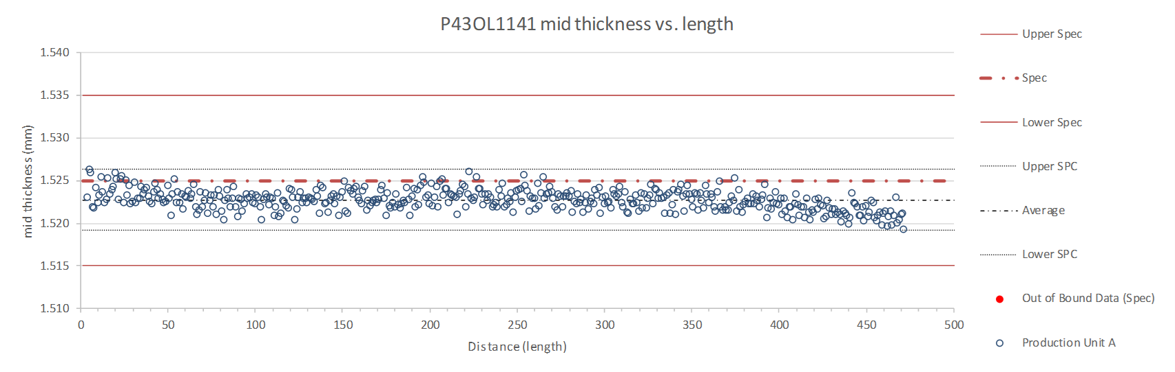
Rollers: P-95 (2019-12-02) and P-96 (2019-12-02)

Slide 25
P43OL1141 – Braiding
Fiberglass Lot #100858, 100602
P/I: 18.9
Spool tension: 10 lbs. (payoff); 20 lbs. (takeup)
Bobbin payoff tension: 0.125 lbs. (min), 0.250 lbs. (max)
NEWT 10-stack QC:
  Cycle #1) 0.148 mm; #2) 0.147 mm; #3) 0.145 mm;
  Mean 0.147 mm
LBNL 10-stack verification QC:
  Cycle #1) 0.149 mm; #2) 0.148 mm; #3) 0.147 mm;
  Mean 0.148 mm
Vector #464342

Slide 26
P43OL1141 – Wire Parameters
Properties | Inspected Average
Wire Diameter | 0.851 ± 0.006 mm (LBNL)¹
Cu ratio ª | 53.9% (OST)
Strand twist pitch ª | 19.0mm (OST)
RRR (RW) ª | 343 (OST)
RRR (15% rolled) ª | 229 (OST)
I_{C} (4.2 K, 15 T) ª | 389 A (OST)
I_{C} (4.2 K, 14 T) ª | 485 A (OST)
I_{C} (4.2 K, 13 T) ª | 593 A (OST)
I_{C} (4.2 K, 12 T) ª | 716 A (OST)
ª First billet averaged, then weighted average according
to the spool distribution in the cable
¹ As-received, all LBNL respooling data; mean ± 1 sigma

Slide 27
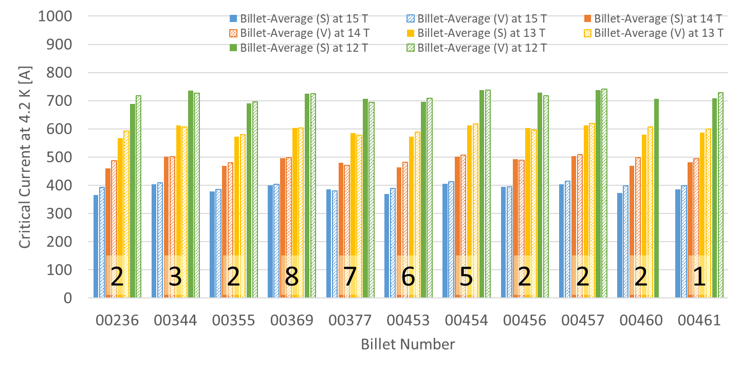
P43OL1141 – Wire Parameters
Supplier (S) and Verification (V) I_{C} Data
Number of spools from that billet used in the cable

Slide 28
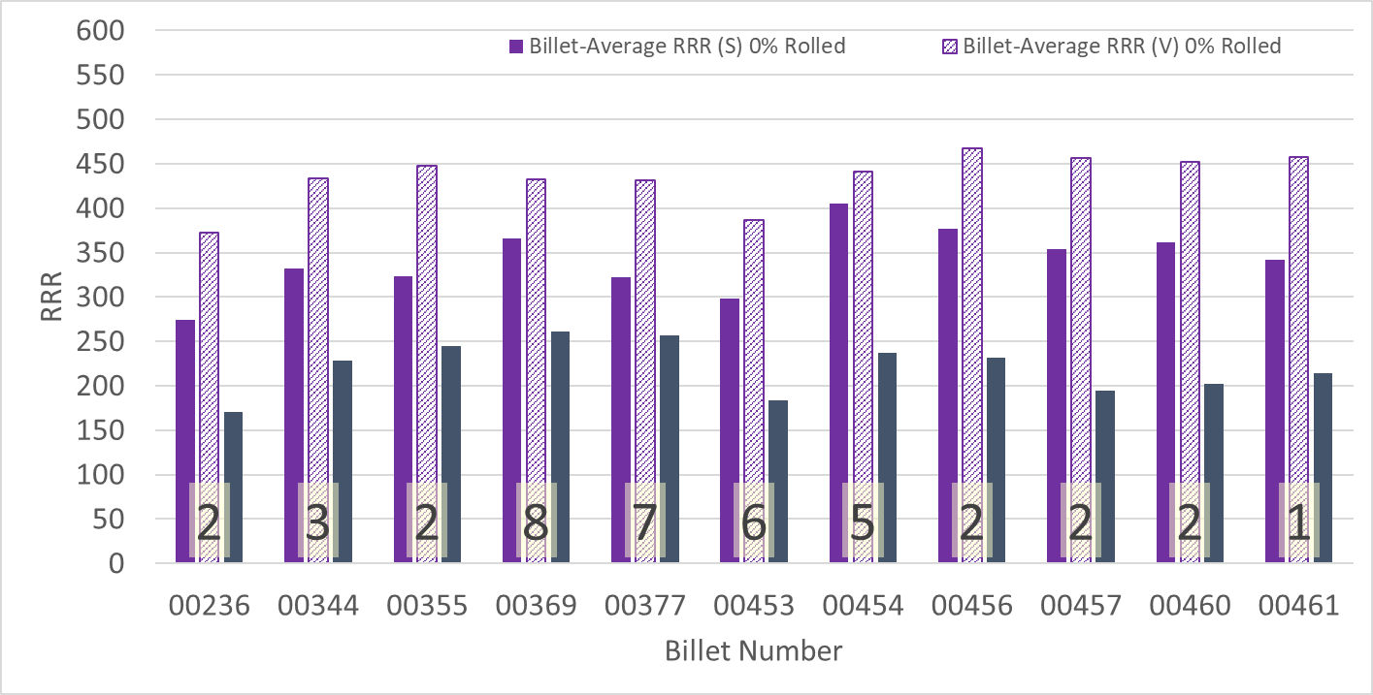
P43OL1141 – Wire Parameters
Supplier (S) and Verification (V) RRR Data
Number of spools from that billet used in the cable

Slide 29
P43OL1141 – Extracted Strand RRR
 | Cable ID | No. of Units from Billet (spool) | HT/sample ID | Major edge RRR | Minor edge RRR | Straight section 1 RRR | Straight section 2 RRR
ID #1 | PO08S00344A04U P43OL1141AE05E | 3 (3) | LRLK200731ALC1 | 353 | 349 | 429 | 415
ID #2 | PO08S00454A08U P43OL1141AE29E | 5 (4) | LRLK200731ALC1 | 353 | 281 | 406 | 443
ID #3 | PO08S00369A01U P43OL1141AE41E | 8 (8) | LRLK200731ALC2 | 364 | 340 | 397 | 431
ID #4 | PO08S00377A03U P43OL1141AE51E | 7 (7) | LRLK200731ALC1 | 386 | 295 | 408 | 434
ID #5 | PO08S00453A02U P43OL1141AE57E | 6 (3) | LRLK200731ALC1 | 309 | 263 | 360 | 375
Vector #464342

Slide 30
P43OL1146 – Cable Date, Lengths
Cable Manufacture Date
  01 July 2020 (Production run)
Cable Length:
  475 m (LBNL, fabricated, including LBNL samples)

Slide 31
P43OL1146 – Strand and SS Core ID
Spools:
Core:
  120L04A7322313
    Heat: 844979. Lot: 16-597
    Material: 316L
    Chemical Properties CoT/CoC #172660-1: 0.14 wt% Co
    Core width: 12.0 mm
PO08S00344A01U x 1 ULs | PO08S00355A01U x 2 ULs | PO08S00361A02U x 1 ULs | PO08S00381A05U x 1 ULs
PO08S00344A03U x 1 ULs | PO08S00358A04U x 2 ULs | PO08S00361A03U x 2 ULs | PO08S00382A02U x 1 ULs
PO08S00344A05U x 1 ULs | PO08S00358A07U x 1 ULs | PO08S00362A02U x 3 ULs | PO08S00383A01U x 2 ULs
PO08S00347A02U x 1 ULs | PO08S00359A01U x 3 ULs | PO08S00364A02U x 1 ULs | PO08S00383A02U x 2 ULs
PO08S00347A03U x 2 ULs | PO08S00359A02U x 1 ULs | PO08S00366A02U x 2 ULs | PO08S00383A05U x 1 ULs
PO08S00353A05U x 1 ULs | PO08S00360A01U x 1 ULs | PO08S00367A01U x 2 ULs | PO08S00409A03U x 1 ULs
PO08S00354A03U x 1 ULs | PO08S00360A02U x 1 ULs | PO08S00381A04U x 1 ULs | PO08S00416A02U x 1 ULs
28 spools from 18 different billets

Slide 32
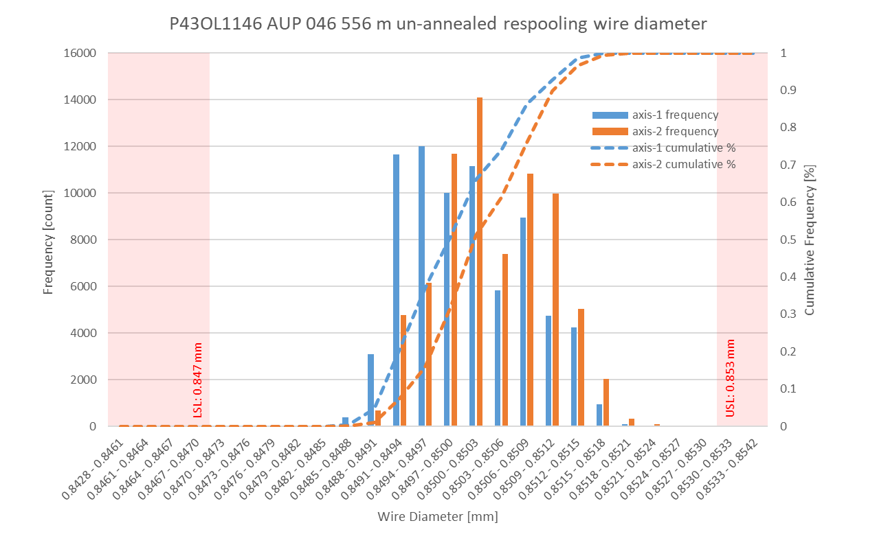
P43OL1146 Respooling Wire Diameter
Below LSL: 0.003%
Above USL: 0.002%

Slide 33
P43OL1146 – Cable QC Data Summary
CME:
Residual Twist: 130°
10-stack:
  Qualification: 1.524 mm
  Production tail end: 1.525 mm
 | Pressure (MPa) | Angle (°) | Width (mm) | Thickness (mm)
Maximum | 17.0 | 0.394 | 18.175 | 1.527
Average | 17.0 | 0.370 | 18.144 | 1.523
Minimum | 16.9 | 0.320 | 18.135 | 1.515
Sigma | 0.01 | 0.012 | 0.005 | 0.002

Slide 34
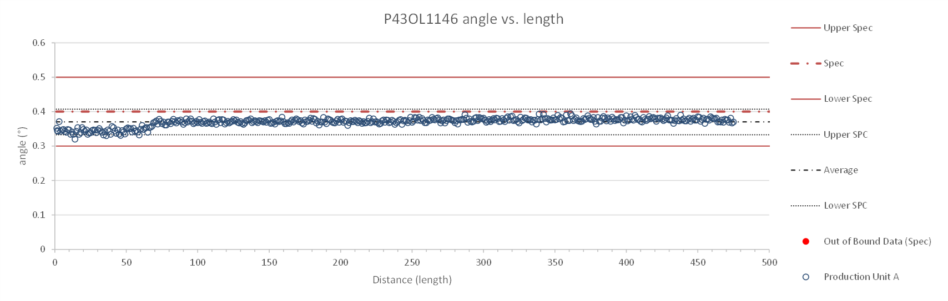
Rollers: P-93 (2019 12 02) & P-94 (2019 12 02)

Slide 35
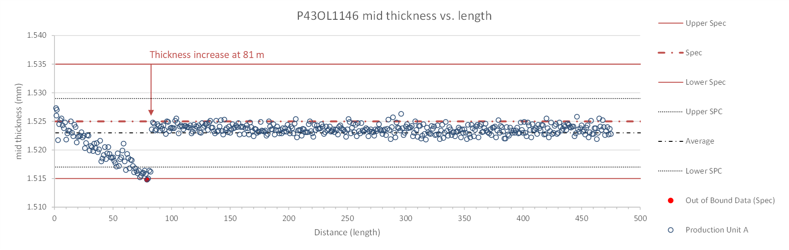
Rollers: P-93 (2019 12 02) & P-94 (2019 12 02)

Slide 36
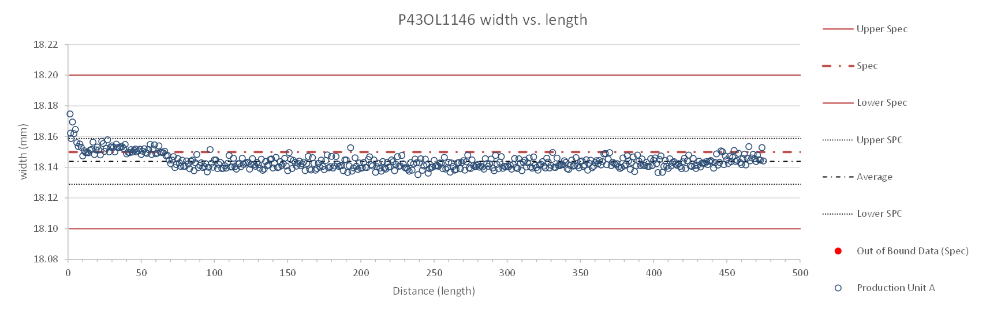
Rollers: P-93 (2019 12 02) & P-94 (2019 12 02)

Slide 37
P43OL1146 – Braiding
Fiberglass Lot: #11154
P/I: 18.9
Spool tension: 10 lbs. @ payoff. 20 lbs. @ takeup (12 lbs min)
Bobbin payoff tension: 0.125 lbs. ≤ T ≤ 0.250 lbs.
Insulation Thickness (at 5 Mpa)
Site | Cycle #1 (mm) | Cycle #2 (mm) | Cycle #3 (mm) | Average (mm)
NEWT | 0.151 | 0.149 | 0.148 | 0.149
LBNL Verification | 0.147 | 0.145 | 0.144 | 0.145
Vector #464342

Slide 38
P43OL1146 – Wire Parameters
Properties | Inspected Average
Wire Diameter | 0.8502 ± 0.0006 mm (LBNL)¹
Cu ratio ª | 53.89% (BOST)
Strand twist pitch ª | 18.7mm (BOST)
RRR (RW) ª | 339 (BOST)
RRR (15% rolled) ª | 247 (BOST)
I_{C} (4.2 K, 15 T) ª | 389 A (BOST)
I_{C} (4.2 K, 14 T) ª | 484 A (BOST)
I_{C} (4.2 K, 13 T) ª | 591 A (BOST)
I_{C} (4.2 K, 12 T) ª | 713 A (BOST)
ª First billet averaged, then weighted average according
to the spool distribution in the cable
¹ As-received. LBNL respooling data. Mean ± 1 sigma

Slide 39
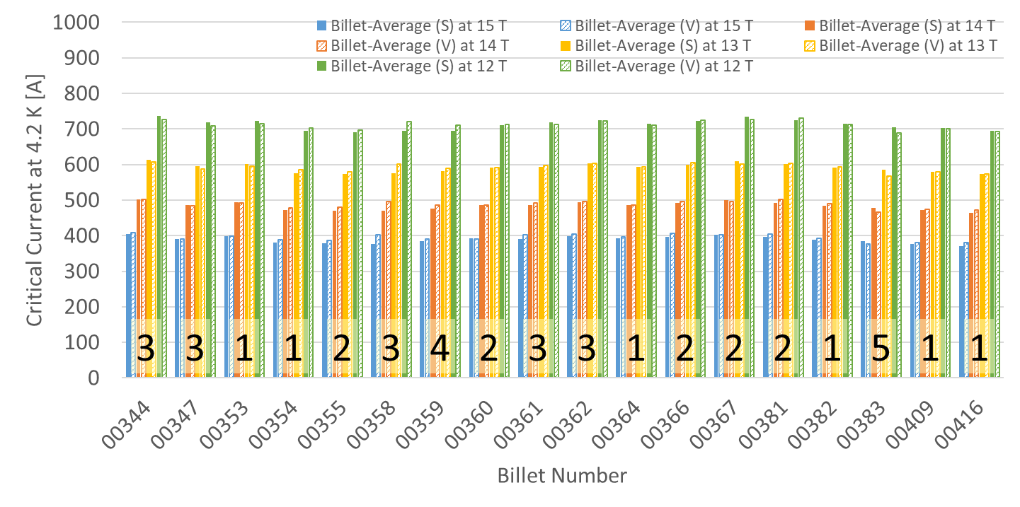
P43OL1146 – Wire Parameters
Supplier (S) and Verification (V) I_{C} Data
Number of spools from that billet used in the cable

Slide 40
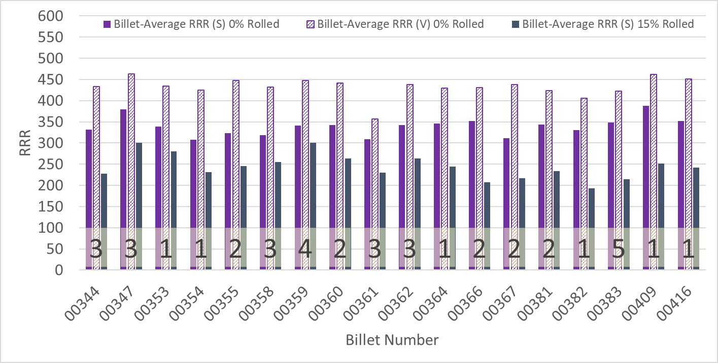
P43OL1146 – Wire Parameters
Supplier (S) and Verification (V) RRR Data
Number of spools from that billet used in the cable

Slide 41
P43OL146 – Extracted Strand RRR
 | Cable ID | No. of Units from Billet (spool) | HT/sample ID | Major edge RRR | Minor edge RRR | Straight section 1 RRR | Straight section 2 RRR
ID #1 | PO08S00383A01U P43OL1146AE06E | 5 (2) | LRLK201012ALC1 | 332 | 261 | 390 | 384
ID #2 | PO08S00355A01U P43OL1146AE09E | 2 (2) | LRLK201012ALC1 | 361 | 281 | 413 | 409
ID #3 | PO08S00361A03U P43OL1146AE13E | 3 (2) | LRLK201012ALC2 | 330 | 234 | 383 | 388
ID #4 | PO08S00344A03U P43OL1146AE57E | 3 (1) | LRLK201012ALC2 | 350 | 250 | 411 | 404
ID #5 | PO08S00347A02U P43OL1146AE60E | 3 (1) | LRLK201012ALC1 | 391 | 295 | 448 | 438
Vector #464342

Slide 42
P43OL1146 – I_{c}, Qual Samples
Wire/ Cable Strand | I_{c}(A) at Field (T)
 | 12 T | 13 T | 14 T | 15 T
PO08S00362A02U P43OL1146AE49E | 684 | 571 | 469 | 382
PO08S00366A02U P43OL1146AE01E | 679 | 568 | 466 | 376
PO08S00359A01U P43OL1146AE23E | 670 | 555 | 458 | 369

Slide 43
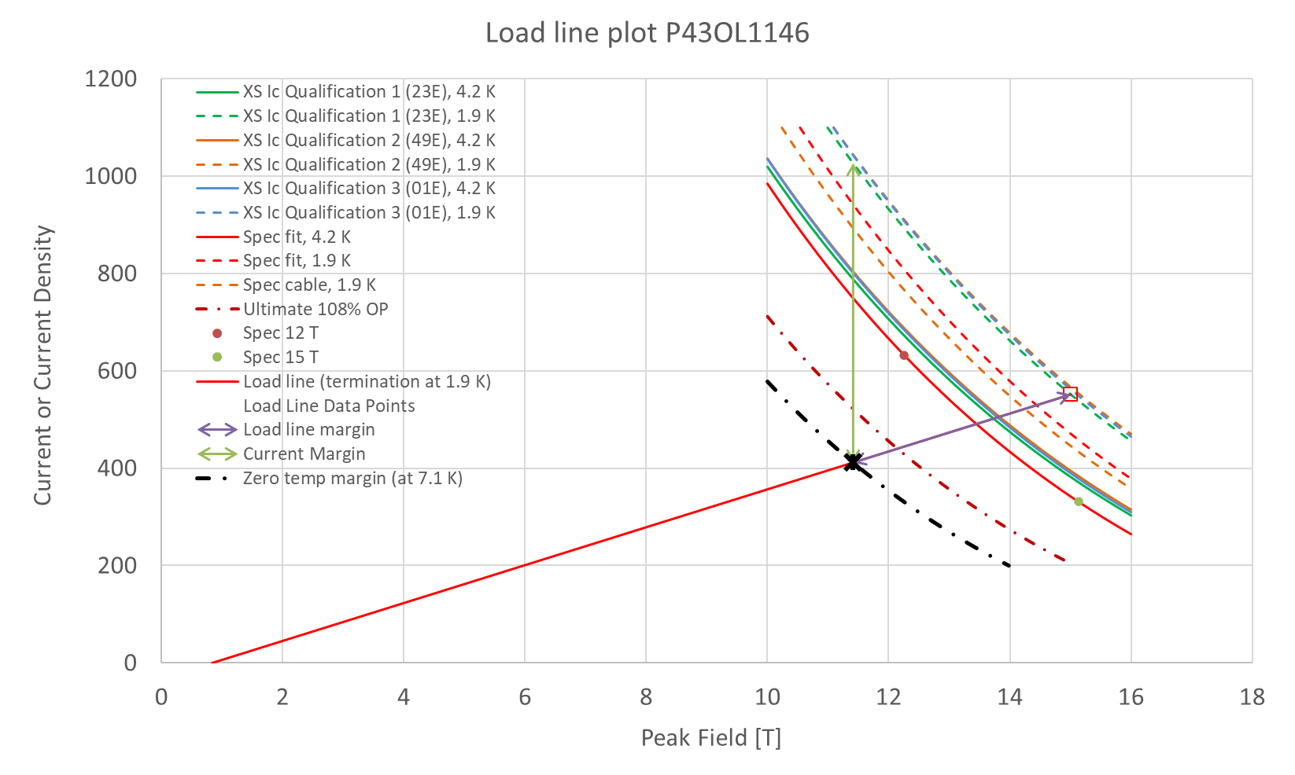
P43OL1146 – SSL Plot, Qual Samples

Slide 44
P43OL1135 – Cable Date, Lengths
Cable Manufacture Date
  2019 07 08 (Production run)
Cable Length:
  471 m (LBNL, fabricated, including LBNL samples)

Slide 45
P43OL1135 – Strand and SS Core ID
Spool:
  PO08S00452A01U x 5 ULs,
  PO08S00451A01U x 1 ULs,
  PO08S00450A01U x 18 ULs,
  PO08S00451A02U x 16 ULs,
Core:
  120L16A7322313
    Core width: 12.0 mm; material: 316L;
    Heat: 844979; Lot: 16-597;
    Chemical Properties CoT/CoC 172660-1: 0.14 wt% Co
From 3 billets

Slide 46
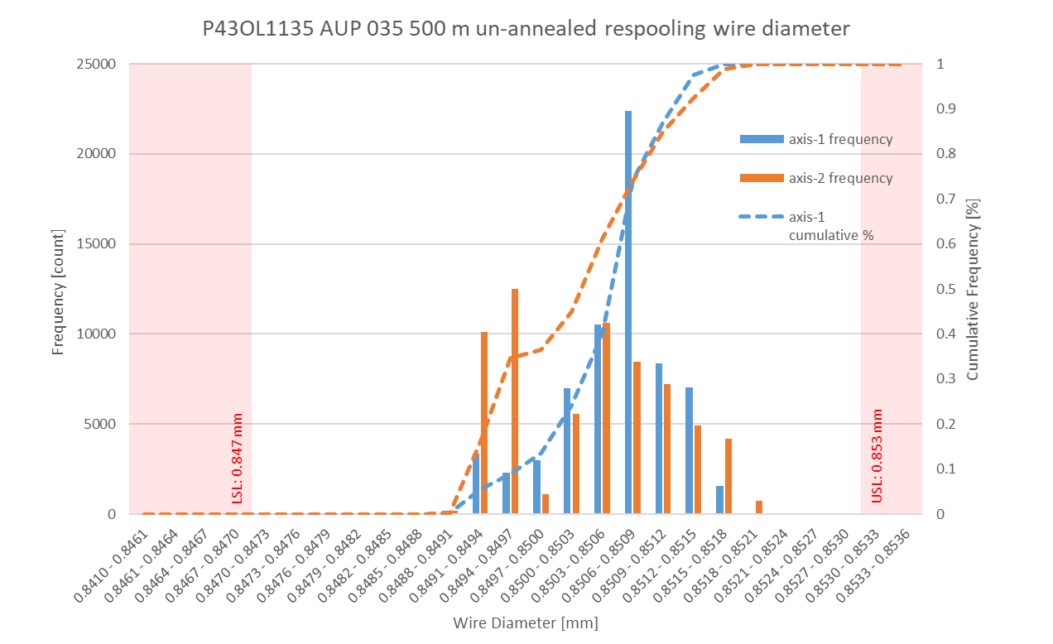
P43OL1135 Respooling Wire Diameter
Below LSL: 0.00%
Above USL: 0.00%

Slide 47
P43OL1135 – Cable QC Data Summary
CME:
Residual Twist:
  125°
10-stack:
  Qualification: 1.532 mm
  Production tail end: 1.529 mm
 | Pressure (MPa) | Angle (°) | Width (mm) | Thickness (mm)
Maximum | 17.1 | 0.425 | 18.182 | 1.537
Average | 17.0 | 0.403 | 18.152 | 1.530
Minimum | 17.0 | 0.374 | 18.146 | 1.525
Sigma | 0.01 | 0.009 | 0.003 | 0.002

Slide 48
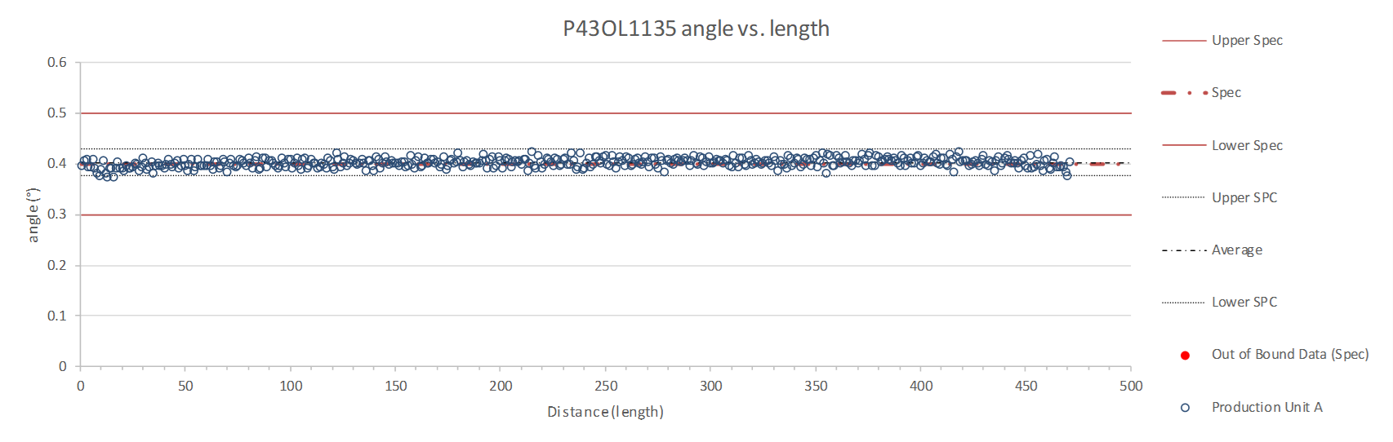
Rollers: P-91 (2017-12-08) and P-92 (2017-12-08)

Slide 49
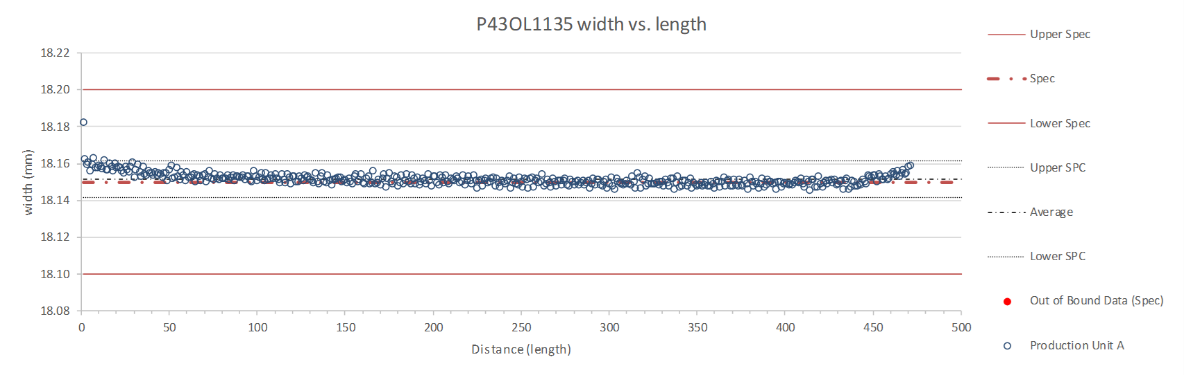
Rollers: P-91 (2017-12-08) and P-92 (2017-12-08)

Slide 50

Rollers: P-91 (2017-12-08) and P-92 (2017-12-08)

Slide 51
P43OL1135 – Braiding
Fiberglass Lot #100858
P/I: 18.9
Spool tension: 10 lbs. (payoff); 20 lbs. (takeup)
Bobbin payoff tension: 0.125 lbs. (min), 0.250 lbs. (max)
NEWT 10-stack QC:
  Cycle #1) 0.151 mm; #2) 0.149 mm; #3) 0.148 mm;
  Mean 0.150 mm (see DR #11920)
LBNL 10-stack verification QC:
  Cycle #1) 0.145 mm; #2) 0.142 mm; #3) 0.141 mm;
  Mean 0.143 mm
Vector #464342

Slide 52
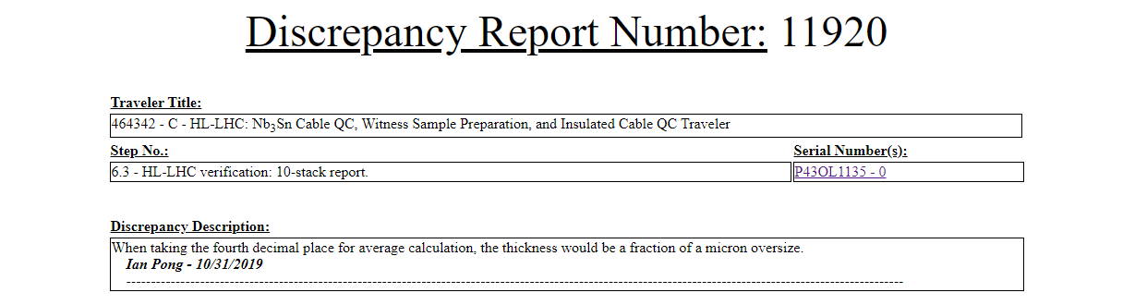
Discrepancy Report #11920
Average insulation thickness measurement a fraction of a micron oversize
Attributed to measurement uncertainty; should not impact cable readiness

Slide 53
P43OL1135 – Wire Parameters
Properties | Inspected Average
Wire Diameter | 0.850 ± 0.001 mm (LBNL)¹
Cu ratio ª | 54.0% (OST)
Strand twist pitch ª | 18.7mm (OST)
RRR (RW) ª | 376 (OST)
RRR (15% rolled) ª | 209 (OST)
I_{C} (4.2 K, 15 T) ª | 379 A (OST)
I_{C} (4.2 K, 14 T) ª | 475 A (OST)
I_{C} (4.2 K, 13 T) ª | 583 A (OST)
I_{C} (4.2 K, 12 T) ª | 706 A (OST)
ª First billet averaged, then weighted average according
to the spool distribution in the cable
¹ As-received, all LBNL respooling data; mean ± 1 sigma

Slide 54
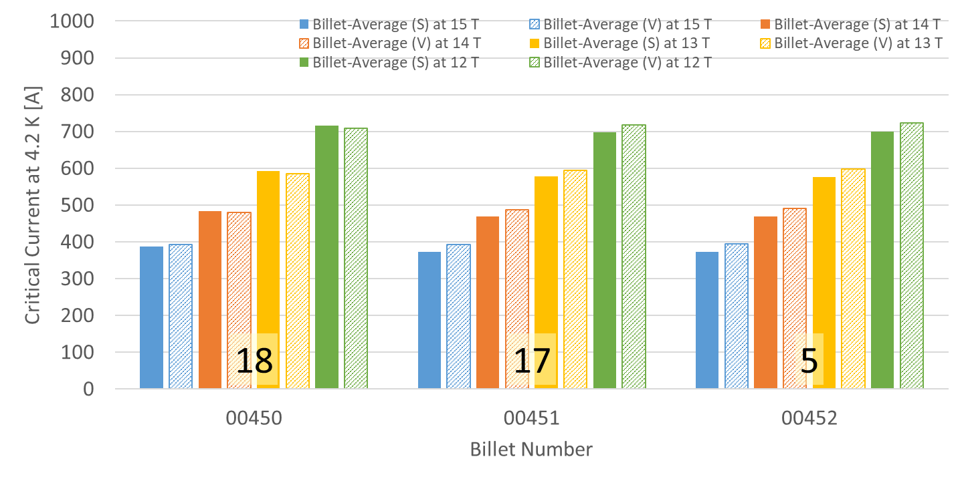
P43OL1135 – Wire Parameters
Supplier (S) and Verification (V) I_{C} Data
Number of spools from that billet used in the cable

Slide 55
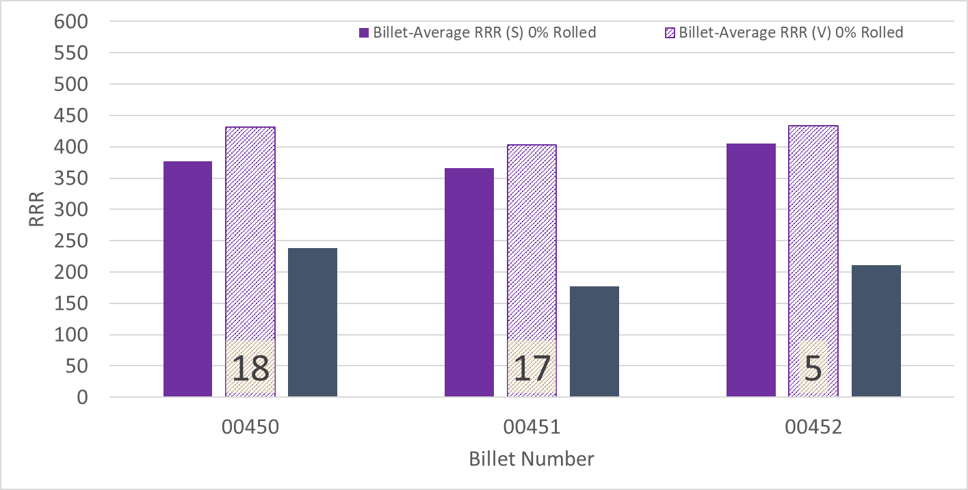
P43OL1135 – Wire Parameters
Supplier (S) and Verification (V) RRR Data
Number of spools from that billet used in the cable

Slide 56
P43OL1135 – Extracted Strand RRR
 | Cable ID | No. of Units from Billet (spool) | HT/sample ID | Major edge RRR | Minor edge RRR | Straight section 1 RRR | Straight section 2 RRR
ID #1 | P43OL1135AE05E PO08S00452A01U | 17 (9) | LRLK200206ALC1 | 348 | 280 | 377 | 359
ID #2 | P43OL1135AE39E PO08S00451A02U | 17 (8) | LRLK200206ALC1 | 231 | 202 | 297 | 282
ID #3 | P43OL1135AE37E PO08S00451A02U | 12 (7) | LRLK200206ALC1 | 324 | 204 | 343 | 316
ID #4 | P43OL1135AE12E PO08S00450A01U | 12 (5) | LRLK200206ALC1 | 294 | 256 | 388 | 387
ID #5 | P43OL1135AE11E PO08S00450A01U | 11 (5) | LRLK200206ALC1 | 297 | 289 | 353 | 361
Vector #464342

Slide 57
P43OL1143 – Cable Date, Lengths
Cable Manufacture Date
  27 Jan 2020 (Production run)
Cable Length:
  472 m (LBNL, fabricated, including LBNL samples)

Slide 58
P43OL1143 – Strand and SS Core ID
From 12 billets
Spools:
Core:
  120L07A7322313
    Heat: 844979. Lot: 16-597
    Material: 316L
    Chemical Properties, CoT/CoC #172660-1: 0.14 wt% Co
    Core width: 12.0 mm
PO08S00354A04U x 5 ULs | PO08S00454A01U x 1 ULs | PO08S00460A01U x 2 ULs
PO08S00368A07U x 2 ULs | PO08S00454A05U x 1 ULs | PO08S00460A02U x 1 ULs
PO08S00377A02U x 1 ULs | PO08S00457A06U x 1 ULs | PO08S00460A03U x 3 ULs
PO08S00378A01U x 2 ULs | PO08S00458A03U x 3 ULs | PO08S00461A01U x 4 ULs
PO08S00453A06U x 2 ULs | PO08S00459A01U x 2 ULs | PO08S00461A02U x 4 ULs
PO08S00453A08U x 3 ULs | PO08S00460A07U x 2 ULs | PO08S00463A01U x 1 ULs

Slide 59
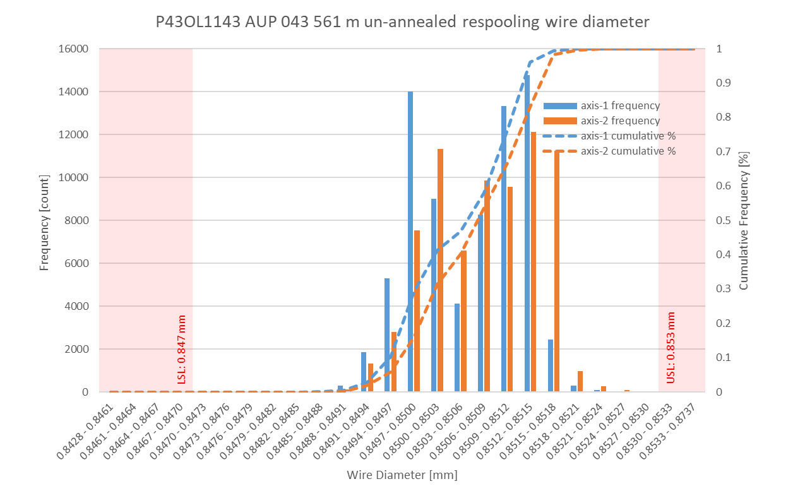
P43OL1143 Respooling Wire Diameter
Below LSL: 0.002%
Above USL: 0.012%

Slide 60
P43OL1143 – Cable QC Data Summary
CME:
Residual Twist: 120°
10-stack:
  Qualification: 1.529 mm
  Production tail end: 1.525 mm
 | Pressure (MPa) | Angle (°) | Width (mm) | Thickness (mm)
Maximum | 17.09 | 0.419 | 18.164 | 1.536
Average | 17.01 | 0.381 | 18.146 | 1.528
Minimum | 16.97 | 0.333 | 18.135 | 1.523
Sigma | 0.02 | 0.019 | 0.007 | 0.003

Slide 61
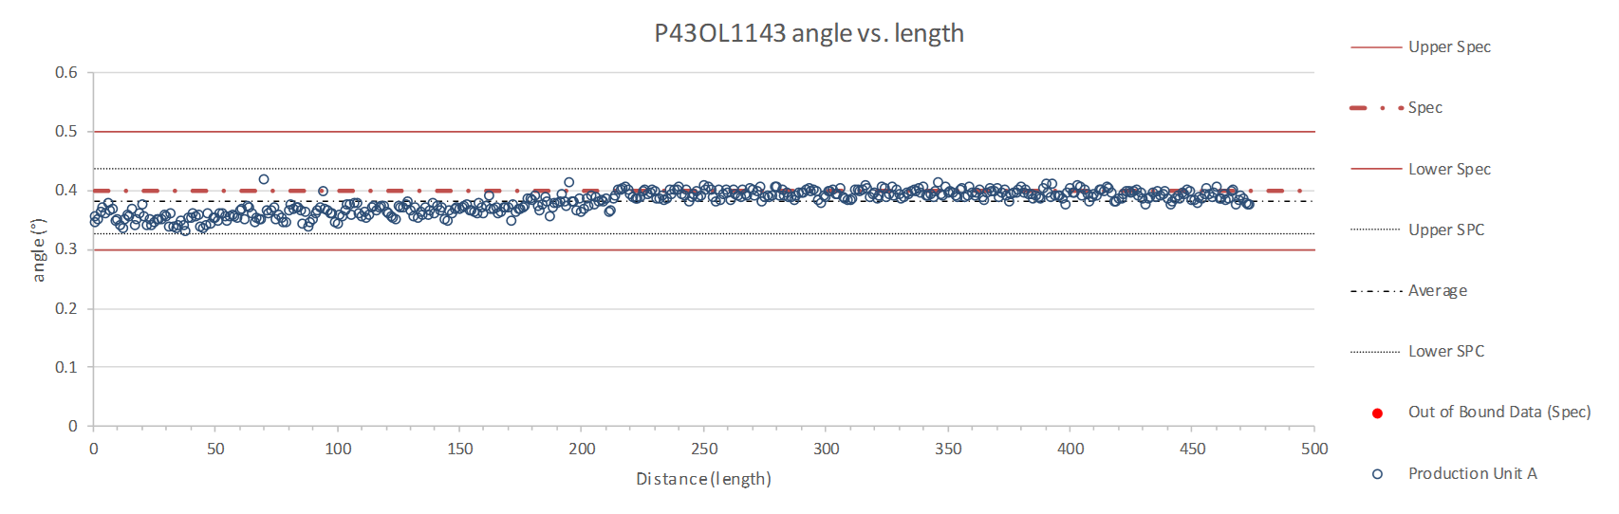
Rollers: P-95 (2019 12 02) & P-96 (2019 12 02)

Slide 62
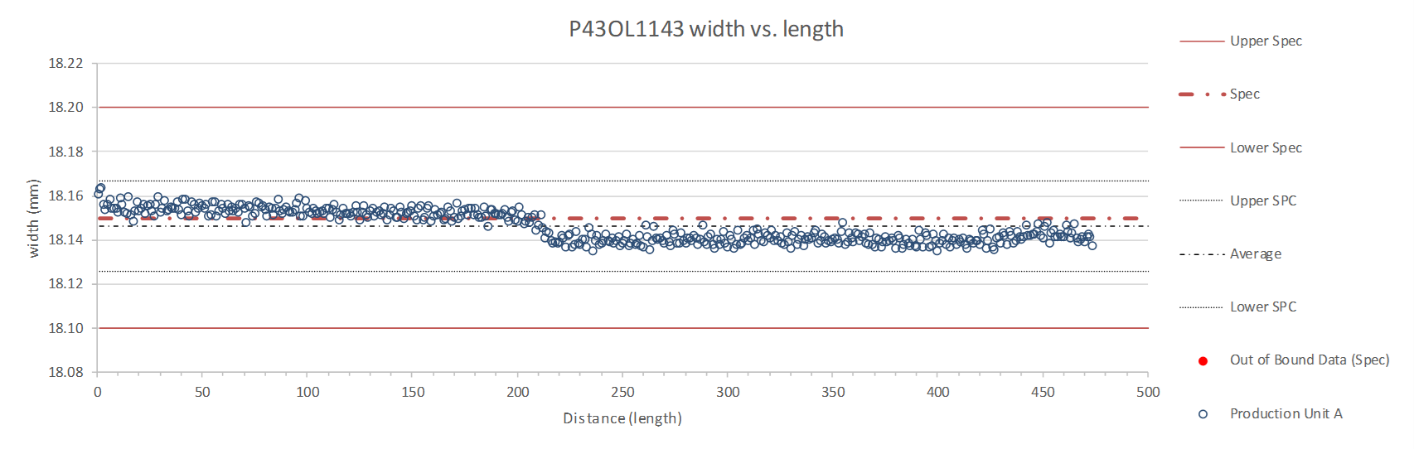
Rollers: P-95 (2019 12 02) & P-96 (2019 12 02)

Slide 63
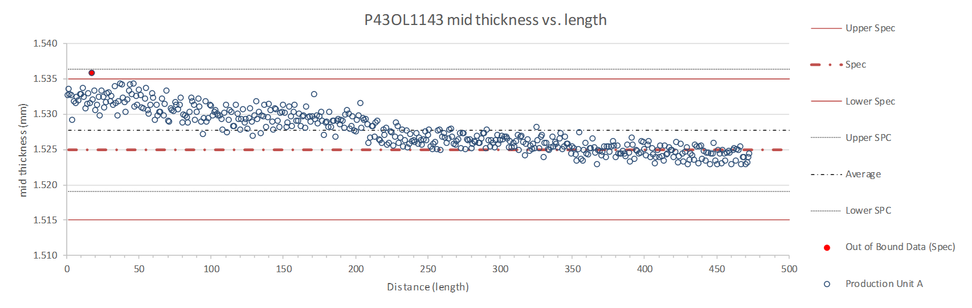
Rollers: P-95 (2019 12 02) & P-96 (2019 12 02)

Slide 64
P43OL1143 – Braiding
Fiberglass Lot: #11154
P/I: 18.9 & 18.0
Spool tension: 10 lbs. @ payoff. 20 lbs. @ takeup (12 lbs min)
Bobbin payoff tension: 0.125 lbs. ≤ T ≤ 0.250 lbs.
Insulation Thickness (at 5 Mpa)
Site | Cycle #1 (mm) | Cycle #2 (mm) | Cycle #3 (mm) | Average (mm)
NEWT | 0.151 | 0.148 | 0.146 | 0.148
LBNL Verification | 0.148 | 0.147 | 0.145 | 0.147
Vector #464342

Slide 65
P43OL1143 – Wire Parameters
Properties | Inspected Average
Wire Diameter | 0.8507 ± 0.001 mm (LBNL)¹
Cu ratio ª | 54.09% (BOST)
Strand twist pitch ª | 18.7mm (BOST)
RRR (RW) ª | 339 (BOST)
RRR (15% rolled) ª | 214 (BOST)
I_{C} (4.2 K, 15 T) ª | 384 A (BOST)
I_{C} (4.2 K, 14 T) ª | 480 A (BOST)
I_{C} (4.2 K, 13 T) ª | 588 A (BOST)
I_{C} (4.2 K, 12 T) ª | 712 A (BOST)
ª First billet averaged, then weighted average according
to the spool distribution in the cable
¹ As-received. LBNL respooling data. Mean ± 1 sigma

Slide 66
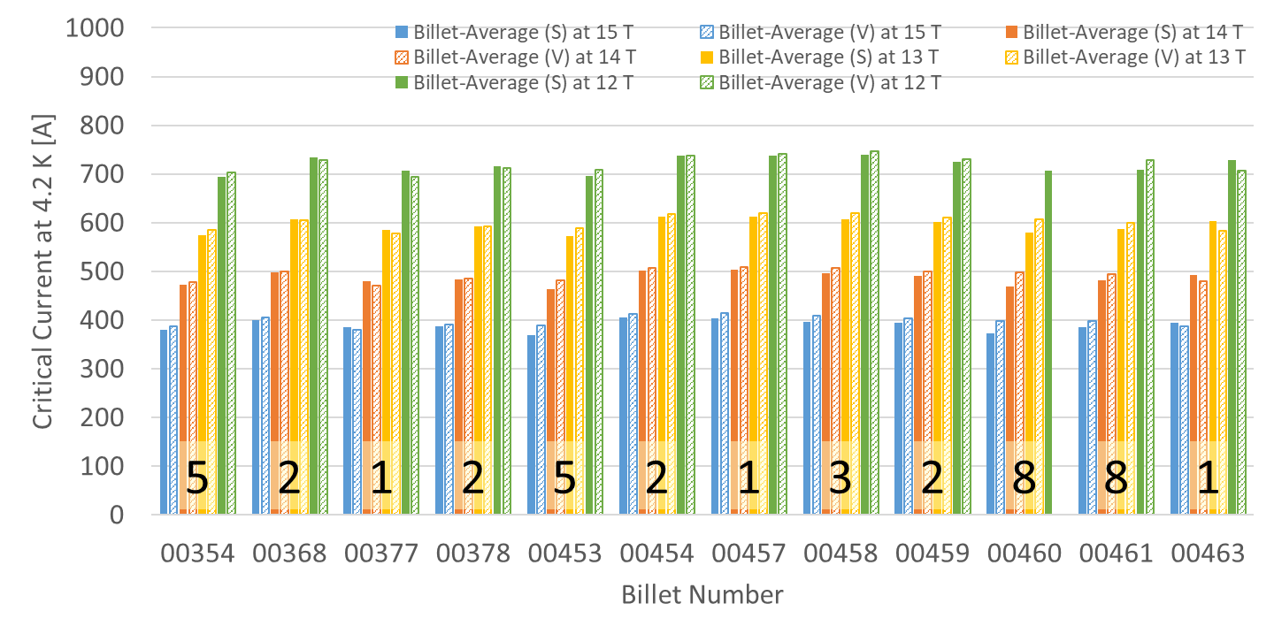
P43OL1143 – Wire Parameters
Supplier (S) and Verification (V) I_{C} Data
Number of spools from that billet used in the cable

Slide 67
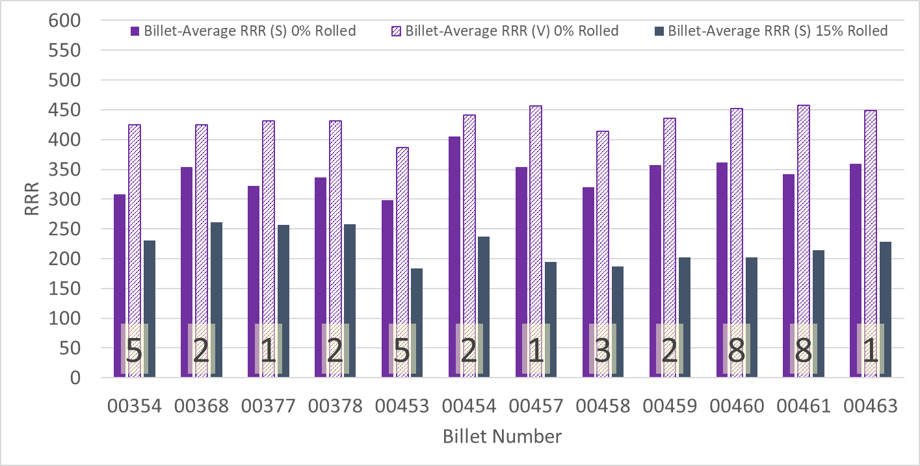
P43OL1143 – Wire Parameters
Supplier (S) and Verification (V) RRR Data
Number of spools from that billet used in the cable

Slide 68
P43OL1143 – Extracted Strand RRR
 | Cable ID | No. of Units from Billet (spool) | HT/sample ID | Major edge RRR | Minor edge RRR | Straight section 1 RRR | Straight section 2 RRR
ID #1 | PO08S00461A01U P43OL1143AE53E | 8 (4) | LRLK200609ALC3 | 353 | 281 | 400 | 413
ID #2 | PO08S00354A04U P43OL1143AE05E | 5 (5) | LRLK200609ALC3 | 391 | 214 | 385 | 392
ID #3 | PO08S00460A03U P43OL1143AE09E | 8 (3) | LRLK200609ALC3 | 364 | 254 | 386 | 379
ID #4 | PO08S00461A02U P43OL1143AE13E | 8 (4) | LRLK200609ALC3 | 368 | 291 | 432 | 417
ID #5 | PO08S00458A03U P43OL1143AE36E | 3 (3) | LRLK200609ALC3 | 349 | 211 | 339 | 349
Vector #464342

Slide 69
P43OL1143 – I_{c}, Qual Samples
Wire/ Cable Strand | I_{c}(A) at Field (T)
 | 12 T | 13 T | 14 T | 15 T
PO08S00354A04U P43OL1143AE05E | 671 | 557 | 455 | 366
PO08S00354A04U P43OL1143AE06E | 673 | 558 | 456 | 367
PO08S00461A02U P43OL1143AE15E | 683 | 566 | 460 | 370
PO08S00461A02U P43OL1143AE17E | 695 | 575 | 469 | 377

Slide 70
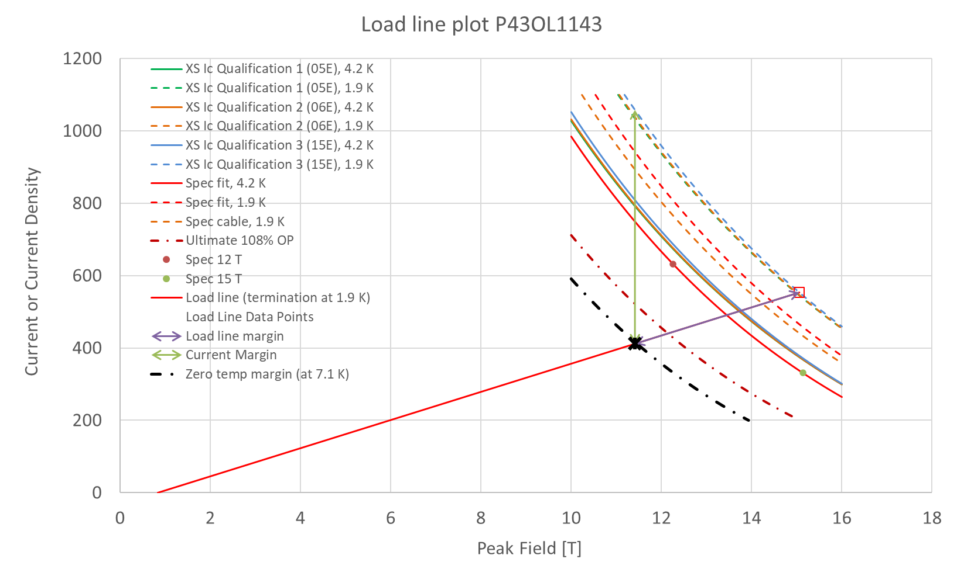
P43OL1143 – SSL, Qualification I_{c}

