Slide 1
MI/RR 2021 Summer Shutdown
2 Nov 1947
1974
D. Morris
M. Murphy
03 – Sep - 2021
1947

Slide 2
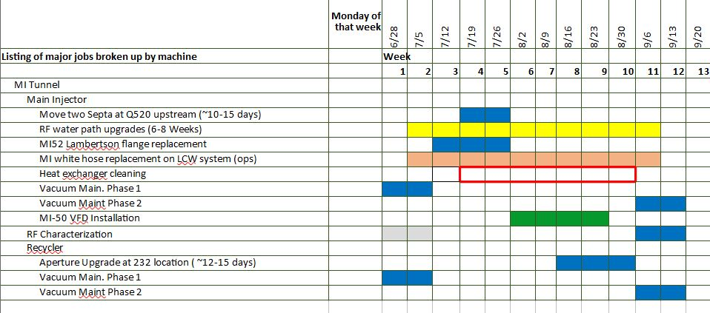
Work Scheduling
x
x
x
x
x
x
x
x
x
x
x
x
x
x
x
x
x
x
x
x
<number>

Slide 3
Tunnel Work In Progress
520 Septa Relocation
Fix two issues with motion control
MIRF
Continue with RF maintenance
Instrumentation
Re-purpose cables for IPMs
Ion Pump
Identify and repair failed cables (813, 821, 314)
MI LCW secondary manifold “white hose” replacement
Valves need to be verified ring wide
Upstairs: Heat Exchanger cleaning finishing up MI-10, restoring all heat exchangers to operation
Contract ends today
<number>

Slide 4
Tunnel Work Scheduled for Next Week
MI Vacuum ion pump maintenance
MI RF Maintenance
MI RF Station 13 water path re-work
MI Quad inductance measurements
MI tunnel inspections (valves, ground faults, etc)
KRSS Switch over Sept. 7th
<number>

Slide 5
Work Scheduled for Next Week
Today: Pressurize the MI Magnet LCW system to 30 psi
Next week:
Tunnel tours for leaks
Turn on LCW pumps
More tours for leaks
Bump pumps to move air out of the system
Start to recover resistivity
<number>

